Slide 1

ism

Slide 2
Introduction
The perspectives we have already looked at focus on large groups and whole institutions to see how they influence behaviour and shape society.
Interactionism is different to this, this perspective focuses on smaller groups rather than looking at whole social institutions to see how society is shaped.
Interested in what goes on within (rather than between) social institutions and interactions between people.

Slide 3
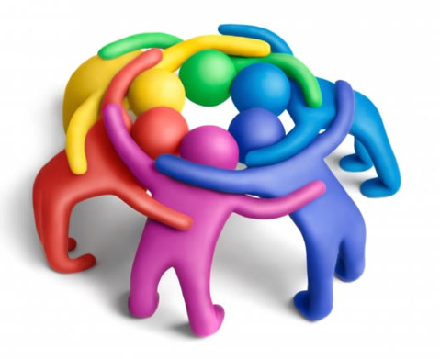
What kind of groups do Interactionist’s study?
They study diverse groups such as the interactions between ….
  Teenage gangs and older people
    Teachers and students
      Patients and visitors on hospital wards
  They study how the groups respond to each other
They see our behaviour as being a result of…
  How we interpret situations within smaller groups
    How we see ourselves in relation to other people in the group
      Examples?

Slide 4
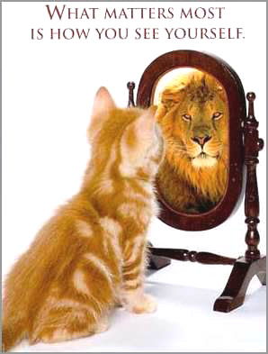
Self image
Interactionist’s study the complex interactions between people, their family and friends
They believe that these relationships have a big influence on who people decide they are.

Slide 5
Impact of self image
When people are ill they……………
Label themselves as ill e.g. having a cold or being ‘under the weather’
They can attach a label to themselves.
Others can attach a label to them…….such as, who?
The labels can be either quite positive or negative.
Some labels have a stigma attached to them, can you think of some examples?

Slide 6
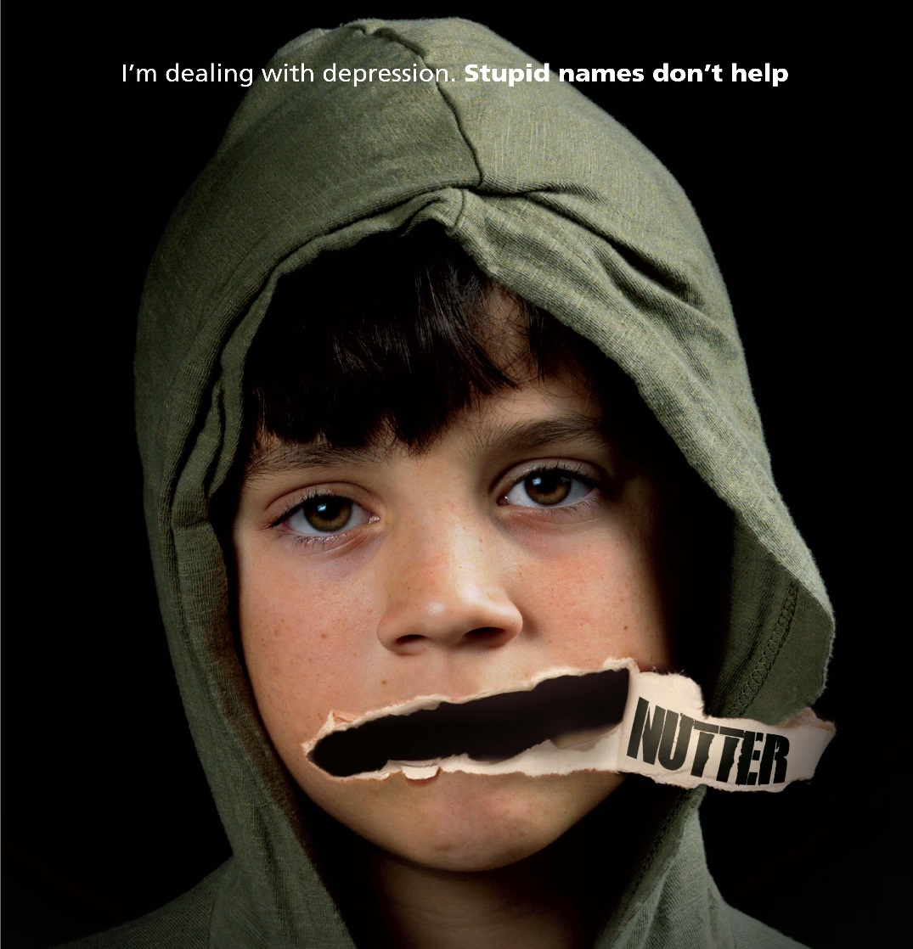
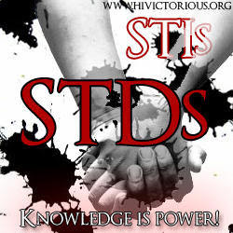
Stigma of labels
Some people may not state they are ill, due to an attached stigma
E.g. HIV – Gay sex
STD – Promiscuous
THRUSH - Promiscuous

Slide 7
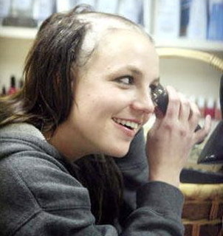
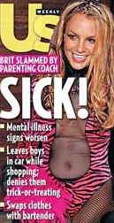
The stigma is attached due to the interpretation of the illness by the people who place the label.
Examples from popular culture?

Slide 8
Labelling
CONSIDER WHAT THE ISSUES MIGHT BE WITH LABELLING?
e.g. Once diagnosed with, and labelled as having depression, what might happen ?
A main concern with labelling is that once a person is labelled as having an illness, that individual can fall into a negative cycle.
This can have an impact on whether they recover or not.
Apart from health – what are the other labels people can receive?

Slide 9
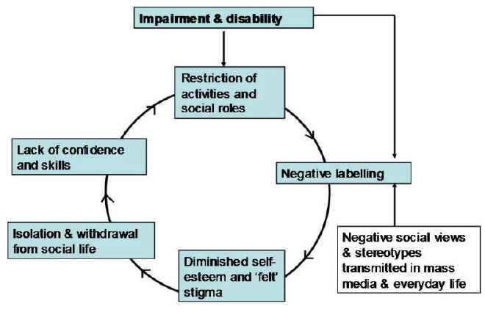
Impact of Labelling

Slide 10
Assignment 1
You can now complete Task 1 (P1)
Interactionism
Explain how interactionism influences individual behaviour.
Outline the issue of labelling and the effects of being stigmatised.

