Slide 1
collectivism
Sharing the responsibility of health

Slide 2

The Welfare State

Slide 3

Collectivism
Collectivism is a political view rather than a perspective like the previous ones we have looked at….
It is a view that the state is responsible for providing care & welfare
This view prioritises the needs of the disadvantaged & vulnerable groups in society and develops services to help these vulnerable people, these groups include:
Disabled
Unemployed
Low Income
Children
Older People
Mentally ill people
Sick people
Looking after people COLLECTIVELY
As a country together….

Slide 4

Collectivism
Collectivism values shared responsibility in society…
For example…
As a working member of society in the UK we all pay taxes in the form of National Insurance Contributions, some of this funds the National Health Service (NHS) in the UK.
This means that we are COLLECTIVELY sharing the responsibility of all members of the UK and
Europe's health.
The government should be in charge of managing money raised and the services provided for the vulnerable…

Slide 5
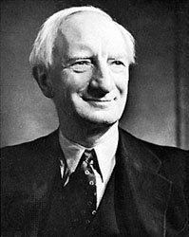
Collectivism:
History of the welfare system
After World War ll many of society were living in deprived conditions.
A Politian named Beveridge identified 5 issues that needed to be addressed:
Poverty
Disease
Ignorance
Squalor (Dirt & Filth – Poor Housing)
Idleness (Lack of employment)

Slide 6

Collectivism:
History of the welfare system
Consider the services that are now provided in todays society to improve:
Poverty
Disease
Ignorance (Inadequate Education)
Squalor (Dirt & Filth – Poor Housing)
Idleness (Lack of employment)

Slide 7

Collectivism:
History of the welfare system
Through the proposals made by Beveridge the Welfare State was developed…
This included:
Social Security
NHS
Free Education
Council Housing
Welfare systems were seen as a way of tackling major issues together collectively as a country.

Slide 8
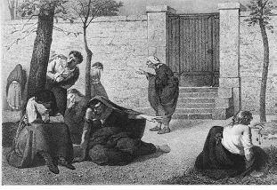
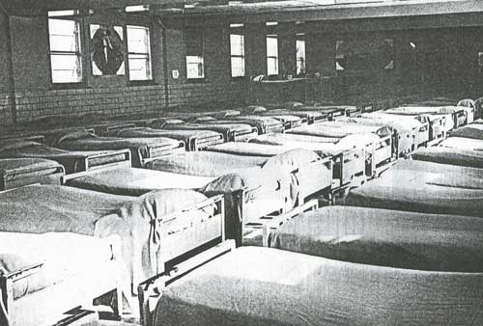

Collectivism:
History of the welfare system
In the past people with mental health problems were cast away to mental health asylums and tied up and basically imprisoned…

Slide 9



Collectivism:
History of the welfare system
Nowadays, people with mental health problems are treated by the NHS in all types of different patient centred methods and are treated until complete recovery.

Slide 10

Assignment 1: Perspectives p1
You can now complete the Collectivism part of your P1 Assignment
Outline the view that emphasises the value to society of shared responsibility for each other.
Include information on how health and social care are provided
Eg. The origins of the NHS
150 Words – 200 Words

Slide 11
The New right
Society works best if individuals accept responsibility for themselves
Not depending on the state
– Opposite view to Collectivism

Slide 12

The new right
Again, this is a political view rather than a perspective….
It is associated with Conservative political thinking and the Republican party from the USA.
This perspective has been most influential when used by politicians to SUGGEST how society should be run rather than explaining social
structures.
The New Right was developed in the 1980’s when the Conservative Party was in Power

Slide 13

The new right
This view challenges COLLECTIVISM because:
They see welfare as the responsibility of the individual and their family rather than the state (opposite to collectivists view).
They regard state support (benefits) as intrusive and supporting a dependency culture draining resources
– they believe that the state should promote independence, freedom and liberty.
According to the New Right the government should only play as SMALL a ROLE as possible in the provision of welfare

Slide 14

The new right
New Right thinkers argue that private enterprises should be encouraged to create healthy competition which in turn benefits the economy and leads to more effective & efficient services.
They believe that competition provides choice and efficiency and that the state should not be a monopoly provider.
There has been many health reforms in the past 30 years but there is a tense relationship with the collectivist ethos of the NHS and welfare state.
Welfare dependency is bad….
Individual responsibility and personal choice are preferable

Slide 15

Time to vote!
Do you agree with:
The New Right or The Collectivists?
In pairs discuss:
How much responsibility should the state have for providing health, social care and welfare support?
Is it the individuals responsibility or the states for our health & welfare?
Do you think competition within the health secotr would create more efficient & effective services
Discuss this in pairs and then vote which view you wish to support

Slide 16

The new right: Deserving or undeserving?
New Right thinkers make judgements about certain types of people.
They suggest that only people who are in poverty through no fault or their own are deserving of health care
And those who waste their talents and settle for a life on welfare are underserving of health care
The New Right approach fails to consider
barriers which can leave people
marginalised in society and states that these people are inferior to life's ‘natural’ losers.
(EG. Economic, Political, Cultural)
Does everybody get the same start in life?

Slide 17

The new right : Case Study
Simon, aged 45 has mental health problems. He has received care & support from the NHS & voluntary sectors for his problems for over 20 years.
Simon often felt frustrated with the level of services he received and has always said that he would have a better quality of life if the state would just give hit he money to buy care & support services himself.
A new government initiative a
‘Personalisation Policy’ has been introduced,
so now Simon can control his own budget
and personalise his own care.
Simon is very keen as he believes that he understands his needs best.
How does this ‘Personalisation Policy’ express The New Right ideas?
What are the advantages and disadvantages of this method of funding?

Slide 18

The new right: Think
Think about that changes of the provision of health & social care services such as the use of the private sector….?
Discuss this in groups & make notes on the back of your
hand-out

Slide 19
Assignment 1: Perspectives p1
You can now complete the ‘The New Right’ part of your P1 Assignment
Explain how The New Right suggests that society works best if individuals accept responsibility for themselves and that competition leads to more effective and efficient services.
Think about the changes to the provision of health and social care services such as the use of the private sector.
150 Words – 200 Words

