Slide 1
The New right
Society works best if individuals accept responsibility for themselves

Slide 2

The new right
Again, this is a political view rather than a perspective….
It is associated with Conservative political thinking and the Republican party from the USA.
This perspective has been most influential when used by politicians to SUGGEST how society should be run rather than explaining social structures.
The New Right was developed in the 1980’s when the Conservative Party was in Power

Slide 3
The new right
This view challenges COLLECTIVISM because:
They see welfare as the responsibility of the individual and their family rather than the state (opposite to collectivists view).
They regard state support (benefits) as intrusive and supporting a dependency culture – they believe that the state should promote independence, freedom and liberty.
The New Right was developed in the 1980’s when the Conservative Party was in Power

Slide 4

Collectivism
Collectivism values shared responsibility in society…
For example…
As a working member of society in the UK we all pay taxes in the form of National Insurance Contributions which some of this funds the National Health Service (NHS) in the UK.
This means that we are COLLECTIVELY sharing the responsibility of all members of the UK and
Europe's health.
The government should be in charge of managing money raised and the services provided for the vulnerable…

Slide 5
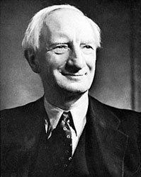
Collectivism:
History of the welfare system
After World War ll many of society were living in deprived conditions.
A Politian named Beveridge identified 5 issues that needed to be addressed:
Poverty
Disease
Ignorance
Squalor (Dirt & Filth – Poor Housing)
Idleness (Lack of employment)

Slide 6

Collectivism:
History of the welfare system
Consider the services that are now provided in todays society to improve:
Poverty
Disease
Ignorance (Inadequate Education)
Squalor (Dirt & Filth – Poor Housing)
Idleness (Lack of employment)

Slide 7
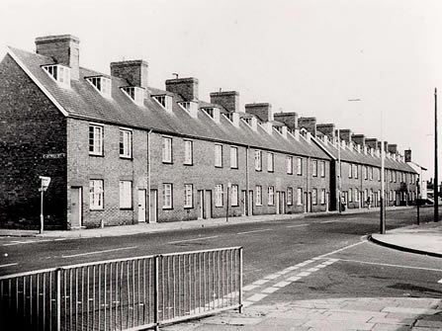
Collectivism:
History of the welfare system
Through the proposals made by Beveridge the Welfare State was developed…
This included:
Social Security
NHS
Free Education
Council Housing
Welfare systems were seen as a way of tackling major issues together collectively as a country.

Slide 8
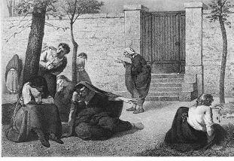
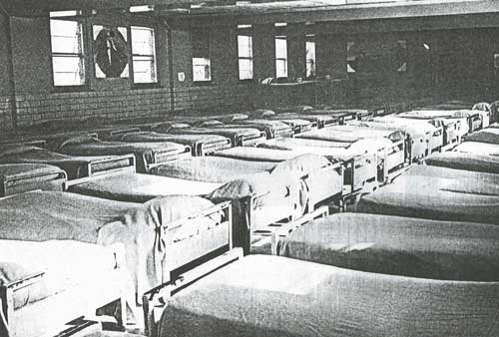

Collectivism:
History of the welfare system
In the past people with mental health problems were cast away to mental health asylums and tied up and basically imprisoned…

Slide 9



Collectivism:
History of the welfare system
Nowadays, people with mental health problems are treated by the NHS in all types of different patient centred methods and are treated until complete recovery.

Slide 10

Assignment 1: Perspectives p1
You can now complete the Collectivism part of your P1 Assignment
Outline the view that emphasises the value to society of shared responsibility for each other.
Include information on how health and social care are provided
Eg. The origins of the NHS
150 Words – 200 Words

