Slide 1
task 1
Scenario
There are many different ways of thinking about how societies develop. The main sociological perspectives have distinctive ways of approaching health and social care and part of the training of professionals involves developing an understanding of these different approaches.
Task 1
Explain the key features of the main sociological perspectives on health
feminism explain feminism in 200 - 300 words
You must include an overview of ALL the different types of feminism

Slide 2
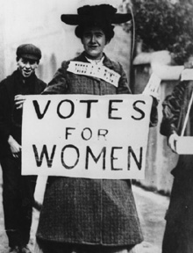
Feminism

Slide 3
Feminism
Feminism is an alternative conflict theory, like Marxists, feminists see society as being fundamentally divided but between the sexes rather than between classes. Feminists believe that women are unfairly treated and they want to change society so that there is equality between men and women.
Feminist sociology stresses the importance of gender divisions in society and it portrays these divisions as working to the overall advantage of men. It is men who rule society and who have the power in most social situations – in relationships, in families, in schools and so on. This situation is called patriarchy.

Slide 4
Patriarchy
A social organisation which believes the man is head of the house
A lot of gender stereotypes come from socialisation…
In what ways do you think our upbringing & socialisation could influence gender inequalities?

Slide 5
There are three main types of feminist approach:
Marxist feminism
Radical feminism
Liberal feminism
You need to discuss each of these in your assignment so make notes on your hand-out as we go along…

Slide 6
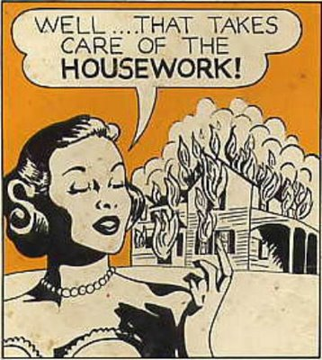
Marxist feminism
See women, especially working class women as oppressed by both capitalism and men.
Women produce the next generation of workers and look after the husbands and the next generation of workers They are dominated by their husbands and are subsiding industry.
The family would not be ready for work if someone did not take responsibility for domestic life and this remains the responsibility of the women.

Slide 7
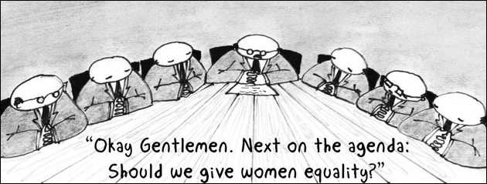
Radical feminism
For radical feminists, it is not capitalism that dominates women, but men.
Men dominate women and the family is seen as a patriarchal institution.
They see the socialisation of women as housewives and mothers as a form of oppression and this oppression as a characteristic of nuclear family life.

Slide 8

Liberal feminism
They would argue that changes have taken place. They believe that , through changing attitudes and legislation such as the Equal Pay Act (1970)and the Sex Discrimination Act (1975) there is more equality.
Liberal feminists believe that improvements will continue by means of legislation and policy.

Slide 9
Socialisation
Women are socialised into caring roles

Slide 10
Activity
What gender stereotypes do you think you encountered as a child?
Hint:
Think about what your parents roles were?
What toys did you buy or want when you were a child?
What was your favourite colour?
What did you want to be when you were older?
How would people describe you as a baby? Eg. Cute/ Pretty

Slide 11
Further information
Use a Btec level 3 health and social care text book –
Look up unit 7 and you will find lots of information.
Independent research
FOR next lesson I would like you to research the next sociological perspective, interactionism
Spend at least 15 minutes seeing what you can find.
Note your findings (I must see written evidence) of your research

