Slide 1

ism

Slide 2
Introduction
The perspectives we have already looked at focus on large groups and whole institutions to see how they influence behaviour and shape society.
Interactionism is different to this, this perspective focuses on smaller groups rather than looking at whole social institutions to see how society is shaped.
Interested in what goes on within (rather than between) social institutions and interactions between people.

Slide 3
Interactive theories – Social Action Theory
Recognises that individuals are not passive but have a role within society.
Fails to acknowledge why some groups have the power to label others or put constraints on individuals.
We will concentrate on this theory later in the power point

Slide 4
Symbolic interactionism
People impose meaning on the world through the use of symbols , especially language
Blumer stated this theory shows society as an ongoing process of interaction, involving people constantly interpreting situations and adjusting to one another.
Criticism – does not explain the power structures in society or recpognise the influence of historical context and passed experience of the interactions taking place.

Slide 5
Phenomenology
Slightly different to social action theory, concerned with explaining how people make sense of the world rather than examining the causes of the behaviour.

Slide 6
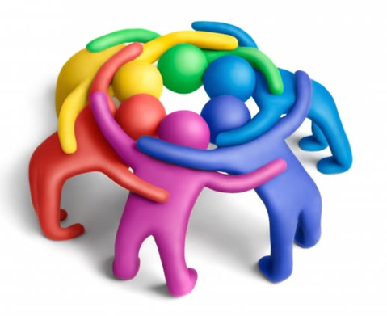
What kind of groups do Interactionist’s study?
They study diverse groups such as the interactions between ….
  Teenage gangs and older people
    Teachers and students
      Patients and visitors on hospital wards
  They study how the groups respond to each other
They see our behaviour as being a result of…
  How we interpret situations within smaller groups
    How we see ourselves in relation to other people in the group
      Examples?

Slide 7
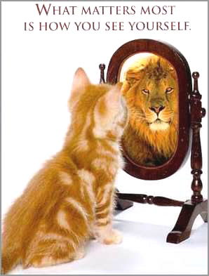
Self image
Interactionist’s study the complex interactions between people, their family and friends and their links with the professional services.
Our self concept is shaped and developed by interactions with others.
They believe that these relationships have as much influence as any medical diagnosis on whether people decide they are ill or not.

Slide 8
Impact of self image
When people are ill they……………
Label themselves as ill e.g. having a cold or being ‘under the weather’
They can attach a label to themselves.
Others can attach a label to them…….such as, who?
The labels can be either quite positive or negative.
Some labels have a stigma attached to them, can you think of some examples?

Slide 9
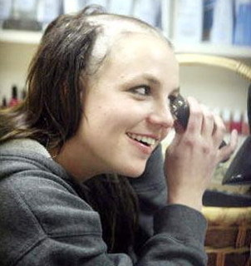

The stigma is attached due to the interpretation of the illness by the people who place the label.
Examples from popular culture?

Slide 10
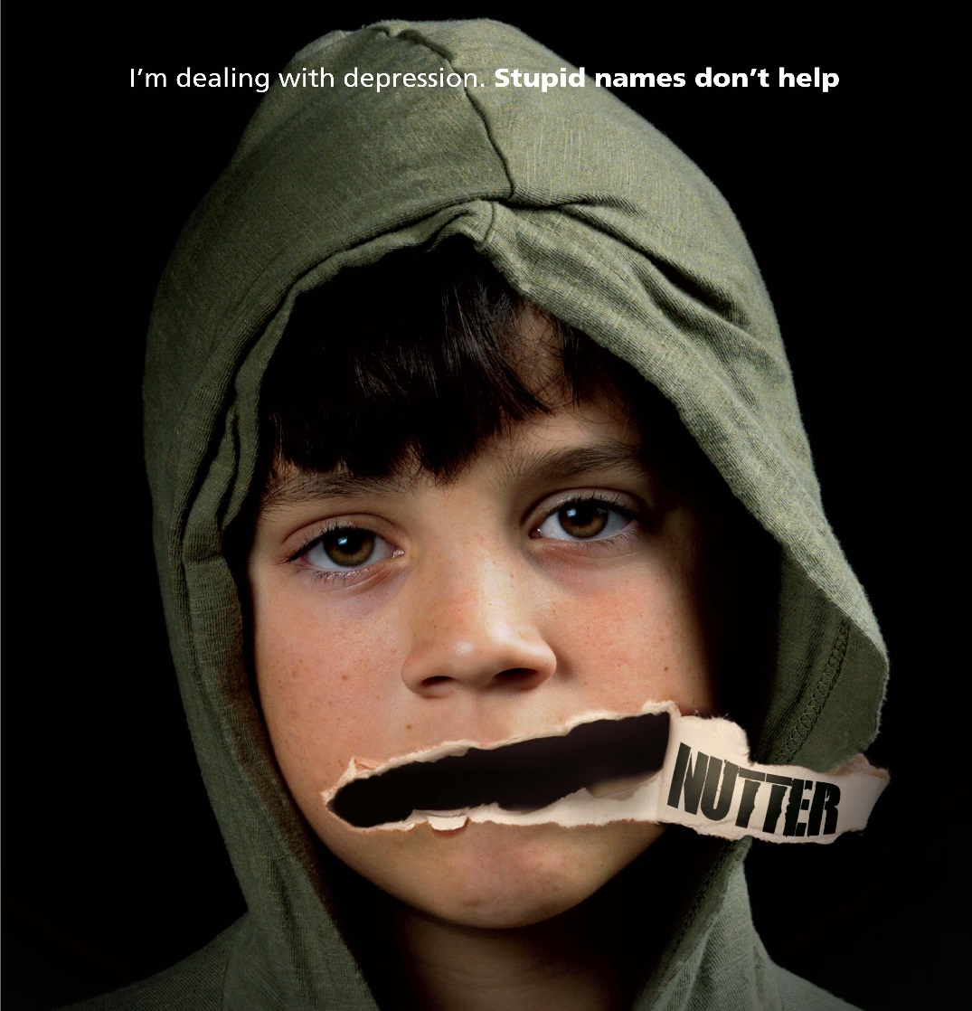
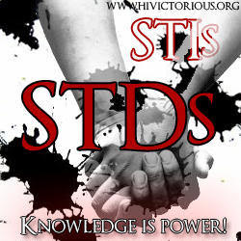
Stigma of labels
Some people may not state they are ill, due to an attached stigma
E.g. HIV – Gay sex
STD – Promiscuous
THRUSH - Promiscuous

Slide 11
Labelling
CONSIDER WHAT THE ISSUES MIGHT BE WITH LABELLING?
e.g. Once diagnosed with, and labelled as having depression, what might happen ?
A main concern with labelling is that once a person is labelled as having an illness, that individual can fall into a negative cycle. (self fulfilling prophercy)
This can have an impact on whether they recover or not.

Slide 12
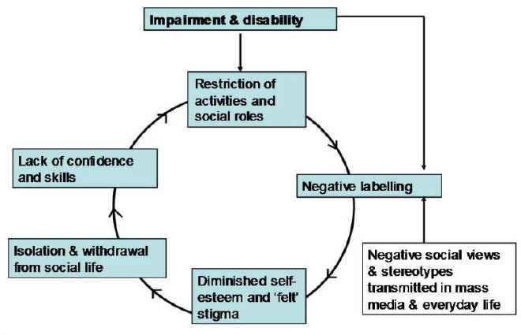
Impact of Labelling

Slide 13
Assignment 1
You can now complete Task 1 (P1)
Interactionism
Explain how interactionism influences individual behaviour.
  How do we interpret ourselves?
    How are we influenced by others? (Health & Social care professionals/family)
      We have the power to choose how we behave
        How do our interactions with others shape our self-image?

Slide 14
Interactionism
Outline the issue of labelling and the effects of being stigmatised.
  What is labelling?
    What is stigma?
    What is the issues with labelling? - Outline the NEGATIVE CYCLE and link to depression
      People may not admit they’re ill due to stigma. Give examples

