Slide 1
task 1
Scenario
There are many different ways of thinking about how societies develop. The main sociological perspectives have distinctive ways of approaching health and social care and part of the training of professionals involves developing an understanding of these different approaches.
Task 1
Explain the key features of the main sociological perspectives on health
MARXISM explain MARXISM in 200 words
Be sure to incorporate the language and define the terms e.g. bourgeoisie etc

Slide 2
Marxism

Slide 3
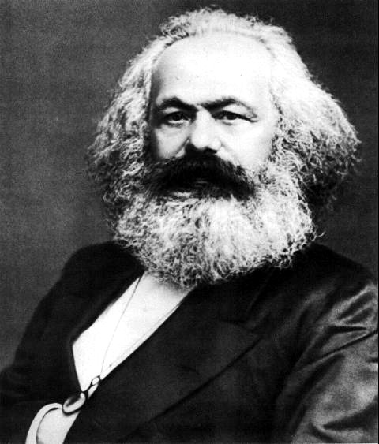
Marxism
Karl Marx
(1818-1883)
Marxism is a sociological theory based on the ideas of Karl Marx. It is a structuralist theory but based on conflict rather than consensus (Functionalism).
Marxists see society as being divided by class.

Slide 4
Marxism viewpoints basically argue that one group in society the upper/middle class (bourgeoisie) are more powerful. This power is economic (based on wealth).
To stay in power the bourgeoisie need to control and exploit the working class (proletariat).
U/C
Class Conflict
W/C

Slide 5

Class conflict
Marx pointed out that the different interests of the U/C and the W/C created class conflict. The U/C wanted profit while the W/C wanted higher wages.
The Bourgeoisie are referred to as the Upper (ruling) class due to the amount of power, status and influence they held within society. They controlled the workforce and therefore government had to keep them happy or risk high unemployment levels and lose investments.
Within this society the upper class must maintain the unequal social structure i.e. keep the working class working so that the upper classes can gain more and more capital (wealth).

Slide 6

Marxists argue that capitalist ideology shapes the way of life of a society – its culture e.g. the mass media convinces us through advertising to buy more material goods. We want to be rich so that we can buy more and more and somehow this will make us happy.
What is more, while we are doing all this we are not noticing the inequalities and exploitation of the capitalist system. This is described as ‘false class consciousness’ – we are not aware of our ‘real’ identity as exploited and oppressed workers.

Slide 7

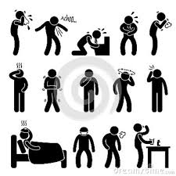
Marxists argue that the institutions are organised to benefit the ruling class.
The family – provides socialisation of children, preparing them for the disciplines and routines of work.
The health system ensures a healthy workforce which in turn ensures more profit for the ruling classes as workers don’t take time off sick! They believe that doctors hide the real social causes of illness (poverty, class inequality etc.) by focusing on the individual and their physical symptoms.

Slide 8
summary
Marxism says history is a product of material class struggle in society.
In a capitalist society the bourgeoisie (economic minority) dominate the proletariat (working class).
Capitalism is exploitative in the way that it takes the unpaid labour from the working class.
(Rasheed, 2010)

Slide 9
Further information
Use a Btec level 3 health and social care text book –
Look up unit 7 and you will find lots of information.
Independent research
FOR next lesson I would like you to research the next sociological perspective, Feminism
Spend at least 15 minutes seeing what you can find.
Note your finings (I must see written evidence) of your research

