Slide 1
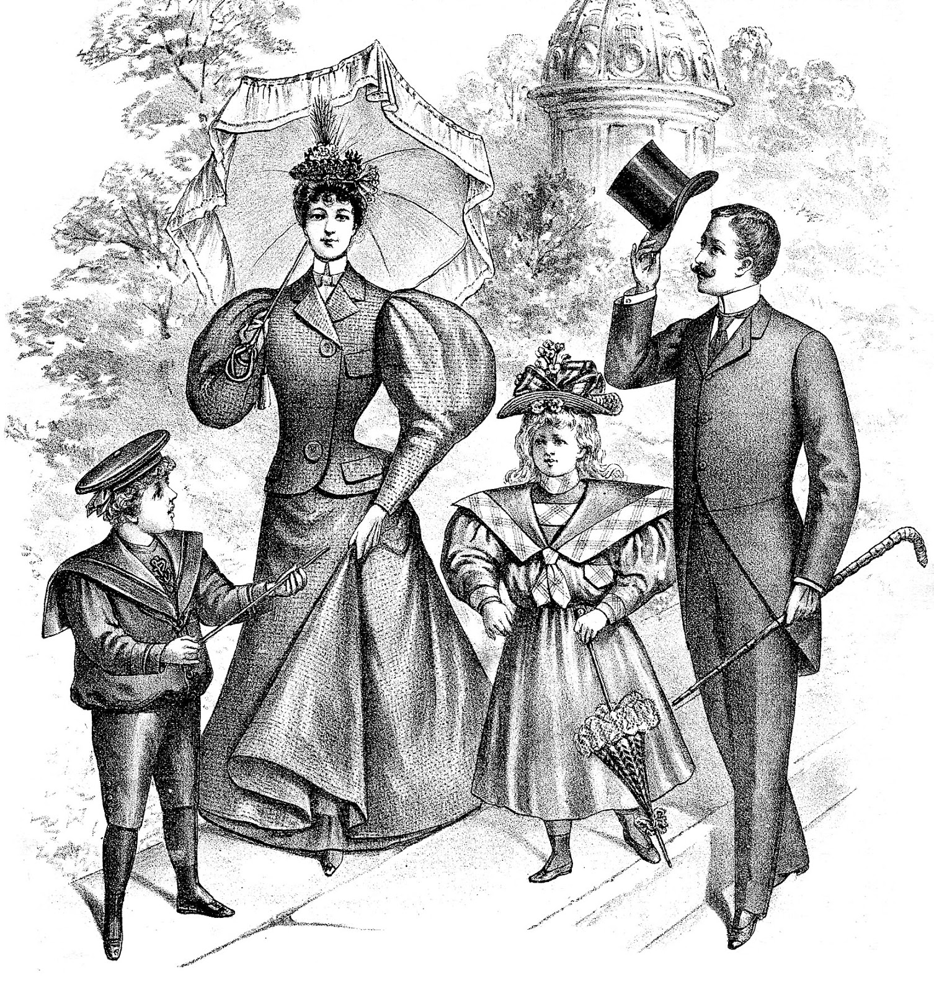
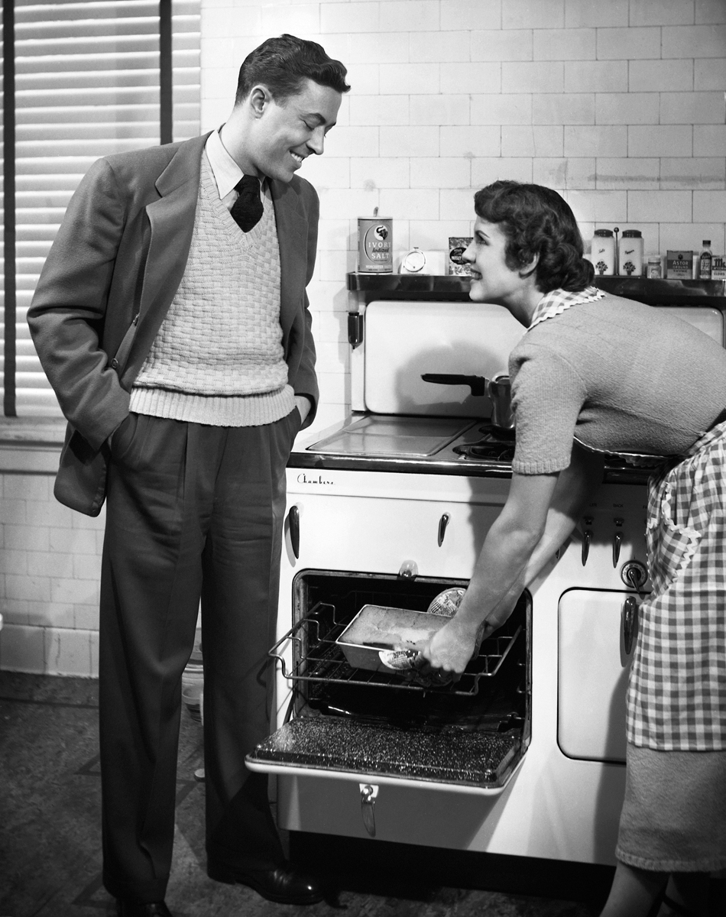
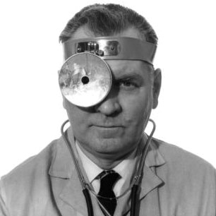
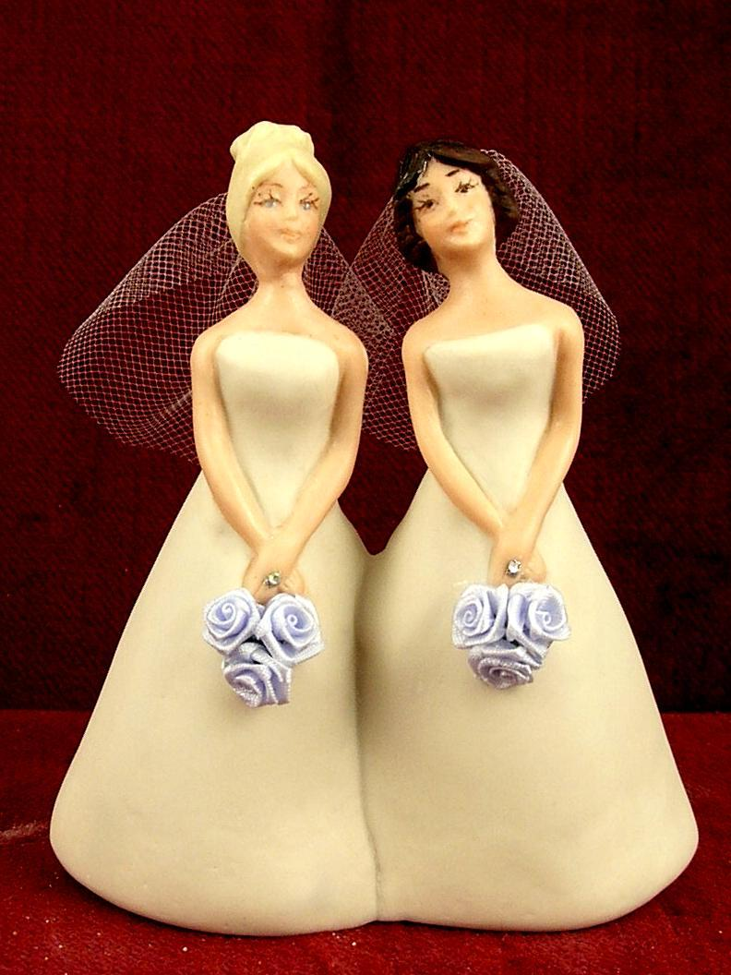

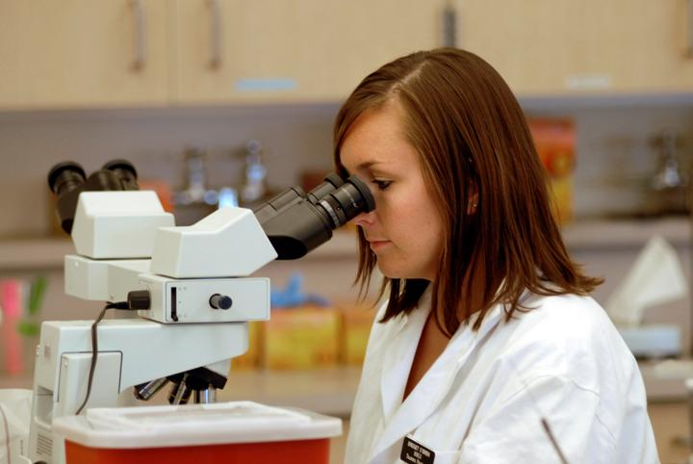
Postmodernism
Starter: On your hand-out try & identify the relevance of these pictures & what POSTMODERNISM could be about?

Slide 2
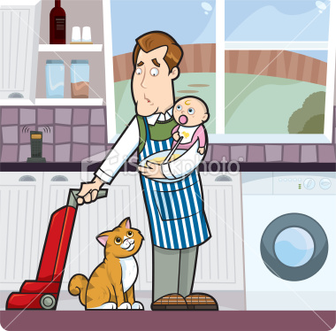
Postmodernism
It is an approach that looks to understand society by focusing on rapid change and uncertainty in our society.
Postmodernists would say that we can no longer talk about established institutions such as:
Family
Religion
Economy
….because nothing is staying the same anymore
Postmodernists say society now is much less stable
now, more fragmented and fast changing which causes uncertainty & chaos within our societies
For example we see and think about
‘The Family’ in a different way these days, family structure, roles and relationships within the family can be diverse, there is no longer a ‘Typical Family’

Slide 3

Postmodernism: Fragmented Society
In the past life was very different to what we experience today.
Everyone had their own roles, responsibilities and places within society.
Women had a place in the home, they were the
carers of the family.
Men had a place as head of the family, they went to
work and has a right to education unlike women.
There was a fixed structure to life…
Today…
We can make our own choices and decide
what path we wish to take despite our
gender both men & women work and have a right to eduction & we are affected by the media

Slide 4

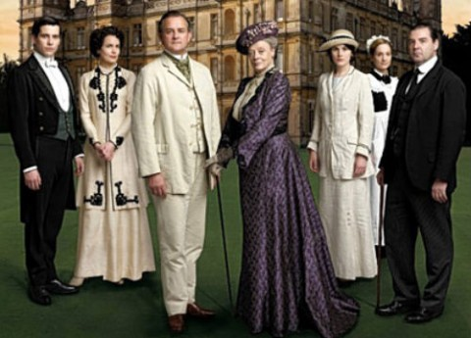
We have gone from…
This
This

Slide 5
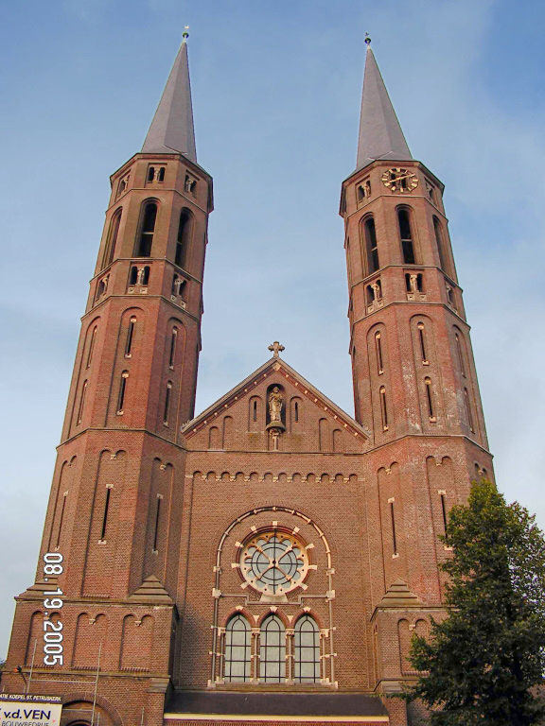
Postmodernism
In modern industrial society:
Social institutions (Families & Communities)
Social Roles (Family Roles)
And beliefs (Strict Religion)
that people held were very straight forward and rigid….
Postmodernists believe that this is now a thing of
the past.
For example whole communities would gather together on Sunday to attend church

Slide 6


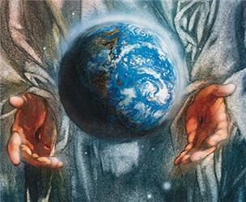
We have gone from…
This
This

Slide 7
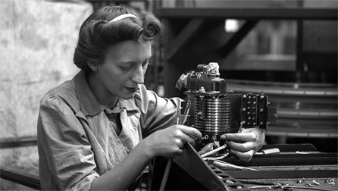
Postmodernism
Employment
In the past people would take on a ‘Job for life’ but nowadays very rarely do people begin a job that they see as a ‘Job for life’.
Working life today, just like social life today is unpredictable, less certain and risky.
Not only just from an employers perspective but as
a personal social perspective too, today we have
more choice to change our minds and
take risks
Postmodernists argue that society is no longer based upon stable, permanent social institutions that people can base their lives around like they did in the past.

Slide 8
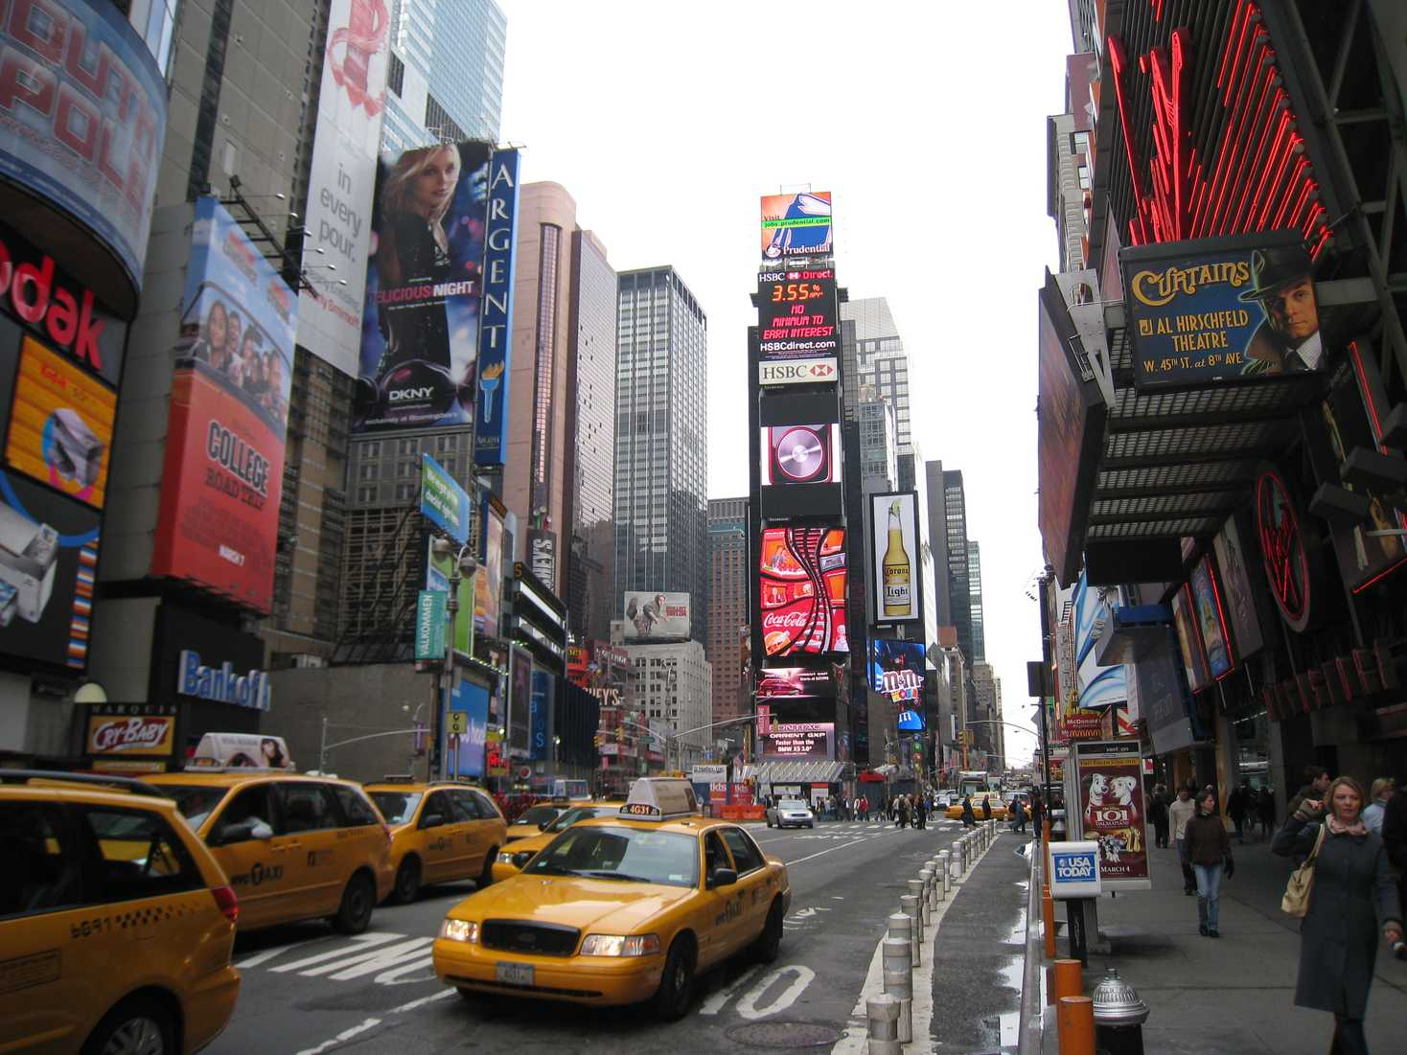
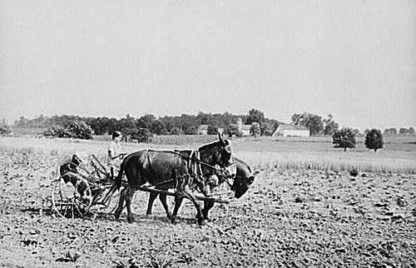
We have gone from…
This
This

Slide 9
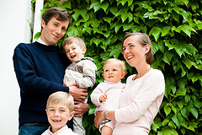
Your Turn!
Discuss the following questions in pairs & note your answers down in your hand-outs.
1. What types of family can you identify in society now?
Discuss this and makes lists of all the different family types that you are aware of or part of…
2. Do you think there is a ‘TYPICAL ‘ family type?
3. What do you think would happen in society if:
The number of marriages fell rapidly?
Civil Partnerships (Same sex) were widely accepted by all religions & cultures
Divorce rates grew rapidly?
There was a large rise in single parent families?
You have 7 minutes

Slide 10

Assignment 1: Perspectives p1
You can now complete the Postmodernism part of your P1 Assignment
Outline the postmodernism approach to society.
150 Words – 200 Words

