Slide 1
Epithelial Tissues

Slide 2
Epithelial Tissues
Cells are the smallest units of life.
In complex organisms- such as a human being, cells group together with one another based on similar structure and function to form tissues.
Tissues provide the numerous functions of organs necessary to maintain biological life.
Epithelia tissues may be classified as Simple or compound.

Slide 3
Simple Epithelial Tissue
Simple Epithelial Tissue is a single cell layer thick and is located where diffusion, absorption, filtration, and secretion are principal functions.
The cells of simple epithelial tissue range from thin, flattened cells to tall, columnar cells.
Some of these cells have cilia that create currents for the movement of materials across cell surfaces.
Others have microvilli that increase the surface area for absorption.

Slide 4
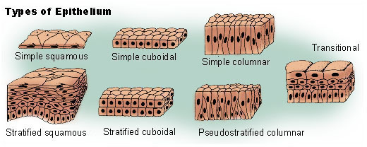

Slide 5
Simple Epithelial Tissue
Simple epithelial cells may be:
  Squamous
  Cuboidal
  Columnar
  Ciliated

Slide 6
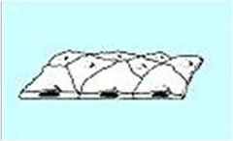
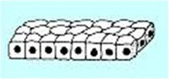
Simple Epithelia
Simple epithelial cells may be:
  Squamous- Single layer of flattened cells. Forms a thin smooth membrane. Allows diffusion to take place easily. Found in :Smooth lining of Heart, Blood Vessels, Lymph, Alveoli.
  Cuboidal- Cube shaped cells lying on a basement membrane.
  Actively involved in secretion, absorption and excretion.
  Forms the tubules of the kidneys and is found in some glands.

Slide 7
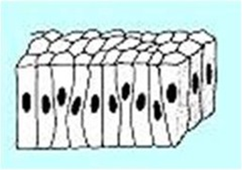
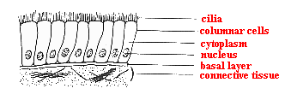
Simple Epithelia
  Columnar
  Single layer, rectangular in shape on a basement membrane Modified columnar cells (goblet cells) secrete mucus. Found lining the organs of the digestive tract – some absorb the products of digestion & others secrete mucus.
  Ciliated
  Some of these cells above have cilia that create currents for the movement of materials across cell surfaces. Others have microvilli that increase the surface area for absorption.
  Ciliated epithelium is usually found in the air passages like the nose. It is also found in the uterus and Fallopian tubes of females. The movement of the cilia propel the ovum to the uterus.

Slide 8
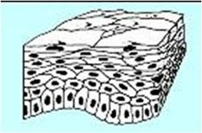
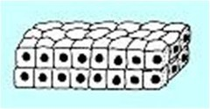
Stratified Epithelial Tissues
Stratified epithelia have two or more layers of cells:
Stratified squamous epithelium
Stratified cuboidal epithelium

Slide 9
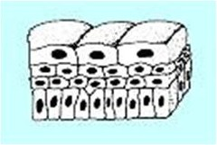
Stratified Epithelial Tissues (cont)
Transitional epithelium
Transitional cells range from flat to tall cells that can extend or compress in response to body movement.
Composed of several layers of pear shaped cells. Found in the lining of the bladder and allows for stretching as the bladder fills with urine

Slide 10
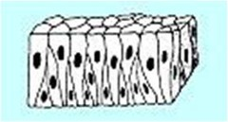
Stratified Epithelial Tissues (cont)
Pseudostratified columnar epithelium
Pseudostratified epithelium describes a single layer of cells of different sizes, giving the appearance of being multi layered.
Pseudostratified columnar epithelium is found lining the trachea, bronchi, male urethra, and a few other places.

Slide 11
Compound Epithelial Tissue
Stratified squamous epithelium is further classified by the presence or absence of keratin, a tough protective protein.
There are two types of stratified squamous epithelial tissues:
  1) keratinized and
  2) Non-keratinized.

Slide 12
Types of Stratified Squamous Epithelial Tissues
Keratinized stratified squamous epithelium contains keratin, a protein that strengthens the tissue. Keratin makes the epidermis (outer layer) of the skin somewhat waterproof and protects it from bacterial invasion. The outer layers of the skin are dead, but glandular secretions keep them soft. Found on dry surfaces that are subject to wear & tear – skin, hair & nails.
  2) Non-keratinized stratified squamous epithelium This type of epithelium, called mucosa, is well adapted to withstand moderate abrasion but not fluid loss. The cells on the exposed surface are alive and are always moistened. Found in wet areas- line the oral cavity and pharynx, nasal cavity, oesophagus, vagina, and anal canal.

Slide 13
Functions of Epithelial Tissue
Protection Epithelial cells from the skin protect underlying tissue from mechanical injury, harmful chemicals, invading bacteria and from excessive loss of water.
Sensation Sensory stimuli penetrate specialised epithelial cells. Specialised epithelial tissue containing sensory nerve endings is found in the skin, eyes, ears, nose and on the tongue.
Secretion In glands, epithelial tissue is specialised to secrete specific chemical substances such as enzymes, hormones and lubricating fluids.
Absorption Certain epithelial cells lining the small intestine absorb nutrients from the digestion of food.
Excretion Epithelial tissues in the kidney excrete waste products from the body and reabsorb needed materials from the urine. Sweat is also excreted from the body by epithelial cells in the sweat glands.
Diffusion Simple epithelium promotes the diffusion of gases, liquids and nutrients. Because they form such a thin lining, they are ideal for the diffusion of gases (eg. walls of capillaries and lungs).
Cleaning Ciliated epithelium assists in removing dust particles and foreign bodies which have entered the air passages.
Reduces Friction The smooth, tightly-interlocking, epithelial cells that line the entire circulatory system reduce friction between the blood and the walls of the blood vessels.

