Slide 1
An Outline of the Gross Structure and functions of the Body Systems 2
Renal, Nervous, Endocrine, Reproductive, Lymphatic, Musculoskeletal and Immune Systems.

Slide 2
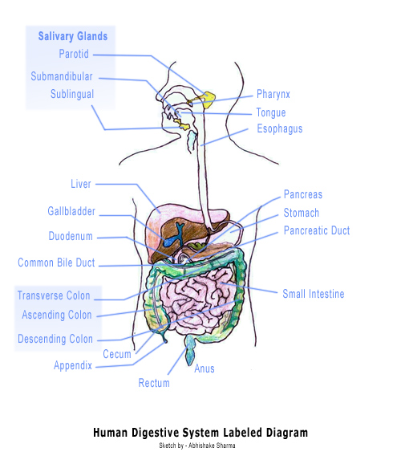
What do I need to produce to meet P3?
Produce a labelled diagram of each Body system, which identifies the main organs.
Write an explanation of the functions of the system and the structures within it.
Functions of the Digestive system
The main function of the digestive system is to break down food so that the components can be used by the body. It also removes undigested waste found the body and is key in the production of chemicals from the liver. (Stretch & Whitehouse 2010, BBC Health 2012)
The teeth – tear and grind food to begin the digestive process ................................

Slide 3
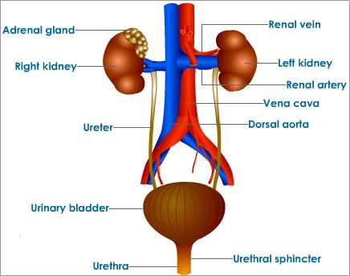
Renal System
Structures
Kidneys
Ureters
Bladder
Urethra

Slide 4
Functions of the Renal System.
Removes excess water and salts from the body
Eliminates nitrogen containing waste
Involved in maintaining blood pressure
Involved in the production of hormones and the production of Red Blood Cells.

Slide 5
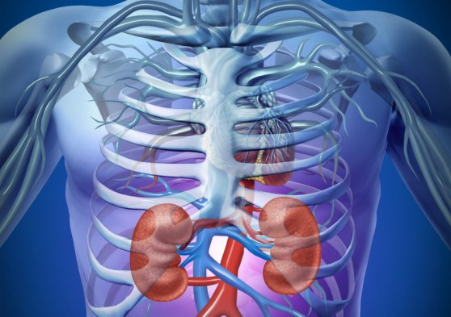
The Kidneys - function
http://www.youtube.com/watch?v=mXfvLmJ40HA&feature=player_embedded (Watch this video clip)
Removing waste products and water from the blood.
Controlling blood pressure
Hormone Production
Healthy kidneys make hormones
Renin and angiotensin to regulate
how much sodium (salt) and fluid
the body keeps.
Calcitriol to maintain the levels of
calcium and phosphate in the blood
and bones.
Erythropoeitin (EPO) –this is carried in the blood to the bone
marrow where it stimulates the production of red blood cells.
Ref: http://www.ccmtutorials.com/renal/pathphys/page_02.htm

Slide 6
Functions of the other structures within the urinary System.
The Ureter’s
Funnel the urine down into the bladder.
The bladder
To hold urine.
The Urethra
To expel urine from the body.

Slide 7
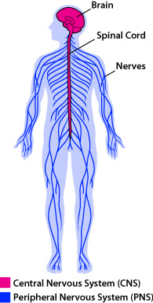
Nervous System
Structures
CENTRAL NERVOUS SYSTEM (CNS)
- brain
- spinal cord.
PERIPHERAL NERVOUS SYSTEM (PNS) :
- nerves

Slide 8
Functions of the Nervous System
Receives and interprets information from the environment.
It controls and regulates all voluntary and involuntary activities of human body.
Not only does it control the voluntary functions of human body
that are directed by human will; it also controls those functions
that are below the level of consciousness of human beings.
Control of a function means that the intensity of that function
can be increase or decreased according to the demands of the
human body.
Coordination of the different systems & organs of the body
Not only does it produce coordination between different
systems, it also coordinates the different organs of a system.
Reflex actions protect the body from injury.

Slide 9
Functions of the structures
The Brain
controls the body's autonomic functions such as respiration, digestion and heart rate.
It also processes all the messages transmitted via the nerves from the sensory organs.
Spinal cord
This is the information superhighway of the body. It carries information up to the brain and instructions back down.
Nerves
Nerves conduct impulses from the receptor organs to the spinal cord and the brain. They also conduct impulses from the brain to the receptor organs

Slide 10
The Endocrine System
The endocrine system is a collection of glands that secrete different hormones for the various functions and chemical reactions occurring within the body; these control how the body functions.
Functions
The main function is to maintain a stable environment within the body
It controls and co- ordinates organs
Maintains blood glucose, water and salt levels according to changes occurring in the body
It promotes the structural changes of the body such as changes in height and the development of sexual organs.
Assists in reproduction

Slide 11
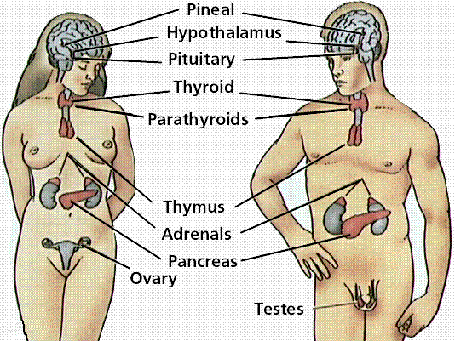
Endocrine System

Slide 12
Endocrine Glands & their fuction
Pineal gland – secretes Melatonin that helps regulate the sleeping cycle of a person.
Hypothalamus – secretes releasing hormones which control the anterior pituitary gland.
Pituitary Gland - secretes a range of hormones to control many other endocrine glands.
The anterior lobe of the pituitary gland regulates the activity of the thyroid, adrenals, and the reproductive glands and produces growth hormone. It also plays a role in the body's absorption of nutrients and minerals. Endorphins are also secreted by the pituitary that acts on the nervous system and reduces the feeling of pain.
The posterior lobe of the pituitary gland produces anti-diuretic hormone that helps to control the water balance in the body.

Slide 13
Thyroid Gland- produces thyroid hormones, that controls the Metabolic rate (rate at which the cells use up energy from food for production of energy). The thyroid hormones are important in growth of bones and the development and growth of the brain and nervous system in children.
Parathyroid Gland- regulates the amount of calcium in the blood.
Adrenal Glands – secrete adrenaline – prepares the body for action. Also secrete corticosteroids which maintain chemical balance.

Slide 14
Pancreas - makes insulin, secreting it directly into the bloodstream to reduce the blood glucose level and glucagon which raises the level of blood glucose.
Ovaries in the Female – secrete oestrogen which controls the development and functioning of the female sex organs. Progesterone prepares for and maintains pregnancy.
Testes in the Male – secrete androgens which control the development & functioning of the male sex organs

Slide 15
Reproductive System
Male
Female
Scrotum
Testes
Vas Deferens
Seminal Vesicle & Prostrate Gland
Penis
Ovaries
Fallopian Tubes
Uterus
Cervix
Vagina

Slide 16
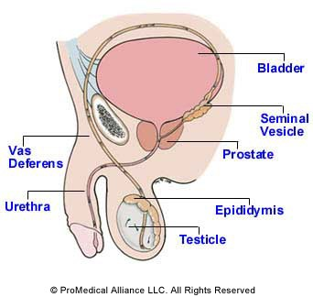
Reproductive System (male)

Slide 17
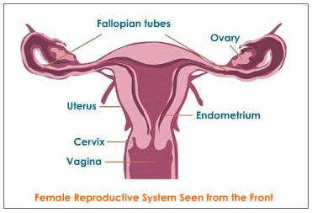
Reproductive System (female)

Slide 18
Functions of the Reproductive System
Male
The production of male gametes -spermatozoa (sperm)
Transportation of sperm to the female reproductive tract
Production of the male sex hormone
Female
The production of female gametes – ova.
Production of the Female sex hormones.
Growth and protection of the embryo/ fetus after fertilisation.

Slide 19
Functions of the structures
Scrotum – Houses the testes and maintains their temperature at a level cooler than the body thus promoting normal sperm formation.
Testes - secrete the primary male hormone, testosterone. Production & storage of sperm
Vas Deferens - Storage of sperm & conduction of sperm from the Testes to the urethra.
Seminal Vesicle & Prostrate Gland - Secretion of seminal fluids that carry sperm. Washes the sperm from the urethra; provides nourishment of sperm & protection of the sperm from hostile acidic environment of vagina
Penis Male organ for sexual intercourse & conduit for urine form bladder
Ovaries - produce ova and hormones.
Fallopian tubes- serve as tunnels for the ova to travel from the ovaries to the uterus. Conception, the fertilization of an egg by a sperm, normally occurs in the fallopian tubes. The fertilized egg then moves along the fallopian tube to the uterus.
Uterus - home to a developing fetus.
Cervix - opens into the vagina, allows sperm to enter and menstrual blood to exit. Dilates during labour to allow the fetus to be expelled.
Vagina: joins the cervix to the outside of the body.

Slide 20
Lymphatic System
Structures
Lymphatic vessels
Lymph Nodes
Tonsils
Thymus gland
Spleen
Functions
Removes excessive tissue fluid and proteins from the spaces between the cells
Defence of the body
Transport of fatty acids from the digestive system

Slide 21
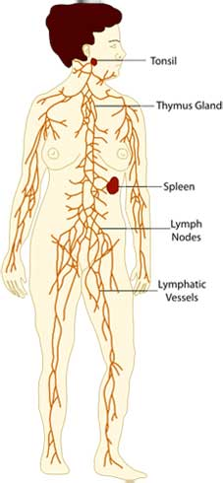
Lymphatic System

Slide 22
Functions of the structures.
Lymphatic vessels -Transport lymph (fluid containing nutrients, oxygen, hormones, and fatty acids, as well as toxins and cellular waste products), from peripheral tissues to the veins of the cardiovascular system
Lymph Nodes – Act as a filter for lymph. Lymph nodes also contain small blood vessels to ensure that the lymphocytes produced in response to an infection can quickly enter the blood and be taken to where they are Tonsils - clusters of lymphatic tissue that are found in the pharynx, as most potential infections will enter the body through the mouth and nose, they extra defence against infections at this ‘front line’.
Thymus gland - The site of T-lymphocyte maturation, development, and control
Spleen– filters the blood. Lymphocytes in the spleen fight infections in the blood and cells in the spleen called ‘macrophages’ dispose of debris. It removes old and damaged red blood cells from the circulation and acts as a store for platelets, which are tiny cells that normally help with the clotting of our blood.

Slide 23
Musculo-skeletal System
This system comprises of the bones of the skeleton and its associated tissues that stabilize or connect the bones (Skeletal System) and the Muscular System which is made up of some 700 different voluntary (striated) muscles.
Structures
Bones
Tendons
Ligaments
Muscles
Function of the Skeletal System
Provides the frame work of the body
Protect vital structures within a bony case.
Function of the Muscular System
Main function is movement, muscles are the only tissue in the body that has the ability to contract and therefore move the other parts of the body.
The maintenance of posture and body position. Muscles often contract to hold the body still or in a particular position rather than to cause movement.

Slide 24
Functions of the Musculo-skeletal system
So if we combine these two systems the functions are:
Enables movement in combination with the nervous system.
Protects vital organs
Supports organs
Manufactures many of the blood cells
Stores calcium

Slide 25
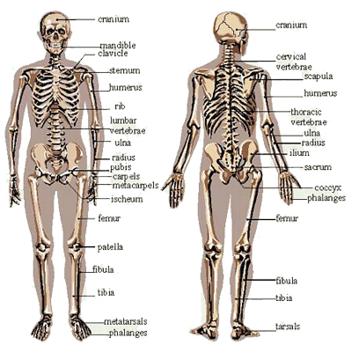
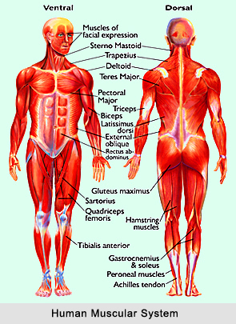
Musculo-skeletal System
You do not have to name all the individual names of the bones and muscles!

Slide 26
Functions of the structures within the Muscular Skeletal System
Bones - perform five main functions.
Provide support for the body — The skeletal system provides structural support for the entire body. Individual bones or groups of bones provide a framework for the attachment of soft tissues and organs.
Store minerals and lipids — Calcium is the most abundant mineral in the body and 99% of this is found in the skeleton. The bones also store energy reserves as lipids in areas filled with yellow marrow.
Produce blood cells — Red blood cells, white blood cells, and other blood elements are produced in the red marrow, which fills the internal cavities of many bones.
Protect body organs — Many soft tissues and organs are surrounded by skeletal elements.
Provide leverage and movement — Many bones function as levers that can change the magnitude and direction of the forces generated by muscles.

Slide 27
Tendons — attach muscle to bone.
Ligaments — attach bone to bone.
Skeletal muscles — These muscles contract to pull on tendons and move the bones of the skeleton.
Muscles also maintain posture and body position,
support soft tissues, guard entrances and exits to
the digestive and urinary tracts, and maintain body
temperature.

Slide 28
Immune System
Often not included as a main system, it is a collection of cells tissues & organs involved in other body systems.(Stretch & Whitehouse 2010)
Function of the Immune system
Defends the body against invasion by micro-organisms
Rejects material perceived as foreign – immune response
Has an anticancer role.
Functions of the individual structures have been covered in the relevant body systems

Slide 29
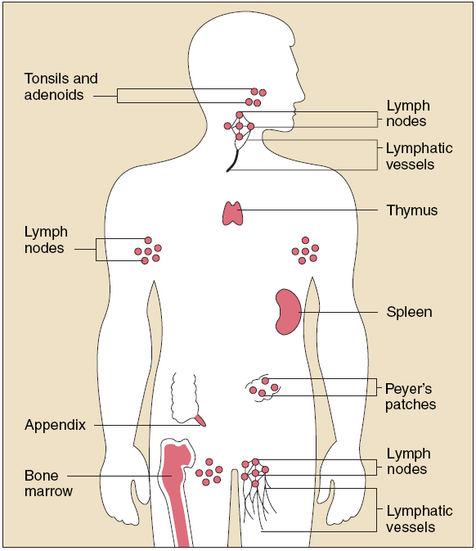
Immune System.

