Slide 1
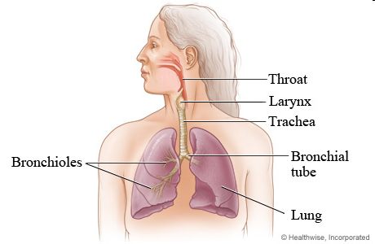
The physiology of the respiratory & cardiovascular systems in relation to energy metabolism in the body.

Slide 2
Body Systems involved.
Respiratory System (taking in oxygen) http://www.youtube.com/watch?v=hc1YtXc_84A
Cardio – vascular system (supplying oxygen to the cells of the body)

Slide 3
The Respiratory System

Slide 4
The respiratory system’s main task is to supply oxygen to the body and get rid of waste gases, primarily Carbon dioxide.
This is achieved by ventilation or breathing

Slide 5
Need to refresh your memory about the respiratory System?
http://www.bbc.co.uk/bitesize/ks3/science/organisms_behaviour_health/life_processes/revision/4/
Use the above site to help you
You should also read pages 206 -210 of the Stretch & Whitehouse text book.

Slide 6
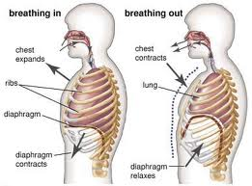
Breathing/ventilation - Inhalation
Inhalation (breathing in) the intercostal muscles and the diaphragm contract.
This enlarges the chest cavity and causes the lungs to draw in air.
The partial vacuum created in the thoracic cavity draws air through the nose, pharynx, larynx, trachea, and down into the two bronchi, through the bronchioles and into the alveoli sacs of the lungs.

Slide 7
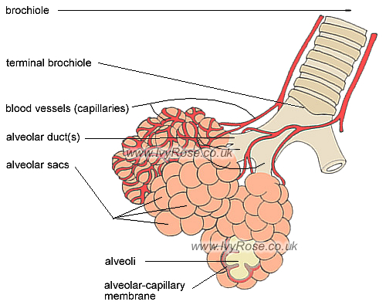
Alveoli
The lungs contain more than 300 million alveoli.
Alveoli are many microscopic blind-ending air pouches.
Alveoli are connected to its terminal bronchiole via an alveoli duct.
Gaseous exchange takes place within the alveoli.
The alveoli-capillary membrane separates the air inside the alveolus from the blood-carrying capillary on the outside of the alveolus. This is the membrane through which the gases oxygen and carbon-dioxide are exchanged during the breathing process.

Slide 8
Gaseous exchange in the lungs
The alveoli are adapted to make gas exchange in lungs happen easily and efficiently.
they give the lungs a large surface area
they have moist, thin walls (just one cell thick)
they have a large number of capillaries surrounding them.
The gases move by diffusion from where they have a high concentration to where they have a low concentration:
Oxygen diffuses from the air in the alveoli into the blood.
Carbon dioxide diffuses from the blood into the air in the alveoli.

Slide 9
Breathing /ventilation - Exhalation
During exhalation (breathing out) the diaphragm and intercostal muscles relax and return to their resting positions.
This reduces the size of the thoracic cavity, thereby increasing the pressure and forcing air out of the lungs removing carbon dioxide.

Slide 10
Changes to the rate of breathing
Chemoreceptors in the walls of the blood vessels that detect the levels of carbon dioxide in the blood.
If cellular respiration is increased, the rising levels of Carbon Dioxide triggers the chemoreceptors.
This stimulates the Medulla of the Brain and nerve impulses to the diaphragm & the intercostal muscles increase.
This causes the Breathing rate to increase, along with the depth of breathing.

Slide 11
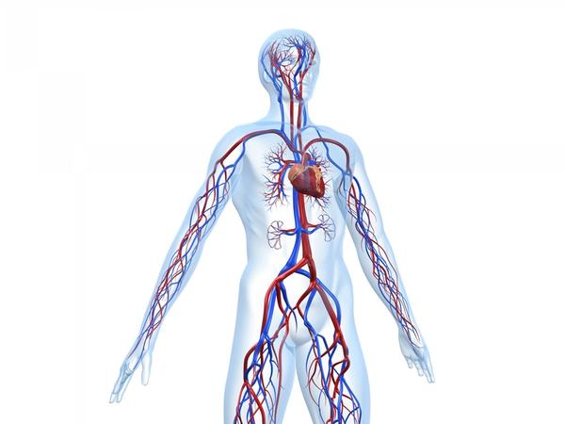
The Cardiovascular System

Slide 12
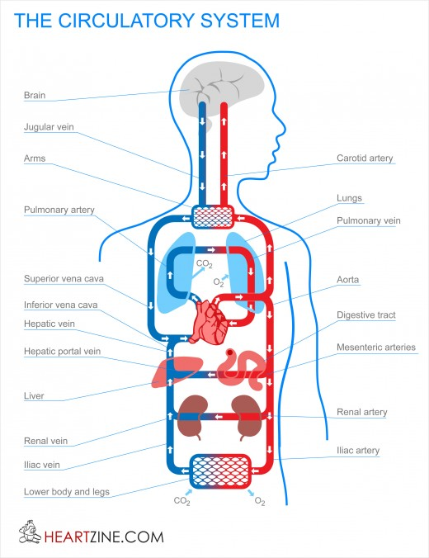
Recap
Gross Structures
The heart
Blood vessels
Blood – Red Blood cells
A key function is the transport and supply of oxygen and glucose to the cells of the body.

Slide 13
Need to refresh your memory about the Cardiovascular System?
http://www.bbc.co.uk/schools/gcsebitesize/pe/appliedanatomy/0_anatomy_circulatorysys_rev1.shtml
Use the above site to help you
You should also read pages 199-206 of the Stretch & Whitehouse text book.

Slide 14
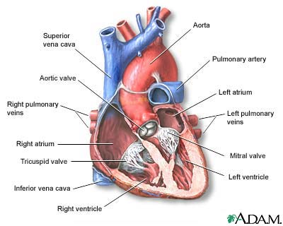
The Heart
Key to the effective transport of oxygen and other materials such as glucose to the cells.
The heart is a pump that sends some blood to the lungs and some blood to the rest of the body each time it beats.
The blood in on the left side is kept separate from the blood on the right side.
This is called double circulation and is a more efficient way of delivering oxygen to the tissues than single circulation.

Slide 15
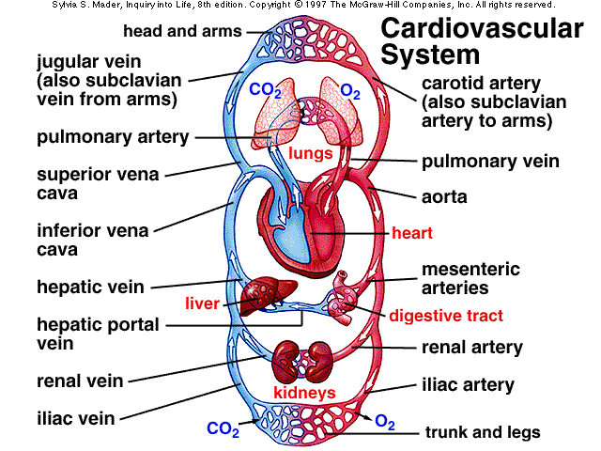
Double Circulation
Left side of the heart –SYSTEMIC CIRCULATION
Circulates oxygen rich blood through the body
Right side of the heart PULMONARY CIRCULATION
Circulates oxygen poor blood back to the lungs to collect oxygen.

Slide 16
Pulmonary Circulation
Deoxygenated blood enters the heart through the Vena Cava and collects in the right Atrium.
The Atrium contracts forcing the blood through the tricuspid valve into the right ventricle.
The Right ventricle contracts forcing blood through the semi-lunar valve/pulmonary valve into the pulmonary artery.
The semi-lunar valve stops blood flowing back into the ventricle when the ventricle relaxes.
Blood is moved through the pulmonary arteries (these are the only arteries to carry deoxygenated blood) to the pulmonary capillary system

Slide 17
How oxygen starts its journey to the cells
http://www.youtube.com/watch?v=WXOBJEXxNEo&feature=related
Diffusion takes place in the pulmonary capillary system carbon dioxide is given off and oxygen is collected.
Oxygen diffused from the alveoli of the lungs into the blood and attaches to Haemoglobin of the erythrocytes (red blood cells) to form Oxyhaemoglobin.
Oxygenated erythrocytes are sent via the pulmonary veins back to the left atrium of the heart to be transport to the cells by the systematic circulation.

Slide 18
Systemic Circulation
Freshly oxygenated blood enters the left atrium via the 4 pulmonary veins.
It is forced through the mitral valve into the left ventricle.
From there it is forced through the aortic semi-lunar valve into the Aorta.
The blood is then distributed around the body via the arteries and the finer arterioles to the capillary network of the to the systemic system to supply the cells with oxygen .

Slide 19
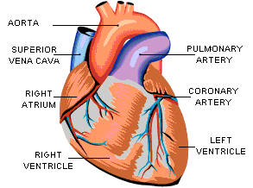
The Cardiac Cycle.
Cardiac muscle contracts and relaxes to force blood
from the heart and around the body.
Systole or Systolic period – contraction phase
Diastole or diastolic period – relaxation phase
In the healthy heart both atria and the ventricles
contract simultaneously.
See pages 202-203 in the Stretch &
Whitehouse textbook

Slide 20
The Cardiac Cycle.
Atria (atrium) contract
Ventricles bulge
Ventricles begin to contract
Systole in the ventricles
Ventricles relax
Tricuspid & Bicuspid valves are forced open. Blood fills the atria again.
1
2
3
4
5
6

Slide 21
Cardiac Cycle in more detail.
Atria contract – blood is pushed into the ventricles under pressure.
Ventricles bulge –pressure forcing the tricuspid & bicuspid valves shut. Atria relax and begin to fill with blood.
Ventricles begin to contract – pressure in the blood rises and forces open the aorta & pulmonary valves.
Systole in the ventricles – blood is pushed into the aorta and pulmonary artery. These walls are elastic & begin to expand.
Ventricles begin to relax – blood falls back with the effect of gravity for a few moments and catches in the pockets of the semi-lunar valves, pressing them together & closing off the opening.
Tricuspid & Bicuspid valves are forced open – blood rushes from the filled atria into the ventricles during their diastolic phase. On being filled to about 70%capacity, atrial systole occurs and the heart has completed it’s cycle.

Slide 22
Cardiac Output.
Cardiac Output = volume of blood expelled in one minute.
Therefore Cardiac Output
= heart rate x stroke volume.
(Each ventricle has a capacity of 70 cubic Cmsof blood – this is
Stroke Volume & is the quantity of blood expelled at each beat of
the heart)
Variations in Cardiac Output
Exercise and stressful circumstances can increase the stroke volume to between 110 & 140 cubic cms depending on the activity.
Heart at rest varies but is usually between 60 & 80 beats per minute.

Slide 23
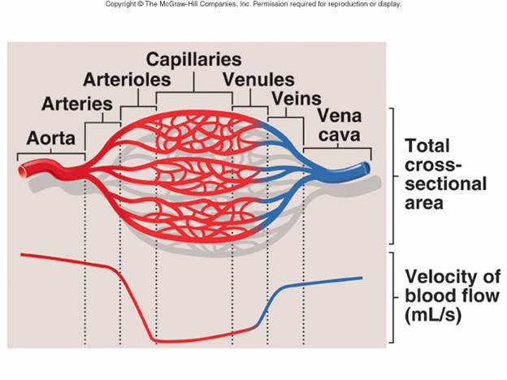
Oxygen's journey to the tissues & cells
Oxygenated blood leaves the heart via the Aorta into the arteries under pressure.
The arteries branch into arterioles.
Eventually the blood enters the capillaries.
The capillary network connects the arteries to the veins.
The capillary walls are a single layer of epithelium cells enabling molecules to cross easily to the tissues/cells.
When the oxygenated blood reaches the working tissues that are producing carbon dioxide, the raised acidity level caused by the carbon dioxide and the low oxygen level cause the oxyhaemoglobin to be broken down and the oxygen is released to the tissues.

Slide 24
The transport of Carbon dioxide to the lungs.
Deoxygenated blood with a higher concentration of carbon dioxide is transported back to the heart from the capillaries via the venules and the veins entering the heart via the vena cava.
It then travels through the right side of the heart to the Pulmonary Artery and the lungs (pulmonary Circulation)

Slide 25
Cellular respiration
This usually occurs in the presence of oxygen
Aerobic respiration
(To refresh your memory see page 181 and the earlier power point)
carbon dioxide
glucose
+ oxygen
energy
+
+ water
If muscles cannot get an adequate oxygen supply Anaerobic respiration occurs within the cells of the muscles to supply oxygen
(An-Aerobic = without Aerobic )

Slide 26
Anaerobic Respiration.
With no oxygen available, glucose is burned to produce energy and lactic acid.
Glucose = Energy + Lactic acid
After anaerobic activity, oxygen is needed to neutralize and break down the lactic acid.
Oxygen + lactic acid = carbon dioxide + water
Rapid and deep breathing is needed for a short period after the exercise to supply the oxygen and to remove the carbon dioxide which accumulates .

Slide 27
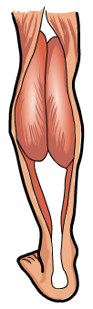
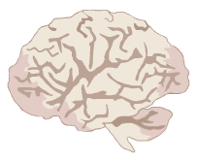
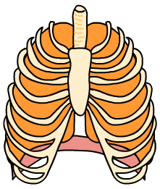
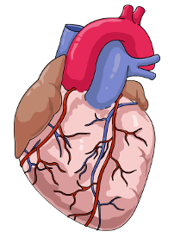
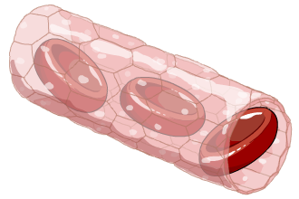
Muscle cell respiration increases – more oxygen is used up and levels of CO₂ rise.
The brain detects increasing levels of CO₂ – a
signal is sent to the lungs to increase breathing.
Breathing rate and the volume of air in each breath increase. This means that
more gaseous exchange takes place.
The brain also tells the heart to beat faster so that more blood is pumped
to the lungs for gaseous exchange.
More oxygenated blood gets to the
muscles and more CO₂ is removed.

