Slide 1
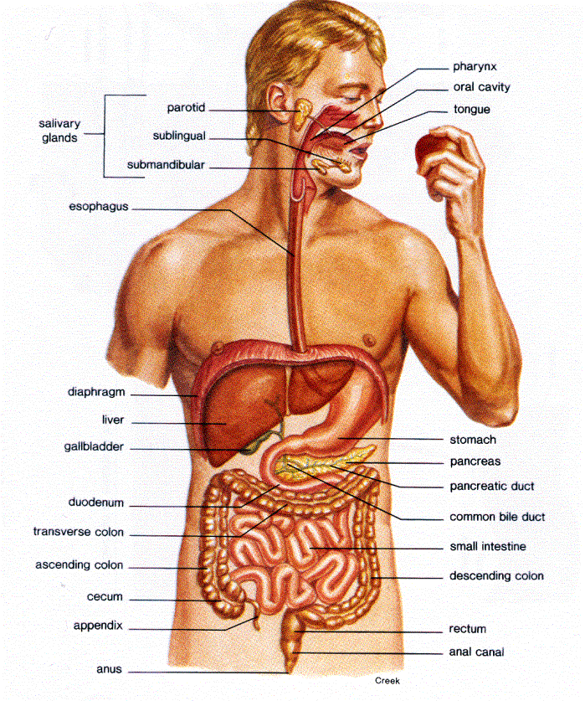
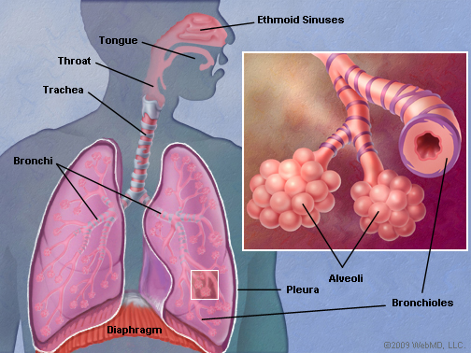
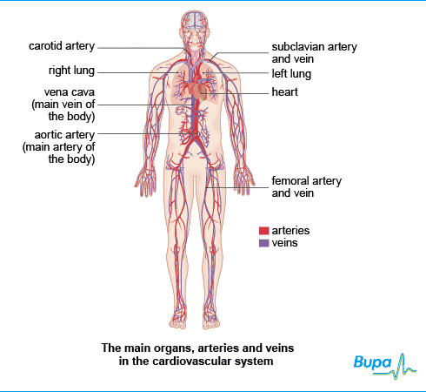
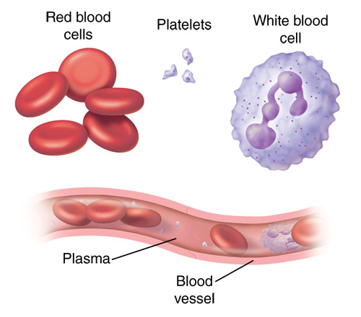
Energy & the Body systems.
An Overview

Slide 2

Check of learning on the role of energy
Write out this slide – filling the gaps as you go.
Energy is needed for the body to __________.
It is needed for molecules to move ___ and ___ of the _____ and for breaking down _______ into smaller components and for building new molecules.
__________ is the breakdown of larger molecules to a simpler molecules to release energy.
__________ is when energy is used to build more complex structures such as hormones or to repair tissues.
___________ is a process of continuous chemical changes in the cells. The speed at which these reactions take place is known as the metabolic ________.

Slide 3
Body systems involved in ensuring the body receives the components to make energy
Several body systems are involved including the Respiratory, Digestive, Cardiovascular and the Nervous system.
The Systems involved in the supply of the main components for energy are:
The Digestive System – Glucose
The Respiratory System – Oxygen
The Cardiovascular system – transporting
Oxygen & Glucose and removing waste
products ( Carbon Dioxide & Water)

Slide 4
Glucose and other nutrients
Cardiovascular System
Glucose & Oxygen absorbed into the bloodstream.
Pumped by the heart via the arterial system to the cells.
Venous system removes Carbon Dioxide & Water from the cells.
Oxygen
Digestive System
Takes in food & water.
Uses enzymes to breakdown food to simple soluble substances. Absorbed into the blood stream.
Respiratory System
Oxygen taken in & Carbon Dioxide & Water expelled during breathing.
Oxygen & Glucose
Cell Respiration Energy created
Carbon Dioxide & Water

Slide 5
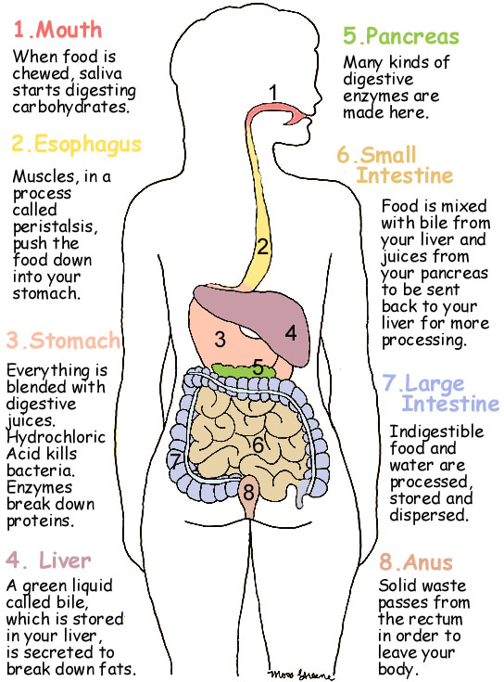
Overview the Digestive System.
Food and water are ingested, chewing breaks down the food and saliva starts to digest the food.
This process of digestion continues in the stomach and small intestine, with further enzymes being secreted from the liver and pancreas.
The simple soluble materials such as Glucose are absorbed into the blood stream to be transported to the cells.

Slide 6
Overview -The Respiratory system
Oxygen rich air is drawn into the lungs during breathing, this travels into the alveoli
Gaseous exchange takes place in the alveoli.
Oxygen diffuses across
into the blood within
the capillaries and
carbon dioxide diffuses
out of the blood.
Carbon dioxide is expelled during breathing.

Slide 7
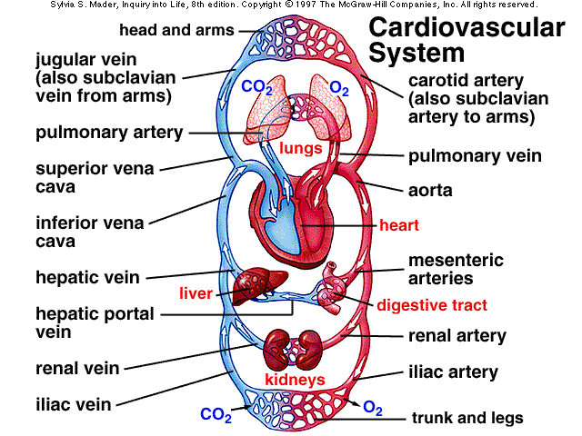
Overview – The cardiovascular System
Deoxygenated red blood cells travel from the systemic circulatory system by the pumping action of the heart, through the heart and into the Pulmonary artery and the Pulmonary System.
They then travel through the pulmonary capillary system and pick up oxygen and give off carbon dioxide.
The oxygenated red blood cells then travel through the pulmonary veins to the heart to be sent via the Aorta and the arterial network of the to the systemic system to supply the cells with oxygen .

Slide 8
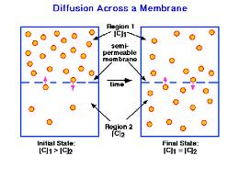
Diffusion
This is the process which allows dissolved substances to pass through the cell membranes to get into or out of a cell.
The molecules move from a high concentration to an area of lower concentration.
The greater the difference in the concentrations the faster diffusion takes place.
The difference is known as the concentration gradient.

Slide 9
Individual activity
http://www.bbc.co.uk/schools/gcsebitesize/science/add_aqa_pre_2011/cells/cells3.shtml
Using the above website make a set of notes to help you explain diffusion.
Watch how carbon dioxide and oxygen diffuse.

