Slide 1
The role of energy in the body.
L02: Understand the functioning of the body systems associated with energy metabolism

Slide 2
What does the specification ask for ?
Look at your specification what is the learning outcome asking for?
In summary
To be able to explain what energy is
Identify why energy is important in the body
Explain how the body uses energy
Investigate in more detail the three systems of the body that are involved in providing the necessary requirements for the release of energy within cells.

Slide 3
What will the assignment & assessment criteria be asking me to do?
Produce a report that provides an overview and explanation of how the body uses energy. This should explain the physiology of two named body systems in relation to how the body utilises energy and discuss the role of energy in the body. It should also analyse how the two body systems interrelate to perform these functions.
P4 Explain the physiology of two named body systems in relation to energy metabolism in the body
M1 Discuss the role of energy in the body
D1 Analyse how two body systems interrelate to perform a named function/functions

Slide 4
What is energy?
Power which may be translated into motion, overcoming resistance, or effecting physical change; the ability to do work.
(medical- dictionary.thefreedictionary.com 2013)
Look at this web page for a basic explanation:
http://www.childrensuniversity.manchester.ac.uk/interactives/science/energy/what-is-energy/

Slide 5
Types of Energy
Energy can exist in several forms
Chemical
Heat
Light
Sound
Electrical
Nuclear

Slide 6
Laws of Thermodynamics
Transformation of energy by heat and work
First Law
Energy is not destroyed or lost but passed from one form to another.
Second Law
When energy is exchanged, the efficiency is imperfect and part of the energy will escape.
(Morton et al 2000)
Ref: Morton D et al (2000) Oxford Revision Guides AS & A level PE. OPU. Oxford

Slide 7
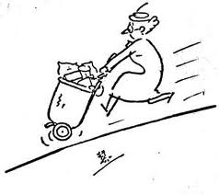
Energy use in the Body

Slide 8
Why does the body need energy?
Muscular activity & movement.
To circulate blood,
Breathing & taking in oxygen
Using oxygen
Transmitting nerve impulses
Digesting food
Making new cells
Making enzymes and hormones

Slide 9
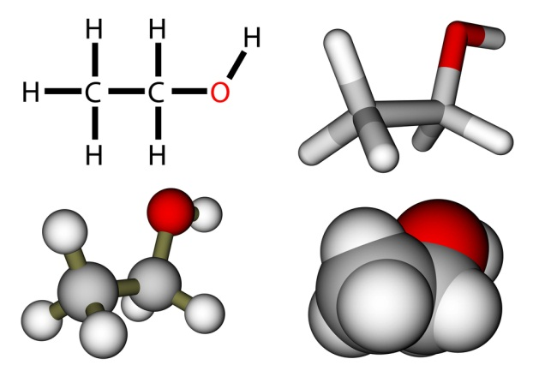
Chemical Energy
Most common type of energy used in the body.
The energy is a chemical bond that unites atoms or molecules together.
When a new bond is made between two atoms energy is required and this is usually in the form of heat.
When a bond is broken and the atoms are released energy is also released.
These chemical processes taking place in the body are known as metabolism.

Slide 10
Metabolism = Anabolism + Catabolism
Anabolism
The process of building complex molecules from simple substances and using energy
Catabolism
The process of breaking down the molecules and releasing energy. An example of this is the oxidation of glucose (cell respiration) that occurs in the mitochondria of a cell

Slide 11
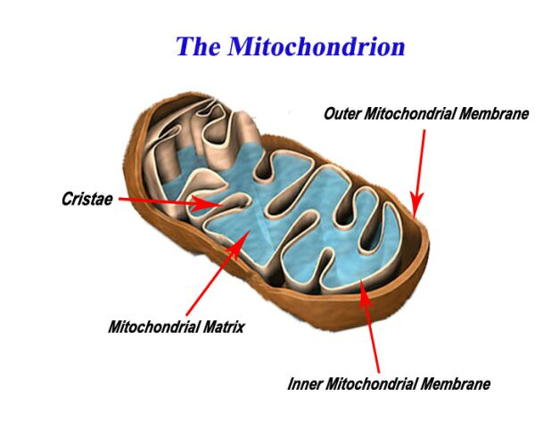
Cellular or Internal Respiration
This is energy production by the cells in the
mitochondria and to be efficient needs
Oxygen.
This results in carbon dioxide being produced as a waste product (this is exchanged in the lungs for oxygen and is known as external respiration).

Slide 12
Cellular Respiration - Steps
The process of cellular respiration is a very complex reaction that involves many enzymes, coenzyme and molecules. Each and every step is a series of complex chemical reactions, that helps in the production of energy.(buzzle 2013)
Ref:http://www.buzzle.com/articles/cellular-respiration-diagram.html
The 3 Steps of Cellular Respiration
Glycolysis
Krebs cycle
Electron Transfer

Slide 13
Watch the series of video clips on Cellular respiration.
http://www.sumanasinc.com/webcontent/animations/content/cellularrespiration.html
TIP!
The subtitles could be useful in helping you writing up your report

Slide 14
Individual activity.
http://www.bbc.co.uk/bitesize/higher/biology/cell_biology/respiration/revision/1/
Use this site to help increase your knowledge and to help you explain cellular respiration.

Slide 15
The simple explanation
Cells need a quick easy way to get energy for anabolism: this is done with ATP (Adenosine Triphosphate) in the Mitochondria.

Slide 16
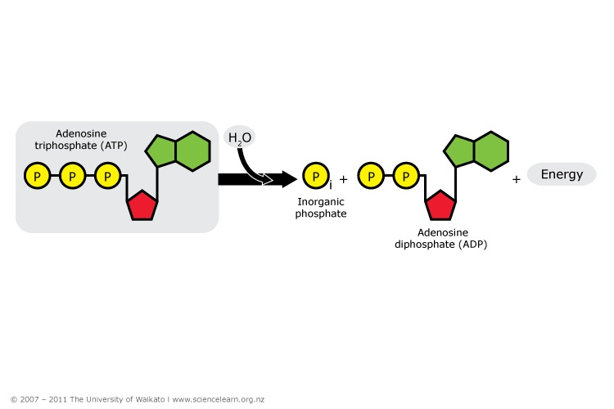
Unlocking energy in the Cells
ATP is an unstable molecule, the bonds of which are easy to break making it a useful source of energy for cells.
When Energy is Required
ATP breaks down to ADP (Adenosine Diphosphate) releasing energy from the chemical bonds.
ATP → ADP + P (Phosphate molecule) + free energy

Slide 17
ADP is then recycled to be built up again into ATP using the energy released from Glycolysis -
Glucose + Oxygen = Carbon Dioxide + Water + ENERGY
C6H12O6 + 6O2 = 6CO2 + 6H2O + ENERGY
The Energy released combines with ADP + a Phosphate molecule to create ATP.
Food energy + ADP + P → ATP
Catabolic reactions generate energy to make ATP, and the ATP energy is used to drive anabolic reactions, such as metabolic turnover (replacement of cell parts), growth and cell division, and special functions (such as secretion, absorption, contraction, or signalling).

Slide 18
Recap of the Laws of Thermodynamics
Food
Energy Released
Building
(muscle tissue)
Heat
(warmth)
Electrical
(nerve impulses)
Transport
(blood flow)
First Law
Energy is not destroyed or lost but passed from one form to another.
Chemical
Energy
Potential Energy
Kinetic
(movement)
Special uses
Second Law
When energy is exchanged, the efficiency is imperfect and part of the energy will escape.

Slide 19
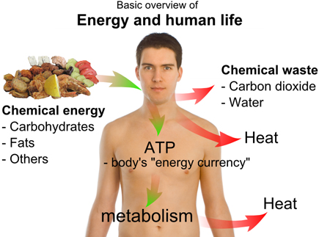

Slide 20
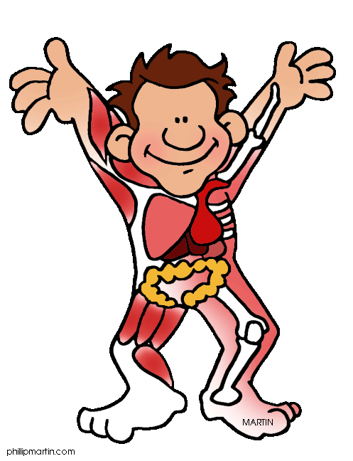
Systems involved in providing the body with energy
Digestive system
Respiratory System
Cardiovascular System.

Slide 21
Other useful sources to stretch & challenge.
http://www.phschool.com/science/biology_place/biocoach/cellresp/intro.html
http://www.s-cool.co.uk/a-level/biology/respiration
http://cellularrespiration.net/
http://staff.jccc.net/pdecell/cellresp/respintro.html

