Slide 1
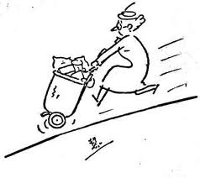
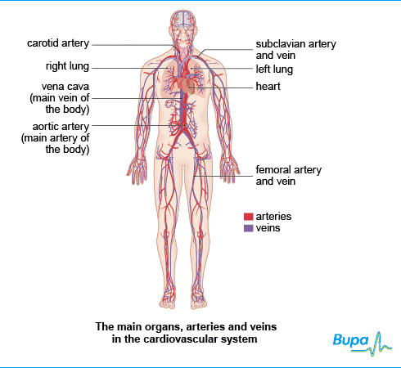
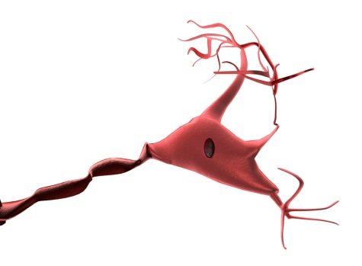
How the body systems interrelate during physical activity.

Slide 2
Aim
To explain how the body relationships interrelate with one another to supply oxygen to the cells.
To provide a framework for the writing of the D1 criteria.

Slide 3
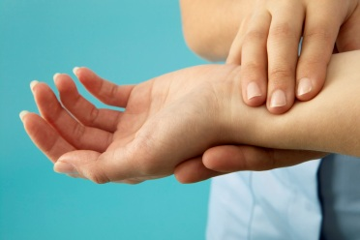
The body at rest.
Resting heart/pulse rate
60 -80 bpm (beats per minute)
Normal resting breathing rate
16 -20 breathes per minute
Ref; Stretch & Whitehouse(2010)

Slide 4
Recap - How the Respiratory & Cardiovascular System work together.
The lungs and heart work together to keep the cells supplied with the oxygen and other substances that they need and to remove metabolic debris.
The heart powers the circulatory system that takes carbon dioxide to the lungs and delivers oxygen from the lungs to the tissues.
The right side of the heart takes in oxygen-depleted, carbon-dioxide-filled blood and transports this to the lungs via the pulmonary artery. The blood moves through the pulmonary arterioles into tiny capillaries that surround the alveoli.
During the few moments that blood passes through the alveolar capillaries gaseous exchange occurs. The erythrocytes load up with oxygen from the alveoli and carbon dioxide is diffused from the blood into the alveoli for expiration.
Oxygenated blood leaves the alveolar capillaries and moves back into the left chambers of the heart through pulmonary veins. Each stroke of the heart sends this freshly-oxygenated blood out via the aorta into the circulation to travels to the tissues and organs throughout the body.
(Livestrong 2013, Kingston 2001,Stretch & Whitehouse 2010)

Slide 5
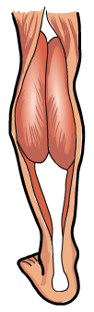
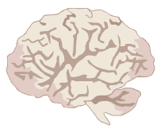
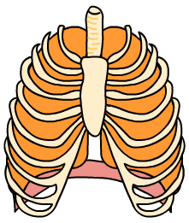
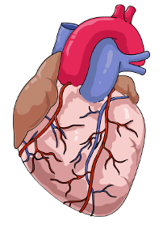
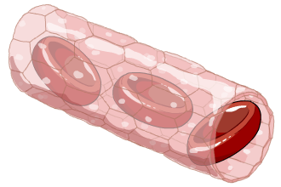
Muscle cell respiration increases – more oxygen is used up and levels of CO₂ rise.
The brain detects increasing levels of CO₂ – a
signal is sent to the lungs to increase breathing.
Breathing rate and the volume of air in each breath increase. This means that
more gaseous exchange takes place.
The brain also tells the heart to beat faster so that more blood is pumped
to the lungs for gaseous exchange.
More oxygenated blood gets to the
muscles and more CO₂ is removed.

Slide 6
During Physical Activity/Exercise
When physical activity begins, the muscles cells require oxygen to manufacture energy.
The heart rate increases due to SA node of the heart increasing the electrical impulses stimulating the cardiac muscle to contract more frequently, increasing the heart beat. so that more blood is pumped to the lungs for gaseous exchange and therefore more oxygen is pumped to the cells and carbon dioxide and water are removed.
At the same time in the respiratory system the breathing rate and the volume of air in each breath increase
( Livestrong 2013, Kingston 2001,Stretch & Whitehouse 2010)

Slide 7
Why does this occur?
In the heart
this occurs so that more blood is pumped to the lungs for gaseous exchange and therefore more oxygen is pumped to the cells and carbon dioxide and water are removed.
In the lungs
ventilation increases so that gaseous exchange can occur more quickly.

Slide 8

If this does not occur
The cells will not get the oxygen they require to function correctly.

Slide 9
Which other systems are involved in control the supply of oxygen and the removal of Carbon dioxide?
Respiratory & Cardiovascular Systems
Endocrine
Nervous

Slide 10
How does the Nervous system interrelate to control the pulse and breathing rates?
The nervous system uses special receptors with in the body to detect changes within the body. These send messages back to different areas of the brain so that adjustments can be made.
Chemoreceptors
The Nervous system detects the rising carbon dioxide concentration in the blood during physical activity by special receptors known as chemoreceptors in the aorta and carotid arteries. This information is passed to the medulla oblongata of the brain.
Stretch Receptors
During exercise the muscles surrounding the veins are contracting more rapidly, which pushes blood back to the right atrium of the heart. The right atrium stretches to accommodate the increased mount of blood entering and stretch receptors in the heart muscle relay the information to the medulla oblongata.

Slide 11

The nervous system responds to the information received from these receptors to send a simultaneous
response to the respiratory and cardiovascular system.
In the Respiratory system, messages are sent to the diaphragm and the intercostal muscles to alter the breathing rate and depth of breathing accordingly
In the Cardiovascular system, the response to the combination of chemoreceptors and the stretch receptors messages sends information to the SA node of the heart increasing the electrical impulses stimulating the cardiac muscle to contract more frequently, increasing the heart rate. This reduces the pressure on the right full atrium and increases the transport of blood around the system moving excess carbon dioxide to the lungs for expulsion from the body and oxygen to the cells.

Slide 12

The sympathetic and parasympathetic nervous systems work together to control the heart rate.
Parasympathetic Nerves
When the body no longer needs the increased cardiac output required during exercise, the receptors in the carotid arteries and the aorta signal to the vagus nerve of the parasympathetic nervous system.
This also originates in the medulla oblongata of the brain. Messages are sent via the vagus nerves to the SA node of the heart that slows down heart rate.

Slide 13
The Endocrine System
Produces hormones.
Noradrenaline
Secreted by some sympathetic nerves.
It has the ability to cause the arteries to contract, forcing blood through at a faster rate.
Plays a role in increasing the heart rate and the strength of the beats.
Acetylcholine
Secreted by the vagus nerve
Help to slow the heart rate.

Slide 14
Conclusion
We can see that the not only do the respiratory and cardiovascular systems rely on each other to ensure the body as an adequate amount of oxygen, they are also reliant on the nervous and endocrine systems to ensure the body cells receive the oxygen they require to function effectively.
In summary “the job of acquiring oxygen and disposing of the waste product carbon dioxide falls to several more body systems. The respiratory system includes the lungs, and it moves oxygen into the body and eventually into the bloodstream. It also moves carbon dioxide out of the bloodstream, into exhaled air. The circulatory system distributes oxygen throughout the body. The nervous system, including the brain, keeps track of oxygen concentration of the blood and helps to increase or decrease the rate of respiration as needed by the body.”(Livestrong 2013)
http://www.livestrong.com/article/204615-all-the-body-systems-how-they-interact-with-each-other/#ixzz2JTUXpJGy

Slide 15
Useful sites
http://www.blurtit.com/q670687.html
http://www.livestrong.com/article/179482-body-systems-how-they-work-together/
http://www.livestrong.com/article/204615-all-the-body-systems-how-they-interact-with-each-other/#ixzz2JTUXpJGy

