Slide 1


Biodiversity
And
Populations

Slide 2
On Whiteboards…
Write down as many factors you can remember from GCSE which affect organisms
There are 9 questions to complete

Slide 3
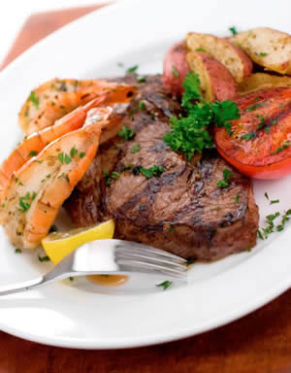
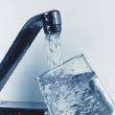






Factors which affect organisms

Slide 4
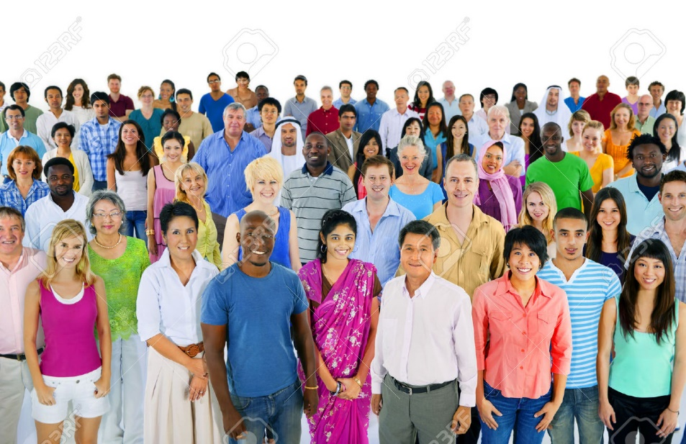

Why is sample size important?
Why is this sample size
Better than this sample size?
Larger number so results more representative
More variety of organisms so more representative

Slide 5
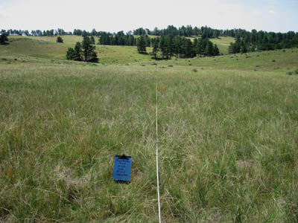
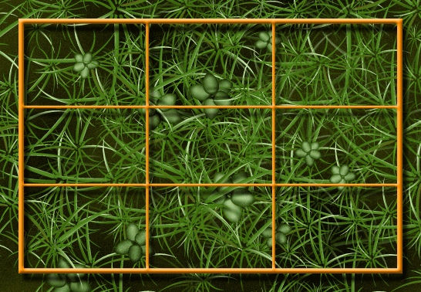
Name these and describe what they are used for.
Tape measure/line transect
Lay out grid or line to place quadrats
Frame quadrat
Placed along tape measure at regular intervals to identify species

Slide 6
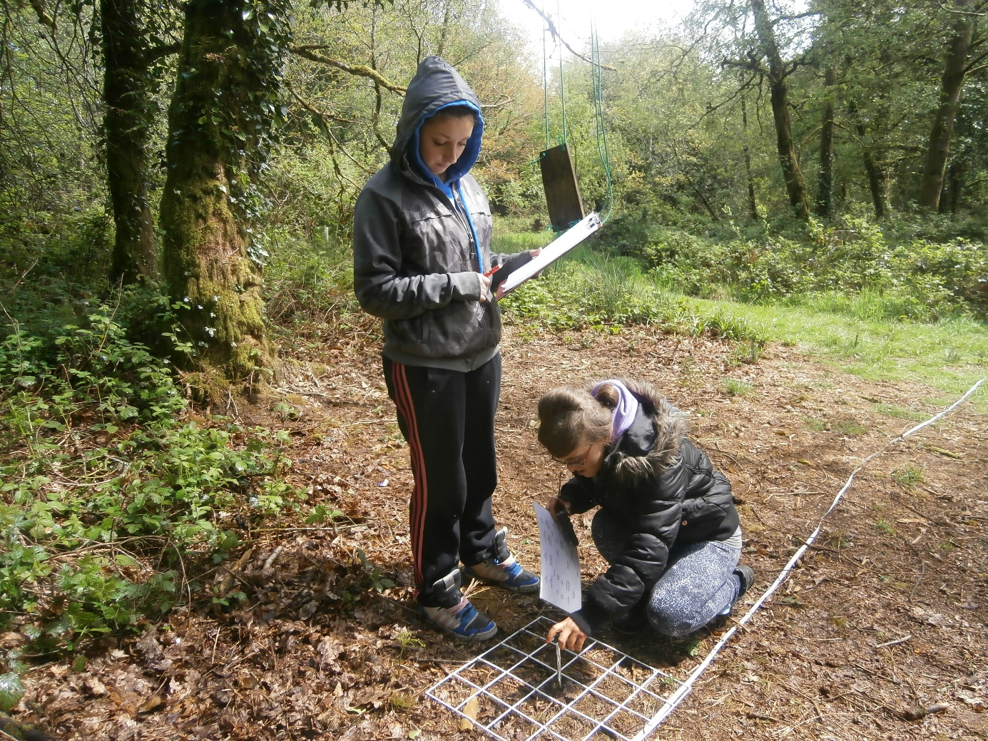
How could these students increase the RELIABILILTY for this investigation?
Place THREE or more quadrats at each point on the transect

Slide 7
What do we do with the data from the 3 quadrats?
Calculate a mean so the result is reliable
And we can spot anomalies
We do NOT remove anomalies

Slide 8
Define these terms
The average of the values collected in the sample
Most common value
Middle value when values are placed in ascending/descending order
Mean
Mode
Median

Slide 9
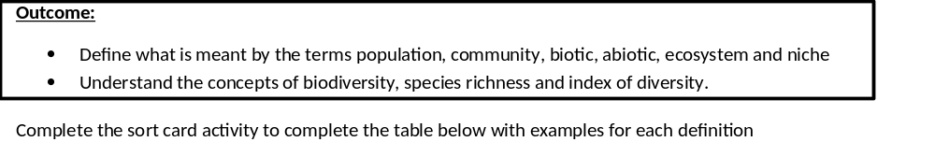
Complete the sort card activity matching the term to the definition and applying your knowledge to work out the right example.
Complete the table on page 2 in your booklet.
In your exam you will be given a specific context so you need to be able to read the introduction and identify the example for each term.
For on-line learning the sort card statements are muddled up on the next slide.

Slide 10
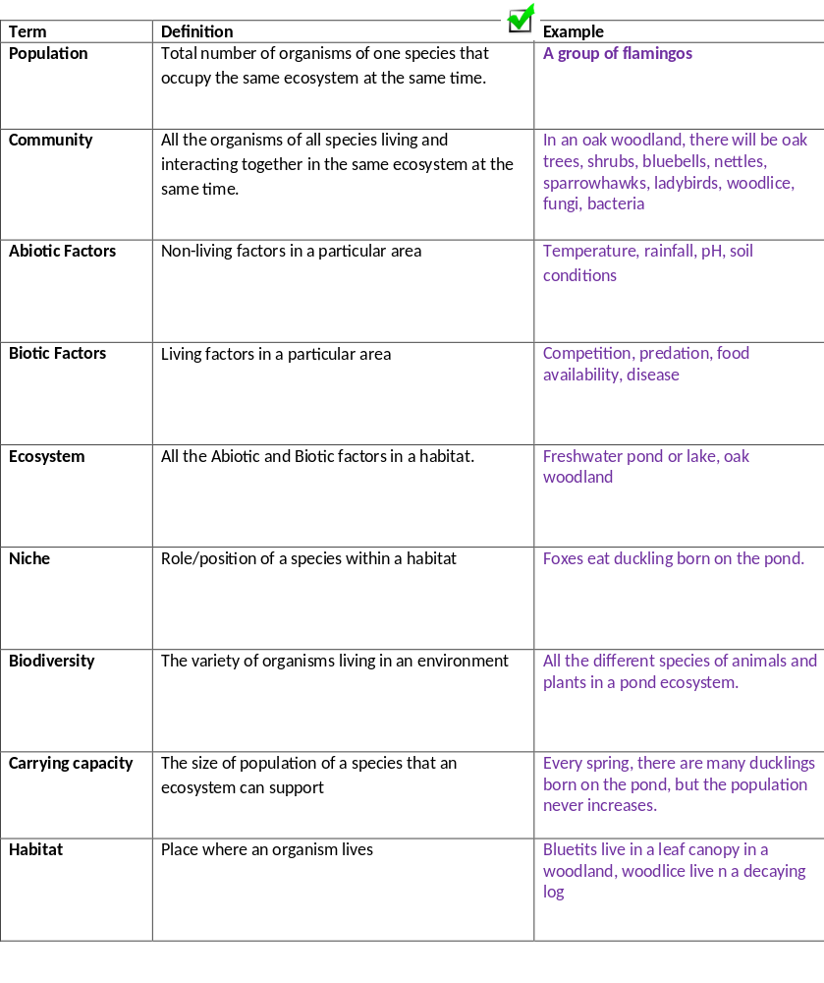
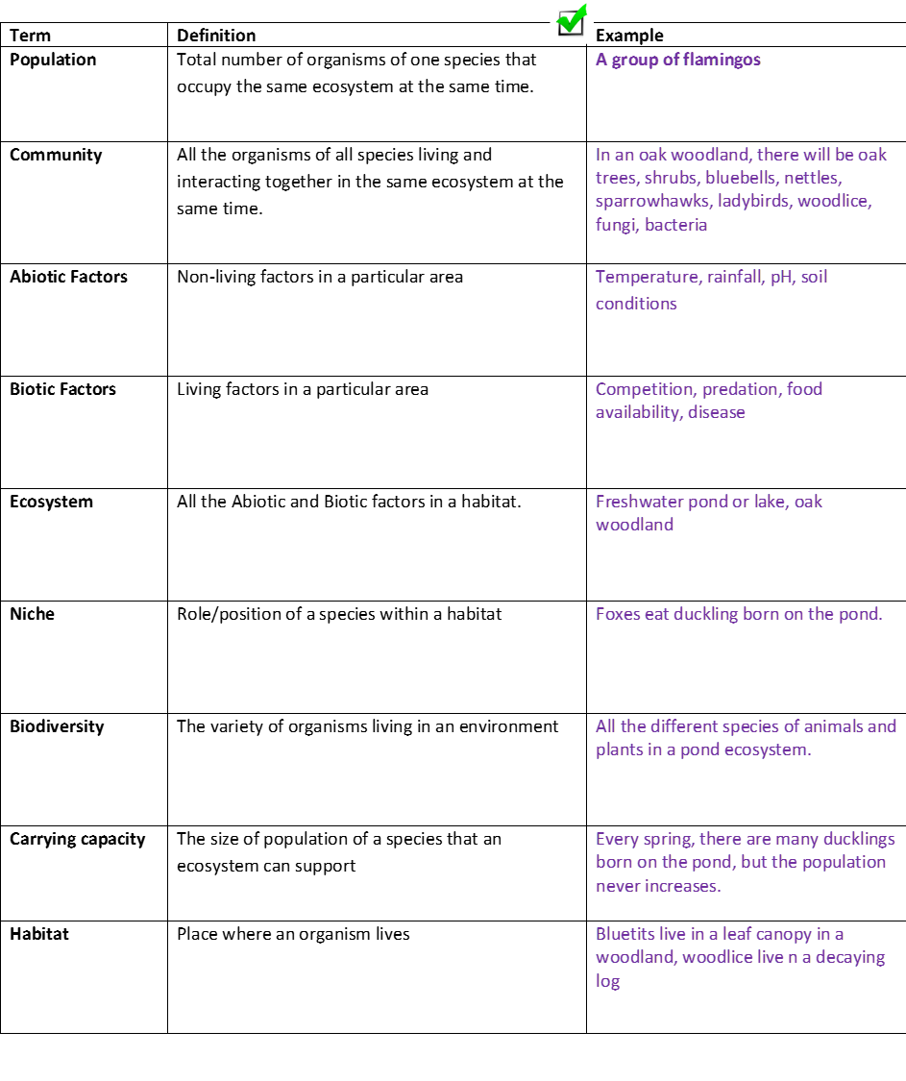

Slide 11
On whiteboards test yourself ….
Can you make a spider diagram/mindmap linking all these terms together to help you understand how they are linked to each other.

Slide 12
Ecosystem
Has a…
Made of…
Carrying capacity
Biotic and Abiotic
For each …
Example is..
Has a..
Within..
Population
Niche
Habitat
Form…
Community
You can also draw this in the space at the bottom of page 2

Slide 13
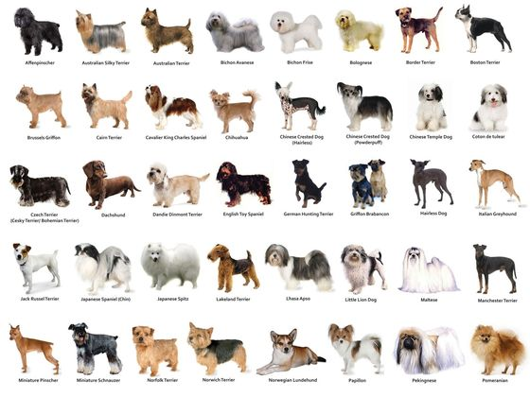
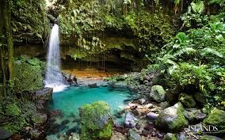
Biodiversity
There are 3 different types of diversity that you need to understand:
Species Diversity: Number of different species and the number of individuals of each species within any one community
Genetic Diversity: Variety of genes possessed by individuals that make up a population of a species
Ecosystem diversity: Range of different habitats from a small local habitat to the whole of the Earth
Fill in the table on page 3, practicing using the terms.

Slide 14
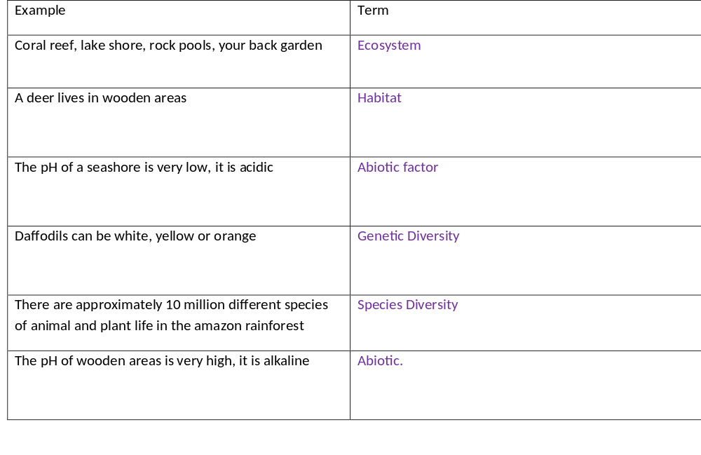
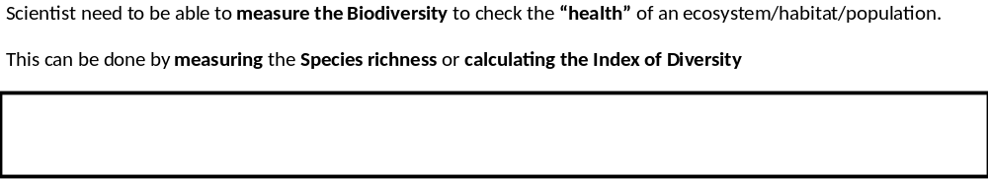

Slide 15
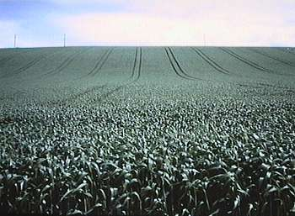
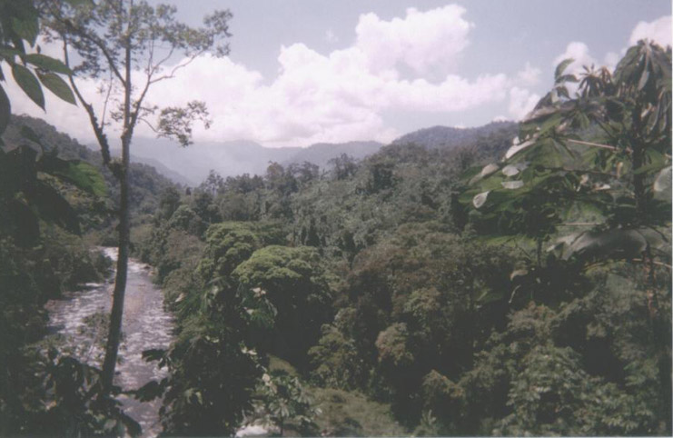
Which do you like better?
A
B

Slide 16
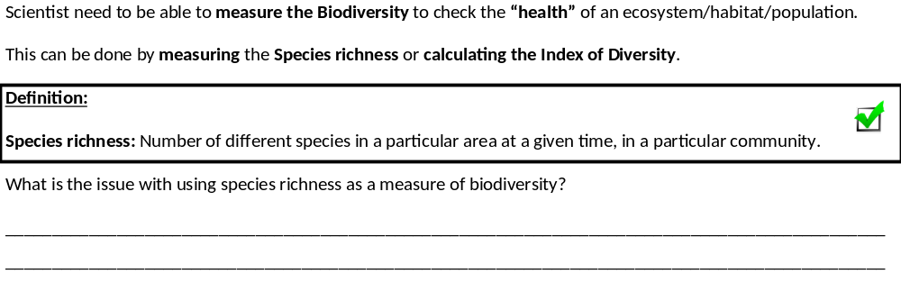
Biodiversity
You have just made qualitative (non-numerical) observations but we need to make quantitative (numerical) statements
E.G Species Richness and Index of diversity.
What is the issue with using species richness as a measure of biodiversity?
Species richness is a measure of the number of species not taking into account of number of individuals in the population/community or their abundance.

Slide 17
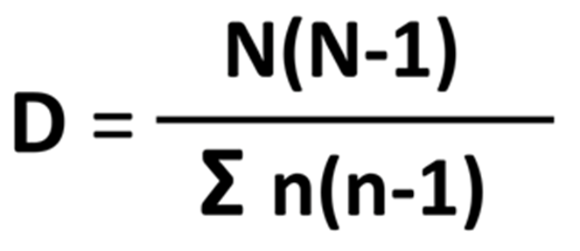

Biodiversity
Calculate the index of diversity (you will need to learn the calculation for your exams)
Fill in terms on page 3 in your booklet

Slide 18
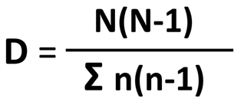
Biodiversity
Calculate the index of diversity (you will need to learn the calculation for your exams)
Total number of organisms of all species
Index of diversity
The sum of…
Total number of organisms of each species
Why do you think the Index of diversity is a better measure of Biodiversity?
______________________________________________________________________________________________________________________________________________________________________________________________
Takes into account the total number of organisms for each different species/population.

Slide 19
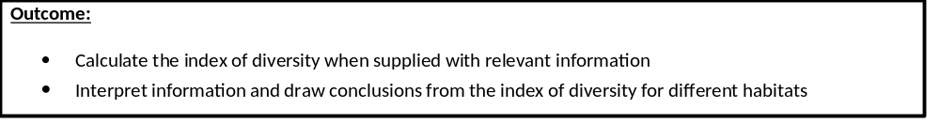
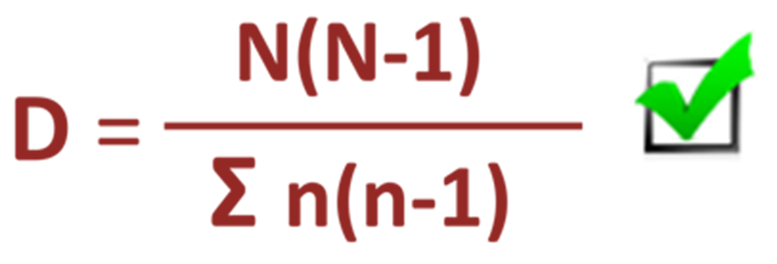
Video that explains how to carry out the calculation 6 minutes
https://www.youtube.com/watch?v=-IZTxApVMSE

Slide 20
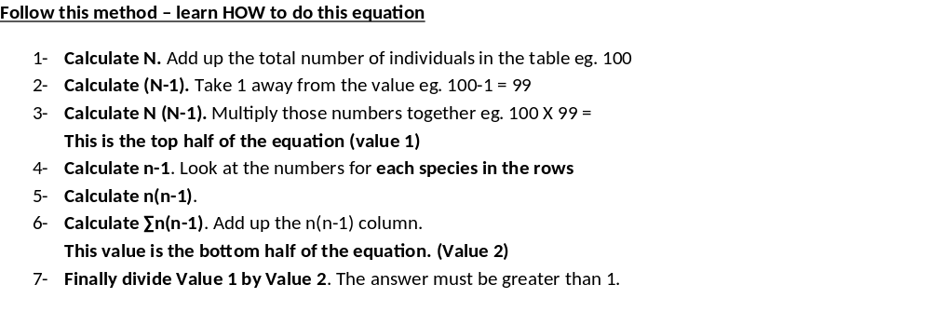
Biodiversity
We will go through example one together using the method on page 4 in your booklet.
You complete the second example on page 4 applying the method we have just learnt.

Slide 21
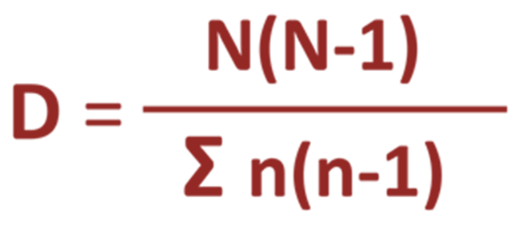
Biodiversity
Species | Number of individuals (n) | n-1 | n(n-1)
Hedgerow | 600
Wheat | 236
Ladybird | 3
Total (N) | 839
N (N-1) = |  | Total
703082
703082
Calculate N. Add up the total number of individuals in the table
Calculate (N-1). Take 1 away from the value
Calculate N (N-1). Multiply those numbers together
This is the top half of the equation (value 1)
600+236+3 = 839
839-1=838

Slide 22
Biodiversity
Species | Number of individuals (n) | n-1 | n(n-1)
Hedgerow | 600
Wheat | 236
Ladybird | 3
Total (N) | 839
N (N-1) = |  | Total
600-1=599
359, 400
55,460
6
703082
236-1=235
3-1=2
414,866
703082
414,866
Calculate n-1. Look at the numbers for each species in the rows
Calculate n(n-1).
Calculate ∑n(n-1). Add up the n(n-1) column.
This value is the bottom half of the equation. (Value 2)
359,400+55,460+6=414,866

Slide 23
Biodiversity
Species | Number of individuals (n) | n-1 | n(n-1)
Hedgerow | 600
Wheat | 236
Ladybird | 3
Total (N) | 839
N (N-1) = |  | Total
600-1=599
359, 400
55,460
6
236-1=235
3-1=2
703082
414,866
Finally divide Value 1 by Value 2. The answer must be greater than 1
703082
= 1.6947207 1.69 to 3SF
414,866

Slide 24
Biodiversity
Now it is your turn, complete the Index of Diversity for Habitat 2 on page 4
Species | Number of individuals (n) | n-1 | n(n-1)
Hedgerow | 126
Wheat | 98
Ladybird | 102
Total | 326
N (N-1) = |  | Total

Slide 25
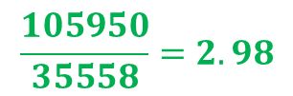
Biodiversity
Species | Number of individuals (n) | n-1 | n(n-1)
Hedgerow | 126 | 125 | 15750
Wheat | 98 | 97 | 9506
Ladybird | 102 | 101 | 10302
Total | 326 | --------- | 35558
$$\frac{105950}{35558}=2.98$$

Slide 26
Biodiversity
What does this value mean?
Biodiversity reflects how well an ecosystem can survive change in environmental conditions.
Stable ecosystems has a high index of diversity
Stable ecosystems will be less affected by change
Stable ecosystem is more likely to have at least 1 species that will survive the change in conditions.

Slide 27
Biodiversity
What a stable ecosystem, an ecosystem with a high index of diversity, looks like?
A large variety of different plant and/or animal species.
No monoculture, all the population sizes are roughly the same
A large variety of habitats and niches for nesting and feeding
Large variety of different food sources available
A low/decrease in Index of Diversity would result in a decrease in the factors listed above

Slide 28
Biodiversity
Using your calculated values for habitat 1 and 2 complete the sentences below. You will not be given the answers for this as you need to be able to apply your knowledge from the examples already given.
Habitat ___ has the highest value and habitat ___ has the lowest value.
Habitat ___ has the most stable ecosystem so will be ______ effected by change in the environmental conditions. Has a __________ variety of different plant/animal species, and __________ variety of habitats and niches so a _____________ variety of different food sources available.
Habitat ___ has the least stable ecosystem so will be ______ effected by change in the environmental conditions. Has a __________ variety of different plant/animal species, and __________ variety of habitats and niches so a _____________ variety of different food sources available.
B
A
B
Less
larger
larger
larger
A
Most
smaller
smaller
smaller

Slide 29
Biodiversity
Apply this knowledge to the exam questions on pages 5-9.
The Question is worth 27 marks. Can you complete the exam question in 35 minutes?
Remember
Highlight which part of your answer is also on the markscheme. Allow you to see which part of your answer are relevant.
If it isn’t on the mark scheme it is not right, if it isn’t written as the markscheme it is not right.
In a different coloured pen add corrections to the question.
Anything you don’t understand make a note of for when you speak to your teacher.

Slide 30
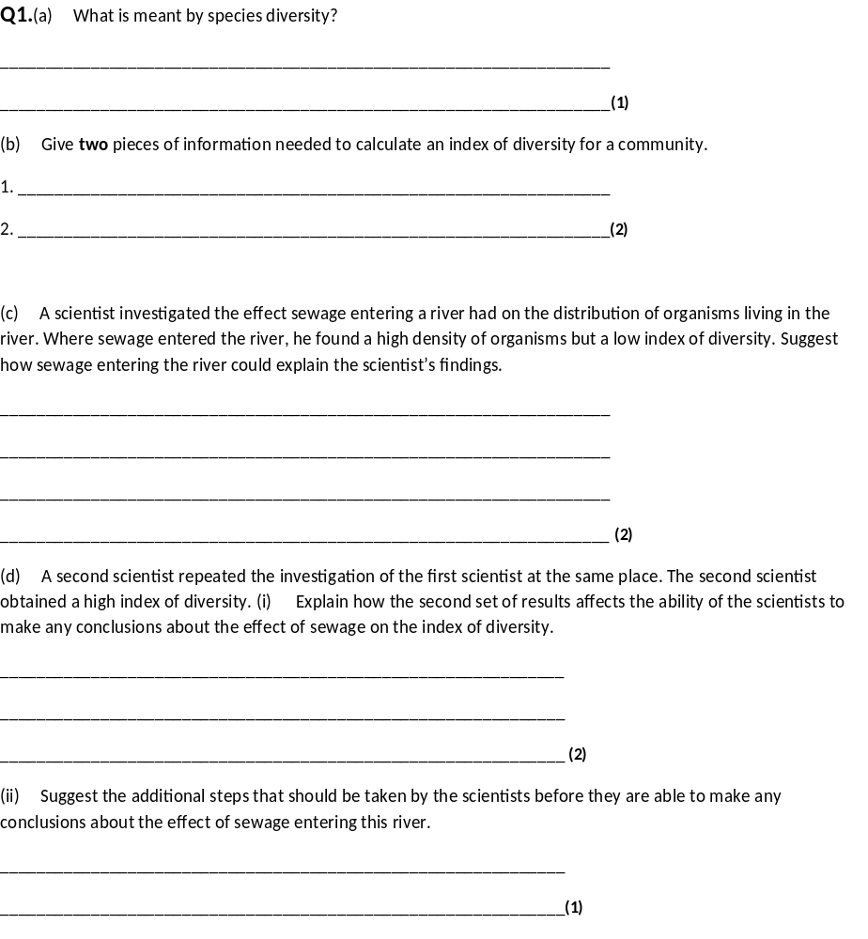
(a) Number of species in a community/habitat/area/ecosystem
Accept: species richness
Reject: in a population
1
(b) 1. Number of/population of (organisms of) each species;. Accept: ‘species richness’
2. Total number of organisms (of all species) / Total number of species; Idea of grand total of all organisms, not just number of different species
2
(c) 1. Described effect of sewage (eg oxygen depletion/is toxic/kills); Accept: eutrophication/description of eutrophication
2. Prevents some/many species colonising/ reproducing/remaining; Accept: only a few species survive
3. Sewage is food source for (individuals of) some/a few/species;
4. (So) increase only in their numbers;
Max 2
(d) (i) 1. Results are not repeatable / are not representative / unreliable / conflict / contradict;
Accept: different / don’t agree
Ignore: not valid/not reproducible/inaccurate
2. Can’t make any conclusions;
2
(ii) Do repeats to find a pattern/distribution/mean (of index of diversity); Need idea of more than one repeat
Accept: use a different technique to obtain more reliable evidence;

Slide 31
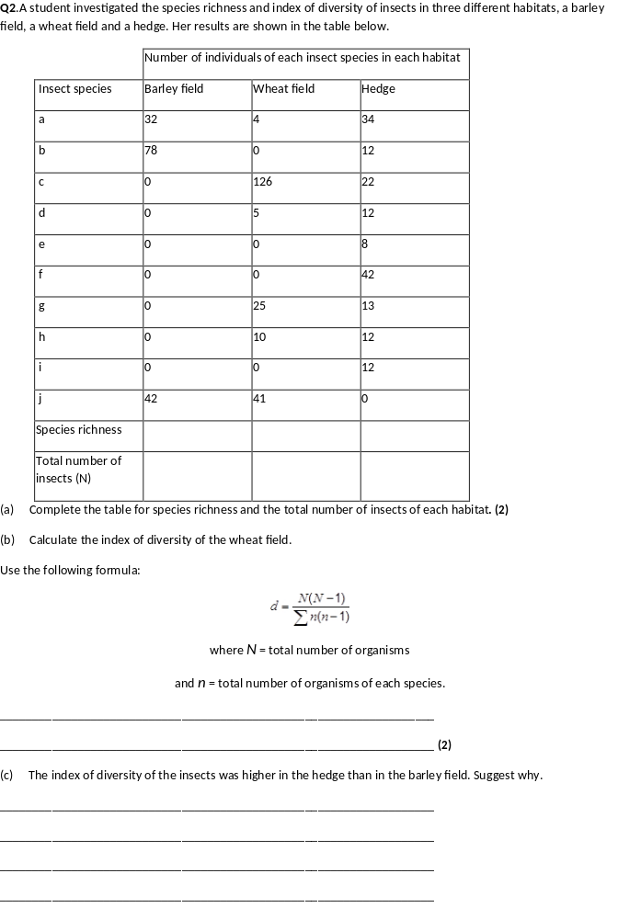
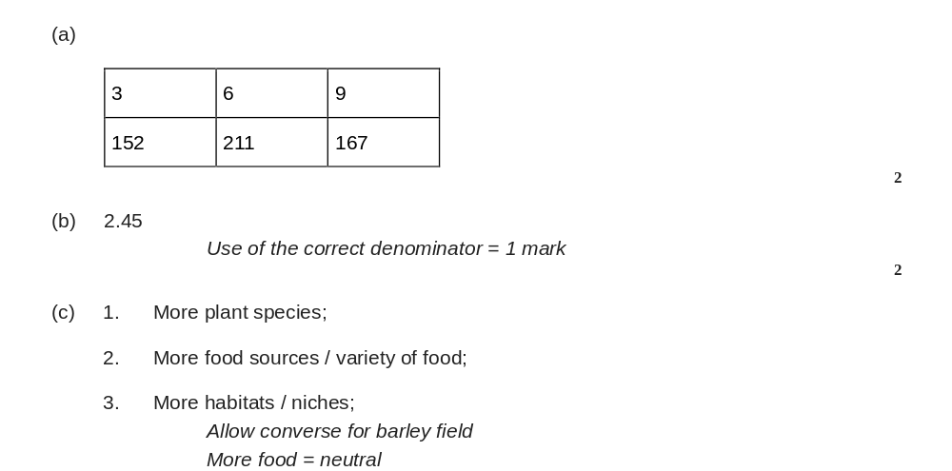

Slide 32
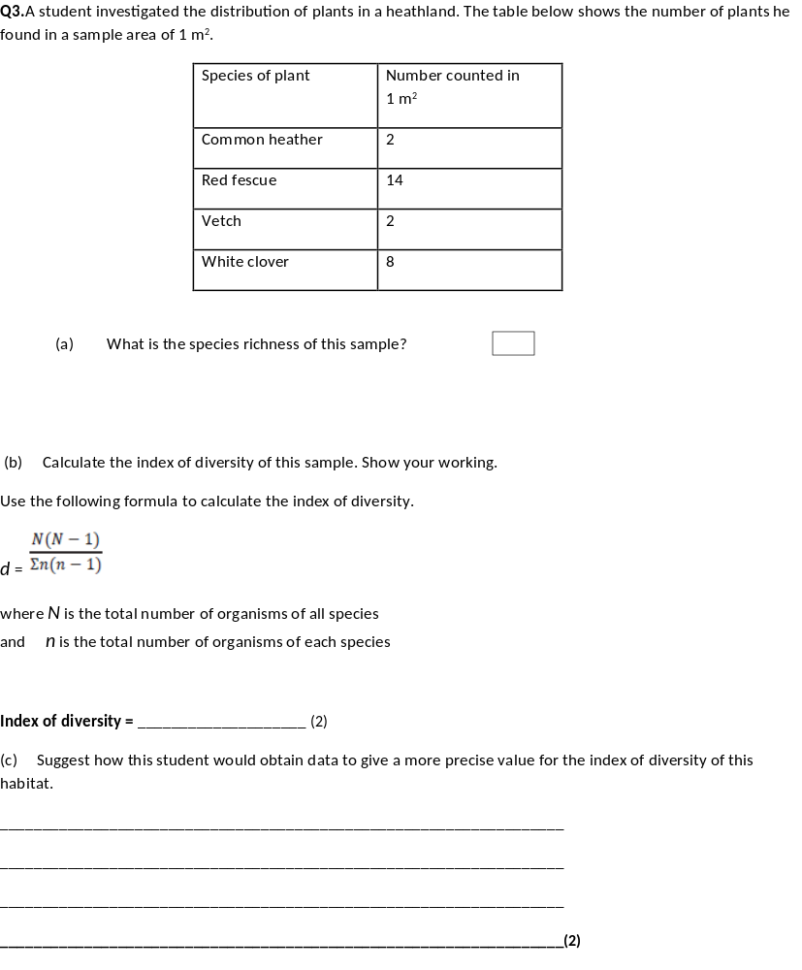
(a) 4:
1
(b) 2.68(6).
If answer incorrect:
Σn(n-1) = 242 = 1 mark
N(N-1) = 650 = 1 mark
2
(c) 1. Take more samples and find mean;
2. Method for randomised samples described.
Allow larger area = 1 mark

Slide 33
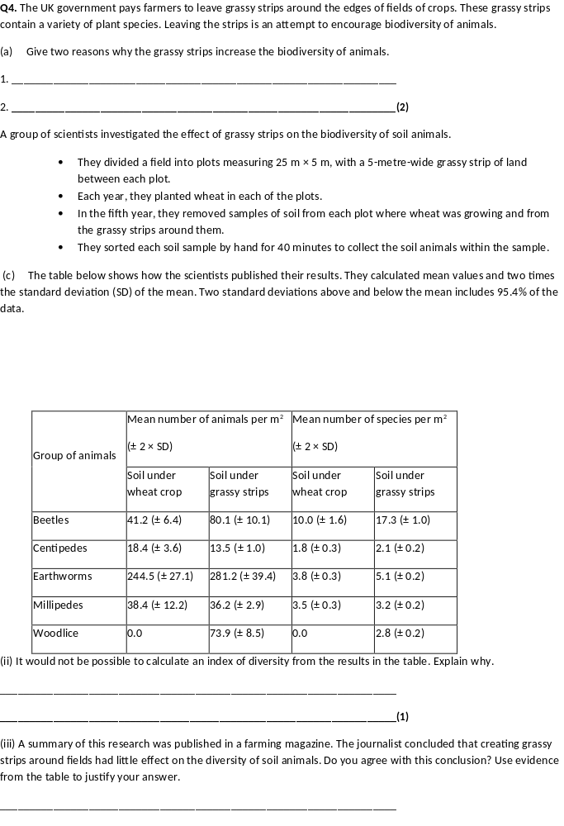
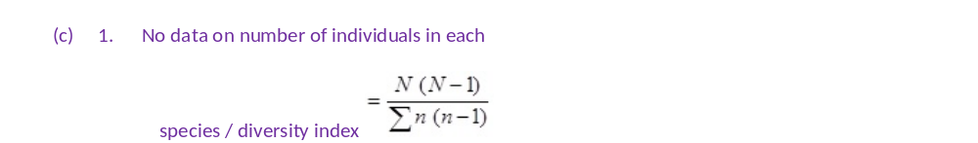
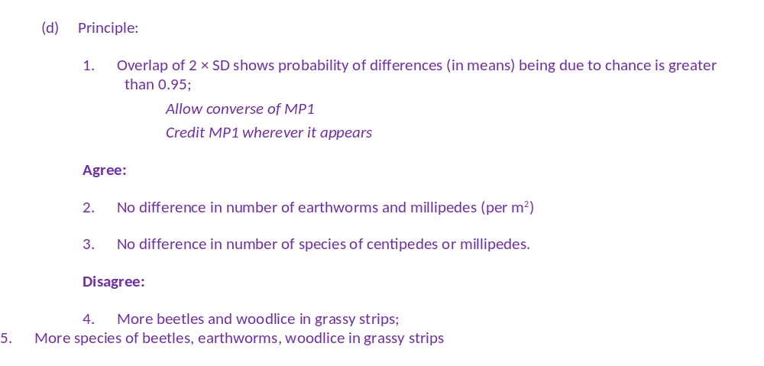
(a) Any two valid reasons; e.g.
1. Increase in plant diversity leads to more types of food for animals;
2. Increase in variety of animals leads to increase in predator species;
3. Increase in niche / habitat

Slide 34
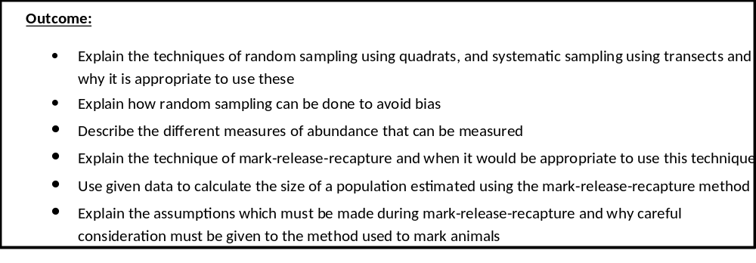
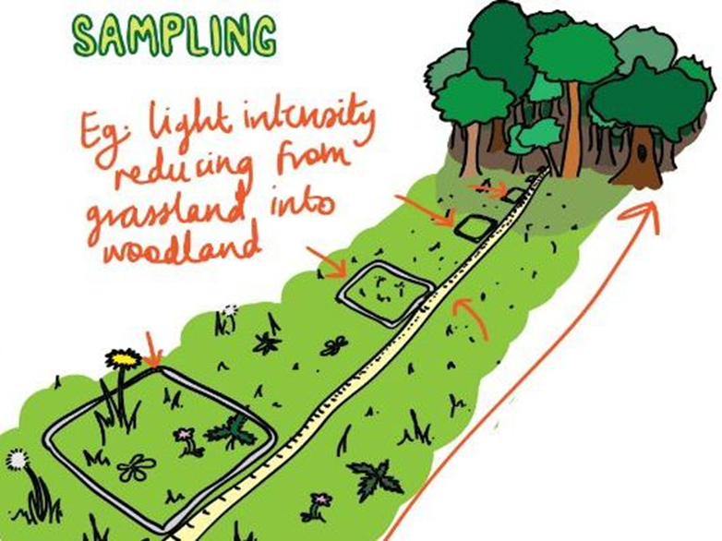
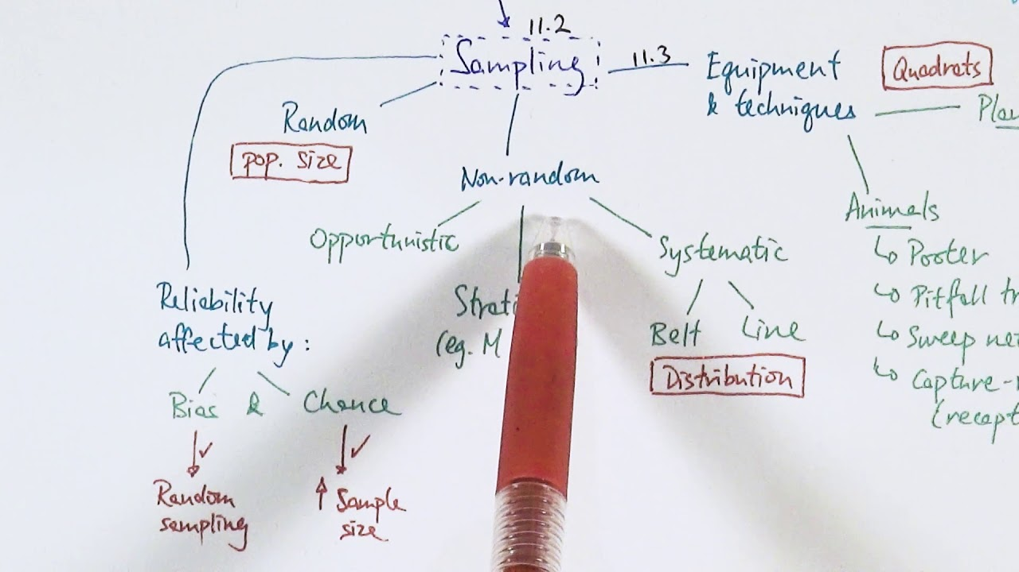

Slide 35

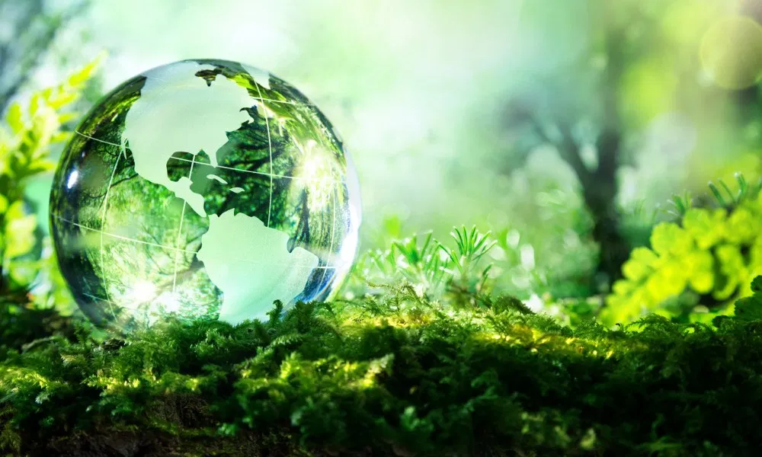
The data collected on species richness and index of diversity is used to make conclusions about different habitats, it informs ecologists of the stability of ecosystems throughout the world and allows ecologists to track how ecosystems are changing over time. This is quite a difficult task for ecologists though as living organisms are so different and can often move/change with the change of the seasons or an ecosystem can be very large and uniform eg the oceans.
To try to make data collected comparable ecologists collect data by sampling.

Slide 36
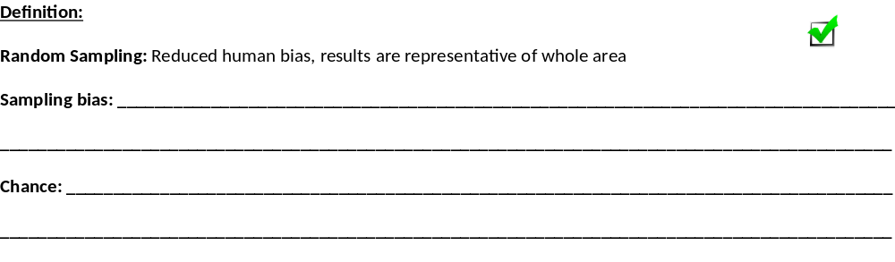
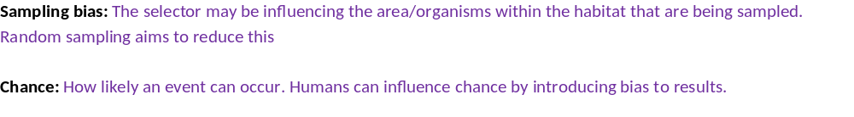
Sampling Techniques
Complete the definitions on page 10 in your booklet.

Slide 37
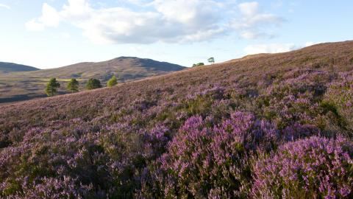
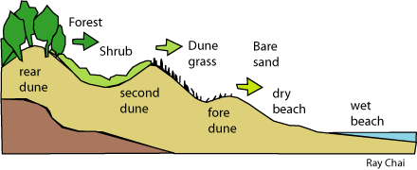
Sampling Techniques
From the introduction to a question you need to be able to identify which type of sampling would be best to use:
Random sampling: If the area is large and uniform with no clear pattern/species you would use random sampling because it is important that your results are unbiased and representative of the whole area. This is an explain question
Systematic sampling: This is used where there is a gradual change in the communities of plants and animals takes place e.g. it may be apparent that the species growing in the meadow gradually change as you move from a dry part to a wetter part, or from the meadow into the edge of adjoining woodland. Sampling is done along a LINE that runs through these changing areas to identify change in species present.

Slide 38


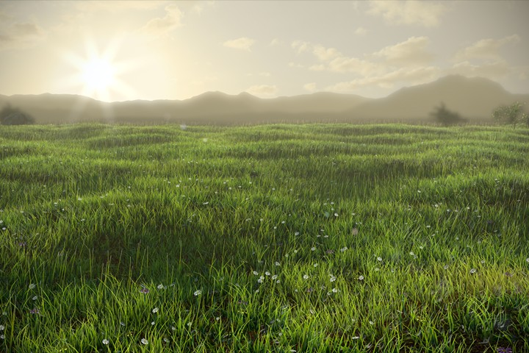
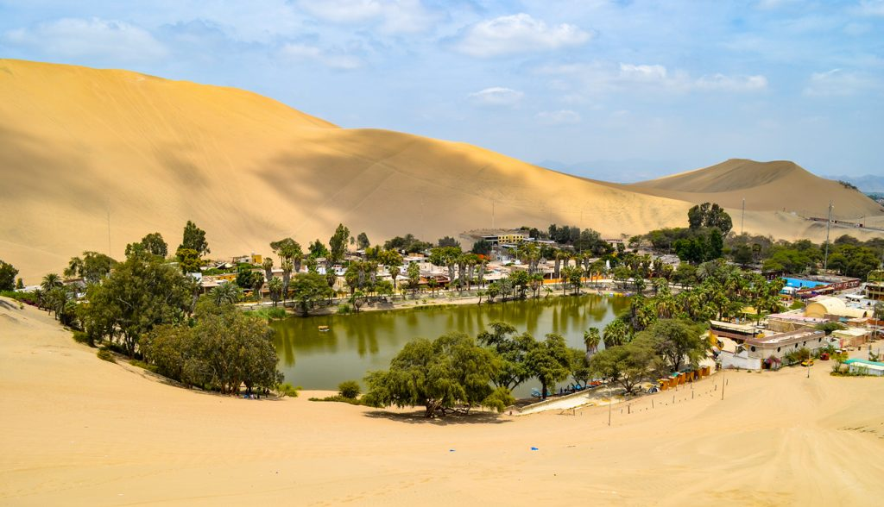
On whiteboards.
Read the information and look at the images. Identify if you would use RANDOM or SYSTEMATIC sampling.
Explain your answer.
A
B
C
D
E: From the base of a mountain to the peak of a mountain
F: From the centre of a well trodden path through heathlands into the forest
G: Sherwood forest

Slide 39
On whiteboards.
Read the information and look at the images. Identify if you would use RANDOM or SYSTEMATIC sampling.
Explain your answer.
A: Random
Uniform
B: Systematic
From one point to another
C: Random
Uniform, large
D: Random
Large
E: From the base of a mountain to the peak of a mountain. Systematic- change
F: From the centre of a well trodden path through heathlands into the forest. Systematic- change
G: Sherwood forest. Random- large

Slide 40
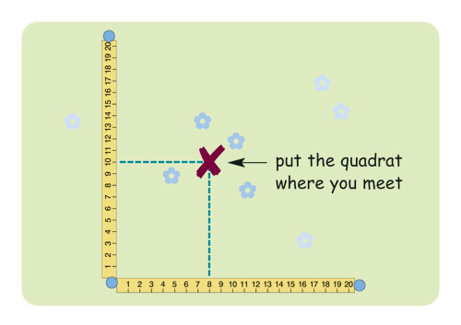
How to carry out random sampling.
Method:
Set up a grid axis using 2 tape measures at right angles to each other,
Each metre is a marker.
Using a random number generator select two numbers at random and use these numbers as co-ordinates.
At these co-ordinates place a frame quadrat.
Organisms are identified using a key, animals can be counted/collected to give information on abundance, absence or presence of species.
Repeat procedure at different times of the day, seasons, month etc.
Collect data on % cover using a frame quadrat

Slide 41
Why is it best to carry out random sampling?
Advantages of carrying out random sampling
1. Use a large sample size. This will reduce the influence of chance and anomalies and allow you to calculate a mean which makes your results more precise
2. Analyse the data collected to determine the influence of chance on the data collected. Carry out statistical tests to make your results more valid.
3. Use random sampling instead of systematic sampling. Random sampling reduces human bias

Slide 42

How to carry out Systematic Sampling
Method:
To monitor change along a habitat/area (environmental gradient).
Place a line or belt transect across length of area,
Quadrat is placed at regular intervals eg every metre.
Organisms are identified using a key, animals can be counted/collected to give information on abundance, absence or presence of species.
Repeat procedure at different times of the day, seasons, month etc.
The quadrats are used to collect information on plant species.
You can either collect quantitative data: percentage cover
Or
Qualitative data: ACFOR scale.
Both are a measures of abundance of plants species.

Slide 43
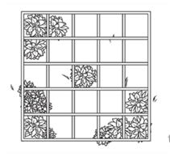
How to work out percentage cover when randomly sampling plants.
Split quadrat into equal number of squares.
Quadrat has 25 squares
4. Then add all the squares together to work out the total % cover of the plant within the whole quadrat
Quadrat
2. Work out % represented by each square by dividing 100% by the number of squares into the quadrat.
100/25 squares = 4% for each square
If a plant covers a whole square = 4%,
If the plant covers half the square = 2%,

Slide 44
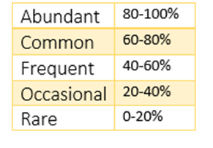
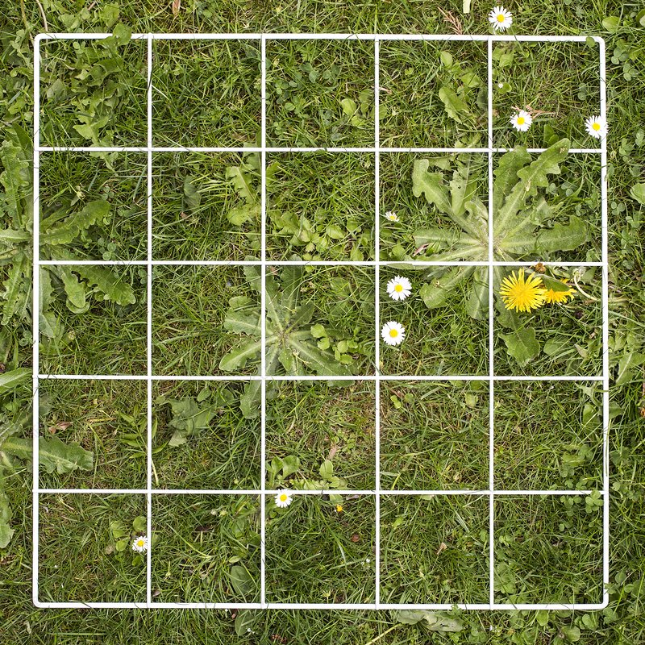
ACFOR scale when randomly sampling plants

Slide 45
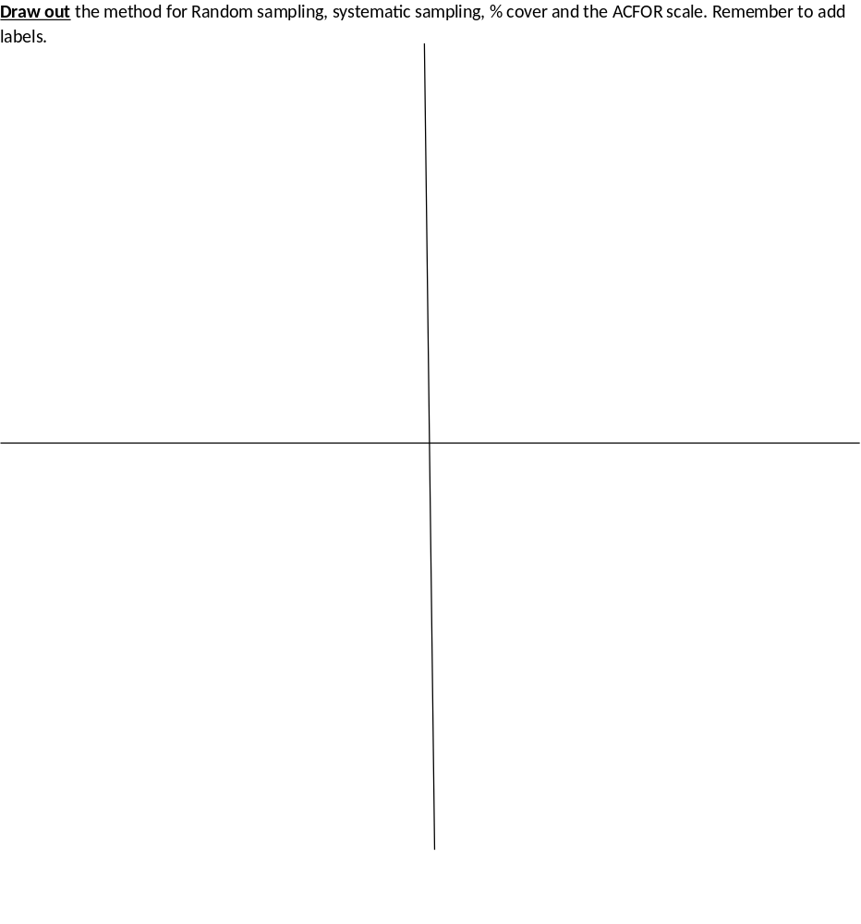
Revision poster:
On page 12 draw out the methods on page 10-11.
Converting text into diagrams makes your brain work harder so you are more likely to remember the information.

Slide 46
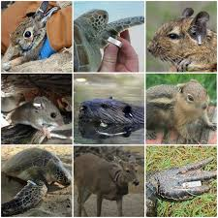
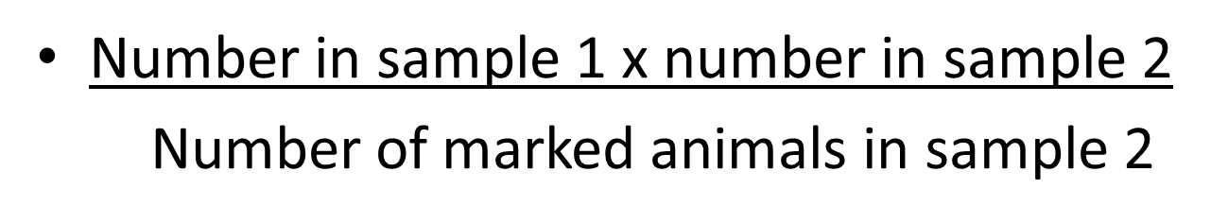
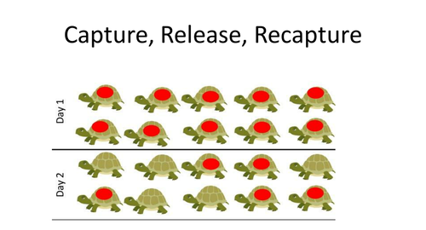
Mark Release recapture method when randomly sampling animals
These techniques cannot be easily used with animals as they are mobile

Slide 47
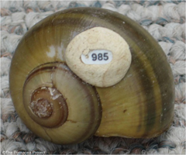
Mark Release recapture method when randomly sampling animals
Method:
Catch a sample of animals and count them
Mark each one
Release back into habitat
Leave for 1-2 days so they can mix
Catch a second sample
Count the total, and the number which are marked

Slide 48
Mark Release recapture method when randomly sampling animals
Total numbers of animals in a population =
Number in sample 1 x number in sample 2
Number of marked animals in sample 2
Complete worked example on page 13 in your booklet.
Have a go at practice question 1 and 2 on page 13 in your booklet.

Slide 49
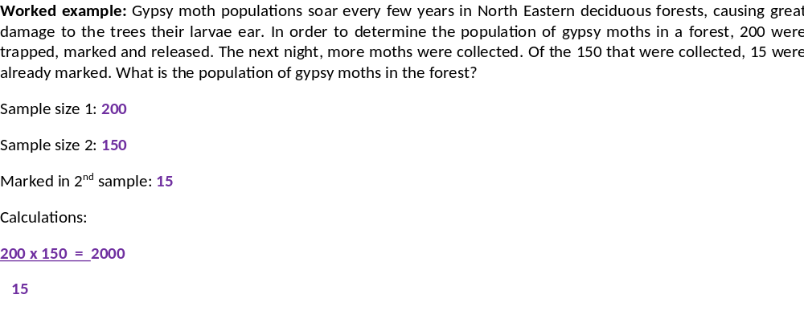
Mark Release recapture method when randomly sampling animals
Complete practice question 1 and 2 on page 13 in your booklet

Slide 50
Mark Release recapture method when randomly sampling animals
1. In order to determine snail populations, 340 snails were captured tagged and released. Later, 420 snails were captured. Of the 420 snails, 16 were already marked. What is the size of the snail population? Show your working
2. 150 Marlin were captured, tagged and returned to the deep ocean, where they live. Later, when 140 Marlin were captured, 7 of the Marlin has tags. What is the size of the Marlin population? Show your working.
340 x 420 = 8925
16
150 x 140 = 3000
7

Slide 51


Mark Release recapture method when randomly sampling animals

Slide 52
Apply this knowledge to the exam questions on pages 14-18.
The Question is worth 27 marks. Can you complete the exam question in 35 minutes?
Remember
Highlight which part of your answer is also on the markscheme. Allow you to see which part of your answer are relevant.
If it isn’t on the mark scheme it is not right, if it isn’t written as the markscheme it is not right.
In a different coloured pen add corrections to the question.
Anything you don’t understand make a note of for when you speak to your teacher.

Slide 53

(a) 1. Draw grid over (map of) area;
2. Select squares / coordinates at random.
2
(b) 1. No emigration / immigration;
2. No losses to predation;
3. Marking does not affect survival;
4. Birth rate and death rate equal;
5. (In this case) all belong to one population.
2 max
(c) 1. Only glows brightly with UV, so doesn’t make insects more visible;
2. So doesn’t affect / increase predation;
OR
1. Glows brightly with UV marking visible;
2. So makes it easy to pick out labelled insects.
2

Slide 54



Slide 55

(a) (i) Produces a more reliable mean / average / makes sure sample was representative / reduce effect of extreme values / identify anomalies;
Ignore references to chance
1
(ii) Removes bias;
1
(b) Two marks for correct answer of 5.8;
One mark for incorrect answer that clearly shows denominator as 216;
2

Slide 56

(c) 1. Increase in variety of plants / shrubs / grass;
2. More habitats / niches;
3. Greater variety of food sources / more food sources;

Slide 57

(a) 1. Compete (with fertile males) to mate / for food / resources OR intraspecific competition;
2. Do not reproduce / breed OR Reduces population (of mosquitoes);
1. Must convey idea of competition.
2. Accept: ‘fewer mosquitoes’ / ‘fewer offspring’.
2
(b) 1. Capture / collect / sample, mark and release;
2. Leave time for mosquitoes / Aedes to disperse before second sampling / collection;
3. (Population =) number in first sample × number in second sample divided by number of marked in second sample / number recaptured;
3. Accept: correct equation.
3
(c) (Radiation) affects their ‘attractiveness’ / courtship / survival / life span;
Accept: ‘die / less likely to survive due to radiation’.
Accept: ‘disease can be transmitted by other means’ (other than mosquitoes).
1

Slide 58

(d) To maintain number / competition as they die / have a short life span;
Accept: to replace mosquitoes that have died.
1
(e) 1. Number (of mosquitoes in treated area) is low / lower at / after 12/13/14/15/16 weeks = 2 marks;
2. For one mark accept number (of mosquitoes in treated area) is low/lower without reference to relevant week;
Accept: amount for number, comparison of numbers (of mosquitoes) for lower/low.
2

Slide 59


On page 2 fill in the definitions, can you fill these in without having to look back to the beginning of the booklet?
Total number of organisms of one species that occupy the same ecosystem at the same time
Non-living factors in a particular area
Living factors in a particular area
The size of population of a species that an ecosystem can support

Slide 60

Measuring Biodiversity in an Ecosystem.
We know how to measure biodiversity but we also need to identify factors which could be affecting the population or communities in the Ecosystem, so are affecting Biodiversity.

Slide 61
Limiting Factors

Slide 62
Limiting factor
Temperature - Abiotic
pH - Abiotic
Light intensity- Abiotic
Water, humidity- Abiotic
Oxygen - Abiotic
Accumulation of toxic waste- Abiotic
Disease - Biotic
Predators- Biotic
Shelter – Abiotic

Slide 63
On whiteboards…..
Apply your knowledge of definitions to the 2 questions below:
a) Suggest what happens when any abiotic factor is below the optimum for a population?
b) Suggest what happens if no individuals have adaptations that allow survival?
Fewer individuals can survive
No longer adapted to environment
Population has become extinct.

Slide 64
Limiting factor- Abiotic
Abiotic factors in the habitat or ecosystem can affect the carrying capacity of the ecosystem so limit the size of the populations and biodiversity.
Complete the tables on page 2-3 in your booklet applying your Year 1 knowledge.
Half the table has been completed for you, use this as a guide to complete the missing information.
You will need to APPLY this information to the context of the question

Slide 65
Temperature
Temperature above | Temperature below
Enzyme activity increased | Enzyme activity reduced
Metabolic rate increased | Metabolic rate reduced
CC is increased | CC is reduced
More energy available for growth/reproduction. If temp too high enzymes denature, organisms die. | More energy used to maintain body temp, less energy for growth/reproduction.

Slide 66
Light Intensity
LI above | LI below
Photosynthesis increases | Photosynthesis decreases
Faster plant growth/reproduction. | Slower plant growth /reproduction
Greater population size | Smaller population size
CC is increased | CC is reduced
More food availability | Less food available for other organisms.

Slide 67
pH
pH above | pH below
Enzyme activity reduced | Enzyme activity reduced
Metabolic rate reduced | Metabolic rate reduced
CC is reduced | CC is reduced
Enzymes denatured | Enzymes denatured

Slide 68
Water and humidity
Water availability reduced.
Populations are reduced, only specially adapted species can live there.
Low Humidity
Increased transpiration rates in plants & evaporation of water from animal’s bodies.

Slide 69



Limiting factor- Biotic

Slide 70

Role/position of organism within the habitat

Slide 71


Video explaining the decline of the red squirrel in the UK (2 minutes)
https://youtu.be/aE3x3k_QpD4

Slide 72
Apply this knowledge to the exam questions on pages 4-7.
The Question is worth 33 marks. Can you complete the exam question in 36 minutes?
Remember
Highlight which part of your answer is also on the markscheme. Allow you to see which part of your answer are relevant.
If it isn’t on the mark scheme it is not right, if it isn’t written as the markscheme it is not right.
In a different coloured pen add corrections to the question.
Anything you don’t understand make a note of for when you speak to your teacher.

Slide 73

(a) (i) the non-living / physical part (of an ecosystem / environment);
1
(ii) density-independent, with named abiotic factor and a specific effect;
1
(b) capture, count and release;
carefully mark to avoid detection;
recapture, count marked and unmarked;
(information from an equation is valid)
3

Slide 74

(a) angle, moisture and pH (all required)
1
(b) system for subdividing quadrat into, e.g. many squares;
method of estimating cover in small squares, e.g. counting those where cover over 50%, or cover at points (of intersection);
2
(c) increasing vegetation cover is related to increasing moisture content (allow ‘affects‘ moisture content or vice versa, not ‘causes);
correlation is significant / not due to chance / can reject null hypothesis/ only 1 in 20 / 5% probability that the correlation is due to chance;
2
(d) factor; and linked effect e.g. wind-blown particles trapped;
accumulation of soil;
OR
accumulation of organic / dead / decomposed matter / humus;
increase in mineral ions / improved water retention / improved soil structure;
2 max

Slide 75

(a) Community;
1
(b) (Less) competition for food/resource; Ignore: competition for niche/habitat.
Accept: space/named resource.
Reject: intraspecific competition.
1
(c) 1. Correlation but does not mean a causal effect;
Ignore: positive/ negative (correlation).
2. Other abiotic/biotic/named factor involved;
Accept: due to presence/absence of fish.
Reject: ‘other factors’ unless further qualified.
3. Variation in numbers of beetles species at same/similar particular pH;
Accept: same number of beetles at different pHs.
Accept: ‘scattered results’ / ‘anomalies’ / ‘spread of results’.
4. Large sample;
Max 3
(d) Fish feed on predator/consumer of water beetle;
Accept: beetles feed on fish/faeces.
1

Slide 76

(a) All / group of species / all / group of populations / all the organisms;
Accept equivalent terms for group. Answers which only refer to organisms must have idea of all the organisms not just a
group of organisms.
Reject answers which include ‘environment’ or abiotic factors as part of the definition
1
(b) (i) 7.2 - 8.4 (metres); Accept answer of 1.2
(ii) 1. Food / prey / oxygen; Do not accept ‘resource’ for mark point 1 unless this is qualified as food / prey / oxygen
2. Less / no competition; Reference to light and CO₂ as a resource negates mark point 2, Ignore intraspecific / interspecific for mark point 2
2
3 max

Slide 77



Slide 78

(a) Samples collected at random;
Method for choosing random sites – random
coordinates / position from tables / calculator / other suitable means;
Other named factor constant e.g.:
Same size of net / same width of opening of net / use of one quadrat / Quadrats of same size / of stated size / same area
disturbed / collect each Sample for same time;
3
(b) Caenidae in deep water – because highest standard deviation / ‘S.D.= 7.92’
1
max 2

Slide 79

(c) (i) An organism’s role / in the ecosystem / community;
[ALLOW refs. To trophic levels / named]
(IGNORE refs. To habitat)
1
(ii) Caenidae found mainly in deep water AND Baetidae in shallow water / one family mainly in deep water AND the other in shallow water;
1
(iii) Reduces competition for named factor – e.g. food / shelter / O₂ ;
To ensure both types survive / otherwise better adapted type displaces other type;
OR
Ref. to ‘Competitive exclusion principle’ = 2 marks

Slide 80

Limiting factor- Biotic
From the Evolution booklet can you remember the definition for inter and intra specific competition without looking back at your notes?
Competition between organisms of the same species for the same resource
Competition between organisms of a different species for the same resource

Slide 81

Limiting factor- Biotic
Predator-prey relationships are examples of INTERSPECIFIC competition, with one organism directly affecting the population size of another organism.
https://www.youtube.com/watch?v=rNjPI84sApQ – Video showing an example of predator-prey relationships and how this affects population size.
Exam note:
When describing a graph you need to:
Quote the title of BOTH axis
Comment on all GRADIENTS
Quote data from beginning to end of the gradient

Slide 82
Limiting factor- Biotic
Exam note:
When describing a graph you need to:
Quote the title of BOTH axis
Comment on all GRADIENTS
Quote data from beginning to end of the gradient
Describe the graph between 1975 to 1985 for the snowshoe hare population
Between 1975 to 1977 the snowshoe hare population decreases in a steep gradient from 80,000 to 10,000.
Between 1977-1981 the population increases in a steep gradient from 10,000 to 55,000
From 1981 onwards the population decreases to 20,000.

Slide 83
Limiting factor- Biotic
Exam note:
When describing a graph you need to:
Quote the title of BOTH axis
Comment on all GRADIENTS
Quote data from beginning to end of the gradient
Explain the changes in population size.
The decrease in snowshoe hare population is due to an increase in artic fox population.
The predator population has increased so will need more food to sustain the population growth.
Increase in predation and a decrease in prey causes the predator population to also decrease in the following years.
A decrease in the predator population means a decrease in predation so an increase in prey population.

Slide 84
Apply this knowledge to the exam questions on pages 9-10.
The Question is worth 18 marks. Can you complete the exam question in 23 minutes?
Remember
Highlight which part of your answer is also on the markscheme. Allow you to see which part of your answer are relevant.
If it isn’t on the mark scheme it is not right, if it isn’t written as the markscheme it is not right.
In a different coloured pen add corrections to the question.
Anything you don’t understand make a note of for when you speak to your teacher.

Slide 85

(a) (i) true indication of growth / water mass may vary;
1
(ii) intraspecific;
1
(iii) the denser the planting the greater the yield;
above a planting density of approx 30 competition for named resource / named limiting factor / population density not limiting; (accept nutrients / space reject food)
2
(b) use genetically identical plants / clones / asexual reproduction / tissue culture;
maintain identical environmental conditions / named condition;
reference to density of planting;
2 max

Slide 86

1 4 year cycles;
2 predator / stoat peaks after prey / lemming;
3 lemmings increase due to low numbers of stoats / available food;
4 more food for stoats so numbers increase;
5 increased predation reduces number of lemmings;
6 number of stoats decreases due to lack of food / starvation;

Slide 87

(b) smaller populations have fewer different alleles / more homozygosity / less heterozygosity / smaller gene pool / lower genetic variability;
migrants bring in new alleles / increase gene pool;
2
(c) geographical isolation of populations;
variation present in population(s);
different environmental conditions / different selection pressures / different phenotypes selected;
change in genetic constitution of populations / gene pools / allele frequency;
4

Slide 88


Slide 89


Succession- Primary
Primary succession occurs from bare uncolonized land by pioneer species to climax community.
At each stage in succession, new species change the environment becoming less suitable for the previous species.

Slide 90


Succession- Secondary
Secondary succession has been colonised previously but communities have been destroyed
Changes that organisms produce in their abiotic environment can result in a less hostile environment and change biodiversity. Conservation of habitats frequently involves management of succession.

Slide 91

Succession- Primary
Primary Succession
Inhospitable environment
Climax community
Pioneer species
Marram grass
Sea rocket
Sea Couch grass
Birdsfoot Trefoil
Sand Fescue

Slide 92
Pioneer species
Role:
Increases humus/organic content of the soil
Increases water retention/minerals of soil
Increases habitats/shelter
Decreases soil erosion
Features:
A-sexual reproduction so single organisms can rapidly multiply
Rapid germination
Have increased photosynthesis- as no other food available

Slide 93

Succession- Primary
Hostile environment
Abiotic factors
Less hostile enviro
Pioneer species
Climax community
Increased species diversity
Outcompete pioneer species so more like to survive
Pioneer species
Adapted to hostile enviro

Slide 94
Less organic content eg minerals
Less habitat variety
Less food sources
More organic content due to decomposing plant/animal material
More habitat variety
More food sources
Pioneer species
Climax community
Low species richness/diversity
Higher species richness/diversity

Slide 95
Succession- Primary
Add details to the diagram on page 12 in your booklet.
You will be given a specific example in the exam so you will need to apply your answer to the exam question.
Primary Succession
Inhospitable environment
Climax community
Pioneer species
Marram grass
Sea rocket
Sea Couch grass
Birdsfoot Trefoil
Sand Fescue

Slide 96
Primary Succession
Inhospitable environment
Stage 2:
Increases humus/organic content of the soil
Increases water retention/minerals of soil
Increases habitats/shelter
Decreases soil erosion
Stage 3:
N fixing bacteria
Greater water retention
More stable
More humus
Stage 4:
Greater biodiversity
Greater biomass
Climax community
Pioneer species
Stage 1:
Hostile-More alkaline
Marram grass
Sea rocket
Sea Couch grass
Birdsfoot Trefoil
Sand Fescue

Slide 97
Apply this knowledge to the exam questions on pages 13-15.
The Question is worth 26 marks. Can you complete the exam question in 32 minutes?
Remember
Highlight which part of your answer is also on the markscheme. Allow you to see which part of your answer are relevant.
If it isn’t on the mark scheme it is not right, if it isn’t written as the markscheme it is not right.
In a different coloured pen add corrections to the question.
Anything you don’t understand make a note of for when you speak to your teacher.

Slide 98

(a) 1. (Overall, data show an) increase in species richness / increase in species diversity / increase in total number of living organisms;
2. Baetis quilleri and / or Pentaneurini guttipennis are pioneers;
3. (Pioneers cause) named change of environment e.g. provide food for other species;
4. New species / example from data colonise once there is a change;
5. Baetis quilleri / Pentaneurini guttipennis / Helicopsyche mexicana decline / outcompeted / eaten as succession continues.
5
(b) Correct answer 5.5 = 2 marks;
Allow 1 mark for correct calculation of mean population growth rate per day for each species, i.e:
Cryptolabis paradoxa = 3.226, Leptohyphes packeri = 0.585
2
(c) 1. Same species present (over long time) / stable community (over long time);
2. Abiotic factors (more or less) constant (over time)
3. Populations stable (around carrying capacity)
2 max

Slide 99

(a) Crabgrass; Reject: grass or grassland Reject: crabgrass if another organism is also included
1
(b) 1. Species / plants / animals change the environment / conditions / add humus / nutrients etc. / less hostile (habitat);
2. Species / plants better competitors;
2
(c) (Only) plants which can photosynthesise with less light (remain);
Accept converse but do not award mark for idea that plants cannot photosynthesise and die because there is no light
Answers must be in context of being or not being able to photosynthesise with less light
1

Slide 100

(a) 1. colonisation / pioneering;
2. microscopic plants at start;
3. death / decomposition;
4. named change in environment e.g. increase in organic matter / stabilisation;
5. new species colonise once there is a change;
6. increase in number of species / diversity / increase in total amount of living material / biomass / more niches / increase in nutrient availability / change from more extreme conditions / more stability;
6
5

Slide 101

(b) marking principles:
one mark – direct result of removing forest cover; e.g. soil erosion / leaching
one mark – specific effect on organisms in lake;
e.g. more sediment / nutrients (for plants to grow)
2
(c) 1. named nutrient availability;
2. numbers of producers providing energy (for a food chain) / light intensity affecting the rate of photosynthesis;
3. disease killing (weaker) members of species / predation described;
4. space for nest building / niches;
5. competition for a named limited resource / (intra and interspecific) competition explained;

Slide 102

Complete questions on page 16-18 using textbook pages

Slide 103


Slide 104


Slide 105


Slide 106
Apply this knowledge to the exam questions on pages 18-21.
The Question is worth 22 marks. Can you complete the exam question in 28 minutes?
Remember
Highlight which part of your answer is also on the markscheme. Allow you to see which part of your answer are relevant.
If it isn’t on the mark scheme it is not right, if it isn’t written as the markscheme it is not right.
In a different coloured pen add corrections to the question.
Anything you don’t understand make a note of for when you speak to your teacher.

Slide 107

Prevent extinction / loss of populations / reduction in populations / loss of habitats / save organisms for future generations (idea of);
Neutral: references to ‘playing God’ / animal rights
1
(ii) A suitable example of how some species may be important financially e.g.
1. medical / pharmaceutical uses;
2. commercial products / example given;
3. tourism;
4. agriculture;
5. saving local forest communities;

Slide 108

(b) 1. Fewer plant species / decrease in plant diversity;
Accept: converse arguments for islands with a high percentage of forest remaining
1. Neutral: fewer plants
2. Fewer habitats nesting sites / niches / food sources / varieties / less protection from predators / hunters / environment;
2. Neutral: fewer homes
2. Neutral: less food
2
(c) 1. Number of (individuals / birds of) each species;
1. Neutral: number of species
2. Total number of individuals / birds of all species;
2. Accept: ‘total number of birds’ as given context for ‘all species’ in the investigation
2
(d) 1. (Larger birds have) a low(er) SA:VOL;
Neutral: reference to fat / feathers
2. (So) less heat loss / more heat retained;
MP2 is independent of MP1
2

Slide 109

(a) (i) Method of positioning quadrats,
E.g. Find direction and distance from specified point / find coordinates on a grid / split area into squares;
Method of generating random numbers;
E.g. From calculator / numbers drawn from a hat;
Q Do not credit any method that relies on throwing a quadrat
2
(ii) Calculate running mean / description of running mean;
When enough quadrats, this shows little change / levels out (if plotted as a graph);
Enough to carry out a statistical test;
A large number to make sure results are reliable;
Ignore terms that are not incorrect
Regards large numbers as 10 / 10% +
Need to make sure work can be carried out in the time available;
2 max

Slide 110

(b) Coppice different parts of the wood at different times;
As data show many daffodils flowering 4 / 5 years after coppicing;
Q Second point needs specific reference to the graph, numbers and time after coppicing. Accept any correct answer that does this.
2
(c) Positive correlation between rainfall and flowering / the higher the rainfall, the more daffodil flowers;
Negative correlation / the higher the temperature the fewer daffodils in flower;
All statistically significant so not likely to be / not due to chance;
2 max

Slide 111

(a) source of pests / animals, and effect on crop;
source of weeds / no longer taking nutrients, hence competition / reduced yield; creation of larger fields / leaving room,
hence more efficient use of machinery / grow more crops;
hedgerows have to be maintained, so removal saves time / money;
2 max
(b) allows beetles to remain / survive / over winter in the middle of the field / strip of grass;
effect on distribution, e.g. do not normally reach the centre of the field / can reach all parts;
2
(c) increases biodiversity;
source of food for animals;
habitat / nest for animals;
reduce need for insecticides / attracts insects away from crop;
windbreaks / prevent erosion / run-off / leaching;
migratory corridors;
2 max

