Slide 1
Monomers, Polymers, Condensation Reactions, Hydrolysis Reactions
Or
MPCH (for short)
3.1 Biological Molecules

Slide 2

3.1 Biological Molecules
Outcomes:
Explain what a monomer and polymer are
Complete the definition on page 2 in your booklet.
Skill:
Definitions in Biology are very important, you must learn the exactly
These definition are part of your memory tasks.
You can be asked to define the term OR the term will be in the questions and you will be expected to understand it.
Definitions:
Monomer:
Polymer:
Polymerisation:
Condensation:
Hydrolysis:
Metabolism:
When you see this symbol it means this information is mark scheme perfect.
You must learn this information.

Slide 3
3.1 Biological Molecules
Outcomes:
Explain what a monomer and polymer are
Complete the definition on page 2 in your booklet.
Definitions:
Monomer: One of many small repeating molecules that combine to form a polymer
Polymer: Large molecule made up of repeating smaller molecules
Polymerisation: Process of producing a polymer
Condensation: Addition of a monomer to another with the removal of water, forming a bond
Hydrolysis: Splitting of the polymer into its monomers with the addition of water, breaking a bond
Metabolism: All chemical processes that take place within the cells of an organism

Slide 4
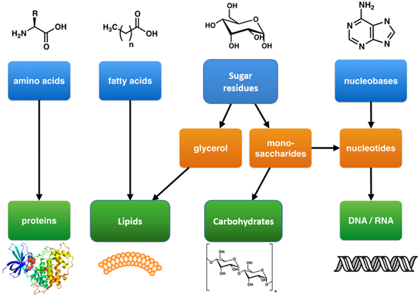
Monomers
Polymers
Biological molecule | Scientific name | Monomer | Polymer
Carbohydrate | Saccharides | Monosaccharide | Polysaccharide
Proteins | Peptides | Amino acids | Protein/Polypeptide
Nucleic acids | Nucleotides | Nucleotides | Nucleotides

Slide 5
Monomers
Polymers
Explain why are Lipids missing from the table?
Cannot form polymer
Made of two different monomers

Slide 6

Outcome
Explain the concept of condensation and hydrolysis reactions in forming/breaking down polymers.
For your exam you will need to:
Draw out the monomers for carbohydrates, lipids, proteins and nucleic acids.
Draw the condensation or hydrolysis of maltose, sucrose, lactose, dipeptide, triglyceride, phospholipid and nucleic acids.
Definition reminder:
Condensation: Addition of a monomer to another with the removal of water, forming a bond
Hydrolysis: Splitting of the polymer into its monomers with the addition of water, breaking a bond

Slide 7
Outcome
Identify common monosaccharides and describe the monosaccharides from which lactose, maltose and sucrose are made.
Present the structure of α -glucose and β –glucose diagrammatically
Explain what is meant by a glycosidic bond and how they form through condensation
Carbohydrates
On whiteboards answer the questions below from GCSE
What is the formula for glucose?
Give examples of single sugars (monosaccharides)
Give examples of complex sugars (polysaccharides)
Give the function for these polysaccharides.
What else can you remember about carbohydrates?
https://www.youtube.com/watch?v=g40u9zlSJ_E
1 minute video overview of condensation and hydrolysis of carbohydrates.

Slide 8
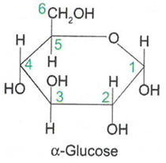
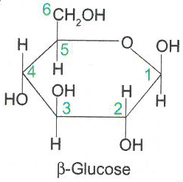
Carbohydrates
Contain the elements C, H and O.
General formula (CH₂O)_{n}
Complete the table on page 3 in your booklet.
Carbohydrate name | No. of C’s
Triose
Pentose
Hexose
3
5
6
On whiteboards,
Use the general formula to work out the formula for the triose and pentose carbohydrates

Slide 9

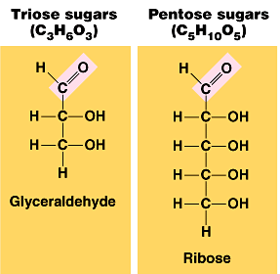
On whiteboards,
Use the general formula to work out the formula for the triose and pentose carbohydrates
Triose sugar = C₃H₆O₃
Pentose sugar = C₅H₁₀O₅

Slide 10
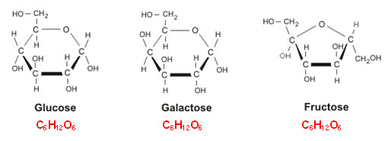
Carbohydrates
Monosaccharides
Definition
Isomer: Same Chemical formula, different structural formula
Properties
Dissolve in water and are reducing sugars
They all have the same chemical formula C₆H₁₂O₆ and are therefore isomers.
You need to know – Alpha glucose, beta glucose, fructose and galactose.

Slide 11

Carbohydrates
Monosaccharides
Structure:
Diagram of Alpha glucose
Exam tip: Can you write yourself a method to remember how to draw these hexose sugars?
Draw a ring structure connected by O
Number the C’s started below the O
Hydrate the C’s (add H₂O)
For alpha glucose the H is above C1 and OH below C1
For alpha glucose C1,2 and 4 are the same.

Slide 12
Carbohydrates
Monosaccharides
Structure:
Diagram of Beta glucose
Exam tip: Can you write yourself a method to remember how to draw these hexose sugars?
Draw a ring structure connected by O
Number the C’s started below the O
Hydrate the C’s (add H₂O)
For beta glucose the H is below C1 and OH above C1
For beta glucose C2 and 4 are the same.

Slide 13
Carbohydrates
Monosaccharides
On whiteboards:
Draw out alpha glucose FROM memory, do not look at your notes.
Mark your diagram out of 3.
Ring structure with connecting 0 correct
All C’s numbered correctly
All C’s hydrated correctly for alpha glucose.
In your exam this will need to be perfect for 1 mark
On page 3 in your booklets:
State the structural difference between alpha and beta glucose.
Alpha H Above C1, Beta H Below C1

Slide 14


Memory tasks:
At the beginning of your Biology lessons you will complete a memory task
from the previous lessons.
You will have to recall exact mark scheme perfect answers to develop your working memory.
How does this prepare you for your exams?
AO1: Demonstrate knowledge and understanding of scientific ideas, processes, techniques and procedures
Green ticks are mark scheme perfect answers so will often be your memory tasks.
Assessment objectives (AOs) | Component weightings (approx %) |  |  | Overall weighting (approx %)
 | Paper 1 | Paper 2 | Paper 3
AO1 | 44–48 | 23–27 | 28–32 | 30–35
AO2 | 30–34 | 52–56 | 35–39 | 40–45
AO3 | 20–24 | 19–23 | 31–35 | 25–30
Overall weighting of components | 35 | 35 | 30 | 100

Slide 15
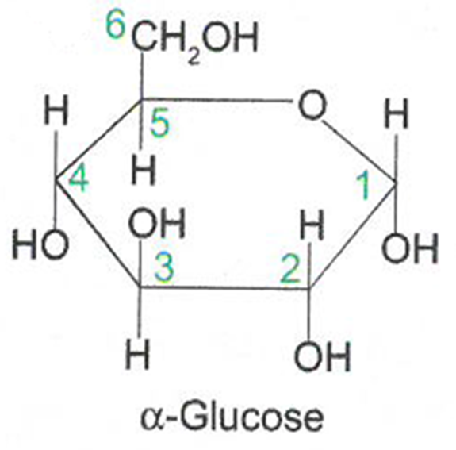
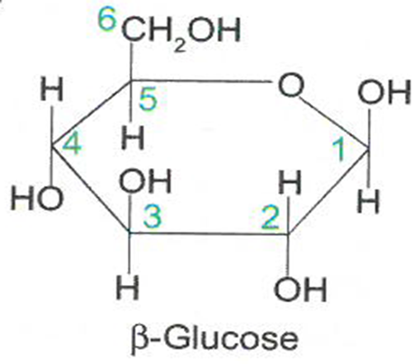
Memory task:
Learn to draw alpha and beta glucose from memory.

Slide 16
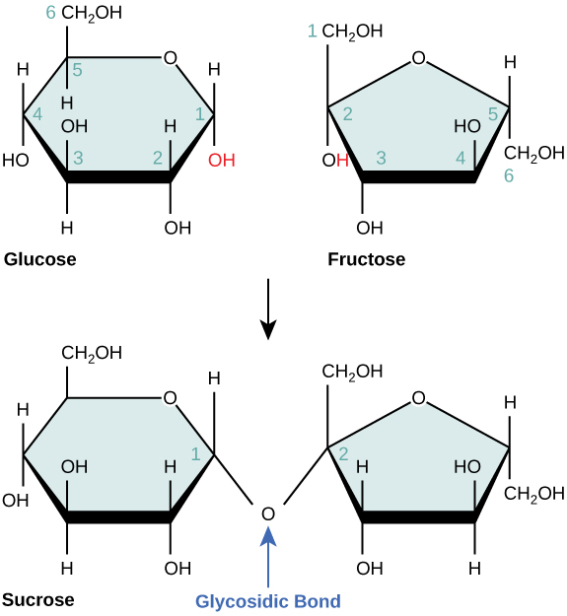
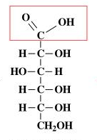
Carbohydrates
Disaccharides
Properties:
Dissolve in water and can be reducing or non-reducing sugars
Made from two monomers joined by a condensation reaction
Forming a covalent bond called a glycosidic bond.
A reducing sugar has a reducing agent.
Usually the oxygen atom in the ring structure is free to donate electrons
Non-reducing sugars do not have reducing agents, the reducing agent is bonded.

Slide 17
Carbohydrates
Disaccharides
Condensation reaction: Rules for drawing
Always show the groups involved
Always show water is released
Always circle and label the bond formed
+
Enzyme

Slide 18
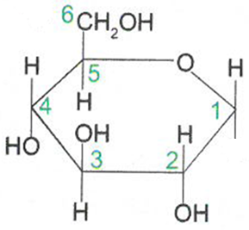
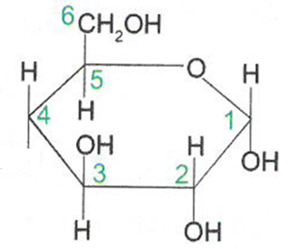
Carbohydrates
Disaccharides
1,4 glycosidic bond
O
Maltose
+
H₂O
Complete the diagram on page 4.

Slide 19
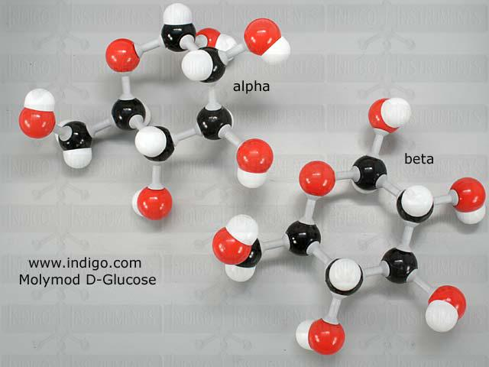
Carbohydrates
Disaccharides
With the group next to you, make a Maltose molecule with your 2 Molymod α-glucose molecules.

Slide 20
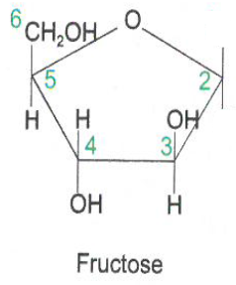

Carbohydrates
Disaccharides
On Whiteboards…..
Look at the next reaction on page 4- the formation of sucrose.
APPLY your knowledge of condensation reactions and bond the glucose and fructose molecule.
Hint - 1,2 glycosidic bond is formed.
+

Slide 21
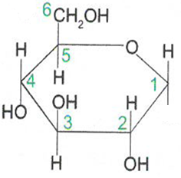
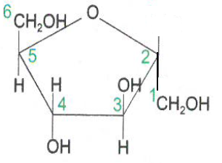
Carbohydrates
Disaccharides
Enzyme
+
1,2 glycosidic bond
O
Remember to:
1) Circle the groups involved
2) Show water is formed
3) Circle & Label the bond formed
+
H₂O

Slide 22
Carbohydrates
Disaccharides
Enzyme
+
1,2 glycosidic bond
O
Exam tip:
The exam can show the monomers in a different orientation, but formation of sucrose is always with a 1, 2 glycosidic bond.
Complete the diagram on page 4.
+
H₂O

Slide 23
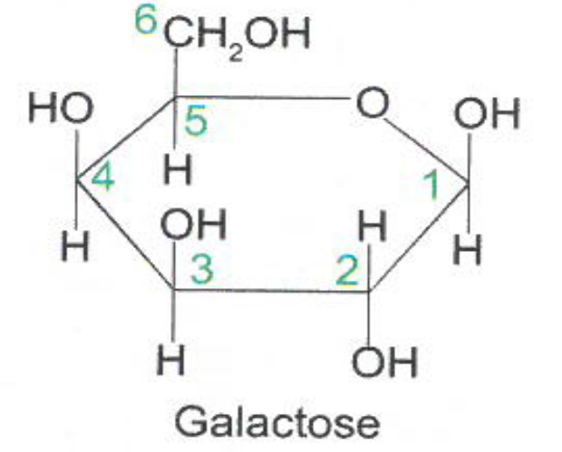
Carbohydrates
Disaccharides
On Whiteboards…..
Look at the next reaction on page 4- the formation of Lactose
Exam tip: You do not need to remember this one for your exam but you might be asked to apply your knowledge to this example.
Hint - 1,4 glycosidic bond is formed.
+

Slide 24
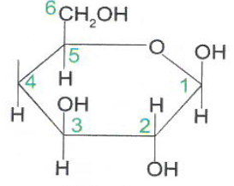
Carbohydrates
Disaccharides
+
Enzyme
1,4 glycosidic bond
+
H₂O
O
Lactose
Complete the diagram on page 4.

Slide 25
Carbohydrates
Disaccharides
Hydrolysis reactions: Rules for drawing
Always show the groups involved
Always show where water is added
Always circle and label the bond broken
Name the monomers formed.
Disaccharides can be broken down by a hydrolysis reaction.
On page 5 draw the hydrolysis reaction of Maltose.
O
Maltose

Slide 26
Carbohydrates
Disaccharides
1-4 glycosidic bond broken
+
H₂O
O
Maltose
Enzyme

Slide 27

Carbohydrates
Disaccharides
Every other B-glucose must by flipped 180 to bond

Slide 28
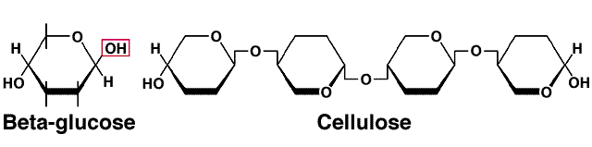
Carbohydrates
Disaccharides
Fill in the question on page 5. In the space make a quick drawing to help you remember this.
How does the structure of alpha and beta glucose change the bonding?
Every other B-glucose molecule is upside down.

Slide 29
Apply this knowledge to the exam questions on page 5-6.
The questions are worth 7 marks. Can you complete the exam question in 10 minutes?
Once you have completed the question, check your answers using the markscheme.
Remember
Highlight which part of your answer is also on the markscheme. Allow you to see which part of your answer are relevant.
If it isn’t on the mark scheme it is not right, if it isn’t written as the markscheme it is not right.
In a different coloured pen add corrections to the question.
Anything you don’t understand make a note of for when you speak to your teacher.

Slide 30
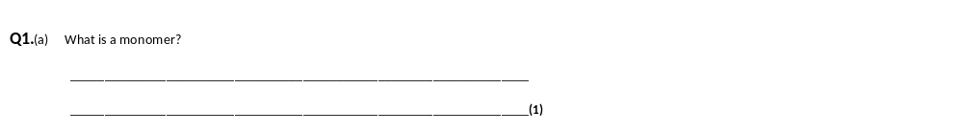
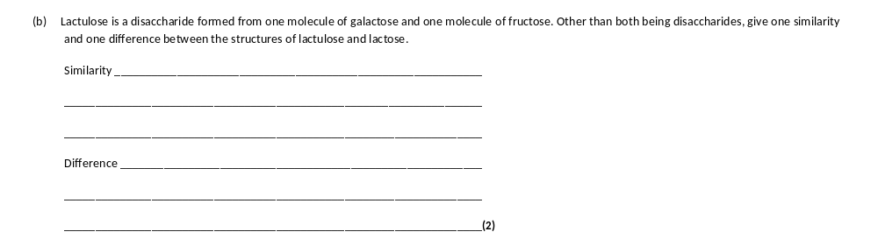
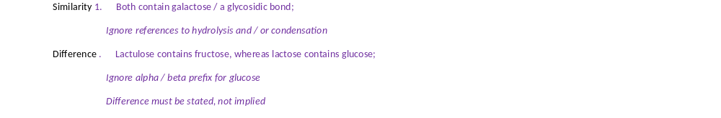

Slide 31
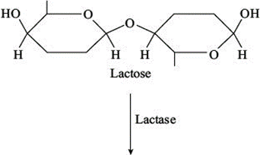
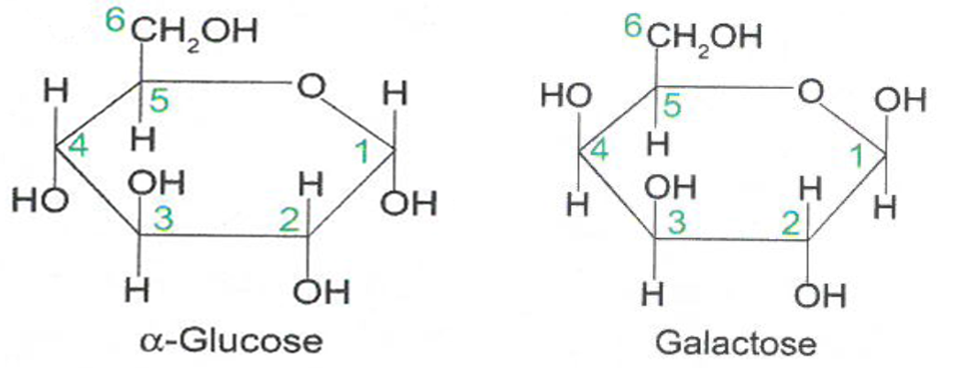
Q2.Lactose is a disaccharide found in milk. In the human small intestine, the enzyme lactase catalyses the hydrolysis of lactose to the monosaccharides, galactose and glucose. These monosaccharides are then absorbed into the blood. Complete the diagram to show the hydrolysis of lactose to galactose and glucose.
Water used
use of water;
must be above arrowhead
OH drawn correctly in place of glycosidic bond on
each monosaccharide;

Slide 32
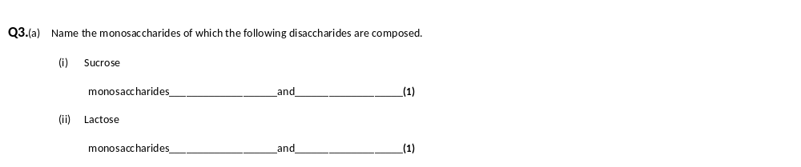
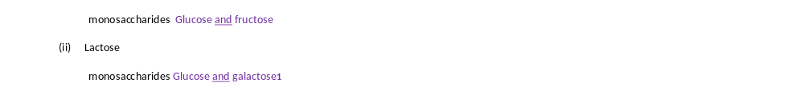

Slide 33
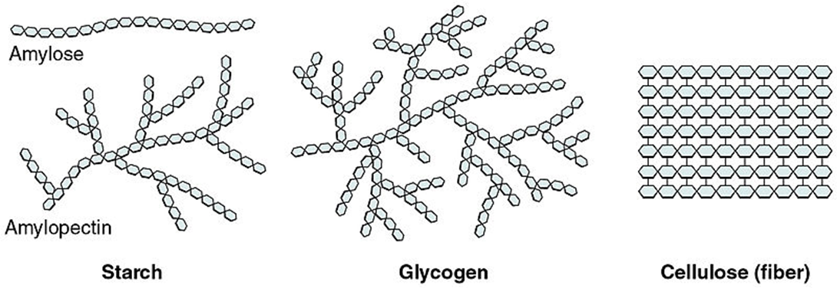
Outcomes:
Describe and explain how polymerisation of α-glucose can form starch or glycogen and how this relates to their function and properties.
Explain why glycosidic bonds between β –glucose form cellulose and how this relates to its function and properties.

Slide 34
Memory task
Draw the condensation of alpha glucose forming maltose.(3 marks)
1,4 glycosidic bond
O
Maltose
+
H₂O
Alpha glucose molecules drawn correctly
Glycosidic bond drawn correctly and labelled
Water released.

Slide 35
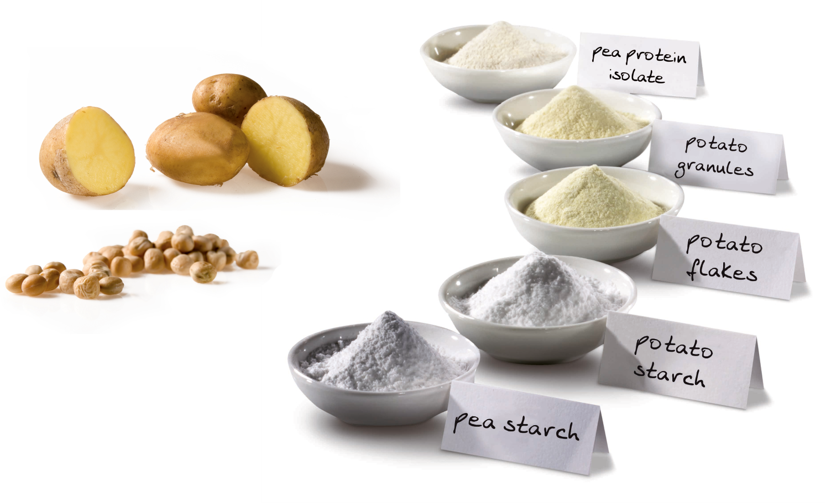
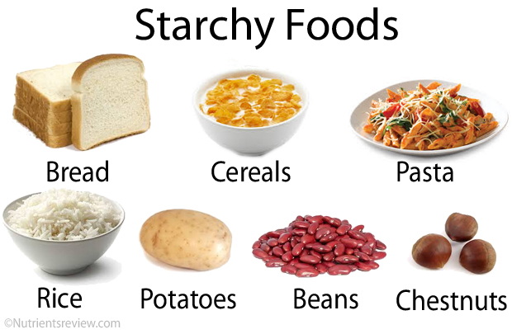
Carbohydrates
Polysaccharides
On whiteboards….
What can you remember about starch?

Slide 36
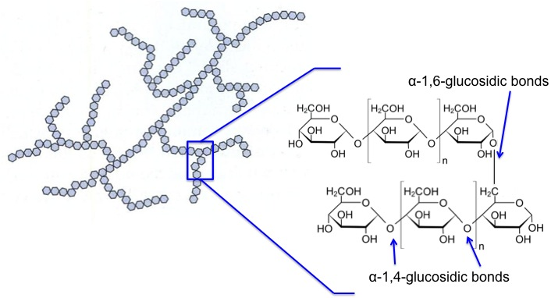
Carbohydrates
Polysaccharides
1.Starch Structure:
Polysaccharide of a-glucose
1-4 and 1-6 glycosidic bonds
Branches and coiled shape held by H bonds

Slide 37
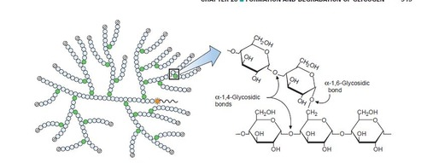
Carbohydrates
Polysaccharides
2.Glycogen Structure:
Polysaccharide of a-glucose
1-4 and 1-6 glycosidic bonds
Branched and coiled shape held by H bonds

Slide 38
Carbohydrates
Polysaccharides
Function/property of Starch and Glycogen:
Main role is as energy storage compound. Starch is in plants only, glycogen is in animals only.
Describe | Explain
Insoluble | Doesn’t affect WP
Branched | Compact/Can fit many in a small space
Polymer of a-glucose | Provides glucose for respiration
Branched | Many ends for enzymes to attach and hydrolyse
Large | Cannot leave cell.

Slide 39
Carbohydrates
Polysaccharides
Complete the CONTRAST TABLE on page 7 in your booklet.
Exam tip:
CONTRAST TABLES.
Must be in a table form with the 2 contrasting factors as headings
Must be direct contrasts on each row.
Number of rows reflect the number of marks.
Definition:
Contrast: Give the differences between
Starch structure | Glycogen structure
Less 1-6 glycosidic bonds | More 1-6 glycosidic bonds
Less branched | More branched.

Slide 40
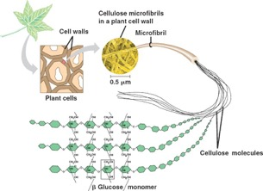
Carbohydrates
Polysaccharides
3.Cellulose Structure:
Polysaccharide of B-glucose
Every other B--glucose upside down
1-4 glycosidic bonds only
Straight chains
Many H bonds between chains forming microfibrils.

Slide 41

Carbohydrates
Polysaccharides
Function/property of cellulose:
Describe | Explain
Long straight chains | Provides rigidity/strength to plant cell wall
Many H bonds forming microfibrils

Slide 42
Carbohydrates
Polysaccharides
Complete the revision poster on page 8 in your booklet.
Add information from your memory first to see what you can remember.
Change colour and add information that you had forgotten.

Slide 43
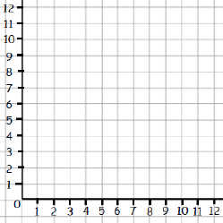
Before starting the exam questions….
On whiteboards…
From GCSE, what are the rules for drawing a graph?
Rule 4: Values go in sequential order.
Even if table goes up like this; 2,4,7,9,12 your axis must go up sequential 2,3,4,5,6,7,etc
Rule 3: Axis points EQUIDISTANT
Same distance apart/each little square represents same value
Rule 2: Dependent variable up the side/ Y axis WITH UNITS in ()
What you fill into the table
Rule 5: Plotted point joined with a DOT-TO-DOT and NO EXTRAPOLATION
Dot-to-dot connect only your plotted no, no points beyond what you have plotted.
Rule 1: Independent variable bottom of graph/ X axis WITH UNITS in ()
1st column in table

Slide 44
Apply this knowledge to the exam questions on page 9-12.
The questions are worth 23 marks. Can you complete the exam question in 28 minutes?
Once you have completed the question, check your answers using the markscheme.
Remember
Highlight which part of your answer is also on the markscheme. Allow you to see which part of your answer are relevant.
If it isn’t on the mark scheme it is not right, if it isn’t written as the markscheme it is not right.
In a different coloured pen add corrections to the question.
Anything you don’t understand make a note of for when you speak to your teacher.

Slide 45
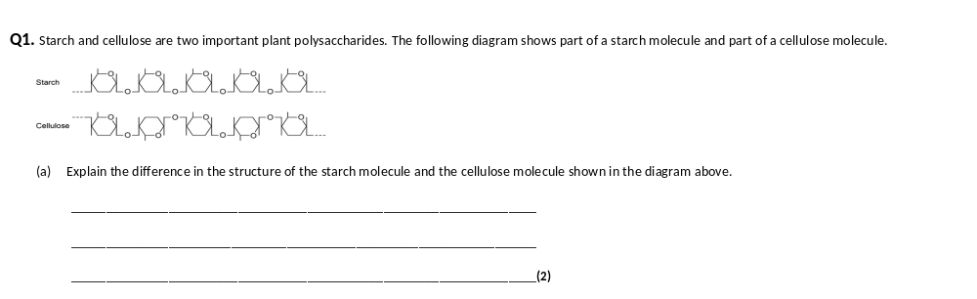
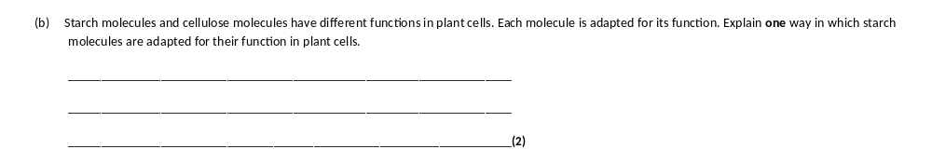
Starch | Cellulose
A-glucose | B-glucose
H above C1/OH below C1 | H below C1/OH above C1
This is a contrast question so should be done as CONTRAST table.
1. Insoluble;
2. Don’t affect water potential; OR
3. Helical; Accept form spirals
4. Compact; OR
5. Large molecule;
6. Cannot leave cell.

Slide 46
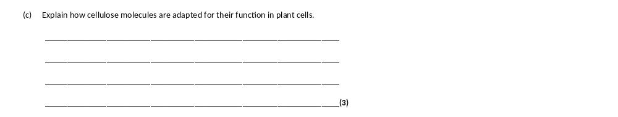
1. Long and straight chains;
2. Become linked together by many hydrogen bonds to form fibrils;
3. Provide strength (to cell wall).3

Slide 47
These are more challenging application and skills questions.
Q2.Scientists investigated the hydrolysis of sucrose in growing plant cells by an enzyme called SPS.
(a) Name the products of the hydrolysis of sucrose.
1. _________________________________________________________________
2. _________________________________________________________________(2)
1. Glucose;
2. Fructose;

Slide 48
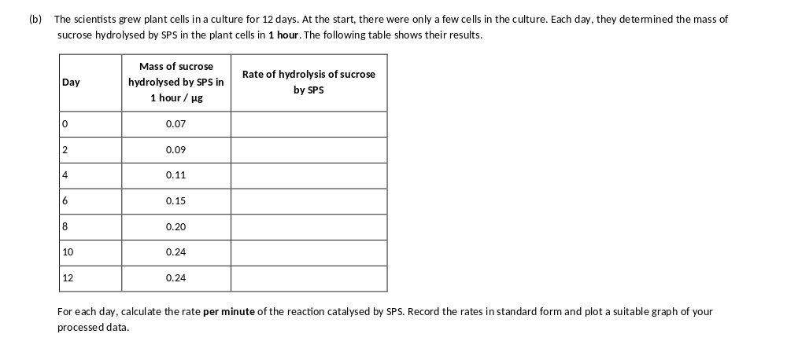
These are more challenging application and skills questions.
Correct answers × 10⁻³
1.17,
1.50,
1.83,
2.50,
3.33,
4.00,
4.00
Eg 0.07/60 minutes = 1.17 × 10⁻³

Slide 49

1. Line graph with rate on y axis and days/time in days on x axis and
linear scales;
Correct answers × 10⁻³ 1.17, 1.50, 1.83, 2.50, 3.33, 4.00, 4.00 (accept to 1DP)
2. Correct units of μg min⁻¹/per minute/minute⁻¹ × 10⁻³;
Reject m⁻¹
Reject if put 10⁻³ on axis for each point
3. Rates correctly calculated and plotted, with line connecting points/line
and no extrapolation;
Do not accept a ruled straight line of best fit
Accept y axis starting at 1
Rate/μg min⁻¹× 10⁻³
Time/days

Slide 50
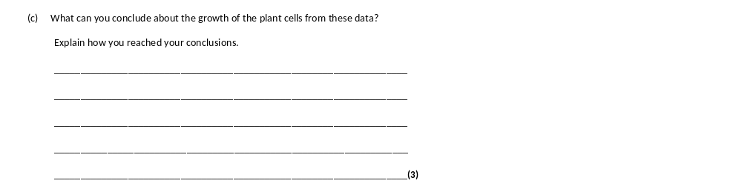
1. Sucrose hydrolysis linked to some aspect of growth;
Accept ‘breakdown
2. Greater the rate of/faster hydrolysis/more SPS activity as plant grows/cells
divide (up to 8/10 days);
Accept ‘breakdown
Accept converse of greater rate of growth, greater rate of hydrolysis
Reject ‘sucrose broken down’
3. Growth/division remains the same/slows after 8/10 days
(because SPS activity is levelling off);
Accept after 8 days/at 10 days growth rate maximum/growth stops

Slide 51
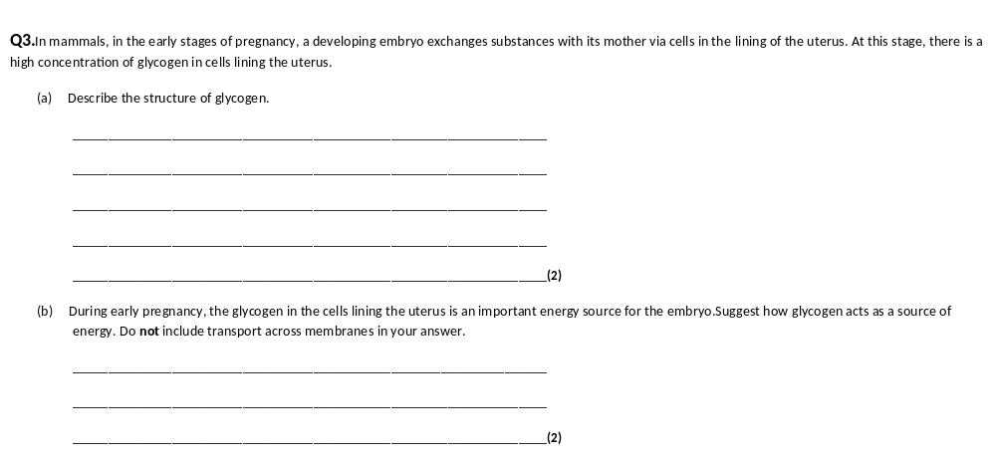
1. Polysaccharide of α-glucose; OR polymer of α-glucose;
2. (Joined by) glycosidic bonds OR Branched structure;
1. Hydrolysed (to glucose);
2. Glucose used in respiration;
1. Ignore ‘Broken down’
2. ‘Energy produced’ disqualifies mp2

Slide 52
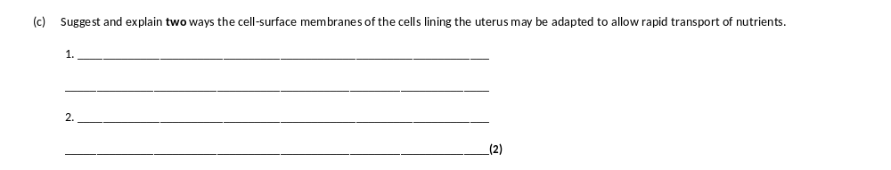
1. Membrane folded so increased / large surface area; OR
Membrane has increased / large surface area for (fast) diffusion / facilitated diffusion / active transport / co-transport;
2. Large number of protein channels / carriers (in membrane) for facilitated diffusion;
3. Large number of protein carriers (in membrane) for active transport;
4. Large number of protein (channels / carriers in membrane) for co-transport;
1. Accept ‘microvilli to increase surface area’
1. Reject reference to villi.
Note feature and function required for each marking point and reference to large / many / more.
List rule applies.
Exam tip:
The list rule. When a question asks for a specific number of points, and you gives more, the general rule is that any wrong answer cancels a correct answer.

Slide 53
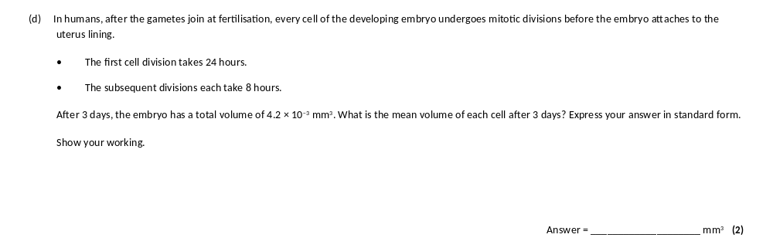
3.3 × 10⁻⁵ OR 3.28 × 10⁻⁵ OR 3.281 × 10⁻⁵;
1 mark for
Evidence of 128 (cells)
Correct numerical calculation but not in standard form gains 1 mark (0.00003281 OR 0.0000328 OR 0.000033);
Working:
Start with 1 fertilised
End of 24 hours = 2 cells
Need to convert 2 remaining day into hours = 48 hours
Each cycle takes 8 hours = 48/8 hours = 6 cycles
2 cell undergo 6 mitotic cycles= 2 x 2⁶ = 128 cells
4.2 x 10⁻³ mm³ / 128 cells= 3.28 x 10⁻⁵ mean volume of each cell after 3 days.

