Slide 1
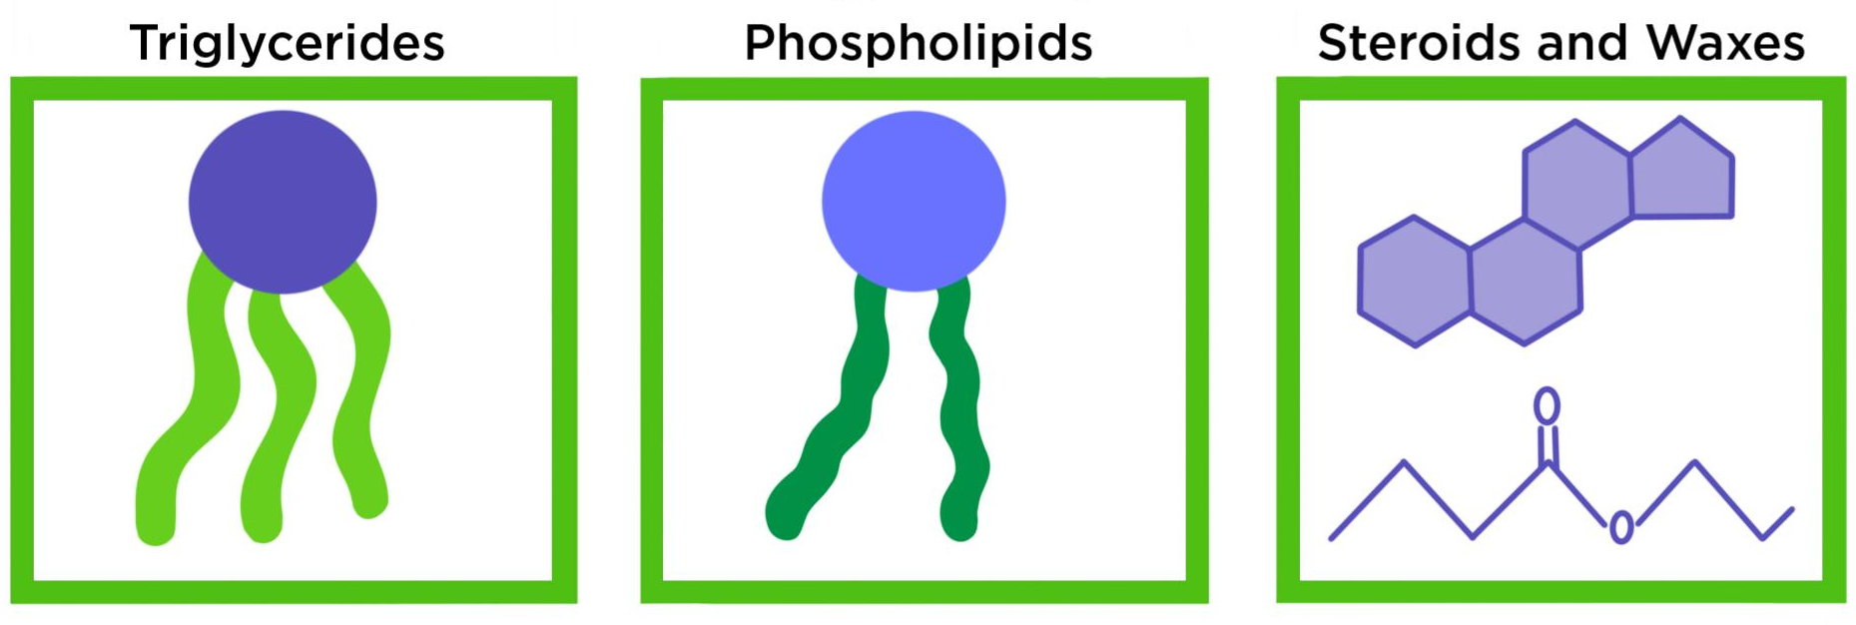
Lipids
From GCSE what can you remember about lipids?

Slide 2
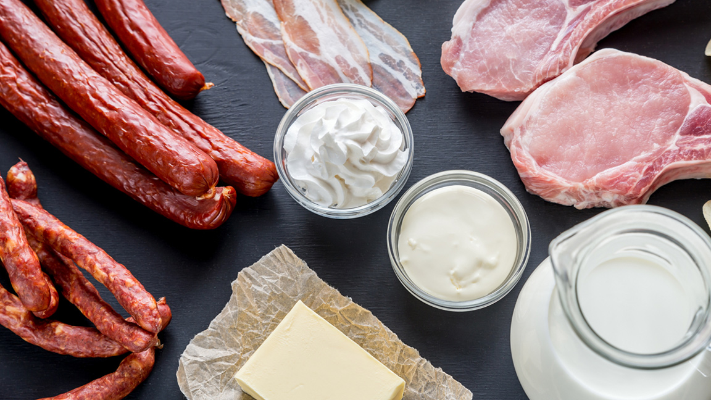
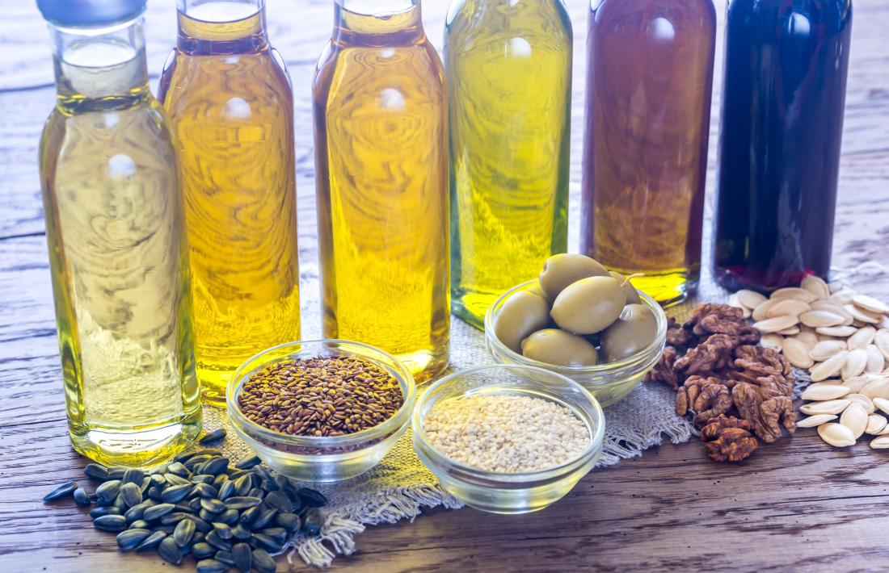
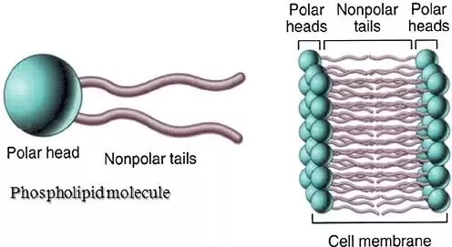
Lipids
Contain C, H, O
Insoluble in water/non-polar
Main groups of lipids are:
- Triglycerides - also known as fats (solid at room temperature) and oils (liquid at room temperature).
- Phospholipids – main component of plasma membranes.

Slide 3

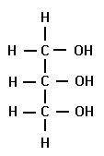
Lipids
Triglyceride Structure
Has 2 monomers:
1 x Glycerol and 3 x Fatty acid chains.
O
Hydrocarbon chain
HO
C
Carboxylic acid group
O
HO
C
O
Fatty acid
Glycerol
HO
C
Draw the monomers into your booklet on page 13.

Slide 4
Lipids
Triglyceride Structure
What are the rules for drawing condensation?
On whiteboards….
Apply your knowledge of condensation to show the formation of a triglyceride, 3 molecules of water and an ester bond.
Always show the groups involved
Always show water is released
Always circle and label the bond formed

Slide 5

Lipids
Triglyceride Structure
O
HO
C
O
Enzyme
HO
C
O
HO
C
Always show the groups involved

Slide 6
Lipids
Triglyceride Structure
H
O
H
C
O
C
O
Always show water is released
Always circle and label the bond formed
H
C
O
C
O
H
C
O
C
H
Ester Bond
+
3 H₂O
Draw the condensation reaction into your booklet on page 13.

Slide 7
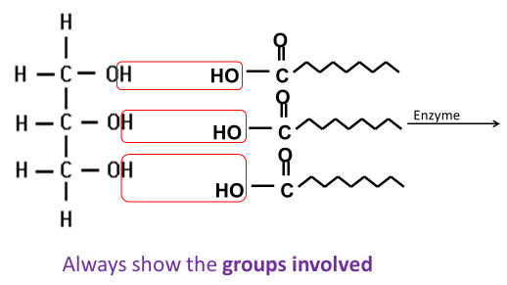
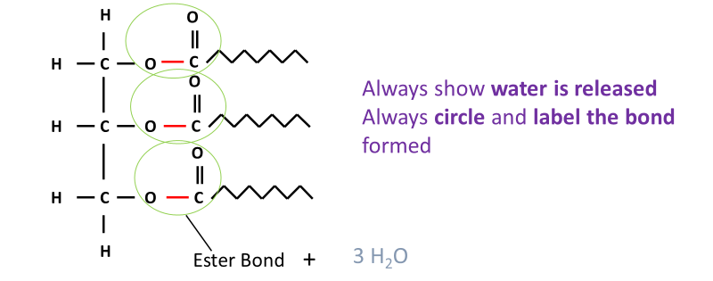
Memory task:
Learn to draw the condensation of a triglyceride from memory.

Slide 8
Lipids
Saturated and unsaturated Fatty acids
Triglycerides - also known as fats (solid at room temperature) and oils (liquid at room temperature).
But why?
Fatty acid chains can be saturated or unsaturated changing the property of the triglyceride.
Fill in the definitions on page 14 in your booklet.

Slide 9

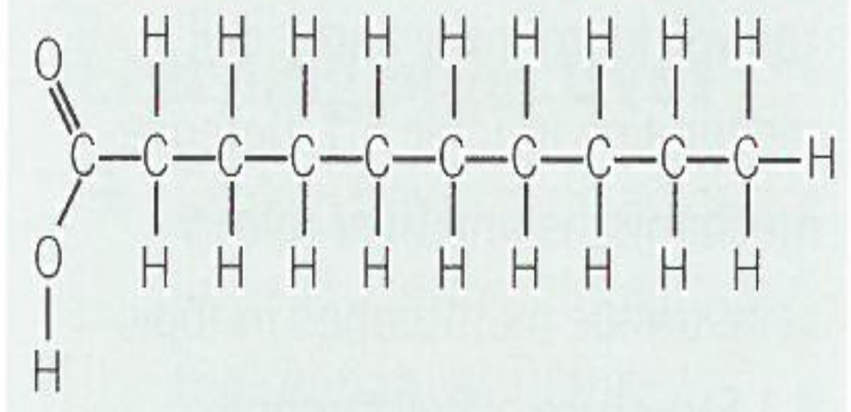
Lipids
Saturated Fatty acids
Triglycerides - also known as fats (solid at room temperature)
Saturated: Single C-C bonds in the hydrocarbon chain
Carboxylic acid group
Additional information:
Saturated fats are solid at room temperature because the hydrocarbon chains are straight so can be more tightly packed together.
Most animal fats are saturated, so animal fats tend to be solid at room temperature

Slide 10

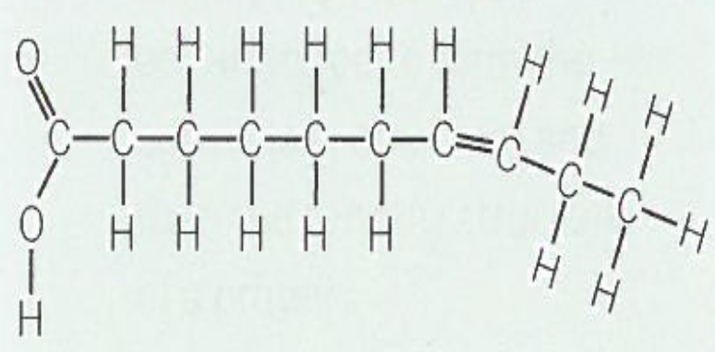
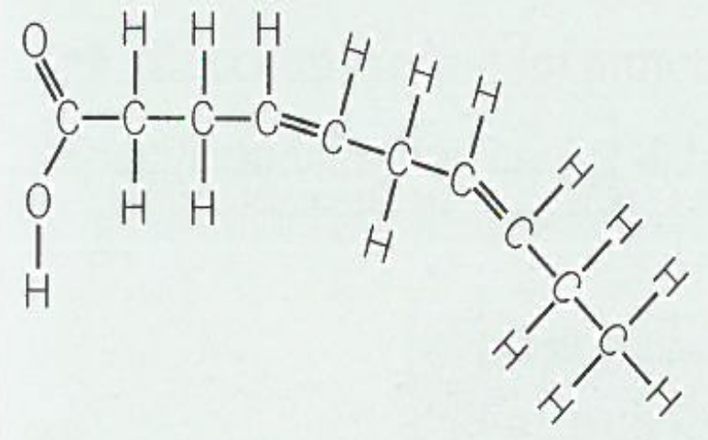
Lipids
Unsaturated Fatty acids
Triglycerides - also known as oils (liquid at room temperature).
Unsaturated: Double C=C bonds in the hydrocarbon chain cause kinks in the chain
Carboxylic acid group
1 carbon-carbon double bond in the hydrocarbon chain = monounsaturated
Many carbon-carbon double bonds in the hydrocarbon chain = polyunsaturated
Additional information:
Unsaturated fats are liquid at room temperature because the hydrocarbon chains are kinky/bent so are less tightly packed together.
Most plant fats are unsaturated, so plant fats tend to be liquid at room temperature

Slide 11
Lipids
Triglyceride Function:
Property | Function/Explanation
Energy store | Many C and H’s so more energy per g then carbohydrates
Large, insoluble and non-polar molecules | Doesn’t affect WP of cell
Storage below dermis of the skin in adipose tissue | Insulation
Metabolic source of water | From respiration due to high ratio of H’s to O
Buoyancy | Low density
Fill in the table on page 14 in your booklet.

Slide 12
Apply this knowledge to the exam questions on page 15-18.
The questions are worth 20 marks. Can you complete the exam question in 25 minutes?
Once you have completed the question, check your answers using the markscheme.
Remember
Highlight which part of your answer is also on the markscheme. Allow you to see which part of your answer are relevant.
If it isn’t on the mark scheme it is not right, if it isn’t written as the markscheme it is not right.
In a different coloured pen add corrections to the question.
Anything you don’t understand make a note of for when you speak to your teacher.

Slide 13
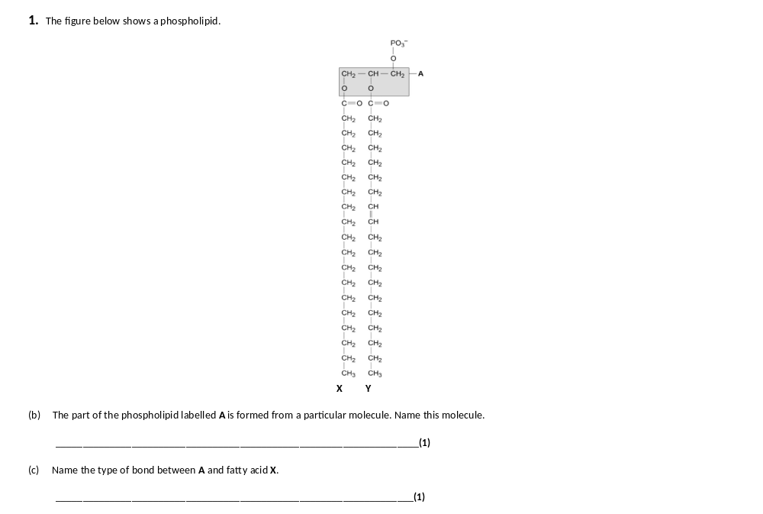
Glycerol.
Ester

Slide 14
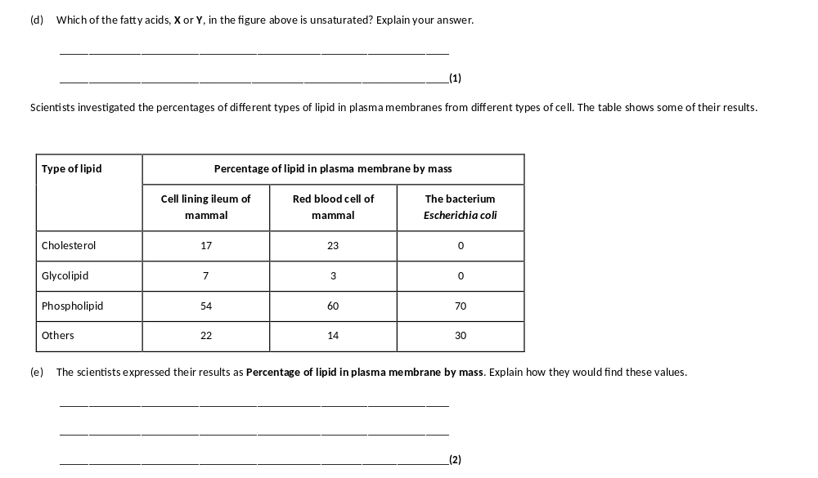
Y (no mark)
Contains double bond between (adjacent) carbon atoms in hydrocarbon chain.
1. Divide mass of each lipid by total mass of all lipids (in that type of cell);
2. Multiply answer by 100.

Slide 15
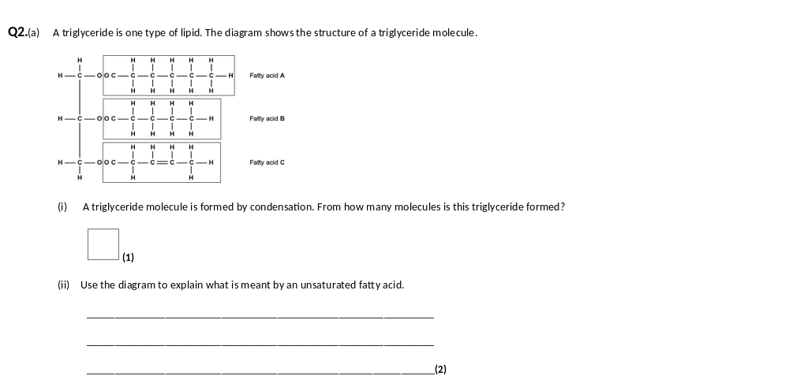
4 / four;
1. Double bonds (present) / some / two carbons with only one hydrogen / (double bonds) between carbon atoms / not saturated with hydrogen;
Answer refers to unsaturated unless otherwise clearly indicated.May be shown in appropriate diagram.
2. In (fatty acid) C / 3;

Slide 16
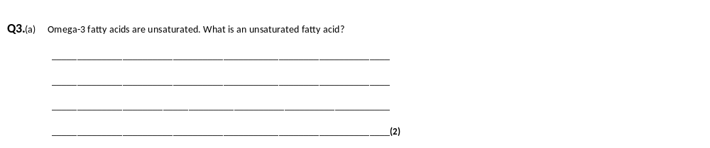
(a) Double bond(s);
(Bonds) between carbon;
C=C bond(s) = 2 marks
‘No’ C=C bond(s) disqualifies 1 mark only
Accept: does not contain maximum number of H for 1 mark
Neutral: contains C=O bonds

Slide 17
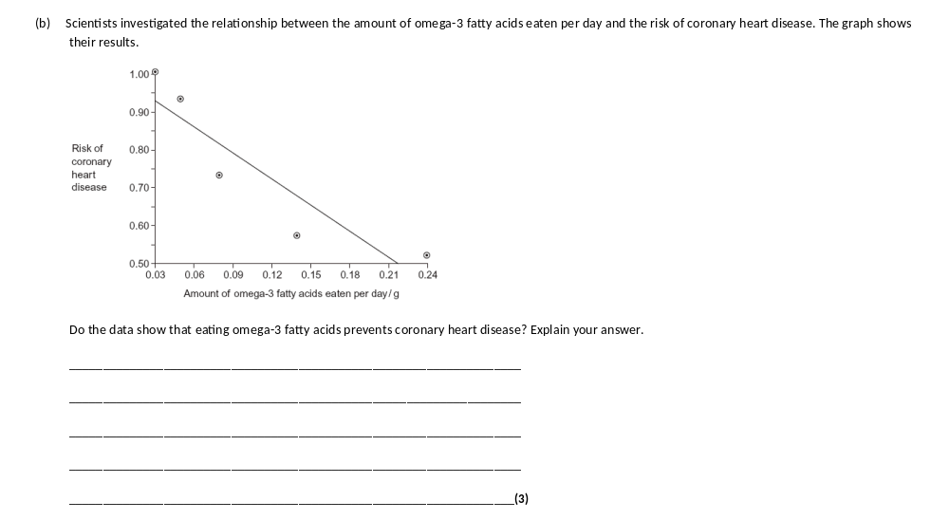
Exam tip:
What the question asks about data you always need to:
Comment on the gradient(s)
With data showing 2 factors always comment on:
Correlation.
When you comment on correlation you must always say:
Correlation does not mean causation
Graph shows negative correlation / description given;
Correlation does not mean causation / prevention / shows lower risk not prevention;
May be due to another factor / example given;

Slide 18
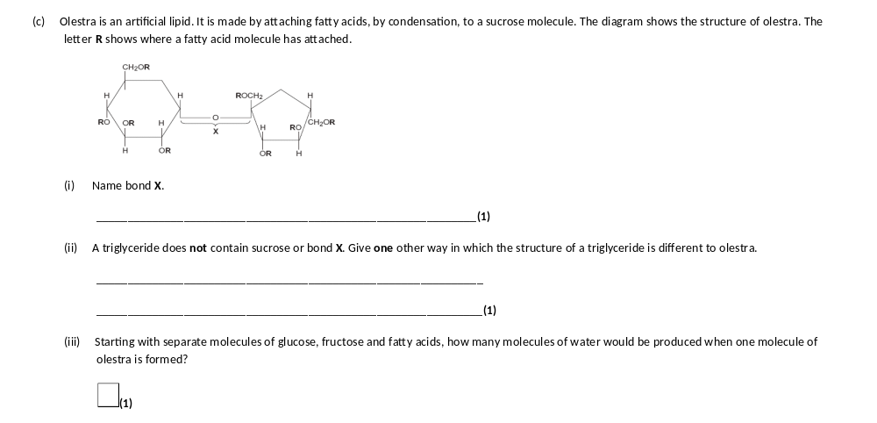
Glycosidic;
Contains glycerol / three fatty acids / forms three ester bonds;
Answers must refer to a triglyceride, Reject: contains three glycerols
9;

Slide 19
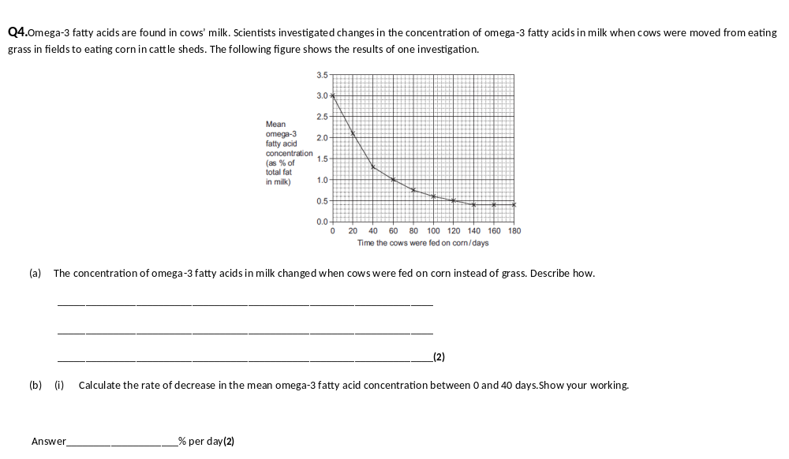
(a) (Omega-3 concentration) falls more rapidly at first;
Levels out at 140 days / concentration of 0.4%;
Two marks for correct answer of 0.04 or 0.043;
1.7 /40 days

Slide 20
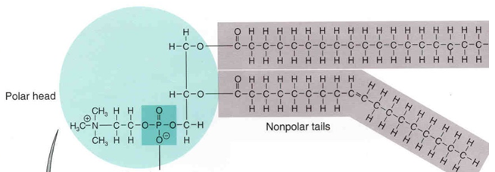
Lipids
Phospholipids Structure
Compare the diagram to the structure of a triglyceride on page 13 in your booklet.
What is different about the structure?
What is similar about the structure?
Compare ( similarities):
Glycerol molecule
Fatty acid chains
Ester bonds
Contrast (differences)
Phosphate group instead of third fatty acid tail

Slide 21
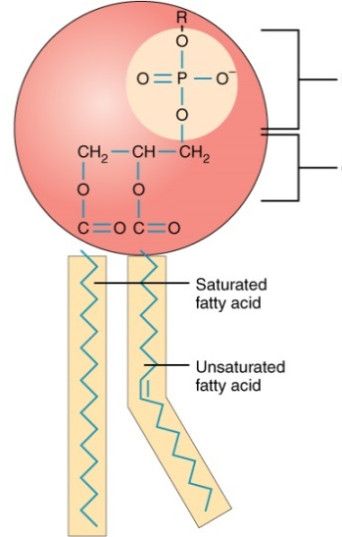
Lipids
Phospholipids Structure
Definition:
Amphipathic: Have polar and non-polar regions
Fatty acids repel water and are referred to as being hydrophobic
Phosphate group is attracted to water and is referred to as being hydrophilic
On the diagram label the hydrophilic phosphate head, the hydrophobic fatty acid tail and circle the C=C double bond.
Hydrophilic phosphate head
Hydrophobic fatty acid tail

Slide 22
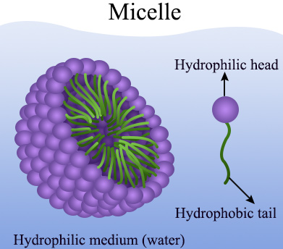
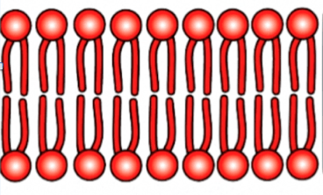
Lipids
Phospholipids Structure
Add details to the diagrams on page 19 in your booklet showing how phospholipids arrange themselves when interacting with water.
When placed in water the phospholipid molecules arrange themselves either:
Hydrophobic tails repel water so face inwards
Hydrophillic head interact with water so face outwards
Form a bilayer
This is the structure of all our membranes.
Hydrophobic tails repel water so face inwards
Hydrophillic head interact with water so face outwards
Form a micelle
This is how lipids are transported in the blood

Slide 23
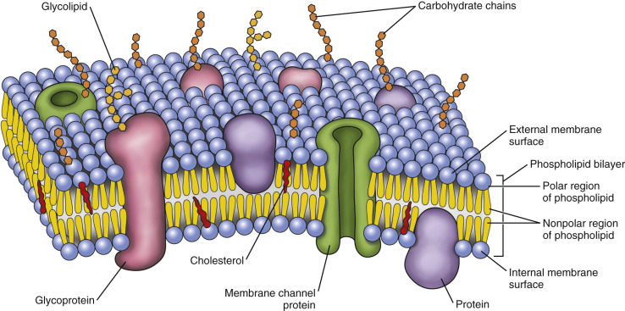
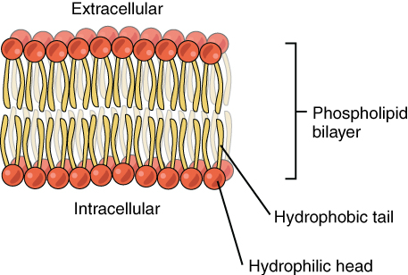
Lipids
Phospholipids Function
Form a bilayer within a cell surface membrane so hydrophobic barrier formed between the inside and outside of cell
Forms membranes inside the cell e.g. mitochondria, to isolate metabolic reactions.
Controls exchange of substances
We will cover the structure of the membrane in more detail in a different booklet.

Slide 24
Lipids
Exam tip: ALWAYS do contrast questions as a table to get fully marks. Examiners notes always say “must be directly comparative statements, on the same line/same sentence”.
Phospholipids Structure and Function
Compare and contrast triglycerides and phospholipids
 | Triglyceride | Phospholipid
Ester Bonds (S) | 3 | 2
Glycerol (S) | Yes | Yes
Fatty acid structure (S) | Saturated and unsaturated | Saturated and unsaturated
Fatty acid number (s) | 3 | 2
Elements (S) | C,H,O | C,H,O,P
Solubility (F) | Hydrophobic | Hydrophilic head, phobic tail
Bilayer (F) | No | Yes
Fill in the table on page 20 in your booklet.

Slide 25
Apply this knowledge to the exam questions on page 20.
The questions are worth 5 marks. Can you complete the exam question in 7 minutes?
Once you have completed the question, check your answers using the markscheme.
Remember
Highlight which part of your answer is also on the markscheme. Allow you to see which part of your answer are relevant.
If it isn’t on the mark scheme it is not right, if it isn’t written as the markscheme it is not right.
In a different coloured pen add corrections to the question.
Anything you don’t understand make a note of for when you speak to your teacher.

Slide 26
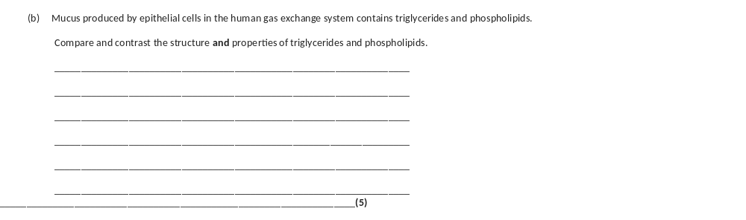
1. Both contain ester bonds (between glycerol and fatty acid);
2. Both contain glycerol;
3. Fatty acids on both may be saturated or unsaturated;
4. Both are insoluble in water;
5. Both contain C, H and O but phospholipids also contain P; Must relate to element.
6. Triglyceride has three fatty acids and phospholipid has two fatty acids plus phosphate group;
7. Triglycerides are hydrophobic/non-polar and phospholipids have hydrophilic and hydrophobic region;
8. Phospholipids form monolayer (on surface)/micelle/bilayer (in water) but triglycerides don’t;

