Slide 1
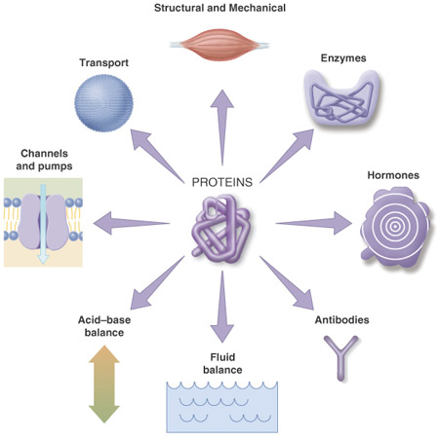
Proteins
From GCSE what can you remember about proteins?
Property:
Contains C, H, O, N and sometimes S

Slide 2
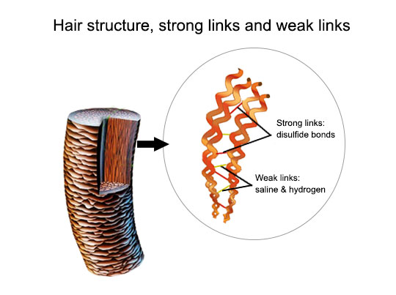
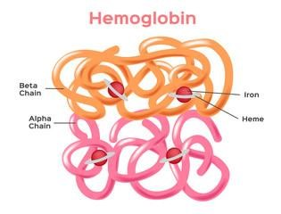
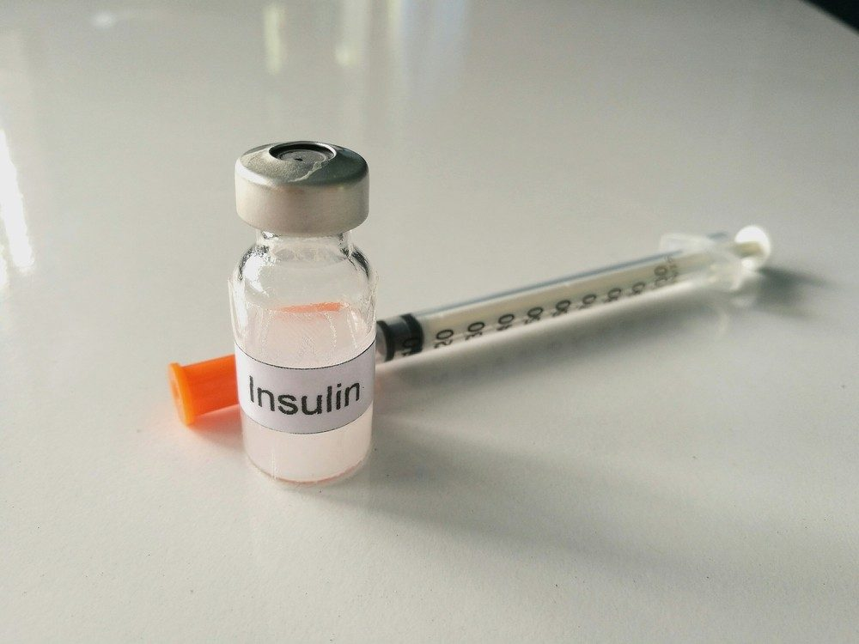
Proteins
Amino Acids
20 naturally occurring amino acids
Same 20 amino acids found in almost all living organisms.
Proteins can be:
  Globular - spherical and soluble. Have a metabolic function e.g. haemoglobin, insulin, enzymes.
  Fibrous – long, thin and insoluble. Have structural function e.g. collagen, keratin

Slide 3
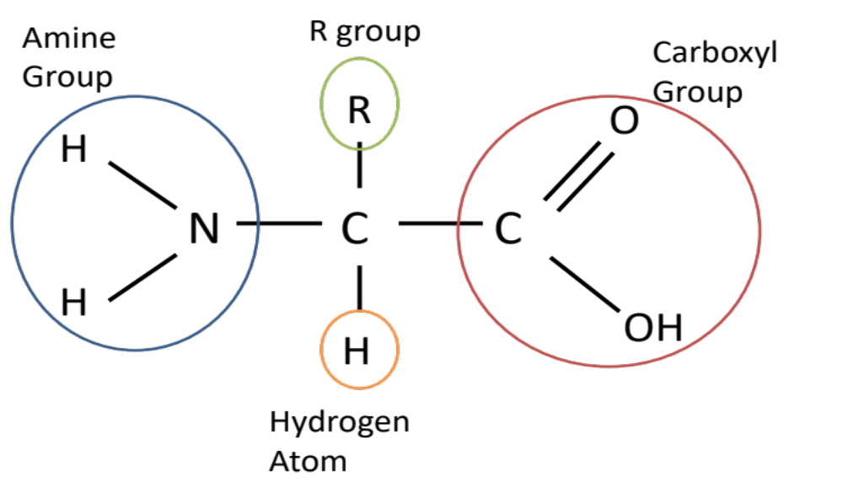
Proteins
Amino Acids
R group (side chain) = differs in all amino acids
Draw and label the amino acid structure into your booklet on page 21.

Slide 4
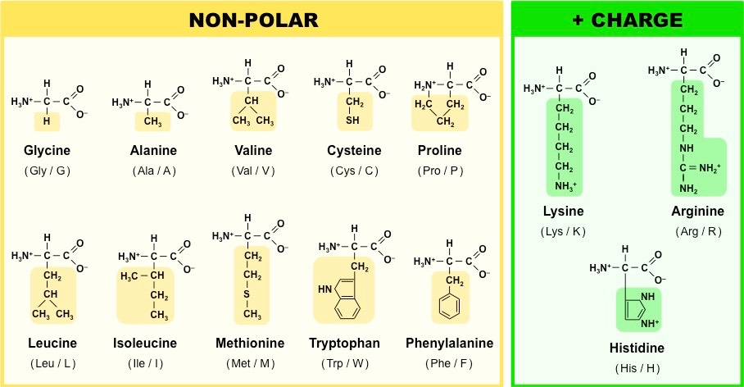
Proteins
Amino Acids
You DO NOT need to know the 20 different types of amino-acid structure
You may be given an amino-acid diagram including the specific R group, focus on the Amine and Carboxylic acid groups.

Slide 5
Proteins
Dipeptides Structure:
Polypeptides formed by condensation reactions
Bond formed is called a peptide bond
Forms between amine group of one amino acid and carboxyl group of the other
What are the rules for drawing condensation?
On whiteboards….
Apply your knowledge of condensation to show the formation of a dipeptide, 1 molecule of water and a peptide bond.
Always show the groups involved
Always show water is released
Always circle and label the bond formed

Slide 6
Proteins
Dipeptides Structure:
Draw the condensation reaction on page 21 in your booklet.
R
O
R
O
H
H
C
+
N
C
N
C
C
H
H
OH
OH
H
H
Always show the groups involved
Condensation
R
O
H
R
O
H
N
C
C
N
C
C
Always show water is released
H
+
H₂O
Peptide Bond
OH
H
H
Always circle and label the bond formed

Slide 7
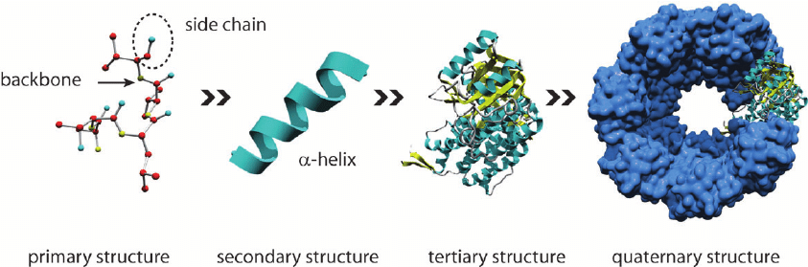
Proteins
Hierarchical protein structure
http://www.bcconline.com/biol10rs/Pearson-Animations/protein_structure.swf
Proteins can consist of a single polypeptide chain e.g. most enzymes, or 2 or more polypeptides e.g. haemoglobin, collagen.

Slide 8
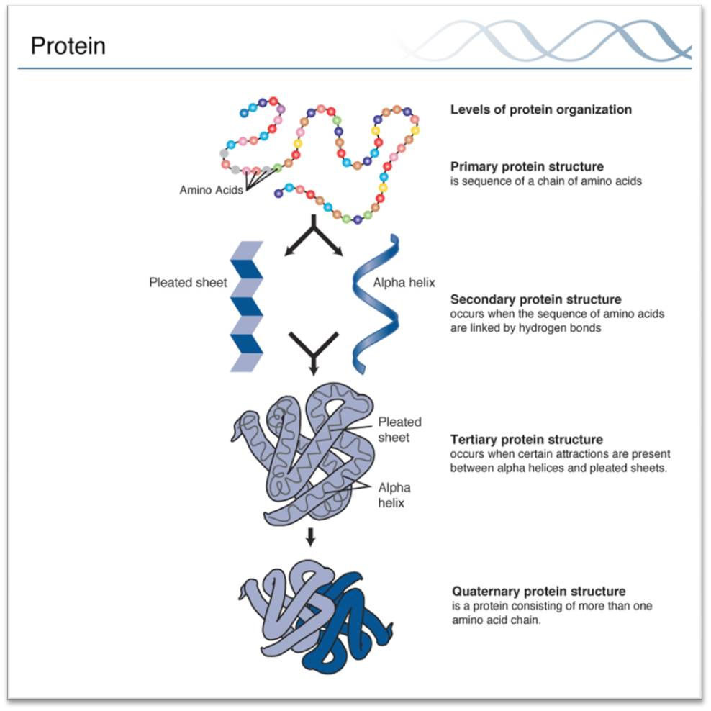
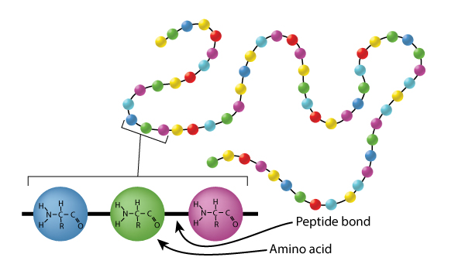
Proteins
Hierarchical protein structure- Primary
Definition:
Polymer of amino acids joined by condensation reaction in a specific order of amino acids in a polypeptide chain.
Bond:
Peptide
Primary structure can be very different which is why proteins have so many different roles.
Polypeptide chains can contain the same amino-acids but in different order so would change the function of the protein.
Polypeptide chains can be different lengths
Polypeptide chains can contain different combinations of amino-acids.
We will learn more about mutations in the Nucleic acid booklet.

Slide 9
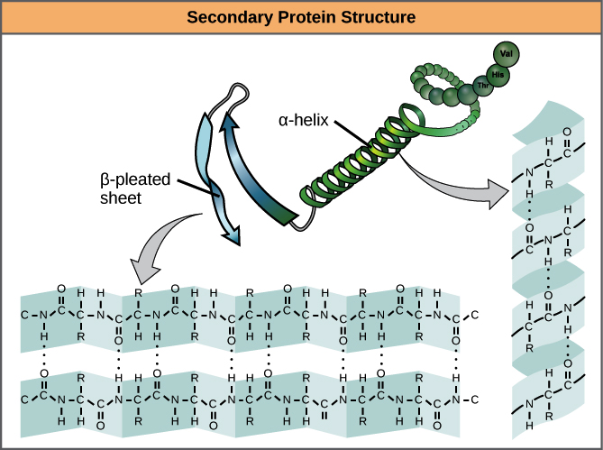
Proteins
Hierarchical protein structure- Secondary
Definition:
Polypeptide chain folds into either:
- α-helix
- β – pleated sheets
Bond:
H bonds

Slide 10
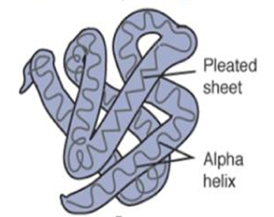
Proteins
Hierarchical protein structure- Tertiary
Definition:
Polypeptide folds further to produce a specific 3D structure.
Bonds:
H bonds – between the polar R-groups of the amino acids. Easily broken by temperature and pH changes
Ionic bonds – between an amino acid with a positive charge and an amino acid with a negative charge if close enough. Easily broken by pH changes,
Disulphide bridges – between amino acids that contain Sulphur in the R-group. Strong covalent bonds but broken by reducing agents.
Tertiary structure is determined by where these bonds form which is determined by sequence of amino acids.
Tertiary structure determines 3D shape and function of the protein.

Slide 11
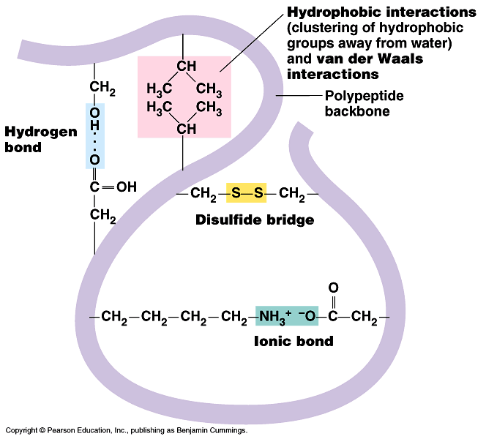
Proteins
Hierarchical protein structure- Tertiary
Beyond the specification
Between the polar R-groups of the amino acids. Easily broken by temperature and pH changes
Between amino acids that contain Sulphur in the R-group. Strong covalent bonds but broken by reducing agents.
Between an amino acid with a positive charge and an amino acid with a negative charge if close enough. Easily broken by pH changes

Slide 12
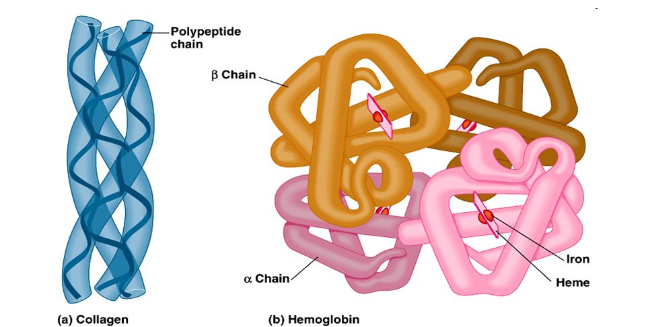
Proteins
Hierarchical protein structure- Quaternary
Definition:
More than one polypeptide chain.
Bonds:
Same as Tertiary
Look at the diagrams of Haemoglobin and collagen.
Explain why these are known as quaternary proteins?
Collagen- Made of 3 polypeptide chains
Haemoglobin- Made of 4 polypeptide chains.

Slide 13
Apply this knowledge to the exam questions on page 23.
The questions are worth 9 marks. Can you complete the exam question in 12 minutes?
Once you have completed the question, check your answers using the markscheme.
Remember
Highlight which part of your answer is also on the markscheme. Allow you to see which part of your answer are relevant.
If it isn’t on the mark scheme it is not right, if it isn’t written as the markscheme it is not right.
In a different coloured pen add corrections to the question.
Anything you don’t understand make a note of for when you speak to your teacher.

Slide 14
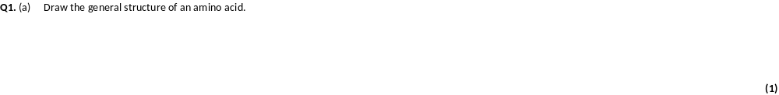
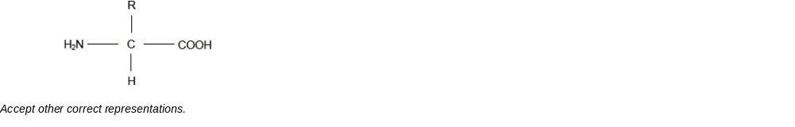

Slide 15
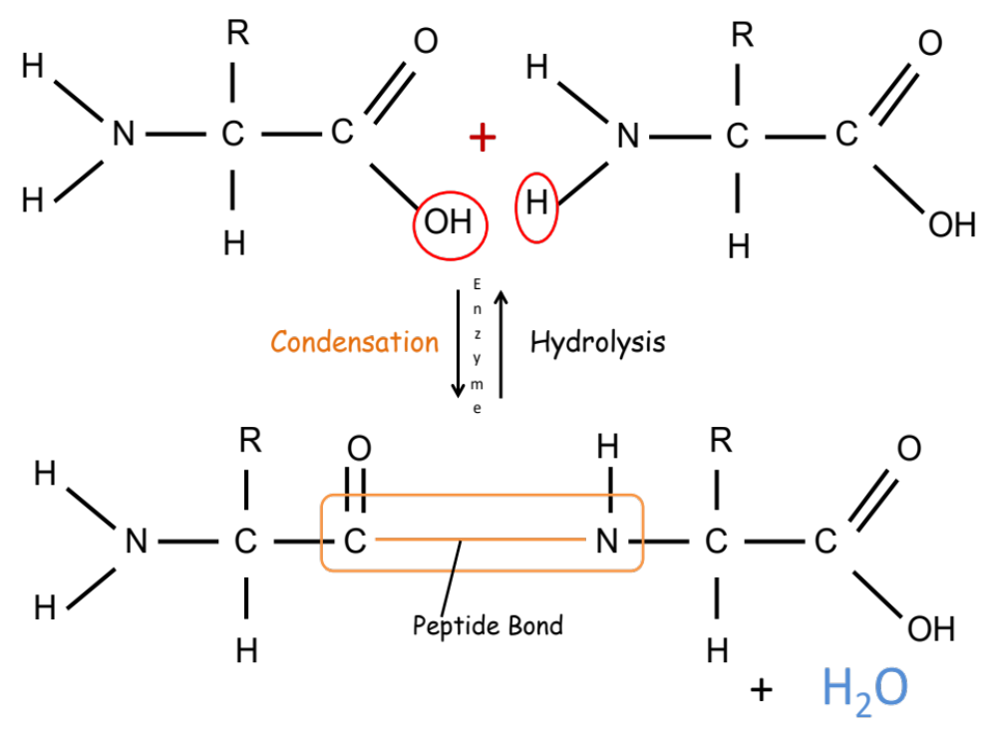
Q2. (a) Glycine, an amino acid. In the space below, draw a diagram to show the dipeptide produced when two molecules of glycine are joined together.
1. Peptide bond shown correctly;
2. Rest of dipeptide structure shown correctly;
b) Name the other molecule formed when two molecules of glycine are joined together.
Water

Slide 16
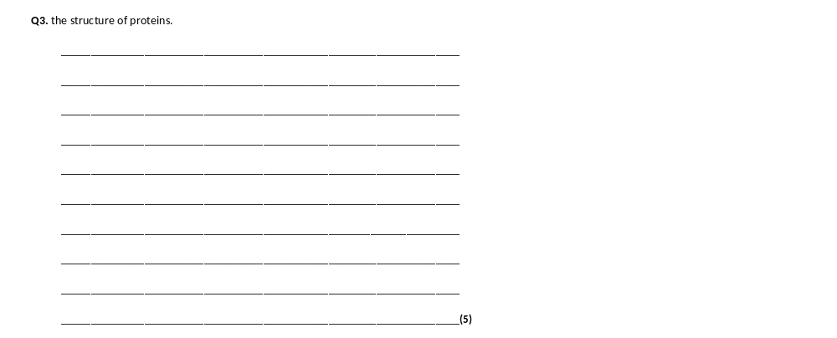
1. Polymer of amino acids;
2. Joined by peptide bonds;
3. Formed by condensation;
4. Primary structure is order of amino acids;
5. Secondary structure is folding of polypeptide chain due to hydrogen bonding;
Accept alpha helix / pleated sheet
6. Tertiary structure is 3-D folding due to hydrogen bonding and ionic / disulfide bonds;
7. Quaternary structure is two or more polypeptide chains.

Slide 17
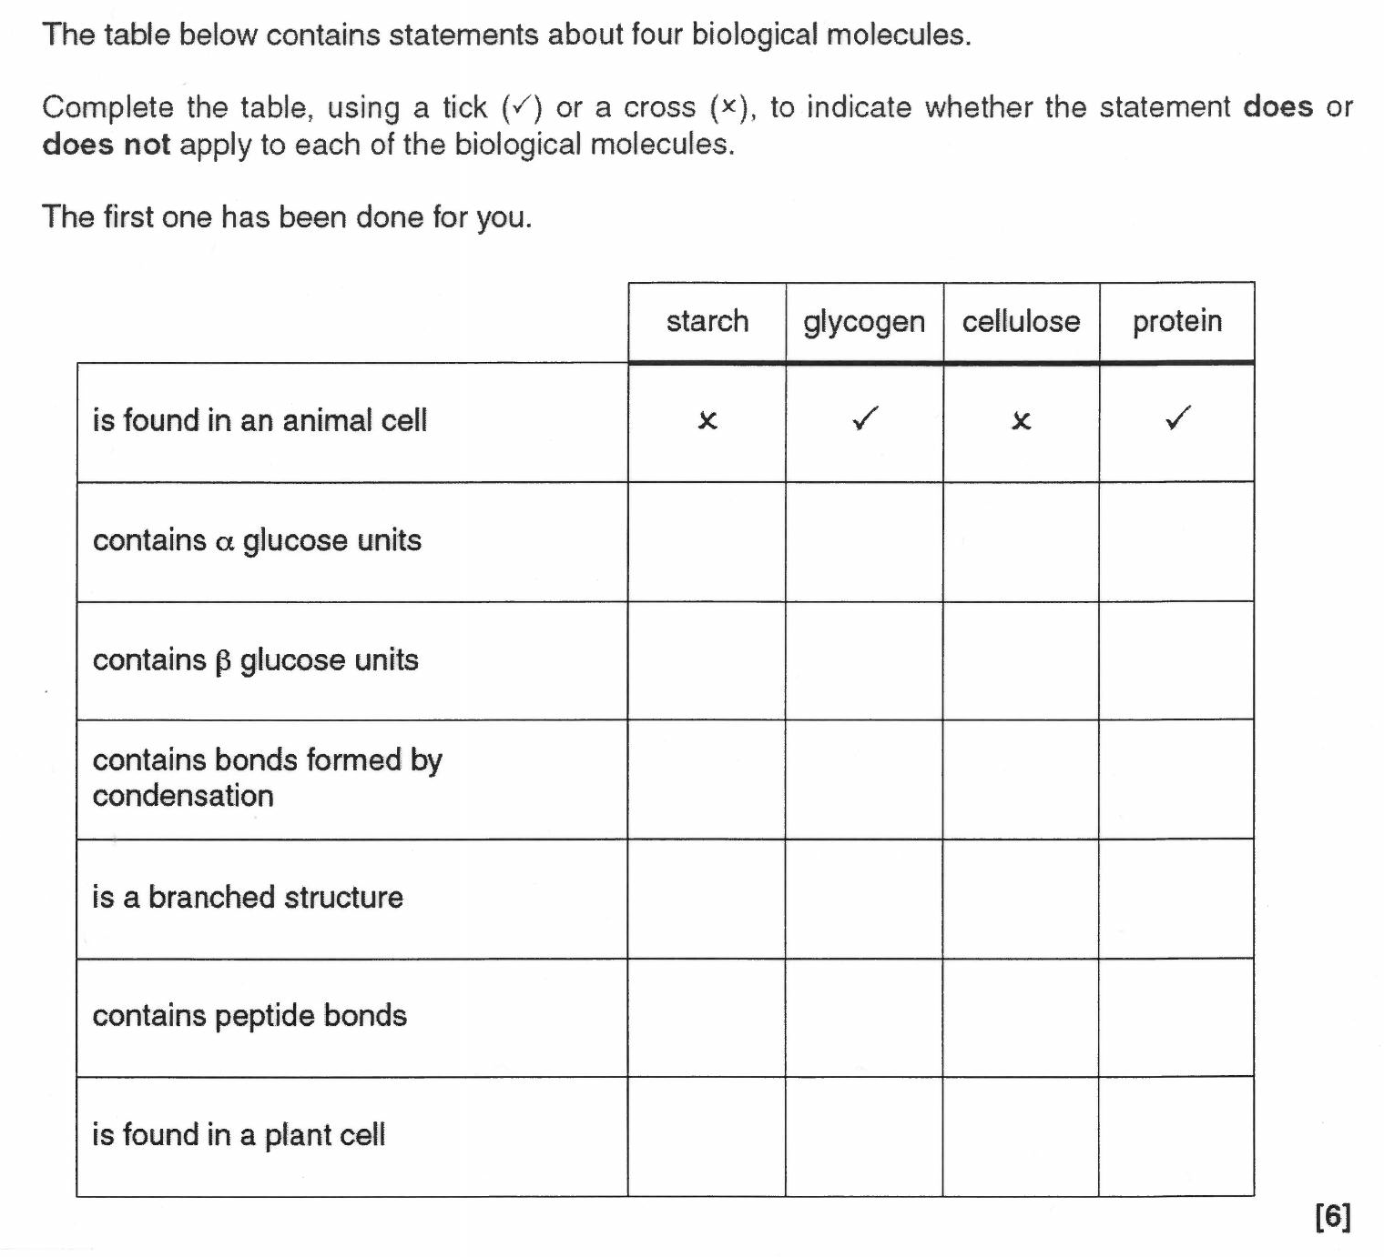



Proteins
On whiteboards…
Can you complete the table below?

