Slide 1
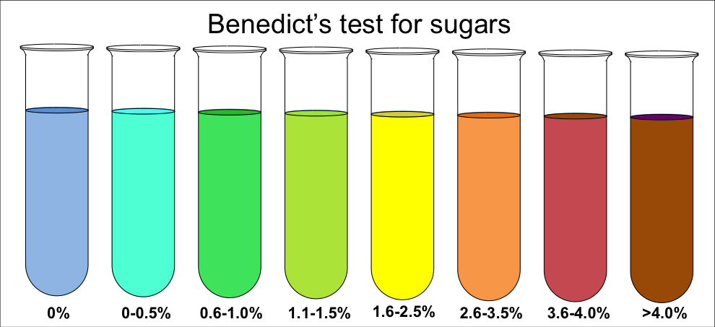
Testing for Biological Molecules
Outcomes:
Describe the Biuret test, the emulsion test, reducing and non-reducing sugar and starch test and how they can be interpreted.
Explain what is meant by qualitative testing and quantitative data.
Describe how the Benedict’s test can be adapted to provide quantitative data
Explain the usefulness of calibration curves or standards.

Slide 2

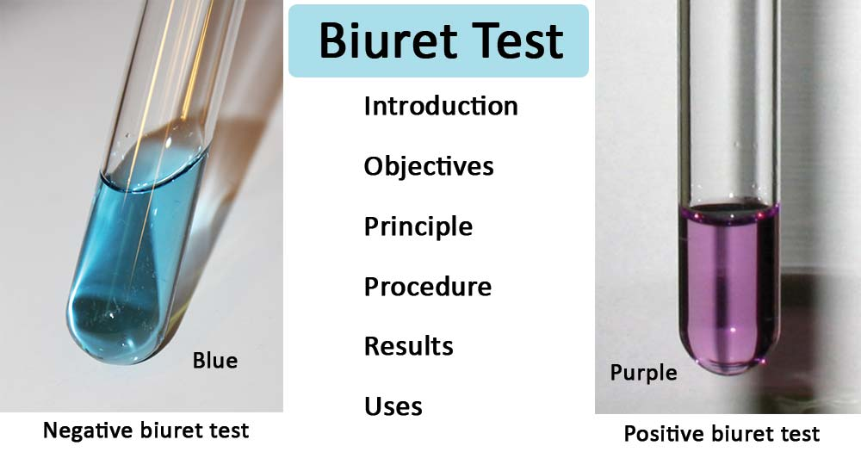
Testing for Biological Molecules- Proteins
Biological molecule | Method | Result
Protein | Add Biuret | Blue to Lilac
https://www.youtube.com/watch?v=FC6oEOAiUSk 2 minutes, extra detail included

Slide 3
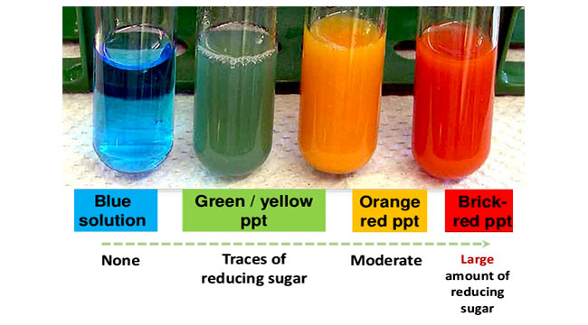
Testing for Biological Molecules- Carbohydrates – Reducing
Biological molecule | Method | Result
Carbohydrates- Reducing sugar | Heat to 80c with Benedict’s | Blue to Brick red precipitate
https://www.youtube.com/watch?v=VqXISeCbmn4 5 minutes

Slide 4
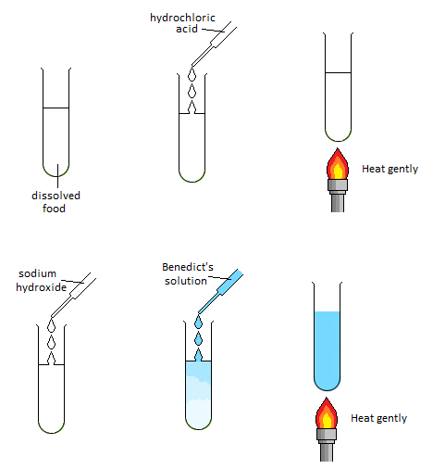
Testing for Biological Molecules- Carbohydrates – Non-Reducing
Biological molecule | Method | Result
Carbohydrates- Non-reducing sugar | Follow Benedict method but solution stays blue. Fresh sample Boil with acid then neutralise with alkali Heat to 80c with Benedict’s | Blue to Brick red precipitate
Why do we use acid and alkali’s?
Acid hydrolyses the glycosidic bond producing monosaccharides
Benedict's only works in alkaline solutions so the solutions must be neutralised with an alkali before adding more Benedict's.

Slide 5
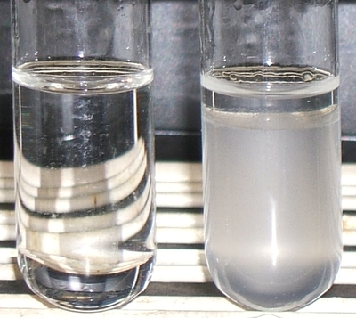
Testing for Biological Molecules- Lipids
Biological molecule | Method | Result
Lipids | Shake with ethanol Then add water | White/milky emulsion
Why is ethanol used?
Lipids are insoluble in water so normal testing solution won’t work
Ethanol is a solvent for lipids

Slide 6
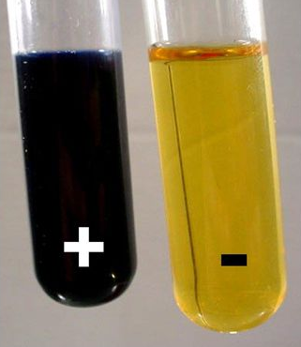
Testing for Biological Molecules- Starch (Polysaccharide)
Biological molecule | Method | Result
Starch | Add iodine | Yellow to blue black

Slide 7
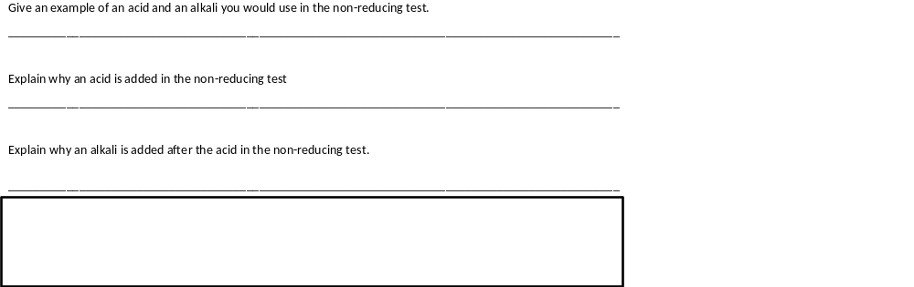
Testing for Biological Molecules
Answer the questions on page 24 in your booklet.
Hydrochloric acid
Hydrolyse the glycosidic bond forming reducing sugars
Benedict’s only works in alkaline conditions.

Slide 8
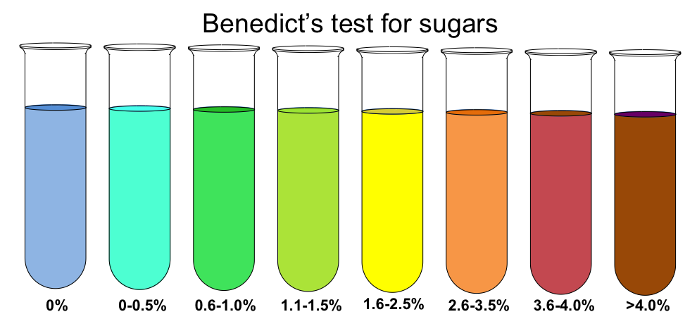
Testing for Biological Molecules- Quantitative Benedict’s.
Definition:
Quantitative data: Numerical measurement of a variable, can be statically analysed
Qualitative data: Judgement, cannot be statically analysed
On page 25 in your booklet, describe the qualitative data.
Lighter colours have a lower conc of glucose, the darker colours have a higher conc of glucose
Does this allow you to work out the exact conc of the solution?
No. This is a subject so influenced by human error.

Slide 9
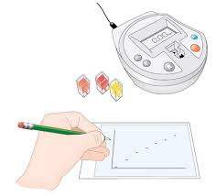
Testing for Biological Molecules- Quantitative Benedict’s.
Describe the method for quantitative Benedict’s test:
Add Benedict’s to different concentration of reducing sugar solution
Heat to 80c in water bath
Separate the coloured solution into cuvettes
Calibrate the colorimeter
Place the cuvette into the colourimeter
Measure the % absorption
Plot a graph.

Slide 10
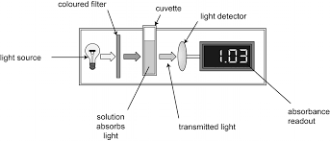
Testing for Biological Molecules- Quantitative Benedict’s.
Calibrate colorimeter using water = 0% absorption
Place sample into cuvette into colorimeter
6. Detects light that is NOT absorbed
3. Turn on light source
7. Quantitative reading
4. Light passes through sample
5. Light is absorbed by precipitate in solution

Slide 11
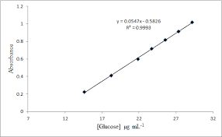
Testing for Biological Molecules- Quantitative Benedict’s.
On page 25 in your booklet sketch a graph showing the % absorption using a colorimeter
The higher the concentration of reducing sugar the higher the absorbance of light.
Describe how you could use this calibration curve to work out the glucose concentration of an unknown solution
Heat to 80c with Benedict’s
Place cuvette in colorimeter
Plot % absorption on calibration graph to work out concentration.

