Slide 1
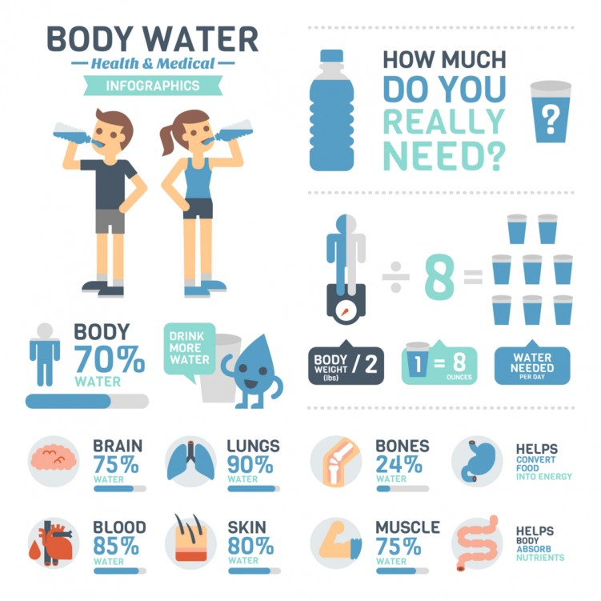
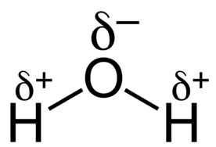
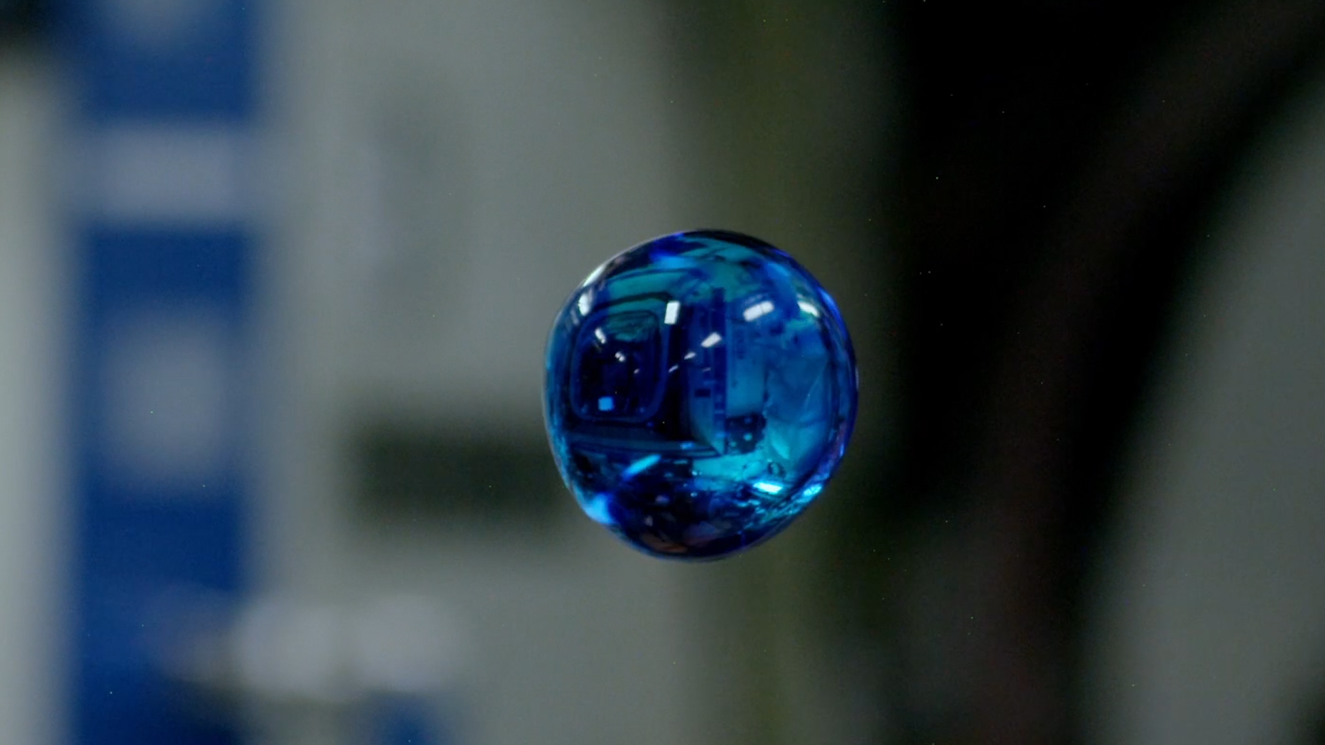
Water.

Slide 2
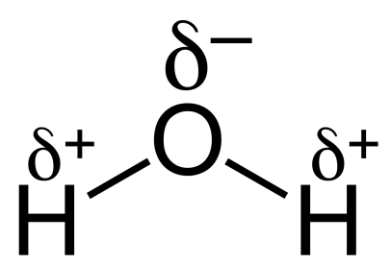
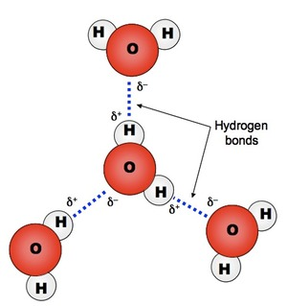
Water- Structure
Major component of cells
Made up of 2 atoms of hydrogen and 1 atom of oxygen
Hydrogens joined to oxygen by covalent bonds.
Electrons are not shared equally – oxygen atom has
slight negative charge, hydrogen atoms have slight positive charge – polar- dipolar
Each water molecule is attracted to each other
Attractions called hydrogen bonds

Slide 3
Water- Property
Property | Explanation | Advantage to organisms
Polar molecule | Universal solvent | Transport ions around the body for faster reaction
Universal solvent | Water is polar allowing ions to dissolve | Transport ions around the body for faster reaction
Reactive | Involved in hydrolysis/condensation reactions | Allows metabolic reactions to occur

Slide 4
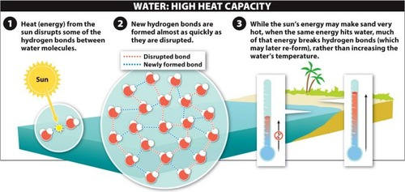
Water- Property
Property | Explanation | Advantage to organisms
High heat capacity | Takes a lot of heat energy to break H bonds Energy is used instead of changing temperature Act as a buffer | External: Stable environment for organisms eg fish Internal: Maintains stable temperature for enzymes and reactions.

Slide 5
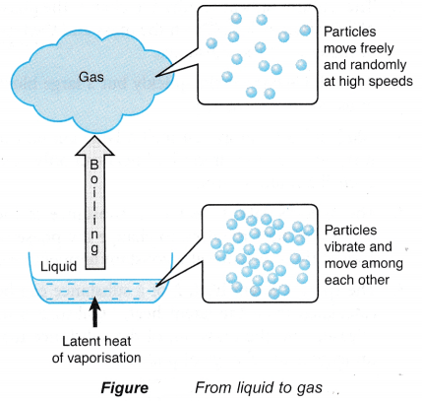
Water- Property
Property | Explanation | Advantage to organisms
Latent heat of vaporisation | Takes a lot of heat energy to break H bonds. Energy is used to change liquid to gas when it evaporates carrying away the heat energy | Heat energy is lost through evaporation allowing animal to cool down.

Slide 6
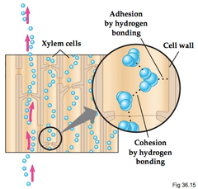

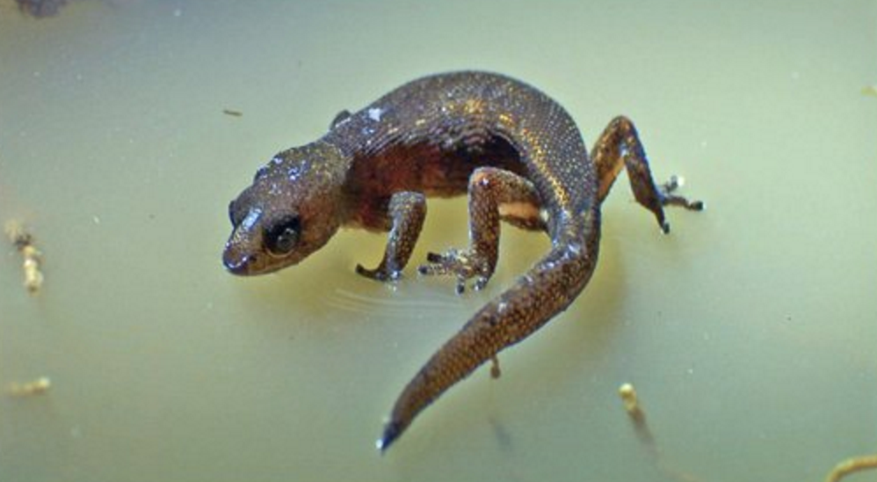
Water- Property
Property | Explanation | Advantage to organisms
Cohesion | Attraction between water molecules Water forms a column for support Water has a high surface tension when in contact with air | Column: Transport ions in plants Surface tension: Habitat for insects.

Slide 7
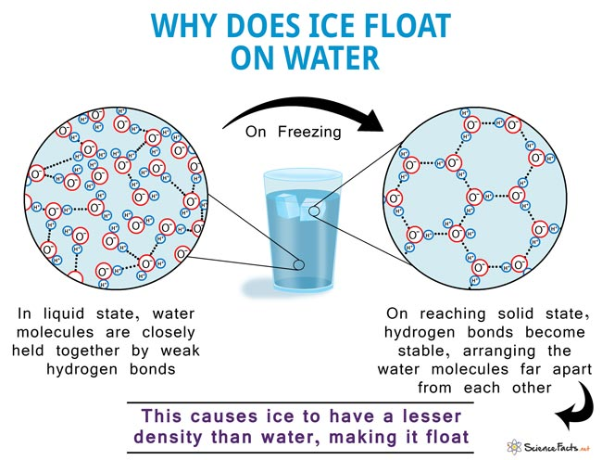
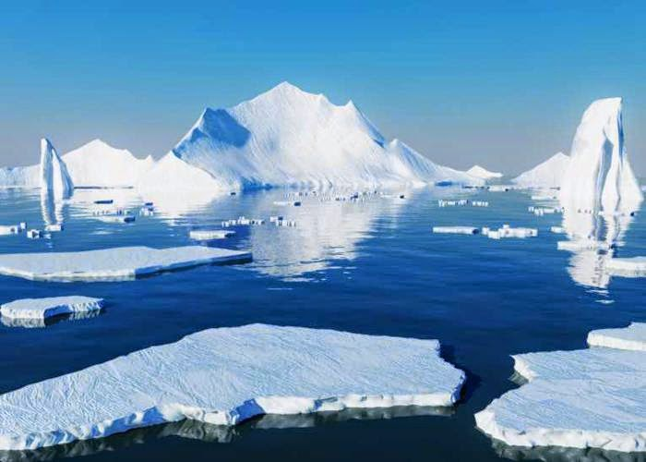
Water- Property
Additional property:
Ice is less dense
Explanation:
In solid state water molecules are arranged far apart lowering density
Advantage to organisms:
Forms habitats e.g. ice bergs

Slide 8
Apply this knowledge to the exam questions on page 27.
The questions are worth 6 marks. Can you complete the exam question in 10 minutes?
Once you have completed the question, check your answers using the markscheme.
Remember
Highlight which part of your answer is also on the markscheme. Allow you to see which part of your answer are relevant.
If it isn’t on the mark scheme it is not right, if it isn’t written as the markscheme it is not right.
In a different coloured pen add corrections to the question.
Anything you don’t understand make a note of for when you speak to your teacher.

Slide 9
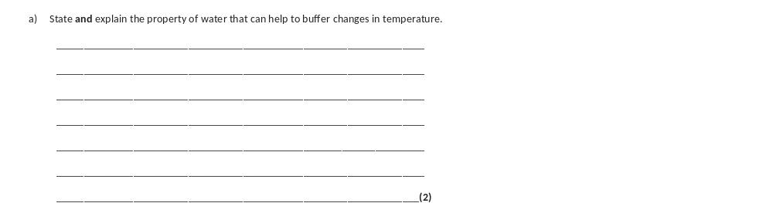
(a) 1. (water has a relatively) high (specific) heat capacity;
Ignore numbers relating to heat capacity
2. Can gain / lose a lot of heat / energy without changing temperature;
OR
Takes a lot of heat / energy to change temperature;
Accept due to H bonding between water molecules

Slide 10
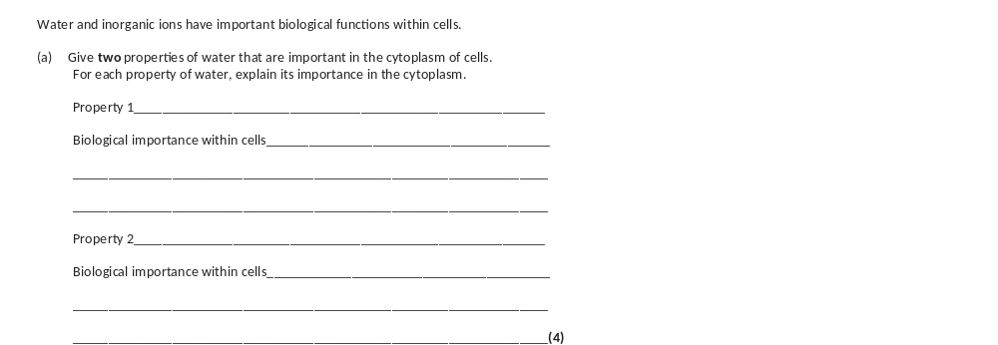
a) 1. Polar molecule;
2. Acts as a (universal) solvent;
OR
3. (Universal) solvent;
4. (Metabolic) reactions occur faster in solution;
OR
5. Reactive;
6. Takes place in hydrolysis / condensation / named reaction;
Polar molecule so acts as (universal) solvent so (metabolic reactions are faster = 3 marks

