Slide 1
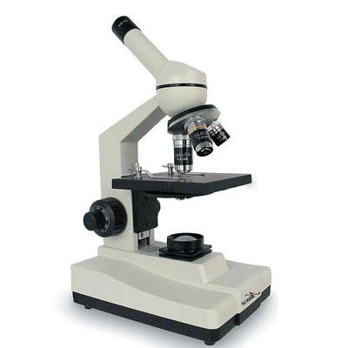
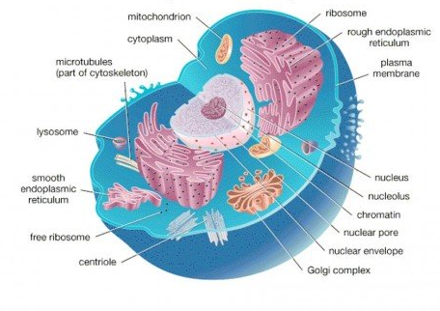
Cell Structure and Microscopy

Slide 2
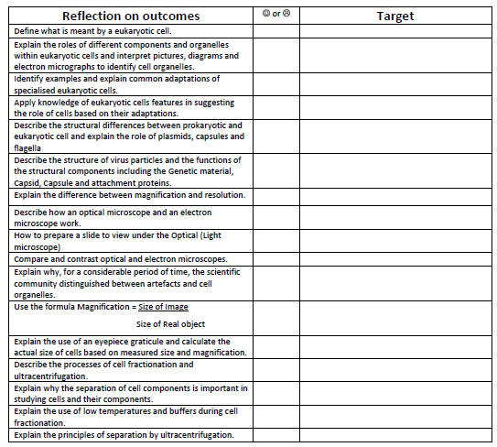

Slide 3
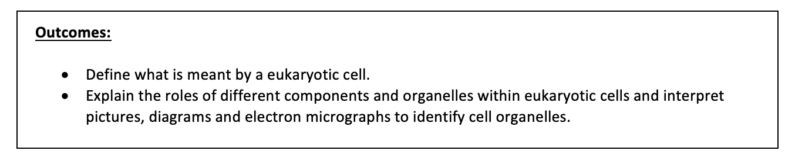
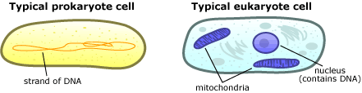
Learning Objectives

Slide 4
Starter
leuusnc mbemarne AND
chotimairdon lalw
Vloucae pchoortslla
iical fallegla
Nucleus
Membrane
DNA
Now, in your pairs, try and write one fact about each of these structures from GCSE.
Mitochondria
Wall
Vacuole
Chloroplast
Cilia
Flagella

Slide 5
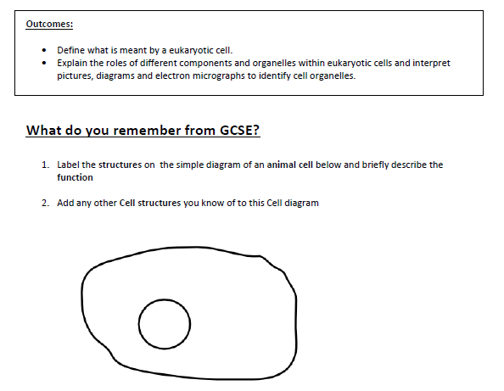

Slide 6
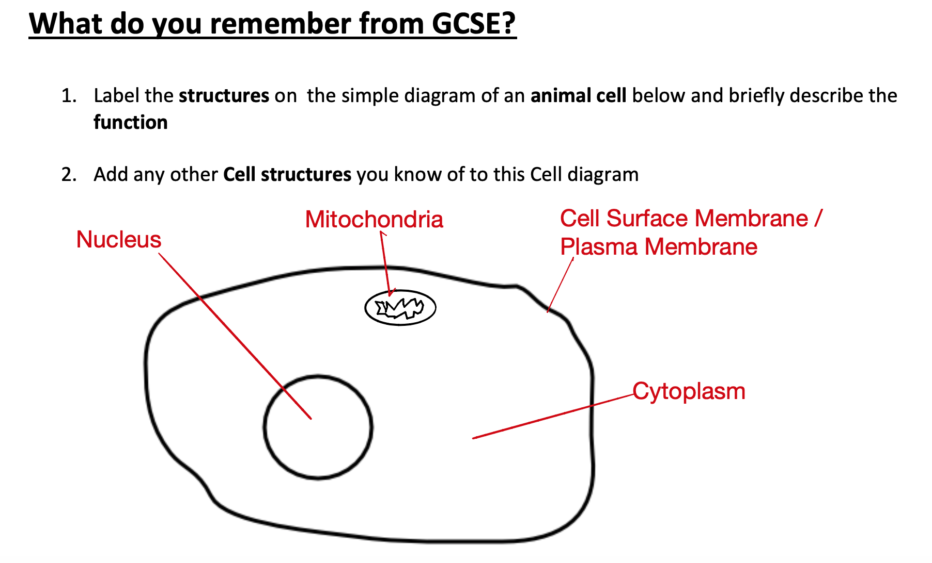

Slide 7
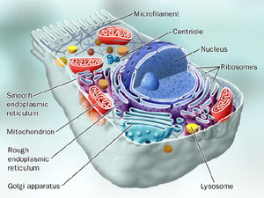
Eukaryotic?
What is a Eukaryote?
Eukaryotic cells have a distinct nucleus and membrane bound organelles.

Slide 8
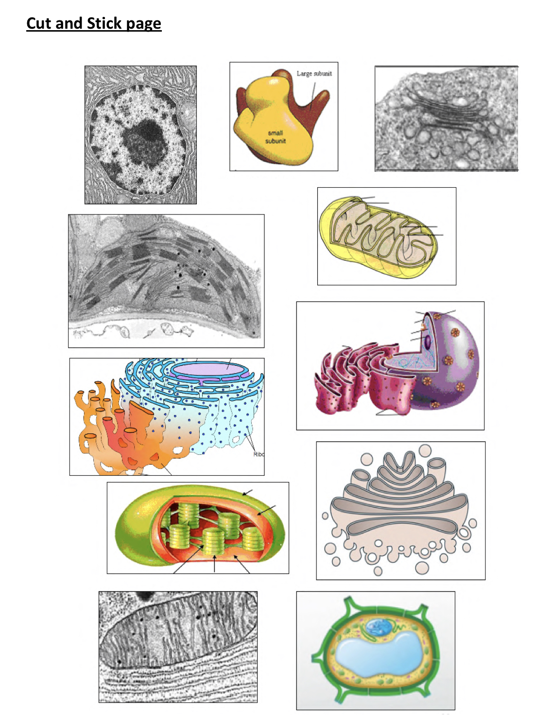
Revision sheet for organelles!
1. On A3 paper, cut out and arrange your different organelles from the sheet attached to the back of your booklet. Some organelles have more than one picture so you may wish to group these together when doing your revision sheet.
Use your notes in you work pack to do the following;
2. Each organelle must be named and labelled with detailed structure.
3. Each must have a description of function.
You must include an appropriate amount of detail.
4. Make it clear which organelles are only found in plant cells.
Ask your teacher if you are unsure about any!

Slide 9
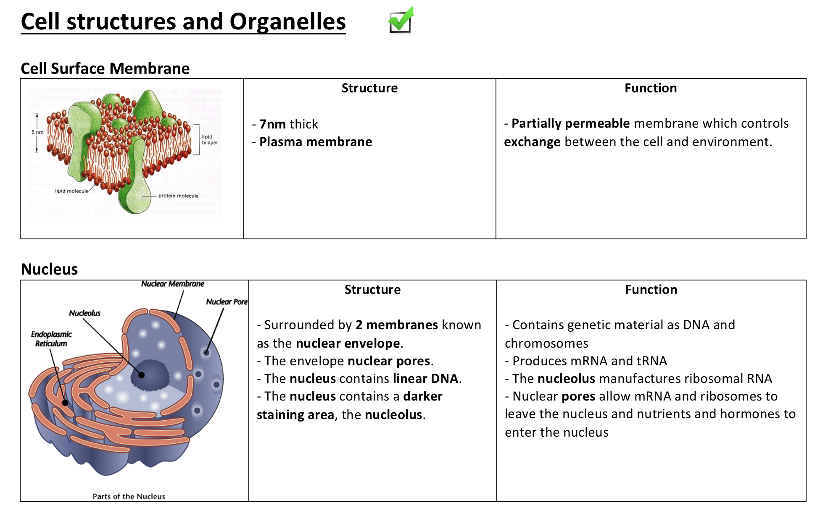
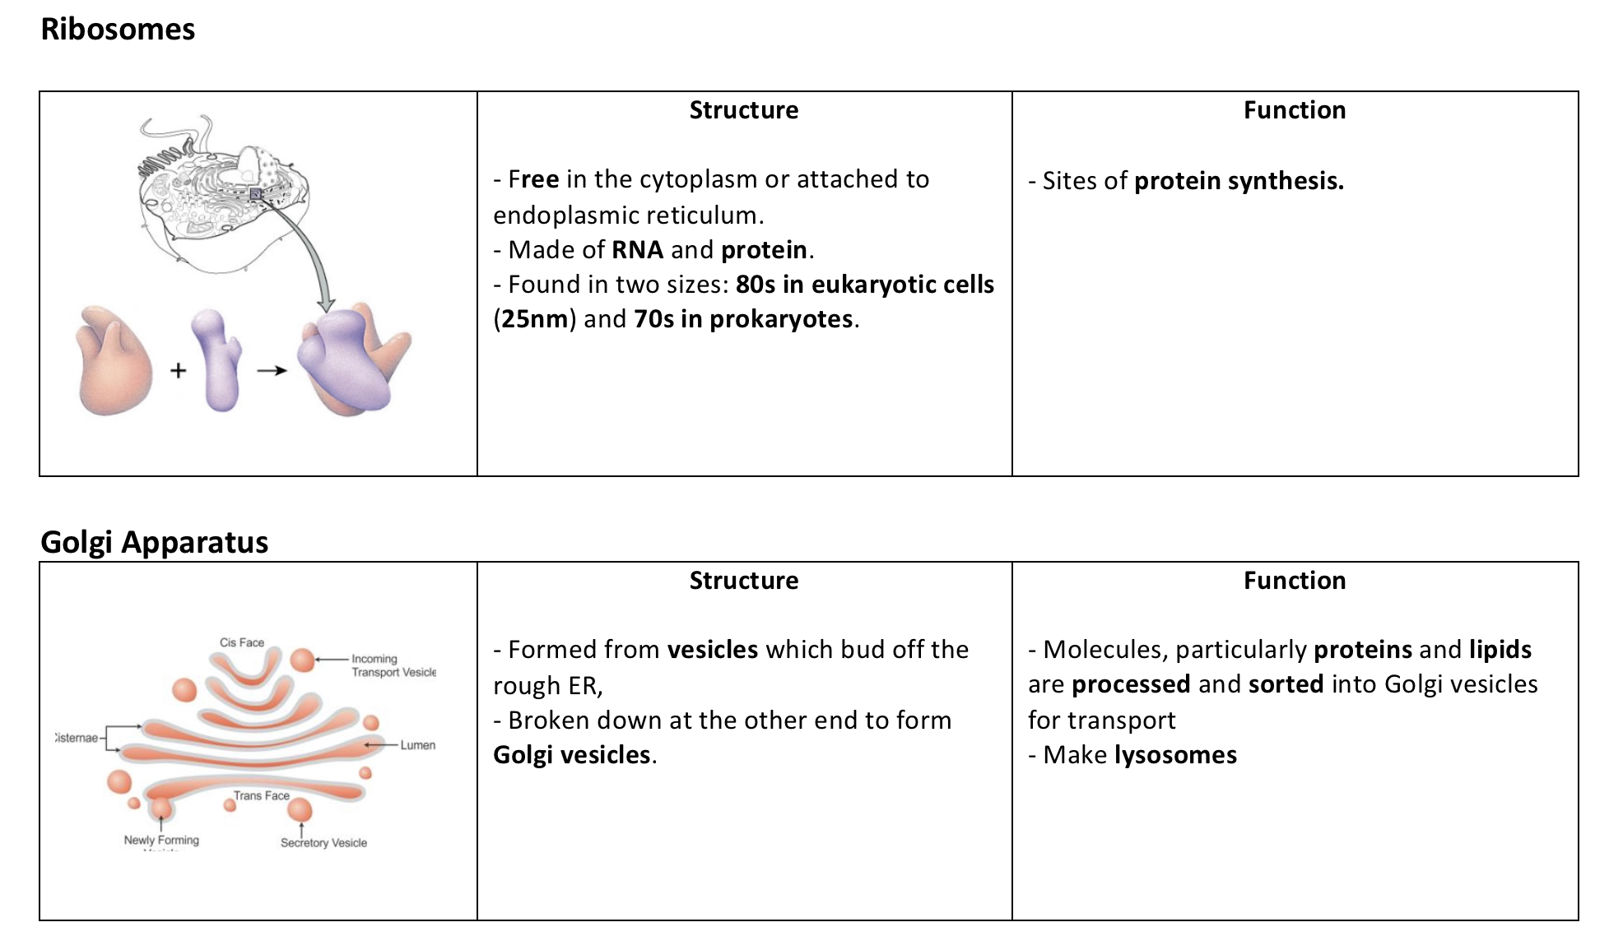
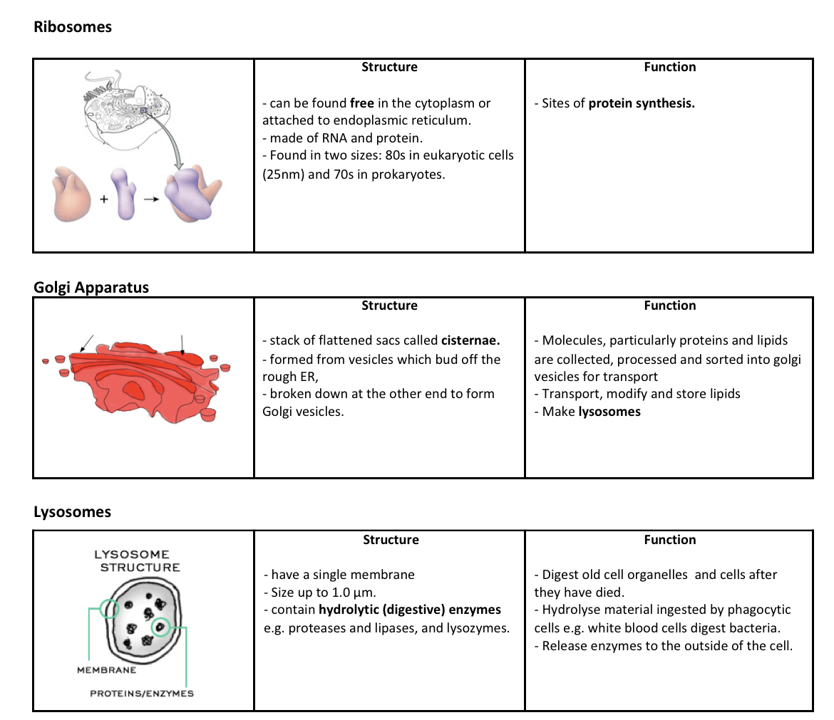
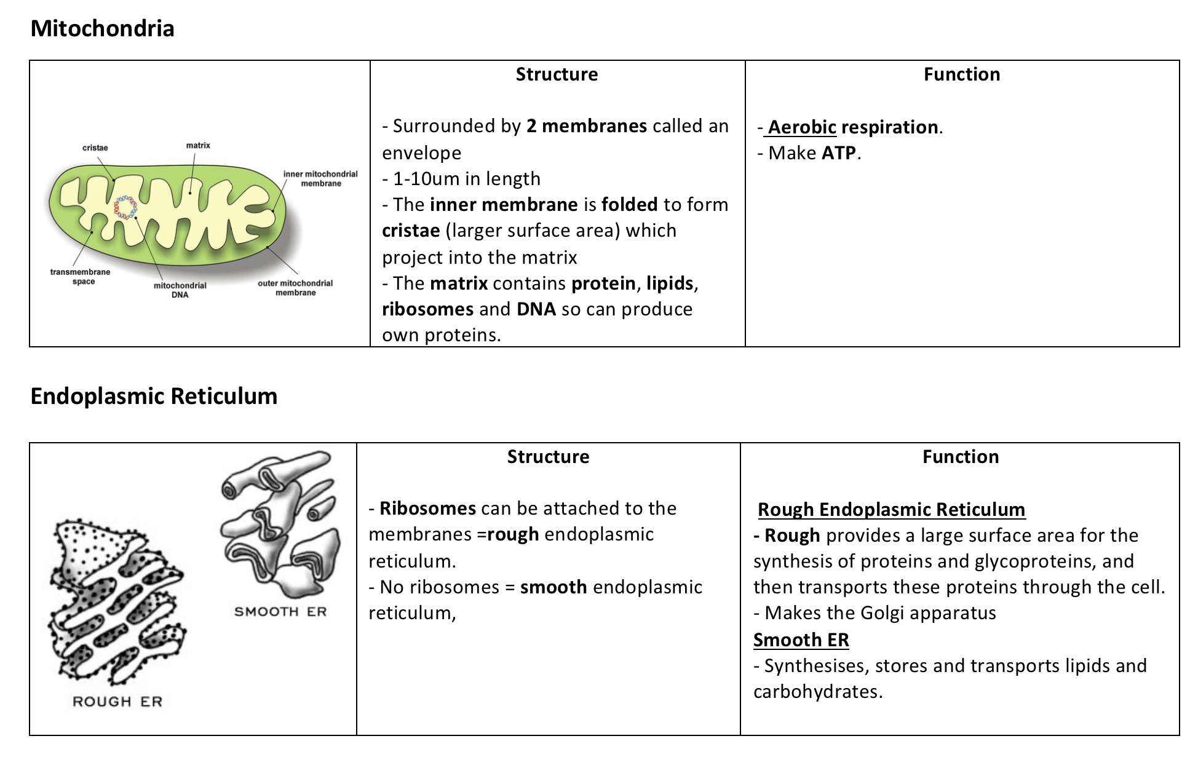
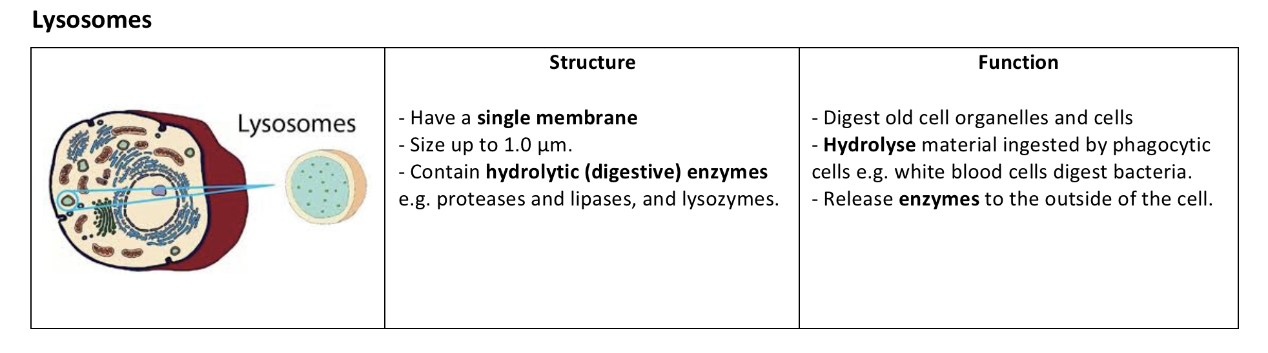

Slide 10
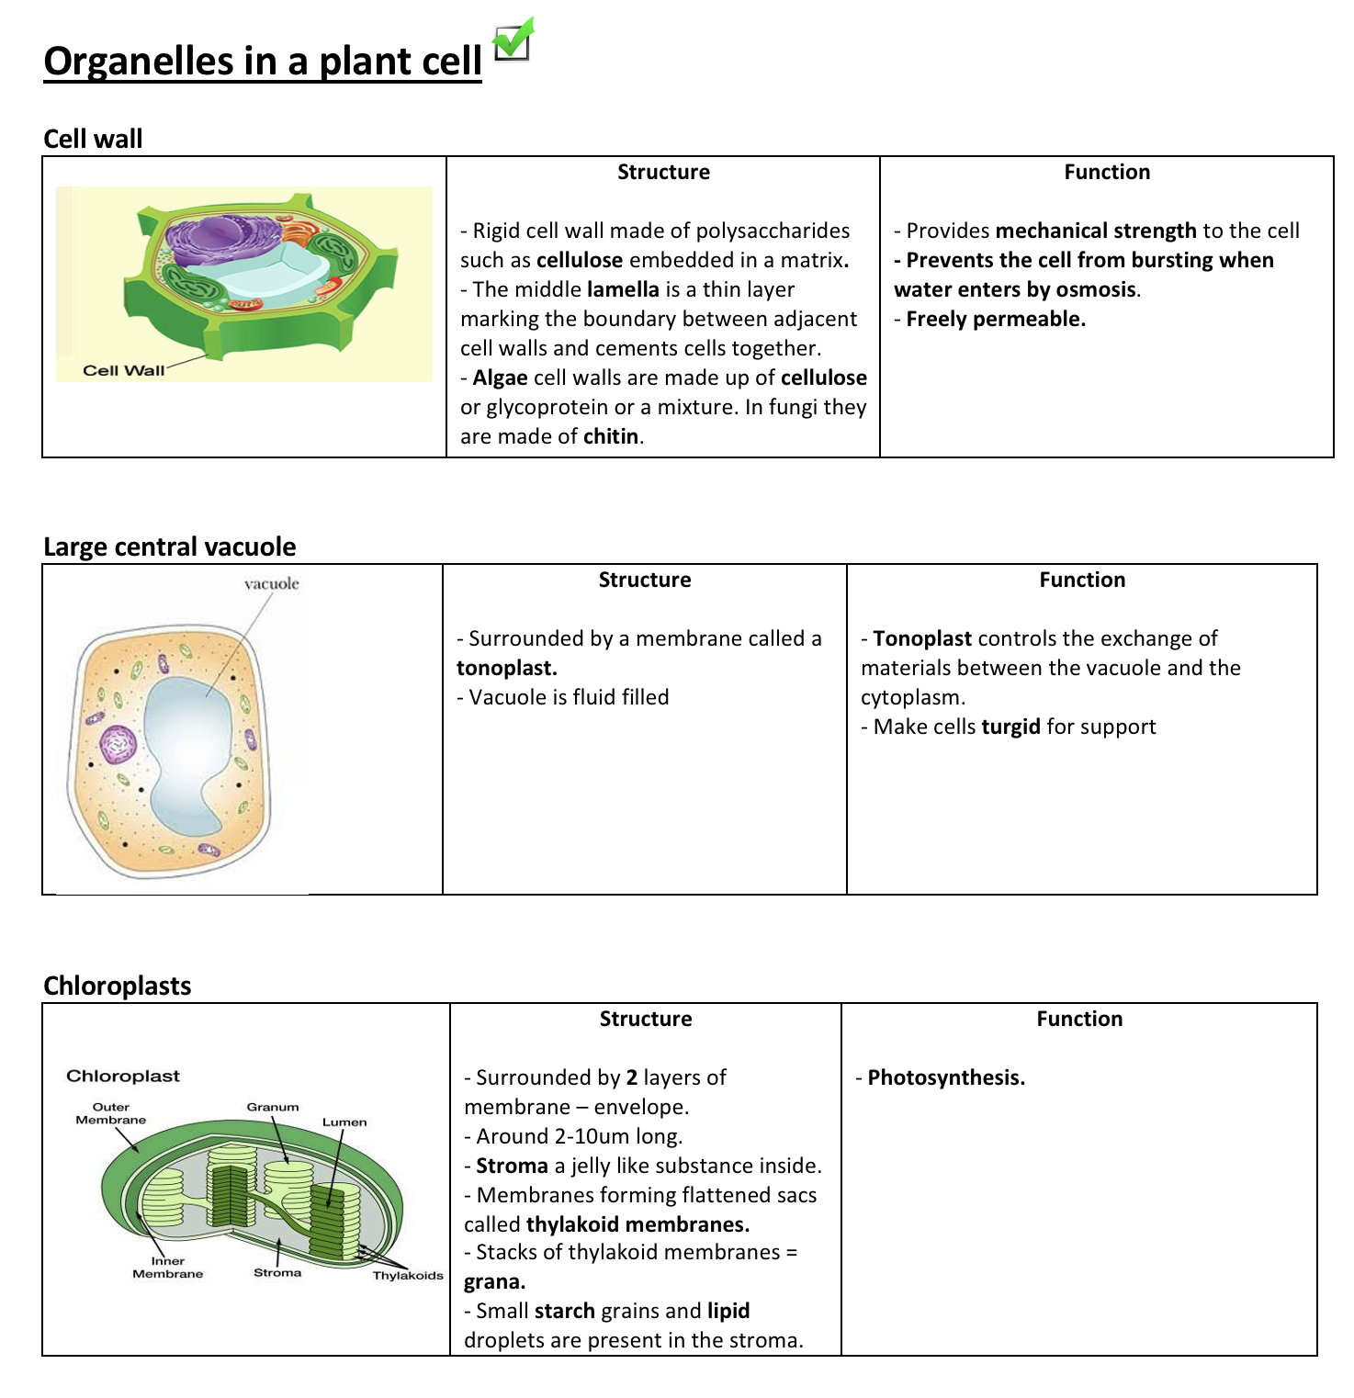

Slide 11
Check so far - Which is the odd one out? Why?
Cell surface membrane, plasma membrane, cell membrane
Rough endoplasmic reticulum, smooth endoplasmic reticulum, ribosomes
Nucleus, mitochondria, chloroplast
Golgi body, rough endoplasmic reticulum, lysosomes
Lysosomes, mitochondria, RER
Nucleolus, chromatin, ribosomes

Slide 12
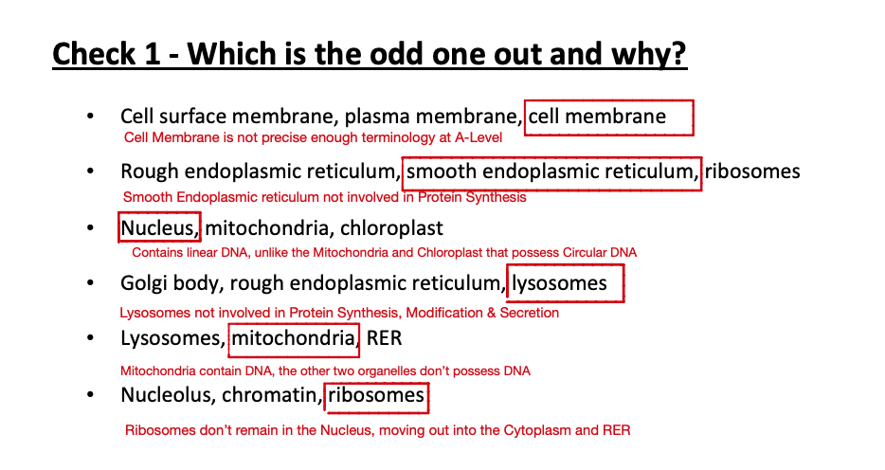

Slide 13
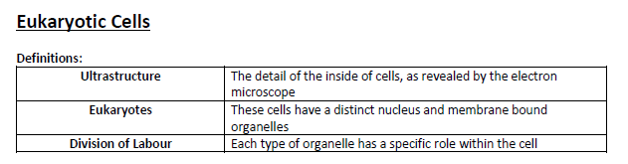
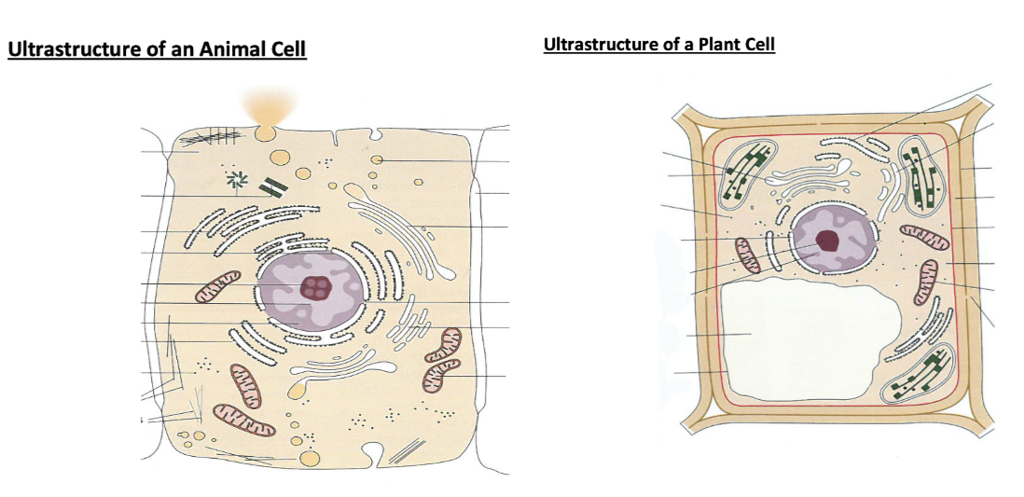
Label the diagrams of the Animal and Plant Cells on Page 5 of your booklet

Slide 14
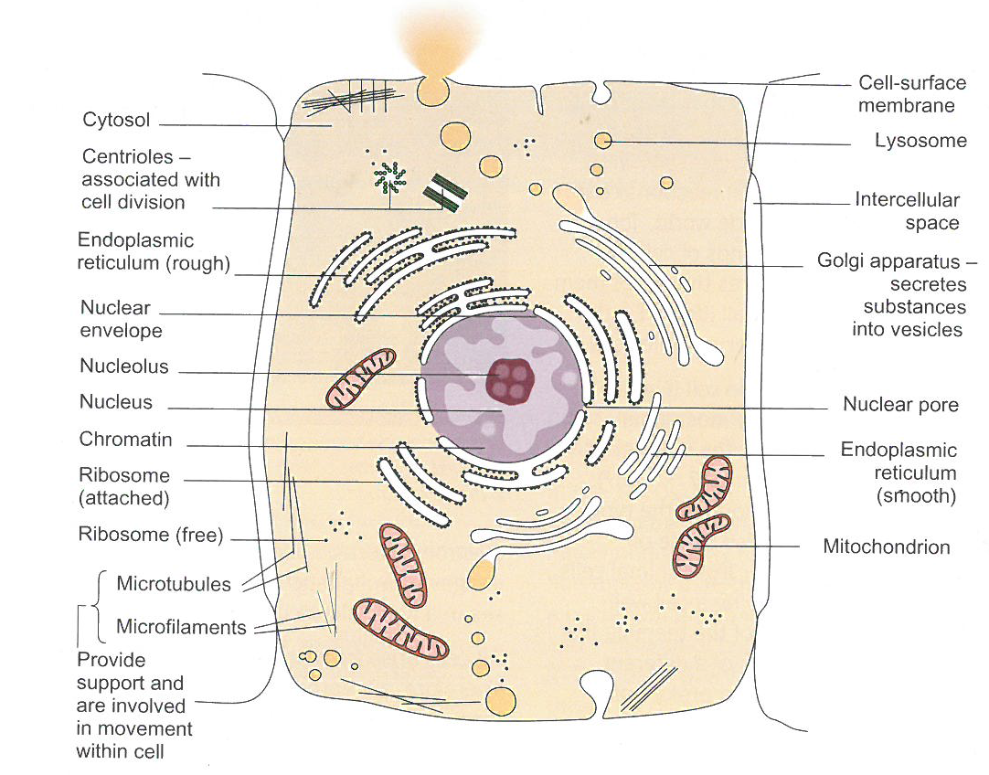

Slide 15
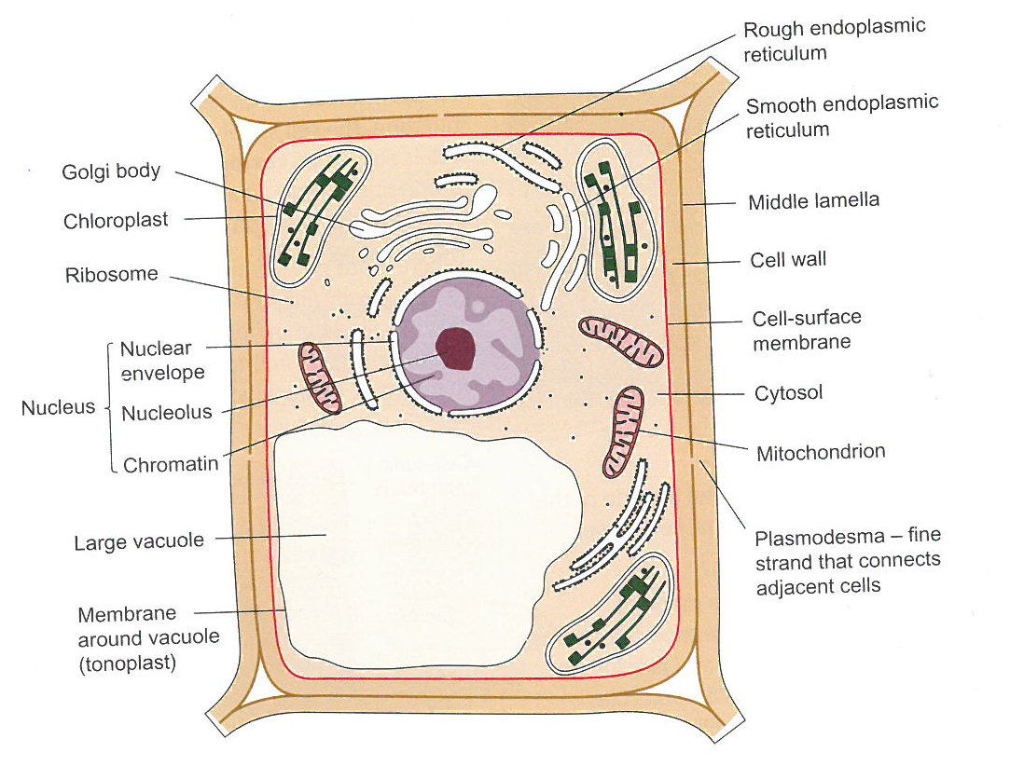

Slide 16
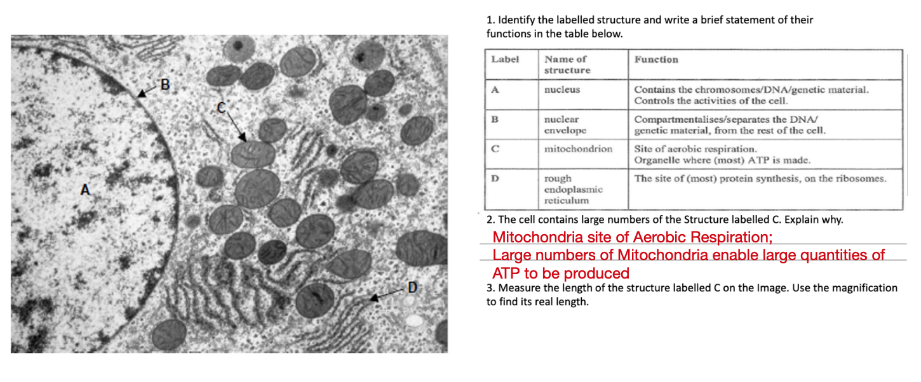
Practice Question – Page 6

Slide 17
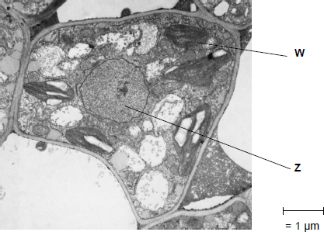
Exam Questions – Page 6
Exam Q
The figure shows a microscopic image of a plant cell.
Give the name and function of structures W and Z.
Name of W –
Function of W –
Name of Z –
Function of Z -
Chloroplast
Photosynthesis
Nucleus
Contain DNA/ chromosomes/holds the genetic information of the cell

Slide 18
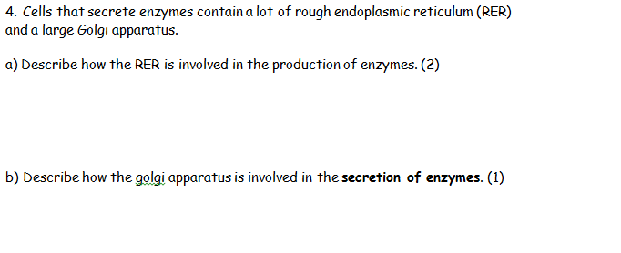
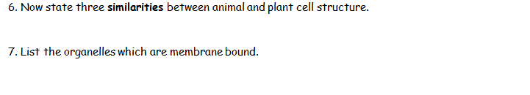
Has ribosomes
To make proteins
Modifies/packages (into vesicles)/transports proteins to cell surface
Both e.g. ribosomes, nucleus, RER, SER, golgi, mitochondria
- Nucleus, RER, SER, mitochondria, golgi apparatus, lysosomes, chloroplasts, vacuole

Slide 19
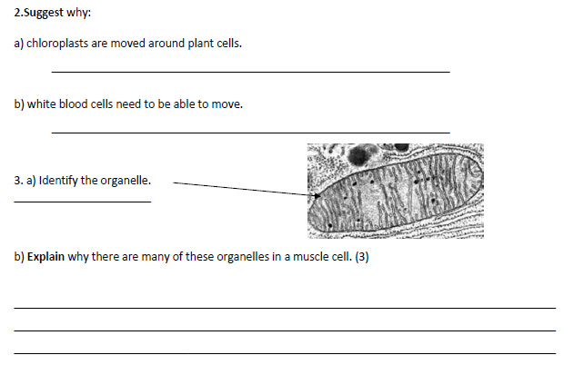
To maximise absorption of light energy for photosynthesis
To follow and engulf pathogens
Chloroplast
Muscle cells need lots of energy
Mitochondria carry out aerobic respiration
ATP produced
Energy store

Slide 20
Has ribosomes
To make proteins
Modifies/packages (into vesicles)/transports proteins to cell surface
Both e.g. ribosomes, nucleus, RER, SER, golgi, mitochondria
- Nucleus, RER, SER, mitochondria, golgi apparatus, lysosomes, chloroplasts, vacuole

Slide 21
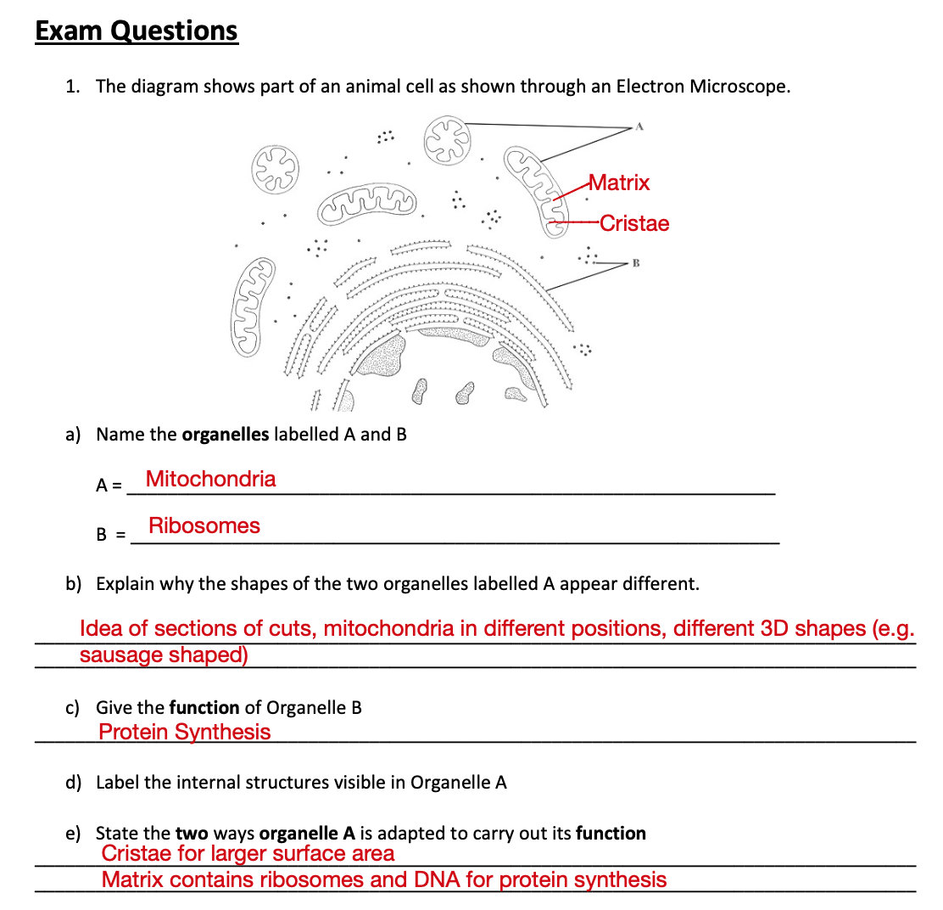
8.

Slide 22
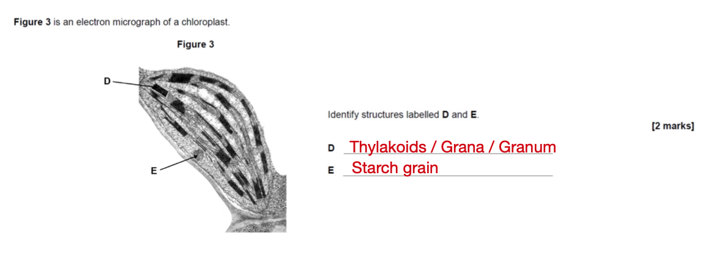

Slide 23
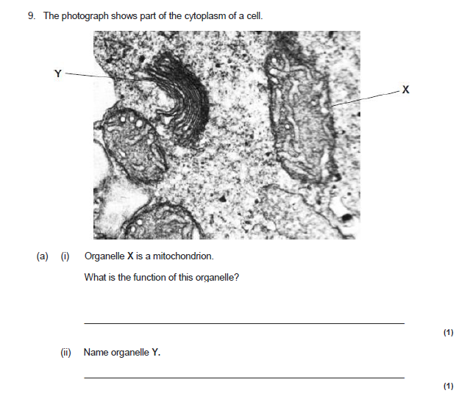
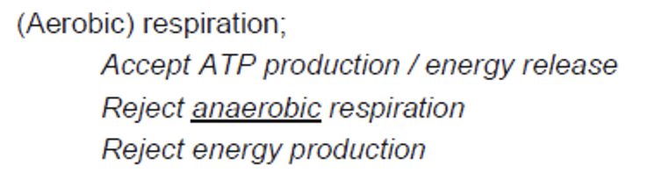
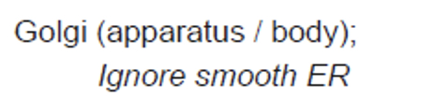
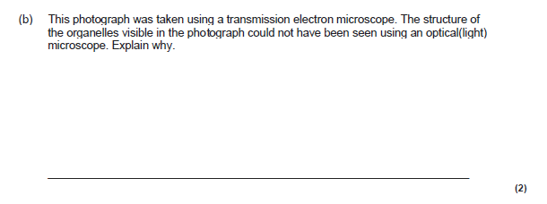
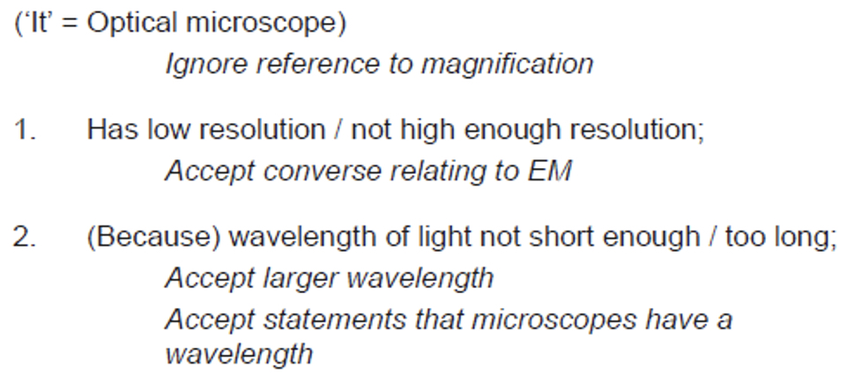

Slide 24
Outline the interrelationship between the organelles involved in the production and secretion of proteins

Slide 25
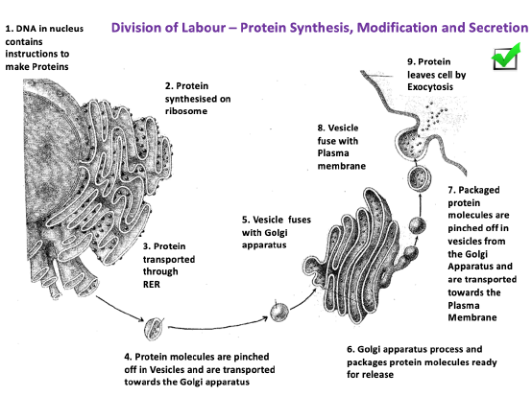

Slide 26
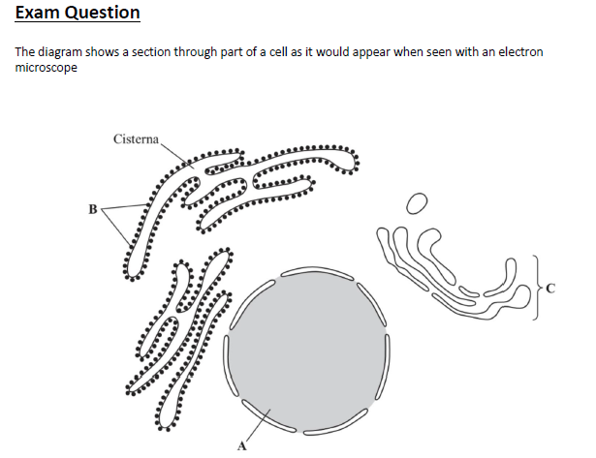
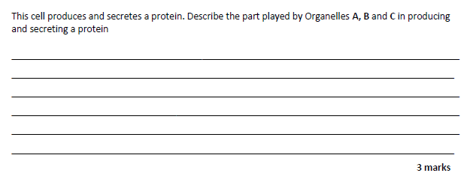

Slide 27
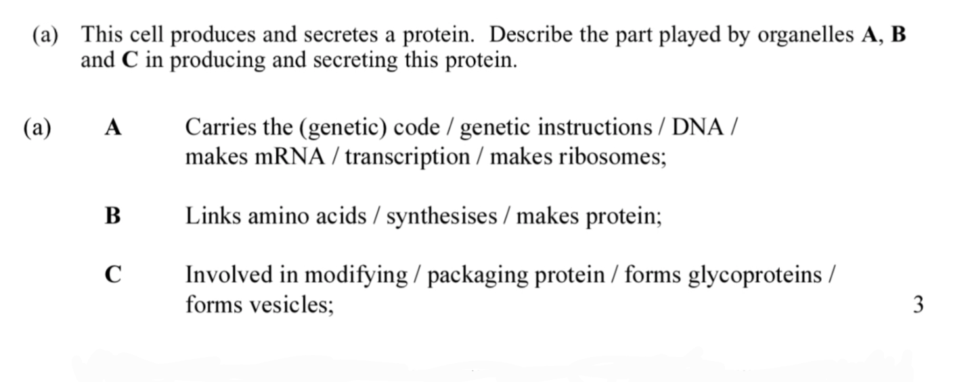

Slide 28
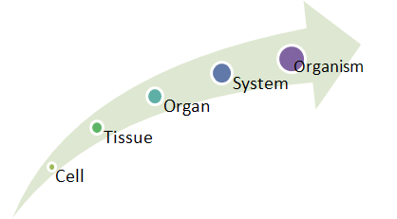
Specialised cells.
The cells of multicellular organisms are specialised in different ways to perform a particular role.
Each specialised cell will have more or fewer of certain organelles and structures to suit the role it carries out.
Q – If all cells in the body have the same set of genes, why do cells of different tissues look different?

Slide 29
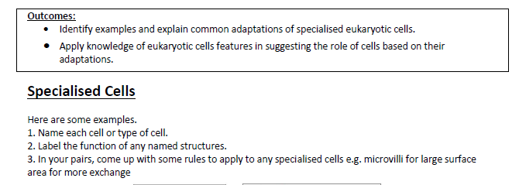
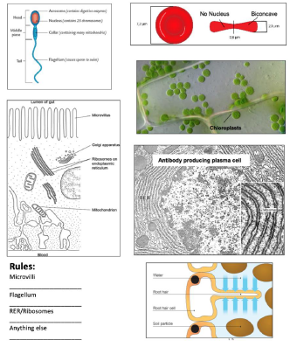

Slide 30
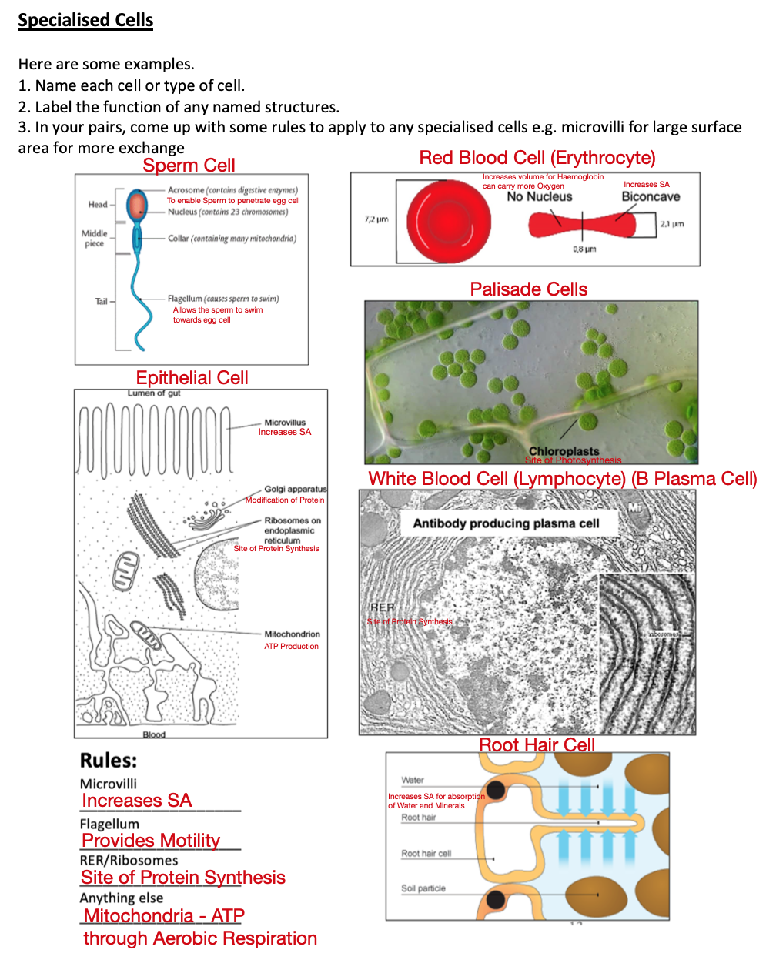

Slide 31
Organisation
How are cells organised?
Have a go at the task on page 12 of your booklet.
Using page 73 and 74 of the Toole and Toole text book, put the following words below in the correct order to describe how cells are organised:
  Tissue, Organ system, Cell, Organism, Organ.
Give an additional example next to the definitions e.g. next to heart, you could have pancreas, leaf etc.
Then have a go at the questions at the bottom of the page using the text book.

Slide 32
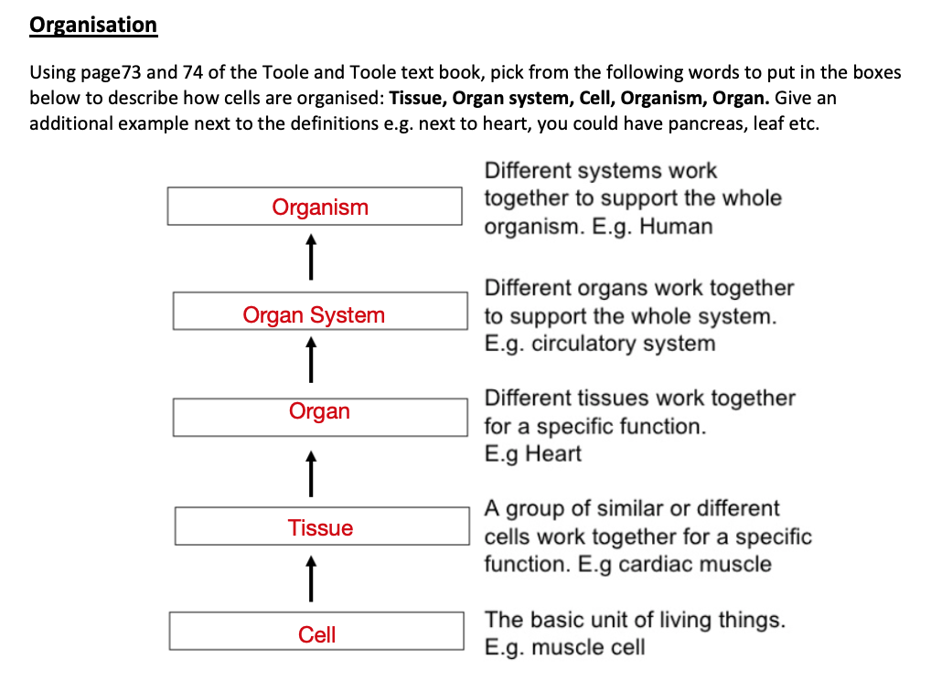

Slide 33
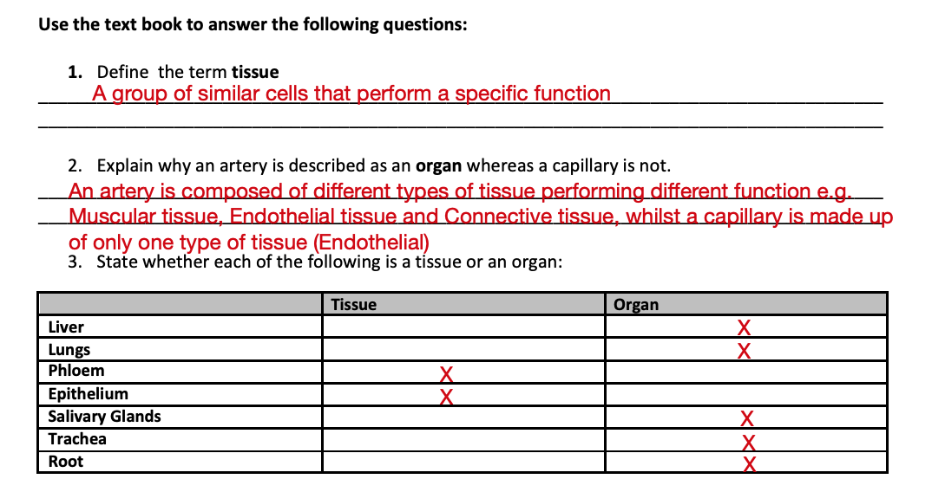
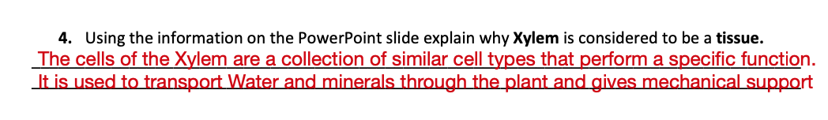

Slide 34
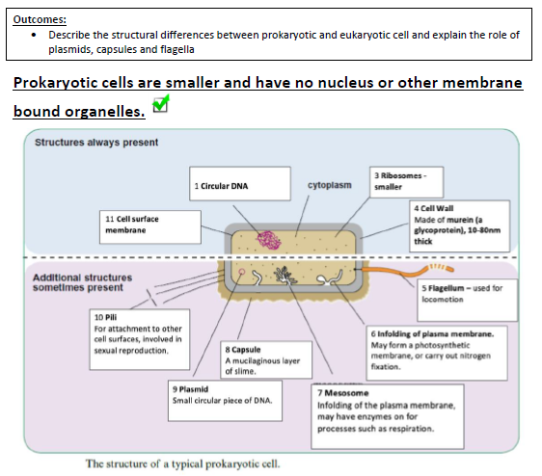

Slide 35
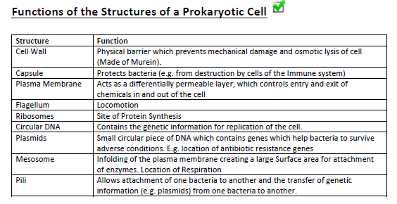

Slide 36
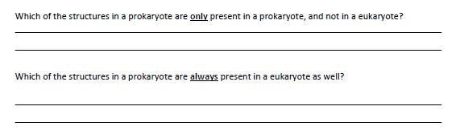
Capsule, Flagellum, Mesosome, Plasmid, Pili
Cytoplasm, Plasma Membrane, Ribosomes

Slide 37
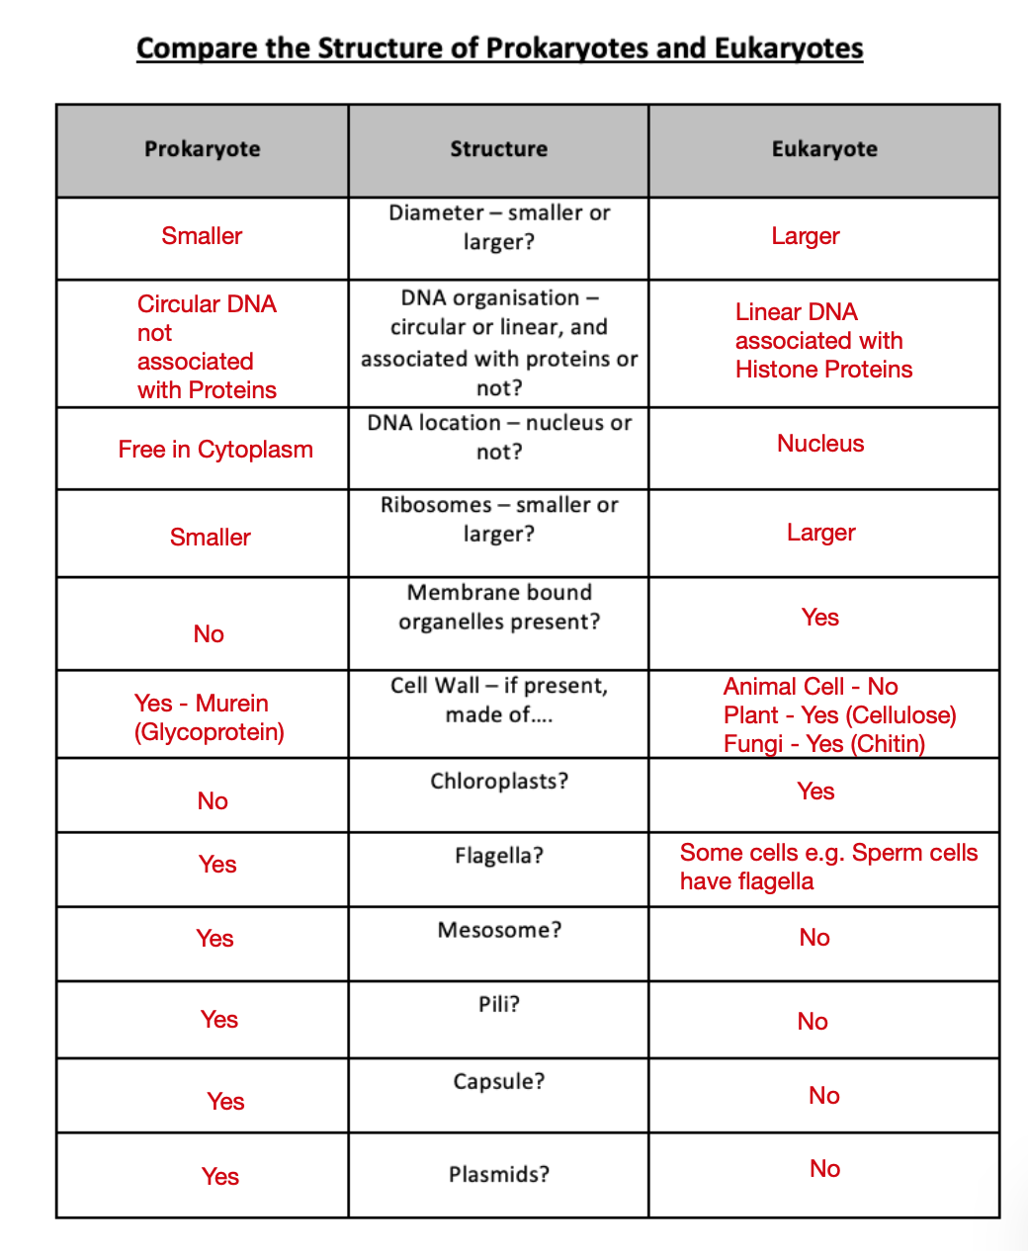

Slide 38
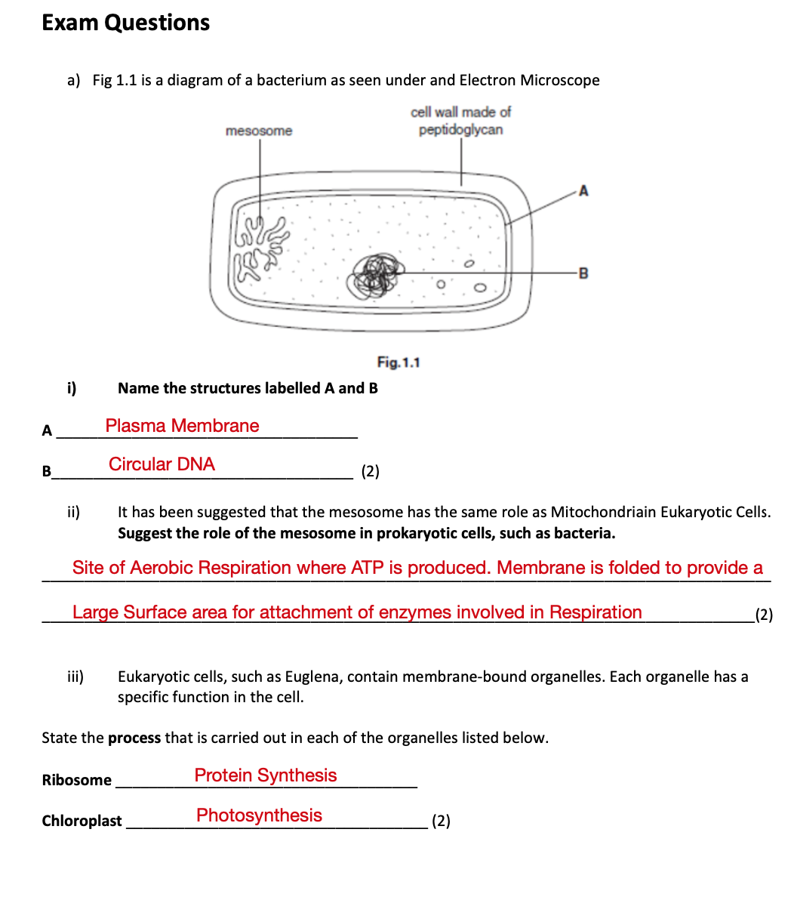

Slide 39
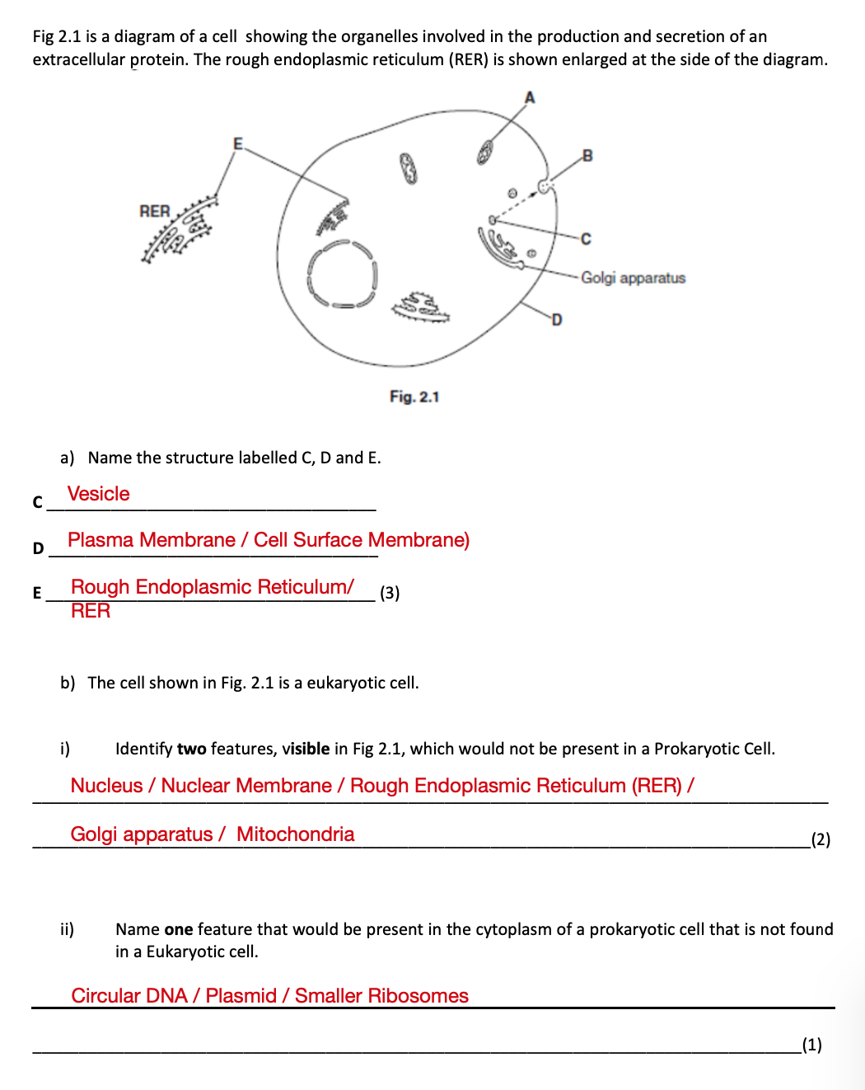

Slide 40
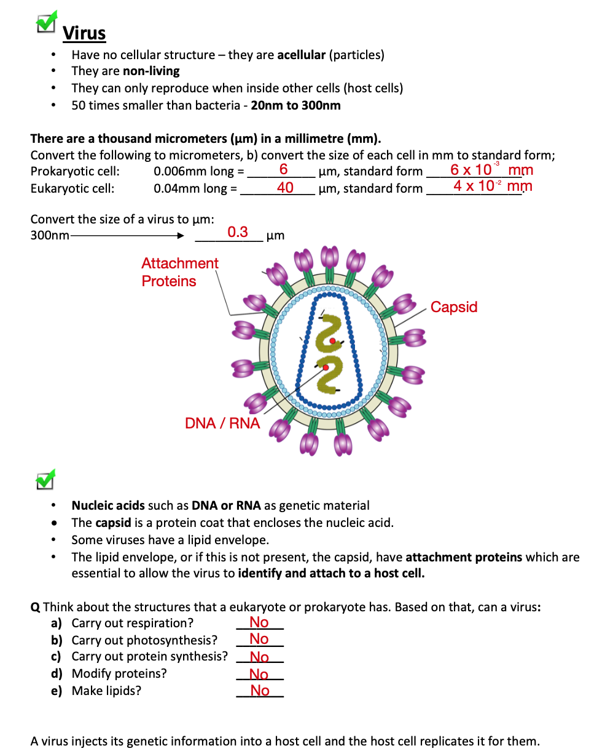

Slide 41


Slide 42


Slide 43



Slide 44


Slide 45


Slide 46


Slide 47


Slide 48


Slide 49


Slide 50



Slide 51


Slide 52



Slide 53


Slide 54


Slide 55


Slide 56


Slide 57


Slide 58



Slide 59


Slide 60


Slide 61


Slide 62


Slide 63





Slide 64



Slide 65


Slide 66



10 epu
100um
10
10

Slide 67



16
29
29 epu
160
29 epu x 10um
= 290 um

Slide 68

Measuring Under the Microscope

Slide 69



enzyme
separate organelles
homogenate
pH

Slide 70

filter
centrifuge

Slide 71

heaviest
lower
mitochondria
supernatent

Slide 72


Slide 73


Slide 74





