Slide 1
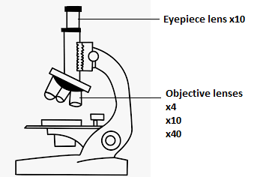
The microscope used to produce the images in this activity is a standard compound microscope, as shown below and works in the same way as the one you used in class.

Slide 2
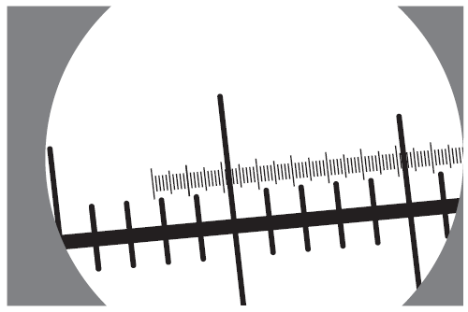
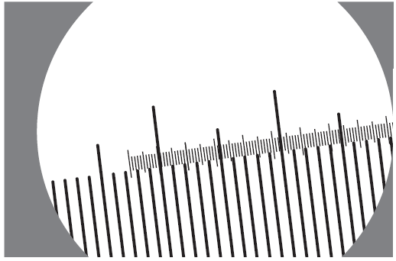
An eyepiece graticule can be calibrated using a stage micrometer.
Figure 1.1 shows the field of view using the x10 objective lens and Figure 1.2 shows the field of view using a x4 objective lens.
Fig 1.1
Fig 1.2

Slide 3
Clearly show the eyepiece graticule calibration using a x4 objective lens. [3]
Clearly show the eyepiece graticule calibration using a x 10 objective lens. [3]

Slide 4
Three microscope slides labelled slide A, slide B and slide C were observed using the x4 objective lens. The microscope slides contain various images or words – as shown on the following PowerPoint slides
Using your calibration calculations from question 1, measure the size of the image using the eyepiece graticule scale at the top of the following PowerPoint slides – you can drag the scale to overlay the image for improved accuracy of measurement BUT DO NOT CHANGE THE IMAGE OR SCALE SIZE!!
You need to choose three images to measure. On your answer sheet you must:
State which slide was used
Draw the image you are measuring
Clearly show what part of the image you have measured
Include a magnification statement

Slide 5
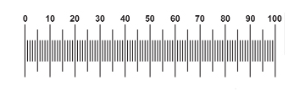
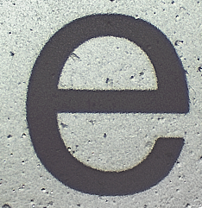
Slide A as viewed using a x 4 objective lens

Slide 6
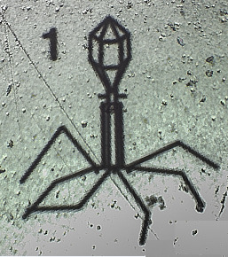
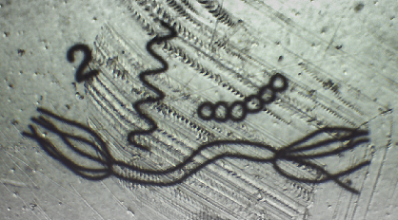
Slide B images as viewed using a x 4 objective lens

Slide 7
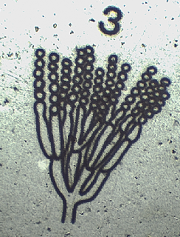
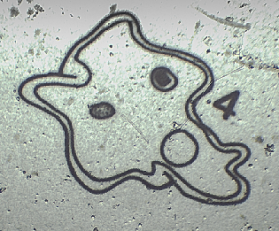
Slide B images as viewed using a x 4 objective lens

Slide 8
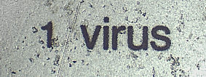
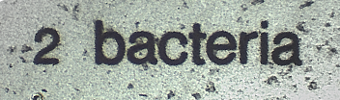


Slide C images as viewed using a x 4 objective lens

