Slide 1
Recap activities.
Test yourself under timed conditions on paper.
In 3 minutes draw and label a DNA molecule
0-7: Ok, 8-10: Good, 11-12: Excellent

Slide 2
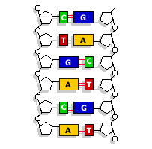
In 3 minutes draw and label a DNA molecule
Sugar phosphate backbone
DNA nucleotide
Phosphate group
Hydrogen bonds
Deoxyribose sugar
Phosphodiester bond
Anti-parallel chains
Polynucleotide chain
Cytosine
Guanine
Adenine
Thymine

Slide 3
In 5 minutes draw and label the process of transcription AND translation.
0-7: Ok, 8-11: Good 12-15: Excellent
0-7: Ok, 8-11: Good 12-14: Excellent

Slide 4
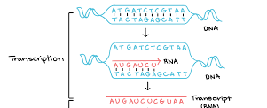
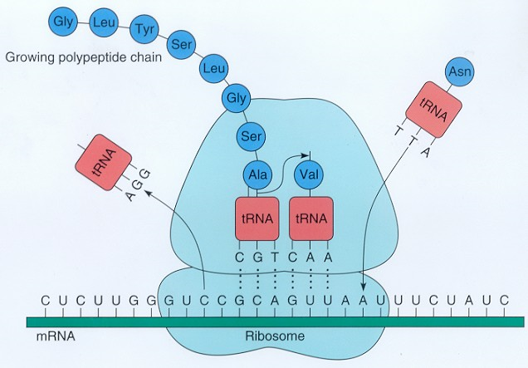
GENE unzipped
DNA Helicase
Breaks H bonds
RNA nucletides
Complementary base pair
A-U, C-G
Triplets into codons
RNA polymerase
Phosphodiester bond
mRNA
Leaves nucleus
To ribosomes
Pre-mRNA spliced to mRNA
Eukaryotes only
Intron removed
mRNA bind to ribosome
At start codon
Exposes codon
Three (codons exposed)
Complementary anticodon
On tRNA
Specific amino-acid attached ( to the tRNA)
Peptide bonds between amino-acids
Condensation reaction
tRNA is released
Attaches to new amimo-acid
Ribosomes moves along 1 codon
Till stop codon
Polypeptide chain formed

Slide 5
In 4 minutes draw and label the process of DNA semi-conservative replication
0-5: Ok, 6-7: good, 8-10: Excellent

Slide 6
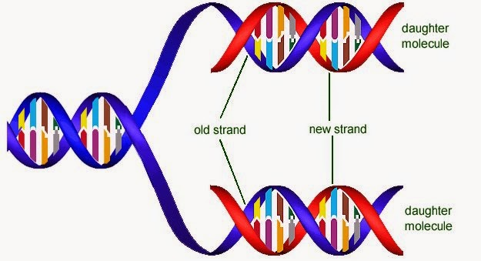
DNA molecule unzipped
DNA helicase
Exposes DNA
DNA nucleotides complementary base pair
Adenine-Thymine, Cytosine-Guanine
DNA polymerase
Phosphodiester bond between nucleotides
Hydrogen bonds
New DNA strand formed
DNA molecule has 1 new strand 1 old strand

Slide 7

Reflect and set yourself a target by answering the questions below?
Which diagram did you feel the most confident with?
Which diagram did you feel least confident with?
Which do you need to focus on?
What are you going to do about?
When will you do this?
How will you know you have achieved this target?

Slide 8
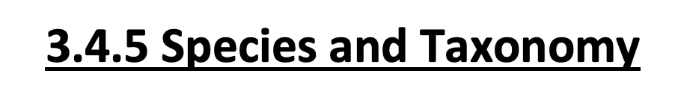
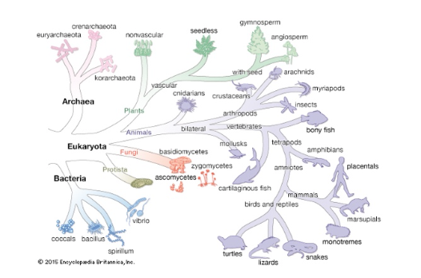
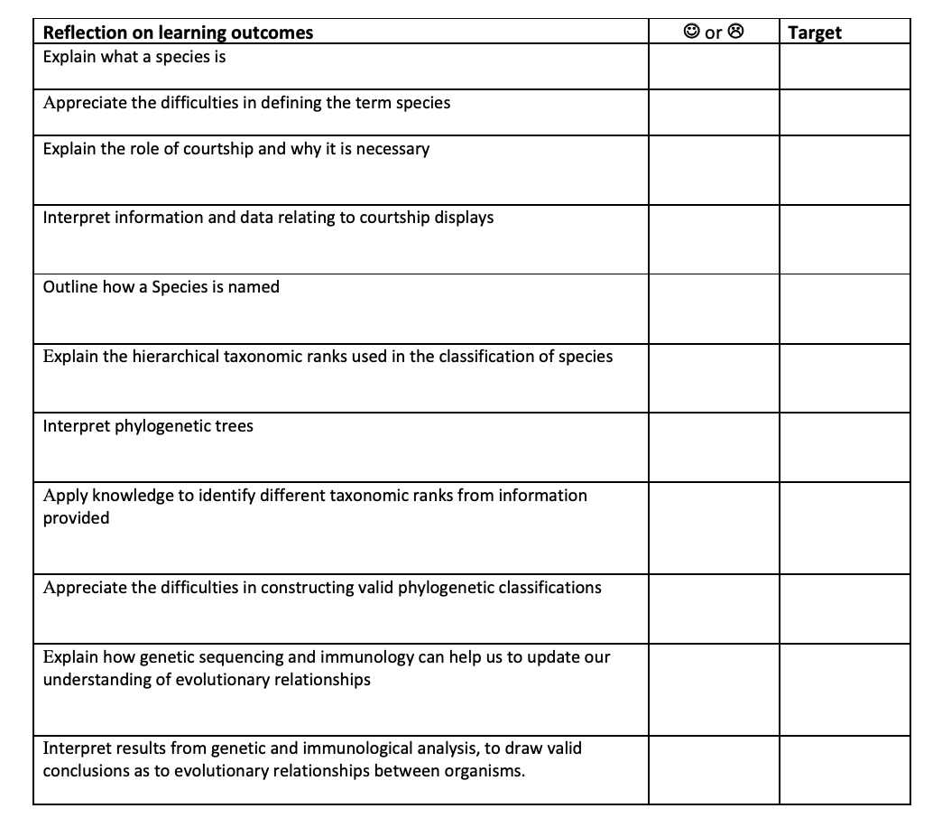
Go onto Connect and download the student booklet. Complete this on your computer as you go through the lessons.
Type your answers in a different colour so when you print the completed booklet you can clearly see your answers.

Slide 9


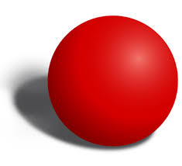
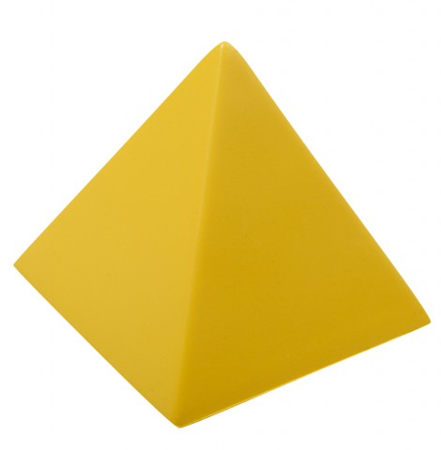
Starter – Come up with your own system to sort these objects into groups

Slide 10
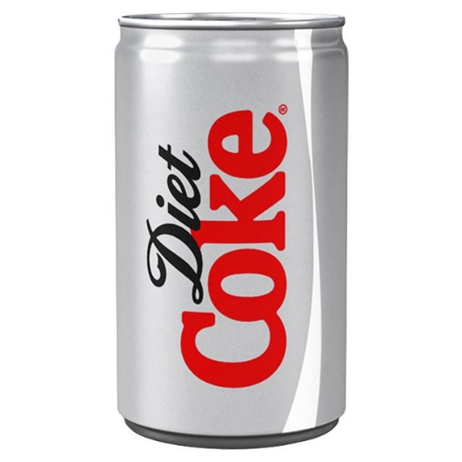
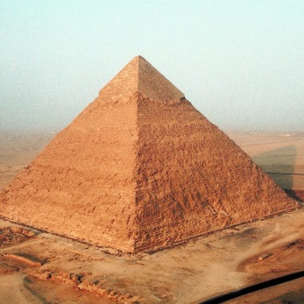
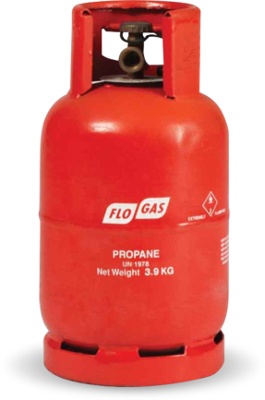
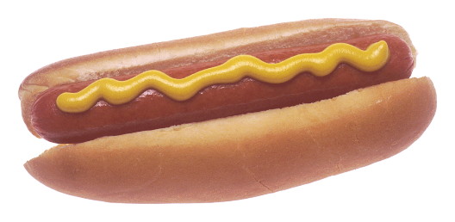

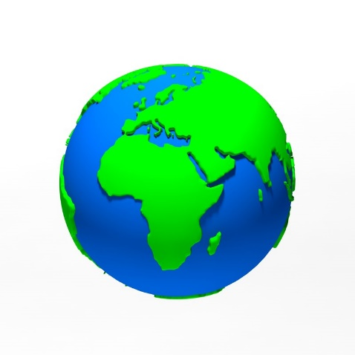
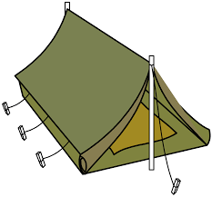


Test your system
Which category would you place these objects into ?

Slide 11
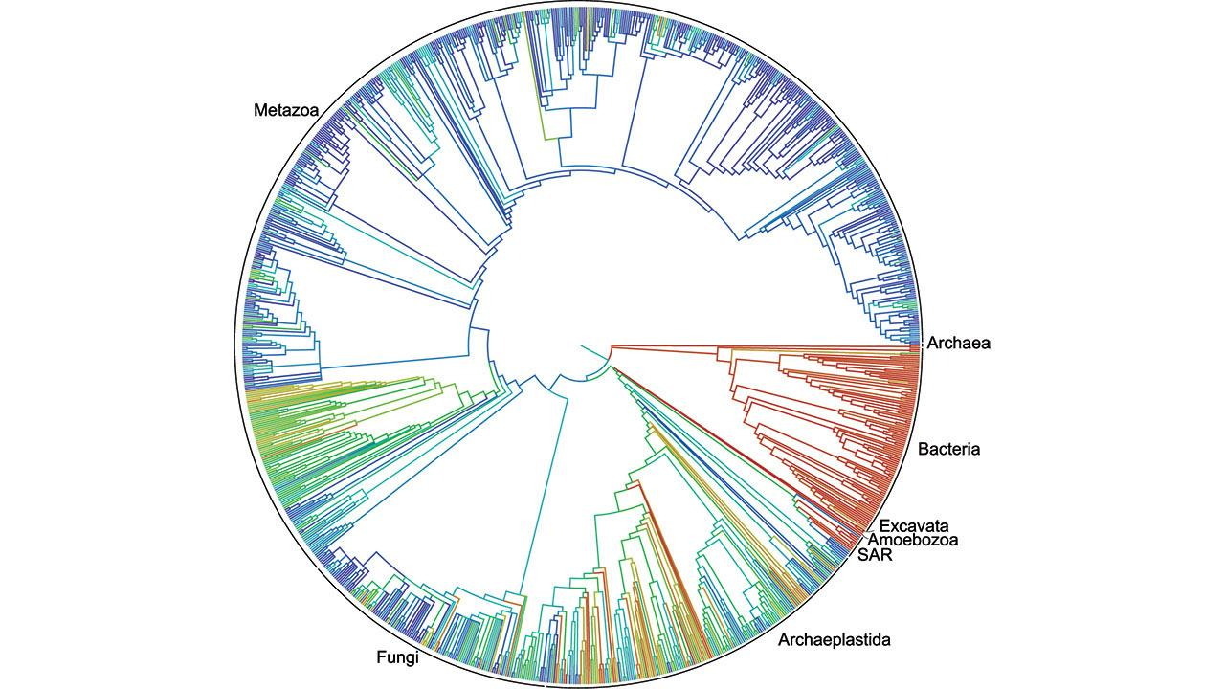
How good was your grouping system? Did the new objects fit into the system neatly?
This is the issue scientists have had with grouping organisms.

Slide 12
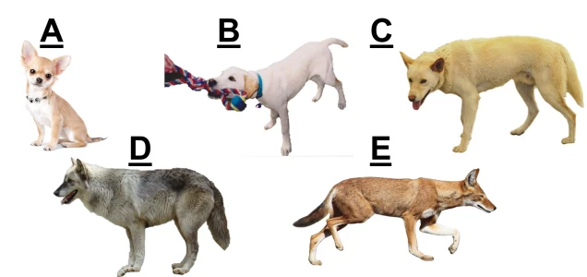
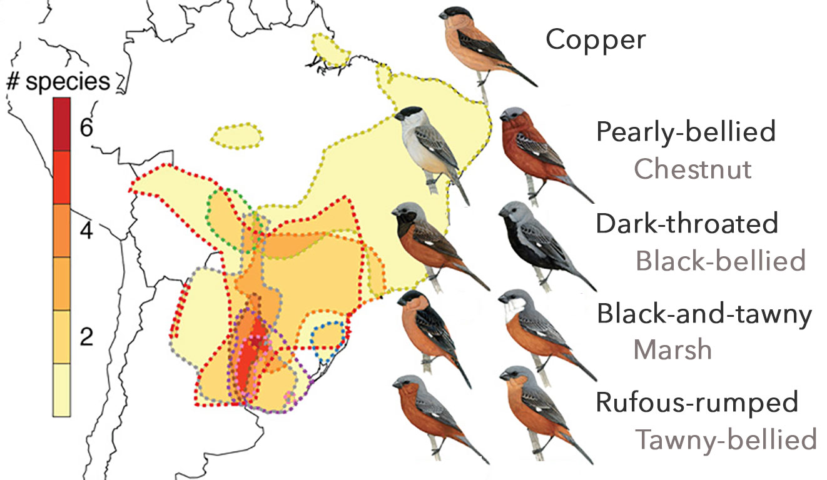
Watch the video link below to explain what a species is, and issues with the definition.
https://www.youtube.com/watch?v=L3dkJVExfdE

Slide 13
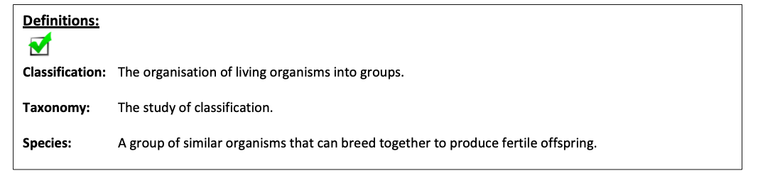
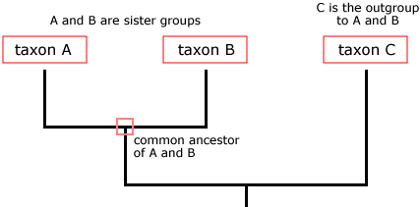
Theses are key definitions we will be using in this booklet.
Remember!
The green tick means this is mark scheme perfect so you will need to learn these.
AO1 skill.
Organisms are grouped into “Taxa” or “Taxon”
The study of these groups and how they are related is called taxonomy
Each “Taxa” contains different species.
Each Taxa becomes more and more specific till the combination of features can only apply to 1 group of organisms.
This is a Species.
Classification is used to separate animals by their physical or biochemical features into groups (taxa)

Slide 14
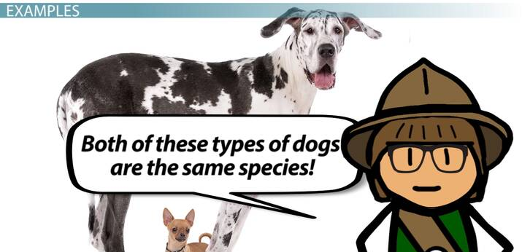
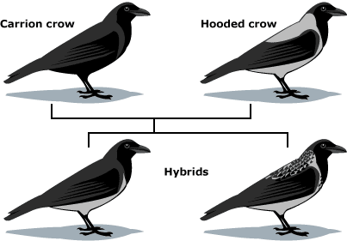

Slide 15
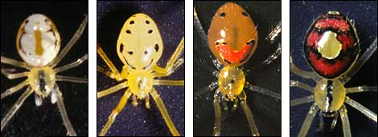
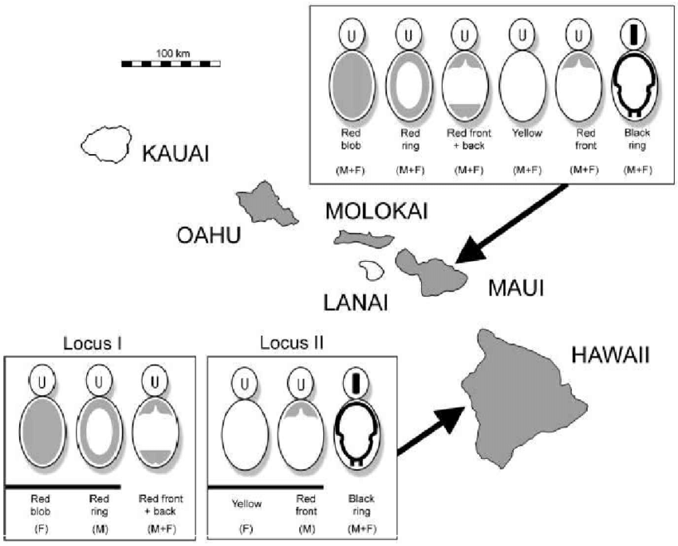
Species
These “Happy face spiders” look different, but since they can interbreed, they are considered the same species: Theridion grallator.
Scenario: An organism is discovered by Taxonomists in Asia. They suspect from observing the characteristics of the organism that it is an example of a Species already classified in Europe. To be certain they would need to mate this individual with the European Species to determine if they are capable of producing fertile offspring. This may cause reclassification of the spiders

Slide 16
Apply this knowledge to the exam questions.
The Question is worth 5 marks. Can you complete the exam question in 8 minutes?
Once you have completed the question, check your answers using the markscheme.
Remember
Highlight which part of your answer is also on the markscheme. Allow you to see which part of your answer are relevant.
If it isn’t on the mark scheme it is not right, if it isn’t written as the markscheme it is not right.
In a different coloured pen add corrections to the question.
Anything you don’t understand make a note of for when you speak to your teacher.

Slide 17
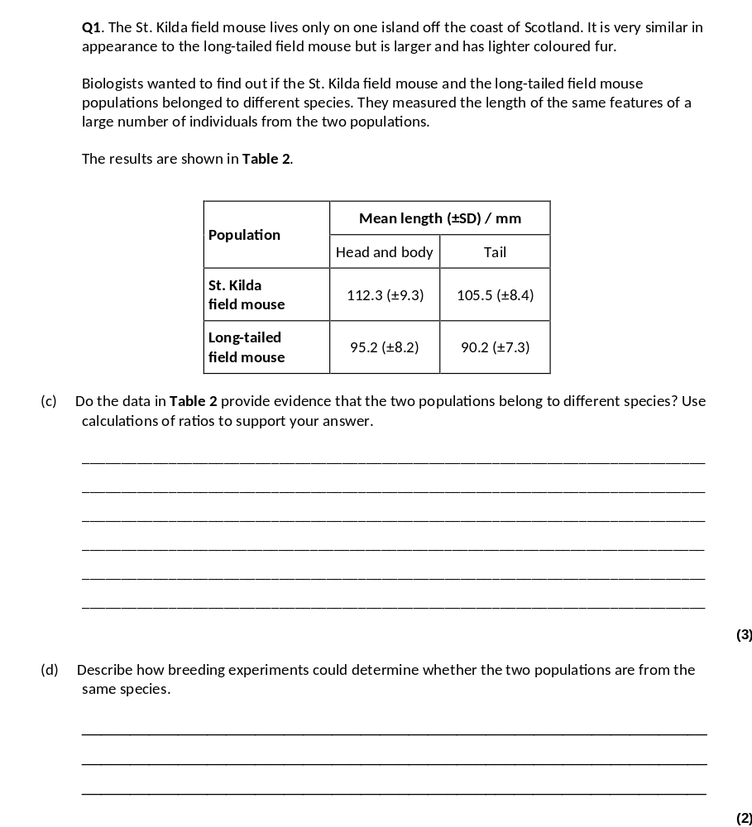
(c) 1. (No) SDs of means of body sizes / sizes of parts of bodies overlap;
2. Calculation of correct head and body: tail ratios;
3. Almost identical, so same body shape / proportions;
3
(d) 1. Breed the two mice together;
2. (Same species) produce fertile offspring.
2

Slide 18

Watch the video to understand the importance of courtship behaviours.
Courtship: 2 minutes
This is what you need to know for your exam. You DO NOT need to know any specific examples, the example will be given in your exam.
Here are some beautiful examples of courtship behaviours
Birds of paradise: 3 minutes
https://www.youtube.com/watch?v=nWfyw51DQfU
Hooded Seal: 2 minutes
https://www.youtube.com/watch?v=Cp13MneGIt8
Peacock spider: 3 minutes
https://www.youtube.com/watch?v=v3HlwwJG85c
https://www.youtube.com/watch?v=80lMLgzCzo0

Slide 19

Courtship behaviour
Members of the same species have the same genes and will share many of the same alleles of these genes, therefore they resemble one another physically and biochemically.
This helps them to distinguish members of their own species from those of other species. The same is true of behaviour.
The behaviour of members of the same species is more alike than that of members of different species.
Courtship ensures mating is successful and the offspring have the maximum chance of survival.
Courtship behaviour helps to achieve this by enabling individuals to:
1. Recognise members of their own species
2. Recognise opposite gender
3. Identify a mate capable of breeding – both partners need to be sexually mature, fertile and receptive to mating.
4. Form a pair bond
5. Synchronise mating (similar to number 3)
6. Stimulates release of gametes.
There is usually a chain of actions that is the same for all members of that species, acting as a stimulus so they can recognise they are of the same species and may be prepared to mate.

Slide 20
Apply this knowledge to the exam questions.
The Question is worth 14 marks. Can you complete the exam question in 18 minutes?
Once you have completed the question, check your answers using the markscheme.
Remember
Highlight which part of your answer is also on the markscheme. Allow you to see which part of your answer are relevant.
If it isn’t on the mark scheme it is not right, if it isn’t written as the markscheme it is not right.
In a different coloured pen add corrections to the question.
Anything you don’t understand make a note of for when you speak to your teacher.

Slide 21
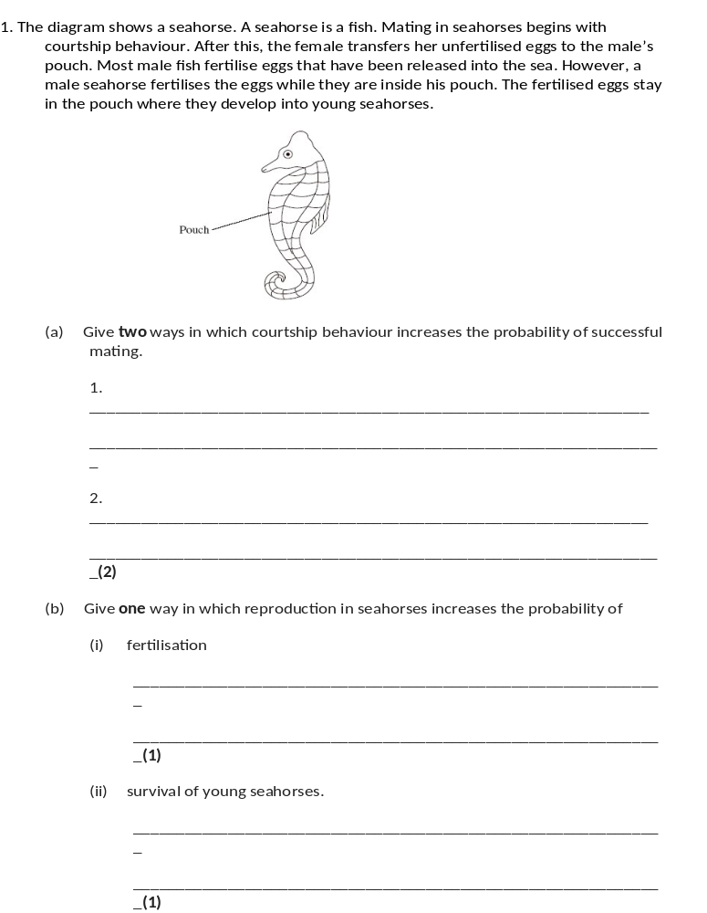
(a) Recognition of same species;
Stimulates release of gametes;
Recognition of mate / opposite gender;
Indication of sexual maturity / fertility;
2 max
(b) (i) Internal fertilisation / fertilisation occurs in pouch / limited area;
Q The term fertilisation is not required in the answer but must be implied.
1
(ii) Protection from predators (developing in pouch);
1

Slide 22
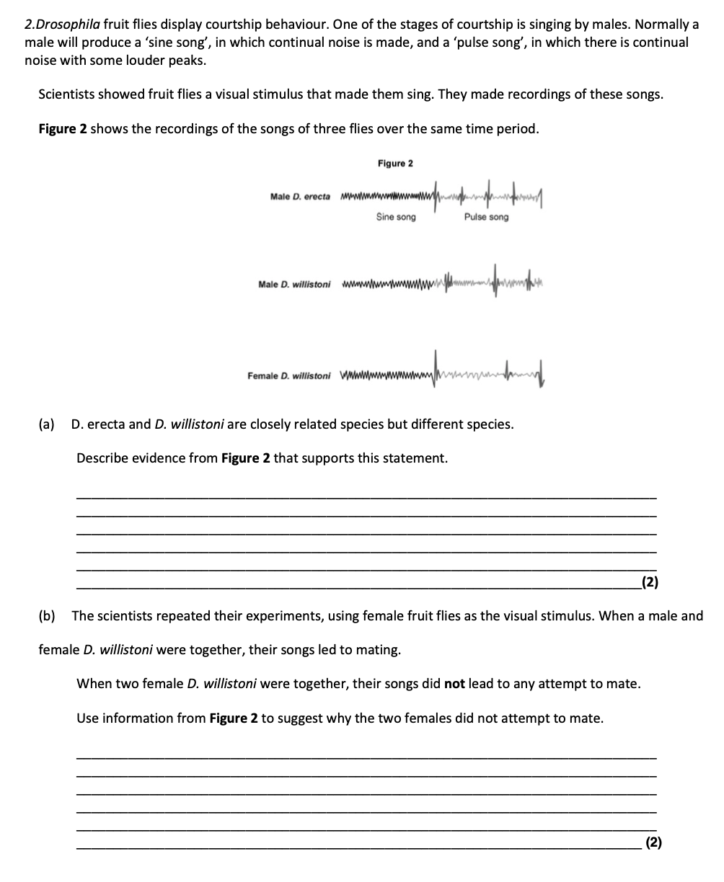

Slide 23
Are these all the same? Can you see any differences?

Slide 24
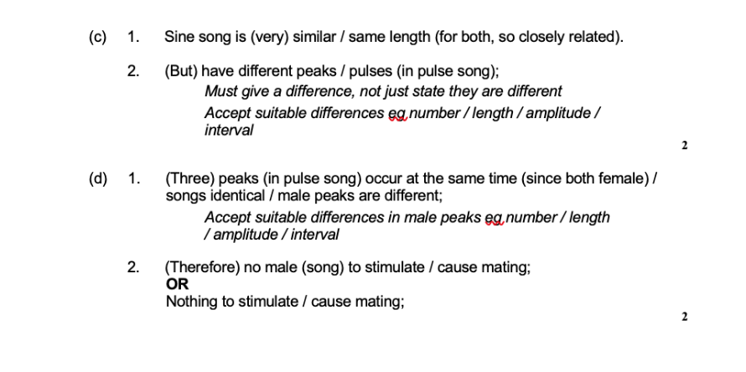

Slide 25
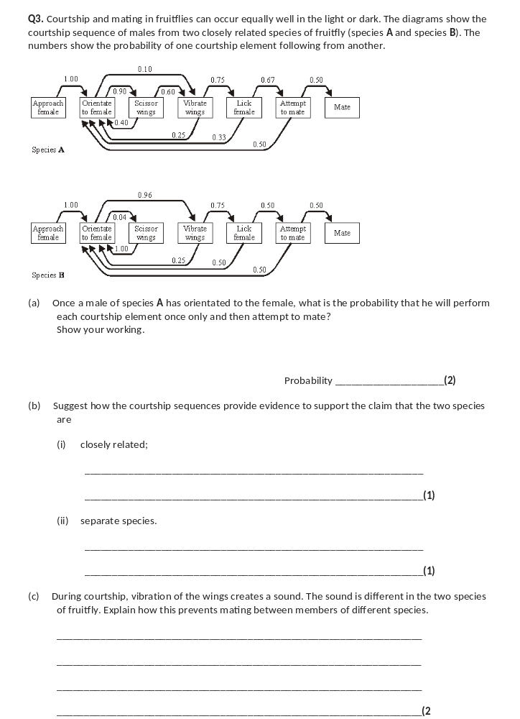
(a) principle of sequential multiplication (0.9×0.6×0.75×0.67);
0.27;
(correct answer 2 marks)
2
(b) (i) similar sequence / actions / sign stimuli;
1
(ii) additional action in sequence(species A) / scissor wings blocks
sequence in B;
1
(c) (acts as) sign stimulus;
responds only to species-specific sound;
2

Slide 26
We will look more closely at how we carry out taxonomy but first we are going to look at how we identify species by their scientific name.
Before you click on the link download the PDF document which can be found in the “Lesson 1” folder in the “on-line learning” tab, complete the document while watching the video. Then continue in your booklet.
Classification video: 8 minutes
https://www.youtube.com/watch?v=DVouQRAKxYo
If you cannot open the document because you can’t open PDF then make your own notes from the video.
This video has more detail than you need. Remember, you only need to learn what is in the booklet.

Slide 27
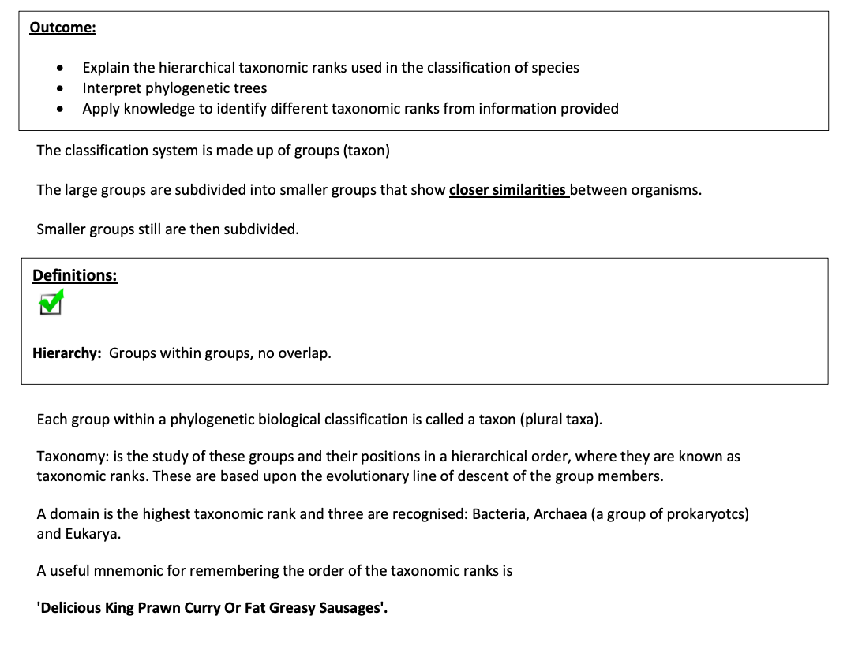

Slide 28
At one time scientists often gave new organisms a name that described their features, for example blackbird. rainbow trout. This practice resulted in the same names being used in different parts of the world for very different species. Therefore, it was difficult for scientists to be sure they were referring to the same organism. Over 200 years ago the Swedish botanist Linnaeus overcame this problem by devising a common system of naming organisms. This system is still in use today. Organisms are identified by two names and hence the system is called
the binomial system.
Two names come from the genus and the species names e.g. Homo sapiens
  Homo = genus name (always has a capital letter)
  sapiens = species name
Can be abbreviated to H. sapiens
The binomial name is always printed in Italics or underlined if handwritten

Slide 29
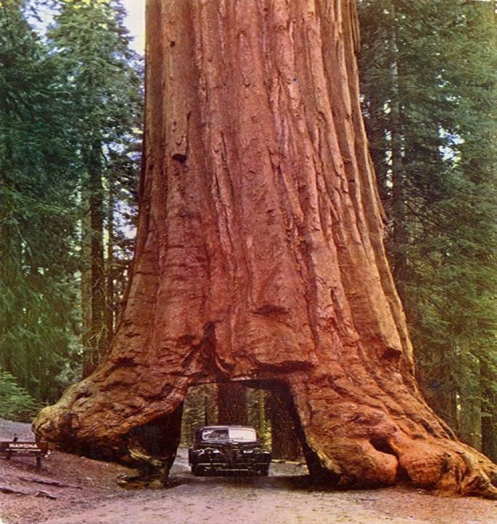
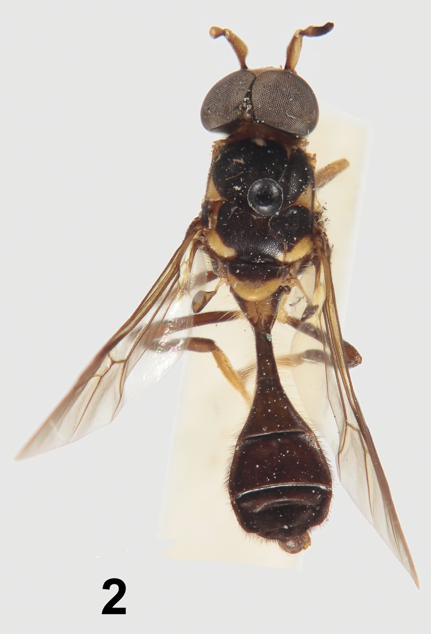
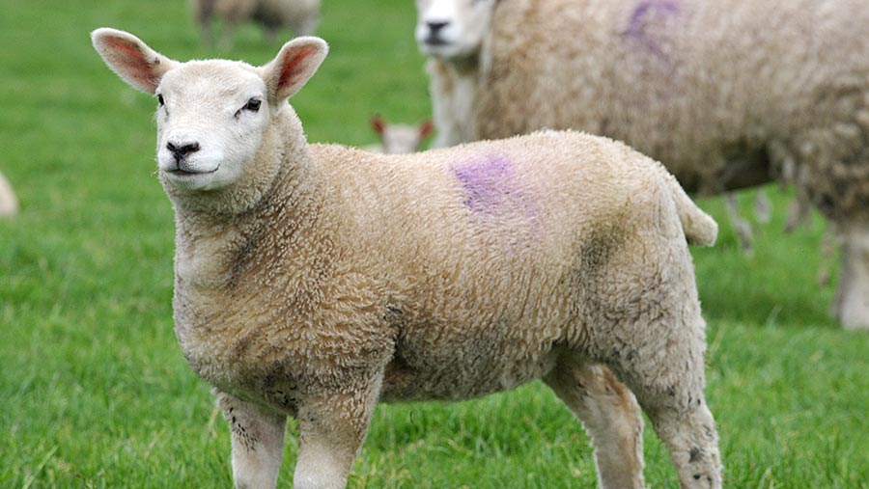
Can you write out the scientific name for the following organisms:
Sheep _________________________________
Blue whale _________________________________
Giant Redwood _________________________________
Malaysian spongy fungi _________________________________
Near solider wasp fly _________________________________
Viti Levu snail _________________________________
Humans _________________________________

Slide 30
Can you write out the scientific name for the following organisms:
Sheep _________________________________
Blue whale _________________________________
Giant Redwood _________________________________
Malaysian spongy fungi _________________________________
Near solider wasp fly _________________________________
Viti Levu snail _________________________________
Humans _________________________________
Remember.
Name should be in italics or underlined if hand written.
Ovis Aries
Balaenoptera musculus
Sequoiadendron giganteum
Spongiforma squarepantsii
Parastratiosphecomyia stratiosphecomyioides
Ba humbug
Homo Spaiens

Slide 31
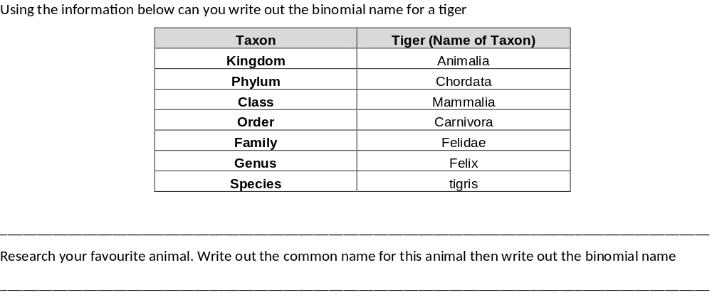
Felix tigris OR Felix tigris (Genus must have Capital letter, can be italic or underlined)

Slide 32
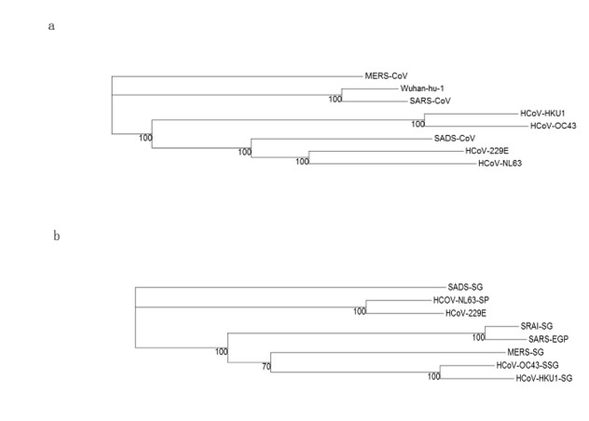
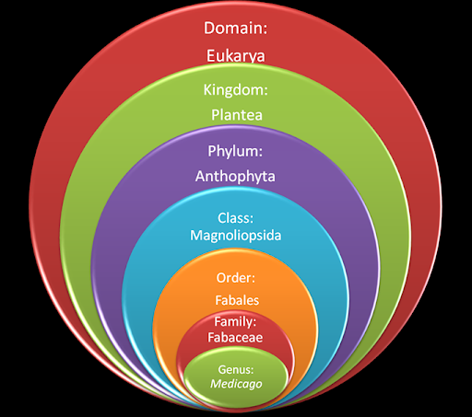
Outcome:
Explain the hierarchical taxonomic ranks used in the classification of species
Interpret phylogenetic trees
Apply knowledge to identify different taxonomic ranks from information provided

Slide 33
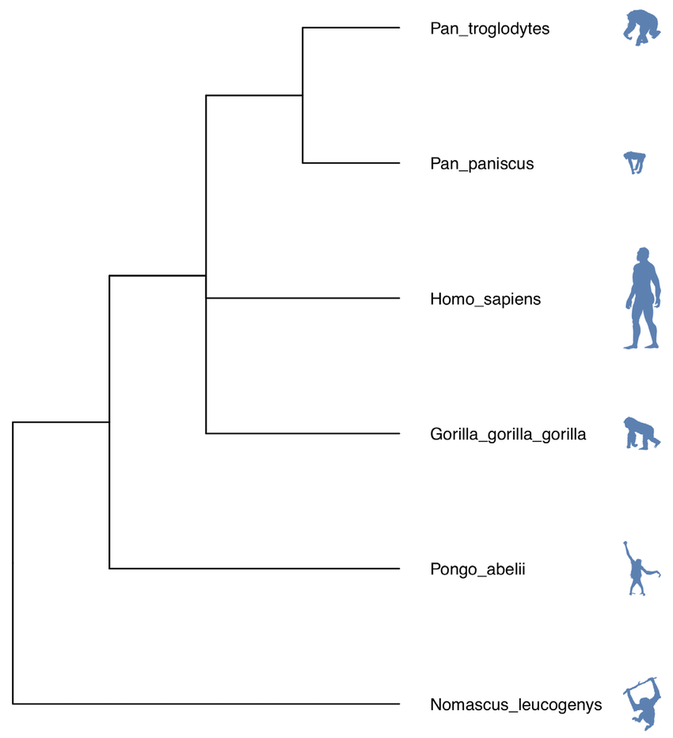
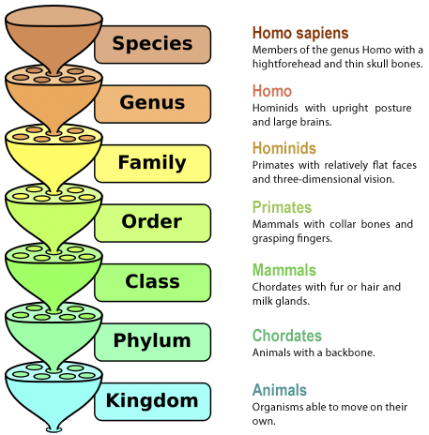
Taxonomy
The phylogenetic classification system is made up of groups (taxon) in a hierarchy
The large groups (taxon) are subdivided into smaller groups (taxon) that show closer similarities between organisms.
Smaller groups still are then subdivided further based on sharing the most similar features.

Slide 34
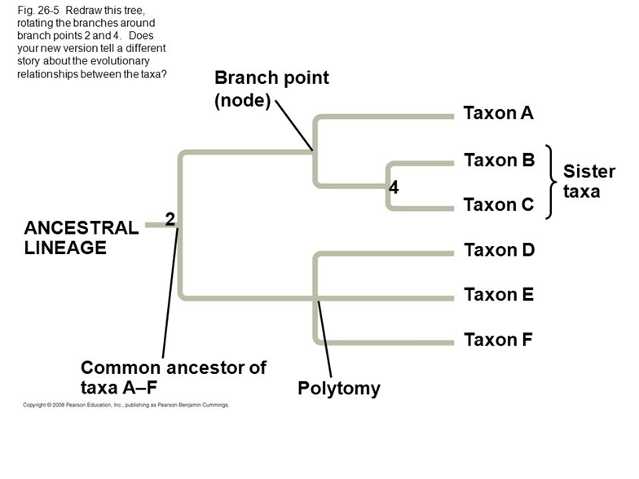
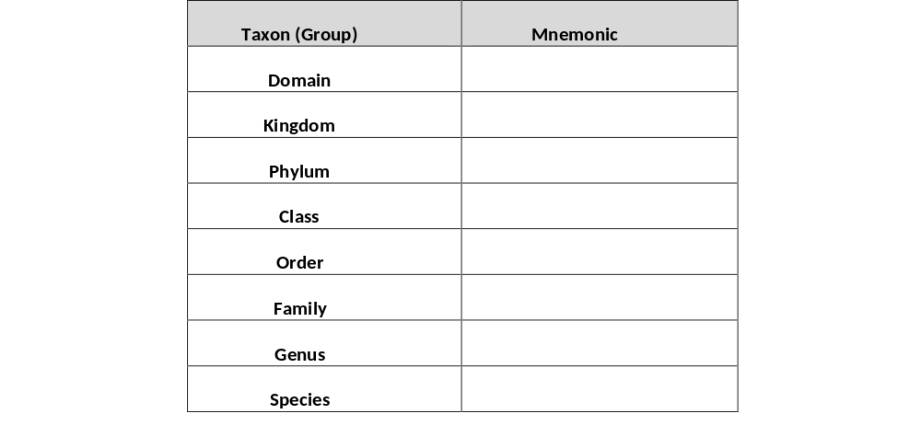
Taxonomy is the study of these groups and their positions in a hierarchical order, where they are known as taxonomic ranks. These are based upon the evolutionary line of descent of the group members – link to Natural selection booklet.
A domain is the highest taxonomic rank and three are recognised: Bacteria, Archaea (a group of prokaryotes) and Eukarya.
A useful mnemonic for remembering the order of the taxonomic ranks is
'Delicious King Prawn Curry Or Fat Greasy Sausages'.

Slide 35
Apply this knowledge to the exam questions.
The Question is worth 6 marks. Can you complete the exam question in 8 minutes?
Once you have completed the question, check your answers using the markscheme.
Remember
Highlight which part of your answer is also on the markscheme. Allow you to see which part of your answer are relevant.
If it isn’t on the mark scheme it is not right, if it isn’t written as the markscheme it is not right.
In a different coloured pen add corrections to the question.
Anything you don’t understand make a note of for when you speak to your teacher.

Slide 36
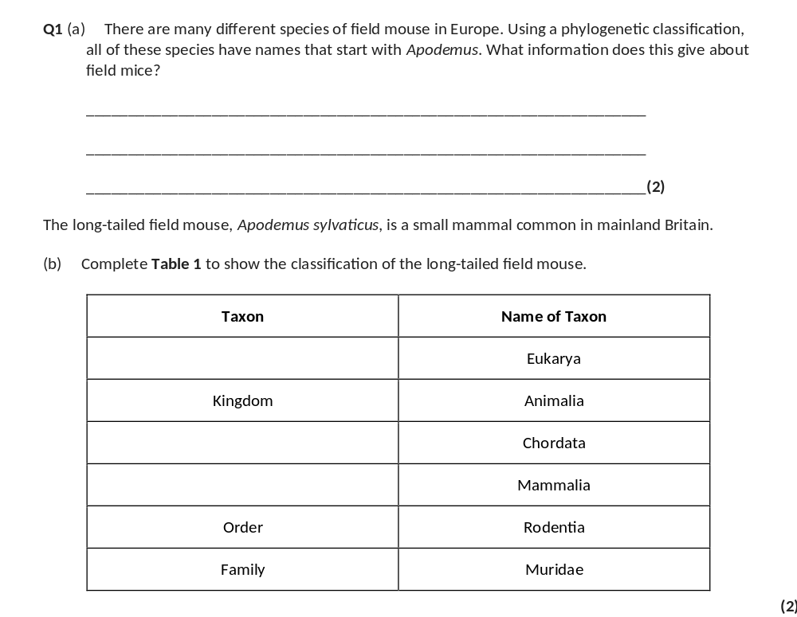
(a) 1. Same genus;
2. Same evolutionary origin / common ancestor.
2
Domain
Phylum
Class

Slide 37
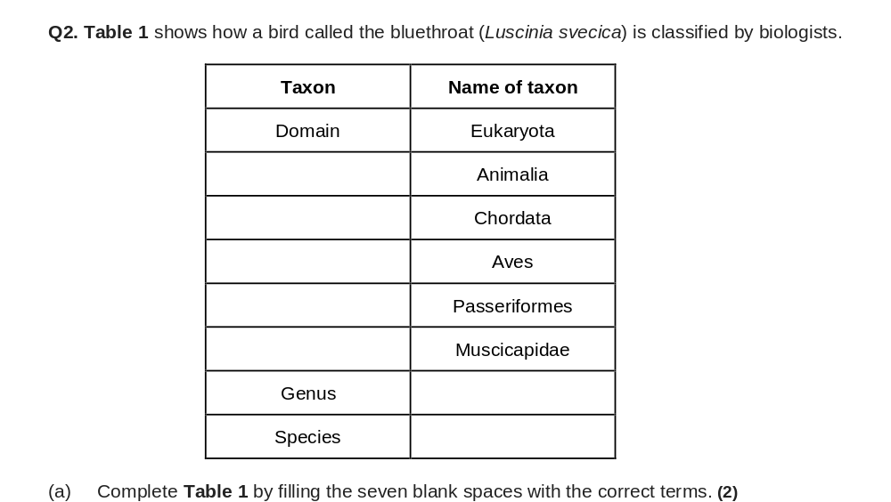
Kingdom
Phylum
Class
Order
Family
Luscinia
svecica

Slide 38
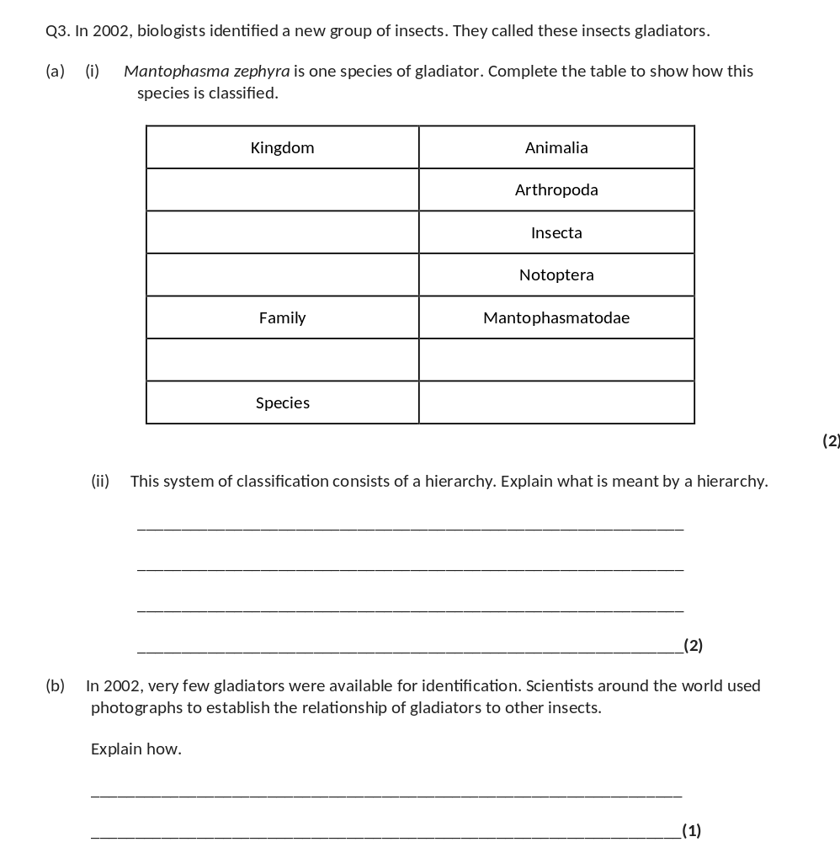
Phylum
Class
Order
Genus
Mantophasma (M) / (Mantophasma)
zephyra;
(ii) Groups within (larger) groups;
No overlap;
2
(b) Comparison of / look for similar features / structures / appearance;
1

Slide 39
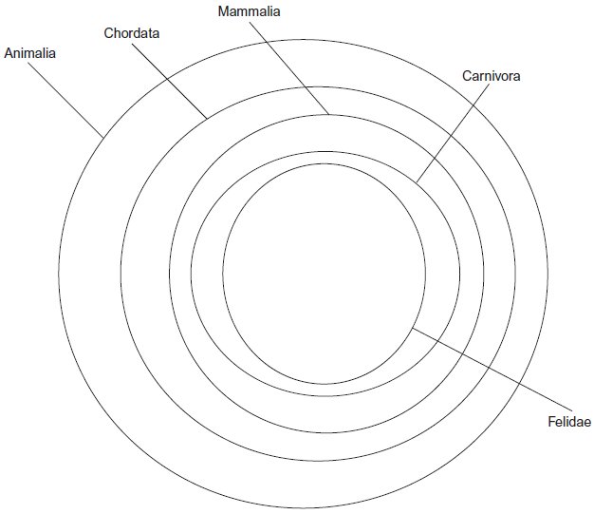
Sometimes the taxa can be presented in different ways, for examples as circles.
Annotate the diagram in your booklet
Circles get smaller so include less different species
Class
Phylum
Kingdom
Order
Biggest, outer circle so encompasses most different species
Hierarchy as none of the circles overlap
Stretch yourself. Can you complete this diagram for the Equidae Family using the taxonomy tree on page 13. You do not need to do a specific species, just a family. Make sure to label your diagram
Family

Slide 40
Phylum: Chordata
Kingdom: Animalia
Class: Mammalia
Order: Perissodactyl
Family: Equidae

Slide 41
Apply this knowledge to the exam questions.
The Question is worth 3 marks. Can you complete the exam question in 5 minutes?
Once you have completed the question, check your answers using the markscheme.
Remember
Highlight which part of your answer is also on the markscheme. Allow you to see which part of your answer are relevant.
If it isn’t on the mark scheme it is not right, if it isn’t written as the markscheme it is not right.
In a different coloured pen add corrections to the question.
Anything you don’t understand make a note of for when you speak to your teacher.

Slide 42
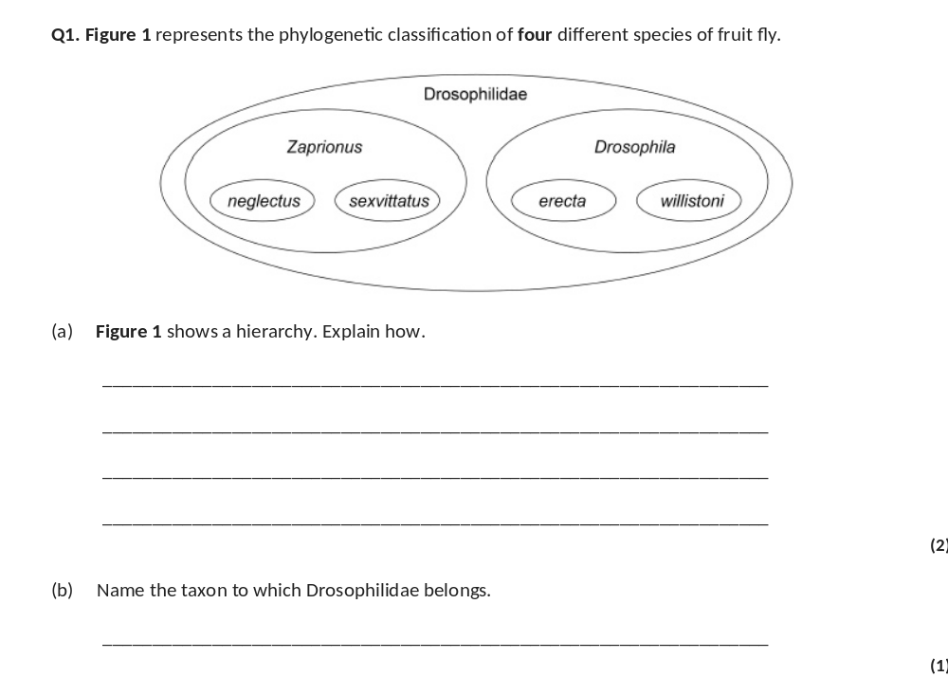
(a) 1. (It shows) smaller groups within larger groups / larger groups containing smaller groups;
Accept groups within groups
2. With no overlap (between groups);
2
(b) Family;
Accept phonetic spellings
1

Slide 43
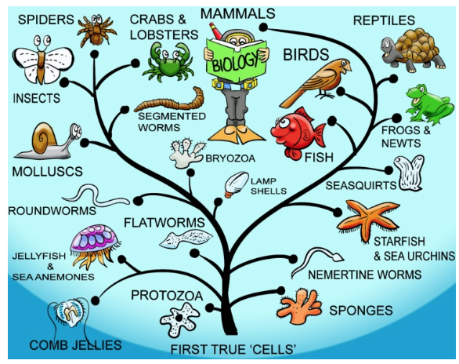
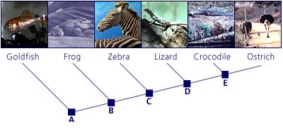
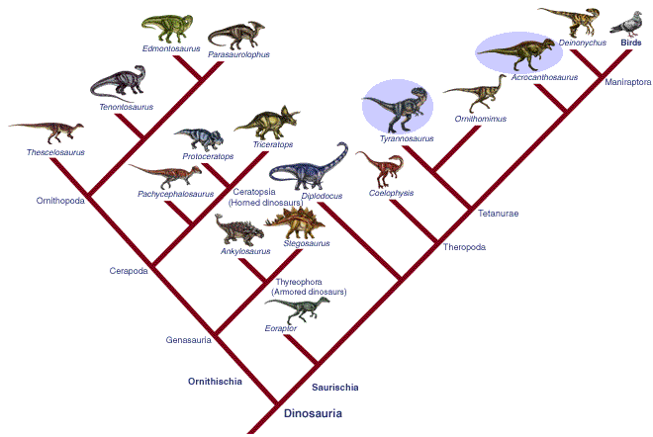
Outcome:
Interpret phylogenetic trees

Slide 44
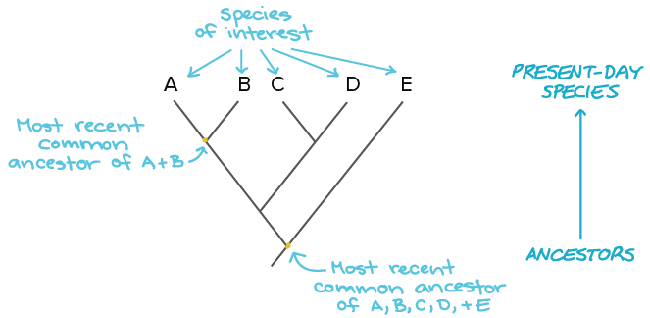
Phylogenetic Classification
Based on evolutionary relationships between organisms and their ancestors
Classifies organisms into groups using shared features derived from shared ancestors
Arranges the groups into a hierarchy.
Evolutionary trees can be created.
An evolutionary tree is used to see how closely species are related, or if
Any 2 species living today have had a common ancestor at some time in the past.
The more closely 2 species are related, the closer they appear together on the evolutionary tree.

Slide 45
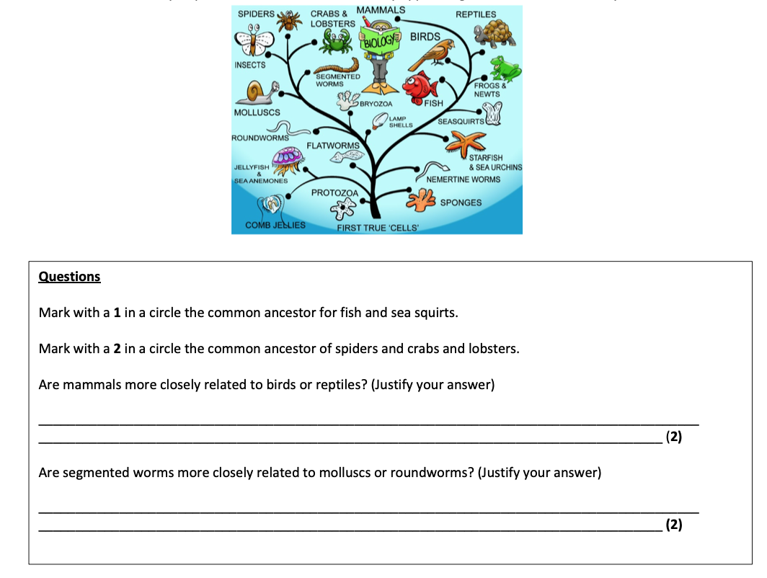

Slide 46

You do not need to know/name the ancestor as this organism will probably not exist anymore.
Just point to where the organism should be on the phylogenetic tree
This is where the 3 organisms branch AWAY from each other so this is the last common ancestor
This is where the 2 organisms branch AWAY from each other so this is the last common ancestor
2
1

Slide 47

Complete this activity on paper as a practice for phylogenetic trees.
You DO NOT need to learn this, you will be given an example to apply your knowledge to in the exam.
This is to practice the method.

Slide 48

Check your answers.

Slide 49
Apply this knowledge to the exam questions.
The Question is worth 11 marks. Can you complete the exam question in 15 minutes?
Once you have completed the question, check your answers using the markscheme.
Remember
Highlight which part of your answer is also on the markscheme. Allow you to see which part of your answer are relevant.
If it isn’t on the mark scheme it is not right, if it isn’t written as the markscheme it is not right.
In a different coloured pen add corrections to the question.
Anything you don’t understand make a note of for when you speak to your teacher.

Slide 50

(a) (i) 1. Groups within groups;
Accept: idea of larger groups at the top or smaller groups at the bottom
2. No overlap (between groups);
2
(ii) 3;
1
1
(iii) Chordata;
Accept: if phonetically correct eg ‘Cordata’
1
(b) (i) 1. (To provide) genetic variation;
Genetic variation must be directly stated and not implied
2. (Allows) different combinations of maternal and paternal chromosomes / alleles;
(ii) 1. (Zedonk has) 47 / odd / uneven number of chromosomes;
Accept: diploid number would be odd
Reject: if wrong number of chromosomes is given
2. Chromosomes cannot pair / are not homologous / chromosome number cannot be halved / meiosis cannot occur / sex cells / haploid cells are not produced;
Accept: cannot have half a chromosome
Q Reject: meiosis cannot occur in sex cells
2

Slide 51



Slide 52

(c) Genus / genera;
If the response has two answers no mark is awarded.
1

Slide 53
Outcome:
Explain how genetic sequencing and immunology can help us to update our understanding of evolutionary relationships
Interpret results from genetic and immunological analysis, to draw valid conclusions as to evolutionary relationships between organisms.

Slide 54
How can we determine the Evolutionary relationships of Species?
1. Comparing the frequency of observable characteristics.
2. Comparing the base sequence of DNA - the more similar the DNA sequence, the more closely related the 2 species are, the more difference in the DNA sequence the less closely related the 2 species are.
Species accumulate mutations over time, so the less closely related they are, the more mutations they will have and therefore the more different the sequences of bases.
3. Comparing the base sequence of mRNA.
4. Amino acid sequences of certain proteins can be compared between different species- the more similar the amino-acid sequence, the more closely related the 2 species are, the more difference in the amino-acid sequence the less closely related the 2 species are.

Slide 55

What can you work your from this DNA sequence?

Slide 56

The more aligned the sequence the more closely related the species.

Slide 57

Complete the practice activities in your booklet

Slide 58


Slide 59


Slide 60


Slide 61
TTT CTT AAC GCT TGT
PHE LEU ASN ALA CYS
TTA CGC
UUC CUU UGU
PHE LEU ASN ALA CYS
Looked at Amino-acid sequence, it is the same in both species. No, don’t agree as the DNA sequence has changed so there are differences
AAG TAA ACA
CUU GCG
PHE LEU ILE ALA CYS
DNA sequence between 2 and 3 is more similar/less differences so more closely related
DNA of species 1 has more differences so less closely related.

Slide 62

(b) Number of different alleles of each gene.
Accept number of different base sequences (found) in each gene
1
(c) 1. Has greater proportion of genes / percentage of genes showing diversity;
2. Percentage is 35% compared with 28% / proportion is 0.35 compared with 0.28.
Allow correct figures that are not rounded up, i.e., 34.9% / 0.349 and 27.8% / 0.278
2

