Slide 1
Learning homework Starter
Describe the structure of proteins (5 marks).
1. Polymer of amino acids;
2. Joined by peptide bonds;
3. Formed by condensation;
4. Primary structure is order of amino acids;
5. Secondary structure is folding of polypeptide chain due to hydrogen bonding;
Accept alpha helix / pleated sheet
6. Tertiary structure is 3-D folding due to hydrogen bonding and ionic / disulfide bonds;
7. Quaternary structure is two or more polypeptide chains.

Slide 2
3.1 Molecules - 3.1.4.2 Enzymes

Slide 3

What can you remember about enzymes from GCSE?

Slide 4
What Are Enzymes And How Do They Work?
Definition:
Enzymes are globular proteins with a specific tertiary structure which act as biological catalysts and increase the rate of reaction by lowering the activation energy.

Slide 5
Metabolism
Almost all reactions in living organisms (metabolism) are catalysed by enzymes
  Anabolic reactions
  Build up complex molecules from simple ones e.g. making a disaccharide
  Catabolic reactions
  Break down complex molecules into smaller ones e.g. breaking down a disaccharide

Slide 6
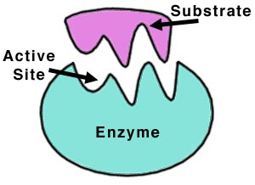
Enzymes are:
Catalysts speed up chemical reactions but remain unchanged at the end and can be reused.
Globular proteins made of amino acids
Coiled into a precise 3D shape determined by tertiary structure
Are soluble in water because they have hydrophilic R groups on the outside and hydrophobic R groups on the inside

Slide 7
Enzyme Structure
Enzymes have an active site. formed by tertiary structure
The active site is a depression on the surface of an enzyme to which a specific substrate binds.
The shape of the active site is COMPLEMENTARY to the shape of the substrate

Slide 8
How Enzymes Work
Label your diagram using the labels on this slide.
Enzyme substrate complex
Products
Active Site
Enzyme
Enzyme
Active site changes shape
Substrate
Enzyme product complex

Slide 9
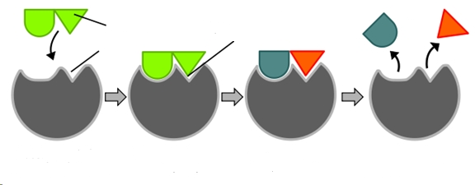
How Enzymes Work
Enzyme
Enzyme substrate complex
Enzyme product complex
Enzyme
Products
substrate
Active site changes shape
active site

Slide 10
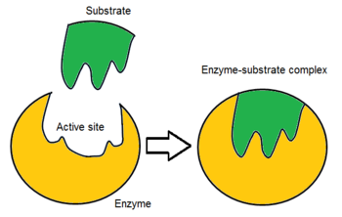
The substrate fits into the active site
An enzyme-substrate complex is formed.
Looking at the diagram, what has changed once the substrate has bound to the active site? Think shape!

Slide 11
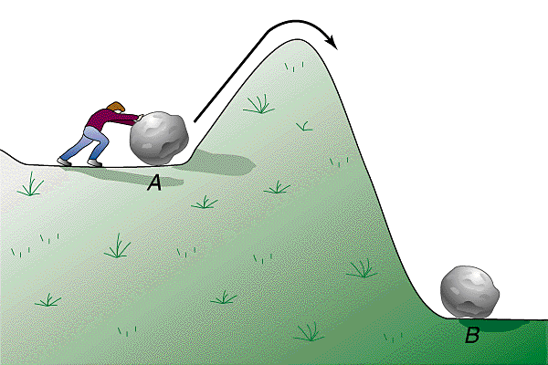
Activation Energy
The minimum amount of energy needed to start a reaction. Enzymes lower the activation energy. This speeds up the rate of reaction.

Slide 12
Activation Energy
Enzymes lower the activation energy required to start a reaction. This speeds up the rate of reaction.
Enzymes do this by bending the bonds between molecules this means that less energy is required for the bonds to be broken when the reaction occurs.
Complete the graph on page 3 of your booklet as we go through the slides

Slide 13
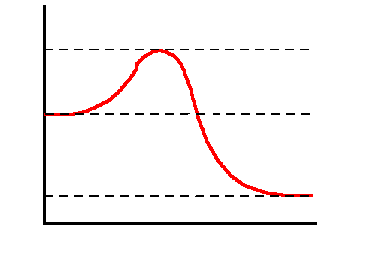
Activation Energy
Energy
Substrate
Products
Progress of reaction

Slide 14
Activation Energy
without enzyme
Activation Energy
Energy
Substrate
with enzyme
Products
Progress of reaction

Slide 15
Activation Energy
without enzyme
Activation Energy
Energy
Substrate
with enzyme
Products
Progress of reaction

Slide 16
Activation Energy
without enzyme
Activation Energy
Energy
Substrate
with enzyme
Products
Progress of reaction

Slide 17
Exam Question
a) Formation of an enzyme-substrate complex increases the rate of reaction. Explain how. (2)
(a) 1. Reduces activation energy;
Accept ‘reduces E_{a}’.
2. Due to bending bonds
OR
Without enzyme, very few substrates have sufficient energy for reaction;
Accept ‘Due to stress/pressure/tension on bonds’ OR ‘Due to weakening bonds’.
Ignore references to ‘breaking bonds’.

Slide 18
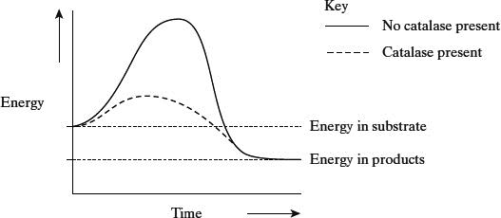
Q2. The graph shows the energy changes which take place during the reaction in which hydrogen peroxide is converted to water and oxygen.
Use the graph to explain why
(i) hydrogen peroxide breaks down at a lower temperature when catalase is present than when it is not present;
______________________________________________________________
______________________________________________________________
(1)
(ii) test tubes A and B became warmer when the reaction was taking place.
______________________________________________________________
______________________________________________________________
______________________________________________________________
______________________________________________________________
(c) (i) Lower activation energy / less energy required to bring about reaction;
(ii) Energy in products / water and oxygen less than energy in substrate / reactants / hydrogen peroxide;
(Difference) given out as heat / exothermic;

Slide 19
Models of Enzyme Action
There are two theories regarding how enzymes work.
1. Induced fit –The most commonly accepted theory
2. Lock and key- You may have heard of this one from GCSE

Slide 20

Lock and Key Hypothesis
This is an older model that states that active sites did not change shape, they are already fully complementary to the substrate.
The induced fit model is more widely accepted as it has been shown that their active sites do change shape.

Slide 21
Induced Fit Hypothesis
Before the reaction the active site is not complementary to/does not fit the substrate
The shape of active site changes as substrate binds forming a enzyme-substrate complex
The substrate forms temporary bonds with the R groups of amino acids lining the active site
This stresses/bends the bonds in substrate
Lowers the activation energy leading to the reaction
EXAM TIP: Always refer to the Active site and not the enzyme

Slide 22
Lock and Key Hypothesis
enzyme
enzyme
active site
Enzyme substrate complex
Enzyme product complex
substrate
product

Slide 23
Task:
1. In the boxes on page 5 Illustrate the two models of enzyme action then annotate your diagrams with comparisons and differences between the two theories
2. When You have finished complete the exam questions on pages 6 and 7

Slide 24
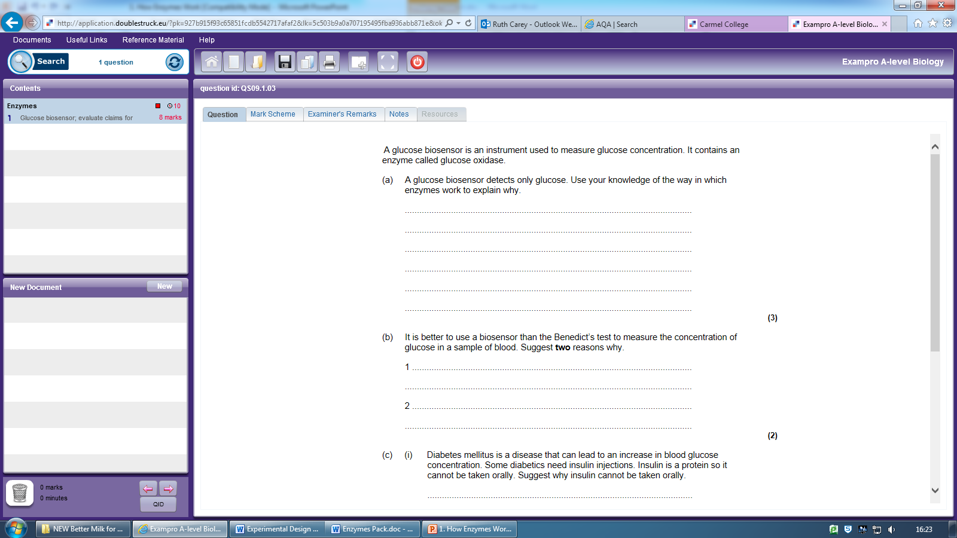
Stretch And Challenge

Slide 25
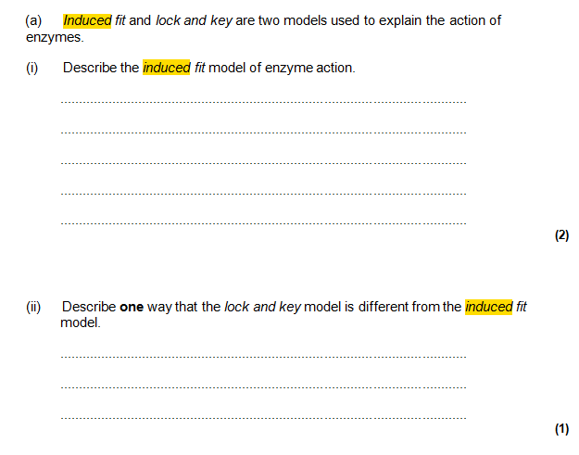
Exam Q
Active site not complementary
Active site changes shape
Allows substrate to fit/ESC to form
Active site does not change shape/is already complementary

Slide 26
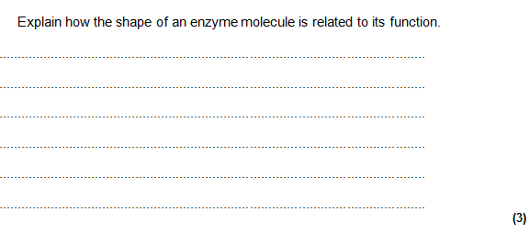
Exam Q
have a specific 3D shape/structure
substrate is complementary in shape
substrate can bind to active site/ Enzyme substrate complex can form.
(2)

Slide 27
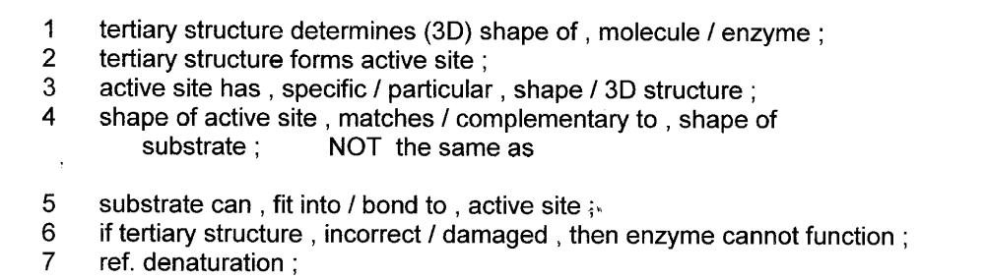
Explain the importance of tertiary structure to the functioning of an enzyme [4]

Slide 28
With reference to the functioning of an enzyme, explain what is meant by the term active site [4]
1 depression / cleft / groove /
2 on (surface of) enzyme ;
4 Active site has a specific shape ;
5 complementary to substrate ;
6 R groups bonds with substrate/ Forms enzyme substrate complex (ESC) ;
8 puts strain on substrate / bends bonds within substrate
9 detail of induced fit ; eg Active site changes shape to become complementary

Slide 29
Biological washing powders make use of enzymes such as lipases and proteases to help remove stains. Explain how biological washing powders help to remove protein stains from clothes [4]
Protease enzyme works on proteins
Details on induced fit, (Active site changing shape to become complementary)
Hydrolyses proteins into amino acids
Peptide bonds broken
Amino acids are soluble so stains removed.

Slide 30
Explain why an enzyme which catalyses the conversion of starch to maltose is unable to catalyse the conversion of a protein into amino acids [2]
active site specific shape ;
Complementary only to starch / starch causes induced fit ;
protein will not , enter active site / fit active site / form ESC ;

Slide 31
Q3. Maltose is hydrolysed by the enzyme maltase. Explain why maltase catalyses only this reaction.
___________________________________________________________________
___________________________________________________________________
___________________________________________________________________
__________________________________________________________________(3)
(c) 1. Active site (of enzyme) has (specific) shape / tertiary structure / active site complementary to substrate / maltose;
Reject active site on substrate.
Must have idea of shape
Assume “it” = maltase
Accept (specific) 3D active site
Reject has same shape
2. (Only) maltose can bind / fit;
Accept “substrate” for “maltose”
3. To form enzyme substrate complex.
Accept E−S complex

Slide 32
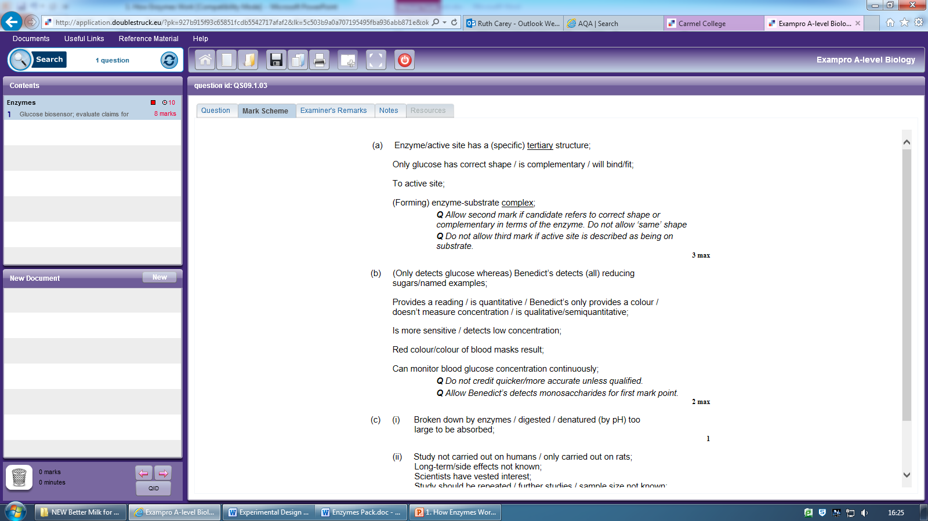
Stretch And Challenge
MS on next slide

Slide 33
Looking at the mark scheme for this question, why is it a harder question?
e.g. - synoptic
- not just statement of fact
- have to apply knowledge

Slide 34
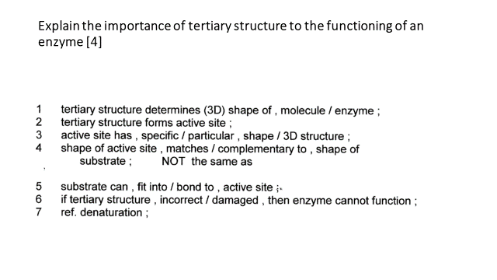
Memory Homework Task:

