Slide 1
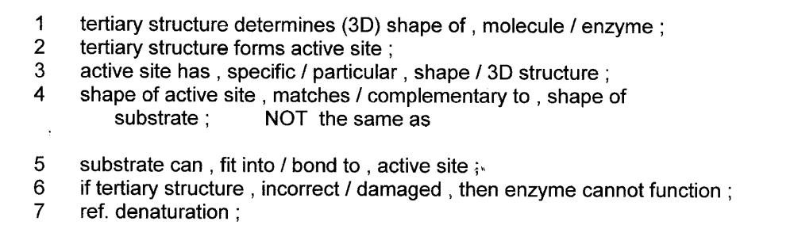
Starter
Explain the importance of tertiary structure to the functioning of an enzyme [4]

Slide 2
Following the rate of an enzyme
controlled reaction
Outcome
Describe and explain trends within graphs, relating this back to the tertiary structure of active sites and the effect of these variables
Calculate rate of reaction from graphs and raw data, and explain the advantage of using initial rate.

Slide 3
Following The Course of An Enzyme-Catalysed Reaction
An enzyme reaction can be followed by either measuring:
  Product formation
  Substrate Conversion
        OVER A PERIOD OF TIME!

Slide 4
Measuring Product Formation
2H₂O₂ O₂ + 2H₂0
catalase
The enzyme is catalase
The substrate is hydrogen peroxide
The products are water and oxygen

Slide 5
Q. Name the type of reaction occurring.
Q. How would you qualitatively measure the rate of this reaction?
Q. How would you quantitatively measure the rate of this reaction?
Decomposition
How quickly bubbles are produced.
Collect and measure the volume of oxygen produced over a set period of time.

Slide 6
The following data was used to plot a graph to show the results of an experiment showing the breakdown of hydrogen peroxide by catalase

Slide 7
Time (s) | Total Volume of O₂ Produced (cm³)
0 | 0.0
30 | 2.5
60 | 4.3
90 | 5.0
120 | 5.5
150 | 5.9
180 | 6.3
210 | 6.6
240 | 6.9
270 | 7.1
300 | 7.2
330 | 7.3
360 | 7.3
390 | 7.3
Which column goes on the Y and X axis?
Plot the data on the graph on page 9 remember to include axis titles and units

Slide 8
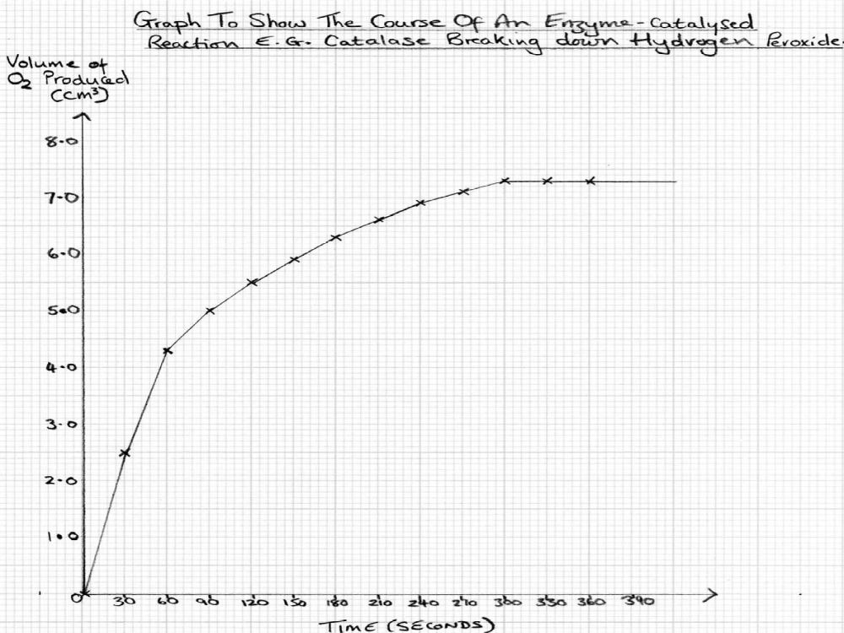
c
b
Label parts a, b and c on your graph
a

Slide 9
Task: : Complete the table below to DESCRIBE and then EXPLAIN what is happening in each section of the graph on page 9.
Letter | Describe | Explain
A
B
C

Slide 10
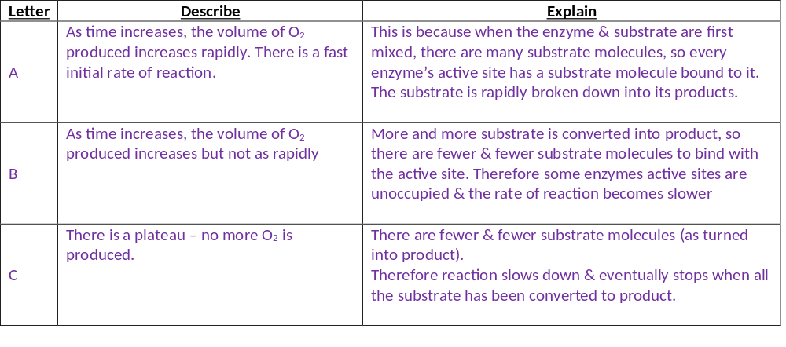

Slide 11
Using the information above and your own knowledge…
When is the rate of an enzyme catalysed reaction the fastest?
What is this rate called?
At the start of the reaction.
The initial rate of reaction.
3. Suggest why it may be better to use this section of the curve rather than simply measuring the rate after a certain period of time?
At the start of the curve there are minimal limiting factors. Factors like substrate concentration can slow the rate of reaction when not in excess.

Slide 12
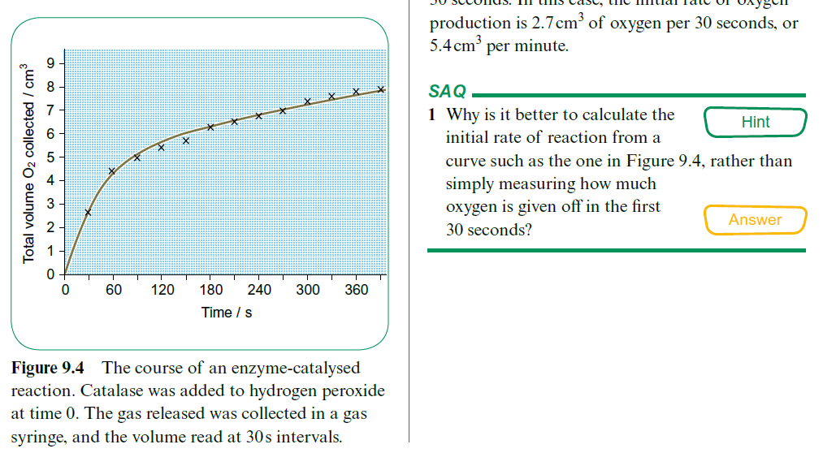
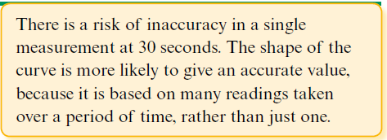

Slide 13
Maths Skill – Calculating the rate of reaction
Sometimes you may be asked to calculate the rate of reaction from a graph.
You will be asked to either calculate the initial rate of reaction or the rate of reaction at a specific point.

Slide 14
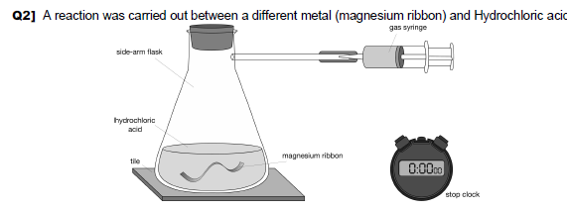
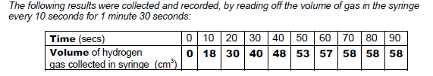
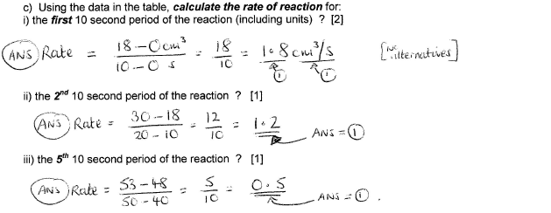
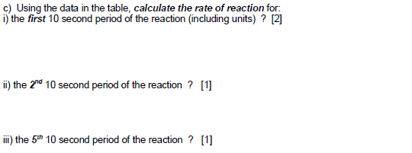
Starter! Mathstastic – Calculators out!
  Rate of reaction = Change in volume
  Change in time

Slide 15
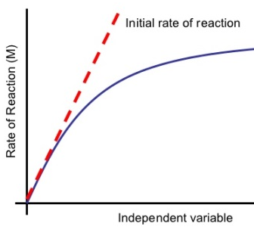
The Initial Rate of Reaction
Step 1. Draw a tangent (using a pencil!) to calculate the initial rate of reaction. Your tangent must go through the intercept at 0.
Step 2. Draw a triangle from this
Step 3. Read off the change in product (Y) and the change in time (X).
Step 4. We now calculate the gradient of this line using the equation
Rate of reaction = change in y
change in x
Volume of product

Slide 16
Step 1. Draw a tangent (using a pencil!) to calculate the initial rate of reaction. Your tangent must go through the intercept at 0.
Step 2. Draw a triangle from this
Step 3. Read off the change in product (Y) and the change in time (X).
Step 4. We now calculate the gradient of this line using the equation
Rate of reaction = change in y
change in x
/cm³
40
So our change in product for Y is 40- 0 and = 40 (Units of volume)
The duration of this change was 20 -0 (Units of time)
So the Initial rate of reaction is 40 / 20 = 2
But we always need to write suitable units based on our axis!
2 (Units of volume) per (Unit of time)
Eg. 2 cm³ per minute or 2cm³ min⁻¹ or 2cm³/min
Volume of product
0
20
Change in time
/ minutes

Slide 17
Now you have a go at calculating the initial rate of reaction for your graph on page 9 of the booklet. Show your working on page 10

Slide 18
Tangent
2. Remember, if you have drawn your triangle a different size, the answer should be the same. You will normally be allowed an answer in a range.
e.g.
7.5/90 = 0.08 cm³s⁻¹
4.7/60 = 0.08 cm³s⁻¹
4.7
7.5
60
90

Slide 19
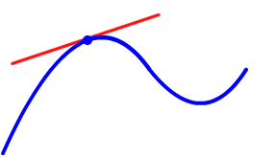
Calculating rate from specific times
  We can measure the change in the rate of reaction at any point on the curve of a graph by measuring the gradient of the tangent to the curve at that point.
  The tangent is the point at which a straight line touches the curve without cutting across it.

Slide 20
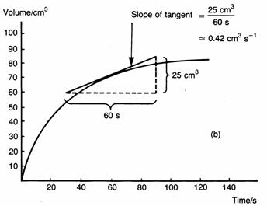
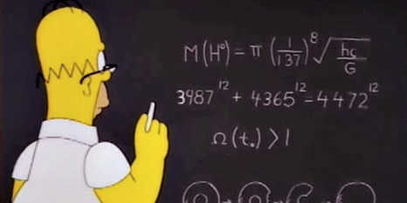
Step 1. Draw a tangent – a straight line that only touches the curve at one point (the point that you are working out the rate of reaction for).
Step 2. Draw a triangle from this (as to the right – the triangle can be any size so you may draw it different to someone else).
Step 3. Read off the change in product (Y) and the change in time (X).
Step 4. We now calculate the gradient of this line using the equation:
Rate of reaction =change in y
change in x
  e.g.

Slide 21
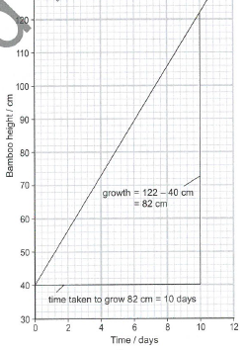
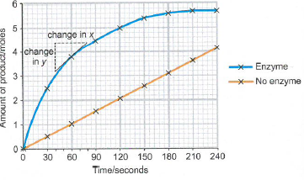
Your Turn! Q’s on pg 11 - answers
1a. 82/10 = 8.2 cm/day

Slide 22
2a. With enzyme 1.2/40 = 0.03 mol per second (unit: mol/s)
(36 – each little square on the x axis is worth 6 seconds
2b. Without enzyme 4/240 = 0.017 mol/s
2c. 0.03 / 0.017 = 1.76 times faster
Label on your Y axis the numbers 1-6

Slide 23
Now use what you have learned to calculate the rate of reaction at 60 seconds using the graph you drew on page 9.
When you have finished move onto the exam questions on page 12 and 13.
Read the exam tip carefully and make sure you read your axis carefully

Slide 24
3. e.g.
8.0-2.6 = 5.4
So…
5.4/192 = 0.03 cm³s⁻¹
OR
6.5-2.6 = 3.9
So…
3.9/138 = 0.03 cm³s⁻¹
Tangent

Slide 25
EXAM TIP: It is very important that you look closely at the y axis, if the axis is showing a measurement of the products or reactants you need to draw a tangent. If the Y axis shows rate of reaction you do not need to draw a tangent and can just read off the graph.

Slide 26
Starter
Explain the importance of tertiary structure to the functioning of an enzyme [4]

Slide 27
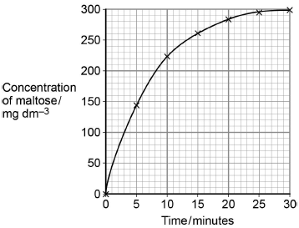
Exam question
a) Determine the rate of the reaction at 10 minutes. Show how you obtained your answer.
(a) 1. Tangent to curve drawn;
Tangent drawn at about 10 minutes
2. Value in range of 8 to 11;
1 mark only for correct answer
2
(b) Explain the results shown in the graph.
(b) 1. (Rate of) increase in concentration of maltose slows as substrate/starch is used up
OR
High initial rate as plenty of starch/substrate/more E-S complexes;
Reject ref. to amylase being used up
2. No increase after 25 minutes/at end/levels off because no substrate/starch left;
Accept ‘little’
Ignore references to substrate a limiting factor
2

Slide 28
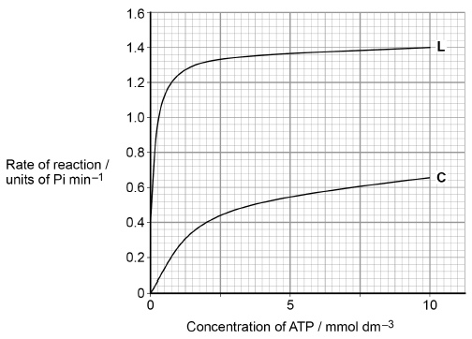
(c) Calculate the rate of reaction of the enzyme activity with no lyxose at 2.5 mmol dm^{–3} of ATP as a percentage of the maximum rate shown with lyxose.
(c) 31.4;;
Allow 1 max for
0.44 and 1.4
32.8
33.1
30
29.3
1.4
0.44 x 100 = 31.4%
1.4
Accept any number of significant figures ≥2, if rounding correct (31.4284714).
Same principle applies to 1 max answers.
32.8 = Both readings at 2.5 mmol dm^{–3} (0.44/1.34)
33.1 = Both readings at 2.5 mmol dm^{–3} (0.44/1.33)
30 = Incorrect reading for C (0.42/1.4)
29.3 = Incorrect reading for C (0.41/1.4)
0.44
0.4

