Slide 1
Factors affecting enzyme controlled reactions
There are several factors that you need to be able to explain how they affect enzyme action:
Temperature pH
Substrate Concentration
Enzyme Concentration
Inhibitors
Learning Outcome: Explain how temperature affects enzyme controlled reactions

Slide 2
Exam questions often ask you to describe and explain!
You need to be able to DESCRIBE and EXPLAIN the effect of different factors on the rate of enzyme reactions
In exam answers ALWAYS quote the figures from the x and y axis in your answers!

Slide 3
As we work through the powerpoint fill in your graph on page 14

Slide 4
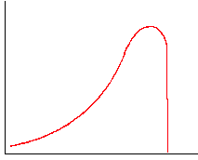
Effect of Temperature
Think about the graph in three sections and describe what is happening at each stage
Rate of Reaction
Temperature

Slide 5
Describe the Effect of Temperature – match the phrase to the region on the graph Match each to it’s explanation on page 14
As the temperature increases the rate of reaction increases slowly, then more quickly
The temperature where the rate of reaction is fastest is called the optimum temperature
Above the optimum temperature, increasing the temperature causes the rate of reaction to decrease rapidly
Rate of Reaction
Temperature

Slide 6
Now explain each section on the graph
At low temperatures - less kinetic energy so fewer collisions between the substrate and enzyme active site - rate is low.
As the temperature increases – more kinetic energy of the substrates and enzymes.
Frequency of collisions between substrate and active sites increase so more enzyme-substrate complexes form, so more product form - rate increases

Slide 7
Optimum temperature is when collisions between substrate and active sites are at their fastest - so rate is fastest

Slide 8
Now explain each section on the graph
Above the optimum temperature the enzyme vibrates more until the H bonds maintaining the tertiary structure break. The shape of the active site changes – enzyme is denatured. The active site and substrate are no longer complementary in shape. Less ESC, EPC and product form – rate decreases rapidly.

Slide 9
To do – on the sketched graph on pg 14:
1. Label the point with the maximum rate of activity.
2. Label the point at which all enzymes are denatured.
3. Label a point where there is not very much kinetic energy.
Answer the questions on page 15
What is meant by the term denatured?
Name the bond that is broken by high temperatures to denature an enzyme.
Suggest the optimum temperature that enzymes work at in mammals.
Suggest why enzymes in biological washing powders are taken from bacteria living in thermal vents.
Shape of the active site changes and is no longer complementary to the substrate
Hydrogen bonds
37.5ºC ( Body Temperature)
So they do not denature in the hot water used to wash clothes ( ie 40 degrees +)

Slide 10

Effect of Temperature
BEWARE – not all enzymes have an optimum temperature of 37ºC
Read questions carefully!!

Slide 11
Beware Examiners Like to Use Confusing Named Enzymes But Follow The Rules For Describing and Explaining the Graphs They Give You

Slide 12
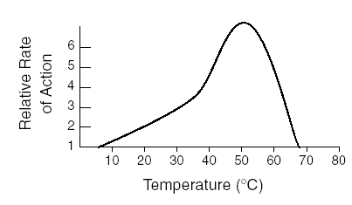
The lesser spotted hopping flea lives in the tail fur of the short-eared New Forest Fox.
The graph shows the effect of temperature on the thingymebobase enzyme which catalyses the break down of thingymebobs to dubrywottsits.
Describe and explain the effect of temperature on the rate of reaction on the third Wednesday of every month ending in “ber”.
So – do you think it matters that the question asks about the third Wednesday etc….?

Slide 13
Task:
Answer the exam questions on page 15 and 16 (8 marks ) 10 minutes
If you finish….
On whiteboards
Explain the effect of temperature on enzyme controlled reactions (5)

Slide 14
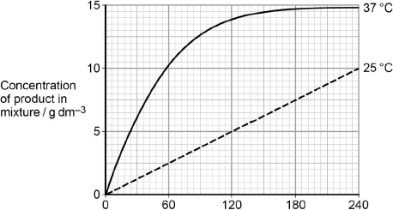
A technician investigated the effect of temperature on the rate of an enzyme-controlled reaction. At each temperature, he started the reaction using the same volume of substrate solution and the same volume of enzyme solution.
(b) Calculate the rate of reaction at 25 °C.
1. 2.5 / 0.04;
1 mark for correct value
2. g dm^{–3} minute^{–1} / g dm^{–3} s^{–1};
1 mark for related unit
(c) Describe and explain the differences between the two curves.( 5)
1. Initial rate of reaction faster at 37 °C;
2. Because more kinetic energy;
3. So more E–S collisions / more E–S complexes formed;
4. Graph reaches plateau at 37 °C;
5. Because all substrate used up.
Allow converse for correct descriptions and explanations for curve at 25 °C
(a) Give one other factor the technician would have controlled.
(a) Concentration of substrate solution / of enzyme solution / pH.

Slide 15
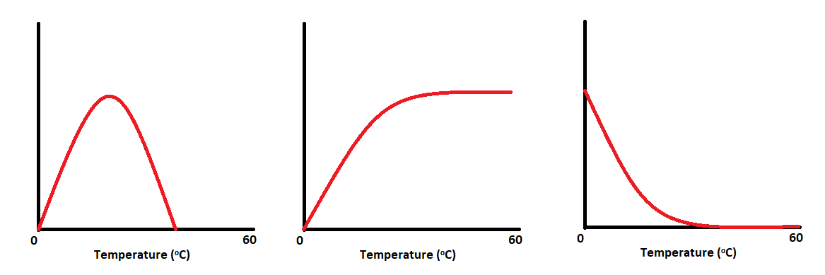
Remember
Read the axis of your graph carefully!
The three graphs below all represent the same reaction- They look different because each Y axis shows a different measuring factor.
Task: Add the correct axis title to each graph including suitable units.
Rate of Reaction, Substrate Concentration, Mass of product released
The enzyme graphs usually plateaux’s (levels off) because one of the other factors is limiting i.e. all of the substrate has been used up or all of the active sites are occupied.

Slide 16
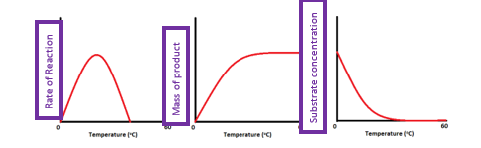

Slide 17
Factors affecting enzymes
Learning Outcome - Explain how pH affects enzyme controlled reactions.

Slide 18
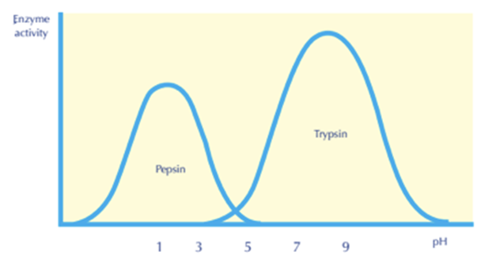
Each enzyme has a pH value that it works at with maximum efficiency called the optimal pH.
If the pH is lower or higher than the optimal pH, the enzyme activity decreases until it stops working. pH is a measure of H+ ion concetration.

Slide 19
For example, pepsin works at a low pH, i.e, it is highly acidic.
Trypsin works at a high pH, i.e, it is basic.
Most enzymes work at neutral pH 7.4

Slide 20
Task: Complete the graph on page 17 showing how pH affects enzyme activity
Label where enzymes have become denatured.
Label on the x axis where the optimum pH is.

Slide 21
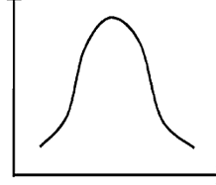
The Effect of pH
Describe the effect of pH on the rate of reaction – remember to try to think of the graph in three parts
Rate of Reaction
pH

Slide 22
Describe the graph:
The pH where the rate of reaction is fastest is called the optimum
Reducing or increasing the pH away from the optimum decreases the rate of reaction

Slide 23
Explain The Effect of pH –
Remember: pH is a measure of H⁺ concentration.
At an optimum pH - tertiary structure/shape of the active site is complementary to the substrate.
ESC form - rate is at its highest

Slide 24
Explain The Effect of pH
Label where enzymes have become denatured.
Label on the x axis where the optimum pH is.
Change in H⁺ concertation can:
  disrupts/break hydrogen bonds and ionic bonds
  Change charge of amino acids in the active site
  Change tertiary structure
  Change shape of the active site
The active site and substrate are no longer complementary in shape.
Less ESC form – rate decreases
Rate of Reaction
pH
The enzyme is denatured.

Slide 25
Have a go at the quick questions the top of page 18
then move on to the exam question on page 18.

Slide 26
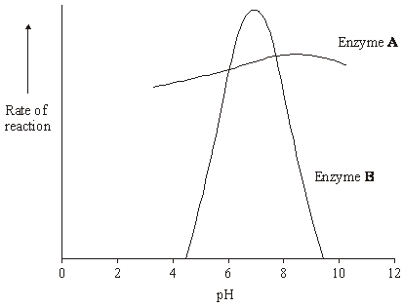
Exam Q
Enzymes A and B digest protein. The graph shows the effect of pH on the rates of reaction of these enzymes.
Pepsin is a protein-digesting enzyme found in the stomach. It has an optimum pH of 2 and is fully denatured at pH 6.
1. Sketch a curve on the graph to show the effect of pH on the rate of reaction of pepsin.
2. Explain why the rate of reaction of enzyme B is low at pH 5.
Rising to a peak at pH2 and falling to 0 by pH 6.
(change in H ion concentration /pH) leads to breaking of ionic and hydrogen bonds holding tertiary structure/changes charge on amino acids;
enzyme/protein/active site loses shape/denatured;
substrate will not bind with/fit active site;
fewer/no ES complexes formed;

Slide 27
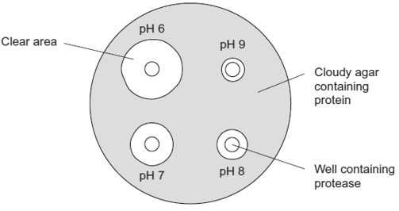
(i) How should the students make sure that the pH of the protease solution did not change?
Use a buffer solution
(ii) Use the diagram to describe the effect of pH on the activity of this protease.
Works best at pH 6 / at higher pH activity decreases;
Accept converse
Insufficient: pH 6 had largest clear area

Slide 28
Investigation into the Effect of pH on Amylase Action
See page- 19 and 20 of the booklet

Slide 29
To start…
What substrate does amylase act on?
What is the product of this reaction?
What will be the independent variable?
How does the enzyme increase the rate of reaction?
Starch
Maltose
pH
Lowers the activation energy

Slide 30
The effect of pH on amylase activity can be investigated using an assay technique.
We are going to do a paper experiment.

Slide 31
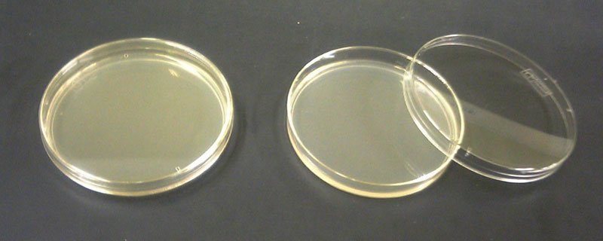
Agar plate

Slide 32
Holes (wells) were cut in the agar plate. A pH buffer and amylase were then put in each well.
The plates were then left to incubate for 24 hours.
pH 9 buffer + enzyme
pH 3 buffer + enzyme
pH 7 buffer + enzyme
pH 5 buffer + enzyme
pH 11 buffer + enzyme

Slide 33
In the middle…
5. What are the positive and negative results when testing for the presence of starch with iodine solution?
6. If amylase hydrolyse starch to maltose, what result would you see?
7. If amylase does not hydrolyse starch to maltose, what result would you see?
If starch present goes from orange/brown to Blue Black
If not present stays orange/Brown
A negative result will stay orange/brown
A positive result will turn Blue Black

Slide 34
The plate was then flooded with iodine solution and rinsed. The diameter of the clear zone (not blue/black in colour) was measured
pH 9
pH 3
pH 5
pH 7
pH 11

Slide 35
You have been provided with 3 sets of results
pH | Diameter of Clear Zone (mm)
 | Replicate 1 | Replicate 2 | Replicate 3 | Mean
3 | 17.0 | 17.0 | 17.0
5 | 21.0 | 20.0 | 24.0
7 | 38.0 | 20.0 | 42.5
9 | 25.0 | 30.0 | 30.0
11 | 0.0 | 0.0 | 11.5

Slide 36
On page 20
8. Calculate the mean diameter for each pH
9. Sketch a graph to show the results.
Answer the questions
Identify which pH provides the optimum condition for amylase to work in.
In which pH did amylase not work at all?
What would be the importance of repeats in the investigation? How many repeats were done here?
Identify the anomalous result or outlier in the data. Why leave the plates for 24 hours rather than 1 hour
What would you do as a control and why?

Slide 37
Answers
pH | Diameter of Clear Zone (mm)
 | Replicate 1 | Replicate 2 | Replicate 3 | Mean
3 | 17.0 | 17.0 | 17.0 | 17.0
5 | 21.0 | 20.0 | 24.0 | 21.7
7 | 38.0 | 20.0 | 42.0 | 33.3
9 | 25.0 | 30.0 | 30.0 | 28.3
11 | 0.0 | 0.0 | 11.5 | 3.8

Slide 38
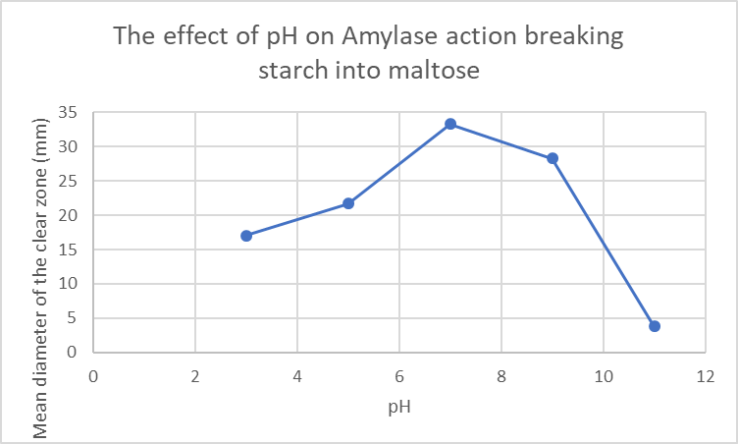

Slide 39
Identify which pH provides the optimum condition for amylase to work in.
In which pH did amylase not work at all?
What would be the importance of repeats in the investigation? How many repeats were done here?
Identify the anomalous result or outlier in the data Repeat 3 for pH 11.
Why leave the plates for 24 hours rather than 1 hour
What would you do as a control and why?
pH 7
pH 11
More repeats increases the reliability of results. 3 repeats have been done here but >10 would be more acceptable
to make sure the amylase has had enough time to interact with the substrate
The concentration of starch, the concentration of enzyme and the temperature as they can all affect the rate of reaction

Slide 40
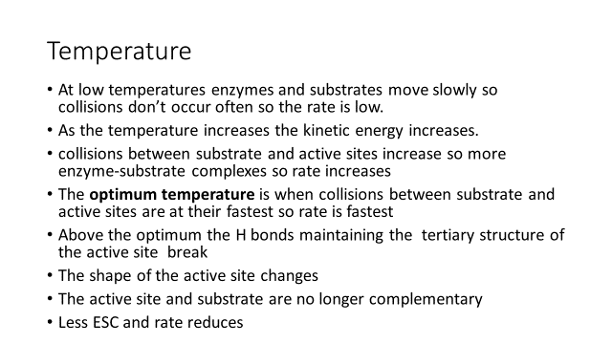
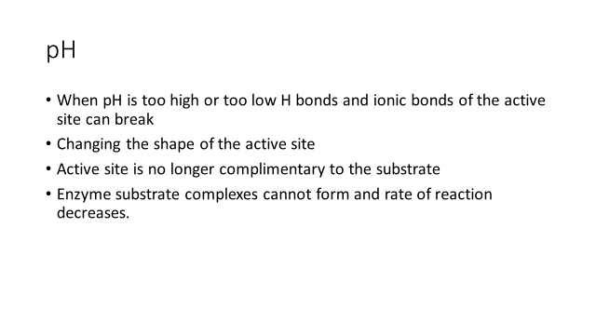
Learning Homework
Explain how temperature and pH affect the rate of enzyme controlled reactions.

