Slide 1
Starter
Explain how temperature and pH affect the rate of enzyme controlled reactions.
Temperature (5)
pH (3)

Slide 2
Temperature
At low temperatures enzymes and substrates move slowly so collisions don’t occur often so the rate is low.
As the temperature increases the kinetic energy increases.
collisions between substrate and active sites increase so more enzyme-substrate complexes so rate increases
The optimum temperature is when collisions between substrate and active sites are at their fastest so rate is fastest
Above the optimum the H bonds maintaining the tertiary structure of the active site break
The shape of the active site changes
The active site and substrate are no longer complementary
Less ESC and rate reduces

Slide 3
pH
When pH is too high or too low H bonds and ionic bonds of the active site can break
Changing the shape of the active site
Active site is no longer complimentary to the substrate
Enzyme substrate complexes cannot form and rate of reaction decreases.

Slide 4
Effect of substrate concentration
Outcome
Explain how substrate concentration and enzyme concentration affect enzyme catalysis
Describe and explain trends within graphs, relating this back to the tertiary structure of active sites and the effect of these variables

Slide 5
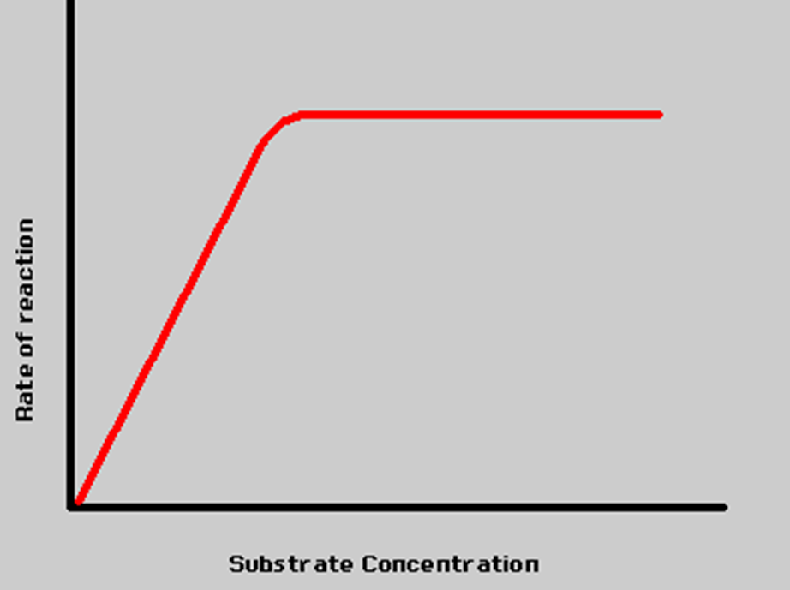
In the presence of a given amount of enzyme, the rate of reaction increases as the substrate concentration increases until a limiting rate is reached.
Further increase in the substrate concentration produces no significant change in the reaction rate.
At this point, so much substrate is present that essentially all of the enzyme active sites have substrate bound to them.

Slide 6

As we work through the next slides Complete the graph on page 21 to show how Substrate concentration affects enzyme controlled reactions
Fully annotate your graph including
Axis titles
Label on the V_{max}.
Label on the part of the graph where the rate of reaction is directly proportional to the substrate concentration.

Slide 7
Effect of Substrate Concentration
Describe
As the substrate concentration increases the rate of reaction increases
Until a certain point is reached when increasing the substrate concentration will not further increase the rate of reaction
The rate of reaction is directly proportional to the substrate concentration

Slide 8
Effect of Substrate Concentration
Explain
As the concentration of substrate molecules increases, collisions between substrates and active sites occur more often
More ESC form
More products form
Rate increases

Slide 9
Effect of Substrate Concentration
Explain
Until a point is reached when all the active sites are occupied with substrate
Further increases in substrate concentration has no effect on increasing the rate
The enzymes are working at their fastest rate - V_{max}
V_{max}
How could you increase the rate of reaction??

Slide 10
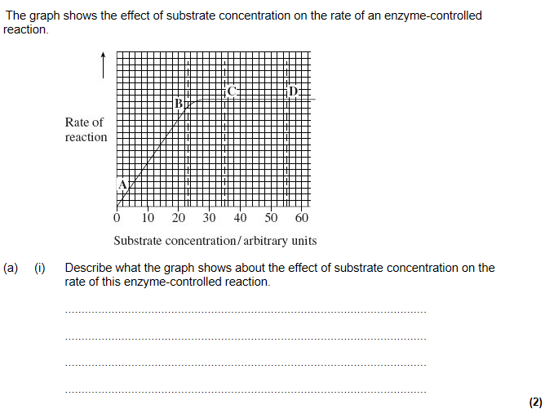
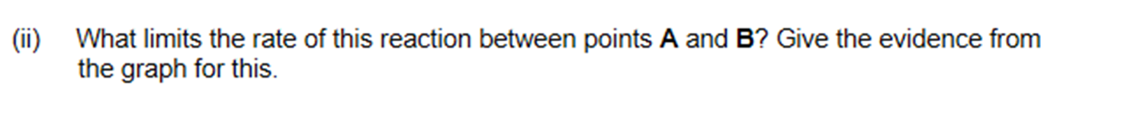
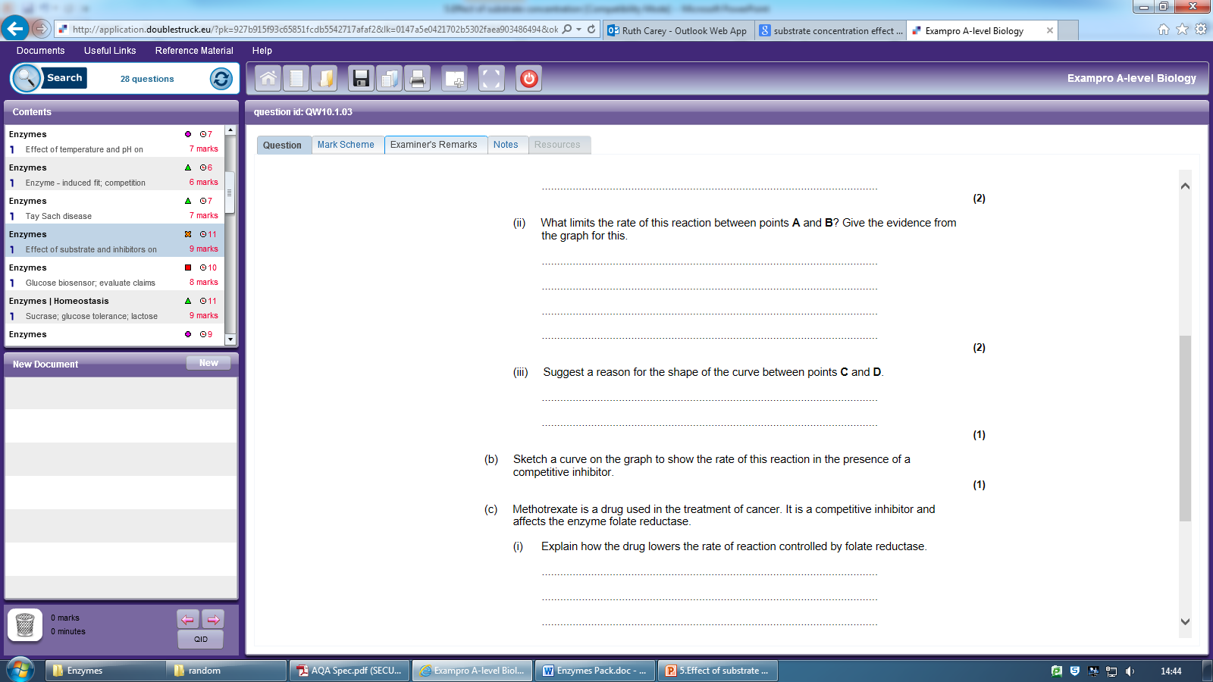
Exam Q not in booklets
Increases then plateaus;
Increases upto/plateaus at 27/28 au;

Slide 11
Substrate concentration;
As substrate concentration increases, rate increases;
All active sites occupied/saturated/maximum number of ESC;

Slide 12
Effect of Enzyme concentration
Outcome
Explain how substrate concentration and enzyme concentration affect enzyme catalysis
Describe and explain trends within graphs, relating this back to the tertiary structure of active sites and the effect of these variables

Slide 13
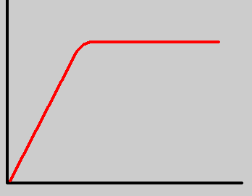
Effect of Enzyme Concentration For A Fixed Concentration of Substrate
Describe
As the enzyme concentration increases the rate of reaction increases
Until a certain point when increasing the enzyme concentration has no further effect on the rate of reaction
Rate of reaction
The rate of reaction is directly proportional to the enzyme concentration
Enzyme concentration
Suggest why the graph levels off
The concentration of substrate is now the limiting factor

Slide 14
Explain
As the enzyme concentration increases the number of active sites increases
More substrate molecules can bind to the active sites to form ESC
So more products form, increasing the rate of reaction
Until a certain point when there are more active sites than available substrate molecules to bind to them and the maximum rate is reached
Rate of reaction
Enzyme concentration

Slide 15
Effect of Enzyme Concentration When Substrate Is In Excess
How would you expect the shape of the graph to change if the substrate was in excess and why?
Rate of reaction
Enzyme concentration

Slide 16
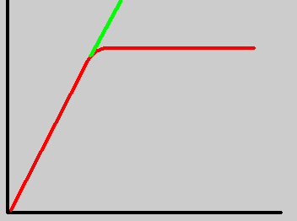
Effect of Enzyme Concentration When Substrate Is In Excess
Describe
As the enzyme concentration increases the rate of reaction increases
The rate of reaction is directly proportional to enzyme concentration
Substrate conc. in excess
Rate of reaction
Enzyme concentration

Slide 17
Effect of Enzyme Concentration When Substrate Is In Excess
Explain
As the enzyme concentration increases the number of active sites increase
More substrate molecules can bind to active sites to form ESC
So more products form increasing the rate of reaction
Substrate conc. fixed
Rate of reaction
Enzyme concentration

Slide 18
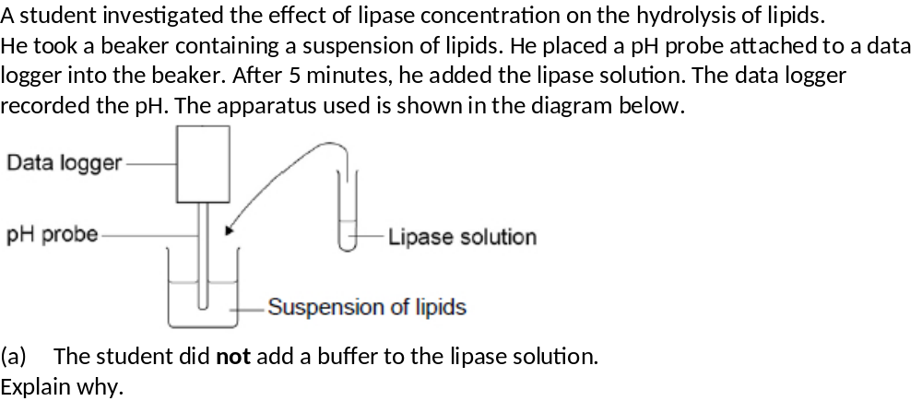
Have a go at the Exam questions on page 23 and 24
(a) Student was measuring change in pH
OR
Buffer would maintain a constant pH.
Boiled lipase solution
1. Volume of suspension of lipids;
2. Concentration of suspension of lipids;
3. Volume of lipase solution;
4. Temperature;

Slide 19
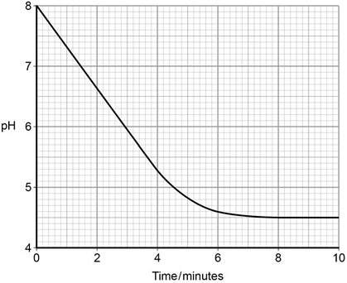
The data logger recorded the pH. The graph below shows what happened after he added the lipase solution.
(d) Draw a tangent on the graph and use it to calculate the rate of change at 5 minutes.
Rate of change at 5 minutes = _________________ pH minute⁻¹
(2)
(e) Explain the results shown in the graph.
(2)
–0.34 = 2 marks
0.34 = 1 mark
1. Fatty acids produced;
2. Curve levels off as all substrate used up.
accept the lower pH inactivates / denatures the enzyme
(f) The student repeated the experiment with a higher concentration of lipase solution.
Describe and explain the results you would expect him to get. (3)
1. Faster fall in pH and levels off at same point;
2. More enzyme = substrate complexes formed;
3. Same amount of fatty acids produced / product

