Slide 1
Starter
Describe and Explain how to concentration of enzymes affects the rate of reaction when the levels of substrate are in excess.

Slide 2
Describe
As the enzyme concentration increases the rate of reaction increases
The rate of reaction is directly proportional to enzyme concentration
Explain
As the enzyme concentration increases the number of active sites increases
More substrate molecules can bind to the active sites to form ESC
So more products form which increases the rate of reaction

Slide 3
Effect of Inhibitors on The Rate of Enzyme Reactions
Outcomes
Explain the effects of competitive and non competitive inhibitors on the rate of enzyme controlled reactions.

Slide 4
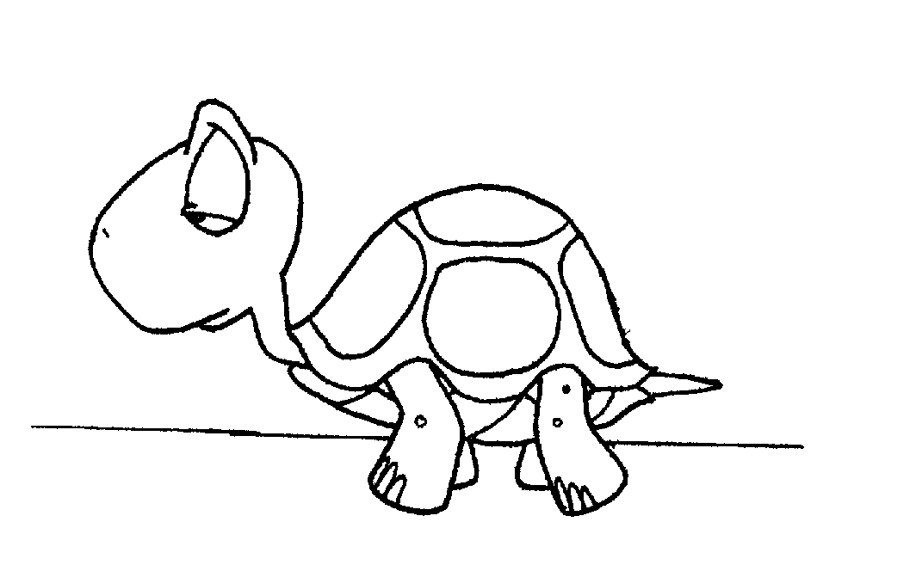
Inhibitors
Enzyme inhibitors are substances which reduce the rate or stop enzyme catalysed reactions because they have some effect on the enzyme molecule

Slide 5
Inhibitors are often useful as they help to regulate enzyme activity and control metabolic functions
Inhibitors
Competitive
Non-competitive

Slide 6
Competitive Inhibitors
Competitive inhibitors have a similar shape to the substrate and compete with the substrate for the active site.
They can occupy the active site.
This prevents the substrate binding, so prevents the formation of ESC so reduces the rate of reaction.
enzyme
Competitive Inhibitor
substrate

Slide 7
Competitive Inhibitors
enzyme
Increasing the concentration of substrate reduces the effect of a competitive inhibitor as it is more likely that a substrate molecule can bind to the active site than a competitive inhibitor
Competitive Inhibitor
substrate

Slide 8
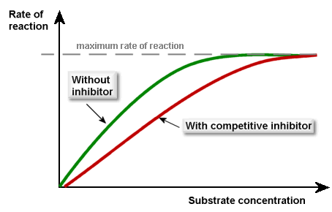
Competitive Inhibitors
Complete the graph on page 24 then in the box draw a diagram illustrating competitive inhibition
Why will both curves eventually meet?

Slide 9
Non Competitive Inhibitor
enzyme
Non competitive inhibitors bind to the enzyme away from the active site – allosteric site
They do not compete with the substrate for the active site
Non Competitive Inhibitor
substrate

Slide 10
Non Competitive Inhibitor
Binding of the non competitive inhibitor disrupts the tertiary structure of the enzyme
This changes the shape of the active site so the substrate is no longer complementary and can not bind. The ESC cannot form.
enzyme
Non Competitive Inhibitor
substrate

Slide 11
Non Competitive Inhibitor
enzyme
Increasing the substrate concentration will not reduce the effect of the inhibitor.
Non Competitive Inhibitor
substrate

Slide 12
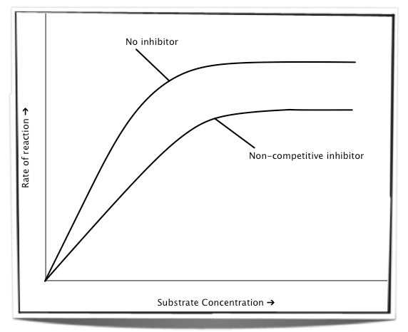
Non Competitive Inhibitors
Complete the graph on page 25 showing 3 lines.
Rate with competitive inhibitors
Rate with just enzyme
Rate when lots of substrate and inhibitor
Then illustrate non competitive inhibition in the space provided on page 26
http://www.youtube.com/watch?v=PILzvT3spCQ

Slide 13
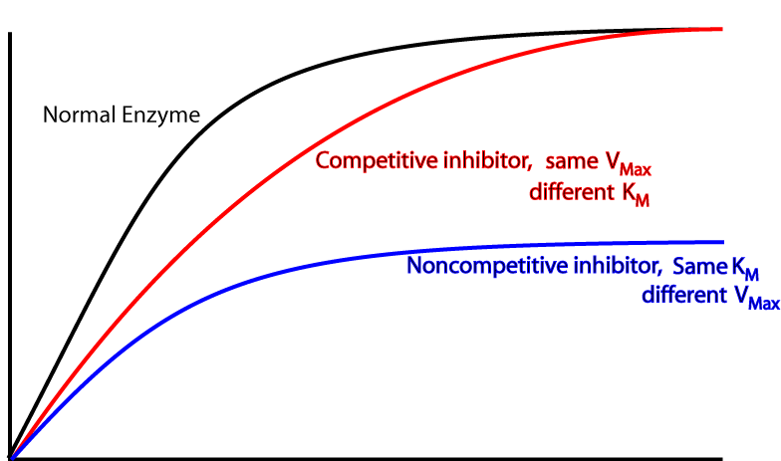

Rate of Reaction
Substrate concentration

Slide 14
Using what you have just learned and your notes on pages 25 and 26
Identify whether the statements on the next slide are true or false and correct each statement if necessary.

Slide 15
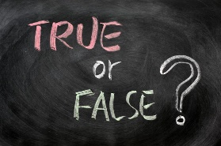
True or False. Use your notes on page 22 and 23
T
Competitive inhibitors bind to the active site.
Only competitive inhibitors reduce the rate of reaction.
Non competitive inhibitors are similar in shape to the substrate.
Both types of inhibition prevent the substrate from binding.
In non competitive inhibition, the substrate binds to the allosteric site.
Increasing the concentration of substrate reduces the effect of a competitive inhibitor.
The binding of the non competitive inhibitor changes the shape of the active site so the ESC cannot form.
Competitive inhibitors are the same shape as the active site.
F
T
T
T
T
F

Slide 16
Now have a go at the exam questions on pages 27 and 28 of the booklet.

Slide 17
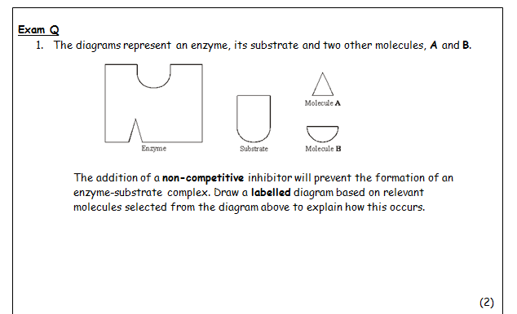
Diagram showing molecule A fitting in inhibition site;
Distortion of active site;

Slide 18
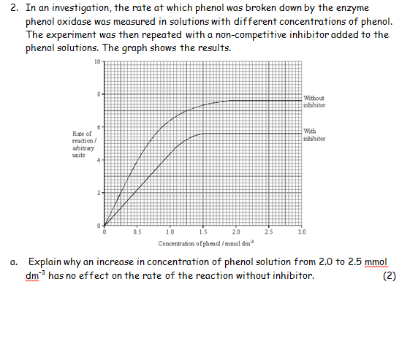
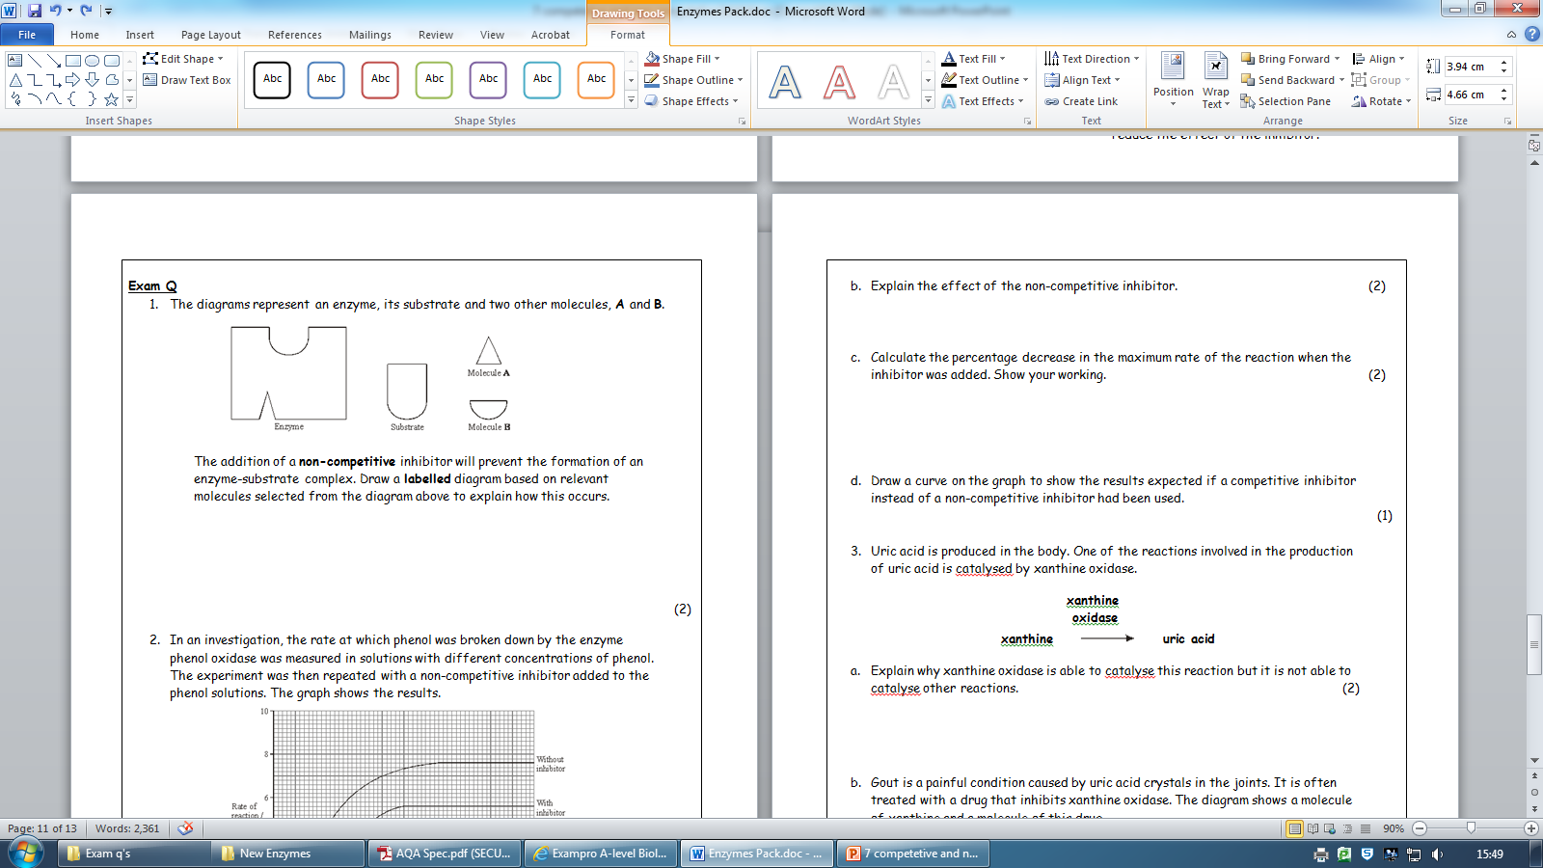
Max rate at which enzyme can combine with substrate/form ESC/substrate no longer limiting/enzyme is limiting;
Active site of enzyme saturated with substrate;
Inhibitor attaches to enzyme away from active site;
Changes shape of active site;
Prevents formation of ESC;
7.6-5.6 x 100;
7.6
- 26.32%; accept 26% or 26.3%

Slide 19
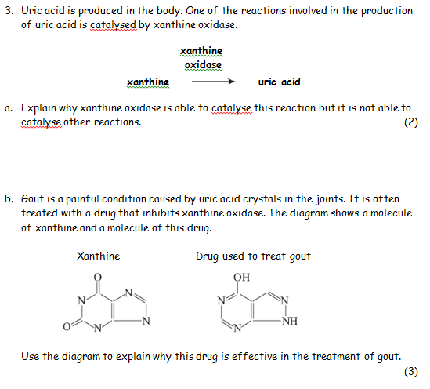
Substrate has specific shape;
Allows binding/forms ESC with active site; OR
Active site has specific shape;
Allows binding/forms ESC with substrate; accept structure = shape
Xanthine similar shape to drug;
Drug fits active site/competes for active site/is a competitive inhibitor;
Less/no uric acid formed;

Slide 20
Learning Homework
Describe and Explain the effect of inhibitors on the rate of enzyme controlled reaction (5)
Generalised mark: Can be in either paragraph
1.Inhibitors prevent ESC so rate of reaction decreases
Competitive
Inhibitors are a similar shape to the substrate
Inhibitors are complementary to and can bind to the active site
Preventing the substrate from forming bonds with the active site
The effect of competitive inhibitors can be overcome by adding more substrate
Non-Competitive
Inhibitors bind away from the active site at the allosteric site
This alters the 3d tertiary structure of the active site
Active site is no longer complimentary to the substrate
The effect of non- competitive inhibitors cannot be overcome by adding more substrate.
Max: 3 from each

