Slide 1
Animal Transport

Slide 2
Learning outcomes:
Explain what is meant by a double circulatory system
Describe the structure of the circulatory system, with reference to the blood vessels entering and leaving the heart, lungs and kidneys
Link the structure of the circulatory system to its role in exchanging and transporting materials
Explain the role of the coronary artery

Slide 3
Use these words
Diffusion
Decreases
Transport
Exchange
Short
Environment
Pump
Absorb
Remove

Slide 4
Why do large organisms need a mass transport system?
Use these words to fill in the blanks
All organisms exchange materials between themselves & the ……………………………… – ………………………… is fast enough for transport over ……………… distances, so can be used in small organisms.
However, as size increases, SA:VOL ratio ………………………… and specialised …………………… surfaces are required to …………………. nutrients and respiratory gases and ……………………… excretory products.
And a ……………………… system is required to take materials from cells to exchange surfaces, from the exchange surfaces to cells, and between different parts of the organism.
Whether or not there is a specialised transport medium and whether or not it is circulated by a ………………………, depends on
The SA:VOL ratio
How active the organism is
Pump
Decreases
Active
Exchange
Short
Remove
Environment
Diffusion
Absorb
Transport
environment
diffusion
short
decreases
exchange
absorb
remove
transport
pump

Slide 5
The smaller the SA:VOL ratio, and the more active the organism, the greater the need for a specialised transport system with a pump.

Slide 6
External structure of the heart
Use p. 171 Toole and Toole to label the structure of the heart in your notes.

Slide 7
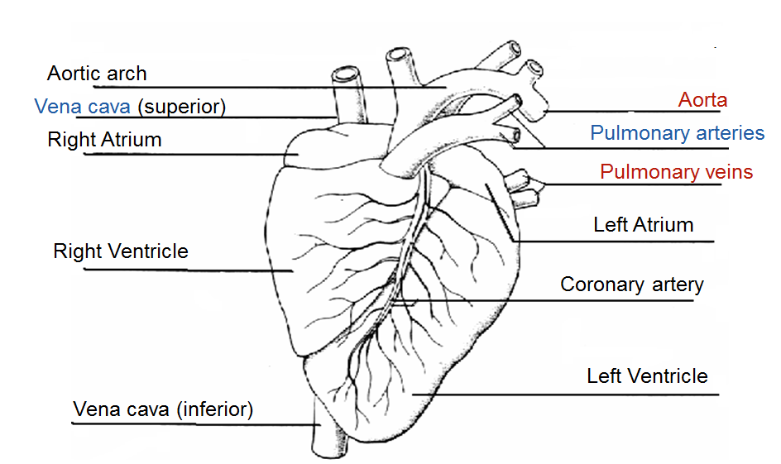
External structure of the heart

Slide 8
Internal structure of the heart
Use p.171 Toole and Toole to put labels on interior structure
Use red to show direction of flow of oxygenated blood
Use blue to show direction of flow of deoxygenated blood
Then complete the blanks in the statements

Slide 9
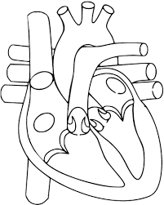
Internal Structure of the Heart
Oxygenated blood out
Pulmonary artery
Deoxygenated blood in
Deoxygenated blood out
Oxygenated blood in
Aorta
Pulmonary vein
Vena cava
Left atrium
Bicuspid valve (left A-V valve)
Right atrium
Semi-lunar valve
Tricuspid valve (right A-V valve)
Left ventricle
Thicker muscular wall of left ventricle
Tendon
Septum
Right ventricle
Apex

Slide 10
Description of structure of the heart
The 2 sides are separated by the septum, which keeps the oxygenated blood on left side separate from deoxygenated blood on right side - ESSENTIAL
Atrio-ventricular valves between each atrium & ventricle – left side = bicuspid; right = tricuspid
Semilunar valves are located in aorta and pulmonary artery
Function of valves is to keep blood flowing in correct direction - maintain unidirectional flow
The A-V Valves link atria to ventricles, and prevent backflow to atria when ventricles contract
S-L valves link ventricles to aorta & pulmonary artery, and prevent backflow into heart when ventricles contract
A-V Valves are attached to ventricles by tendons to prevent valves inverting when ventricles contract
Arteries carry blood away from heart
Veins bring blood back to heart
The more muscle in a chamber wall, the stronger the contraction and the greater pressure produced

Slide 11
Circulatory Systems in Mammals
Mammals have a closed (blood is in vessels), double circulatory system (blood passes through heart twice for each circuit of the body); the 2 systems are:-
Pulmonary circulation – carries deoxygenated blood to the lungs, to take up oxygen & then returned to heart.
Systemic circulation – carries oxygenated blood to the rest of the body, to release oxygen & then returned to heart.
The main advantage of a double circulatory system for mammals is that it increases blood pressure and therefore increases the rate of blood flow to the tissues.

Slide 12
Clip showing circulatory system
http://www.kscience.co.uk/animations/blood system.swf

Slide 13
Structure of the heart
2 pumps, side by side, left & right
4 chambers, 2 upper atria & 2 lower ventricles

Slide 14
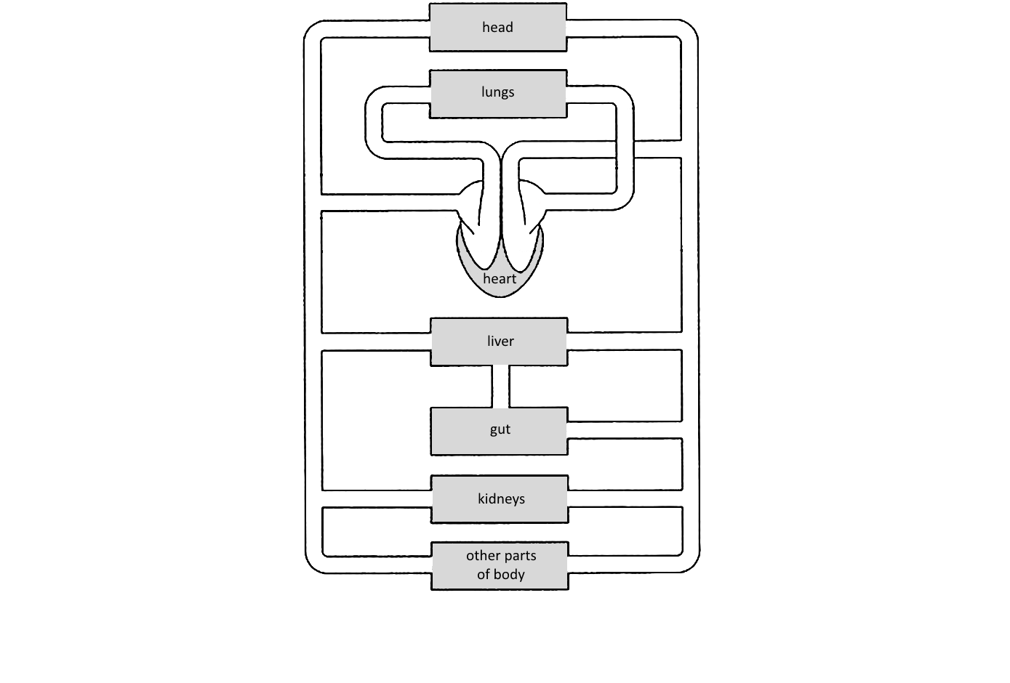
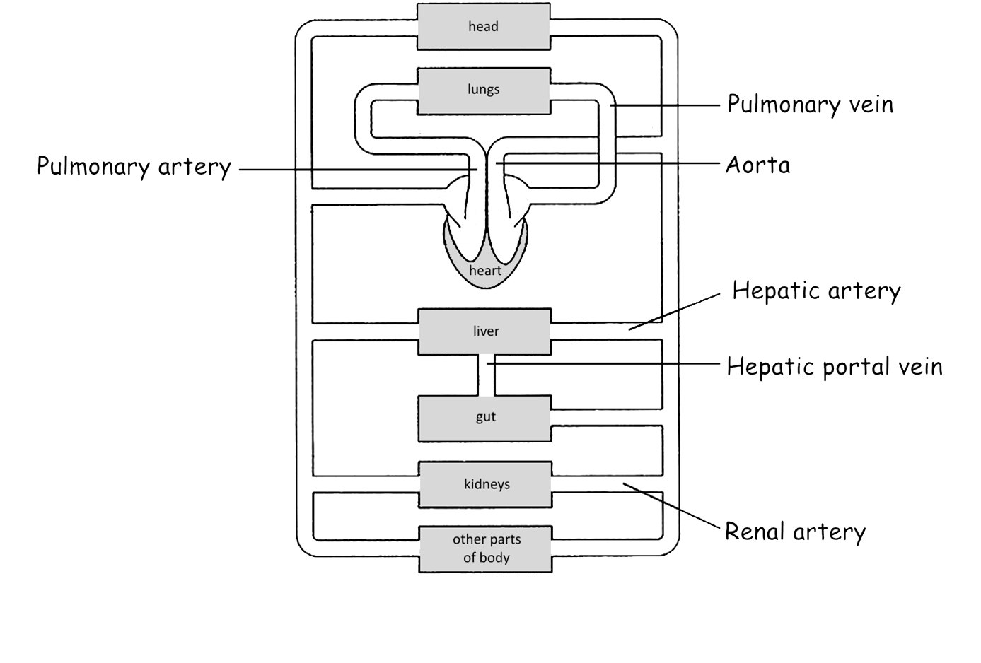
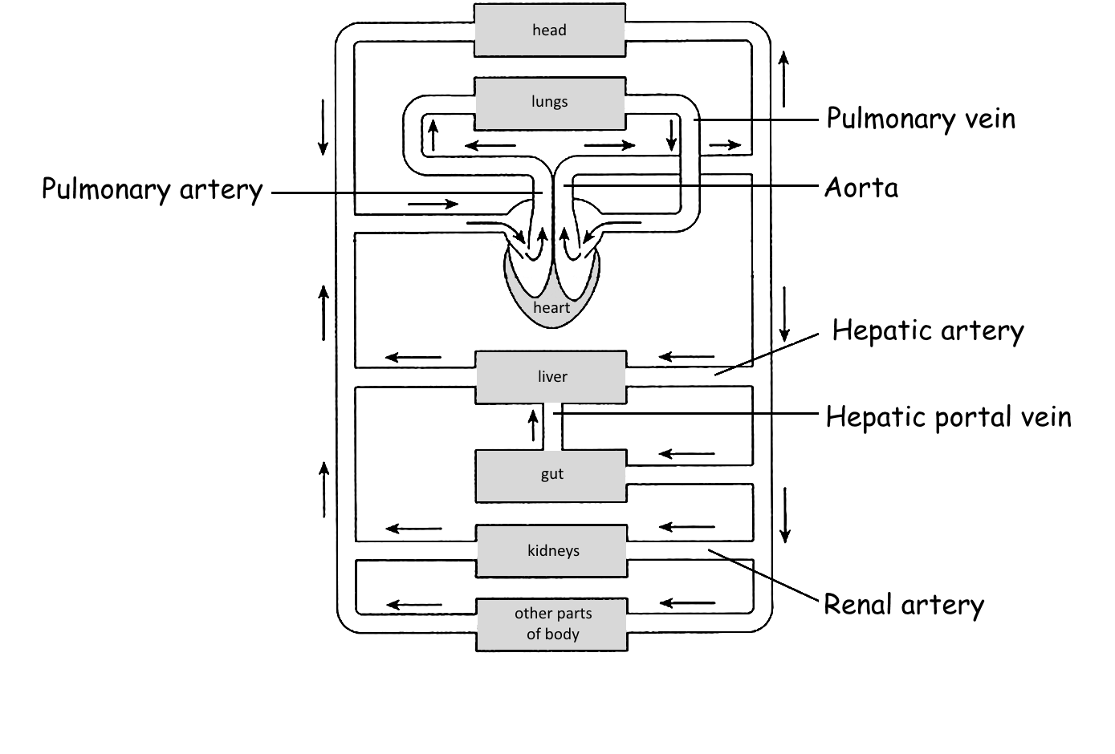
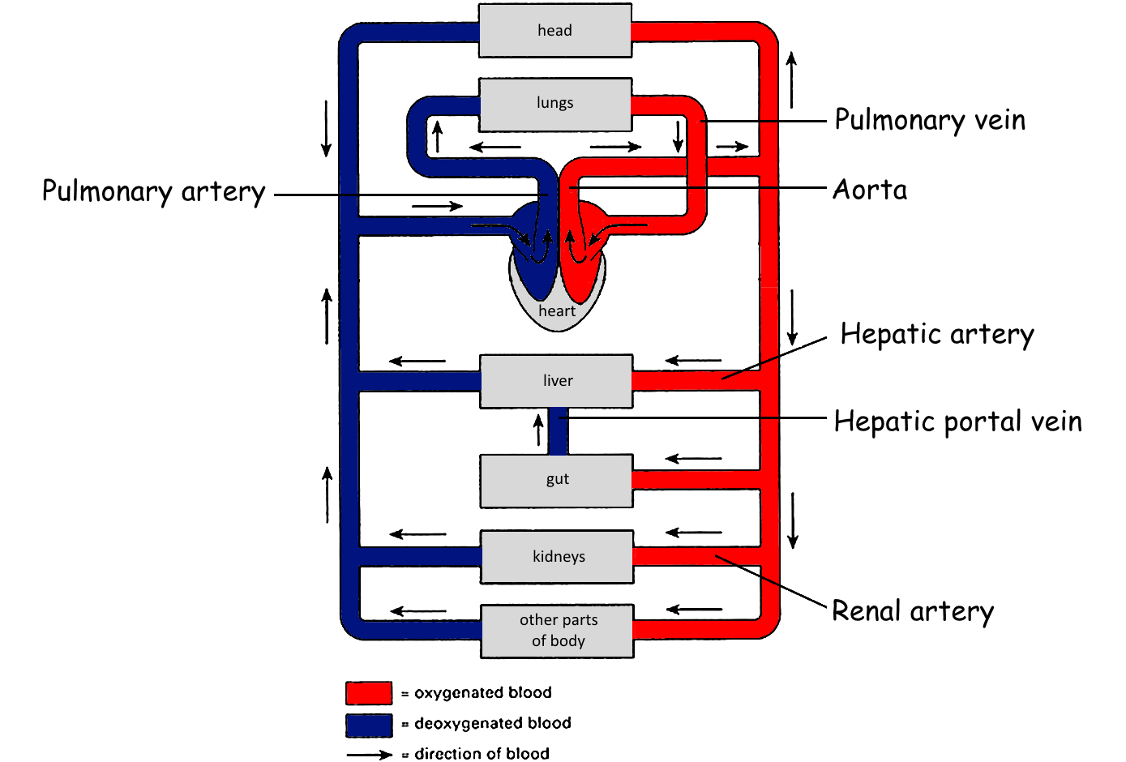
Structure of the heart
Label all blood vessels and heart chambers in the diagram below
Add colour to show oxygenated (red) and deoxygenated (blue) blood.
Left atrium
Left ventricle
Vena cava
Right atrium
Right ventricle

Slide 15
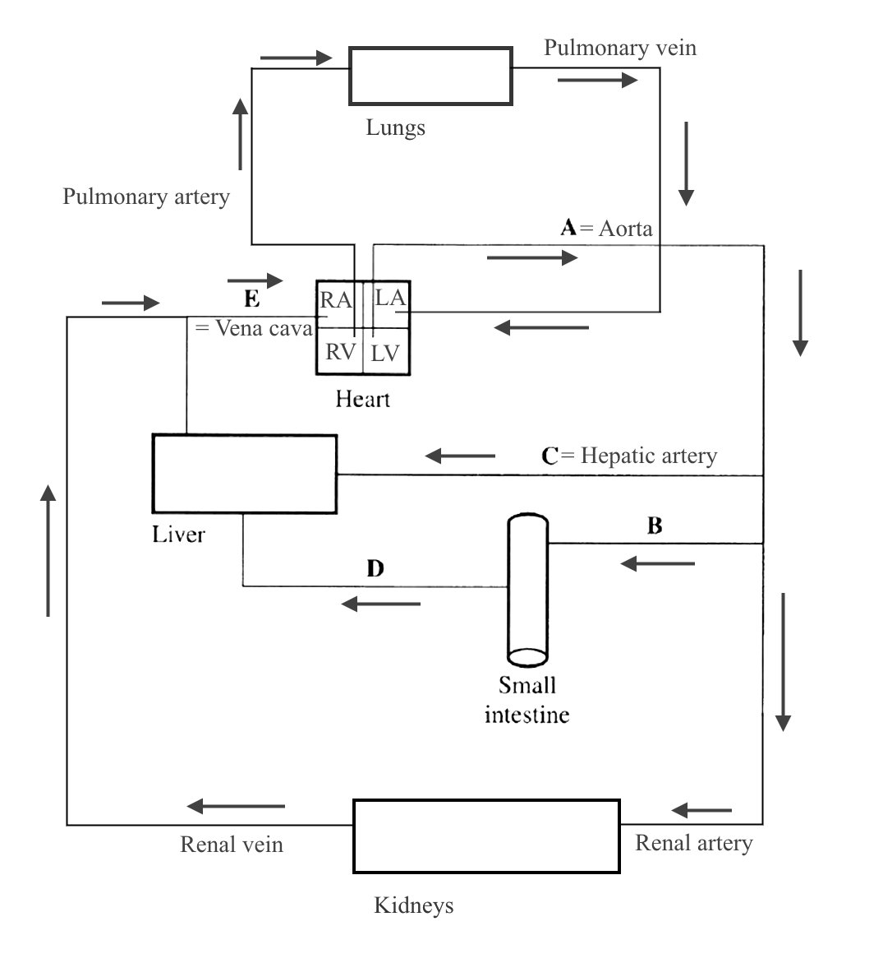
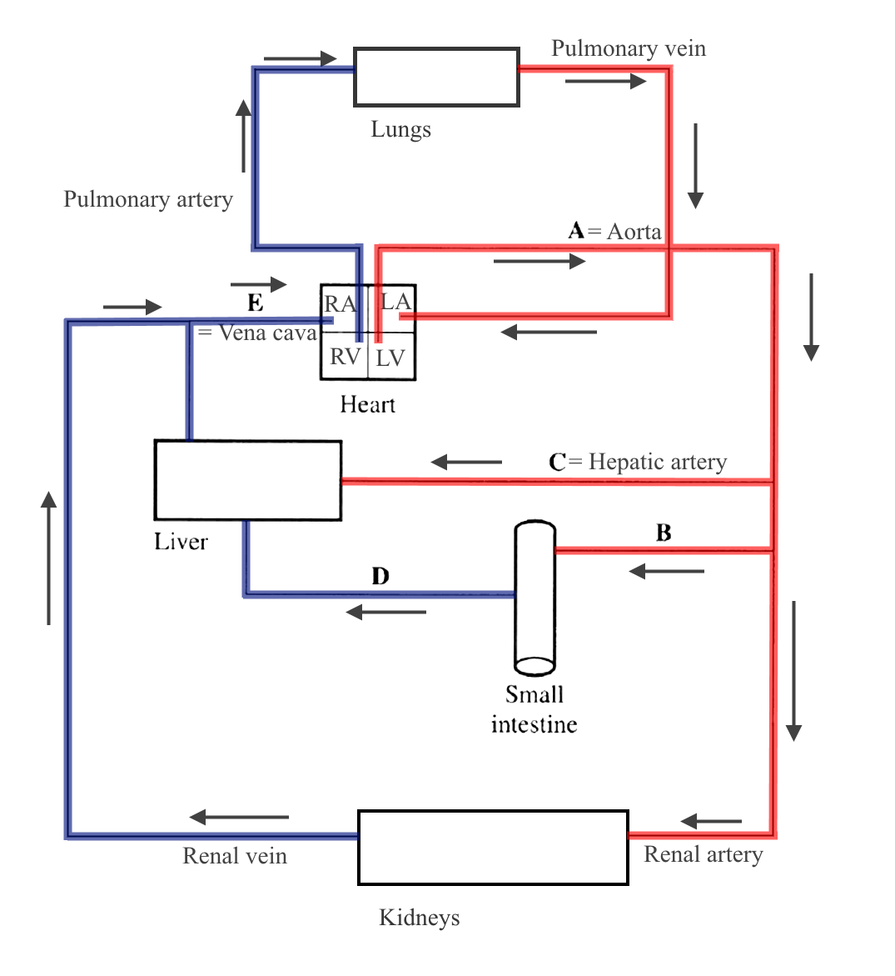
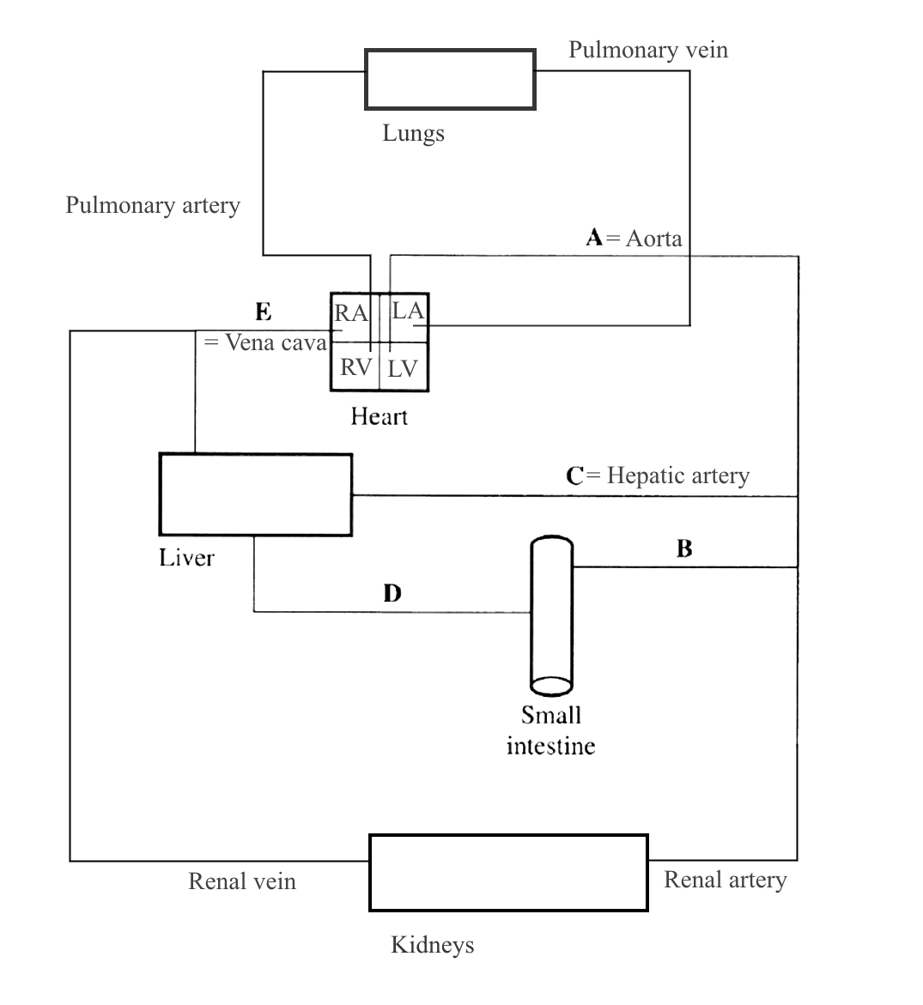
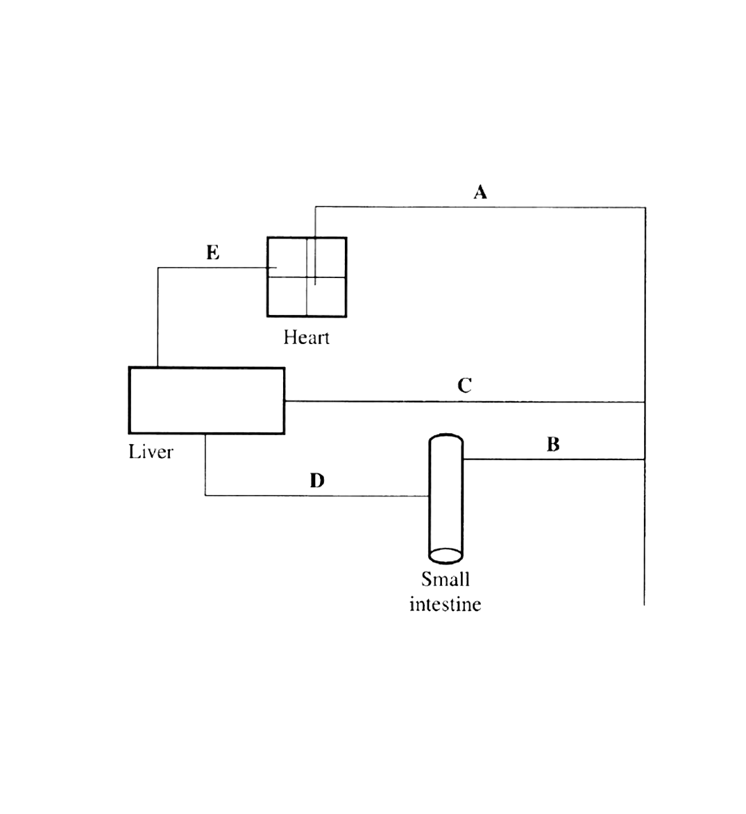
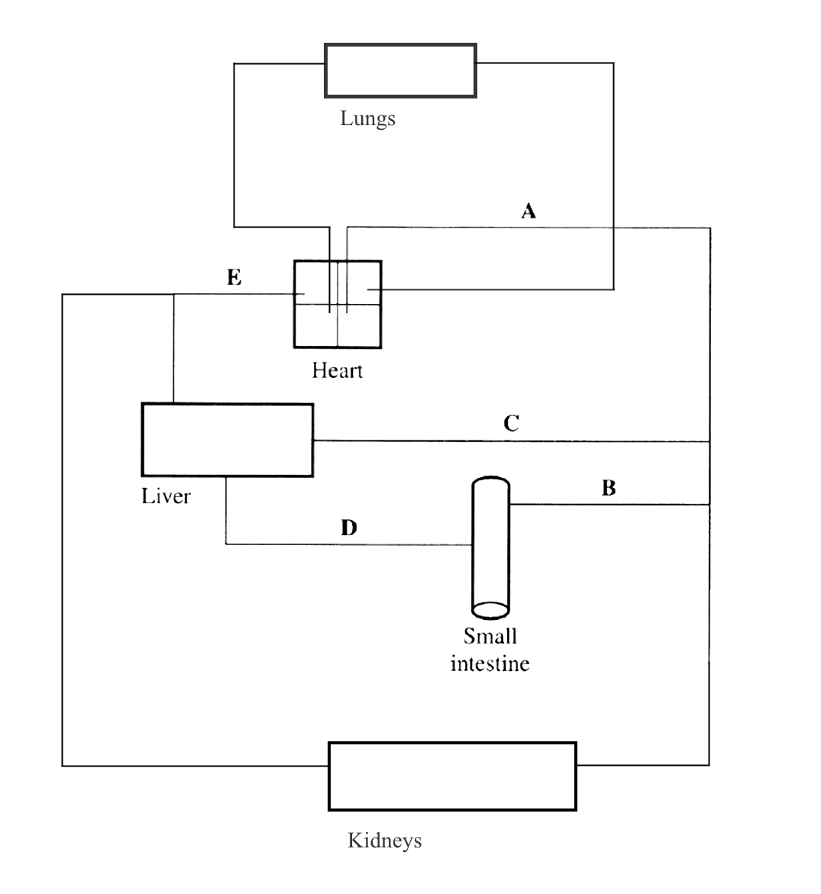
5. Blood vessel E has the lowest pressure

Slide 16
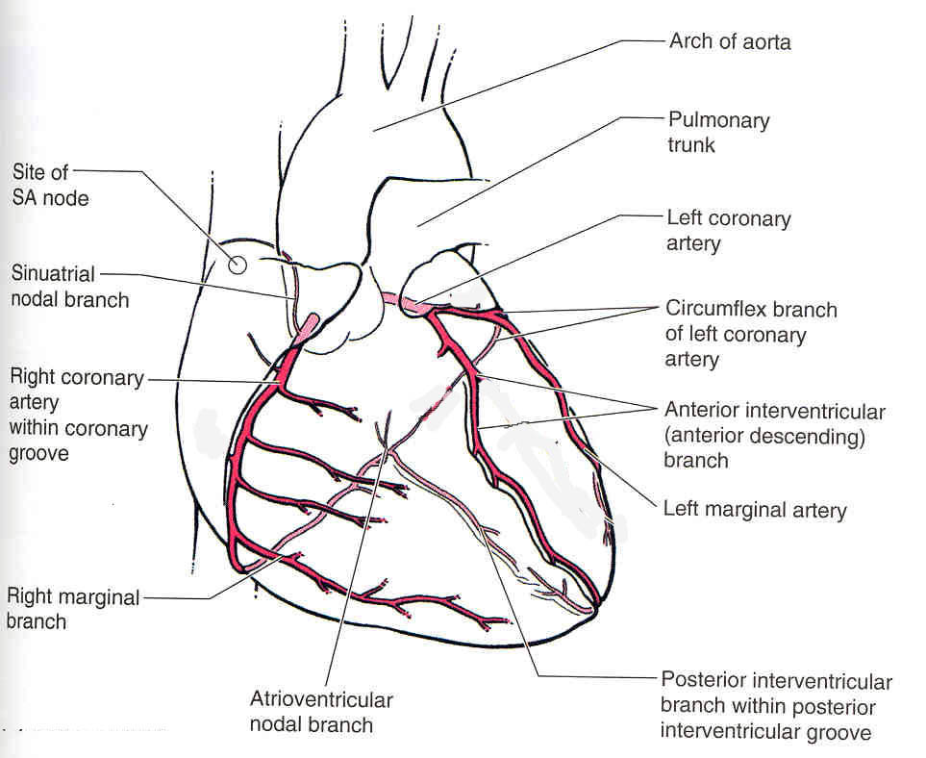
Blood Supply to the Heart
Heart muscle needs its own blood supply.
Arteries branch off from aorta to form the coronary arteries which run through heart muscle, close to outer surface.

Slide 17
Explain the role of coronary arteries, and why a blockage in one of these causes a heart attack (Myocardial infarction) (4)
Coronary arteries carry oxygen to the heart muscle
A blockage such as a blood clot or build up of fatty acids can restrict the flow of blood/ oxygen to the heart muscle.
If the clot blocks the coronary artery completely no oxygen is reaching the heart.
The heart muscle can no longer respire so muscle cells may die.
Resulting in a heart attack.

Slide 18
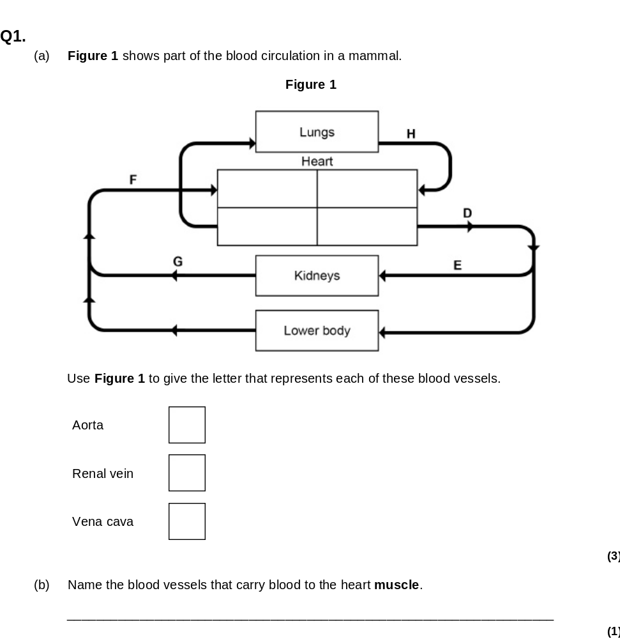
Have a go at exam question 1
  a) D
G
F
b) Coronary arteries

