Slide 1
Heart valves
Learning outcome:
Explain differences in the thickness of cardiac muscle between the atria and ventricles, and between different sides of the heart.
Explain the purpose of the AV and SL valves

Slide 2
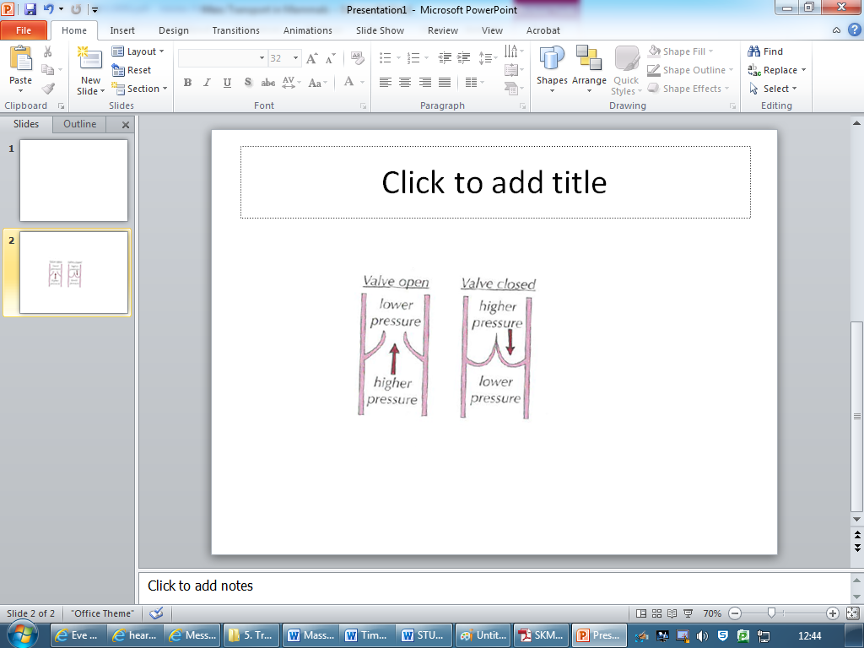
Heart Valves
They only open one way – whether they are opened or closed depends on the relative pressure on either side.
If there is a higher pressure behind the valve, it is forced open
If the pressure is higher in front of the valve, it is forced closed.
They prevent backflow of blood

Slide 3
https://www.youtube.com/watch?v=2jPTt23lRB8

Slide 4
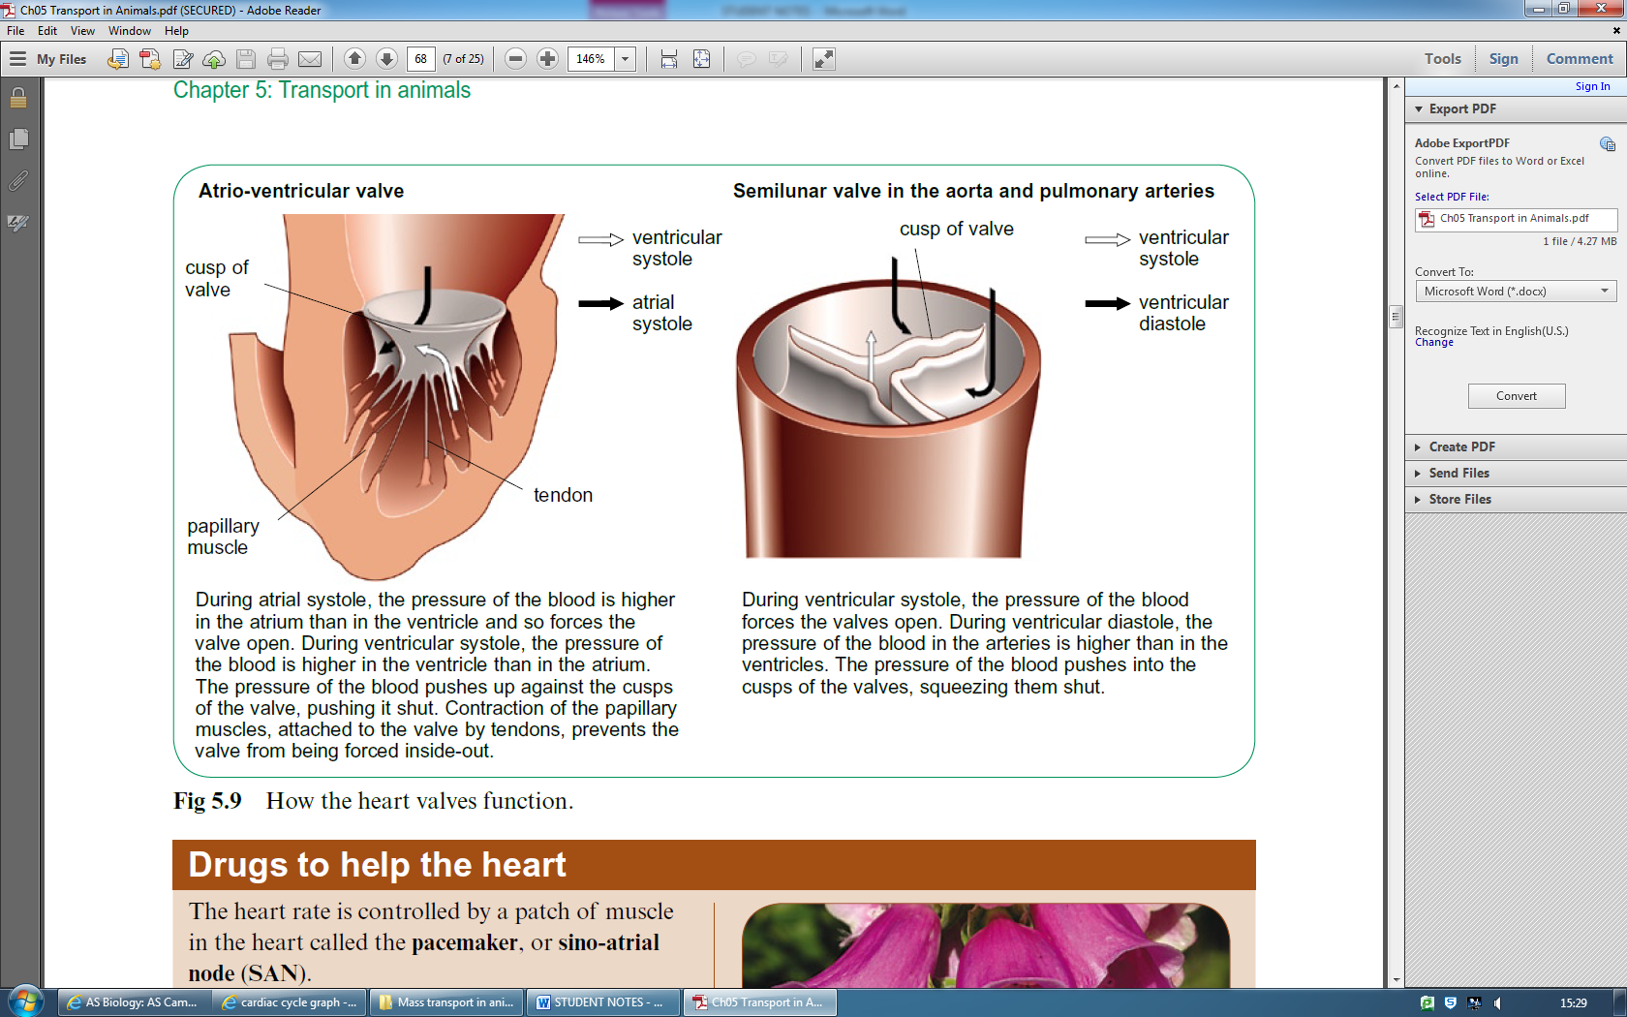

Slide 6
Muscle and Valves
Learning outcomes:
Explain differences in the thickness of cardiac muscle between the atria and ventricles, and between different sides of the heart.
Explain the purpose of the AV and SL valves
Task: Fill in the blanks using given words, and then use the information to annotate the diagram below
direction, pressure, contract, relax, greater, higher, A-V, S-L, atria, ventricles, ventricles, ventricles, ventricles, stronger, stronger

Slide 7
Muscle:
The muscle in walls of atria & ventricles contract to produce pressure to pump blood out
The more muscle in a chamber wall, the stronger the contraction and the greater the pressure produced
The ventricle have a thicker muscular wall for stronger contractions to pump blood out of the heart at higher pressure.
The atria have a thinner muscular wall than ventricle because they only need to produce enough force to push blood down into ventricle
Valves:
There are valves between atria & ventricles, and in the ventricles, to keep blood flowing in correct direction
The AV valves link atria to ventricles, and prevent backflow to atria when ventricle contract
The SL valves link ventricles to aorta & pulmonary artery, and prevent backflow into heart when ventricles relaxes

Slide 8
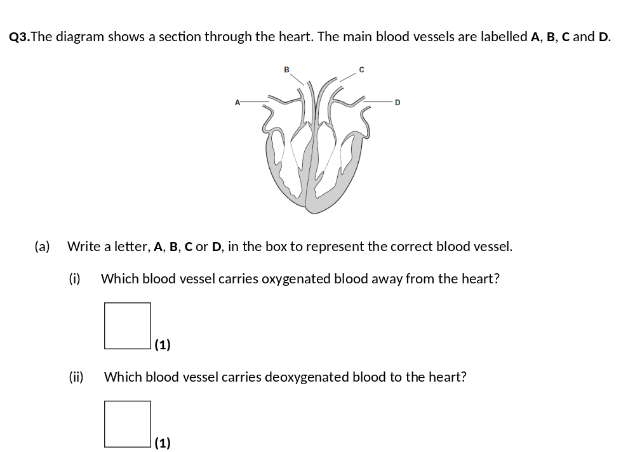
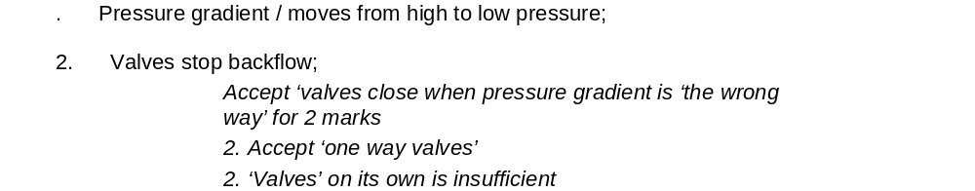
Have a go at the exam questions
Q2.In a healthy person, blood moves in one direction as it passes through the heart. Give two ways in which this is achieved.
1. _____________________________________________________________________
_______________________________________________________________________
2. _____________________________________________________________________
_______________________________________________________________________ (2)
C
A

Slide 9
