Slide 1
Cardiac cycle
Learning Outcomes
Explain the cardiac cycle in terms of atrial systole, ventricular systole and diastole
Analyse and interpret data relating to pressure changes during the cardiac cycle

Slide 2
Cardiac Cycle
This is the ongoing sequence of contraction & relaxation of the atria and ventricles
The 2 phases are contraction (SYSTOLE) and relaxation (DIASTOLE).
Contraction occurs separately in the atria & ventricles
Note the pressure and volume changes throughout the cycle

Slide 3
Cardiac cycle
Ventricular
systole
(contraction)
Diastole
(relaxation)
Atrial
systole
(contraction)
Relaxation = diastole
Contraction = systole

Slide 4
Use these prompts when describing the phases of the cardiac cycle
- Muscle
- Pressure
- Valve
- Direction
My Parents are Very Delightful)

Slide 5
Words to complete gaps on page 10 first of booklet
Ventricles | Increases | Diastole | Higher
Decreases | Vein | Systole | Open
Closed | Atria | Tendons | Arteries
Some words will be used more than once

Slide 6
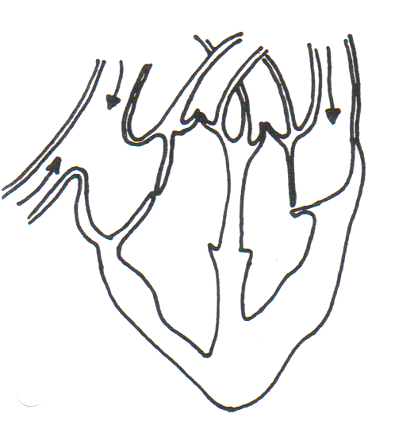
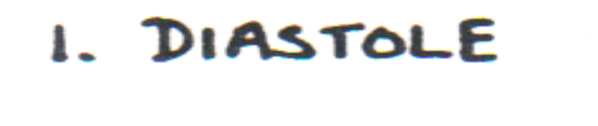
DIASTOLE
ACTION OF THE VALVES IN BOLD!
Heart muscle is relaxed
Pressure increases in the atria
Valves: Bicuspid and tricuspid valves open slightly
Direction: Blood starts to enter ventricles

Slide 7
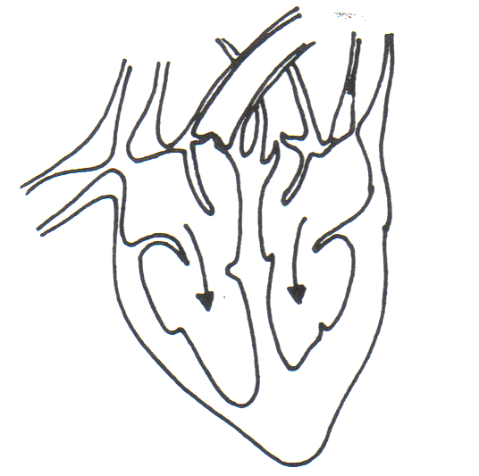

ATRIAL SYSTOLE
Muscles in atrial walls contract
Pressure in the atria increases
Valves: A-V valves are forced open when the pressure in atria is higher than in ventricles
Direction: blood flows into ventricles

Slide 8
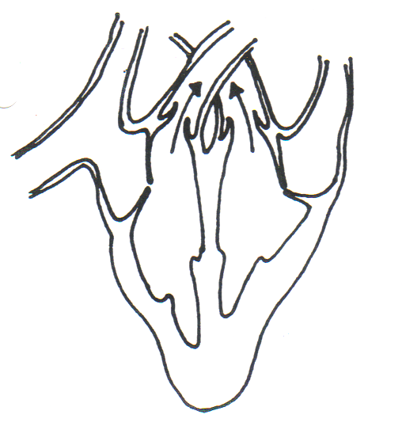

VENTRICULAR SYSTOLE
Muscles in ventricle walls contract
Pressure in ventricles increases
Valves: A-V valves are forced closed when the pressure in ventricles is higher than in atria,
Direction: valves prevent blood flowing back into atria
Pressure in ventricles is also greater than in arteries
Valves: S-L valves are therefore forced open
Direction: blood flows out of arteries

Slide 9
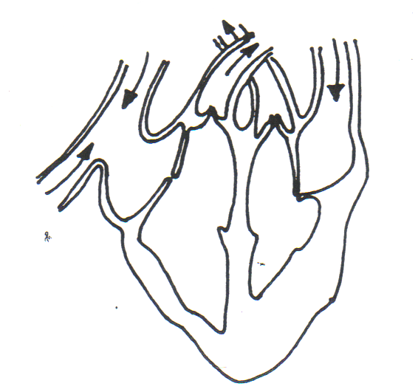

DIASTOLE
Heart muscle relaxes
Pressure in all chambers decreases
Pressure in arteries is now greater than in ventricles
Valves: S-L valves are therefore forced closed
Direction: valves prevent blood flowing back into ventricles
Direction: Blood enters L & R atria from veins

Slide 10
True or False?
The chamber which produces the greatest pressure is the left atrium
The left and right ventricles contract together
When the ventricle contracts the volume increases and the pressure increases
Systole is the relaxation phase of the heart
Semi-lunar valves occur between atria and ventricles
Blood is forced from the ventricles into the arteries because the pressure is higher in the ventricle
Diastole occurs after atrial contraction

Slide 11
Answers
The chamber which produces the greatest pressure is the left atrium F
The left and right ventricles contract together T
When the ventricle contracts the volume increases and the pressure increases F
Systole is the relaxation phase of the heart F
Semi-lunar valves occur between atria and ventricles F
Blood is forced from the ventricles into the arteries because the pressure is higher in the ventricle T
Diastole occurs after atrial contraction F

Slide 12
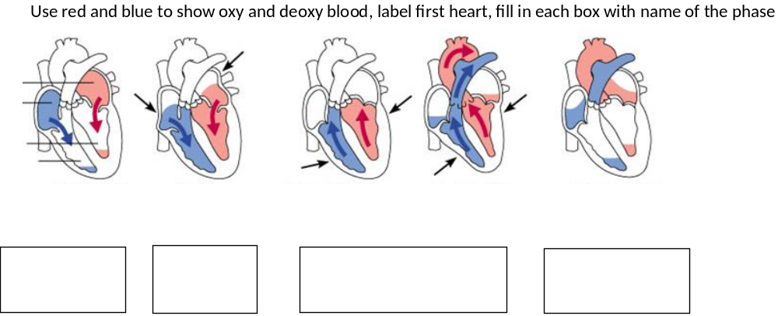
Now back on page 9

