Slide 1
Learning Outcomes
Process data to calculate rates

Slide 2
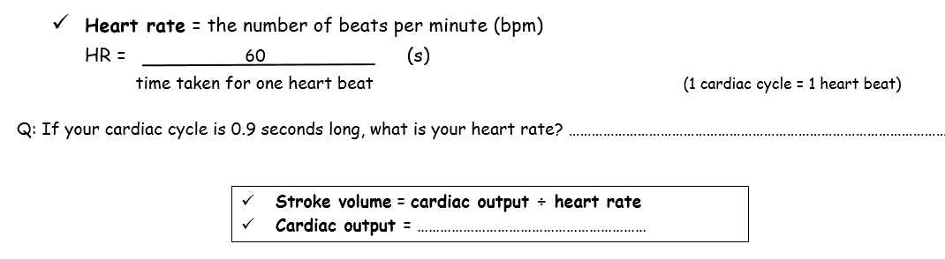
Calculations:
Stoke volume x heart rate

Slide 3
Why does training lower the resting heart rate of an athlete?
There is an increase in size of the heart / ventricles
There is an increase in muscle size in the walls
Therefore there is an increase in the strength of contraction
There is an increase in stroke volume
Cardiac output is the SAME

Slide 4
If a person’s cardiac output is 4.9 dm³min⁻¹, and their heart rate is 70bpm, calculate their stroke volume.
4.9 / 70= 0.07dm³

Slide 5
If a person has a stroke volume of 0.065 dm³ and a cardiac output of 5.2 dm³min⁻¹, calculate their heart rate.
5.2/ 0.065 = 80 bpm

Slide 6
On paper, answer the following questions
Name the chamber of the heart that produced the greatest pressure.
State whether each of the following statements is true or false.
The left and right ventricles contract together.
Veins have pocket valves.
Semi-lunar valves occur between the atria and ventricles.

Slide 7
Answers:
Left ventricle
True
b. True
False

Slide 8
Questions (cont.)
In each case, state what is being described.
On contraction it forces blood into the ventricles.
The relaxation phase of the heart.
Structures that prevent flow of blood from the aorta into the left ventricle.
After a period of training, the heart rate is often decreased when at rest although the cardiac output is unchanged. Suggest an explanation for this.

Slide 9
Answers (cont.)
a. Muscular wall of atrium; b. Diastole; c. semi-lunar valve
Training builds up the muscles of the heart and so the stroke volume increases / more blood is pumped at each beat. This means that. If the cardiac output is the same, the heart rate / number of beats per minute decreases.
5.2/0.065 = 80 bpm

Slide 10
Answer Q
If stroke vol = 61 cm³, heart rate = 79 bpm, what is cardiac output?
If stroke vol = 72.5 cm³, cardiac output = 5075 cm³ per min, what is heart rate?
If heart rate = 75 bpm, cardiac output = 5175 cm³ per min, what is stroke vol?
If stroke vol = 0.067 L, heart rate = 76 bpm, what is cardiac output?
If stroke vol = 0.071 L, cardiac output = 5538 cm³ per min, what is heart rate?
If heart rate = 74 bpm, cardiac output = 5402 cm³ per min, what is stroke vol in L?

Slide 11
Answers
61 cm³ x 79 bpm = 4819 cm³ min⁻¹
5079 cm³ min⁻¹ ÷ 72.5 cm3 = 70 bpm
5175 cm³ ÷ 75 bpm = 69 cm³
0.067 L x 76 bpm = 5.092 L min⁻¹ = 5092 cm³ min⁻¹
5538 cm³ min⁻¹ ÷ 71 cm3 = 78 bpm
5402 cm³ ÷ 74 bpm = 73 cm³ = 0.073L

Slide 12
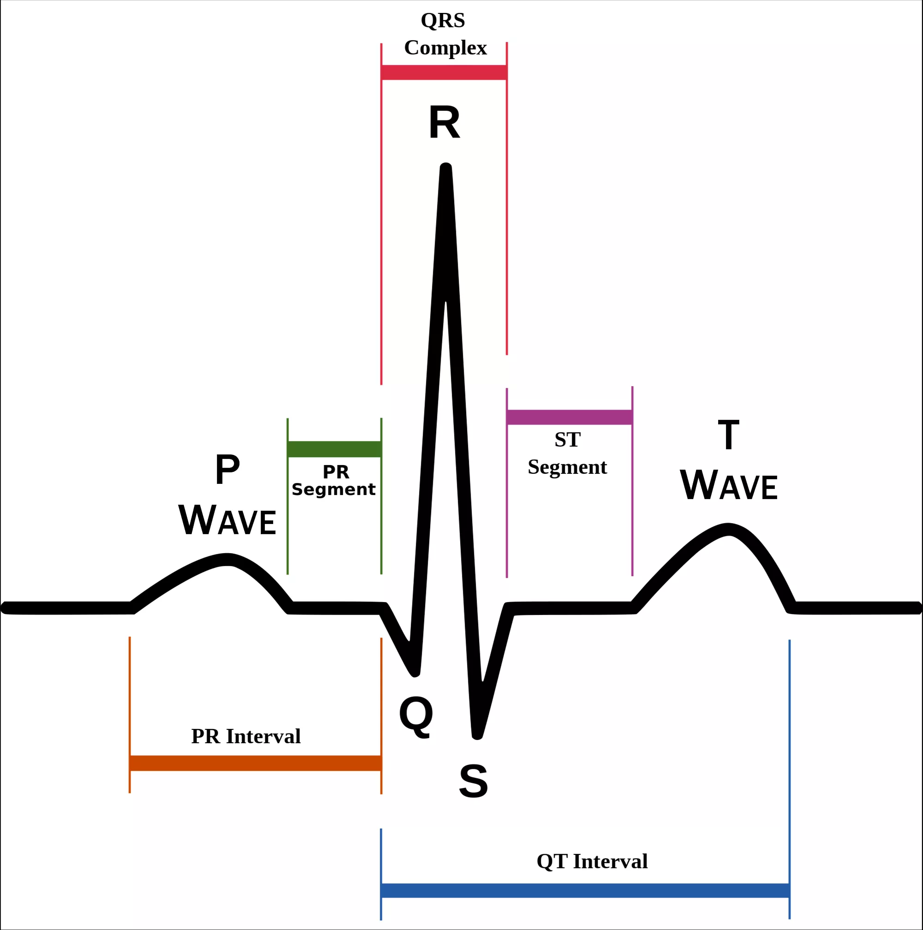
Electrocardiogram (ECG)
During the cardiac cycle, the heart undergoes electrical current changes. Some of the electrical activity generated by the heart spreads through the tissues next to the heart and to the skin where it can be picked up by sensors attached to the skin and converted to a trace.
If displayed on a cathode ray oscilloscope, these electrical changes can produce a trace called the ECG.
This is then used to picture of the heart’s electrical activity and therefore health.
The function of the ECG therefore, is to monitor the electrical activity of the heart.
The ECG consists of a series of waves P, Q, R, S and T .
The P wave shows excitation (contraction) of the atria
QRS shows the excitation (contraction) of the ventricles
The ventricles have more muscle and this is reflected in the greater electrical signal
T shows diastole - ventricle recovery
Therefore a longer T wave means the ventricles have a longer diastole / rest period
You may get exam questions based on ECG diagrams.
•Q--T is the filling time, when the ventricles are relaxed and filling with blood.

Slide 13
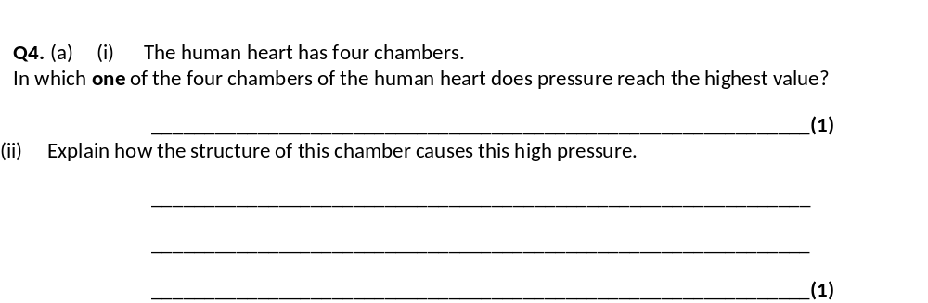
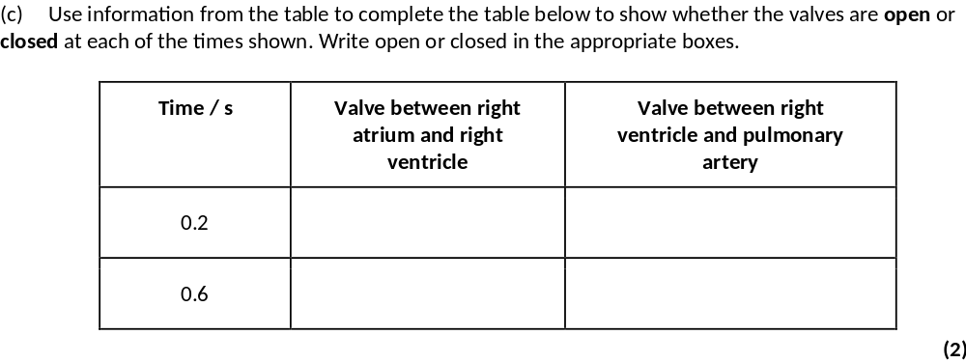
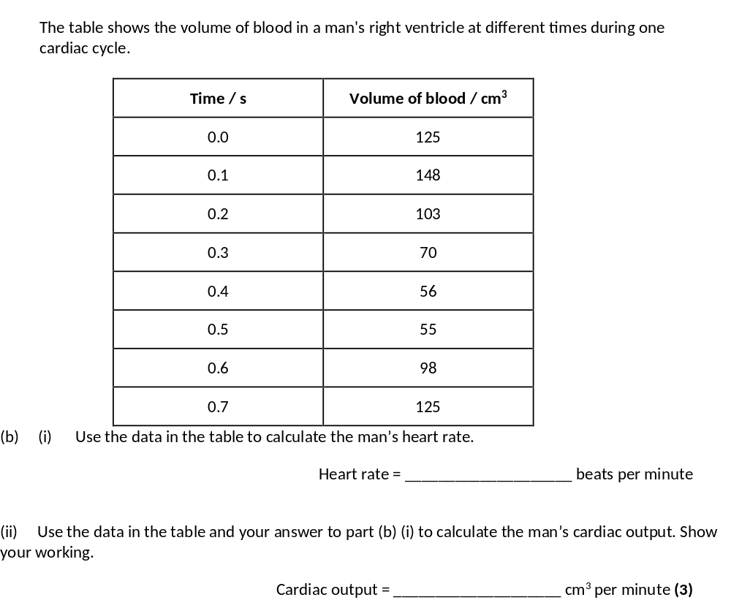
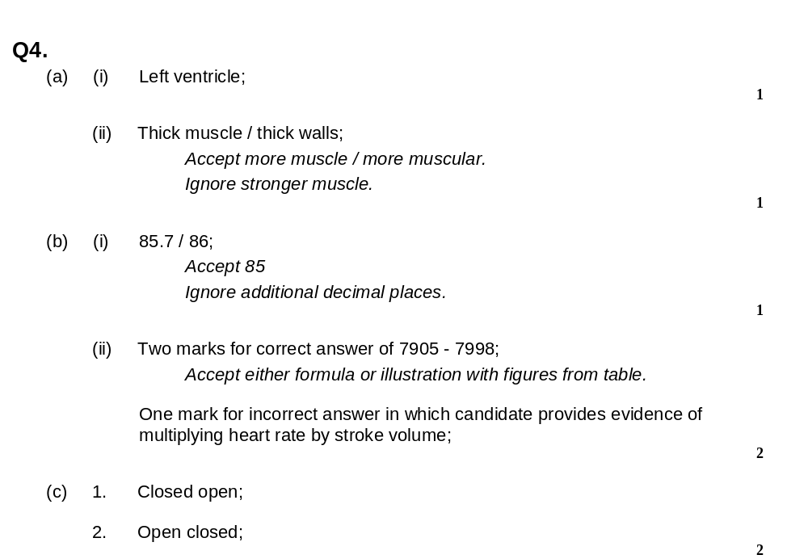
Have a go at exam question 4 and 5

Slide 14
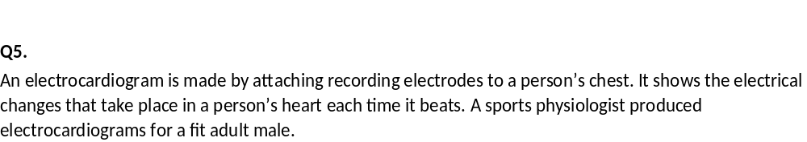
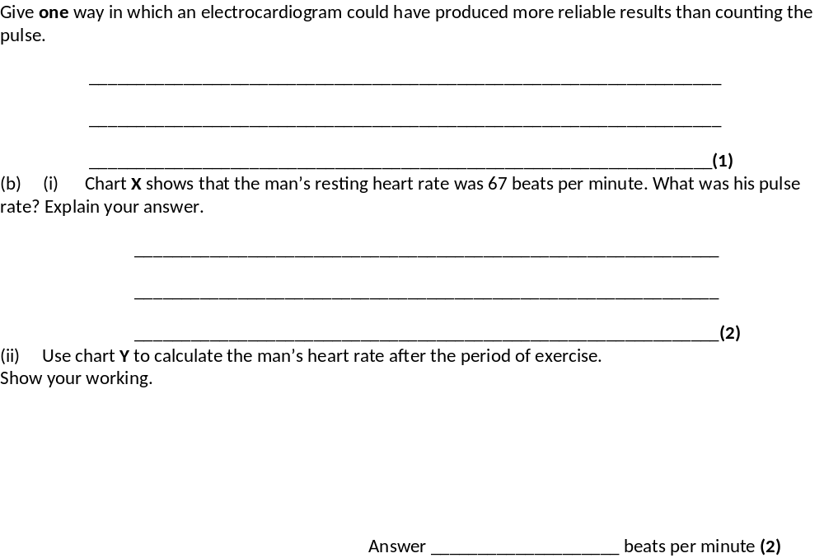
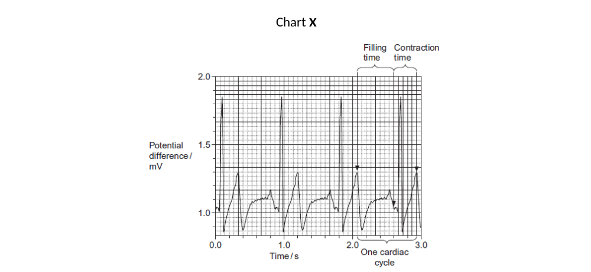
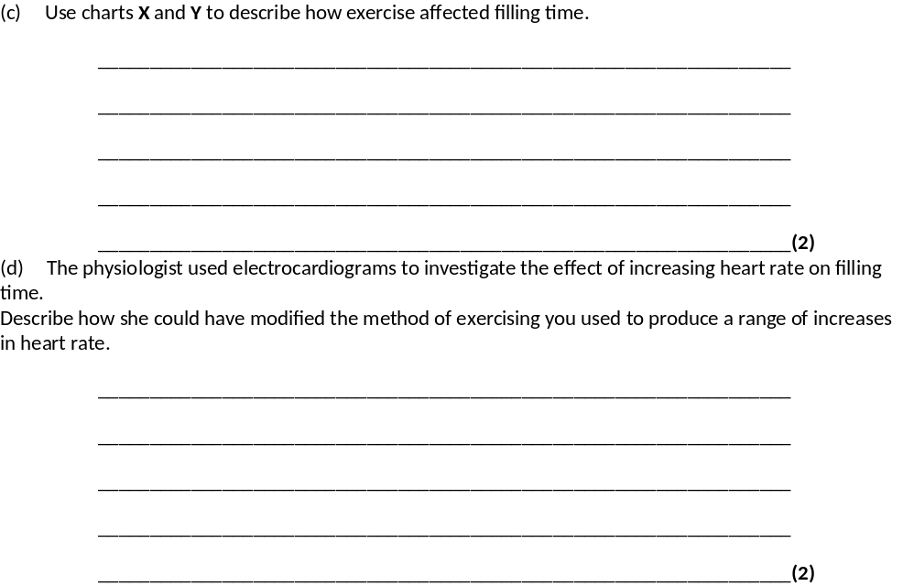
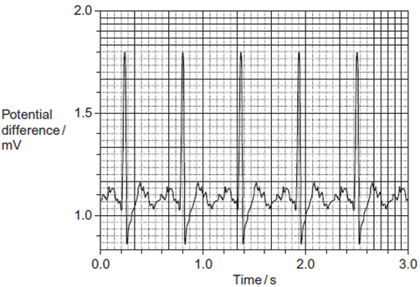

Slide 15
