Slide 2
Learning outcome
Explain the opening and closing of AV and SL valves in terms of the pressure differences at different stages of the cardiac cycle.
Analyse and interpret data relating to pressure changes during the cardiac cycle

Slide 3
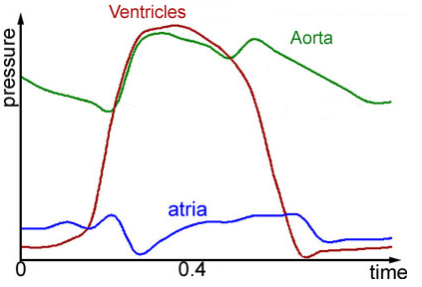
Pressure changes in left side of the heart during the cardiac cycle
3.
2.
4.
1.

Slide 4
Fill in the gaps
Use these words ( you can use a word more than once)
Ventricles,
Arteries,
Atria,
Semi lunar valve,
Atrio-ventricular valves

Slide 5
Ventricular systole causes an increase in pressure in ventricles so it is higher than in atria, therefore the movement of blood pushes the A-V valves shut.
Ventricular systole causes an increase in pressure in ventricles, so it is higher than the pressure in arteries, therefore the movement of blood (generated by the ventricular contraction) pushes the S-L valves open.
Ventricular diastole causes a decrease in pressure in ventricle, so it is lower than in the arteries, therefore the S-L valves close.
Ventricular diastole causes a decrease in pressure in ventricle, so it is lower than in the atria, therefore the A-V valves open.

Slide 6
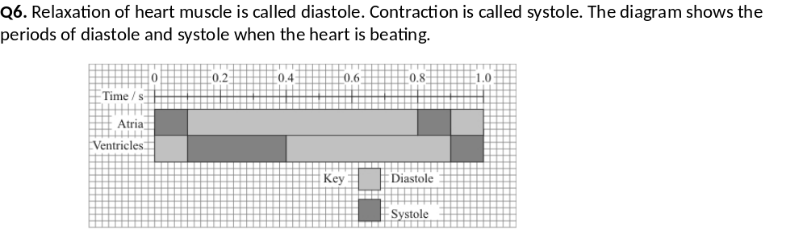
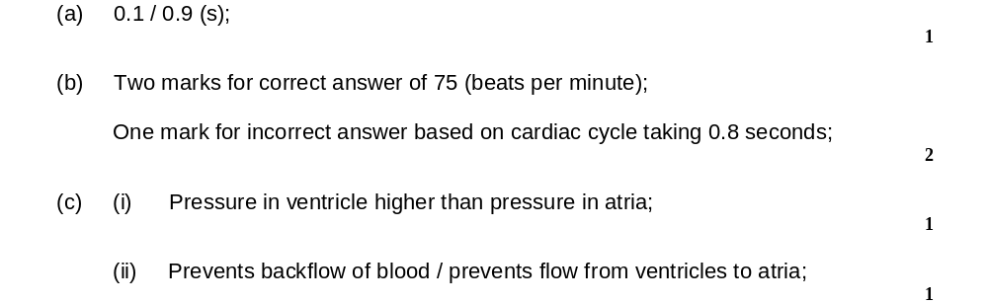
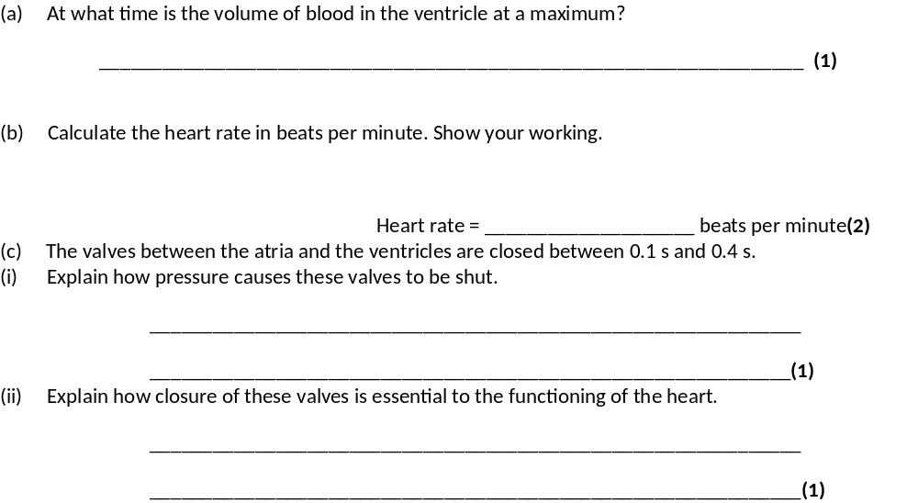
Have a go at exam question 6

Slide 7
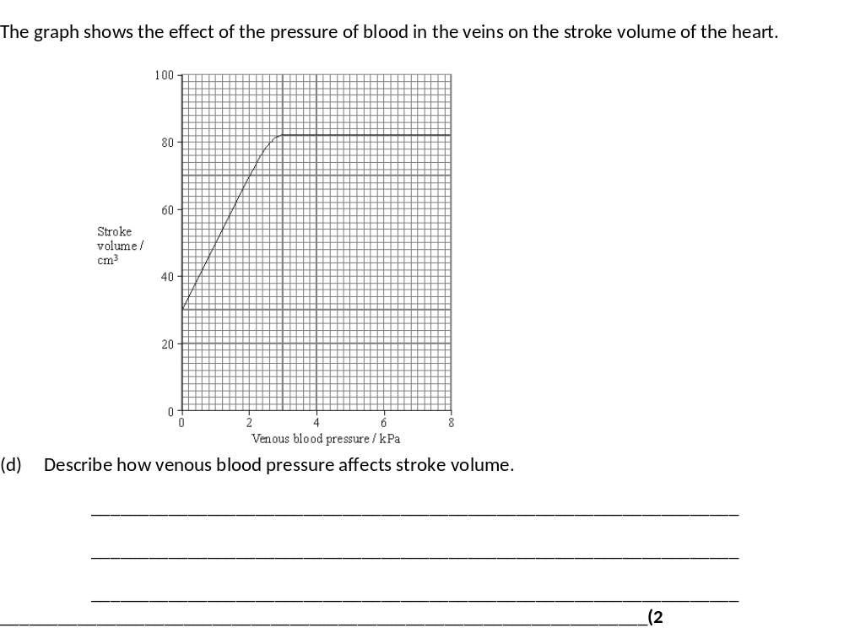
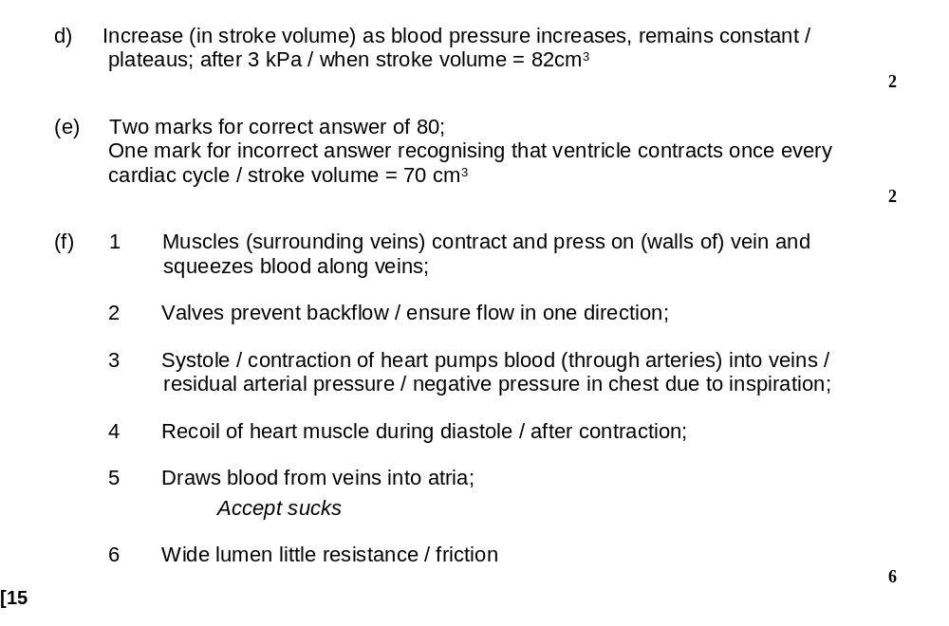
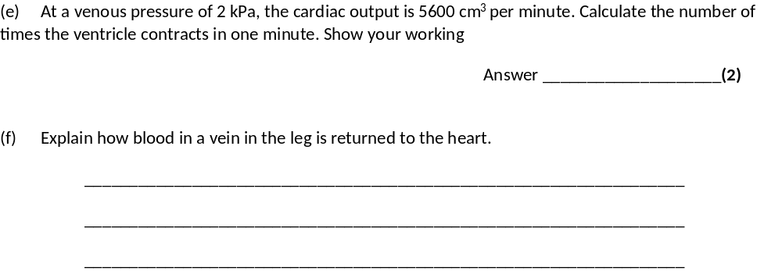
(6)

Slide 8
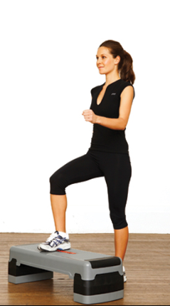

Design an experiment to test the effect of exercise on heart rate.

