Slide 1
Blood Vessels
Outcome:
Describe the structure of arteries, arterioles, veins and capillaries
Relate the structure of arteries, arterioles, veins and capillaries to their functions
Compare and contrast the structure and function of different blood vessels

Slide 2
Fill in the definitions

Slide 3
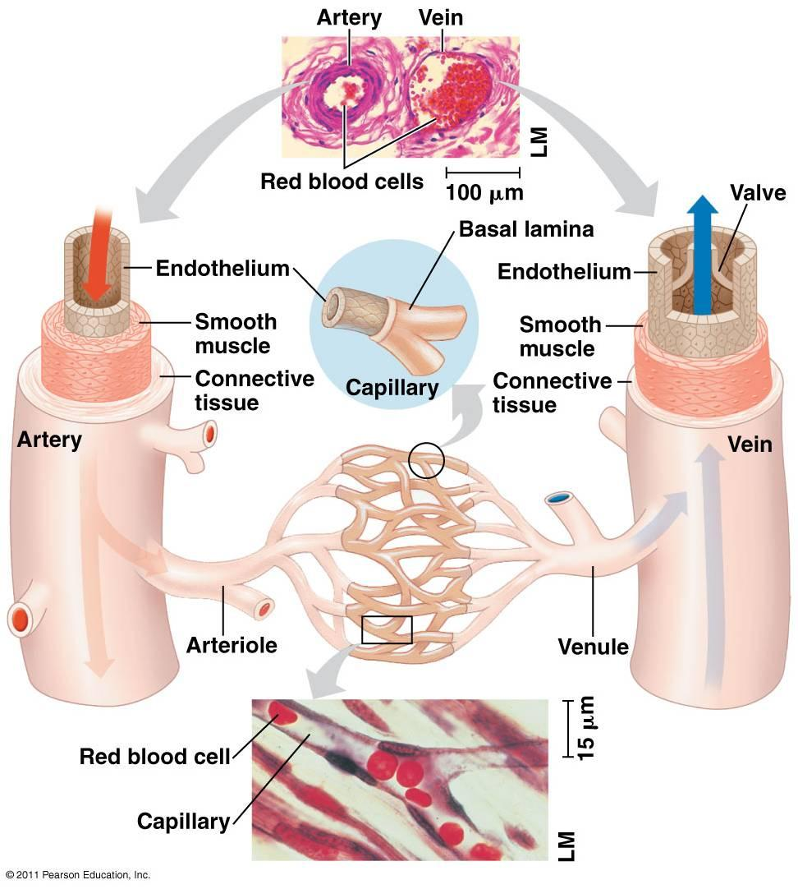
Blood Vessels Fill in the table
Arteries – carry blood away from heart, at high pressure, and into arterioles; blood travels in pulses
Arterioles – smaller arteries that control blood flow from arteries to capillaries
Capillaries – tiny vessels that link arterioles to veins; site of exchange between blood and cells
Veins – carry blood, at low pressure, from capillaries back to heart.

Slide 4
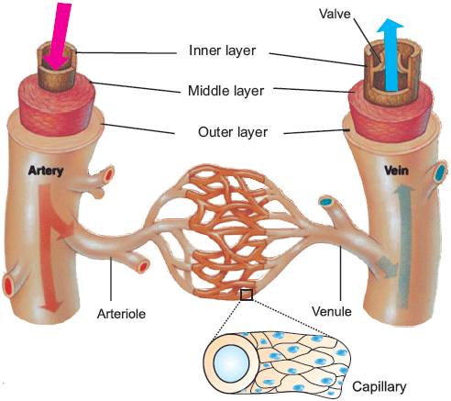
Common structure to arteries, arterioles and veins
Lumen = central cavity
Endothelium = thin, smooth inner lining
Wall = made of muscle, elastic tissue and collagen
The relative proportions of each layer differ in each type of blood vessel, and links to their different functions.

Slide 5
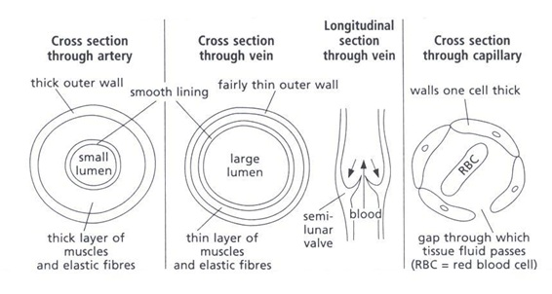
Artery:
Thicker muscular layer
Thicker elastic tissue layer
Wall thicker overall
Lumen is relatively narrower
Vein
Thinner muscular layer
Thinner elastic tissue layer
Wall thinner overall
Lumen is relatively wider
Capillary
wall only 1 cell think
Made of flattened endothelium
Spaces between the endothelial cells allow WBC to escape to get to site of tissue infection

Slide 6
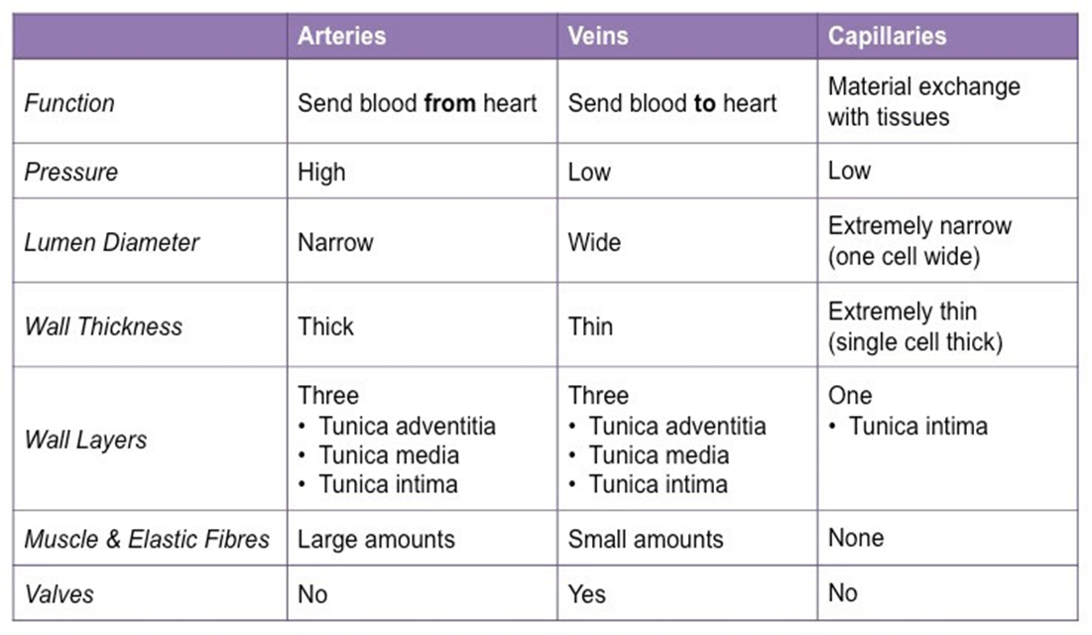

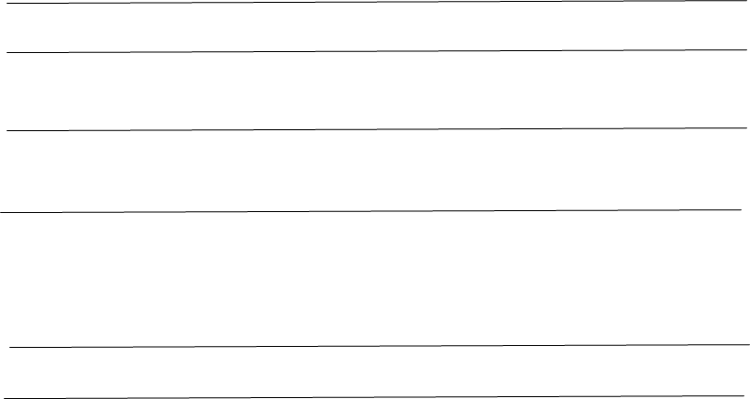


Slide 7
The Aorta and Elasticity
In the aorta wall, elastic fibres stretch when ventricle contracts
and recoil when ventricle relaxes.
This helps to maintain the blood pressure, smoothing it out
and also causes the thickness of the aorta to vary during the cardiac cycle
Which type of blood vessel is the Aorta?
Answer : Artery

Slide 8
Exam question
Explain 4 ways in which the structure of the aorta is related to its function.
Link to :
Elastic tissue
Muscle
Thickness of wall
Endothelium
Valves

Slide 9
Answer
Elastic tissue allows stretch and recoil to maintain blood pressure
Elastic tissue stretches when ventricles contract
Muscle allows contraction, vasoconstriction
Thick walls stop bursting
Smooth endothelium reduces friction
Semi-lunar valves prevent backflow

Slide 10
Structure & function of blood vessels
Sort card activity – then fill in your blanks

Slide 11
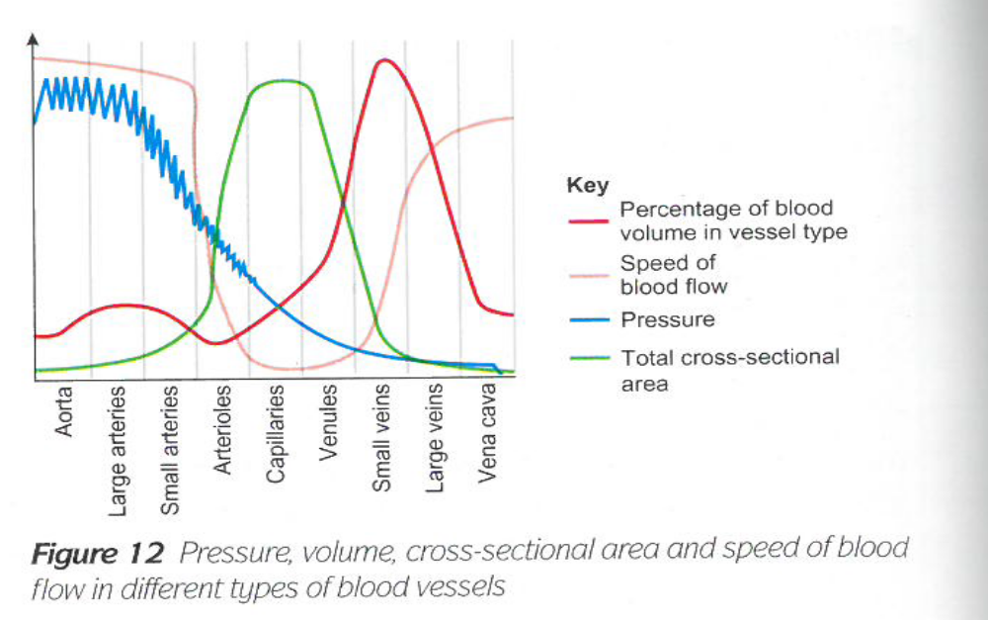
Diagram to show pressure, volume, cross-sectional area and speed of blood flow in different types of blood vessels

Slide 12
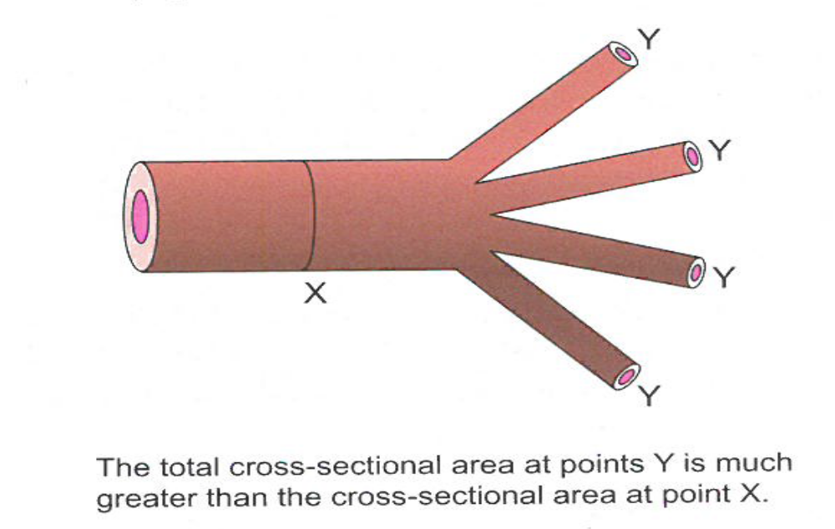
The total cross-sectional area at points Y is much greater than the cross-sectional area at point X
Why are capillaries, arterioles and venules branched?

Slide 13
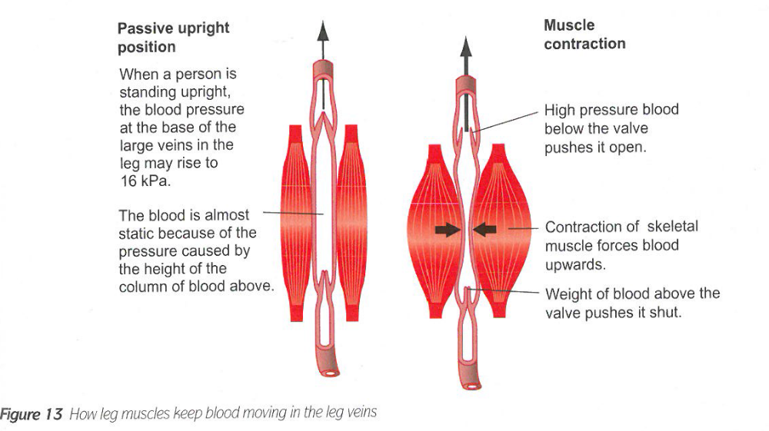
How leg muscles keep blood moving in the leg veins

Slide 14
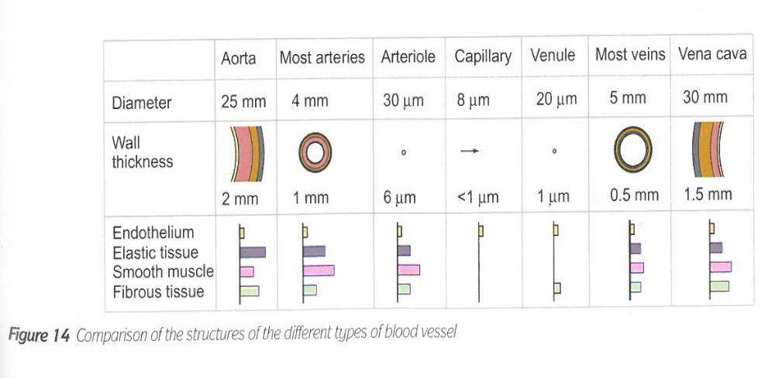
Comparison of the structure of the different types of blood vessels

Slide 15
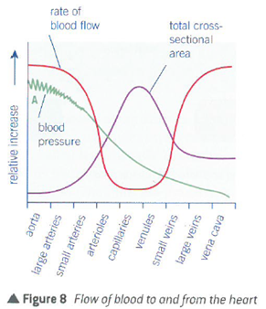
Questions on Blood Vessels (not in booklet)
Describe the changes in the rate of blood flow as blood passes from the aorta to the vena cava.
Explain why blood pressure in region A fluctuates up and down.
Explain why the rate of blood flow decreases between the aorta and capillaries.
Explain how the rate of blood flow in the capillaries increases the rate of exchange of metabolic materials.
Explain why the structure of the capillaries increases the efficiency of the exchange of metabolic substances.

Slide 16
Answers:
Rate of blood flow decreases gradually in the aorta and then very rapidly in the large and small arteries.
It remains relatively constant in the arterioles, then increases, at an increasing rate, in the venules and veins and vena cava.
2. Contraction of the left ventricle of the heart causes distension of the aorta.
The elastic layer in the aorta walls creates a recoil action. There is therefore a series of pulses of increased pressure, each one the result of ventricle contraction.

Slide 17
This is because the total cross-sectional area is increasing, so there is increased frictional resistance from the increasing area of blood vessel wall.
Blood flow is slower, allowing more time for metabolic materials to be exchanged.
Capillaries have a large surface area and very thin walls (single cell thick) and hence a short diffusion pathway.

Slide 18
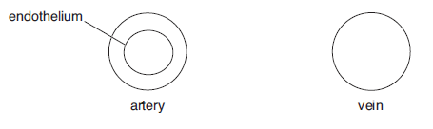
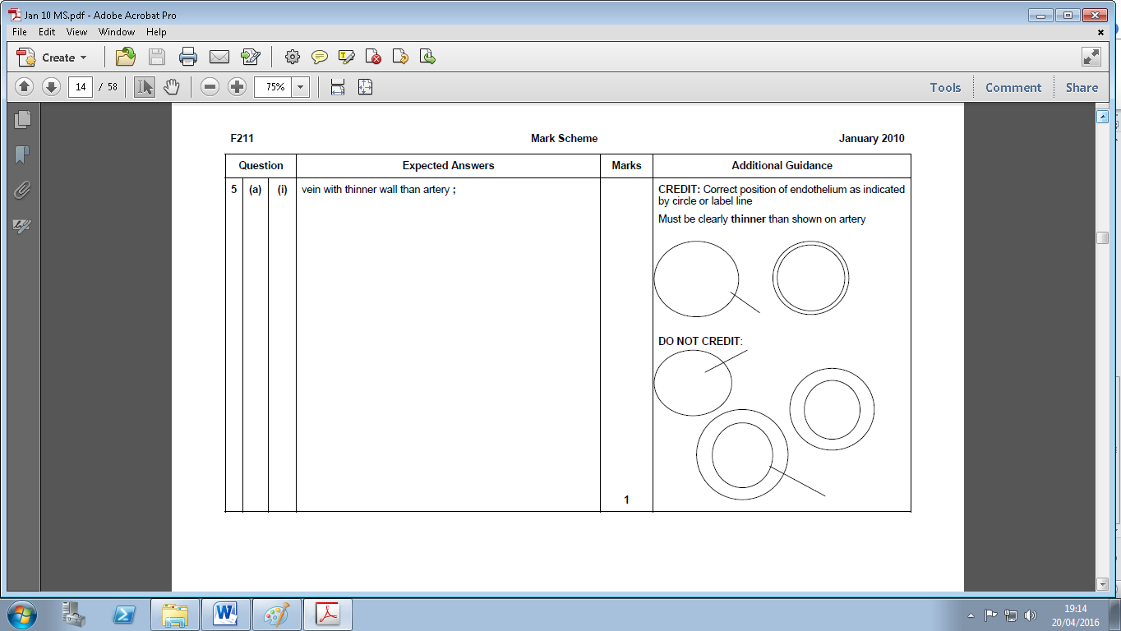
2 a) Figure below represents a transverse section of an artery and vein; draw a line to show the relative position of the endothelium of the vein

Slide 19
2b). State 2 other ways in which the wall of an artery is different from the wall of a vein. [2]
Arteries have –
No valves,
More/ Thicker muscle/elastic tissue
Narrower lumen

Slide 20
3. Explain why the hydrostatic pressure of the blood drops as blood moves away from the heart. [2]
There are more vessels
The vessels have a larger cross-sectional area
There is reduced resistance to blood flow
There is loss of fluid from the capillaries
The arteries can stretch / expand

