Slide 1
Tissue Fluid
It is a watery liquid made from substances that leave the blood in the capillaries,
But does NOT contain RBC, platelets, many WBC or large plasma proteins (these are too large to leave the capillaries).
It contains glucose, amino acids, fatty acids, ions in solution, oxygen and some WBC (macrophages)
It bathes the body cells in the tissues, supplying all the substances above, and receiving carbon dioxide and other waste materials
The capillary bed is the exchange surface and therefore is crucial
Tissue fluid is therefore how exchange of gases & nutrients between blood and cells occurs
It is the environment of the cells – it is “where they live” 

Slide 2
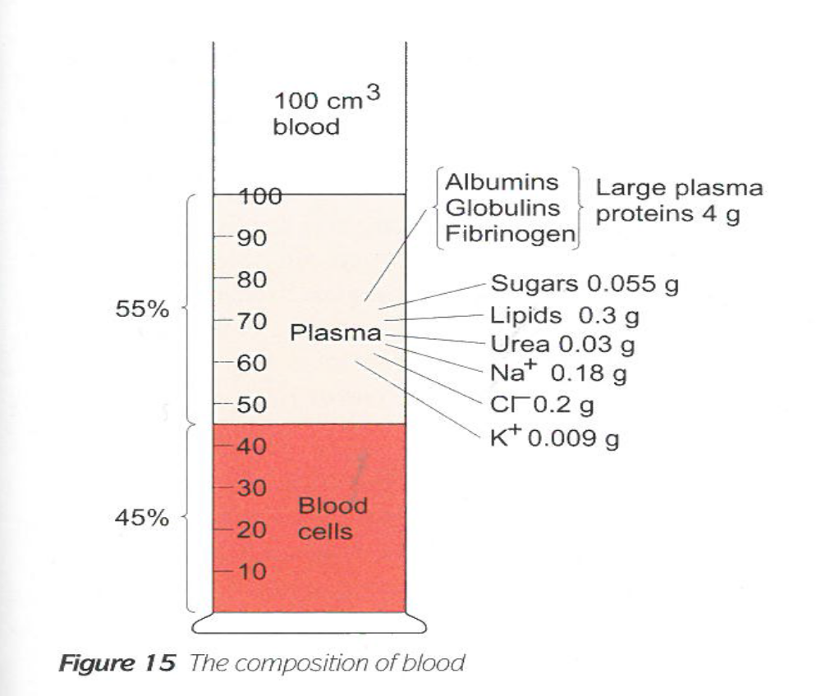
The composition of blood

Slide 3
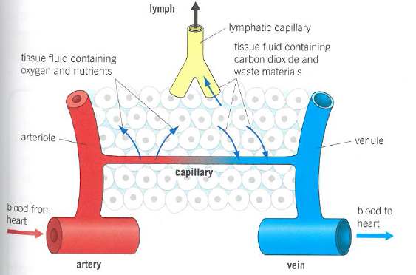
Formation of Tissue Fluid
Transport of O₂, CO₂, glucose, amino acids, urea & proteins
Fill in each box with the correct substance(s)
 | From Capillaries to tissue | To capillaries from tissue
Alveoli
Intestinal villi
Brain
Leg muscles
Liver

Slide 4
Answers:
 | From Capillaries to tissue | To capillaries from tissue
Alveoli | Carbon dioxide | Oxygen
Intestinal villi | Oxygen | Carbon dioxide, glucose, amino acids
Brain | Oxygen, glucose, amino acids | Carbon dioxide
Leg muscles | Oxygen, glucose, amino acids | Carbon dioxide
Liver | Oxygen, glucose, amino acids | Carbon dioxide, urea (and glucose when in low concentration in blood)

Slide 5
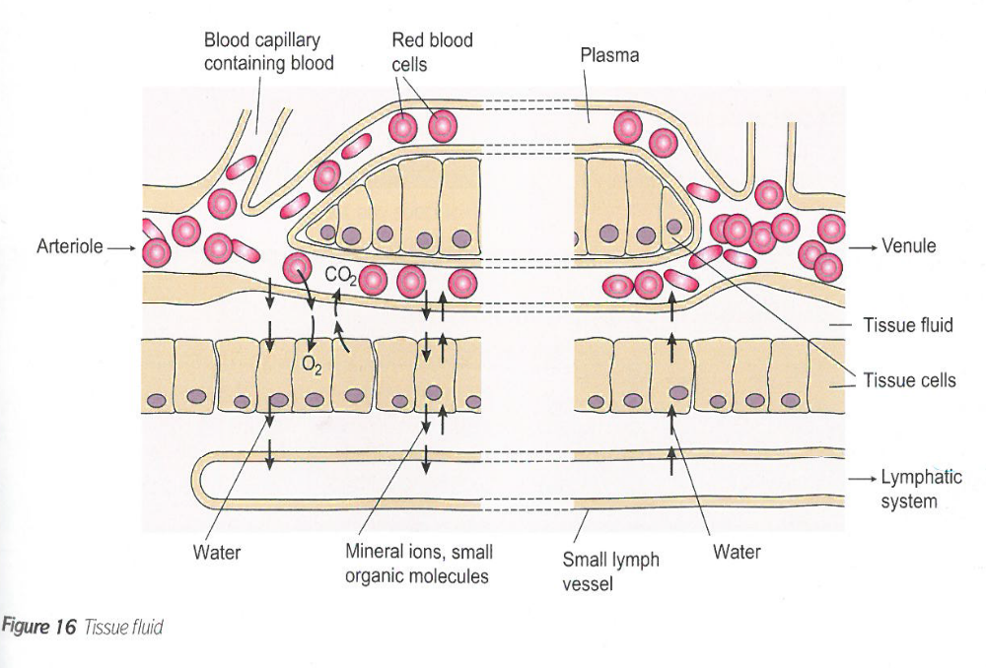

Slide 6
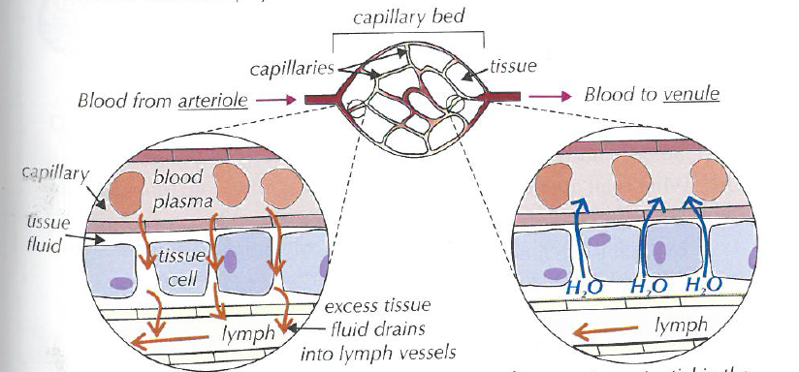
Tissue Fluid
Higher HP in capillaries than in TF – therefore fluid is forced OUT down hydrostatic pressure gradient
Lower water potential in capillaries than in TF – therefore water re-enters by osmosis down a WP gradient

Slide 7
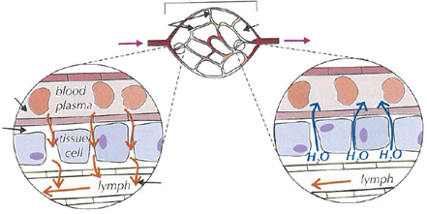
Formation of Tissue Fluid
At Arteriole end:
There is a high hydrostatic pressure (HP) in the capillaries created by contraction of the ventricles.
This is greater than the HP of tissue fluid outside the capillaries
Therefore water to move OUT of capillaries and into the spaces around cells, forming the tissue fluid (TF)
Small molecules are also forced out
Cells and the larger plasma proteins, are too large to cross the membrane = ultrafiltration.

Slide 8
Formation of Tissue Fluid
At Venule end:
The loss of water from the capillaries reduces the HP inside
So the HP is now lower than the issue fluid outside
The water potential is lower inside the capillary than outside in the TF due to the water loss and the fact the larger proteins are still in the capillary
Therefore water re-enters the capillaries from the tissue fluid by osmosis down a water pot gradient.

Slide 9
Exam Question
In humans, substances move out of the capillaries to form tissue fluid.
Describe how this tissue fluid is returned to the circulatory system

Slide 10
Answer
Formation
High hydrostatic pressure
Forces water out, and small molecules
But large proteins remain in the capillary
Return to circulation
There is a low water potential in capillary
Due to proteins which are too large to leave
Therefore WATER enters capillary
By OSMOSIS
And some water returns to circulation via lymphatic system

Slide 11
Questions
Q1. Why does a high BP lead to accumulation of tissue fluid?
Q2. Why does a lack of protein in the blood cause a build up of tissue fluid (Kwashiokor)?
A high blood pressure will cause a high hydrostatic pressure
Which increases the outward pressure from the arteriole end of the capillary
Therefore more tissue fluid is formed
The water potential in the capillary is now not as low
Therefore LESS water is removed into the capillary by osmosis

Slide 12
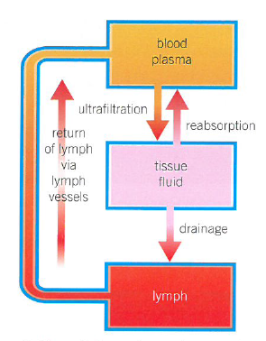
Lymphatic System
Not all 100% the tissue fluid can return to the capillaries.
The remaining fluid (10%)is carried back via the lymphatic system, and is called lymph
This is a system of blind-ending vessels that begins in the tissue = lymph vessels
Small lymphatics (the lymph capillaries) join to form bigger lymph vessels which are found throughout the body
Eventually, the larger vessels drain back into the bloodstream via the left & right subclavian veins
The lymph is moved by:-
Hydrostatic pressure of the tissue fluid that has left the capillaries
Contraction of body muscles that squeeze the lymph vessels
Valves in the lymph vessels ensure the fluid inside moves away from the tissues in the direction of the heart

Slide 13
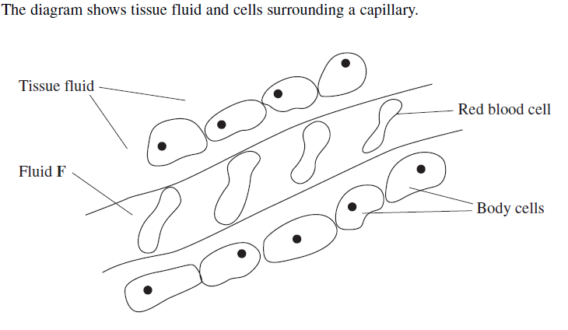
The lymphatic system contains LYMPH NODES which are:
found at intervals along lymph vessels
protect against disease
and where some white blood cells remove pathogens, while others make antibodies
Name F:
Plasma

Slide 14
Comparison of Blood, Plasma & Tissue Fluid
 | Blood | Plasma | Tissue Fluid | Lymph
Red blood cells | yes | no | no | no
White blood cells | yes | no | A very few | Many
Proteins | yes | yes | Yes – fewer & smaller | Yes – fewer & smaller
Fats | yes | yes | yes | Yes – more than blood
Glucose | yes | yes | Yes - less | Yes - less
Amino acids | yes | yes | Yes - less | Yes - less
Oxygen | yes | yes | Yes - less | Yes - less
Carbon dioxide | yes | yes | Yes - more | Yes - more
Location | In blood vessels | In blood vessels | Surrounding cells | In lymph vessels
Direction of Flow | From heart to tissues to heart | From heart to tissues to heart | No flow | Tissues to lymph vessels to blood
Cause of flow | Heart & muscles | Heart & muscles | No flow | Pressure from tissue fluid, valves and contraction of body muscles

Slide 15
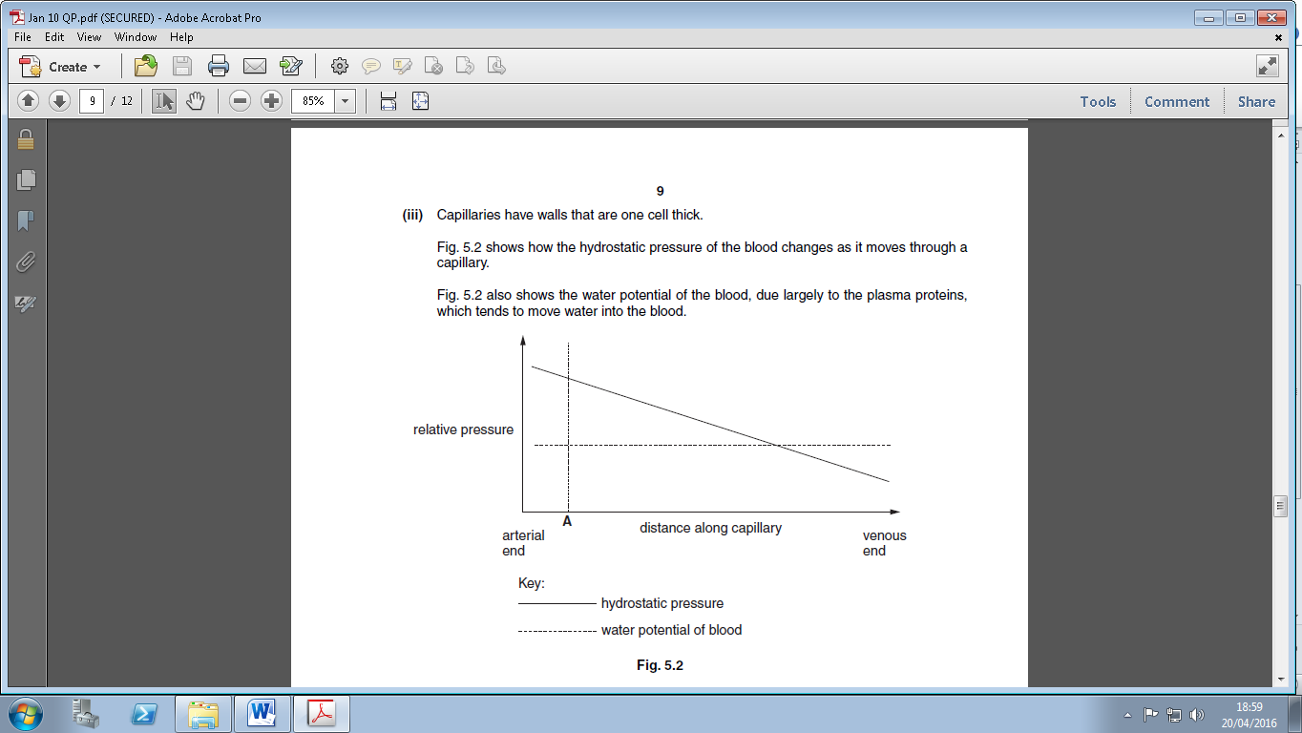
Describe and explain what happens to the blood pressure at point A along the capillary in fig 5.2 [3] Correct the student answer given below:-
As you go along the capillary, the pressure falls from the arterial end to the venous end. This must be because there is less blood in the capillary. Fluid has moved into the capillary at point A, out of the tissue fluid. It moves down a water potential gradient

Slide 16
As you go along the capillary, the pressure falls from the arterial end to the venous end. This is not describing what happens at POINT A , so irrelevant
This must be because there is less blood in the capillary – there is less WATER
Fluid has moved into the capillary at point A, out of the tissue fluid – it moves OUT
It moves down a water potential gradient – down a hydrostatic pressure gradient

Slide 17
Questions
1. Why are there no RBC outside capillaries?
2. Why are there some WBC in tissue fluid?
3. Why are the proteins in TF & lymph smaller and fewer than in plasma?
4. Why is there less glucose & oxygen in lymph than in blood?
5. Why is there more carbon dioxide in the tissue fluid?
They are too big to get through capillary walls into tissue fluid.
They enter here when there is an infection
Most are too big to get through capillary walls into tissue fluid and so fewer to return to lymph
They have been taken up into the cells for aerobic respiration
It has been produced by the cells in aerobic respiration

Slide 18
Complete the exam questions 7 and 8

Slide 19
Q7.
(a) Endothelium / epithelium;
Allow endothelial / epithelial
Reject: epidermis / endodermis
1
(b) Measurement divided by 8;
1
Allow answer in range of 3-3.3 for two marks;
Correct answer gains 2 marks.
1
(c) (i) Stretches / ’expands’ under high pressure / when ventricle
contracts / systole and recoils / ’springs back’ under low pressure / when ventricle relaxes / diastole;
Q References to aorta contracting or relaxing negates marks for stretch and recoil.
Smooths blood flow / maintains blood pressure / reduces pressure surges;
Stretch and recoil without reference to blood pressure etc. = one mark.
Stretch and recoil to smooth blood flow etc. = two marks
Ignore references to aorta withstanding blood pressure or not being damaged.
2

Slide 20
(ii) (Muscle) contracts;
‘It’ in answer = muscle
1
(Arteriole) constricts / narrows / alters size
of lumen / reduces / regulates blood flow (to capillaries);
Allow converse (muscle) relaxes and (arteriole) dilates etc / increase blood flow etc.
Ignore references to pressure
1
(d) (i) Large / increase in (total) cross sectional area / friction / resistance;
1
(ii) (More) time for exchange of substances;
1

Slide 21
Q8.
(a) (i) Made of (different) tissues / more than one tissue;
1
(ii) 1. (Muscle) contracts;
Assume that ‘they’ or ‘it’ = muscle
2. (Arteriole) narrows / constricts / reduces size of lumen / vessel / vasoconstriction;
Ignore: references to pressure
Q Correct context for muscle contracts, vessel constricts
2
(b) (i) Short diffusion distance / pathway;
Accept: thin diffusion pathway
1
(ii) (More) time for exchange / diffusion (of substances);
Accept: example of more time for specific substance to be exchanged
1

Slide 22
(c) 1. Water potential (in capillary) not as low / is higher / less negative / water potential gradient is reduced;
Accept: ‘blood or plasma’ instead of ‘capillary’
2. Less / no water removed (into capillary);
Accept converse: water remains in the tissue
3. By osmosis (into capillary);
Q Marking points 2. and 3. must be in the context of movement into the capillary
Neutral: reference to more tissue fluid being formed as in the question stem
Neutral: reference to lymphatic drainage
3

