Slide 2
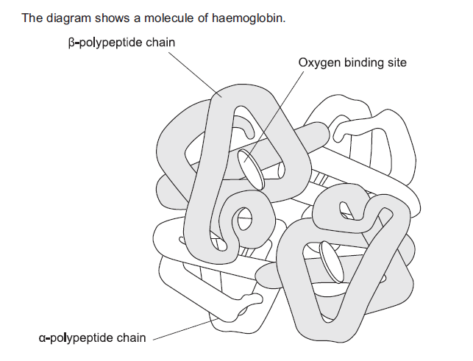
Oxygen Transport in Mammals
Blood consists of a liquid, blood plasma, containing RBC (oxygen transport), WBC (immune system), and platelets (blood clotting).
Located in the RBCs is haemoglobin
What is the evidence from diagram that haemoglobin has a quaternary structure?

Slide 3
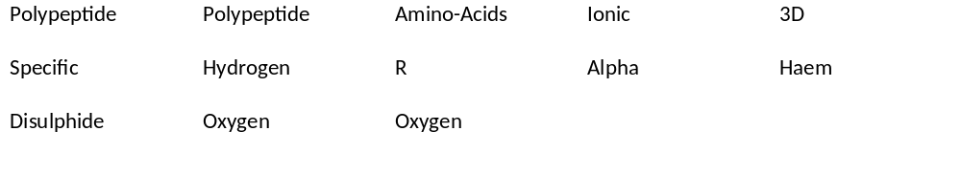
Use these words to fill in the blanks

Slide 4
It is Globular and Soluble with a quaternary structure;
Primary structure = the sequence of ­­­­­­­­­­­­­­_____________________ in 4 polypeptide chains
Secondary structure = each ________________ chain is coiled into an ___________ helix
Tertiary structure = each polypeptide chain is folded into a __________ ____ shape held by _________, ____________ and __________ bonds between the ____ groups – important for its ability to carry oxygen
Quaternary structure = all 4 _________________ are linked together to form a spherical molecule.
Each polypeptide is associated with a _________ group, which contains and Fe2⁺ ion.
Each haem group combines temporarily with 1 _____________. molecule (2 atoms), therefore four ______________ molecules are carried by a single haemoglobin molecule in humans.
amino acids
polypeptide
Alpha
Precise 3D
Hydrogen Ionic
Disulphide
R
polypeptides
haem
oxygen
oxygen

Slide 5
Summary of Hb structure
It has a Quaternary structure = 4 polypeptide chains linked together
Each polypeptide is associated with a haem group, which contains an Fe2⁺ ion.
Each haem group combines temporarily with 1 oxygen molecule (2 atoms)
Therefore four oxygen molecules are carried by a single haemoglobin molecule in humans.

Slide 6
Role
Load oxygen in a high pO₂ where Hb has a high affinity for oxygen = ASSOCIATION = to form OXYHAEMOGLOBIN
This occurs where gas exchange takes place,
in lungs
Unload oxygen in a low pO₂ condition and high pCO₂ where Hb has a low affinity for oxygen = DISSOCIATION = to release it.
This occurs in the respiring cells / tissues
These 2 different roles can be achieved because haemoglobin changes its affinity for oxygen under different conditions

Slide 7
Affinity of haemoglobin for oxygen under different conditions
Region of Body | Oxygen concentration (high/low) | Carbon dioxide concentration (high/low) | Affinity of haemoglobin for oxygen (high/low) | Result (oxygen is associated/ dissociated)
Gas exchange surface | high | low | high | assoc
Respiring tissues | low | high | low | dissoc
Region of Body | Oxygen concentration (high/low) | Carbon dioxide concentration (high/low) | Affinity of haemoglobin for oxygen (high/low) | Result (oxygen is associated/ dissociated)
Gas exchange surface
Respiring tissues

Slide 8
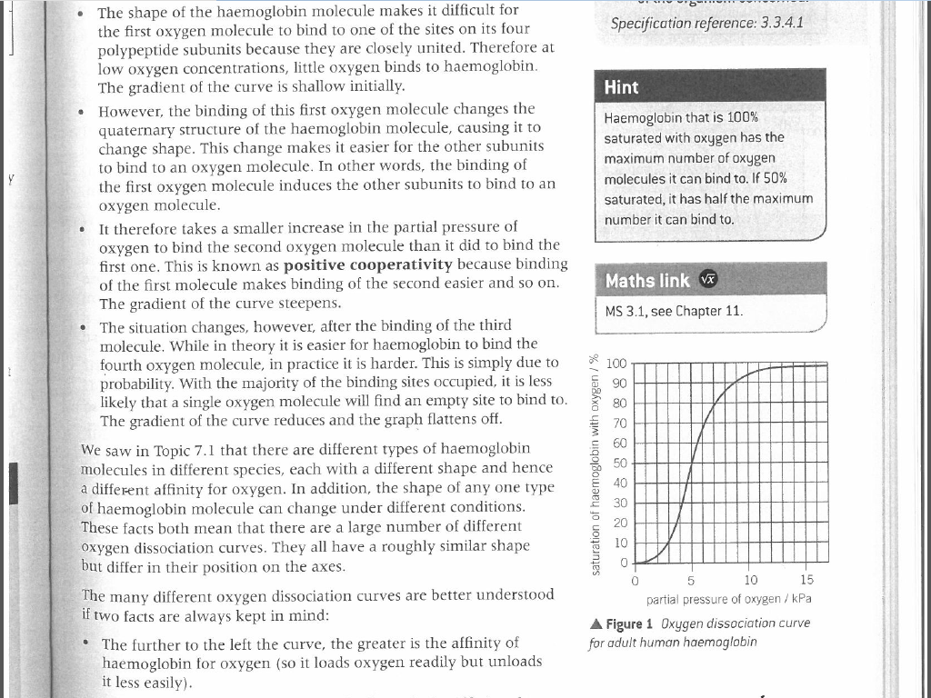
Oxygen Dissociation Curve
The graph shows the relationship between the saturation of haemoglobin with oxygen and the partial pressure of oxygen (pO₂), and is called the OXYGEN DISSOCIATION CURVE
Add labels
What is % saturation of Hb with O₂ at:
6 kPa
8 kPa
15 kp
% Saturation
65%
85%
98%
pO₂
When haemoglobin is exposed to different partial pressures (concentrations) of oxygen (pO2), it does not bind oxygen evenly, giving a sigmoid shape to the curve.

Slide 9
Why is the curve sigmoid?
Starting from the bottom:
As pO₂ increases from 0 to 2 kPa, % saturation increases gradually and curve is shallow
REASON: The shape of the Hb molecule makes it difficult for 1st oxygen molecule to bind to one of the sites on the 4 polypeptide subunits, because they are very closely united. Therefore, at low pO₂ not much oxygen binds to Hb
2. As pO₂ increases more, % saturation increases more, causing a steeper gradient.
REASON: Binding of the first oxygen changes the quaternary structure shape of Hb molecule which makes it much easier for other subunits to bind to an oxygen molecule.
Therefore it takes a smaller increase in (pO₂) to bind 2nd oxygen molecule, and so on

Slide 10
4. As pO₂ increases to above 10 kPa, % saturation flattens out
REASON: Binding of 4th is harder (in practice) due to probability – it is less likely that a single oxygen molecule will find an empty site to bind to.
In reverse – loss of one oxygen makes it easier for the next one to be lost, and so on

Slide 11
What is the relevance?
As blood flows through the lungs, a small increase in oxygen concentration produces a large increase in quantity of oxygen that combined with Hb, which helps the Hb efficiently absorb oxygen in lungs even when the pO₂ is a little lower than normal. Therefore :-
√ Blood leaving the lungs is almost always completely saturated with oxygen.
√ Even if pO₂ in lungs drops a bit below normal, Hb can still pick up oxygen
As blood flows from lungs to body tissues, respiration in the cells is using up the oxygen, therefore pO₂ is very low – now in the steep part of the curve. Therefore:-
√ A slight decrease in pO₂ of tissues produces a large increase in oxygen release from Hb.
√ O₂ is very effectively delivered to the tissues that need it

Slide 12
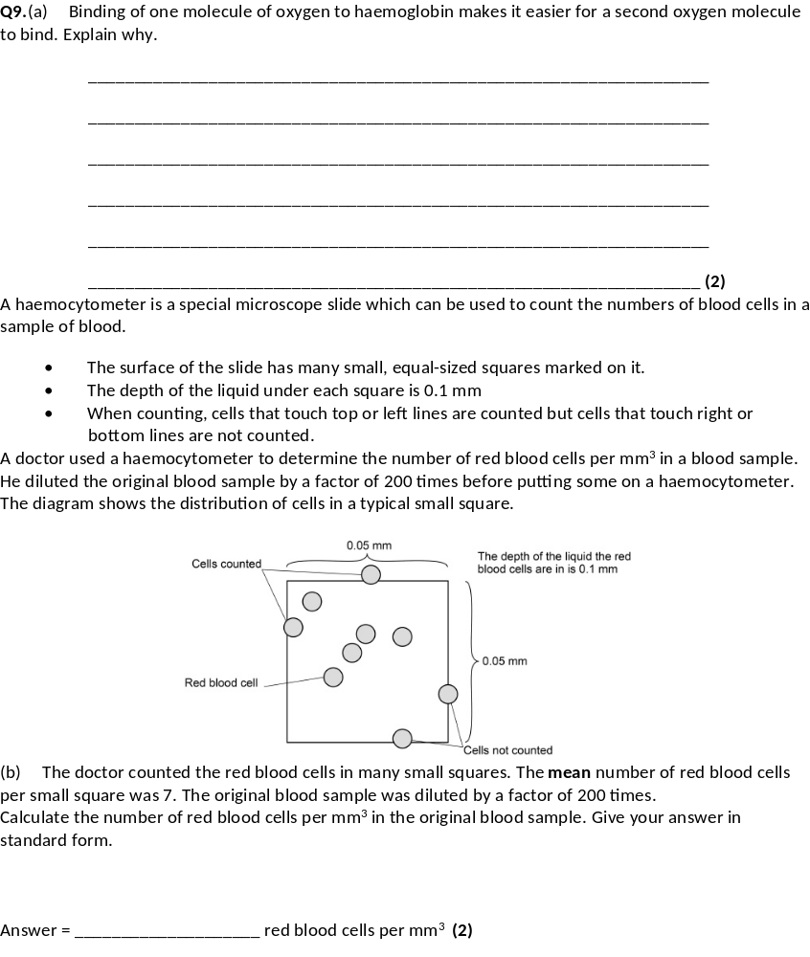
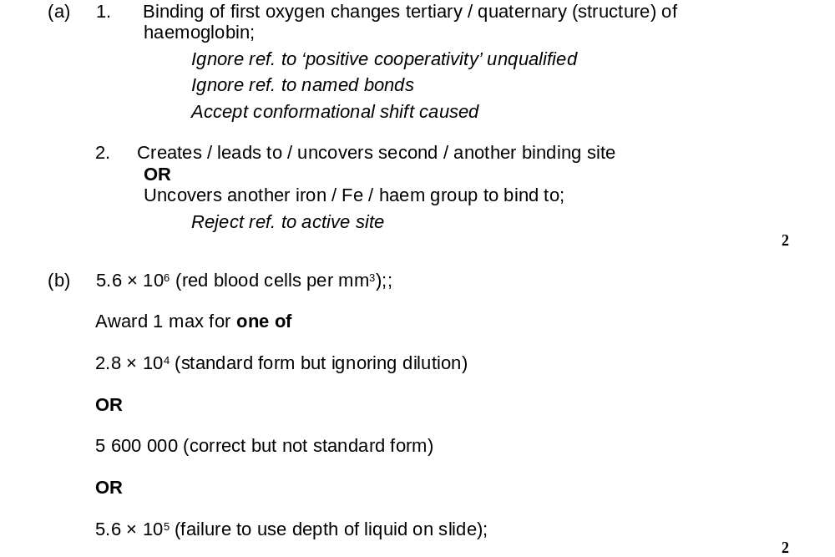
Exam questions

Slide 13
