Slide 1
Effects of Carbon dioxide concentration on Oxygen transport
Bohr Shift.

Slide 2
Outcome:
Explain the effect of carbon dioxide concentration on oxygen dissociation
Relate this knowledge to explain oxygen loading and unloading in different tissues.

Slide 3
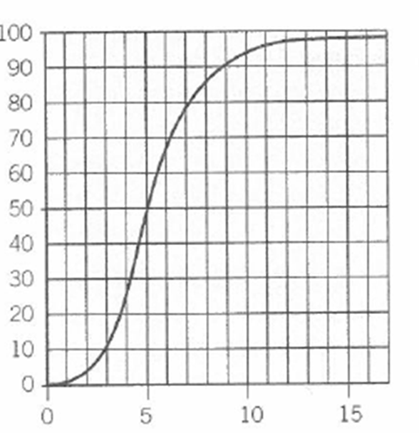
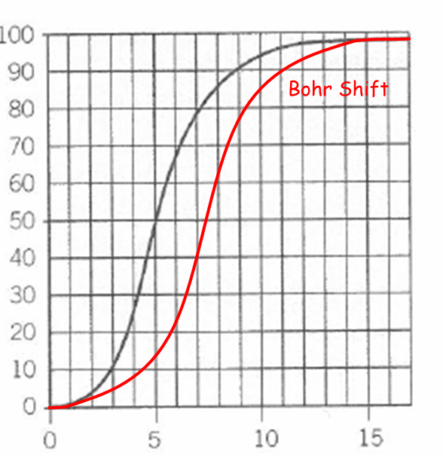
Effects of Carbon Dioxide concentration on Oxygen Transport
When we exercise, more CO₂ is produced, therefore the pCO₂ in the tissues increases
the pCO₂ affects the rate that oxyhaemoglobin dissociates to form oxygen and Hb
the higher the pCO₂, the more readily the oxygen is unloaded from Hb
therefore more oxygen is released for cells during activity.
So, the dissociation curve shifts to the RIGHT i.e. Hb has a LOWER AFFINITY for O₂
= the BOHR SHIFT
Draw the curve for the Bohr Shift
% Saturation
pO₂
How much extra O₂ is released at a pO₂ of 7 kPa when pCO₂ is high? (use your own graph)
On this graph, 40%

Slide 4
What causes the Bohr Shift?
In lungs, CO₂ is constantly being removed.
pH is therefore slightly higher
this changes shape of Hb so that it …………………………… the affinity of Hb for oxygen
therefore loads oxygen …………………………
and is not …………………………… while being transported to tissues
In the tissues, CO₂ is ………………………………… by respiring cells
It combines with water to release H ions in presence of …………………………………………… in RBC
CO₂ therefore ………………………… pH of blood in tissues
This changes shape of Hb so now has a …………………… affinity for oxygen – curve shift to right
Therefore …………………… O₂ is released into respiring tissues.
The more active a tissues it, the …………………… oxygen is unloaded.
Carbonic anhydrase
Lower
Released
More
Increases
Readily
Produced
Lowers
More
increases
readily
released
produced
carbonic anhydrase
lowers
lower
more
more

Slide 5
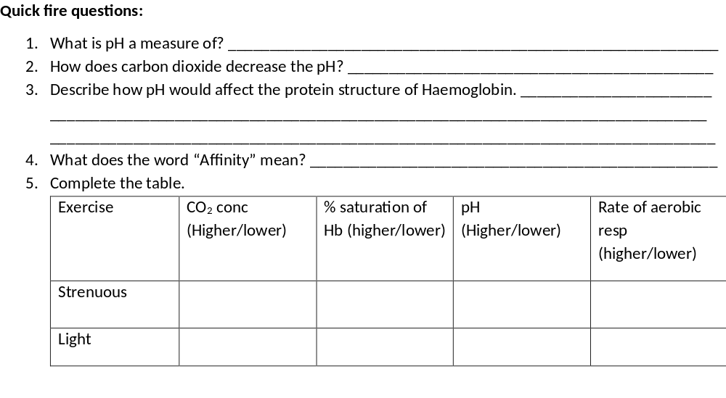
Number of Hydrogen ions in a solution
Reacts with water to from carbonic acid releasing H+
Hb Denatures, Hydrogen and ionic bonds broken, 3D tertiary structure of AS changes shape. Active site no longer complimentary to oxygen. No ESC
Attraction
Higher
Lower
Lower
Lower
Lower
Higher
Higher
Higher

Slide 6
Outcome:
Explain differences between the dissociation curves of different species
Relate these differences to the environment in which the organisms with to explain how these adaptations allow organisms to survive

Slide 7
Different Species
Different species have different types of Hb, with different dissociation curves
Due to adaptions to the different environments they live in.

Slide 8
Complete the gap fill
affinities
The haemoglobin in different organism has different ………………………… for oxygen.
Due to different ……………………… of the haemoglobin molecule
Due to amino acid ……………………………… being slightly different
Resulting in slightly different ………………………… structures. Resulting in different binding properties
Therefore affinity of different haemoglobin molecules ranges from ………………… to …………………… affinity for oxygen.
shapes
sequences
tertiary
low
high

Slide 9
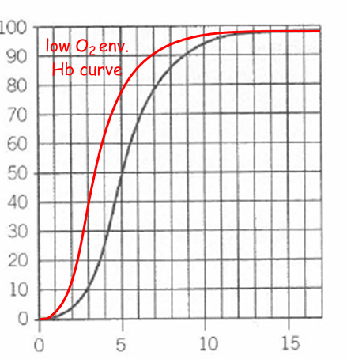

Low oxygen environments, low pO₂
the Hb has a higher affinity as the pO₂ is lower
therefore the Hb is able to load more of the available oxygen, and
be saturated at a lower pO₂.
and the dissociation curve is shifted to the LEFT
Examples: a) foetus in uterus needs to be able to load more O₂ than mother at same pO₂. Therefore enabling oxygen to move from mother to foetus.
b) lugworms live in burrows beneath the sand where there is a low pO₂. Therefore they need to load as much oxygen as possible even when there is not much in the environment.
c) llama lives at high altitudes where atmospheric oxygen concentration is lower, therefore has to be able to load with more oxygen at these low pO₂
% Saturation
pO₂

Slide 10
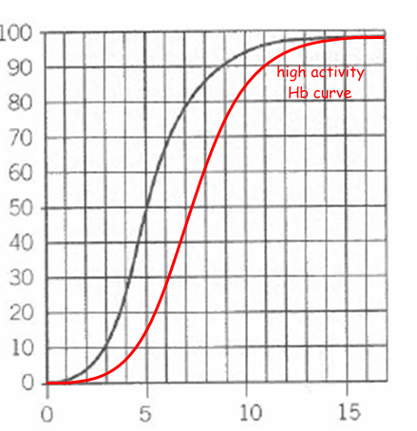
Activity levels & Size
Organisms that are very active and small, have a high O₂ demand
Organisms that are very active and small, have a high O₂ demand
Therefore have a Hb with a lower affinity
They need their Hb to unload oxygen more easily
To supply more oxygen to tissues
For a faster respiration
In all these cases, the dissociation curve is shifted to the RIGHT
% Saturation
pO₂

Slide 11
The larger the animal is,
The more to the left the curve is
The steeper the curve is
The higher the affinity for oxygen
Examples:
Hawk has a very high respiratory rate and lives where there is plenty of oxygen
b) Small mammals have a higher SA:VOL ratio therefore lose heat more quickly, so have a higher metabolic rate to help them keep warm. Therefore have a higher oxygen demand – need the Hb to unload oxygen more easily.

Slide 12
What is the advantage of the foetal Hb being replaces by adult haemoglobin after birth?
A: adult Hb has a lower affinity.
Therefore oxygen can more easily dissociate and be released to the tissues.

Slide 13
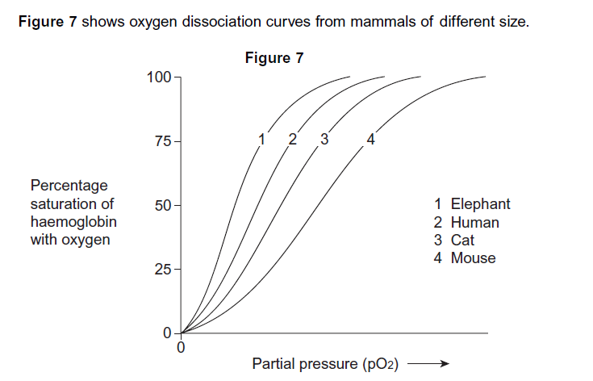
Describe the relationship between the size of mammals and the oxygen dissociation curves of their haemoglobin
The larger the mammal:-
Position of curve….....................................................................................................................
Steepness….................................................................................................................................
Affinity of Hb for oxygen…....................................................................................................
Why does the Hb of smaller mammals have a lower affinity for oxygen?
SA:VOL ratio…...........................................................................................................................
Heat loss…...................................................................................................................................
Rate of respiration…....................................................................................................................
Requirement for respiration …..................................................................................................................................................................................
        Further to left
        Steeper
        Higher
        Smaller animals have greater SA:VOL ratio
        Therefore smaller animals have more heat lost (per unit body mass)
        A larger SA:VOL ratio necessitates greater rate of respiration
        Oxygen required for respiration; therefore Hb releases O₂ more readily (Hb has lower affinity)

Slide 14
Now some questions
Describe the quaternary structure of haemoglobin
2. Explain how DNA leads to different haemoglobin molecules having different affinities
3. When the body is at rest, only one of the four molecules carried by haemoglobin is normally released into the tissues. Suggest why this could be an advantage when the organism becomes more active
4. Carbon monoxide occurs in car exhaust fumes. It binds permanently to haemoglobin in preference to oxygen. Suggest a reason why a person breathing in car-exhaust fumes might lose consciousness

Slide 15
Answers
1. two pairs of polypeptides (α and β) link to form a spherical molecule. Each polypeptide has a haem group that contains a ferrous (Fe²⁺ ion)
2. Different base sequences in DNA - different amino acid sequences – different tertiary / quaternary structure & shape – different affinities for oxygen.

Slide 16
Answers
3. if all oxygen molecules were released, there would be none in reserve to supply tissues when they were more active.
4. Carbon monoxide will gradually occupy all the sites on haemoglobin instead of oxygen. No oxygen will be carried to tissues such as the brain. These will cease to respire and function, making the person lose consciousness.

Slide 17
Now have a go at exam questions 10 and 11

Slide 18
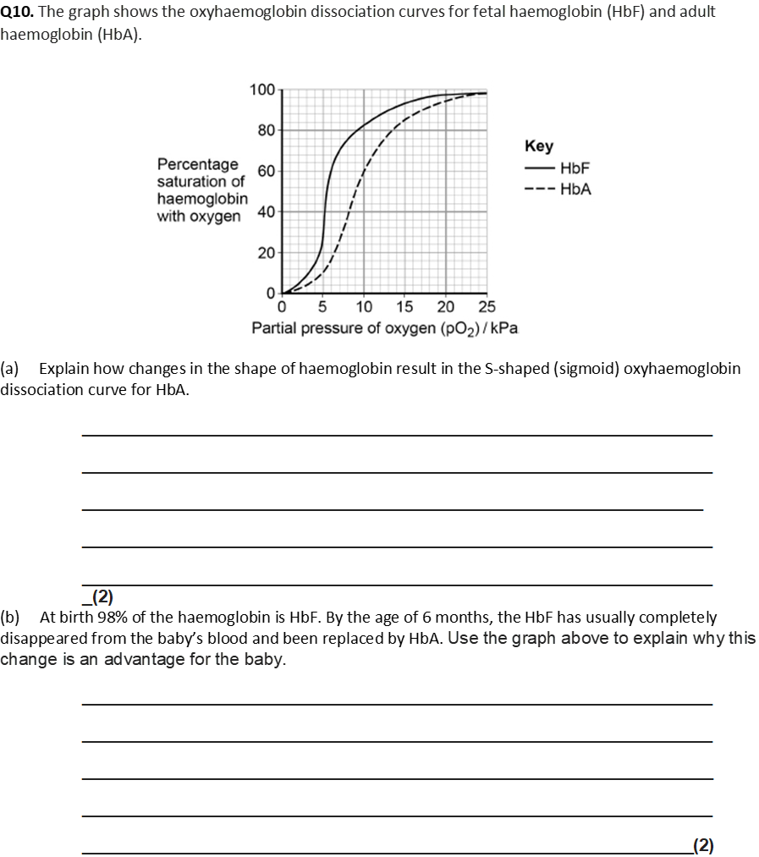
First oxygen binds (to Hb) causing change in shape;
(Shape change of Hb) allows more O₂ to bind (easily) / greater saturation with O₂
OR
Cooperative binding;
2
(b) 1. (HbA has) lower affinity for O₂ at low partial pressures;
OR
(HbA has) lower affinity for oxygen at pp found in tissues;
2. Easier unloading of O₂ for (aerobic) respiration;
2

Slide 19
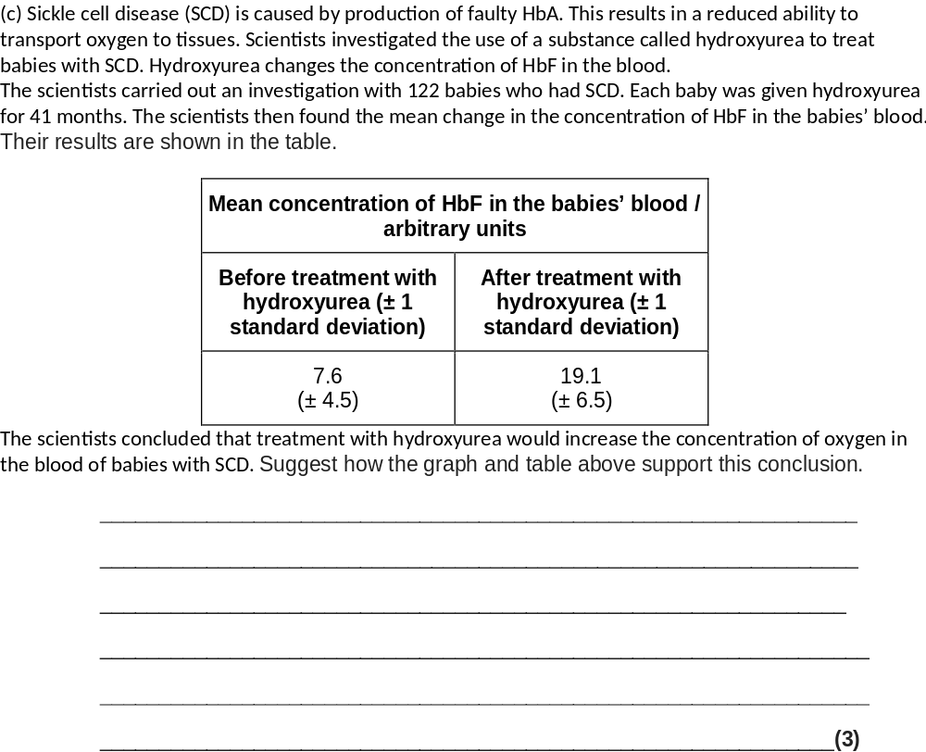
(c) 1. A large/significant increase in HbF;
2. (HbF has) higher affinity for O₂ (than faulty HbA);
3. Higher proportion of HbF in blood so more oxygen carried;
OR
More oxygen carried after treatment;
3

Slide 20
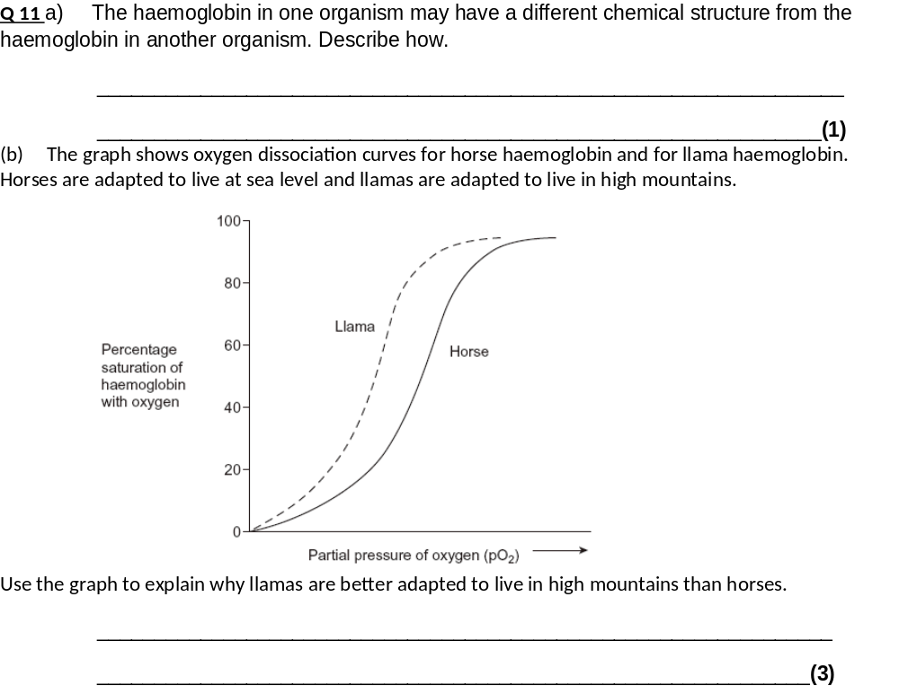
Different primary structure / amino acids / different number of polypeptide chains;
Question is about haemoglobin so do not credit differences in DNA
1
(b) 1. Low partial pressure of oxygen in lungs;
2. (Llama) haemoglobin able to load more oxygen / (llama)
haemoglobin saturated (at low / particular partial pressure of oxygen);
3. Higher affinity for oxygen;
The terms used in the graph (or near approximations) should be used in this answer.
Ignore references to unloading
The answer must relate to llamas
3

Slide 21
Stretch & challenge Q
Why does haemoglobin have a quaternary structure?
What effect does the first oxygen binding have on the structure of haemoglobin?
What are the 2 seemingly conflicting roles of haemoglobin (in lungs and respiring tissues)
How are both roles achieved?

Slide 22
Answers
1. The molecule does not bind oxygen evenly - the shape of the molecule makes it difficult for the first oxygen molecule to bind to one of the sites on its four polypeptide subunits because they are closely united.
2. binding of the first oxygen molecule changes the quaternary structure of the haemoglobin molecule, causing it to change shape.

Slide 23
Answers , contd
It readily associates with oxygen at the surface where gas exchange takes place. And readily dissociates from oxygen at those tissues requiring it.
Both roles are achieved by the fact haemoglobin changes its affinity for oxygen UNDER DIFFERENT CONDITIONS.
i.e. in presence of CO2, the new shape of the molecule binds more loosely to oxygen and as a result, it releases its oxygen.

