Slide 1
Outcomes:
Explain what binary fission is and the organisms which carry out binary fission.
Describe the process of binary fission.
Explain why viruses are not classified as being living organisms.
Describe the sequence of events by which viruses replicate.
Explain why viruses are so difficult to treat and develop medicines against.

Slide 2
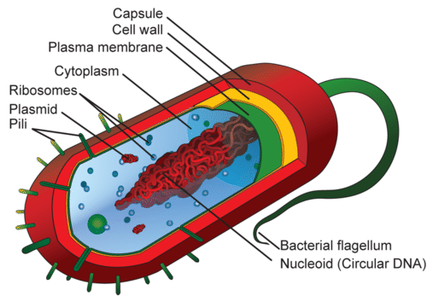
What is Binary fission?
Explain what binary fission is and the organisms which carry out binary fission.
Binary fission occurs in prokaryotic cells
Where in this cell will DNA replication need to occur?
Circular DNA and plasmids
Plasmids can be found in variable amounts.

Slide 3
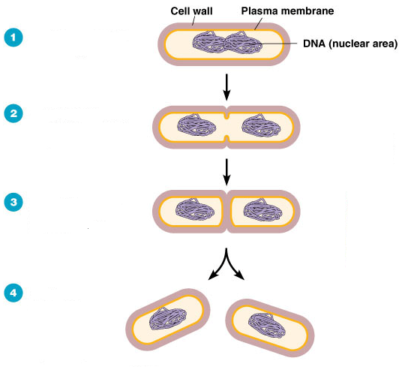
Describe the process of binary fission.
Replication of circular DNA.
Question:
1.A bacterial cell undergoes binary fission every twenty minutes. Starting with a single bacterium how may bacteria will be formed at the end of 3 hours?
3 Hours = 180 minutes
180/20= 9 divisions take place
2⁹ = 512 cells.
2. A bacterial cell undergoes binary fission every twenty minutes. Starting with a single bacterium how may bacteria will be formed at the end of 7 hours?
Give your answer in standard form.
7 hours= 420 minutes
420/20= 21 divisions
2²¹⁼ 2097152
2.1 x 10⁶ bacteria
Cell wall and plasma membrane begin to constrict.
Division of cytoplasm.
Two new daughter cells with single copy of circular DNA.

Slide 4
Viruses are classed as been non-living so do not undergo cell division.
You can be asked to describe the sequence of events by which viruses replicate.
So you will need to make sure you recap this from the immunity topic.
And also…
Explain why viruses are so difficult to treat and develop medicines against which will be summarised on the next slide.

Slide 5
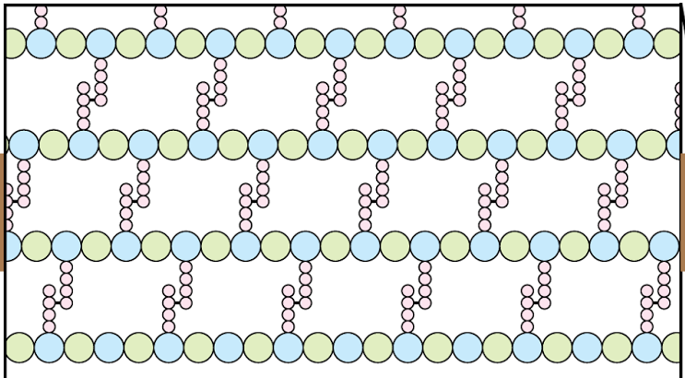
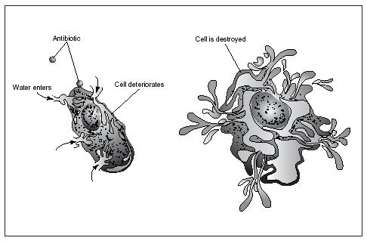
Viruses and antibiotics
Antibiotics work by inhibiting enzymes that catalyse the formation of murein (peptidoglycan) cross linkages in bacterial cell walls.
These cell walls prevent bacterial cells undergoing osmotic lysis
Viruses do not have cell walls – therefore antibiotics are ineffective
Also, once a virus has entered a body cell, antibiotics cannot reach it

Slide 6
Complete exam questions.

Slide 7
Q1.
(a)
1. Binary fission;
2. Replication of (circular) DNA;
3. Division of cytoplasm to produce 2 daughter cells;
4. Each with single copy of (circular) DNA;
1. Ignore reference to ‘chromosome’
2. Ignore ‘copy’.
4. Ignore references to number of plasmids.
2 max

Slide 8
(b)
1. Both denatured (by high temperature);
2. Denaturation faster at 60 °C due to more (kinetic) energy;
3. Breaks hydrogen / ionic bonds (between amino acids / R groups);
4. Change in shape of the active site / active site no longer complementary so fewer enzyme-substrate complexes formed / substrate does not fit;
3. Ignore references to disulphide bonds
3. Accept (at 60 °C) Change in shape of the active site / active site no longer complementary so no enzyme-substrate complexes formed / substrate does not fit;
4

Slide 9
(c)
1. To digest protein;
2. (So) they can absorb amino acids for growth / reproduction / protein synthesis / synthesis of named cell component;
OR
(So) they can destroy a toxic substance / protein;
1. For ‘digest’ accept ‘break down’ here.
2. Accept ‘(so) they can destroy antibodies / antibiotics / viral antigens / bacterial antigens’
2

Slide 10
(d)
1. Hydrolyse (peptide bonds) to release amino acids;
2. Amino acids can cross (cell) membrane;
OR
Dipeptides cannot cross (cell) membrane;
OR
Maintain concentration gradient of amino acids for absorption;
OR
Ensure (nearly) maximum yield from protein breakdown;
2. Ignore references to crossing gut membranes.
2. Accept ‘there are carrier proteins for amino acids’
2. Accept ‘no carrier proteins for dipeptides’
2
[10]

Slide 11
Outcomes:
Explain outcome of mitosis.
Explain the appearance of cells in each stage of mitosis.
Mitosis
Definition:
Production of two daughter cells that have the same number of chromosomes as the parent cell and each other.
What type of cells undergo mitosis?
Body cells

Slide 12
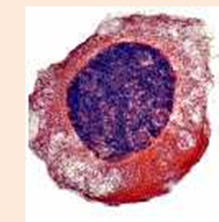
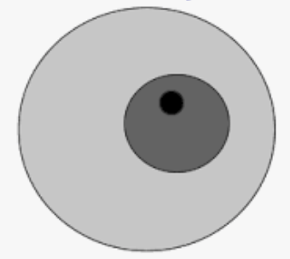

Interphase (not a true stage of mitosis!)
Chromosomes are dispersed (so not visible)
Each chromosome replicates.
Chromosomes made of 2 sister chromatids, joined at centromere.
Homologous pair
Two chromosomes that carry the same genes
centromere
2 sister chromatids
Notes:
Also- Increase in volume of cell/volume of cytoplasm / increase in mass / cell bigger; increase in number of organelles; synthesis of protein/named protein; DNA replication/increase / chromosomes copied; ATP synthesis / respiration;

Slide 13
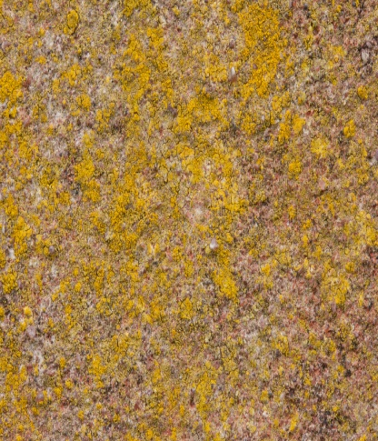
Prophase
Chromosomes shorten and thicken to become visible.
(Chromosomes) appear as (two sister) chromatids joined at the centromere

Slide 14
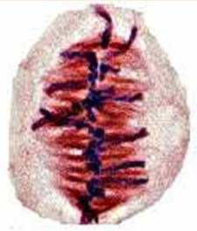
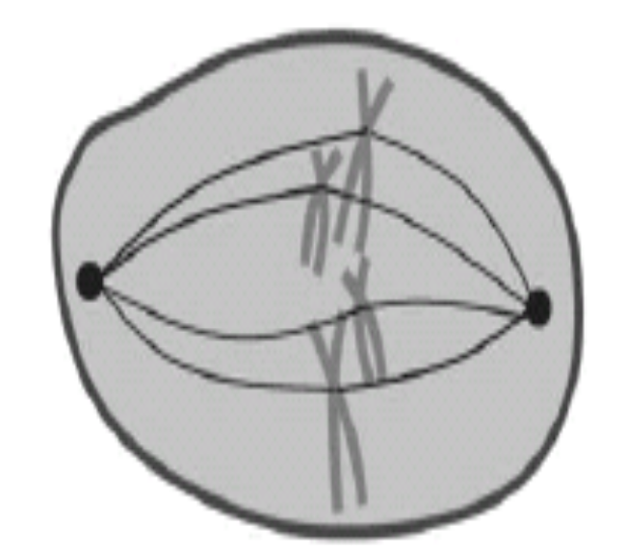
Metaphase

Slide 15
Metaphase
Chromosomes line up on the equator.
Chromosomes attached to spindle fibres by their centromere.

Slide 16
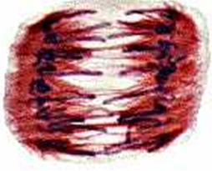
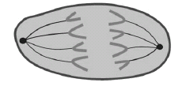
Anaphase

Slide 17
Anaphase
The centromere splits.
Sister chromatids are pulled to opposite poles.

Slide 18
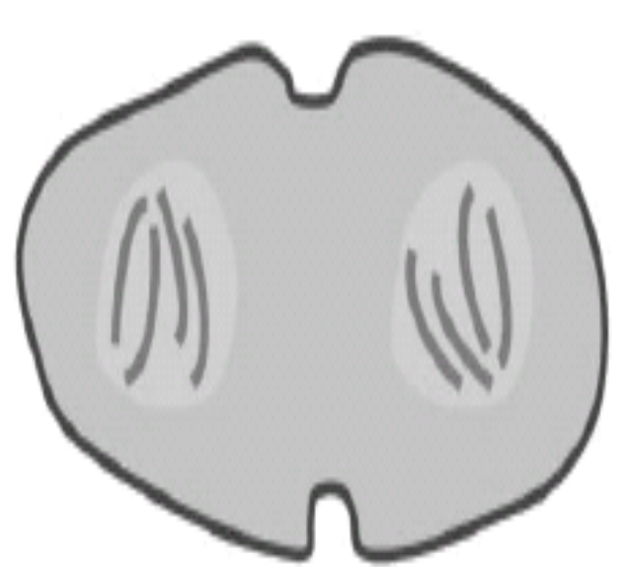
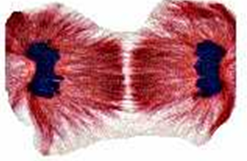
Telophase

Slide 19
Telophase
Chromosomes uncoil and become thinner.
Cytokinesis begins.

Slide 20
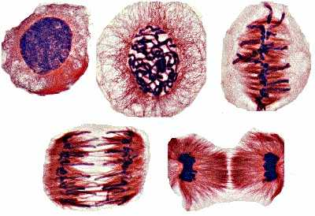
Mitosis- what is this stage?
Whiteboards at the ready!
Interphase
Prophase
Metaphase
Anaphase
Telophase

Slide 21
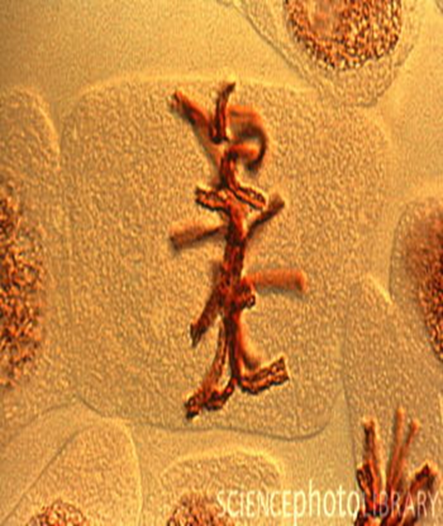
What is this stage?
Metaphase

Slide 22
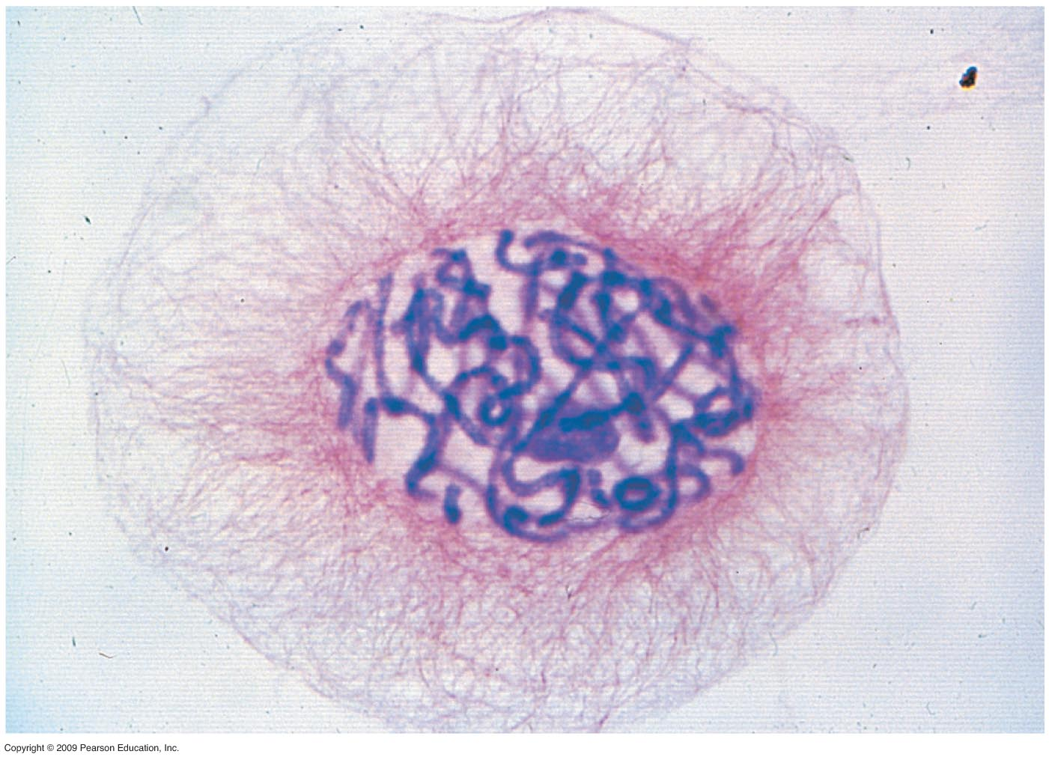
What is this stage?
Prophase

Slide 23
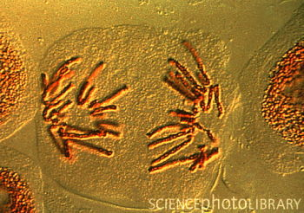
What is this stage?
Anaphase

Slide 24
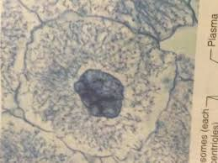
What is this stage?
Interphase

Slide 25
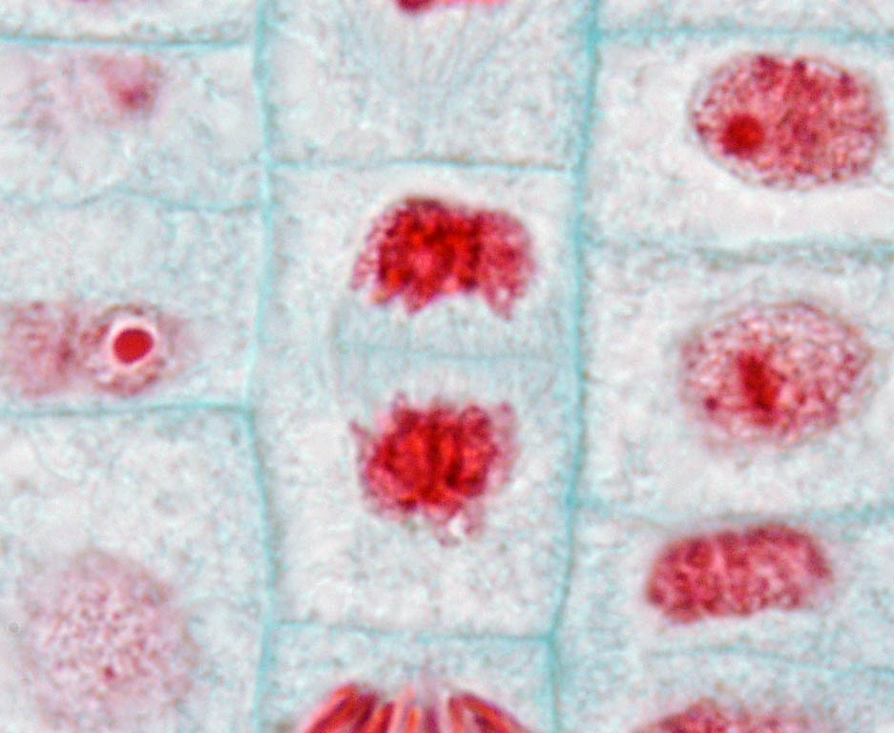
What is this stage?
Telophase

Slide 26
Now complete the exam questions

Slide 27
Q1.
(a) (i) Prophase; 1
(ii) Chromosomes / chromatids moved apart; 1
(iii) A wide range of processes occurs during interphase. This list is by no means exhaustive, but we would expect to see answer such as:
Increase in volume of cell / volume of cytoplasm / increase in mass / cell bigger; increase in number of organelles;
synthesis of protein / named protein;
DNA replication / increase / chromosomes copied;
ATP synthesis / respiration; max 2
(b) Divide real length of bar (in mm) / 10 by 0.02; 1
(c) 12 / 200 × 24 / single error in otherwise correct method;
1.44 hours (1 hour 26 min); 2
[7]

Slide 28
Q2.
(a) Centromere;
1
(b) Same size;
Same shape;
Same genes;
In same sequence/locus/loci;
2 max
(c) Chromatids separate;
(Chromatids) pulled to opposite ends of cell;
By spindle fibres;
Become part of new nuclei;
2 max
[5]

Slide 29
Q3.
(a) DNA replicated/two DNA strands/molecules;
Coiled/condensed/wound up (to make visible);
Giving/made of (two) chromatids;
Attached at centromere; Accept linear so eukaryote; with histone; Accept have become shorter and fatter 2 max
(b) (i) Stage A, anaphase/prophase;
Chromatids/chromosomes moving to poles/chromosomes condensed/
coiled/wound up;
Points not linked but need correct description with stage in this case. Accept prophase because the image could be interpreted as such
2
(ii) Stage B, metaphase;
Chromosomes on equator/attaching to spindle;
Points not linked
Accept equator of cell
Reject centre of cell
Accept chromatids for chromosomes 2
[6]

Slide 30
Outcome:
Explain the different outcomes of meiosis.
Complete diagrams showing the chromosome content of cells after the first and second meiotic division, when given the chromosome content of the parent cell.
Recognise where meiosis and mitosis occurs when given information about an unfamiliar life cycle

Slide 31
Meiosis
Definition:
Production of four daughter cells that have half the number of chromosomes as the parent cell.
What type of cells undergo mitosis?
Sex cells (gametes)

Slide 32
Stages of meiosis
Meiosis involves the formation of 4 daughter cells. This requires 2 divisions of the cell.
Meiosis 1 – first division takes place
Meiosis 2 – second division takes place

Slide 33
Why?
Mitosis gives daughter cells with the same chromosome number.
If we made sperm/eggs by mitosis, when the sperm and egg meet, what would be the number of chromosomes in one cell?
46 + 46 = 92

Slide 34
Meiosis I
Meiosis II
Interphase (pre meiosis)
Prophase I
Metaphase I
Anaphase I
Telophase I
Prophase II
Metaphase II
Anaphase II
Telophase II
Followed by cytokinesis

Slide 35
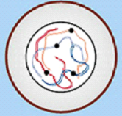
Meiosis I
Interphase
Chromosomes are dispersed (so not visible)
Each chromosome replicates.
Chromosomes made of 2 sister chromatids, joined at centromere.

Slide 36
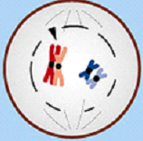
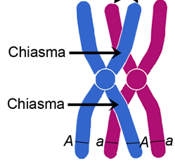
Prophase I
Chromosomes shorten and thicken to become visible.
(Chromosomes) appear as (two sister) chromatids joined at the centromere.
Homologous pairs of chromosomes form bivalents.
Chiasma form → the point where chromosomes cross over each other.
Produces new combination of alleles
Bivalent

Slide 37
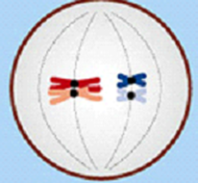
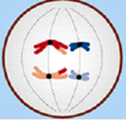
Metaphase I
Homologous chromosomes (in bivalents) line up on the equator.
Chromosomes attached to spindle fibres by their centromere.
Anaphase I
Homologous chromosomes are pulled to opposite poles.

Slide 38
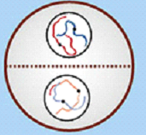
Telophase I
Chromosomes uncoil and become thinner.
Cytokinesis sometimes begins.

Slide 39
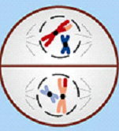
Meiosis II
Prophase II
Chromosomes shorten and thicken to become visible.
(Chromosomes) appear as (two sister) chromatids joined at the centromere.

Slide 40
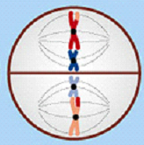
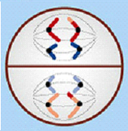
Metaphase II
Chromosomes line up on the equator.
Chromosomes attached to spindle fibres by their centromere.
Anaphase II
Pairs of chromatids are pulled to opposite poles.

Slide 41
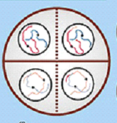
Telophase II
Chromosomes uncoil and become thinner.

Slide 42
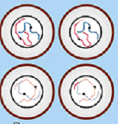
Cytokinesis
Cytoplasm divides (cytokinesis).
Membranes form around new cells.
4 haploid cells produced.

Slide 43
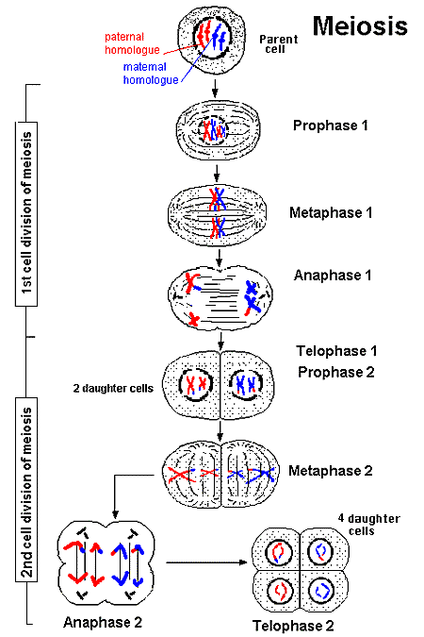
Differences between the two
Meiosis occurs in 2 divisions (I and II) that superficially resemble mitosis:
Meiosis I
Homologous pairs of chromosomes are separated
Meiosis II
Pairs of chromatids are separated

Slide 44
Meiosis | Mitosis
Homologous chromosomes associate in pairs | (Homologues) independent so do not pair
Crossing-over / chiasmata formation | No crossing-over;
Two divisions / → 4 offspring cells | One division / → 2 offspring cells;
Genetically different | Genetically identical

Slide 45
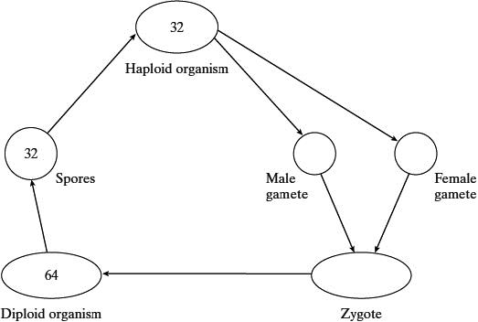
The diagram shows the life cycle of an organism. The numbers show how many chromosomes are present in one cell at each stage of the life cycle.
(i) Name the type of cell division that must be involved in producing the spores.
Meiosis
(ii) How many chromosomes are there in a male gamete from this organism?
32

Slide 46
Outcome:
Explain how meiosis results in variation.
Explain how random fertilisation of haploid gametes further increases genetic variation within a species.
Explain what a non-disjunction event is and how it occurs.
Compare and contrast gene and chromosomal mutations.

Slide 47
Increases variation in 2 ways:
- crossing over in prophase I
- Independent segregation of maternal & paternal chromosomes in anaphase I

Slide 48
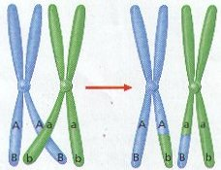
Crossing over
During meiosis 1, the chromatids of each pair of homologous chromosomes become twisted around each other.
During this twisting tensions are created and parts of the chromosome break off.
These broken portions join with the chromatids of its homologous partner.
It is the equivalent portions of the chromosomes that are exchanged.
New genetic combinations of alleles are produced.

Slide 49
RANDOM COMBINATIONS
4 daughter cells have completely different combinations of chromosomes
This is because of random assortment (segregation) of chromosomes in meiosis I, and of the chromatids in meiosis II

Slide 50

Independent segregation/ assortment
brown
Independent assortment is important because it gives rise to new combinations of alleles.
B
brown
brown
blue
brown
B
B
Blood group A
blue
Blood group B
blue
A
A
blue
A
brown
brown
A
brown
blue
A
brown
B
A
blue
A
blue
B
B
blue
B

Slide 51
Why meiosis is important in sexual reproduction
Produces haploid cells so fertilisation maintains the chromosome number in next generation.

Slide 52
Non- disjunction events
Sometimes individual homologous pairs of chromosomes fail to sperate during meiosis. This is known as non-disjunction and usually results in the gamete having either one more or fewer chromosomes. When fertilised with a gamete with a normal complete chromosome number this will make the offspring have more or fewer chromosomes than normal. This will be the same in all their body cells. An example of non-disjunction is down syndrome.
A non-disjunction event is an example of a ‘chromosome mutation’. A chromosome mutation changes the structure or number of whole chromosomes. This is different to a gene mutation which is a change in the base sequence of a gene.

Slide 53
Q1.
(a) (i) 8 ‘chromatids’ each side;
spindle drawn;
2
(ii) 4 chromosomes;
1 from each homologous pair;
2
(b) produces haploid cells / chromosome number halved;
fertilisation maintains the diploid / chromosome number (in next generation);
2
[6]

Slide 54
Q2.
(a) replication / duplication / doubling of chromosomes /
replication of DNA / transcription of DNA;
1
(b) (i) cell to show correct number of chromosomes;
correct shape and position of centromere;
2
(ii) as (i) except everything halved – Ignore crossing over;
(if mitosis and meiosis reversed, allow 1 if otherwise correct)
2
(c) to replace cells;
1
[6]

Slide 55
Q3.
(a) (i) Centromere;
Accept: if phonetically correct
Reject: centriole
1
(ii) 1. Holds chromatids together;
2. Attaches (chromatids) to spindle;
3. (Allows) chromatids to be separated / move to (opposite) poles / (centromere) divides / splits at metaphase / anaphase;
3. Q Neutral: chromosomes or chromatids split / halved / divided
3. Reject: reference to homologous chromosomes being separated
Accept ‘chromosomes’ instead of ‘chromatids’
Ignore incorrect names for X
2 max

Slide 56
(iii) (Homologous chromosomes) carry different alleles;
Accept alternative descriptions for ‘alleles’ eg different forms of a gene / different base sequences
Neutral: reference to maternal and paternal chromosomes
1
(b) (i) (In Figure 2)
1. Chromatids have separated (during anaphase);
1. Q Neutral: split / halved / divided
1. Reject: reference to homologous chromosomes
being separated
or
2. Chromatids have not replicated;
1. & 2. Accept ‘chromosomes’ instead of ‘chromatids’
or
3. Chromosomes formed from only one chromatid;
Accept converse arguments for Figure 1
Ignore references to the cell not dividing as in the question stem
Ignore: named phases
1 max

Slide 57
(ii) 1. Three chromosomes;
Ignore shading
2. One from each homologous pair;
Only one mark for three chromosomes shown as pairs of chromatids
2
(iii) Crossing over / alleles exchanged between chromosomes or chromatids / chiasmata formation / genetic recombination;
Accept: description of crossing over eg sections of chromatids break and rejoin
Neutral: random fertilisation
Reject: reference to sister chromatids
Q Neutral: genes exchanged
Neutral: mutation
1
[8]

Slide 58
Outcome:
Explain what the cell cycle is and why it does not occur in some cells from multicellular organisms.
Describe the stages of the cell cycle.
Recognise the stages of the cell cycle: interphase, prophase, metaphase, anaphase and telophase (including cytokinesis).

Slide 59

The cell cycle
The cell cycle is an ordered set of events, leading to cell growth and division.
G0: Resting phase
Gap Phase 1
Mitosis
INTERPHASE
DNA replication
Gap Phase 2

Slide 60
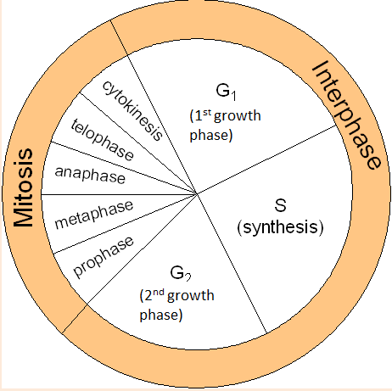
The cell cycle
Interphase occupies most of the cell cycle.
G1 phase: synthesis of proteins
S phase: DNA is replicated.
G2 phase: organelles grow and divide, ATP stores increased.
Nuclear division
Mitosis (PMAT)
Cell division
Cytokinesis

Slide 61
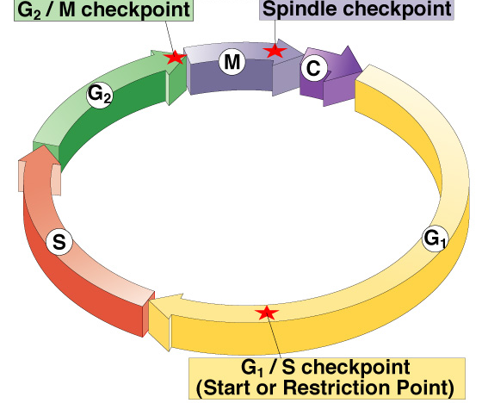
Checkpoint control system
3 major checkpoints:
  G₁/S
    can DNA synthesis begin?
  G₂/M
    has DNA synthesis been
    completed correctly?
    commitment to mitosis
  spindle checkpoint
    are all chromosomes attached to spindle?
    can sister chromatids separate correctly?
cell cycle controlled by STOP & GO chemical signals at critical points

Slide 62
Exam questions
The number of cells at each stage of mitosis was counted. The results are shown in the table.
One complete cell cycle takes 24 hours. The number of cells at each stage is proportional to the time spent at that stage. Calculate the length of time spent in metaphase. Show your working.
Answer ........................................................... Hours (2)
Stage of mitosis | Number of cells
Interphase | 123
Prophase | 32
Metaphase | 12
Anaphase | 6
Telophase | 27
Number of cells in that stage
Total Number of Cells
X nº of hours
123+32+12+6+27 = 200 cells
12/200= 0.06
0.06 x 24 = 1.44 hours

Slide 63
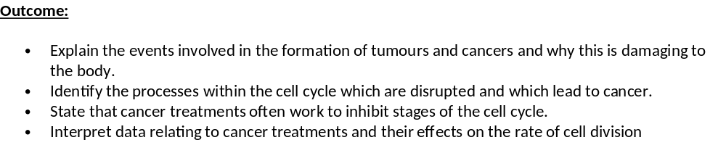
Cancer

Slide 64
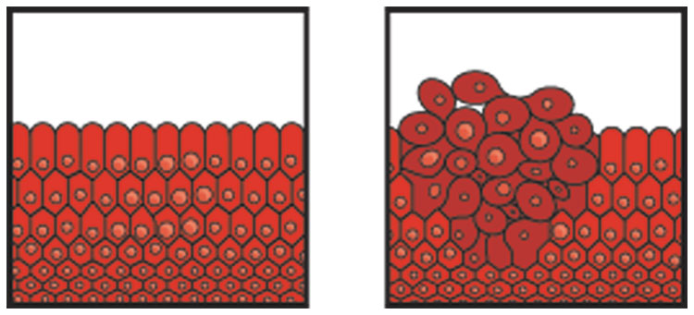
Cancer
Cancer is essentially the incorrect replication of DNA. It is the result of damage to the genes that control cell mitosis and the cell cycle.
Results in uncontrolled cell growth, developing a tumour.
Why are tumours damaging to the body?
may damage organ concerned;
may cause blockages / obstructions;
may damage / exert pressure on other organs;

Slide 65
Cancer treatment
Cancer is often treated by blocking some part of the cell cycle.
Preventing DNA replication
Inhibiting the metaphase by interfering with spindle formation
Problems:
Drugs are most effective against rapidly dividing cells, but they also disrupt the cell cycle of healthy cells.
Hair producing cells divide rapidly, explaining hair loss.

Slide 66
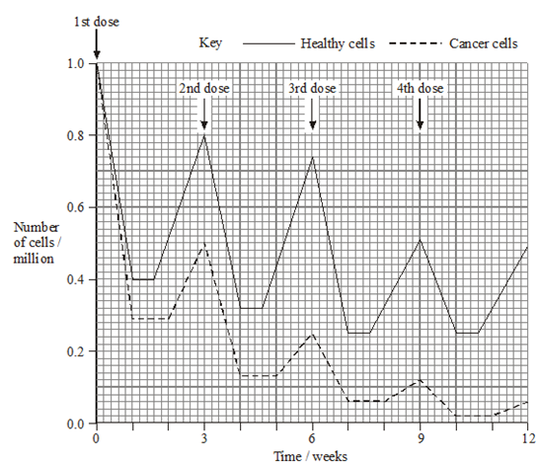
It would be possible to kill more cancer cells by administering the drug more frequently or giving a larger dose. Suggest why
The drug was not given more frequently
The dose of the drug was not increased
If frequency was increased healthy cells would not have time to increase numbers to near normal between treatments;
Healthy cell count would become too low and patient may die.
Increased dose would kill too many healthy cells each treatment,
Healthy cell count would be too low and patient may die.

Slide 67
Q1.
(a) (i) Cells are in interphase;
Accept G phase / S phase.
1
(ii) Cells undergoing mitosis / in telophase / cytokinesis;
Accept all named stages but reject prophase, metaphase or anaphase on their own.
1
(b) 1. 3 hours;
2. Time between beginnings / endings DNA replication / Increases / levelling outs of DNA concentration / for shape (of curve for replication) to be repeated;
3. (DNA) replication takes place once per cell cycle;
Allow close approximation where candidate attempts to be more accurate.
Principle
What is shown on the graph
3
[5]

Slide 68
Q2.
(a) (i) Spindle formed / chromosome / centromere / chromatids
attaches to spindle;
Chromosomes / chromatids line up / move to middle / equator
(of cell);
Do not award second mark for answers referring to chromosomes ‘pairing up’.
Ignore reference to homologous chromosomes unless context suggests pairing which negates second mark.
Neutral: Details on nuclear membrane.
Accept: Diagram for second marking point.
2
(ii) Chromosome / centromere splits / chromatids / ‘chromosomes’ separate / pulled apart;
To (opposite) sides / poles / centrioles (of cell);
Reject: Homologous chromosomes separate for first marking point.
Accept: Diagram for second marking point.
Chromatids / ‘chromosomes’ move to poles / sides / centrioles = 2 marks.
2

Slide 69
(b) (i) Form / replace cells quickly / rapidly / divide / multiply / replicate rapidly;
Neutral: Repair cells.
Answers must convey idea of ‘speed’.
1
(Ii) Correct answer = 774 minutes / 12 hours 54mins = 2 marks;;
Incorrect answer but indicates 3 cell cycles involved = one mark;
2

Slide 70
(c) Prevents / slows DNA replication / doubling / prevents / slows mitosis;
New strand not formed / nucleotides (of new strand) not joined
together / sugar-phosphate bonds not formed;
First marking point must be in context of DNA replication not cell replication.
Do not negate first marking point if role of DNA polymerase is described incorrectly e.g. Reject: ‘joins bases / strands together’.
Role of DNA polymerase must be correct for last marking point.
2
[9]

Slide 71
Q3.
(a)
4
(b) Cancer cells often have faulty / damaged DNA;
Protein / p53 faulty / not made;
Cell (with faulty / DNA) divides / completes cell cycle;
Uncontrolled division produces cancer;
p53 refers to the protein so do not accept reference to p53 mutating.
3
(c) (i) Interphase / S phase / synthesis phase;
1
(ii) Anaphase / A;
1
[9]
Nucleus | Number of chromosomes | Mass of DNA / arbitrary units
At telophase of mitosis | 26; | 30;
From a sperm cell | 13; | 15;

Slide 72
Q4.
(a) (i) (D) B E A C;
1
(ii) metaphase;
1
(b) interphase / S phase;
1
(c) (i) 0.06 × 100;
6(%);
(correct answer 2 marks)
2
(ii) more(cancer cells) killed, cancer cells divide more (often)
(so are more likely to be killed, more susceptible);
1
(iii) longer time to recover;
reduced rate of mitosis / divide more slowly /
increased doubling time;
2
[8]

Slide 73
Q5.
(a) Sequence: C,A,D,B;
1 mark per correct box to 3 max
3 max
(b)(i) Q;
1
(ii) Cell/nucleus has divided / is dividing (into two);
Accept ‒ mitosis (occurring)
Ignore refs to chromosomes dividing
1
[5]

