Slide 1
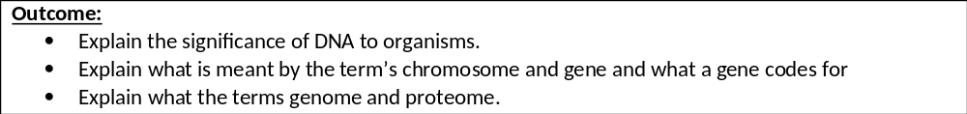
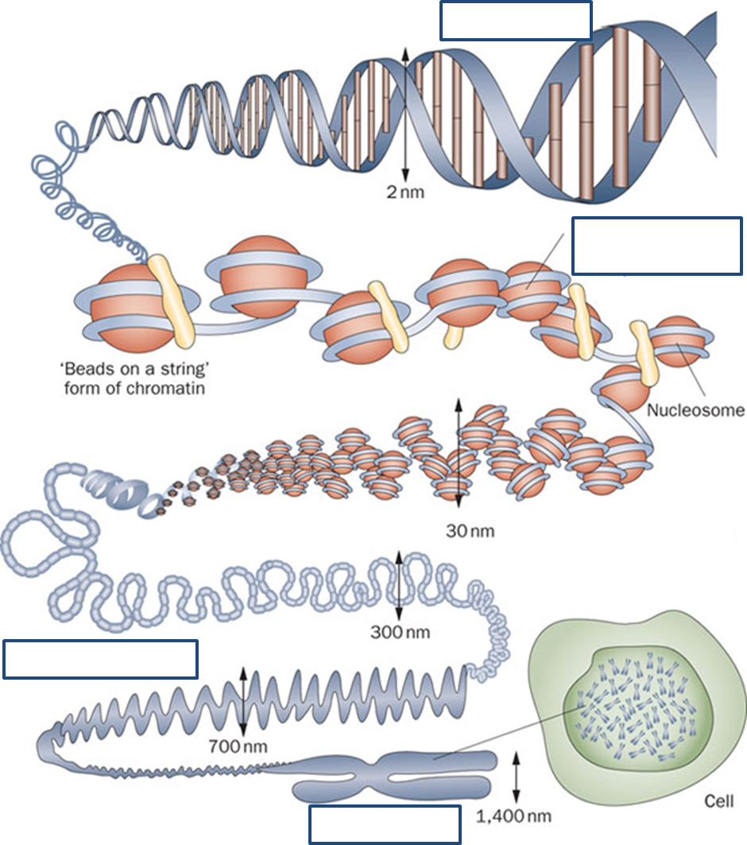

Slide 2
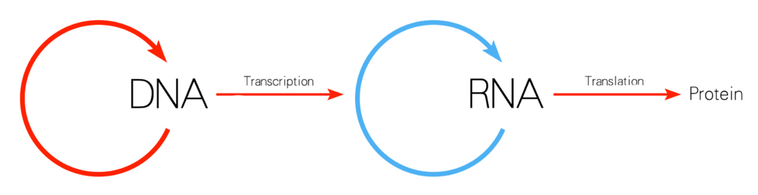
DNA is vital for all living beings – even plants. It is important as coding for proteins and the genetic instruction guide for life and its processes. DNA holds the instructions for an organism's or each cell’s development and reproduction and ultimately death.
There are many different types of proteins that include structural proteins, messenger proteins, enzymes and hormones. These perform various functions from forming the organs, skin and bones and the body to performing actions and functions via messengers, enzymes and hormones.
https://www.youtube.com/watch?v=zwibgNGe4aY- 5 minute video giving overview of the booklet.
Add labels from page 2 in your booklet onto the diagram on page 2 in your booklet.

Slide 3
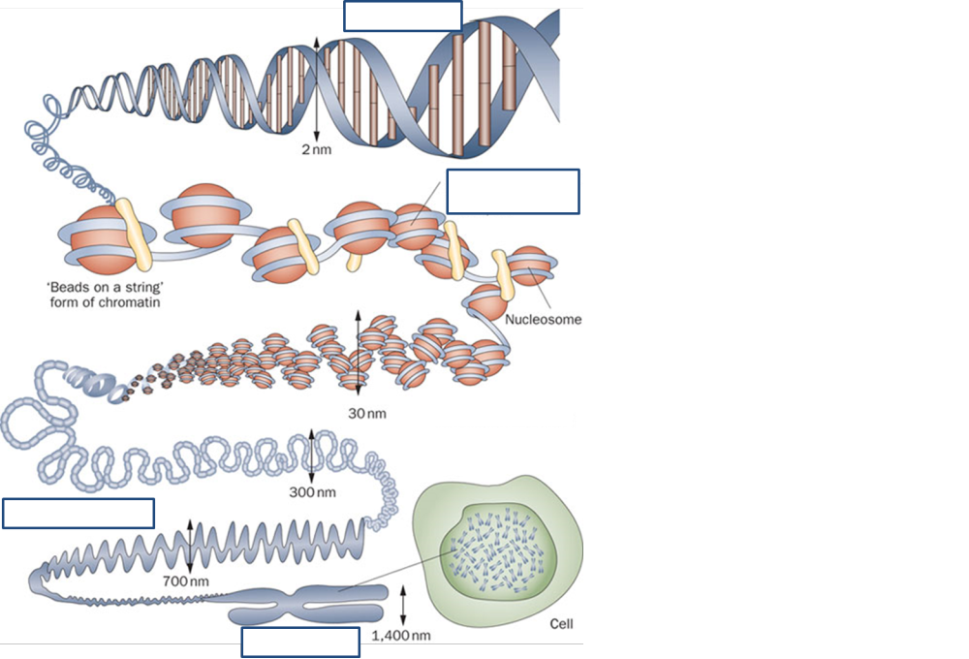
On a whiteboard can you make a paragraph to describe the structure of DNA in the nucleus.
Complementary base pairing of DNA holds the 2 DNA strands in the DNA molecule together.
……..
Sugar phosphate backbone
DNA Helix
2. DNA molecule twists into a DNA Helix
3. DNA helix coils around proteins called histones
4. The DNA and histones form chromatin.
5. Chromatin coils in a chromatid which is copied forming a second chromatid
6. The 2 chromatids are joined together with a centromere forming a chromosome
7. Chromosomes are found in the Nucleus.
Histone
Chromatin
Centromere
Nucleus
Chromosome
Chromatid
A chromosome is complex so we break it down into smaller sections depending on its function.

Slide 4
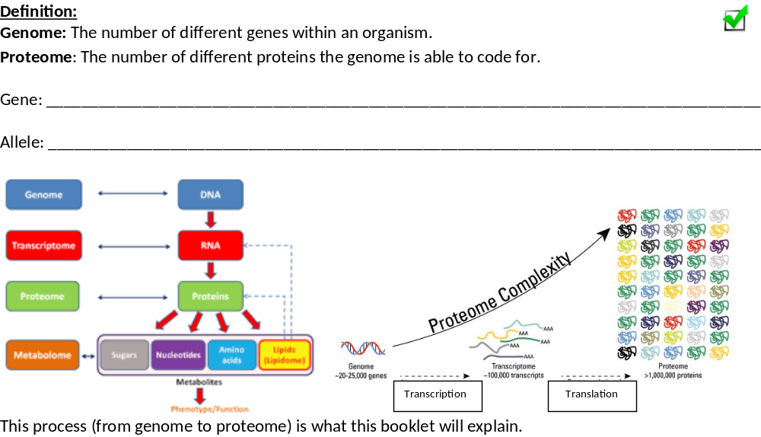
Section of DNA that codes for a protein/primary structure
Variation of a gene

Slide 5
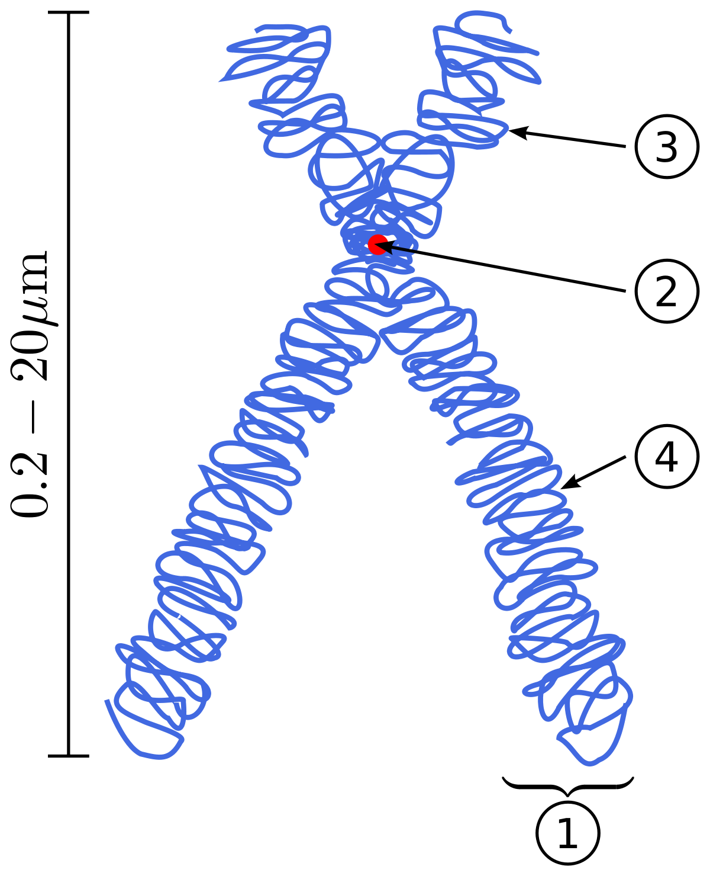
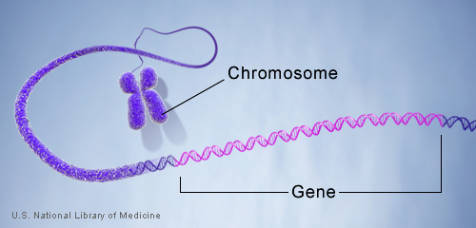
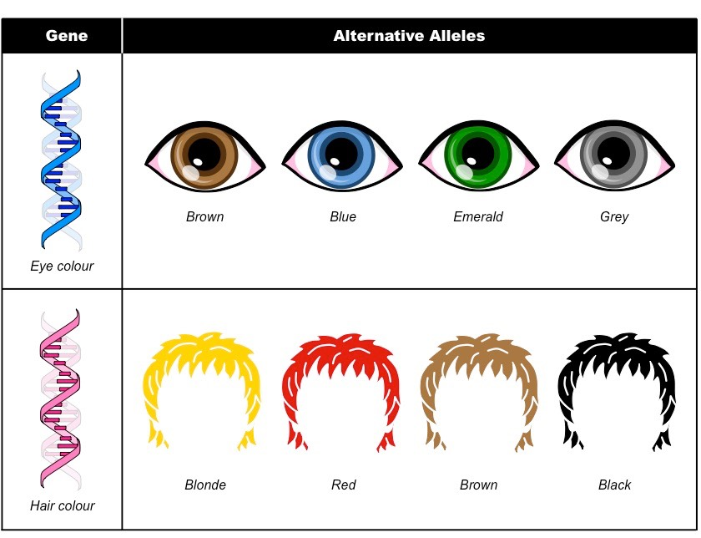
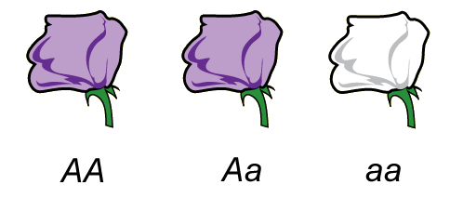
On a whiteboard:
8 9
5
6
Which letter(s) represent the centromere?
Which letter(s) represent the chromosome?
Which letter(s) represent the chromatid?
Which letter(s) represent the gene?
Which letter(s) represent the allele?
What is the gene for this example?
What are the alleles for this example?
2
5
1/5
6, 8
9
Gene: Petal colour
Alleles: Purple, white

Slide 6
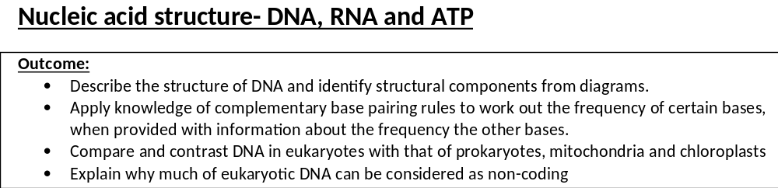
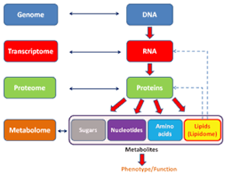

Slide 7

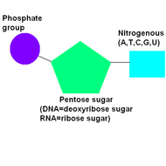
Monomer: Nucleic acid/ Nucleotide
Polymer: Polynucleotide
Component means “what is it made of?”
Condensation Reaction.
Water released,
Covalent bond formed- Phosphodiester
Components:
Phosphate group
Pentose sugar – either Deoxyribose (in DNA) or Ribose (in RNA and ATP)
Nitrogen containing base.
Copy and label the diagram onto page 4 in your booklet
From GCSE can you remember what
A
T
C
G
U stand for?
In your exam you will need to write out the FULL NAMES of the bases
Adenine
Thymine
Cytosine
Guanine
Uracil

Slide 8

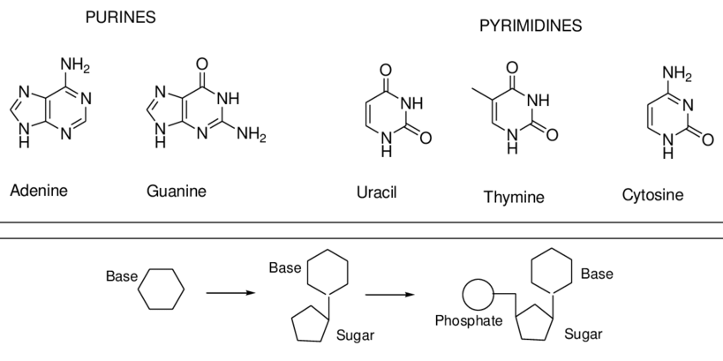
Beyond the specification, good for use in essays.
DNA contains: Adenine, thymine, cytosine and guanine
RNA contains: Adenine, Uracil, cytosine and guanine
Can you remember the definition for condensation and hydrolysis reactions?
Fill in the definitions box on page 5 in your booklet.
ATP contains: Adenine ONLY.

Slide 9
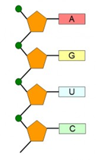
Condensation of nucleotides to polynucleotide chain.
Definition: (recap)
Condensation: Monomer joined to make polymers, water is released, covalent bond formed
Hydrolysis: Polymer to monomer, water is used, covalent bond broken
Complete labelling activity on page then answer the question.
1
9
3
4
5
6
7
8
10
2

Slide 10
Condensation of nucleotides to polynucleotide chain.
Definition: (recap)
Condensation: Monomer joined to make polymers, water is released, covalent bond formed
Hydrolysis: Polymer to monomer, water is used, covalent bond broken
Nucleotide
Name the type of nucleotide shown on the diagram. Explain your answer
RNA
Ribose Sugar
Uracil nitrogen containing base
Only found in RNA
Phosphate
Adenine
Guanine
Uracil
Cytosine
Phosphodiester bond
Condensation reaction
Ribose
Sugar phosphate backbone

Slide 11
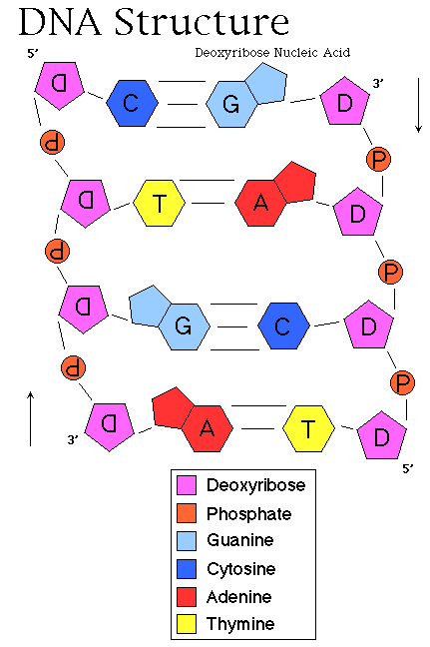
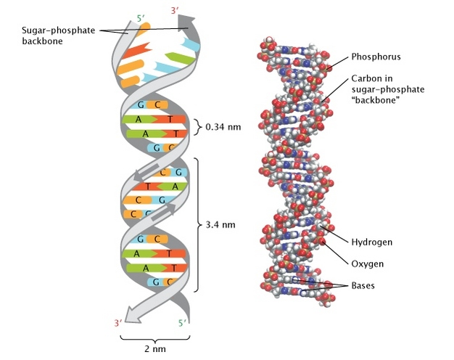
Deoxyribose Nucleic Acid molecule- DNA
DNA is coiled inside the nucleus of the cell.
Contains instructions for the primary structure of proteins, these proteins control the cell activities.
These instructions need to be protected and copied IDENTICALLY multiple times.
The structure and properties of DNA ensures this happens.

Slide 12
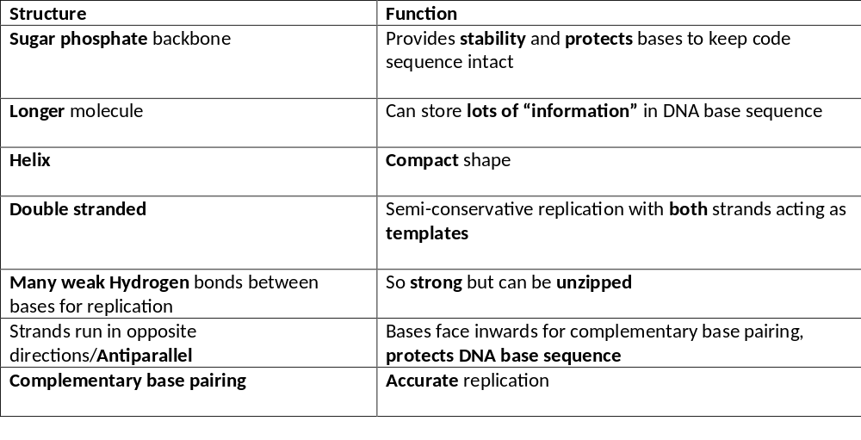
Deoxyribose Nucleic Acid molecule- DNA
Memory task: AO1.
Learn the table below.
Try the kahoot! to test your memory.
“What does it do”
https://create.kahoot.it/share/nucleic-acid-kahoot/f10c7589-d7aa-4ff5-acbd-344e5de50d22
“What is it made of.”

Slide 13
Deoxyribose Nucleic Acid molecule- DNA
Practice comprehension skills.
Using page 38-39 of Toole and Toole research the questions on page 6 in your booklet.
Complete the maths activity.
EXAM NOTE: End of paper 2 will be a synoptic comprehension worth about 6% of you’re a-level grade.
They are easy but you need to practice the skill of answering comprehensions
Have you completed the flipped learning activity in homework 1 to learn about eukaryotic and prokaryotic DNA?
Use this flipped learning to complete the questions on page 6-7 in your booklet
Flipped learning is great practice for developing your research and independent skills to use in your exam or next steps after college.
This also practices your application skills.

Slide 14
How many hydrogen bonds between cytosine and guanine?
How many hydrogen bonds between adenine and thymine?
Why would a higher proportion of cytosine and guanine make a more stable molecule?
DNA is very stable. Does this mean it mutates rarely or frequently?
The two strands forming the double helix (providing strength) are joined only by hydrogen bonds. What does this allow to happen?
Why can it carry a large amount of genetic information?
What does base pairing allow to occur?
3 H bonds
2 H bonds
More H bonds which provide stability, takes more energy to break the bonds
Mutates rarely, important so genetically identical every time DNA is copied
DNA to be unzipped/separated during replication
DNA is a large molecule
Allow DNA molecule to be accurately replicated and transfer information to mRNA

Slide 15
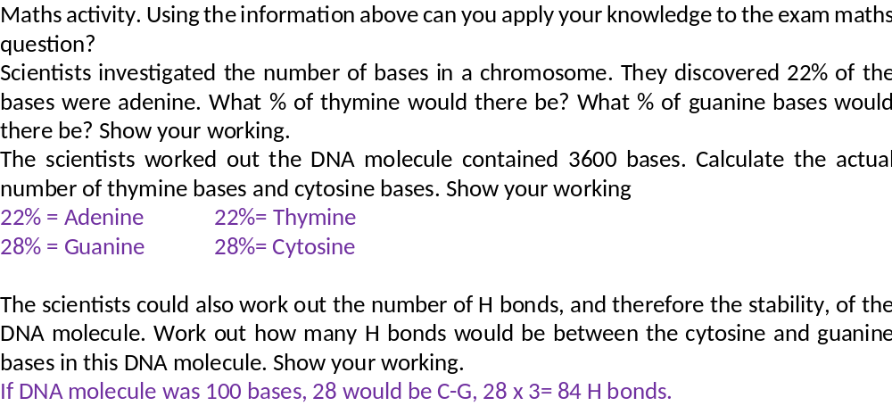


Slide 16
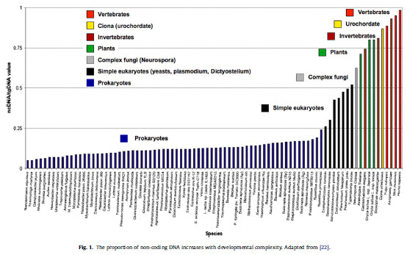
Prokaryotic vs Eukaryotic DNA
Mitochondria and chloroplast both contain DNA separate from the cell. This DNA is similar to prokaryotic DNA. Describe the structure of mitochondrial and chloroplast DNA.
Smaller, no histones (naked), circular.
Found in the Matrix of the Mitochondria and Stroma of the chloroplast
Briefly describe the main points of the endosymbiosis theory.
Smaller prokaryotic cells being absorbed within a membrane by larger cells forming eukaryotic cells.
Smaller cell and larger cell live together.
99% of our DNA is known as non-coding. Give 2 functions of this non-coding DNA. We will be learning more about these non-coding sections later in this booklet and in Year 2.
Promotor region- RNA polymerase can bind during transcription
Terminator region- RNA polymerase released after transcription
Enhancer region- allow proteins for transcription to bind
Silencer regions- allows proteins to bind to prevent transcription
AVP
Proportion of non-coding DNA increases with complexity of the organism.

Slide 17
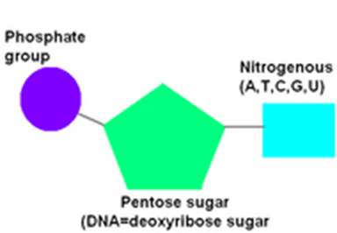
 | Eukaryotic DNA | Prokaryotic DNA
Location in cell. | Nucleus | Cytoplasm
Length? | Longer | Shorter
Histones? | Yes | No (naked)
Non-coding/repetitive regions? | Yes, many | No
Plasmids? | No | Yes
Shape of DNA molecule? | Linear chromosomes | Circular
Describe/draw nucleotide structure?
Bonds? | H between nitrogen bases Phosphodiester between nucleotides | H between nitrogen bases Phosphodiester between nucleotides
Differences
CONTRAST
Similarities
COMPARE

Slide 18
Complete exam questions on page 8 in your booklet

Slide 19
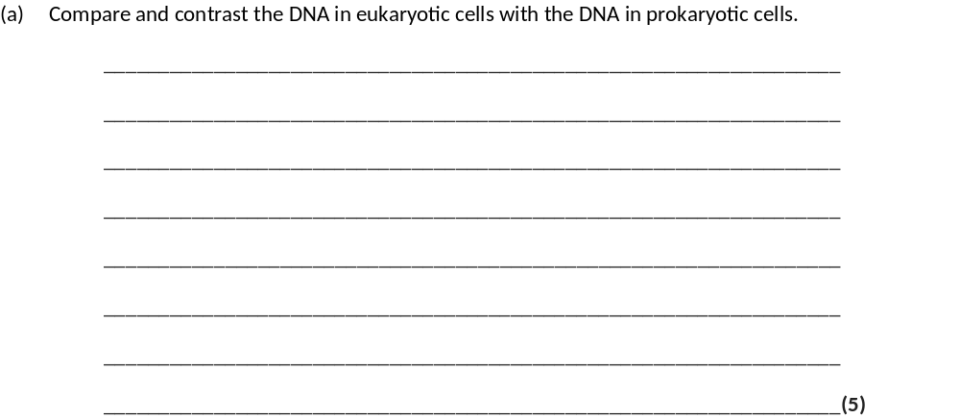
Comparisons
1. Nucleotide structure is identical;
Accept labelled diagram or description of nucleotide as phosphate, deoxyribose and base
2. Nucleotides joined by phosphodiester bond;
OR
Deoxyribose joined to phosphate (in sugar, phosphate backbone);
3. DNA in mitochondria / chloroplasts same / similar (structure) to DNA in prokaryotes;
Accept shorter than nuclear DNA/is circular not linear/is not associated with protein/histones unlike nuclear DNA;
Eukaryotic | Prokaryotic
4. Longer | Shorter
5. Contains introns/non-coding regions | Doesn’t contain introns/non-coding
6. Linear | Circular
7. Associated with histones | Not associated with histone

Slide 20
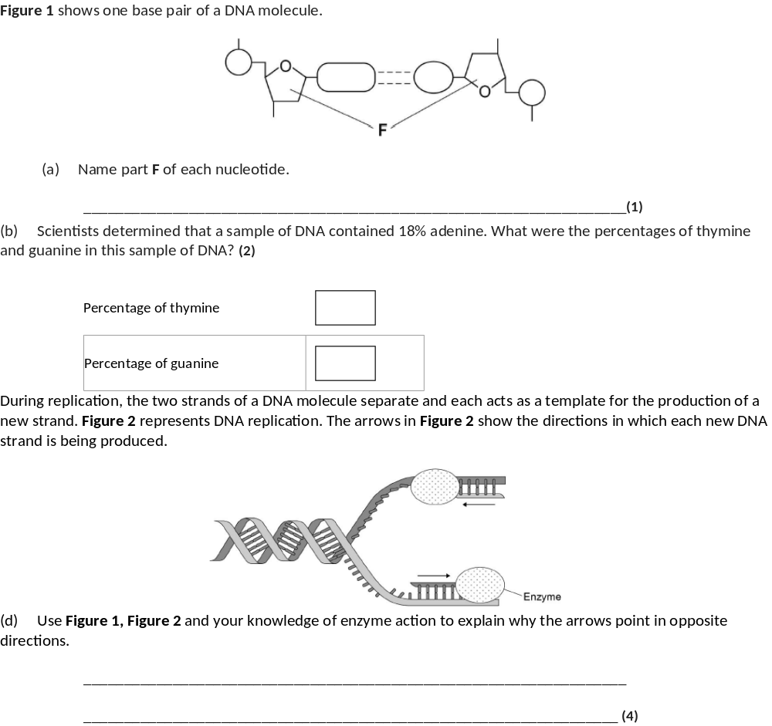
(a) Deoxyribose.
1
(b) 1. Thymine 18 (%);
2. Guanine 32 (%).
2
(d) 1. (Figure 1 shows) DNA has antiparallel strands / described;
2. (Figure 1 shows) shape of the nucleotides is different / nucleotides aligned differently;
3. Enzymes have active sites with specific shape;
4. Only substrates with complementary shape / only the 3’ end can bind with active site of enzyme / active site of DNA polymerase.
4

