Slide 1
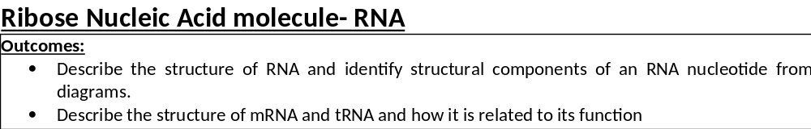
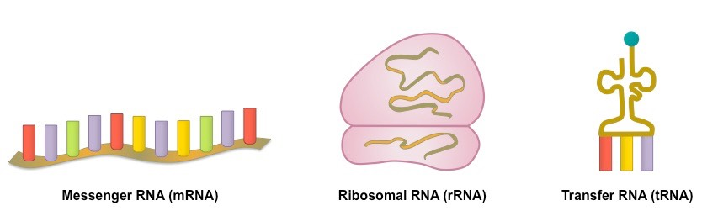
DNA molecule carries the instructions for the primary structure of a protein but the DNA molecule stays in the nucleus so it can be copied multiple times.
How do the instructions get turned into a protein on the ribosomes which are outside of the nucleus in the cytoplasm?
RNA!

Slide 2
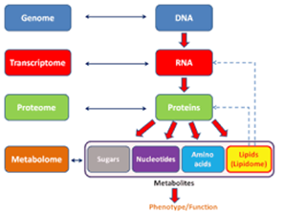

Slide 3

Monomer: RNA nucleotide
Polymer: RNA molecule
RNA is a single, shorter polynucleotide chain with ribose pentose sugar and the nitrogenous base uracil instead of thymine.
There are 3 types of RNA:-
mRNA – Messenger- transfers genetic information from DNA to ribosomes, made in transcription.
rRNA – Ribosomal- component of ribosomes (along with proteins), used in translation.
tRNA – Transfer- used in translation.

Slide 4
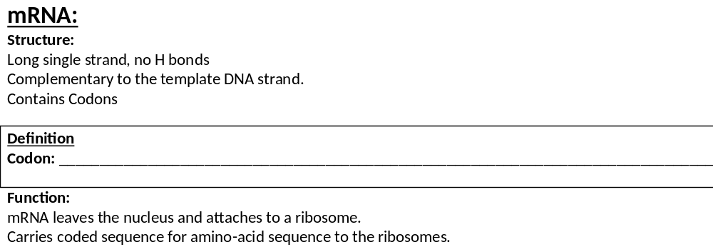


1. Triplet / three nucleotide bases on mRNA;
2. That code for an amino acid;2
Complete mRNA activity on page 9-10 in your booklet.

Slide 5
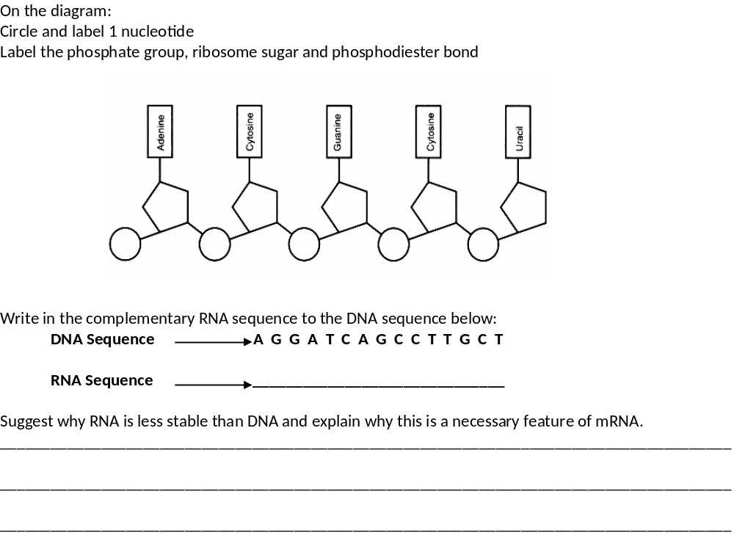
Nucleotide
Phosphate
Ribose
Phosphodiester bond
Exam tip.
When having to do a sequence like this it is always easier to split the sequence into 3 bases at a time
U C C U A G U C G G A A C G A
mRNA is single stranded so doesn’t have H bonds between complementary base pairs
H bonds provide stability

Slide 6
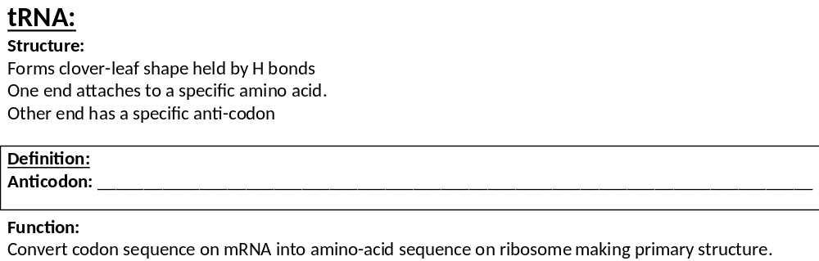
1. Triplet / three nucleotide bases on tRNA;
2. Complementary to codon on mRNA

Slide 7
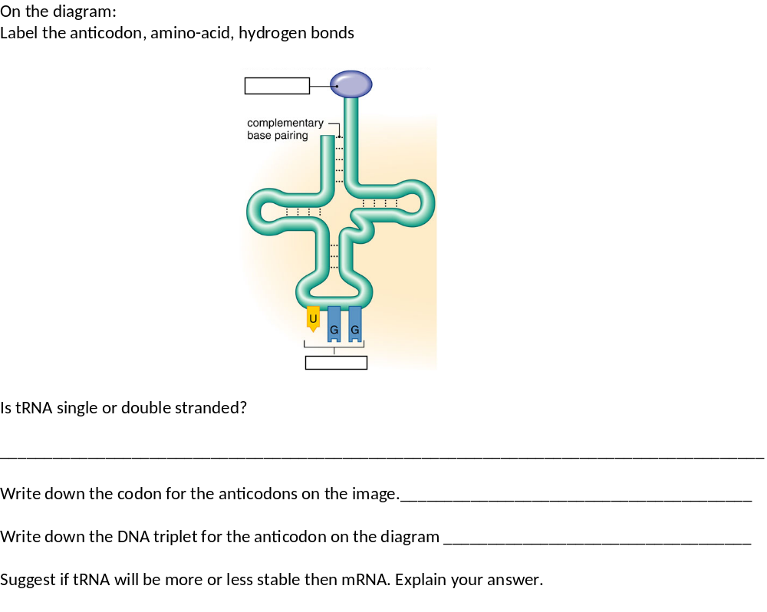
Amino-acid
H Bonding
Anticodon
Single stranded
ACC
TGG
More stable
Folded into clover shape so had H bonds.
H bond provide stability

Slide 8
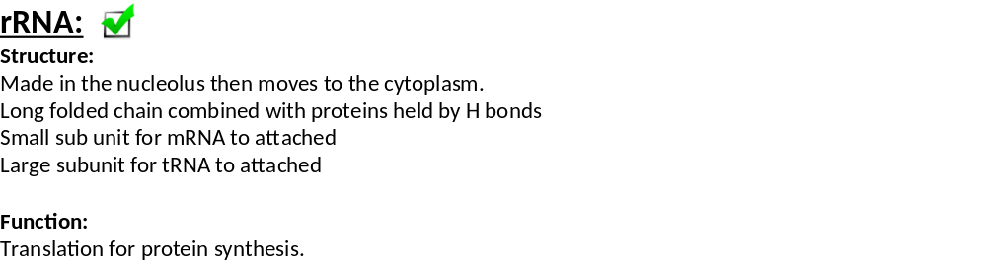
Complete the maths activity on page 11.
Fill in your own description of how you answered the maths questions to help you remember the technique for your exams.

Slide 9
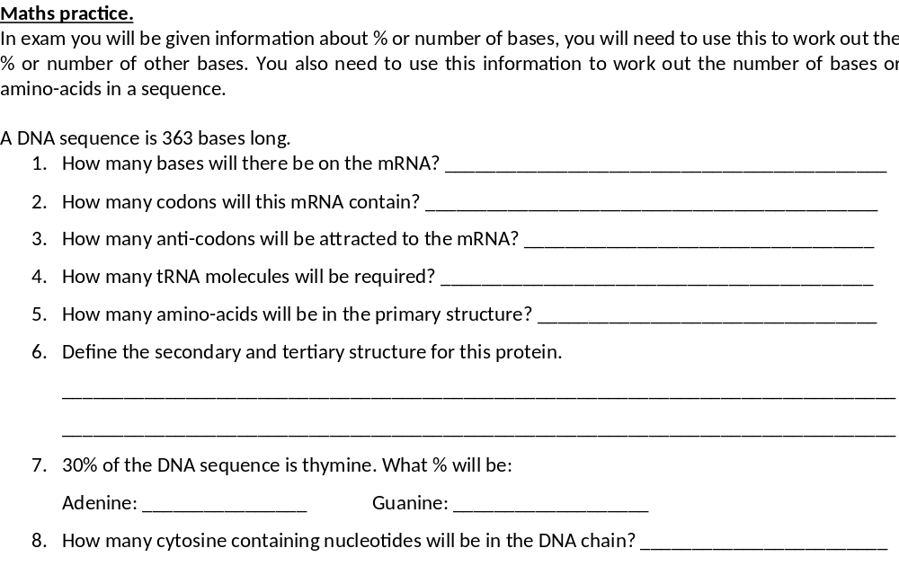
363
3 bases in a codon- 363/3= 121
121
121
121
Secondary: Folded, A-Helix, B-pleated sheet, held by H bonds
Tertiary: Specific 3D shape, held by H, ionic and disulphide bonds between R groups
30% 20%
Cytosine = 20%
DNA = 363 bases = 72.6 nucleotides

Slide 10

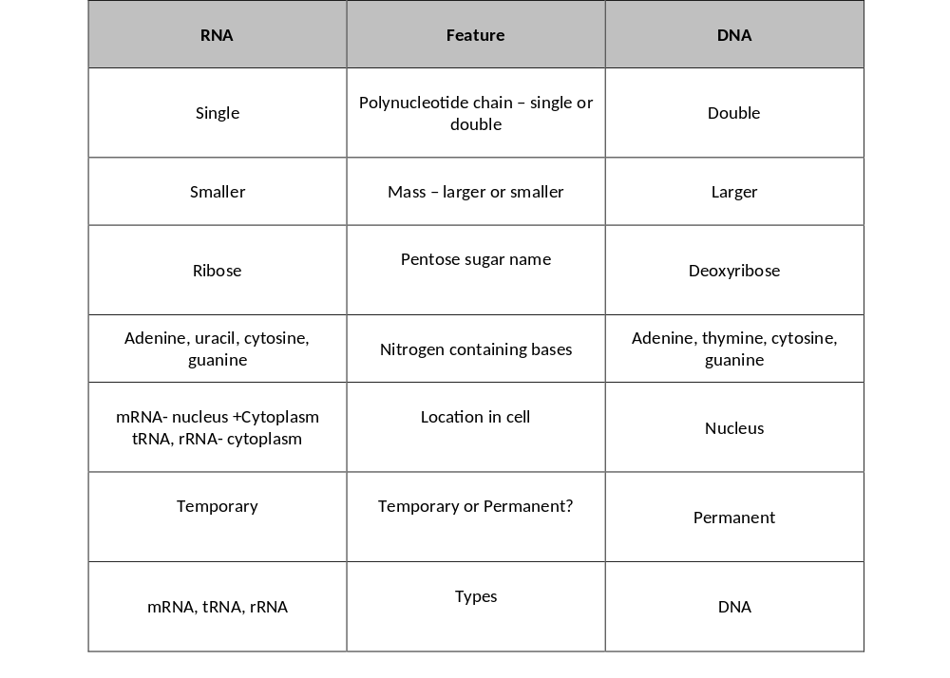
Comparison of DNA and RNA
Using pages 2-11 complete the comparison table on page 12.
Draw your own comparison table for RNA on page 12.
If you are struggling there are some prompts on the next slide.

Slide 11
Comparison of DNA and RNA
 | mRNA | tRNA | rRNA
Name | Messenger | Transfer | Ribosomal
H bonds? | No | Yes | Yes
Shape? | Linear/straight | Cloverleaf | Ball
Name for 3 bases? | Codon | Anticodon | None
Length? | Longest | Shortest | Shorter
Amino-acid binding site? | No | Yes | No
No. of different types | Many for every different gene | 64 for each anticodon | 1

Slide 12
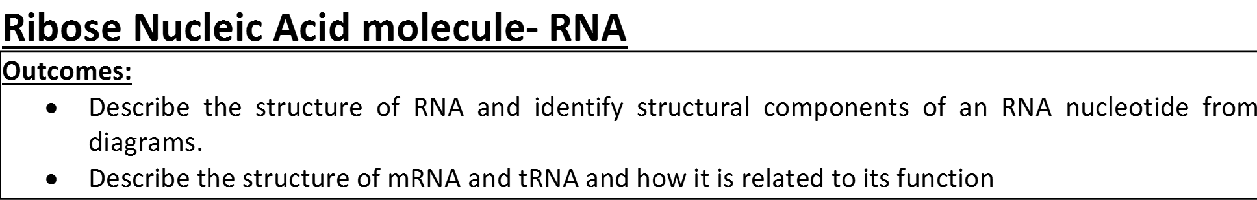
Complete Exam questions

Slide 13
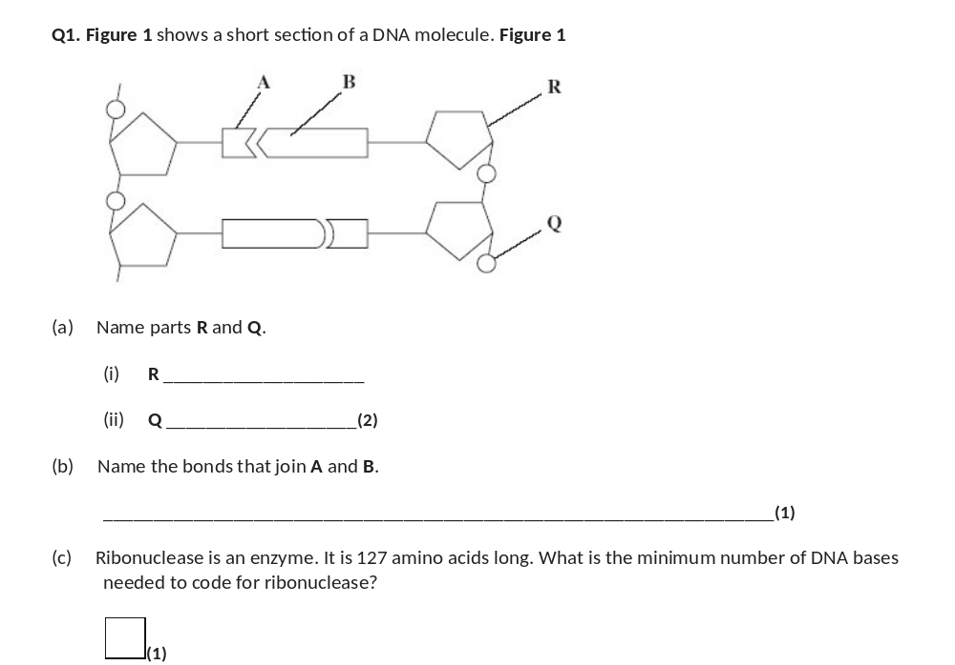
(a) (i) Deoxyribose;
pentose / 5C sugar = neutral
1
(ii) Phosphate / Phosphoric acid;
phosphorus / P = neutral
1
(b) Hydrogen (bonds);
1
(c) 381 / 384 / 387;
1

Slide 14
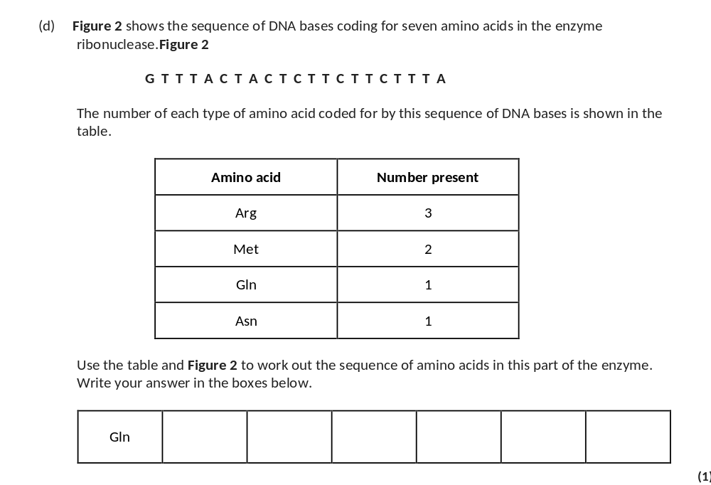
Split the DNA sequence into triplet
First one is Gln
Look at the rest of the triplet, what do you notice?
Compare to how many of each amino-acid is present.
Met Met Arg Arg Arg Asn;
1

Slide 15
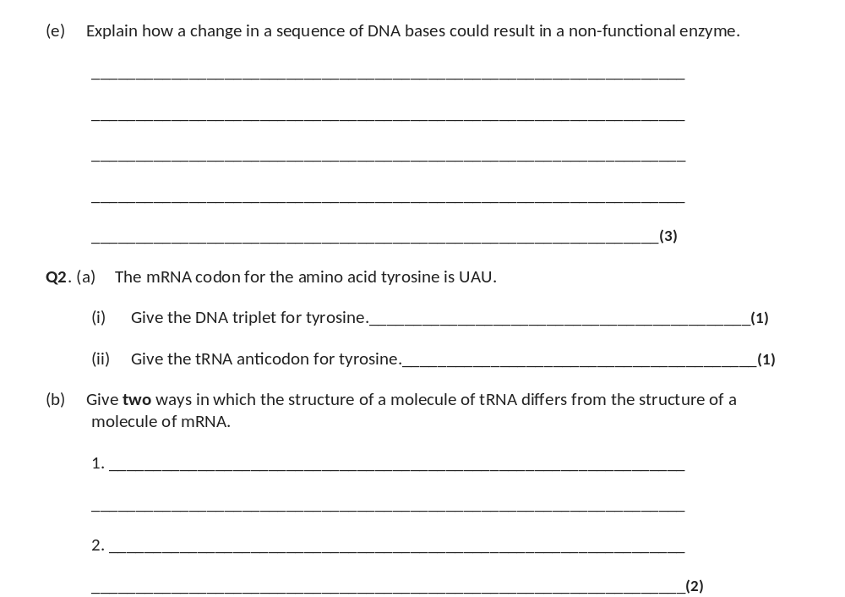
(e) Change in (sequence of) amino acids / primary structure;
Change in hydrogen / ionic / disulfide bonds leads to change in tertiary structure / active site (of enzyme);
Substrate cannot bind / no enzyme-substrate complexes form;
Q Reject = different amino acids are formed
3
(a) (i) ATA;
(ii) AUA;
(b) tRNA ‘clover leaf’ shape, mRNA linear/straight; (allow reference to loop / folded structure)
tRNA standard length, mRNA length depends on gene;
tRNA has an amino acid binding site, mRNA doesn’t;
tRNA has anticodon available / three exposed bases, mRNA has codon;
tRNA has hydrogen bonds (between base pairs), mRNA doesn’t;
2 max
Exam tip: Both tRNA and mRNA are mentioned in the question so you should mention both in your answer
Should be in a table.

Slide 16
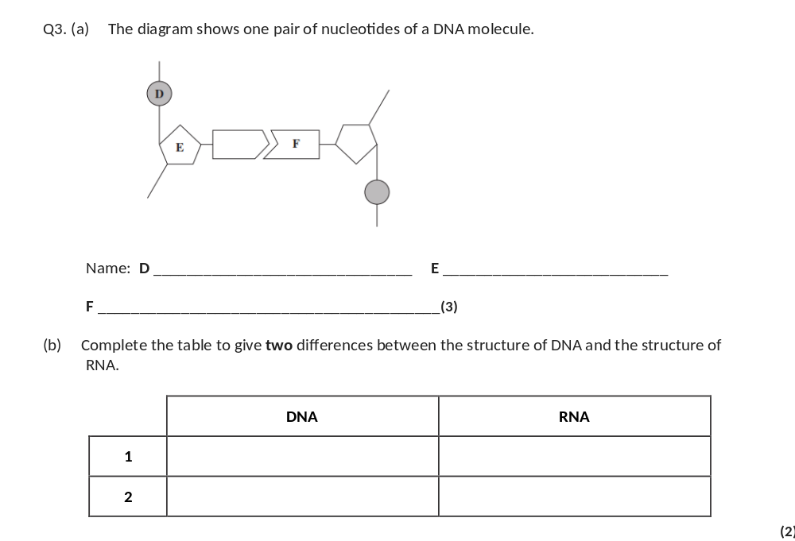
D phosphate;
E pentose sugar/deoxyribose;
F (nitrogenous) base/ organic base/ thymine/adenine/ cytosine/guanine;
In D reject phosphorous
In E
Accept 5-carbon sugar
Reject sugar alone
3
 | DNA | RNA
 | double-stranded | single-stranded
 | deoxyribose | ribose
 | Thymine/T | Uracil/U
 | very large/long | very small/short
(b)
Accept double helix for DNA
Accept longer and shorter
Need comparison but could be in one box
List rule applies.

Slide 17
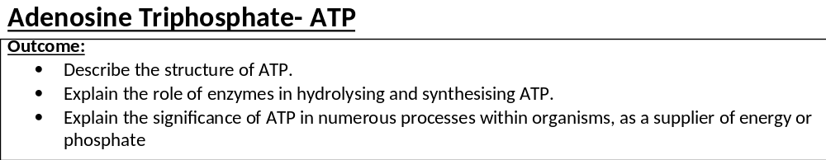
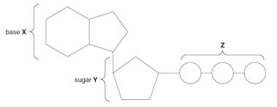
ATP is a type of nucleotide and provides energy for the cell.
Without ATP the cell wont have the energy to carry out any functions.

Slide 18
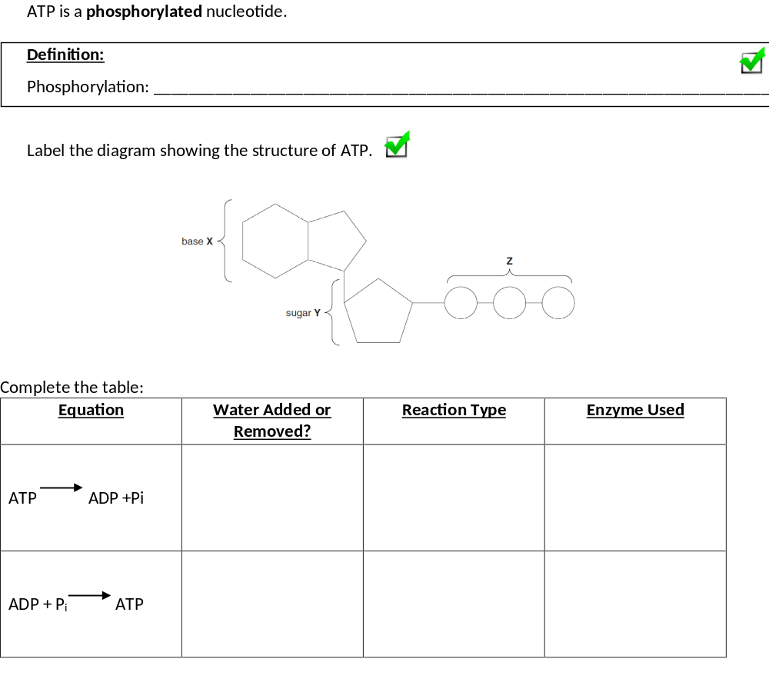
Addition of a phosphate group
Adenine
3 x phosphates
Ribose
Added Hydrolysis ATPase
ATP hydrolase
Removed Condensation ATP synthase

Slide 19
Adenosine Triphosphate- ATP
Explain why ATP is used as an energy source.
Releases energy in small amounts.
One bond broken to immediately release energy.
Phosphorylates other molecules to lower activation energy.
Can be easily reformed/resynthesised.
Soluble but cannot leave the cell.
Complete the revision poster on page 16 in your booklet
Complete Eqs on page 17- 18
Complete comparison table on page 18.
Very common EQ in all 3 papers.

Slide 20
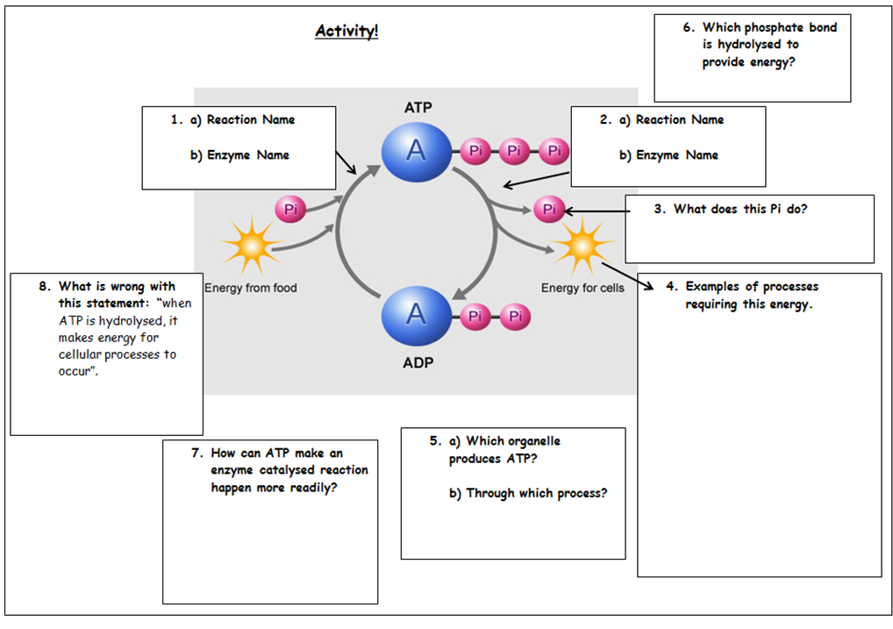
Between last 2 phosphates
Condensation
ATP synthase
Hydrolysis
ATPase/ATP hydrolase
Organic phosphate
Active transport
Protein/lipid/carbohydrate synthesis
Enzyme reactions
Movement of vesicles
Energy can’t be “made”
Mitochondria
Aerobic respiration
Lowers activation energy

Slide 21
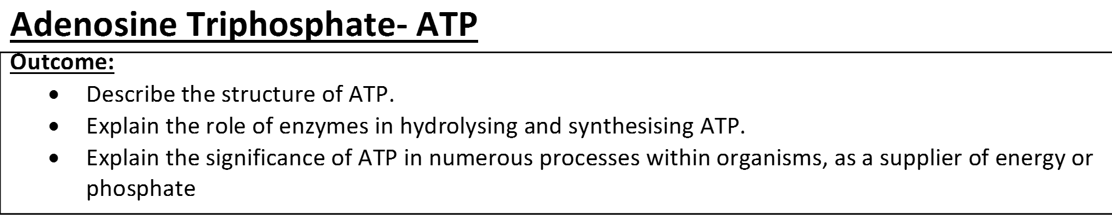
Complete Exam questions

Slide 22
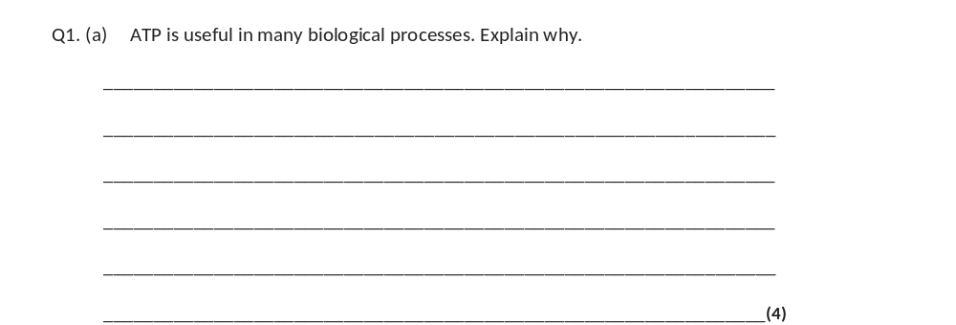
(a) 1. Releases energy in small / manageable amounts;
1. Accept less than glucose
2. (Broken down) in a one step / single bond broken immediate energy compound / makes energy available rapidly;
2. Accept easily broken down
3. Phosphorylates / adds phosphate makes (phosphorylated substances) more reactive / lowers activation energy;
3. Do not accept phosphorus or P on its own
4. Reformed / made again;
4. Must relate to regeneration
4

Slide 23
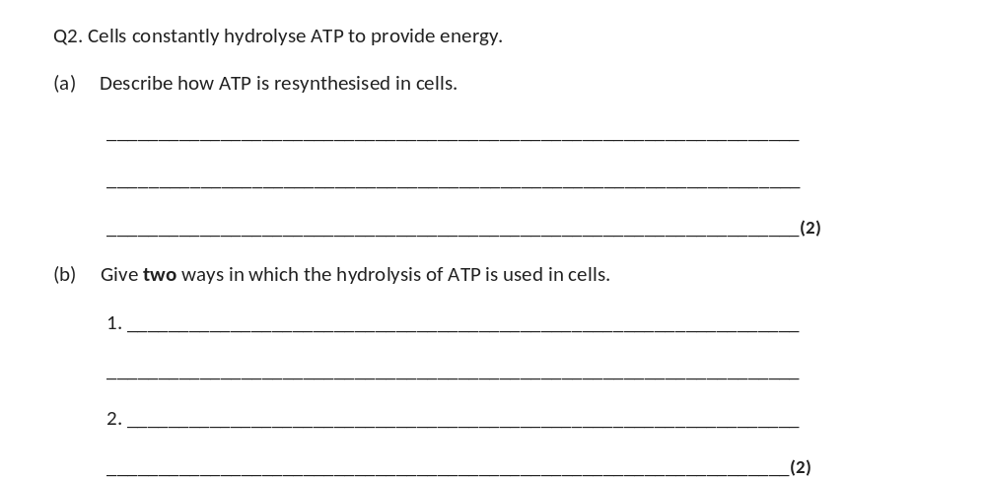
(a) 1. From ADP and phosphate;
Accept
Reject P/Phosphorus
Reject use of water in the reaction
2. By ATP synthase;
3. During respiration/photosynthesis;
2 max
(b) 1. To provide energy for other reactions/named process;
Reject ‘produce’ energy
2. To add phosphate to other substances and make them more reactive/change their shape;
2

Slide 24
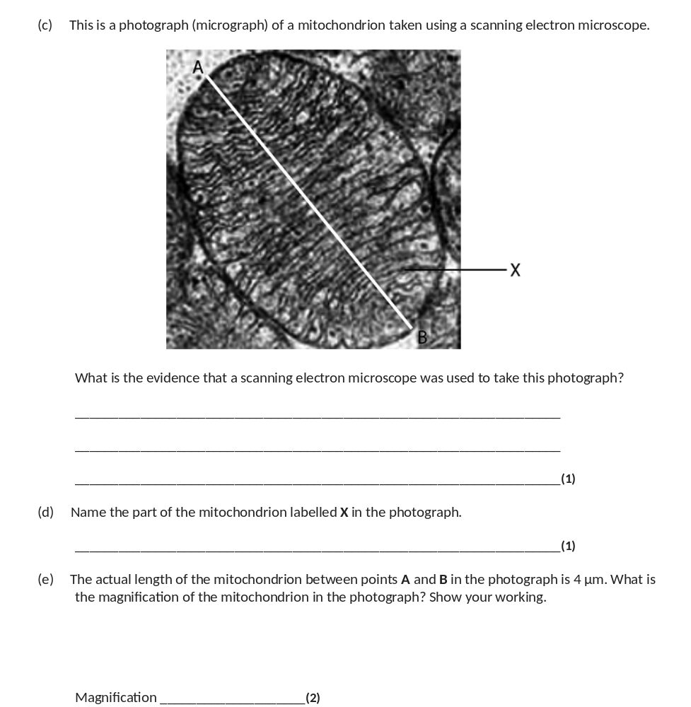
(c) (Can see) 3D image;
1
(d) Crista/cristae;
Ignore matrix
1

Slide 25
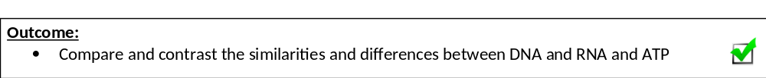
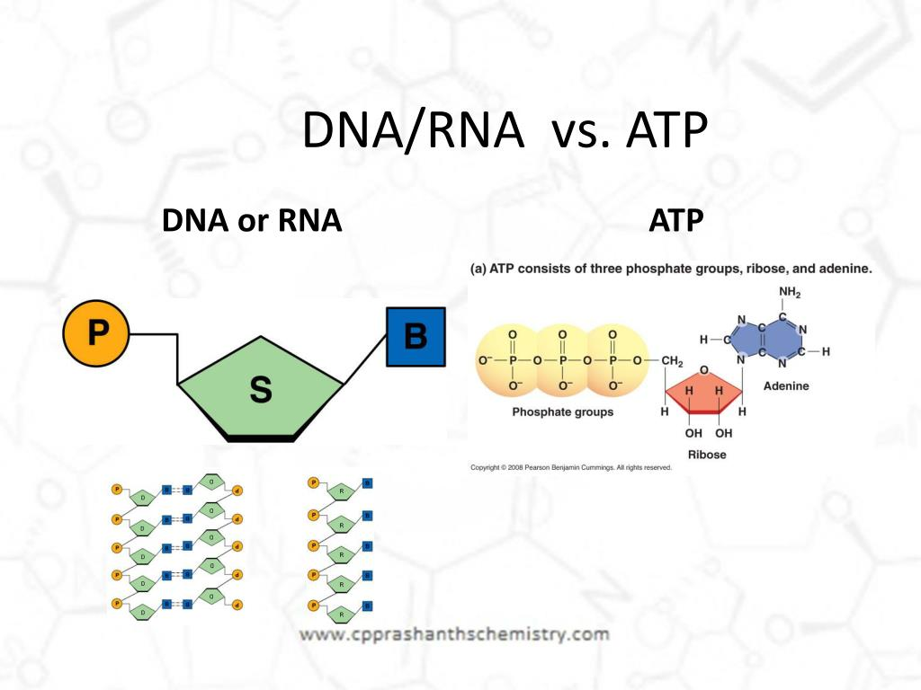
Use booklet pages 2-18 to complete comparison table on page 18

Slide 26
