Slide 1
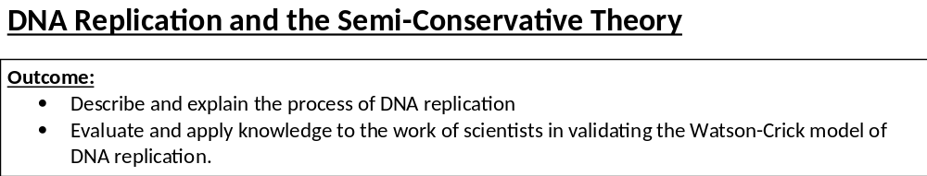
https://www.youtube.com/watch?v=RPIF5ld6V6Q
https://www.youtube.com/watch?v=TNKWgcFPHqw
https://www.youtube.com/watch?v=bee6PWUgPo8
1 minute video, very simple.
3 minute animation. More detail than needed but simple.
Crazy cool video of what actually happens.

Slide 2

When cells divide, each new cell must receive an IDENTICAL copy of the genetic material. DNA must be able to copy itself exactly to form 2 new DNA molecules. This is so the daughter cells have the genetic information to produce the enzymes and other proteins needed.
DNA Helicase separate strands/unzips DNA breaking H-bonds,
Both strands act as template,
Free nucleotides attach by complementary base pairing,
Adenine to Thymine, Cytosine to Guanine (You must write out full words),
DNA polymerase joins nucleotides on new strands forming phosphodiester bonds,
Forming sugar-phosphate backbone,
H-bonds reform between bases,
Semi-conservative replication / new DNA molecules contain one old strand and one new strand.
Definition:
DNA Helicase: ___________________________________________________________________________
_______________________________________________________________________________________
DNA Polymerase: ________________________________________________________________________
_______________________________________________________________________________________
Breaks H bonds between nitrogen bases separating DNA strands
Joins NUCLEOTIDES forming phosphodiester bonds

Slide 3
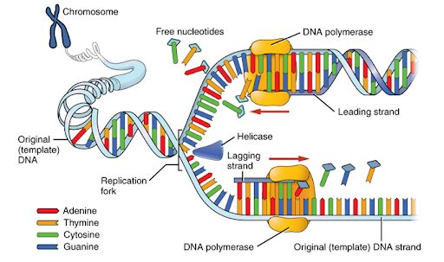
DNA Helicase separate strands/unzips DNA breaking H-bonds,
Both strands act as template,

Slide 4
Free nucleotides attach by complementary base pairing,
Adenine to Thymine, Cytosine to Guanine (You must write out full words),

Slide 5
DNA polymerase joins nucleotides on new strands forming phosphodiester bonds,
Forming sugar-phosphate backbone,
H-bonds reform between bases,

Slide 6
On page 19 draw and label your own diagram showing DNA replication.
Turning written information into a diagram makes your brain work harder so more likely to remember the mark scheme
Semi-conservative replication / new DNA molecules contain one old strand and one new strand.
DO NOT say the DNA contains half new strands and half old strand!

Slide 7
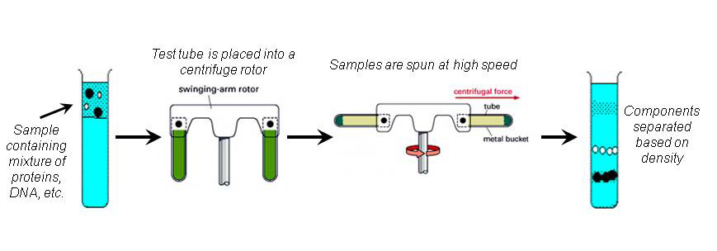
Meselsohn & Stahl
How do we know that semiconservative replication is how DNA actually replicates?
Detailed 6 minute video
http://www.sumanasinc.com/webcontent/animations/content/meselson.html
Read through the method for this experiment on page 20 in your booklet.
Watch the video or read pages 44-45 in the Toole and Toole textbook.
Complete the revision poster on page 21 and the questions on page 20 in your booklet.
To prove semi-conservative replication scientists used the bacteria Escherichia coli (E.coli) and two Nitrogen isotopes – N¹⁴ (light) & N¹⁵ (heavy)
E.coli were grown on a media containing N¹⁵ (heavy isotope) for many generations.
All the nitrogenous bases in the bacteria now contained N¹⁵.
Sample of bacteria removed, the DNA was centrifuged and only 1 heavy band was obtained.
E.coli then transferred to media containing N¹⁴ only (light isotope) and allowed to replicate for 1, 2 and 3 generations.
Sample of bacteria removed, the DNA from each generation was extracted and centrifuged. The results were compared.

Slide 8
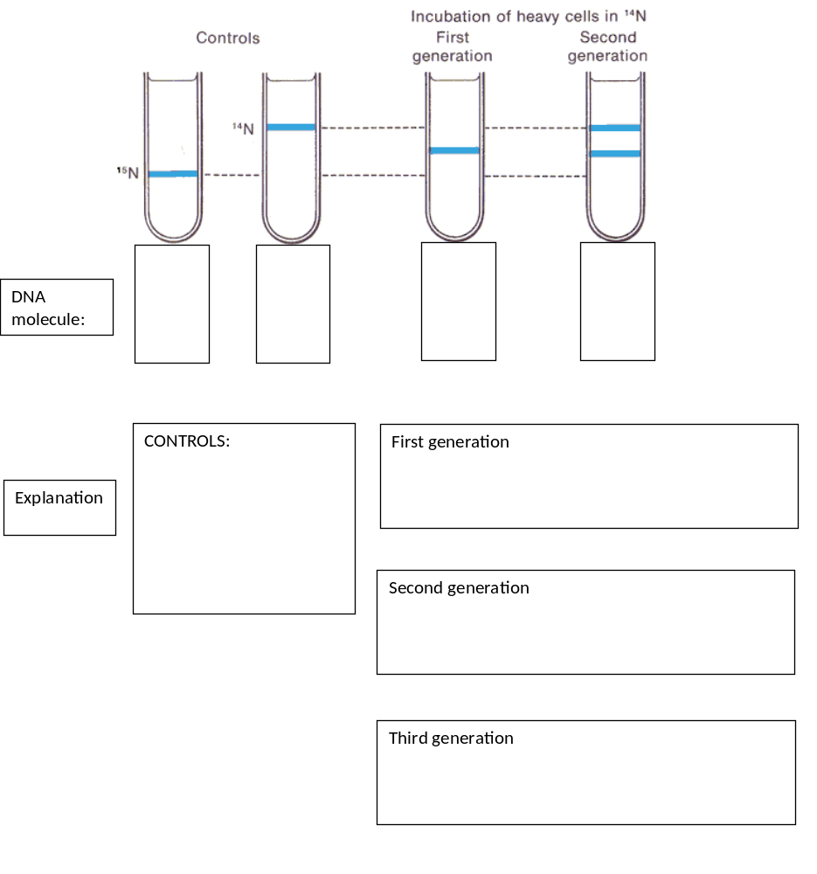
Controls
Control proves that what you are changing is what is causing the affect in the results.
These controls prove the different weights of the N isotopes.

Slide 9
N15
N14.5 N14.5
First Generation.
All bacteria contain N15 in DNA.
Moved to N14 allowed to replicate once.
Original DNA molecule splits into 2 separates strands
Each strand is a template, new strand is made from N14.
DNA molecule contains 1 old and 1 new strand
DNA molecule weighs N14.5.

Slide 10
N15
N14.5 N14.5
Second Generation.
Bacteria on N14 allowed to replicate again.
DNA molecule splits into 2 separates strands
Each strand is a template, new strand is made from N14.
DNA molecule contains 1 old and 1 new strand
Some DNA weighs N14.5.
Some weighs 14.
N14.5 N14 N14 N14.5

Slide 11
N15
N14.5 N14.5
Third Generation.
Bacteria on N14 allowed to replicate again.
DNA molecule splits into 2 separates strands
Each strand is a template, new strand is made from N14.
DNA molecule contains 1 old and 1 new strand
Some DNA weighs N14.5.
Some weighs 14- More than in generation 2.
N14.5 N14 N14 N14.5

Slide 12
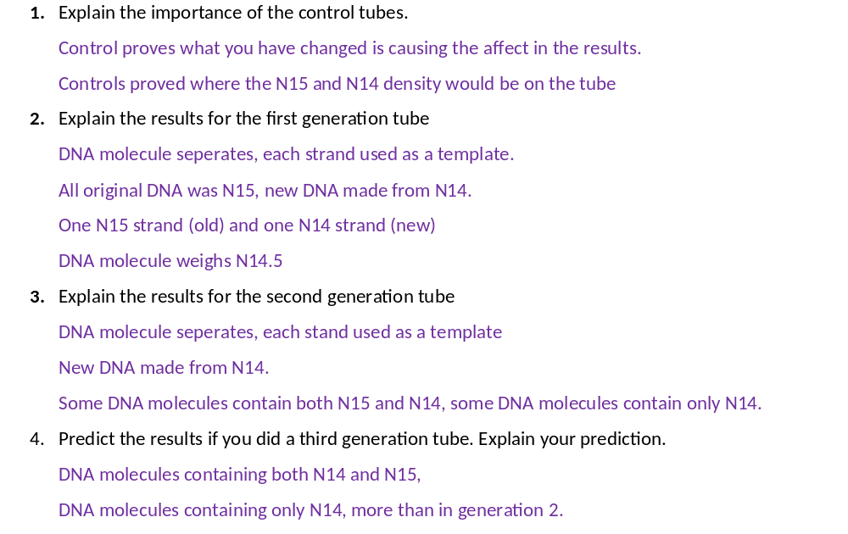

Slide 13
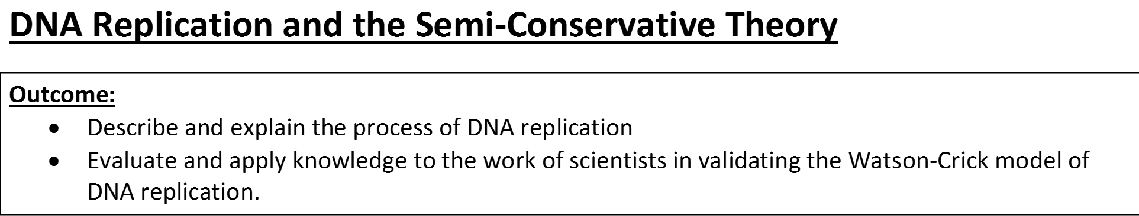
Complete exam questions

Slide 14
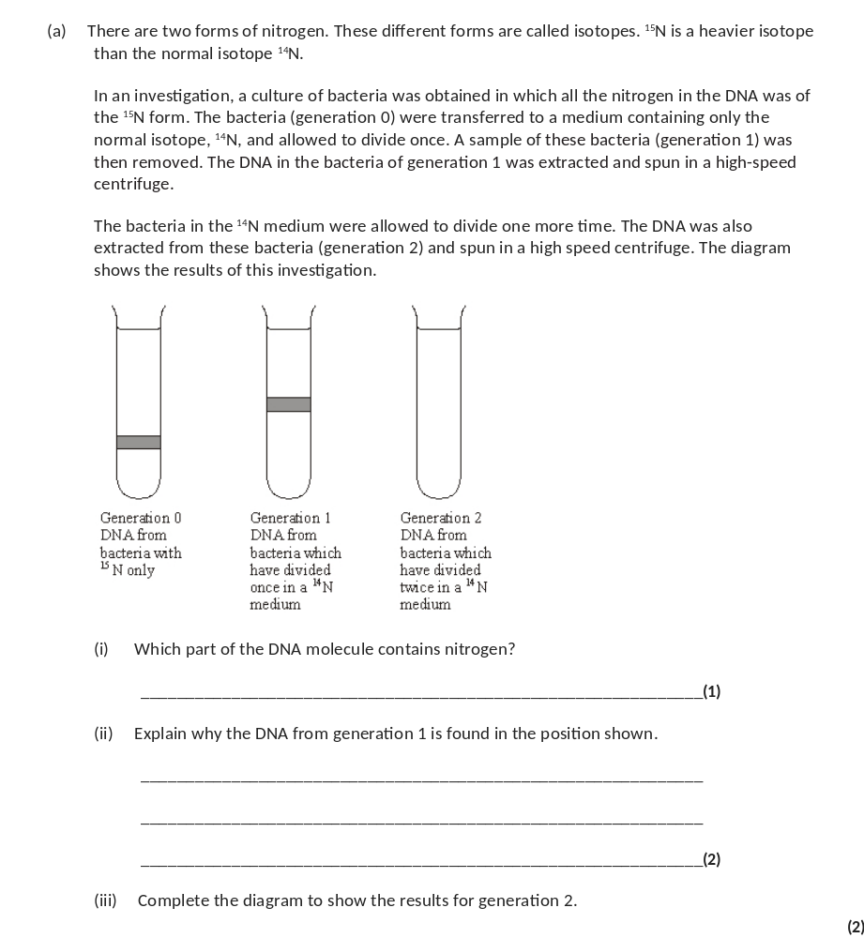
(a) (i) base / named bases;
reject nucleotide or uracil
1
(ii) it has been produced by semi-conservative
replication / one old strand and one new;
One strand has ¹⁵N bases and the other ¹⁴N;
Accept light / heavy N (therefore) it is less dense / lighter;
2
(iii) one band is in same position as generation 1;
one band higher;
accept a line. N.B. need a visible gap
2

Slide 15
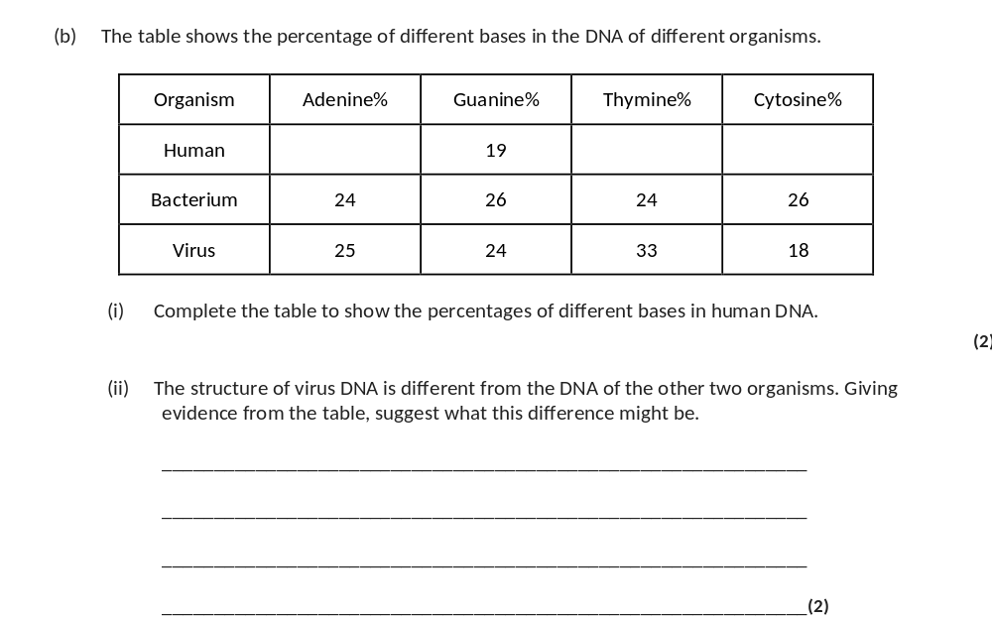
31 31 19
(ii) viral DNA single-stranded / not double-stranded;
evidence from table e.g. not equal amount of A and T
/ C and G / all different;
2

Slide 16
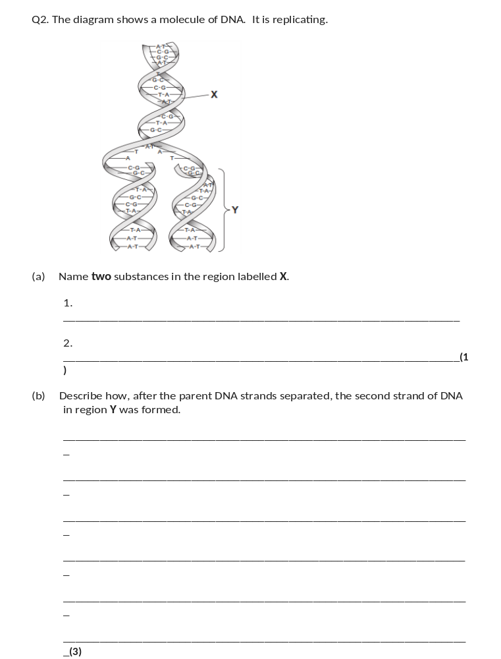
(a) (Pentose) sugar/deoxyribose and phosphate;
Reject ribose and phosphorus
1
(b) Semi-conservative replication;
Complementary pairing;
Hydrogen bonding (of bases/nucleotides);
Condensation/described of nucleotides;
DNA polymerase involved;
Accept example (A, T and C, G)
3 max

