Slide 1
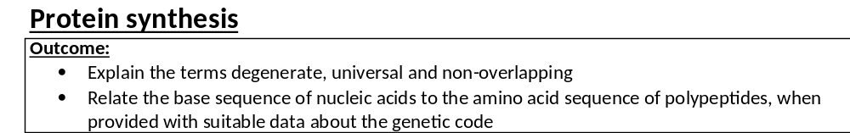
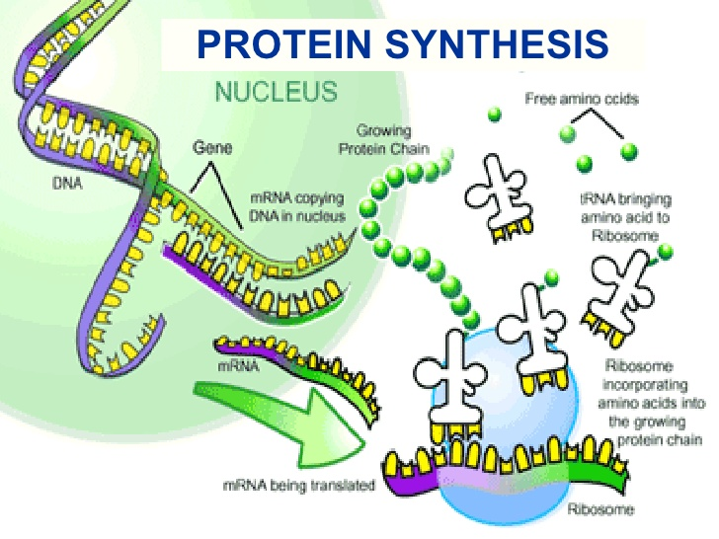
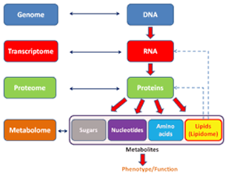
Video which explain the point of DNA and the 2 processes we will be looking at:
https://www.youtube.com/watch?v=zwibgNGe4aY-

Slide 2
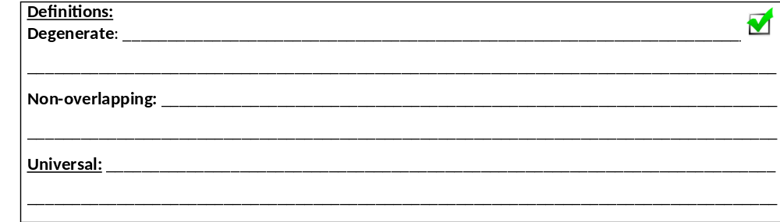
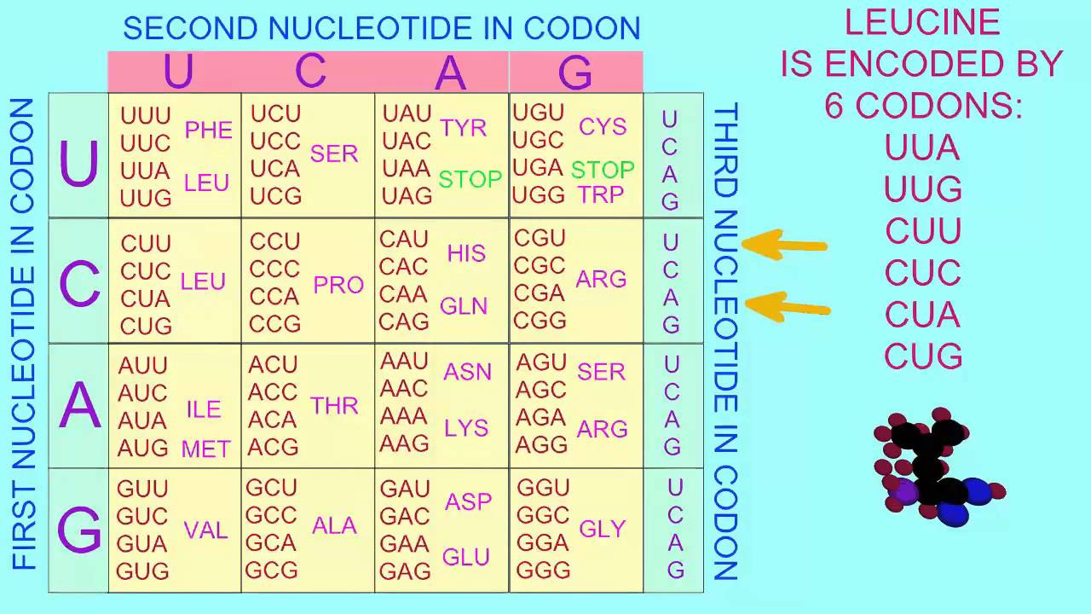
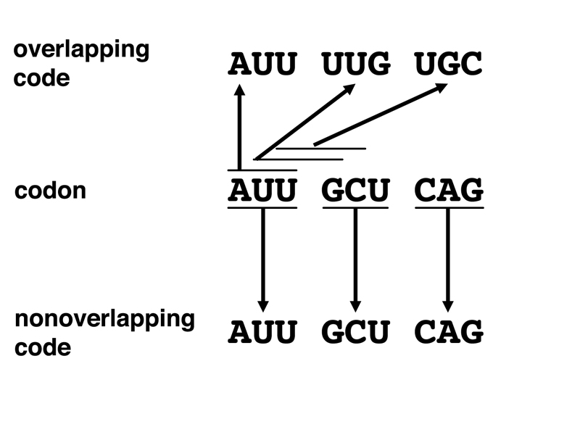
More than one (base) triplet for each amino acid
Each base is part of only one triplet/codon
The same triplet codes for the same amino acid in different organisms
Complete the recap activities on page 24

Slide 3
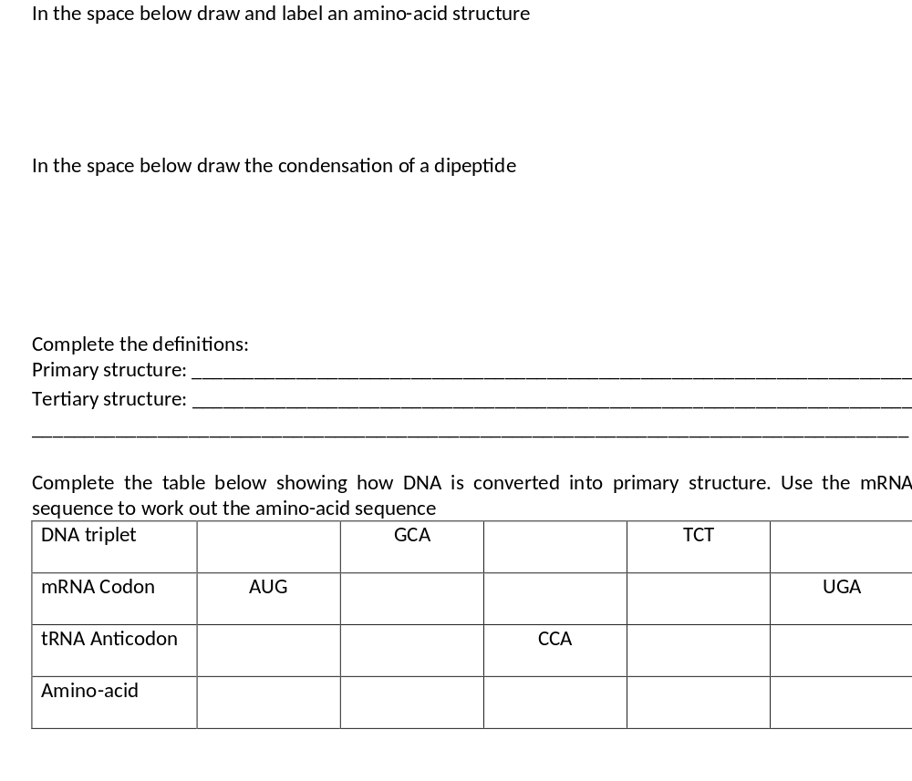
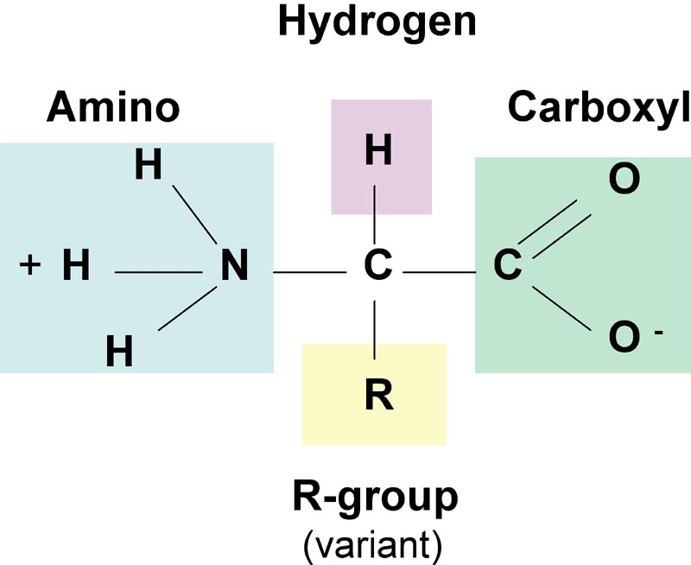
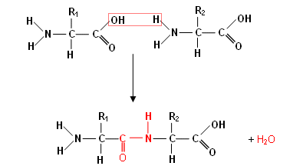
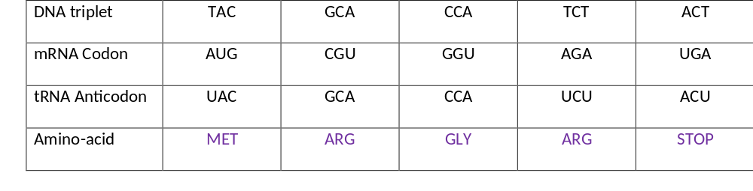
Sequence of amino-acids in polypeptide chain, Peptide bonds
Specific 3D shape held by H, ionic, disulphide bonds between R groups

Slide 4
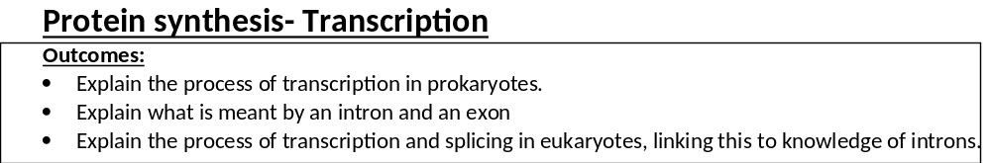
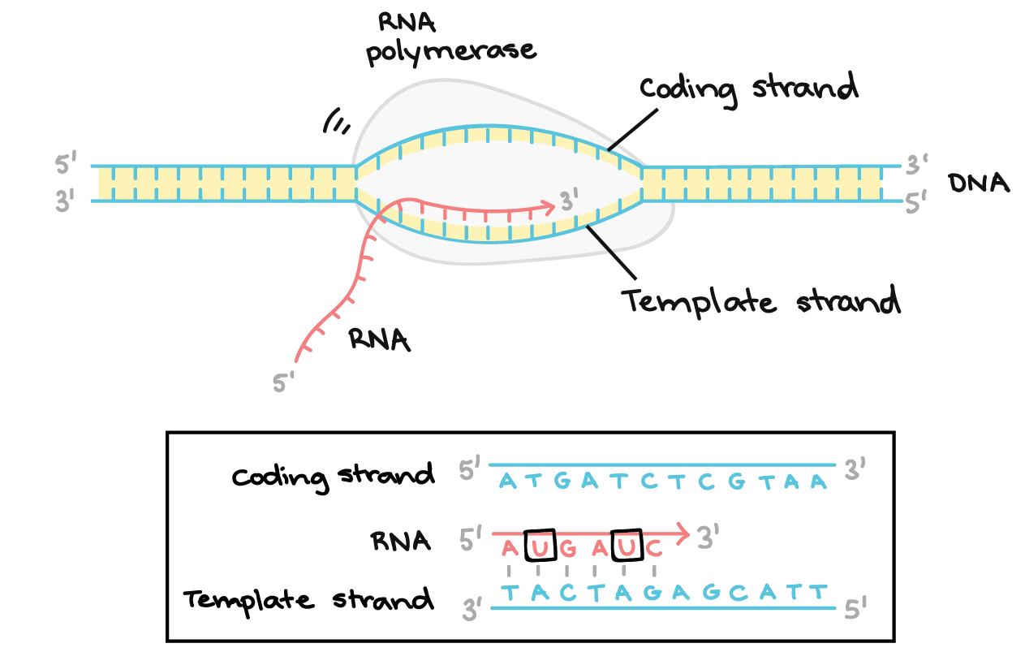

Slide 5
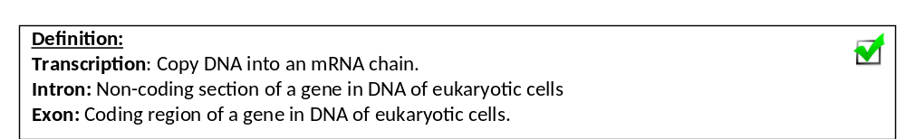
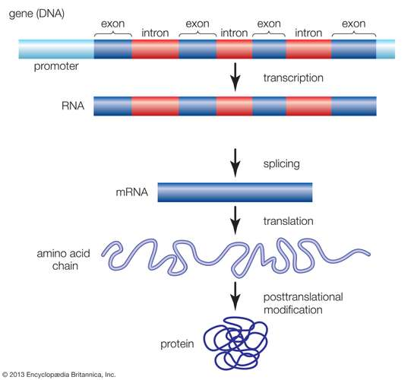
Remember only eukaryotic DNA has non-coding sections
The more complex the organism the more non-coding sections there are.
Prokaryotes DO NOT contains introns,
Prokaryotes DO NOT undergo splicing.
Read through the perfect answers for transcription and translation on page 25 in your booklet.
Watch the video link on the next slide.
Produce your own revision poster for both transcription and translation on page 26 in your booklet.
Stretch and challenge. Try to draw out the process of transcription and translation WITHOUT watching the video. This required a lot of brain power so will make the process more memorable

Slide 6

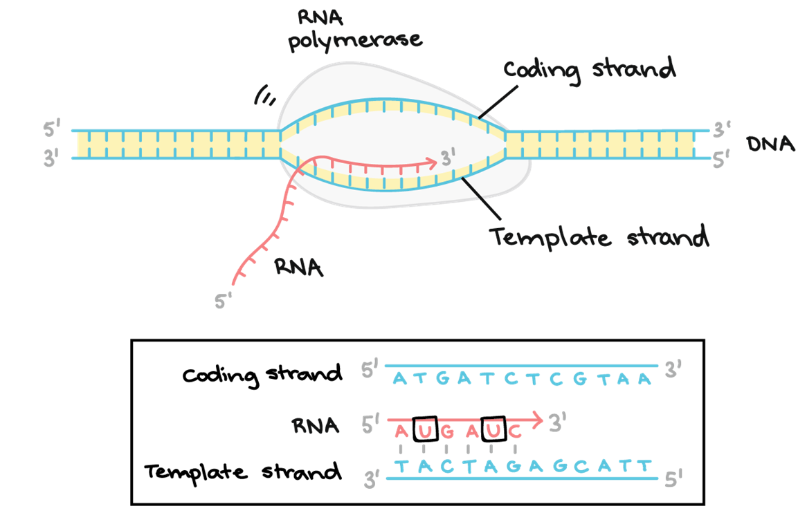
The process:
1. DNA Helicase breaks hydrogen bonds;
2. Only one DNA strand acts as template;
3. RNA nucleotides attracted to exposed bases by complementary base pairing;
4. Adenine to Uracil, Thymine to Adenine, Cytosine to Guanine;
5. RNA polymerase joins (RNA) nucleotides together;
6. Forming phosphodiester bonds forming pre-mRNA chain;
7. Pre-mRNA spliced to remove introns in eukaryotic cells.
https://www.yourgenome.org/video/from-dna-to-protein

Slide 7
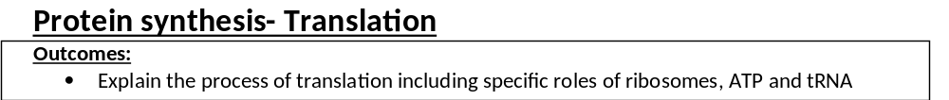
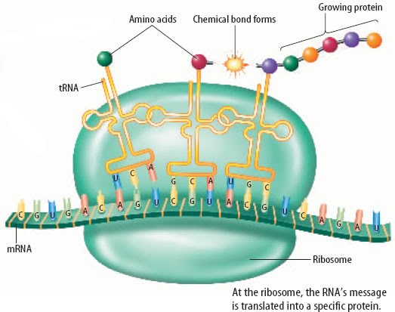

Slide 8
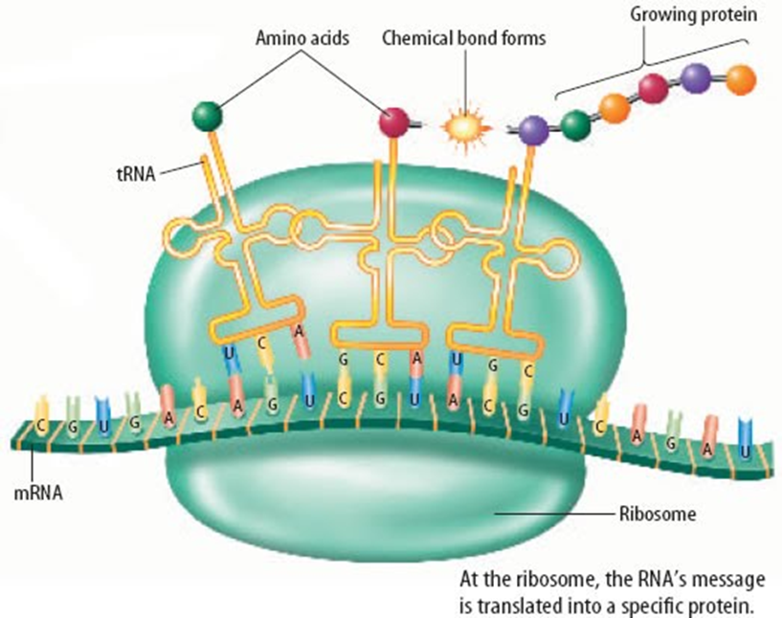
The process:
mRNA attaches to ribosome;
Ribosome moves to the start codon;
Codon on mRNA binds to an anti-codon on tRNA;
Each tRNA brings a specific amino acid;
Ribosome moves along to next codon;
Sequence of codons on mRNA determines order of amino acids;
Formation of peptide bonds between amino acids by condensation reactions;
Using ATP.
https://www.yourgenome.org/video/from-dna-to-protein

Slide 9
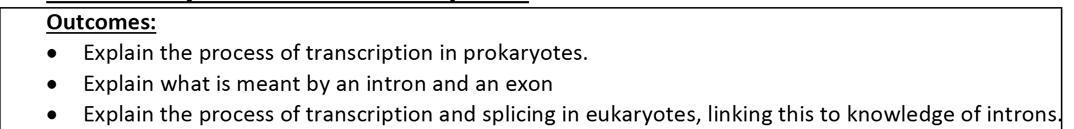
Complete exam questions on pages 27-30

Slide 10
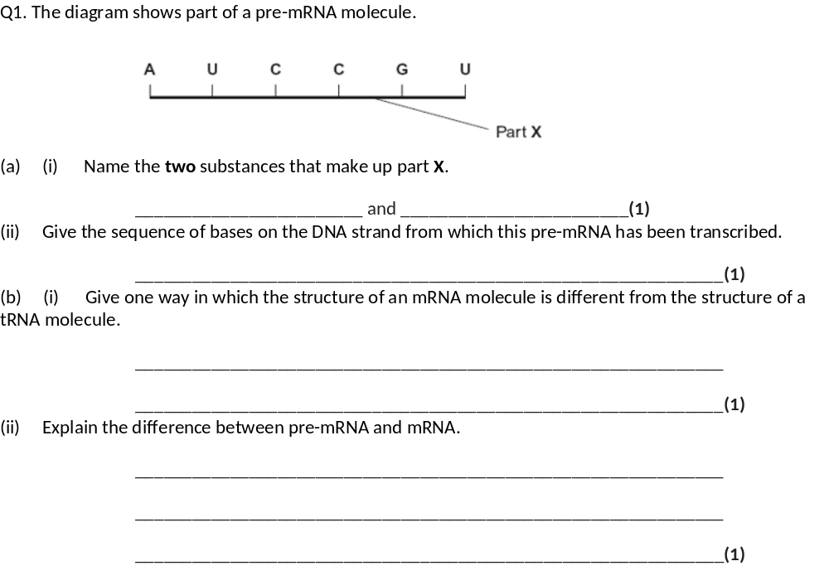
(a) (i) Phosphate and ribose;
Accept in either order. Both correct for one mark.
For phosphate accept PO₄ / Pi / but not P.
Do not accept phosphorus.
Ignore references to pentose / sugar.
(ii) TAGGCA;
(b) (i) Does not contain hydrogen bonds / base pairs / contains
codons / does not contain anticodon / straight / not folded / no
amino acid binding site / longer;
Assume that “it” refers to mRNA.
Do not accept double stranded.
(ii) (pre-mRNA) contains introns / mRNA contains only exons;
Assume that “it” refers to pre-mRNA.
Accept non-coding as equivalent to intron.

Slide 11
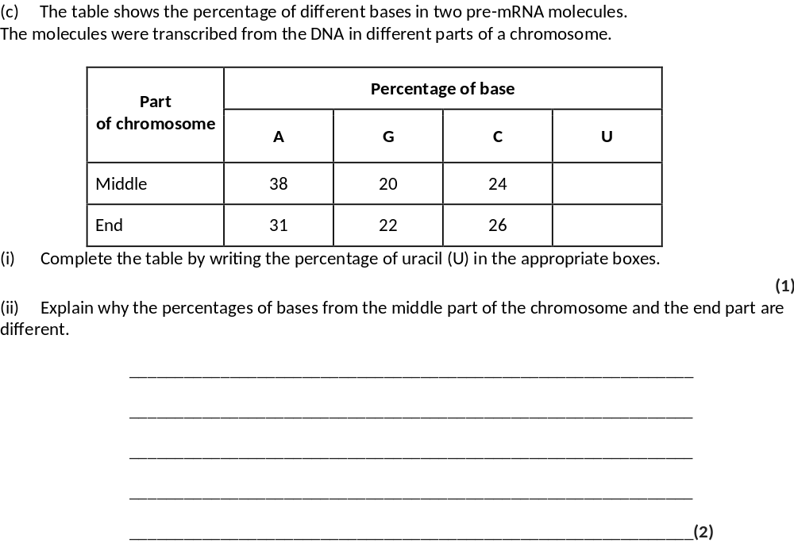
18
21
(ii) 1. Have different (base) sequences / combinations of (bases);
2. (Pre-mRNA) transcribed from different DNA / codes for different proteins;
2

Slide 12
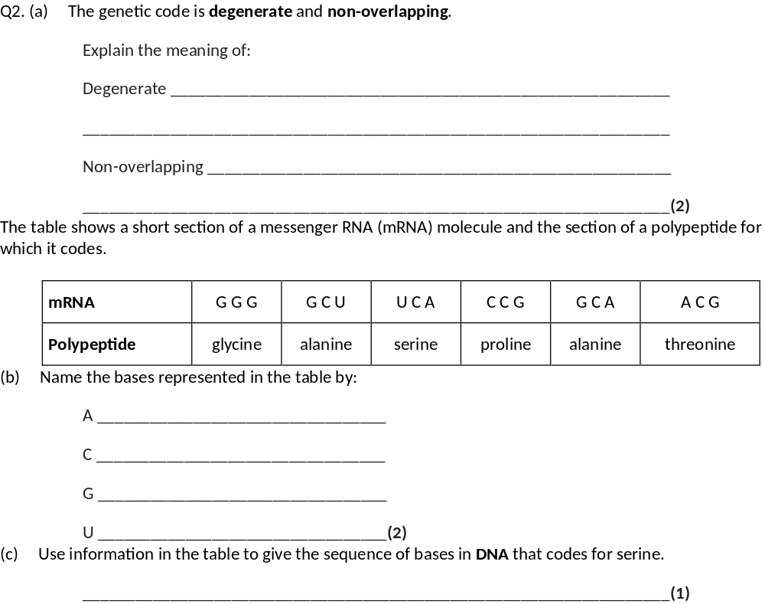
1. Degenerate: more than one (base) triplet for each amino acid;
2. Non-overlapping: each base is part of only one triplet.
Accept codon (as would be applicable to mRNA code)
2
A = adenine
C = cytosine
G = guanine
U = uracil
2 max
(c) AGT;
1

Slide 13
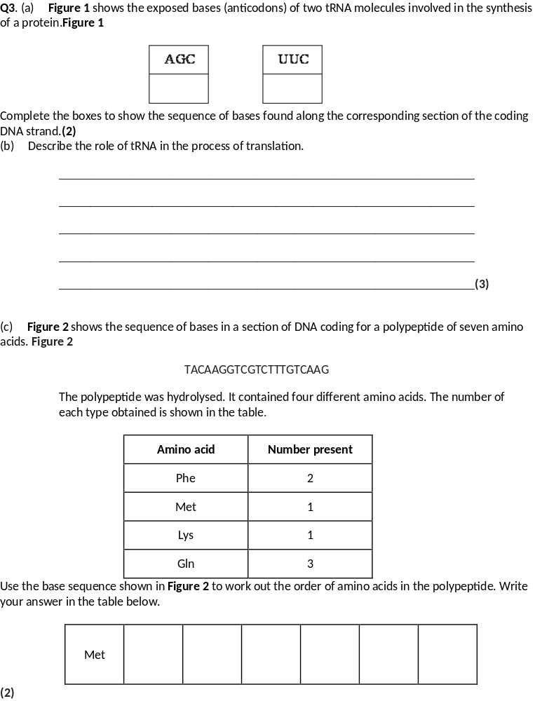
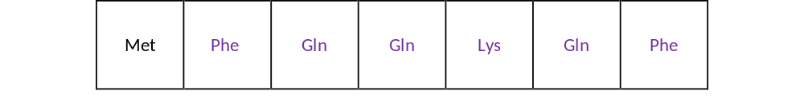
(a) AGC; TTC;
2
(b) anticodon complementary to codon / reads message on mRNA;
specific amino acid;
carried / transferred (to ribosome);
correct sequence of amino acids along polypeptide;
3 max

Slide 14
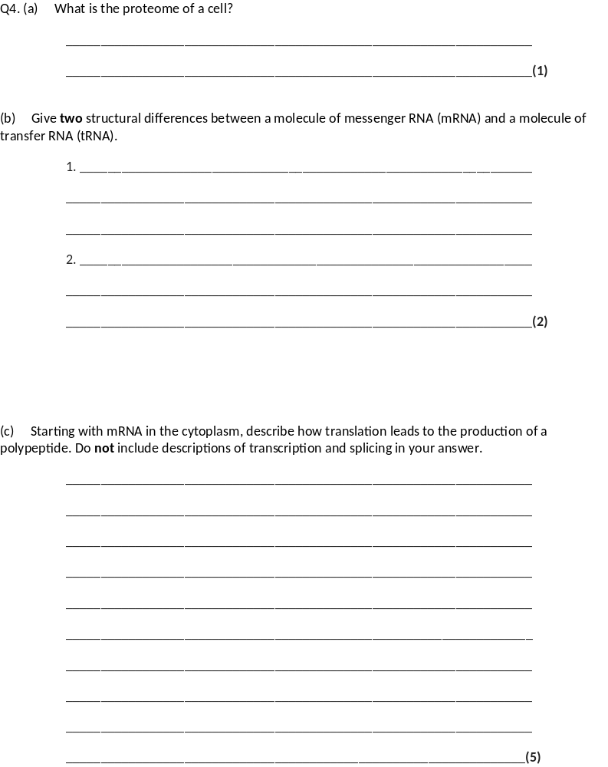
(a) (The proteome is the full) range of / number of different proteins that a cell is able to produce (at a given time);
OR
(The proteome is the full) range of / number of different proteins the genome / DNA is able to code for;
Do not accept number of proteins unqualified
1

Slide 15
(b) 1. mRNA does not have hydrogen bonds / base pairing, tRNA does;
OR
mRNA is linear / straight chain, tRNA is cloverleaf;
2. mRNA does not have an amino acid binding site, tRNA does;
Accept mRNA cannot carry an amino acid, tRNA can
3. mRNA has more nucleotides;
Accept mRNA is longer or converse
4. (Different) mRNAs have different lengths, all tRNAs are similar / same length;
5. mRNA has codons, tRNA has an anticodon;
Statements must be comparative
2 max

Slide 16
(c) 1. mRNA associates with a ribosome / ribosome attaches to mRNA;
Idea of association is required
2. Ribosome moves to / finds the start codon / AUG;
3. tRNA brings / carries (appropriate / specific) amino acid;
Must be explicitly stated and not inferred.
4. Anticodon (on tRNA complementary) to codon (on mRNA);
5. Ribosome moves along to next codon;
OR
Ribosome ‘fits’ around two codons / can fit two tRNAs;
Must be explicitly stated and not inferred.
6. (Process repeated and) amino acids join by peptide bonds / condensation reaction (to form polypeptide);
OR
(Process repeated and) amino acids joined using (energy from) ATP (to form polypeptide);

