Slide 1
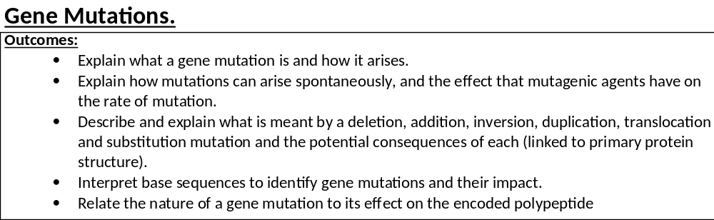
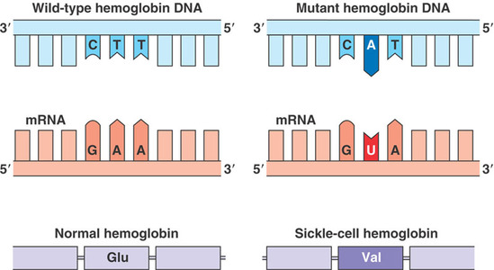
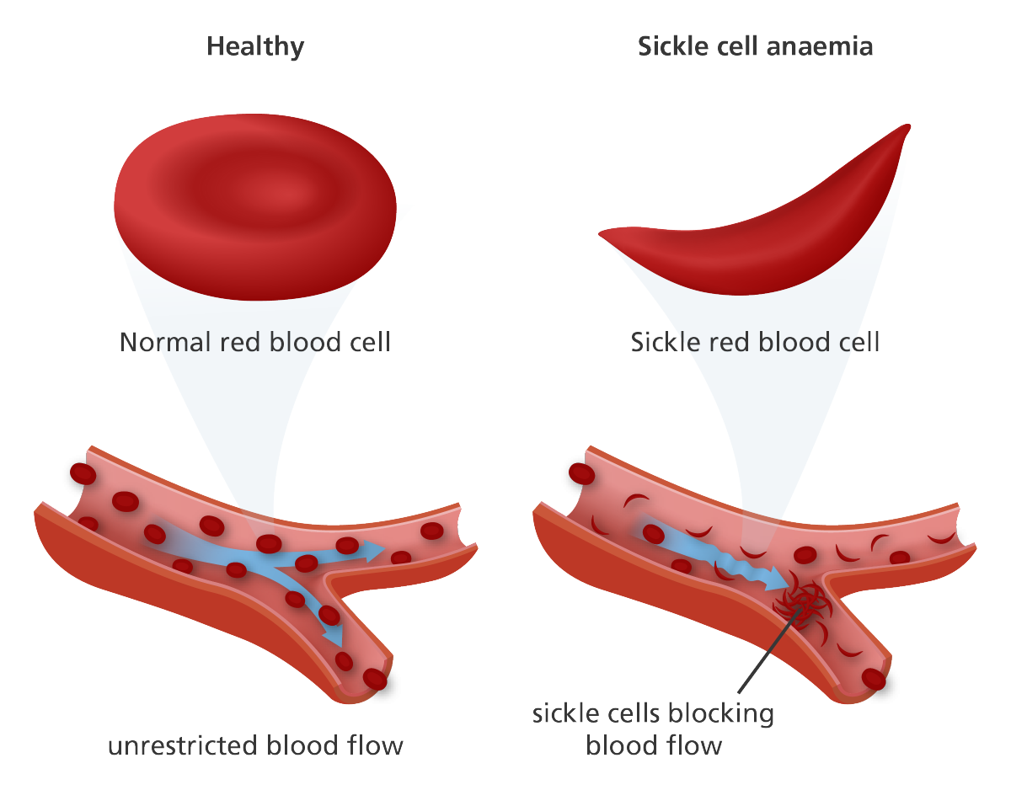

Slide 2
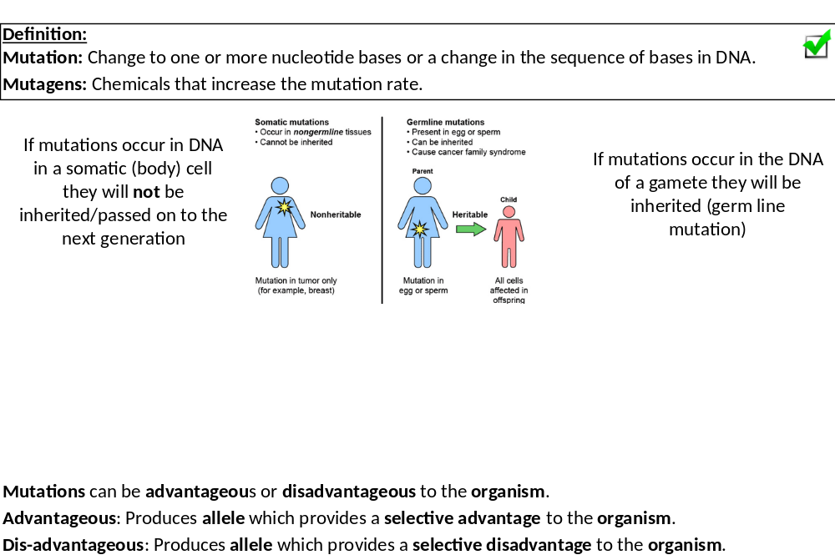
Mutations are changes in the DNA sequence which occur during semi-conservative replication.
This mutation is passed onto all the cells made from this cell.
Depending on what the mutations is, where the mutations is this can affect the proteome or not.
Mutations bring together the knowledge within this whole booklet.

Slide 3
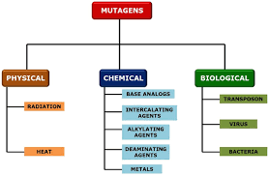
This links to the process of evolution by natural selection which we will look at in another booklet.
Research task.
For your exam there are no examples you need to LEARN, these will be APPLICATION questions and will be linked to the Evolution booklet.
Complete the research and answer the questions on page 31 in your booklet.
You can use google or pages 500-503 in the Toole and Toole textbook. You may also have some general knowledge about these questions so use this as well.

Slide 4
An example of an advantageous mutations and explain why this is an advantageous to the organism
Mutation: Antibiotic resistance, pesticide resistance, increased muscle mass, increased length of neck, change in colouring etc
Advantage to ORGANISM: Increases chances of survival, reduces chance of predation, increases chances of mating etc
An example of a disadvantageous mutations and explain why this is a disadvantageous to the organism
Mutation: Diseases
Disadvantage to ORGANISM: Decreases chances of survival, increased chances predation, decrease chances of mating etc
Suggest why a mutation in an intron would not be advantageous or disadvantageous.
Introns are non-coding sections so wont change the shape of the protein so wont affect the functioning of cell.
Suggest why a mutation in an exon would be advantageous or disadvantageous.
Exons are coding sections so will cause a change in the primary structure, tertiary structure, functioning of the protein/cell
Do all mutations lead to cancer? Explain your answer.
No, only mutations that affect the rate of mitosis. Cancer is uncontrolled mitosis.
What affect do mutagens have on the mutation rate?
Increases the likelihood/rate of mutations

Slide 5
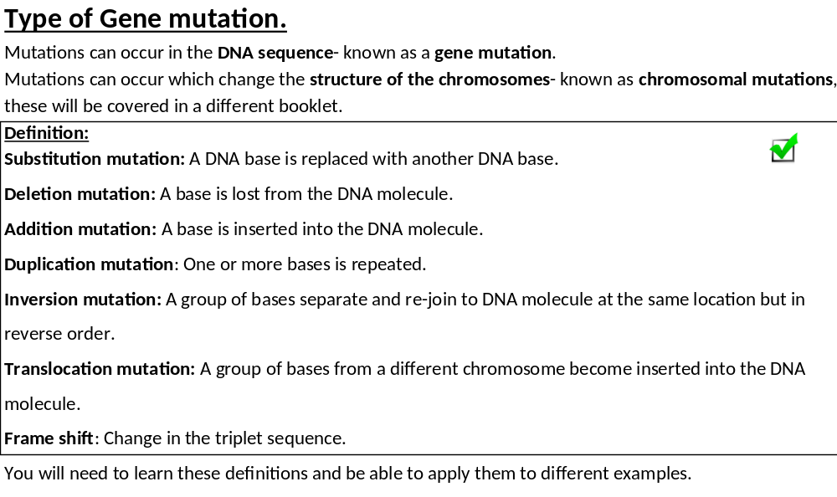

Slide 6
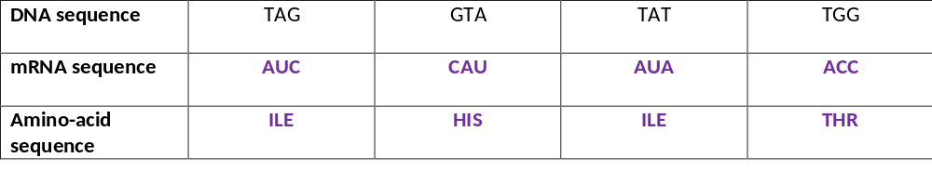
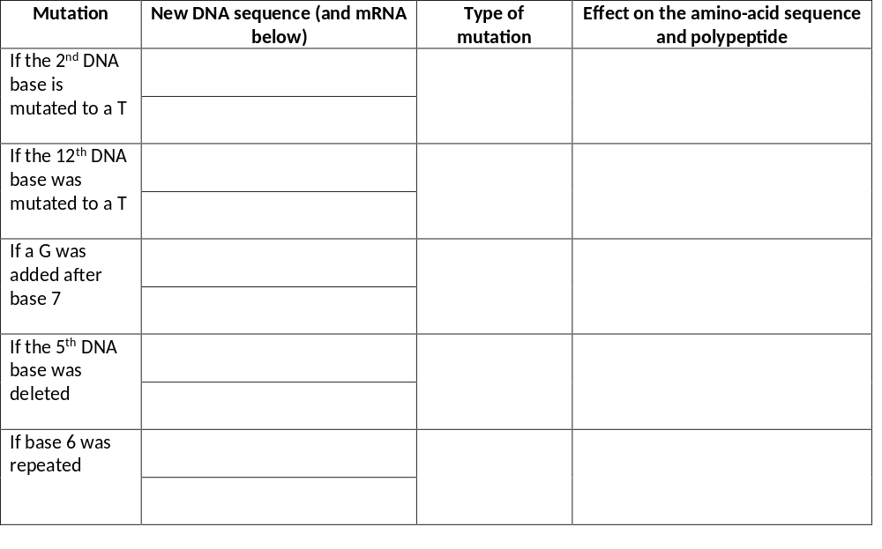
Complete the table below. This is the original sequence, this is the sequence you will be mutating each time.
Now complete the table to see the effect of mutations on the DNA, mRNA and amino-acid sequence.
Use the definitions to identify the type of mutation that has occurred.
We will do the first one together:
TTG GTA TAT TGG
AAC CAU AUA ACC
ILE changed to ASN
Change in primary structure
Change in tertiary structure
Change in bond position
Change in 3D shape
Substitution

Slide 7
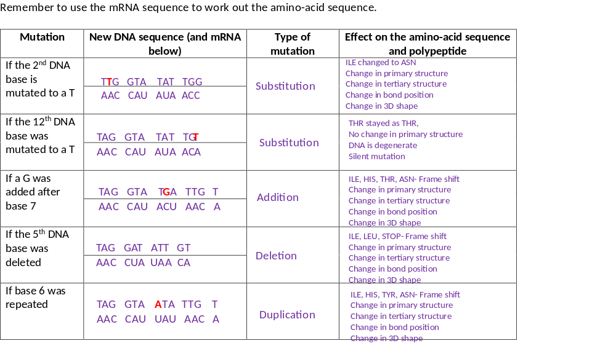

Slide 8
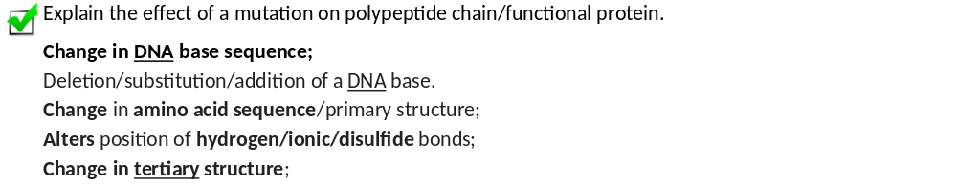
Exam tip.
Always apply your answer to the specific protein given in the question
E.G an enzyme

Slide 9
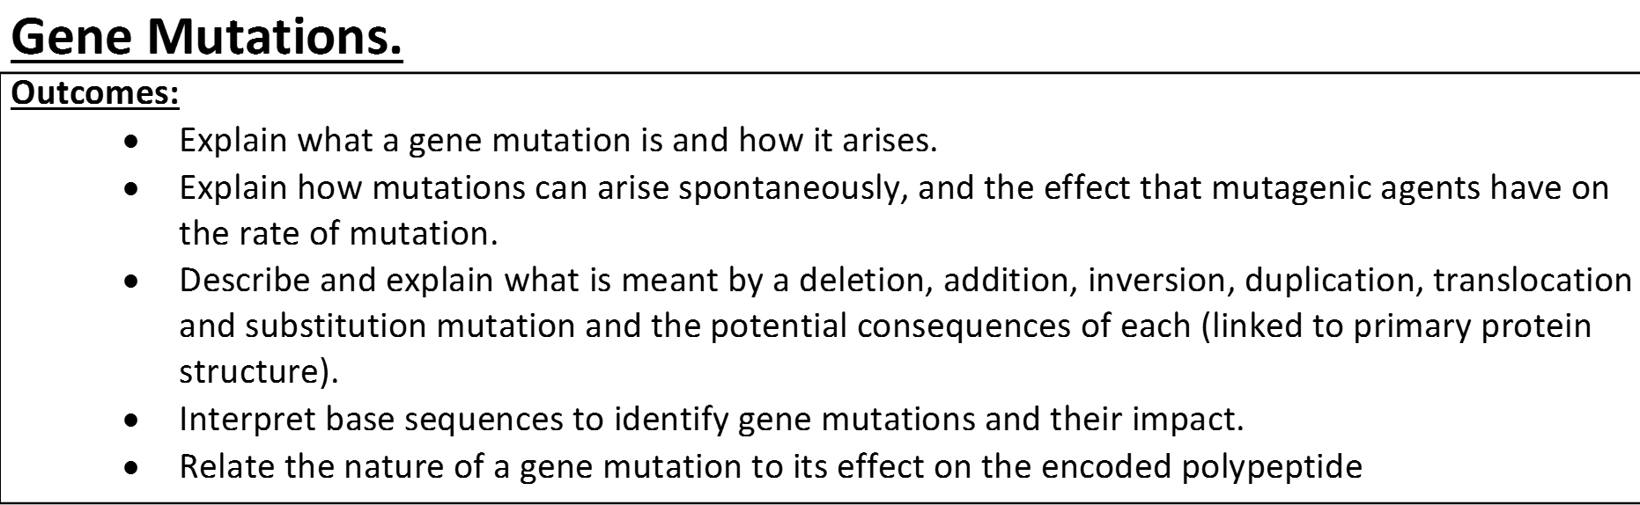
Complete exam questions

Slide 10
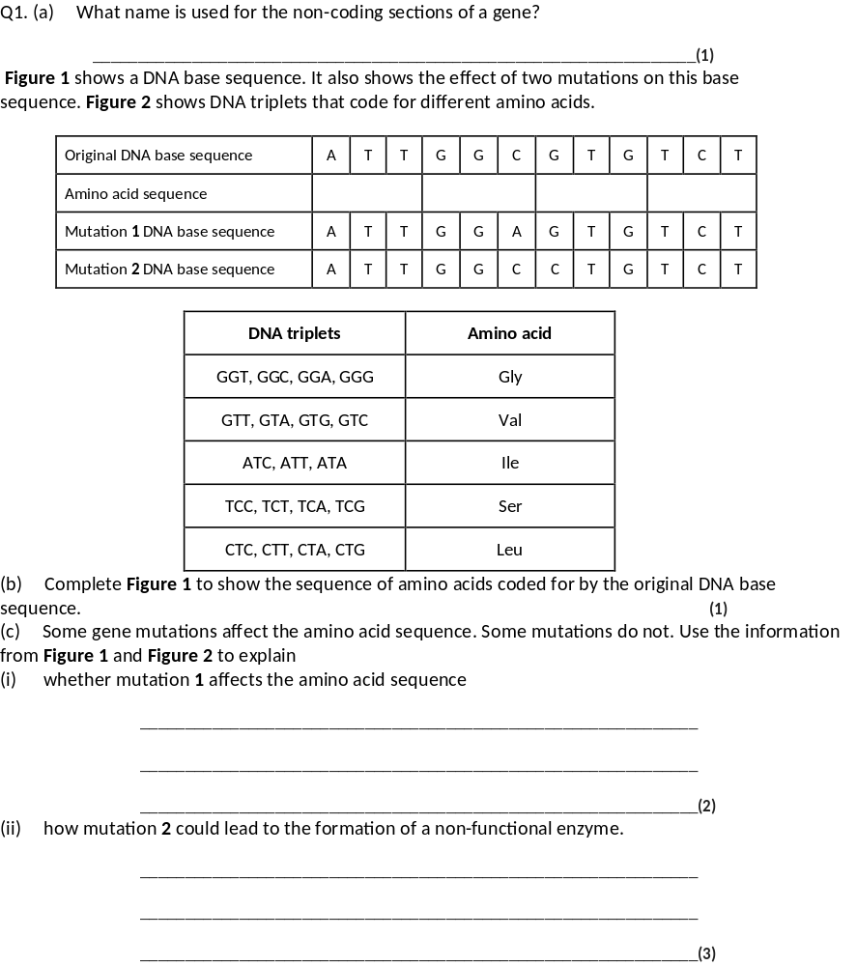
(a) Introns;
1
(b) Ile Gly Val Ser;
1
(c) (i) Has no effect / same amino acid (sequence) / same
primary structure;
Q Reject same amino acid formed or produced.
1
Glycine named as same amino acid;
1
It still codes for glycine = two marks.
(ii) Leu replaces Val / change in amino acid (sequence) / primary structure;
Change in hydrogen / ionic bonds which alters tertiary structure / active site;
Q Different amino acid formed or produced negates first marking point.
Substrate cannot bind / no longer complementary /
no enzyme-substrate complexes form;
Active site changed must be clear for third marking point but does not need reference to shape.
3

Slide 11
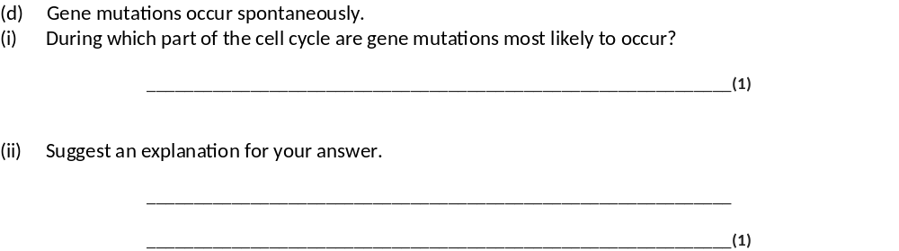
(d) (i) Interphase / S / synthesis (phase);
1
(ii) DNA / gene replication / synthesis occurs / longest stage;
Allow ‘genetic information’ = DNA.
Allow ‘copied’ or ‘formed’ = replication / synthesis
1

Slide 12
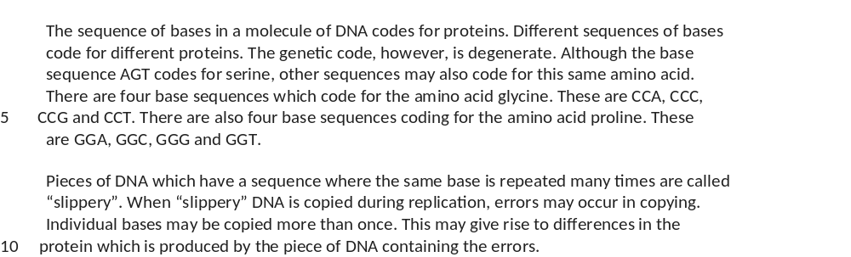
Comprehension Practice.
Read through and pick out the key information BEFORE answering the questions.
What techniques could you use to help you answer the questions?
Definition?
mRNA/tRNA sequence?
Semi-conservative replication
Mutation, duplication?

Slide 13
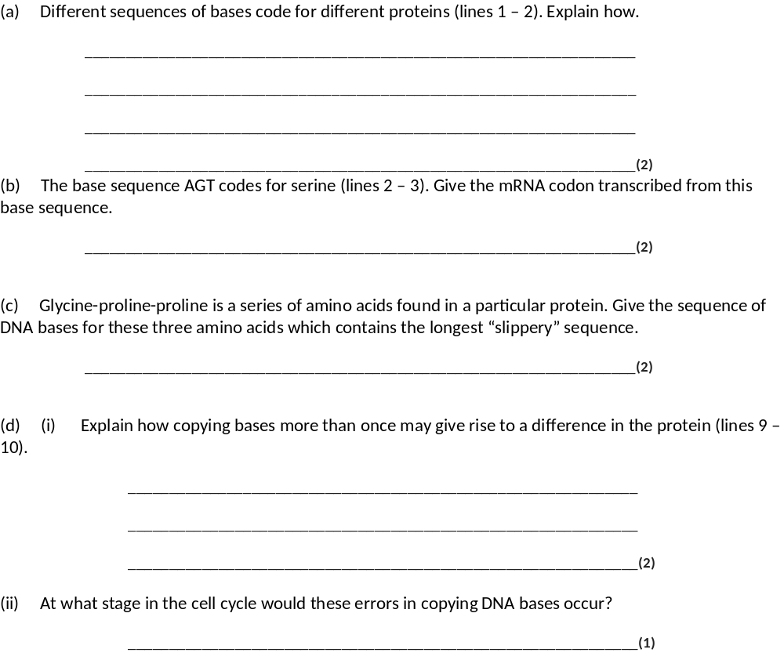
(a) Protein made of (chain of) amino acids;
Each amino acid has its own base / triplet code;
2
(b) UCA = 2 marks
TCA – 1 mark;
2
(c) CCG;
GGG GGG;
2
(d) (i) Changes base sequence;
Of later triplets / amino acid codes;
2
(ii) S-phase / interphase;
1

Slide 14
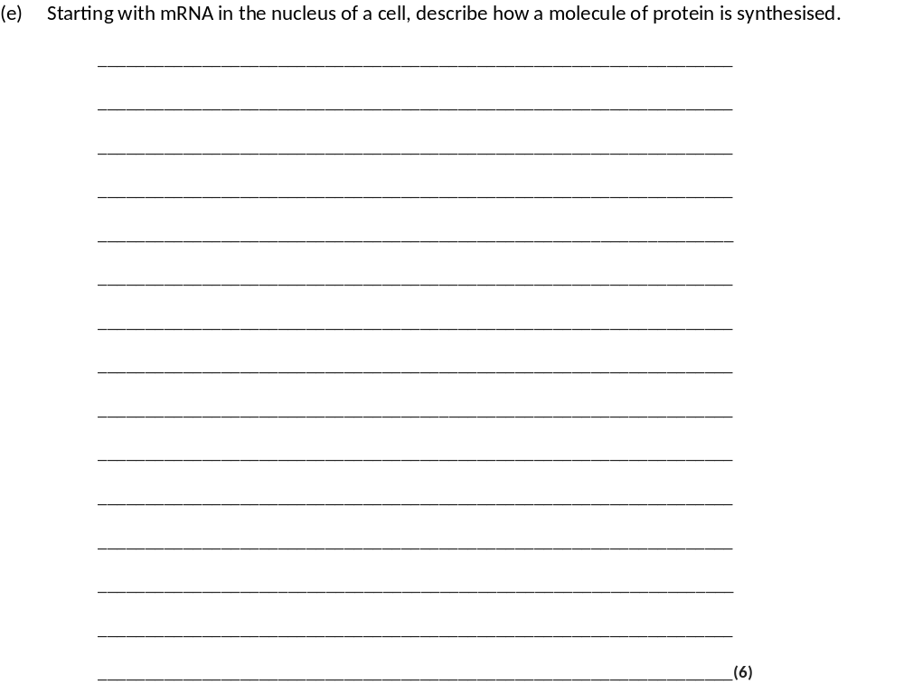
(e) 1. mRNA leaves (nucleus) through nuclear pore;
2. To ribosome;
3. tRNA molecules bring amino acids (to ribosome);
4. Specific tRNA molecule for specific amino acid;
5. Anticodon of tRNA corresponds / complementary to codon on mRNA;
6. Peptide bonds form between amino acids;
7. tRNA detaches and collects another amino acid;
8. Ribosome moves along mRNA;
max 6

Slide 15
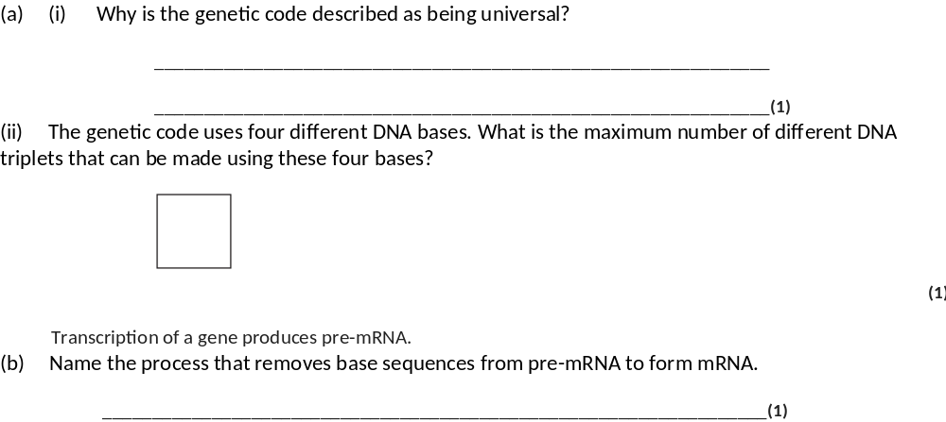
(a) (i) (In all organisms / DNA,) the same triplet codes for the same amino acid;
Accept codon / same three bases / nucleotides
Accept plurals if both triplets and amino acids
1
(ii) 64;
1
(b) Splicing;
Ignore deletion references
Accept RNA splicing
1

Slide 16
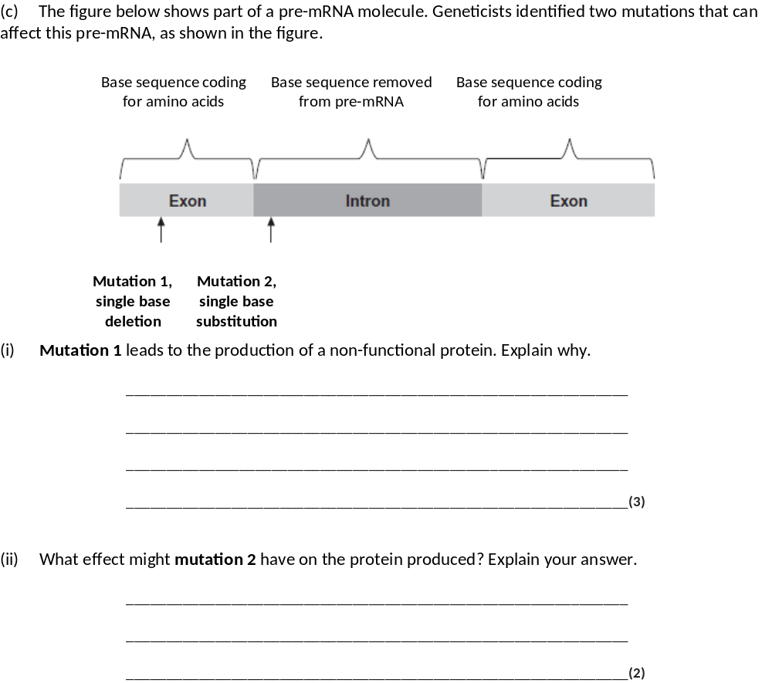
(c) (i) 1. (Mutation) changes triplets / codons after that point / causes frame shift;
Accept changes splicing site
Ignore changes in sequence of nucleotides / bases
2. Changes amino acid sequence (after this) / codes for different amino acids (after this);
Accept changes primary structure
Reject changes amino acid formed / one amino acid changed
3. Affects hydrogen / ionic / sulfur bond (not peptide bond);
4. Changes tertiary structure of protein (so non-functional);
Neutral 3-D structure
3 max
(ii) 1. Intron non-coding (DNA) / only exons coding;
Context is the intron
Do not mix and match from alternatives
Neutral references to introns removed during splicing
1.and 2. Ignore ref. to code degenerate and get same / different amino acid in sequence
2. (So) not translated / no change in mRNA produced / no effect (on protein) / no effect on amino acid sequence;
Accept does not code for amino acids
OR
3. Prevents / changes splicing;
4. (So) faulty mRNA formed;
Accept exons not joined together / introns not removed
5. Get different amino acid sequence;
2 max

