Slide 1
Genome Sequencing and the proteome
Learning outcomes:
Explain how sequencing techniques have become automated and faster
Explain why it is harder to translate genomic sequences into the proteome for complex organisms than for simpler organisms

Slide 2
DNA sequencing
yourgenome.org/teachers/speed.shtml
Watch the video
You do not need to know the process of DNA sequencing but you should be able to apply your knowledge if you are given a question which may refer to the process.
The key thing is to highlight points which have allowed sequencing methods to become faster and more automated

Slide 3
Extra activity
This is a great TED talk introducing the idea of genome sequencing. Watch the video and complete the activity. https://www.youtube.com/watch?v=MvuYATh7Y74.
Definition: What is a genome?
As the video explains, the first human genome (all 3 billion bases) took 20 years. Work out how many bases were potentially sequence per minute. (Note: Work this out in steps will make it easier).
We can now sequence a whole human genome in 26 hours. Work out how many bases are potentially sequence per minute?
Calculate the percentage increase.
Suggest why the genome must first be split into sections.
When the genome was first sequenced the coloured images produced often had to be connected by eye. Suggest why genome sequencing is now much faster.

Slide 4
The Proteome
Definition: All the proteins produced in a given type of cell or organism at a given time.

Slide 5
Your potential proteome (how many proteins can be coded for by your genes) is not the same as your actual proteome (the proteins actually being produced inside a cell).
Suggest why: (Hint: Think about epigenetics, cell specialisation, mitosis, mutations)

Slide 6
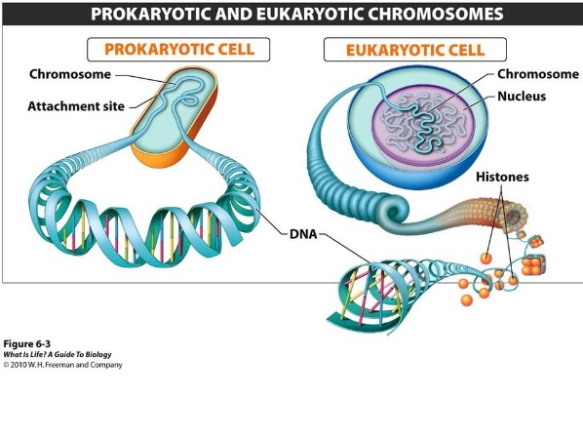
Simple organisms (e.g. prokaryotes) just have one circular piece of DNA that is not associated with histones with very little non-coding DNA
It is easier to determine their proteome
Complex organisms have more DNA and lots (95%) does not code for proteins so it is difficult to determine their proteome
One mystery is that the human body is capable of making more than 100000 proteins even though we only have 25000 genes

Slide 7
Exam Tip!
The exam board’s focus for comparative genomics is “which genes would you choose to compare to draw evolutionary trees?”
When comparing closely related species look at fast evolving genes which are unique to those species. Good examples are genes coding for the specific antigens on their cells.
When comparing distantly related species you need to look at genes which are fundamental to life processes which rarely change and all organisms have in their genome.
Good examples are genes coding for ribosomes and tRNA .

Slide 8
Comparative genomics
Task:
Watch this video: https://www.youtube.com/watch?v=mU9ROpm6d70
Answer the questions in your notes describing the importance of comparative genomics- a big growth area in biology and medicinal research.

Slide 9
How many species genomes can we now sequence?
Describe what is meant by “Comparative genomics”
What is meant when a gene is “conserved”? What does this tell us about this protein/gene?
Suggest the advantage of using computers to compare genes?
Explain why scientists used the 2 plant species to compare again the human genome to identify the potential genes for cilia/flagella formation.
Describe the steps the scientists took to reduce the number of genes to look at from 25,000 human genes to the 1 gene required.
There are 25,000 genes in the human genome, we share 4348 genes with the Chlamydomonas. What % of our genes do we share with this plant species?
Using the method you have described the scientists were able to reduce the number of potential genes from 25,000 to 600. Calculate the percentage decrease.
Suggest why further studies were carried out on the Chlamydomonas instead of the second plant species.
Suggest why further studies were carried out on the Chlamydomonas instead of humans.

Slide 10
Extra activity: Ethics behind gene sequencing.
Watch the video- be aware this is an advert for genome sequencing so think critically about this video. Complete the activities below carefully. https://www.youtube.com/watch?v=IXamRS85hXU
Evaluate the statement: Disease is only determined by your genome.
Evaluate the statement: All mutations in DNA cause genetic diseases
Evaluate the statement: If you carry a mutation you will definitely develop the disease.
What is meant by the word pharmacogenomics?
You opinion. Watch the section on “making your decision” a few times and give your own opinion to the question:
“Would you want to get your genome fully, partially or not sequenced?”
Important: In your response you should clearly give arguments for and against showing you have weighed up the pros and the cons before forming your opinion.
Be ready to debate this in class.

