Slide 1
The Polymerase Chain Reaction (PCR) – an in vitro method of cloning DNA
Learning outcome
Describe the process of PCR in amplifying DNA fragments
Explain the role of Taq polymerase in PCR
Explain the processes of strand separation, primer annealing, and strand synthesis
Evaluate the pros and cons of using PCR to clone DNA fragments over in vivo methods

Slide 2
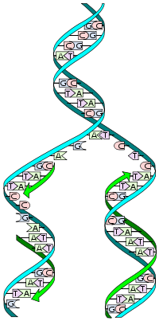
Year 12 Synoptic link
SYNOPTIC LINK
3.1.5 DNA replication
Describe how DNA replication occurs (6)
DNA helix unwinds;
Hydrogen bonds weak / easily broken / unzipped / allow strands to separate by DNA helicase;
New nucleotides attracted to exposed bases on template strand;
Hydrogen bonds form between complementary base pairs / Adenine with Thymine, Cytosine with Guanine;
DNA Polymerase joins adjacent nucleotides together using a condensation reaction to form a sugar-phosphate backbone, joined by phosphodiester bonds;
New (daughter) DNA molecules contains one parent and one new strand;

Slide 3
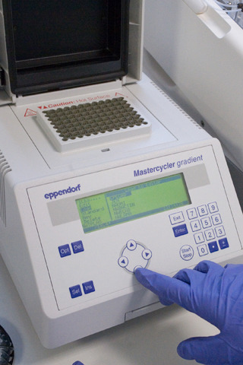
What is PCR?
PCR (polymerase chain reaction) is a method of cloning DNA fragments in a test tube, in vitro to make MANY copies from a small sample
Typical exam Question: Why is the process of PCR carried out?
In order to make MANY copies of the DNA as there is only a small sample to start with e.g. from a crime scene/ from an animal faeces sample
The process is automated, using a machine like this one (called a thermocycler), so it is rapid and efficient

Slide 4
http://www.sumanasinc.com/webcontent/animations/content/pcr.html
http://learn.genetics.utah.edu/content/labs/pcr/

Slide 5
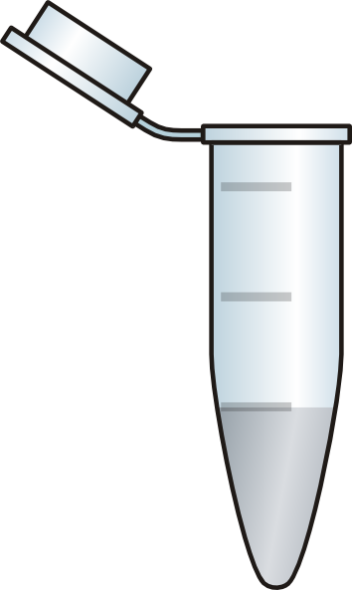

What are the ingredients needed for PCR?
DNA nucleotides
DNA fragment to be copied
primers
Thermostable DNA polymerase (Taq polymerase)

Slide 6
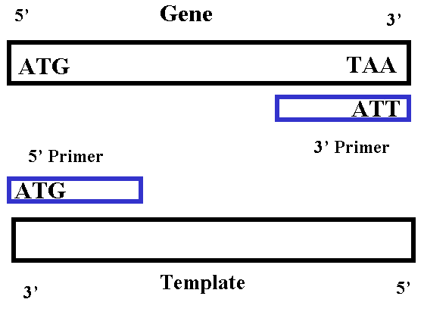

What are primers and why are they needed?
Primers are short sequences of nucleotides that have a complementary set of bases to those at one end of each of the two DNA strands.
They provide the starting sequences for DNA polymerase to join on to.
Primers also prevent the DNA strands from re-joining by reforming hydrogen bonds.

Slide 7
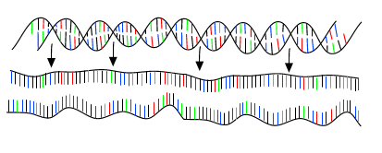
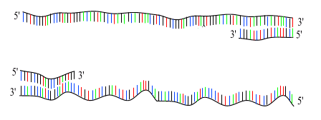
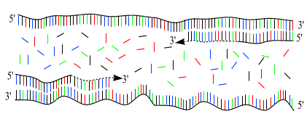
Separation of DNA strand
2. Addition of the primers
3. Synthesis of DNA
Use the words below to fill in the gaps on page 6
Complete maths activity page 7
Condense this process into 50 word in a flashcard
Heated | Primers | Single | 95ºC | 55-60ºC | 2
Annealing | Hydrogen | DNA strands | 72ºC | Denatured | Amplifying
DNA nucleotides | Complementary | Repeated | TAQ polymerase | Extension

Slide 8
Polymerase Chain Reaction
Separation of DNA/ Denaturation
1. The mixture is heated to 95ºC which breaks the hydrogen bonds between the bases, therefore separates the strands and produces single - stranded DNA molecules = denatured

Slide 9
Addition of primer/Annealing
2. The temperature is reduced to 55 – 60ºC to allow primer to bind to the ends of the single-stranded DNA molecules = annealing

Slide 10
DNA Synthesis/Extension
3. The temperature is increased to 72ºC This enables the free DNA nucleotides to attach by complementary base-pairing (A to T, C to G). The new DNA strands are built up using the enzyme Taq polymerase which joins the phosphodiester bonds = extension.
The first cycle is complete.

Slide 11
4. The cycle is repeated
5. The 2 resulting DNA molecules make up the template DNA for the next cycle, thus amplifying the amount of DNA duplicated for each new cycle.

Slide 12
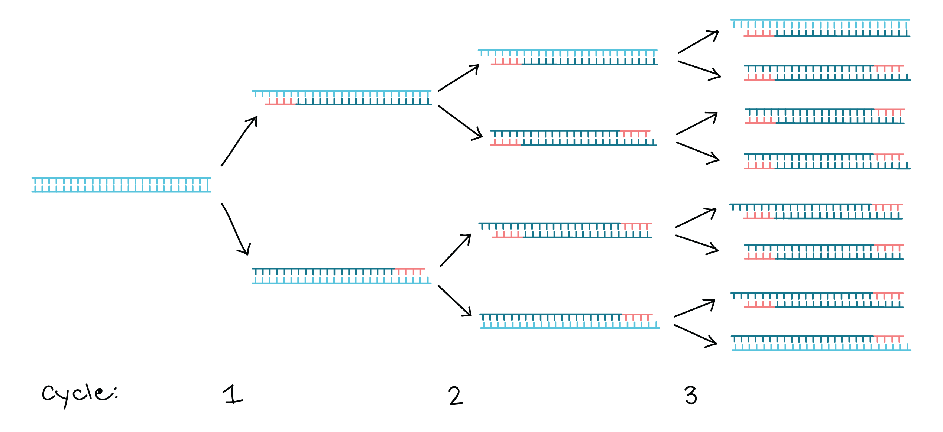
Extra exam Questions
1. Suggest why DNA replication eventually stops in the polymerase chain reaction.
All of the primers or the DNA nucleotides have been used to make new DNA.

Slide 13
2. Why do you need two different primers?
DNA strands run antiparallel
2 different primers are needed, each with a complementary base sequence to the start of each strand

Slide 14
Maths practice
How many cycles will it take to produce 512 DNA molecules? [1 DNA molecule = 2 DNA strands] (2⁹)
How many cycles will it take produce one million molecules?
How many DNA strands will there be after 7 cycles?
How many DNA molecules will there be after 5 cycles?

Slide 15
Maths practice
log₂(512) = 9 cycles
log₂(1000000) = 20 cycles
2⁷ = 128 DNA molecules 128 x2 = 256 strands
2⁵ = 32 DNA molecules

Slide 16
Use Textbook pg 540-541 to answer these questions
a) i) Why is Taq polymerase specifically used?
Comes from a bacterium in hot springs, therefore is tolerant to heat so does not denature at the high temps used in PCR
ii) Why is it important that the DNA used is not contaminated with any biological material?
Biological contaminants may contain DNA which would ALSO be copied
Complete EQ on page 7
Complete CONTRAST box on page 7.

Slide 17
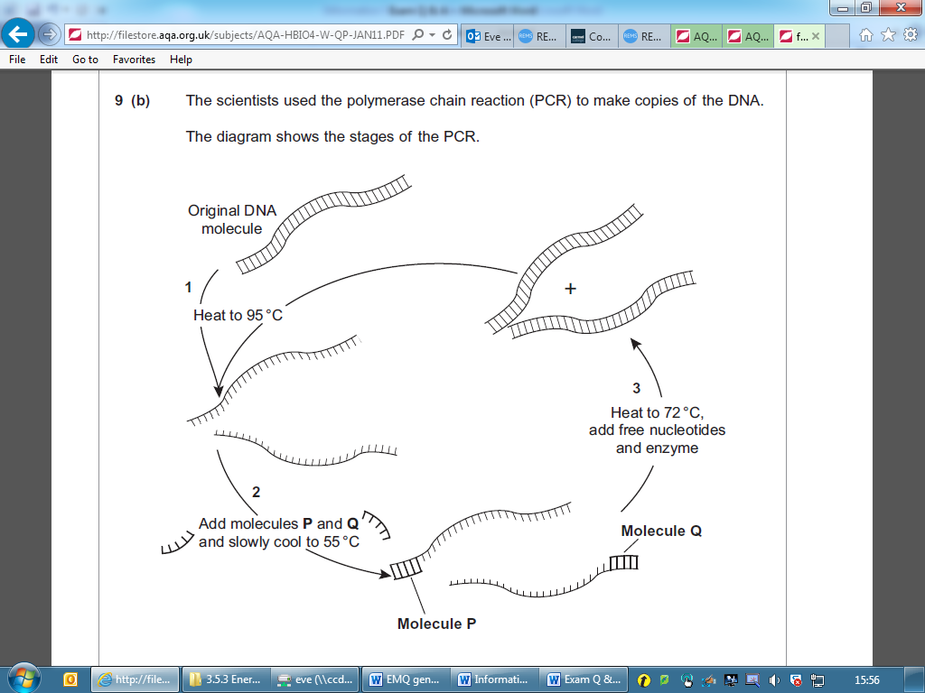

Slide 18
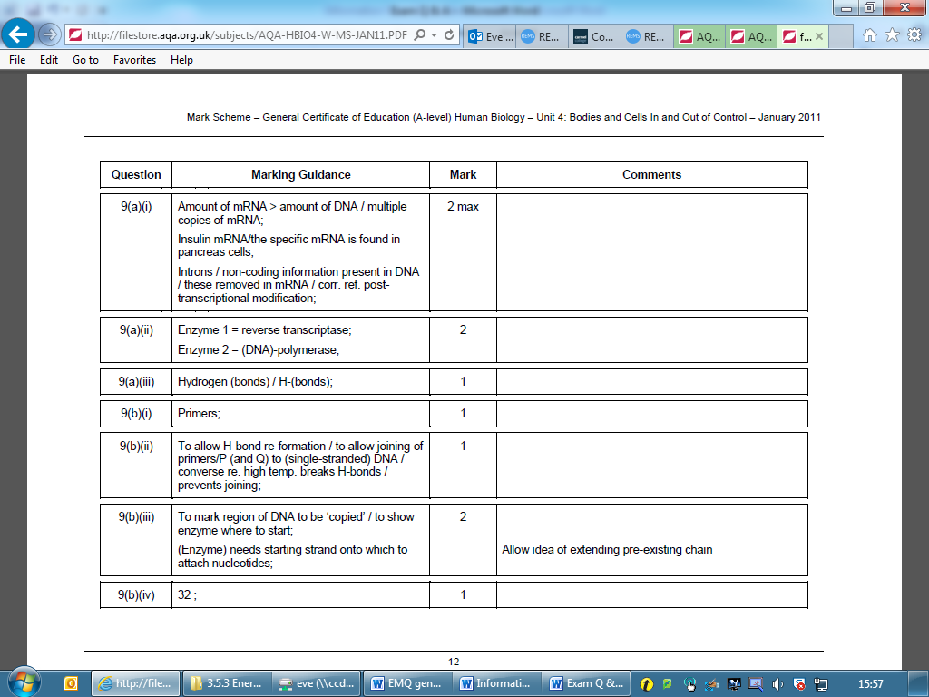

Slide 19
 | Replication method
 | In vivo | In vitro / PCR
Length of DNA replicated | long sequences | short sequences because they has been cut
Method of strand separation | DNA helicase | heating to 95ºC
Are Primers required? Why? | No | yes, too allow replication to start.

Slide 20
Exam Question:
Q1. Describe how PCR is carried out. (6 marks )
MS answer =
1 DNA heated to 90 to 95°C;
2 strands separate;
3 cooled / to temperature below 70°C
4 primers bind;
5 nucleotides attach;
6 by complementary base pairing;
7 temperature 70 - 75°C;
8 DNA polymerase joins nucleotides together;
9 cycle repeated;

Slide 21
Learning outcomes:
Evaluate the pros and cons of using PCR to clone DNA fragments over in vivo methods.

Slide 22
Comparing in vivo and in vitro cloning
In vivo | A/D? | In vitro | A/D?
It takes many days or weeks to produce enough DNA | C | Extremely rapid - a billion copies of a gene can be made in a few hours | P
Very useful when we wish to introduce a gene into another organism therefore can be used in gene therapy | P | No valuable time is lost before forensic analysis and matching can take place | P
It uses vectors and plasmids which means the gene can be delivered into another organism | P | Any contaminating DNA found at a crime scene will be massively increased | C
Produces transformed bacteria which can be used to produce large quantities of gene products e.g. insulin | P | Does not require living cells. It can copy DNA which has been partly broken down | P
Almost no risk of contamination due to the use of restriction endonucleases and creation of sticky ends | P | Requires a very pure sample to prevent contaminant DNA being multiplied | C
It is very accurate. The copied DNA has very few errors as mutations are very rare | P | Any errors in copying DNA will also be copied in subsequent cycles | C
It can be used to copy genes which have not been studied before | P | It cannot be used to copy genes which have not been studied | C
Cannot be copied unless isolated from other material | C | DNA embedded in other material can be copied | P
Reliably copies genes up to about 2 million base pairs long | P | Unreliable when copying fragments longer than 1000 base pairs | C

Slide 23
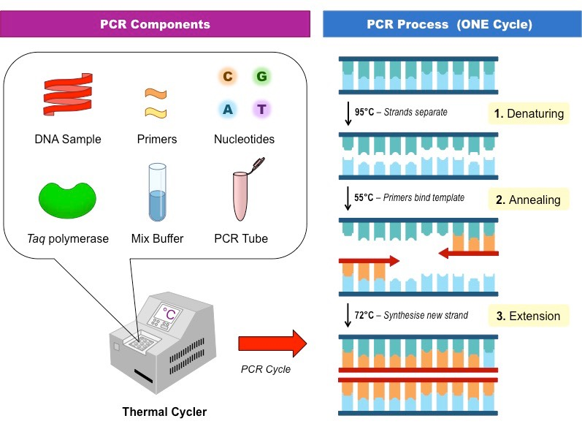
PCR is use to amplify a DNA sample
What next?

Slide 24
Uses:
Forensic analysis- DNA available from crime scences
Detection of disease- cells from embryo can be amplified for testing
Tissue typing
Tissue analysis from endangered/extinct animal samples
Paternity testing
Identification of human remains

Slide 25
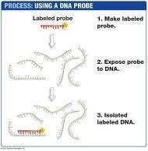
DNA sequencing- probes-
https://www.youtube.com/watch?v=76eKnmCtCTU
Probes are 8-12 base pairs in length
Has bases complementary to DNA sequence/ allele/ gene
DNA has to be denatured to allow probe to anneal to complementary sequence
DNA + probe = hybridisation
(when 2 different DNA sources anneal together)
Probes usually either radioactively or fluorescently labelled.

Slide 26
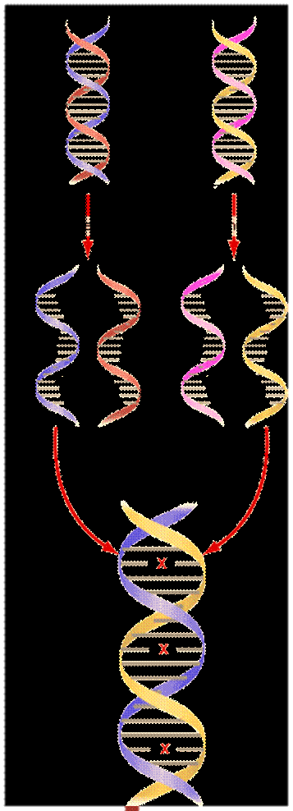
DNA sequencing- hybridisation-
https://www.youtube.com/watch?v=76eKnmCtCTU
2 or more different sources/species of DNA denatured
DNA sources allowed to mix
Complementary DNA sequence bind
DNA has probes/markers added
Allows scientists to see if 2 or more species share common alleles/ DNA sequences.
If 2 species have a lot of complementary DNA what does this mean?

