Slide 1
Genetic fingerprinting and VNTR’s
Learning outcomes:
Describe the methodology involved in producing a genetic fingerprint
Explain what variable number tandem repeats are, and how these allow the production of a virtually unique genetic fingerprint
Explain the applications of genetic fingerprinting.
Interpret genetic fingerprint patterns and draw conclusions

Slide 2
Genetic fingerprinting and VNTR’s
Genomes contains the same repetitive sequences (satellite DNA) of non-coding DNA. The number of bases in the repeat sequence varies (ATG or AGCTTCA) and the length of the repeat sequences (the number of times it repeats), and it is the length of the repeats that are unique to each person.
This can happen in non-coding DNA as mutations will arise and be retained as this has no functional impact
These repeating core sequences are called VNTRs (variable number tandem repeats) if the sequence is between 10-80 bases or STRs (short tandem repeats) if the sequence is between 2-9 bases. (STR is off spec)

Slide 3
The VNTRs can be cut using restriction endonucleases.
These will cut at recognition sequences either side of the VNTR, so it will cut the same section for all people, but the number of repeats and thus the distance between the recognition sites will vary and should be unique to each person, this will produce different sized fragments.

Slide 4
Below person A (on top) has the same repeat sequence as person B, ATG
A repeats only 4 times
12 bases long
ATGATGATGATG
39 bases long
ATGATGATGATGATGATGATGATGATGATGATGATGATG
B repeats 13 times
Person A’s DNA fragment will be lighter than person B

Slide 5
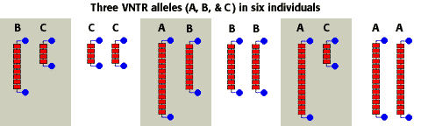
Learning outcome:
Explain what variable number tandem repeats are, and how these allow the production of a virtually unique genetic fingerprint.

Slide 6
Producing genetic fingerprints:
Extract the DNA: e.g. from crime scene/individual/ cells/tissue
Amplify the DNA: PCR
Digestion of DNA: Restriction endonucleases
Separation: Gel electrophoresis
Southern blotting: Transfer to nylon sheet
Hybridisation: Add radioactive or fluorescently labelled probes
Development: Place nylon layer under UV light or expose to X - ray
Interpretation: Make comparisons between bands/ locate specific genes using a DNA ladder

Slide 7
Exam question:
Describe how the technique of genetic fingerprinting is carried out(6)
Comparison of 2 MS – Note the similarities and key terms
1. DNA is cut; 2. Using restriction enzyme; 3. Electrophoresis; 4. Separates according to length/mass/size; 5. DNA made single-stranded; 6. Transfer to membrane/ Southern blotting; 7. Apply probe; 8. Radioactive/ single stranded/ detected on film/ fluorescent; 9. Reference to tandem repeats/VNTRs/minisatellites; 10.Pattern unique to every individual; | 1 DNA extracted from sample; 2 DNA cut/hydrolysed into segments using restriction endonucleases; 3 must leave minisatellites/VNTR/required core sequences intact; 4 DNA fragments separated using electrophoresis; 5 detail of process e.g. mixture put into wells on gel and electric current passed through; 6 immerse gel in alkaline solution / two strands of DNA separated; 7 Southern blotting / cover with nylon/absorbent paper (to absorb DNA); 8 DNA fixed to nylon/membrane using uv light 9 radioactive marker/probe added (which is picked up by required fragments)/complementary to minisatellites/VNTR; 10 (areas with probe) identified using X-ray film/autoradiography;

Slide 8
Uses of genetic fingerprinting
1. Forensic science:
The pattern of the DNA profile is compared with those of the victim and the suspect.
If the profile matches the suspect it provides strong evidence that the suspect was present at the crime scene (NB: it does not prove they committed the crime).
If the profile doesn’t match the suspect then that suspect may be eliminated from the enquiry.
2. Determine genetic relationships:
DNA profiles can be used to determine whether a particular person is the parent of a child.
A child’s paternity (father) and maternity (mother) can be determined.
This information can be used in
  Paternity suits
  Inheritance cases
  Immigration cases

Slide 9
Medical diagnosis:
Can be used to diagnose genetic disorders and cancer
Particularity those caused by an unknown mutation of several mutations.
Allows for more specific drug treatment.
Determine genetic variability in a population:
Animal and plant breeding:
Prevent inbreeding

Slide 10
Example: A Paternity Test
By comparing the DNA profile of a mother and her child it is possible to identify DNA fragments in the child which are absent from the mother and must therefore have been inherited from the biological father.
Mother
Child
Man
Genetic variability within a population
A population whose members have very similar genetic fingerprints has little genetic diversity. A population whose members have a greater variety of genetic fingerprints has greater genetic diversity.

Slide 11
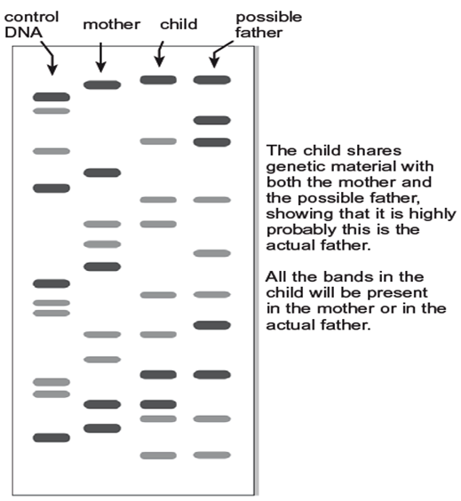

Slide 12
