Slide 1
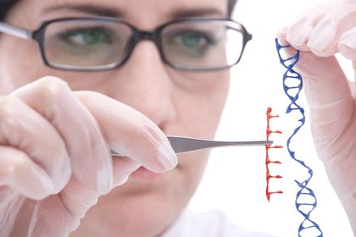
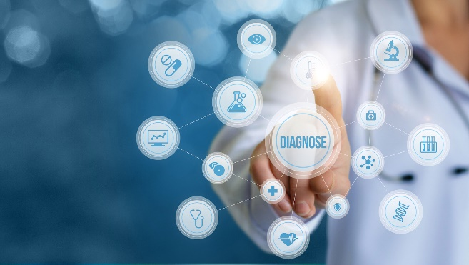
DNA probes, hybridisation and genetic screening

Slide 2
Learning outcomes:
Explain how DNA probes and hybridisation are used to locate specific alleles.
Explain the benefits of screening for genetic diseases.
Explain some of the issues raised by screening, and the role of genetic counsellors.
Evaluate information relating to screening individuals for genetically determined conditions and drug responses.

Slide 3
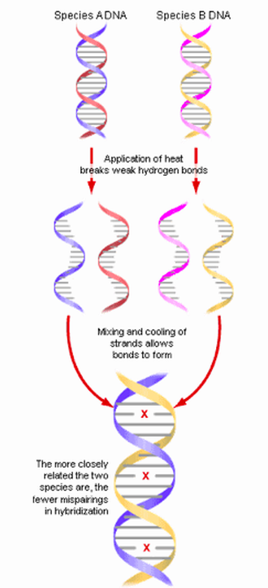
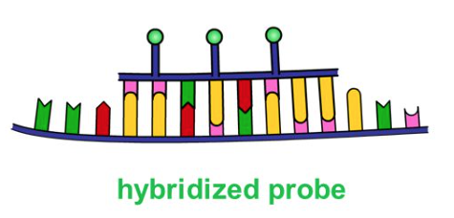
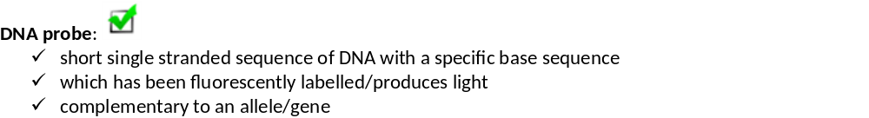
Learning outcomes:
Explain how DNA probes and hybridisation are used to locate specific alleles.
Definitions:
DNA hybridisation:
Annealing/joining 2 strands of DNA/RNA from 2 different sources (eg different species or 2 different organism). Technique is used to identify complementary genes/alleles or how similar species are.

Slide 4
Learning objectives
The use of labelled DNA probes and DNA hybridisation to locate specific alleles of genes.
The use of labelled DNA probes that can be used to screen patients for heritable conditions, drug responses or health risks.
The use of this information in genetic counselling and personalised medicine.
How is DNA hybridization used to identify genes
https://www.youtube.com/watch?v=xoxUWGl8WFs
Khan academy microarray- 8 minute video.
Watch the video and complete the questions on page 5
Note:
Proliferation means more cell division (mitosis),
Assay means to test the activity of a biological molecule, eg testing the transcription rate/activity for a protein.

Slide 5
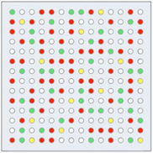
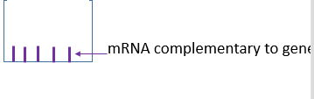
More proteins are produced. Protoncogens to oncogenes.
Less proteins are produced. TSG
Nothing happened to gene C
Testing the transcription activity of multiple genes in a small space e.g. a chip
Microarray from the top:
5. Microarray well:

Slide 6
6.
mRNA (or biological molecule we are testing for) inside cell is located
mRNA from inside cells are fluorescently labelled different colours. Eg cancer = yellow, normal = blue.
Cancer and normal cell are broken apart
Add content of both cells to the same well.
The well will light up.
Computer is used to scan microarray to detect colours.
7. If yellow means DNA is from cancer cell, gene has been upregulated/expressed more.
8. Gene B is down regulated/not expressed in cancer cell so well would be blue not yellow
9. See if gene is up or down regulated/not expressed.

Slide 7
How are DNA probes used to identify genes?
Phenylketonuria (PKU) is a rare inherited disorder. People with PKU can't break down the amino acid phenylalanine, which then builds up in the blood and brain causing death. At 5 days old, babies are given blood spot screening to check if they have it.
Answer these questions:
What must be done to the DNA before the gene probe can be used? From the PCR process describe how this would be achieved?
The temperature is dropped. What happens and explain the importance of dropping the temperature.
Which section of the target gene will the probe bind to?
Once the location of the gene has been identified by the probe, how can scientists detect it?
Why might a scientist want to screen a patients DNA?
How might probes be used in personalised medicine to develop bespoke treatments for patients?

Slide 8
Answers
Make DNA single stranded. Use heat to denature strands (could also use enzymes/alkaline solution)
Allow primers/p robe to bind
Complementary DNA sequence
If probe is fluorescent use UV light, if radioactive use X-ray film and produce autoradiograph.
Identify alleles for disease, identify mutations in genes, identify suspects in crime e.t.c.
Some drugs may be more effective in treating people with particular alleles.

Slide 9
How are DNA probes used to determine how a patient responds to a specific drug.
Herceptin is a drug which only works on specific receptors for 1 type of breast cancer.
Question: How could a DNA probe be used to test if Herceptin should be prescribed?
Use radioactively/fluorescently labelled DNA probe with a complementary sequence to part of the allele which codes for specific receptor
If probe binds to DNA and this is identified on a autoradiograph/under UV light the allele is present.
This allele would be transcribed and translated into receptor and be present in CSM of breast cancer cells.
Treat these individuals with Herceptin.

Slide 10
Genetic Counselling
If a couple have been identified as being at risk of having a child with a genetic disorder a counsellor provides advice before or after screening.
What advice could you give?

Slide 11
The role of a genetic counsellor
Provides advice before or after screening about:
Being a carrier for a disease
Most appropriate type of screening test and the risks of screening
Result of screening test the type of allele discovered
Most effective treatment
Quality of life with condition and life expectancy
Possibly of termination
Chance of it occurring in future pregnancies using pedigree diagram
Use of donor/ IVF with screening

Slide 12
Advice need to be given in light of beliefs and culture
Example:
A woman with a family history of breast cancer may have genetic counselling to help her decide whether or not to be screened for known mutations that can lead to breast cancer, e.g. a mutation in the BRCA1 TSG. If she is screened and the results is positive, genetic counsellors might explain to the woman what her lifetime chance of developing breast cancer is. Counselling could also help the woman to decide if, for example, she wants to take surgical steps to reduce the risk of breast cancer developing.
Advice need to be given in light of beliefs and culture

Slide 13
Learning objectives
The use of labelled DNA probes and DNA hybridisation to locate specific alleles of genes.
The use of labelled DNA probes that can be used to screen patients for heritable conditions, drug responses or health risks.
The use of this information in genetic counselling and personalised medicine.
Exam focus:
Complete exam questions on page 14 - 17
These are all application questions.
READ and ANNOTATE the information carefully

Slide 14
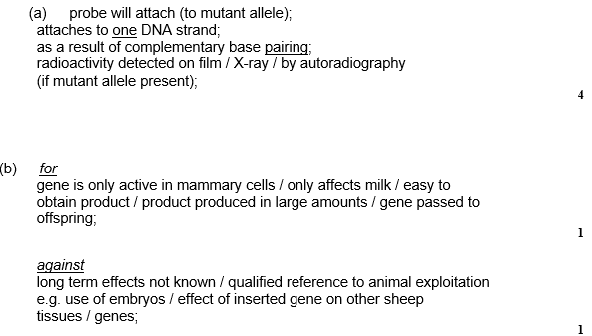
Question 1

Slide 15
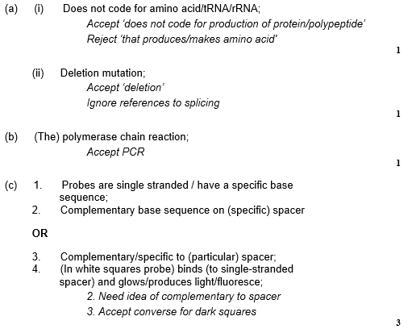
Question 2

Slide 16
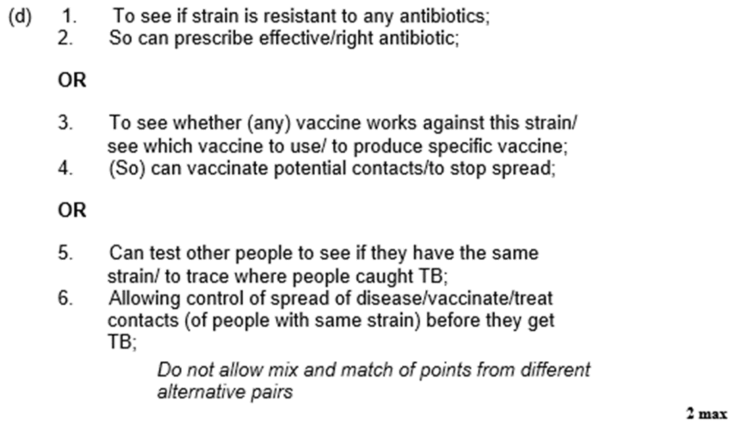

Slide 17
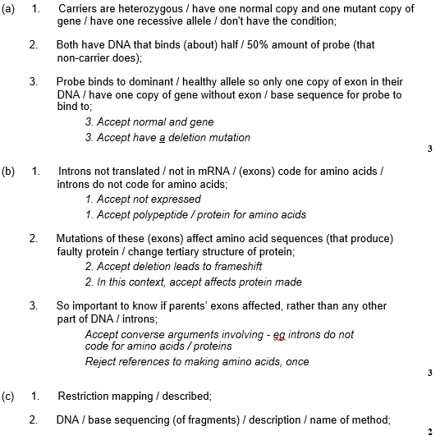
Question 3

Slide 18

Question 4

Slide 19
Learning outcomes
Interpret information relating to the use of recombinant DNA technology.
Evaluate the ethical, financial and social issues associated with the use and ownership of recombinant DNA technology in agriculture, in industry and in medicine.
Balance the humanitarian aspects of recombinant DNA technology with the opposition from environmentalists and anti-globalisation activists
(Note: these learning outcomes are not required AO1 specification knowledge but used to develop ideas)

Slide 20
Task :
Read the laminated pages and CONDENSE this information into the boxes on page 7 and 8 in your booklet.
You DO NOT need to learn specific examples but you will be given specific examples which you with have to ethically discuss.

Slide 21
Exam focus
Task:
Complete exam questions on page 19 – 21 .
These are all application questions.
READ and ANNOTATE the information carefully.

Slide 22
Question 1:
Yes because:
Many embryos die/are discarded;
Some offspring with heart failure;
Introduction of new genes has unforeseen consequences for (future generations of) pigs;
No because:
4. Potential benefit for human (diet);
5. Successful production of at least some healthy cloned piglets.
Question 2:
Can control herbicides as weeds among growing crops;
without harming crop
Weeds compete with crops/example
Weeds reduce yield of crop/herbicide increases yield
b) i) Reproductrion/pollen/bacteria
ii) Mutation

Slide 23

Question 3

Slide 24

Question 4

Slide 25
Learning objective:
Relate recombinant DNA technology to gene therapy.
Explain the principles of gene therapy
Explain the difference between somatic and germline gene therapy
Explain why germline therapy is prohibited
Evaluate the effectiveness and risks of gene therapy.
Log onto : http://learn.genetics.utah.edu/content/genetherapy/
Read “What is Gene Therapy”, and make brief notes on first 2 paragraphs.
Do interactive: “Gene delivery: tools of the trade” and read text to make a table on advantages and disadvantages of viral and liposomal vectors.
Read “ challenges in gene therapy” and make notes on the risks of gene therapy
Read “Gene therapy Success” and make notes on some of the applications of gene therapy in treating certain diseases.
Do interactive: “Space doctor” - and enjoy yourself ☺

Slide 26
Learning objective:
Relate recombinant DNA technology to gene therapy.
Explain the principles of gene therapy
Explain the difference between somatic and germline gene therapy
Explain why germline therapy is prohibited
Evaluate the effectiveness and risks of gene therapy.

Slide 27
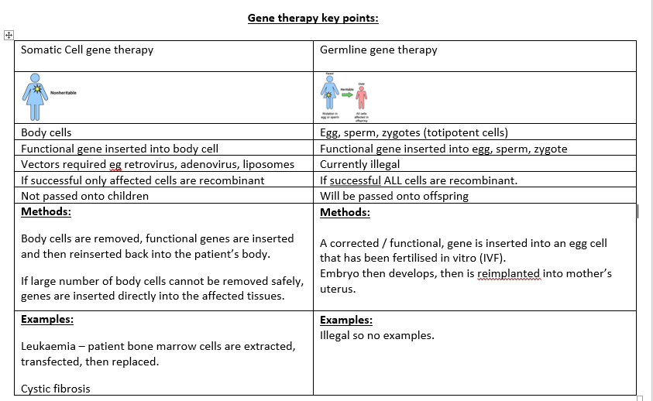

Slide 28
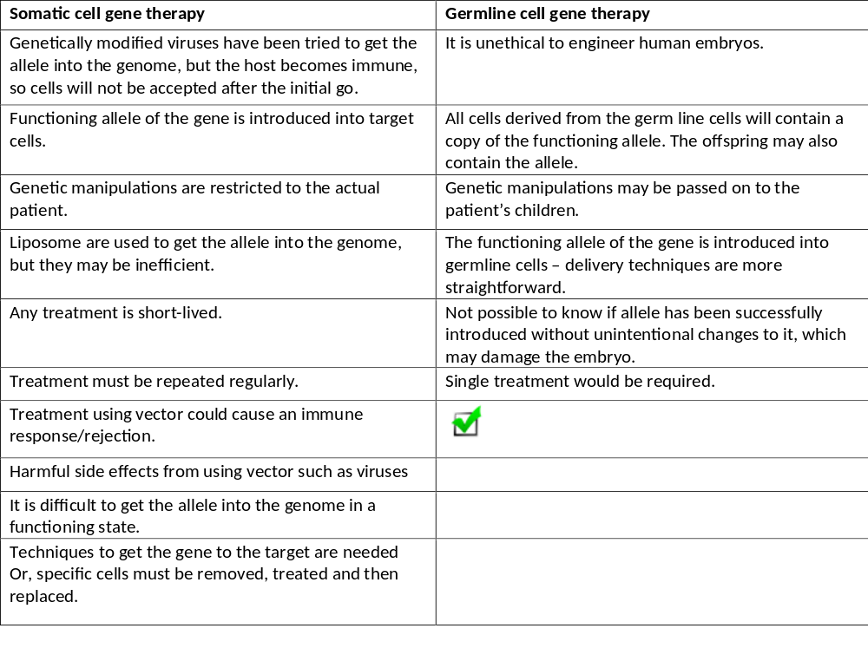

Slide 29
Learning objective:
Relate recombinant DNA technology to gene therapy.
Explain the principles of gene therapy
Explain the difference between somatic and germline gene therapy
Explain why germline therapy is prohibited
Evaluate the effectiveness and risks of gene therapy.
Task:
Complete exam questions on page 24 - 26
These are all application questions.
READ and ANNOTATE the information carefully

Slide 30
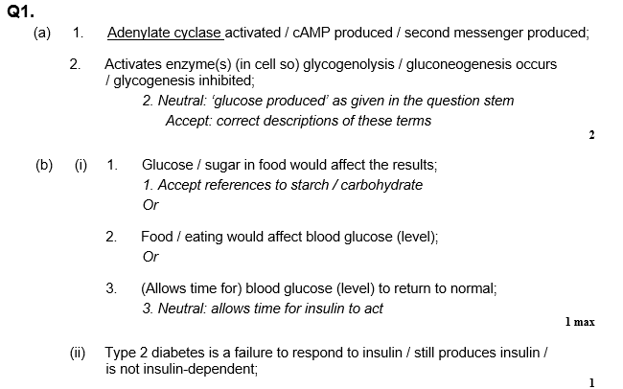

Slide 31
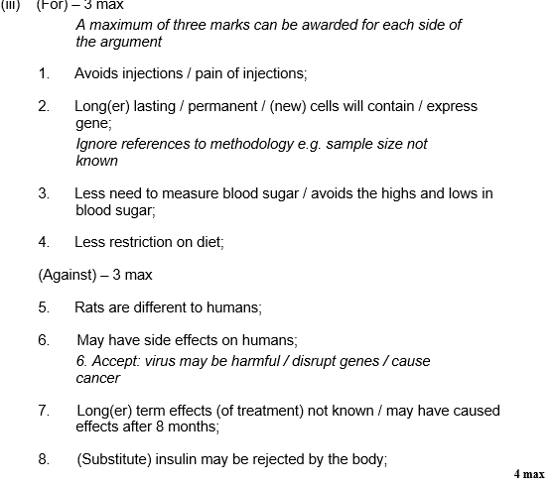

Slide 32
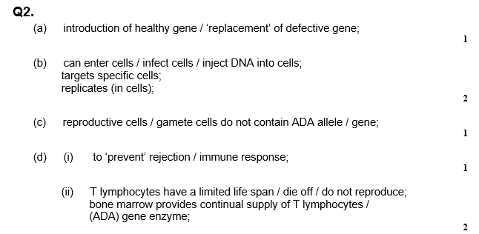

Slide 33
