Slide 1
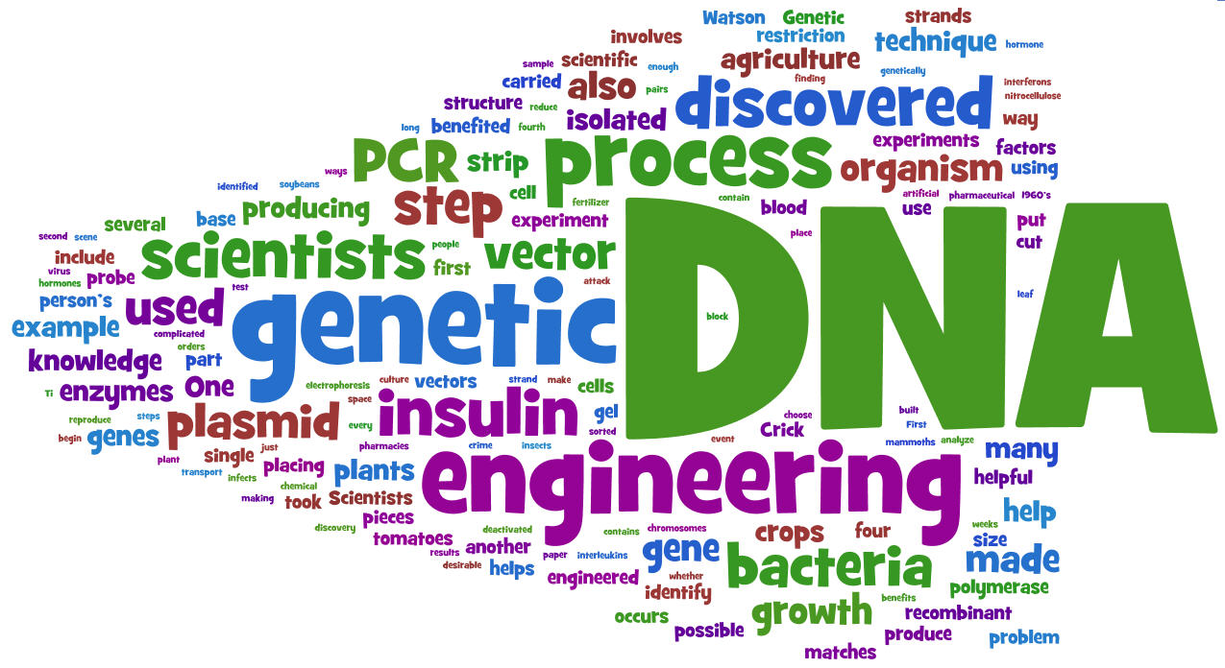
RECOMBINANT DNA TECHNOLOGY

Slide 2
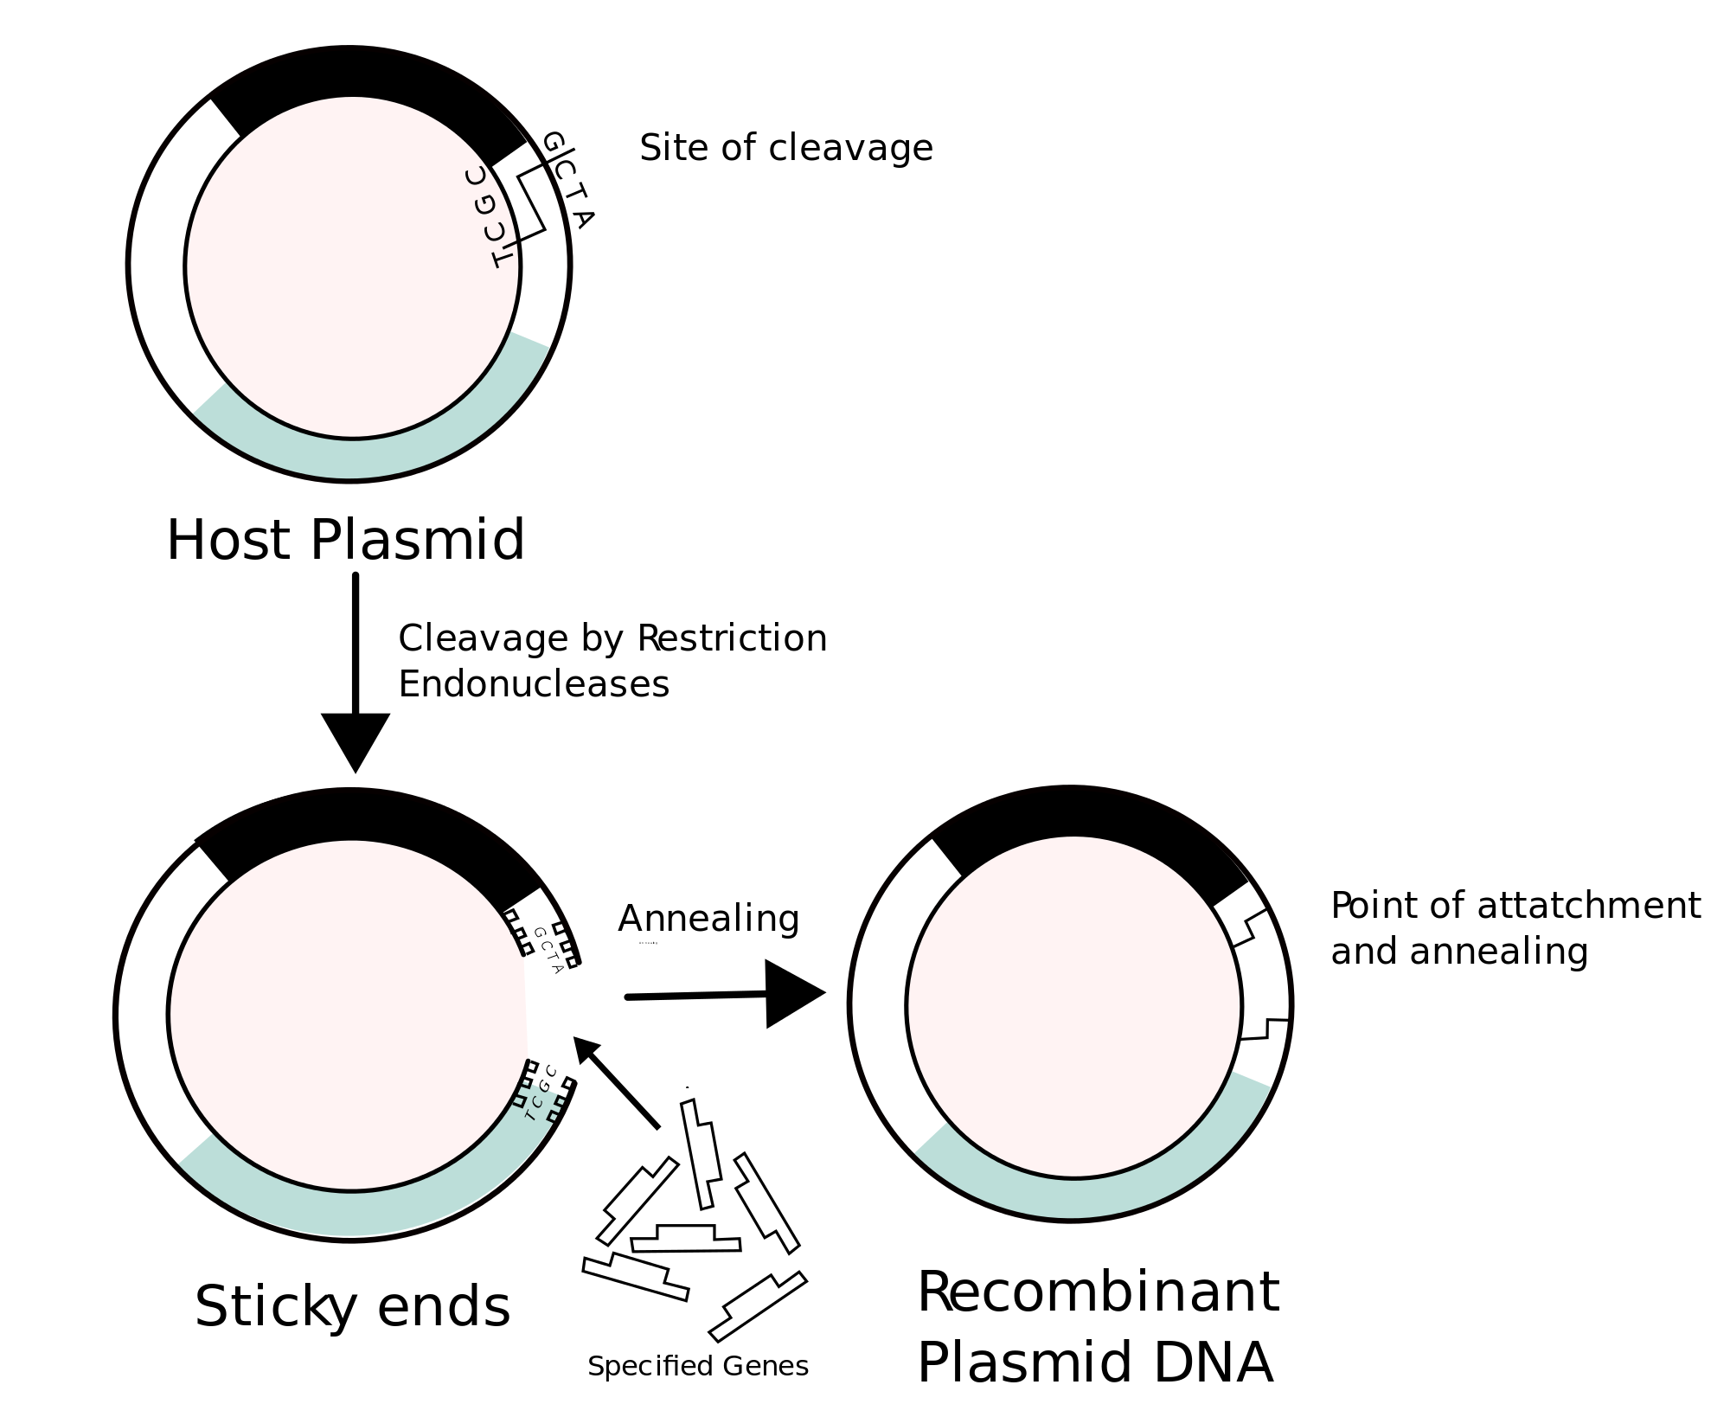
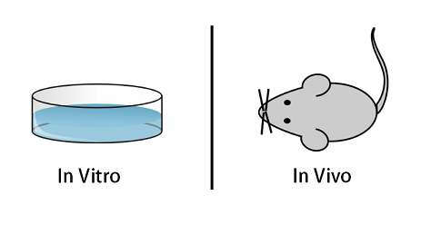

Outcome:
Explain what is meant by recombinant DNA technology
Recombinant DNA: DNA from 2 different sources joined together.
The 2 sources do not need to be from the same species
In vitro:
“within glass”.
Experiments performed testtubes/petri dishes outside of the living organism.
In vivo :
“within living organism”
Experiments performed within the living organism.

Slide 3
Outcome: explain what is meant by recombinant DNA technology
Watch the 2 video links below.
Overview of genetic engineering: Use the words on page 2 in your booklet to complete the gaps on page 2 in your booklet.
Video 1 doesn’t work anymore
Video 1: http://highered.mcgraw-hill.com/sites/0072437316/student_view0/chapter16/animations.html#
Video 2: http://m.youtube.com/watch?v=8Dd7M9PGhgQ – 6 minutes .

Slide 4
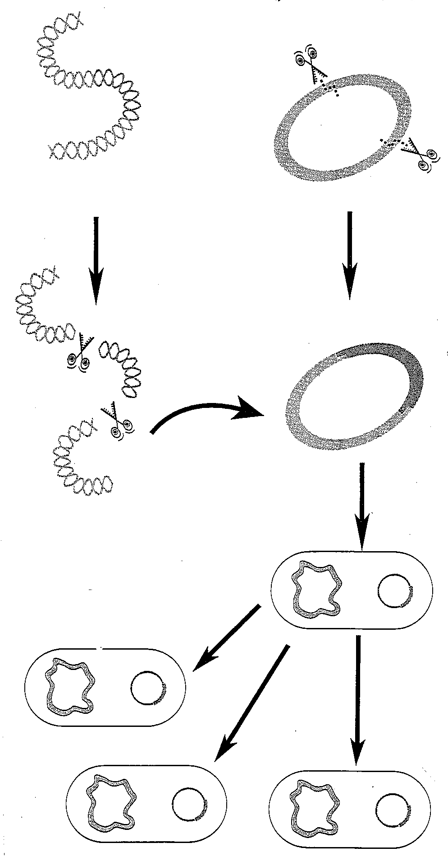
Overview
1. The required gene is obtained from donor DNA
3. Plasmid DNA is cut with a RE (at a Restriction Site)
2. First located with a gene probe
5. The enzyme produces complementary sticky ends
6. Donor DNA is joined into a vector, e.g. a plasmid, using ligase enzyme – seals
S-P backbone
4. Donor DNA is cut with SAME RE as used to cut plasmid
8. Vector (recombinant plasmid) carries the gene into recipient cell, e.g. bacterial cell, which divides
7. A recombinant
plasmid is formed
10. When protein synthesis occurs, the donor gene is expressed, and the required product is made
9. The new cells all have the recombinant plasmid, i.e. they are transgenic
This describes how a gene can be transferred from one organism to another

Slide 5
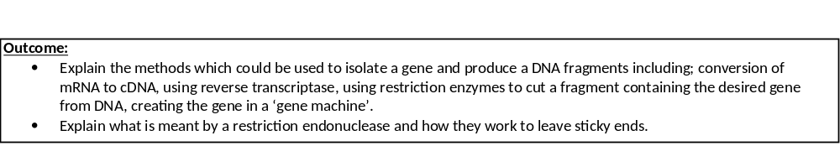
Add definition to page 2 in your booklet:
Definition:
Vector: Carries DNA, into host organism

Slide 6
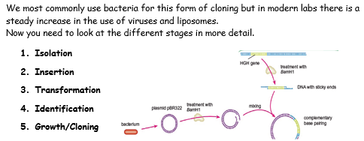

Slide 7

Isolation of the Gene
We will be completing these in a different order. Start on page 5.
Fragments of DNA can be isolated by several methods, including:
Conversion of mRNA to complementary DNA (cDNA) using reverse transcriptase
Using restriction enzymes to cut a fragment containing the desired gene from DNA
Creating the gene in a ‘gene machine’
From the spec

Slide 8
The gene may be a few hundred bases amongst many millions in the human genome. There a number of methods used to isolate the gene:
Method 1: Using reverse transcriptase.
Method 2: Using restriction enzymes
Method 3: Using a gene machine
Watch the following youtube video: https://www.youtube.com/watch?v=pDHCHa1C85Y
1 minute 14 to explain what restriction enzymes are.

Slide 9
Method 2: using restriction enzymes to cut a fragment containing the desired gene from DNA
Restriction enzymes are also known as restriction endonucleases.
Restriction endonucleases are enzymes which cut (hydrolyse) DNA at specific base sequences (recognition sequences).
Different restriction endonucleases cut DNA at different specific sequence of bases (recognition sites) because the shape of the recognition site is complementary to the enzymes active site. These recognition sites occur in the DNA of all species of organisms- but not in the same places!
These recognition sequences are palindromic - base pair read the same in opposite directions.
If recognition sequences for these enzymes are present at either side of the DNA fragment you want, you can use restriction endonucleases to separate it from the rest of the DNA. The DNA sample is incubated with the specific restriction endonuclease, which cut DNA fragment out of DNA.

Slide 10
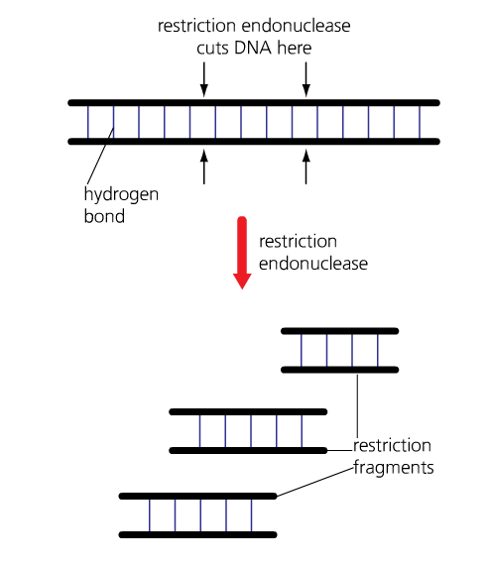
NOTE: It is important that the recognition sequence for the selected restriction endonuclease does not occur within the gene you want to isolate.
Restriction enzymes are made by bacteria to cut out viral DNA sequences from the bacterial DNA.

Slide 11
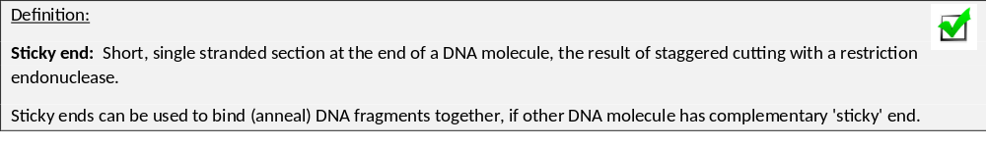
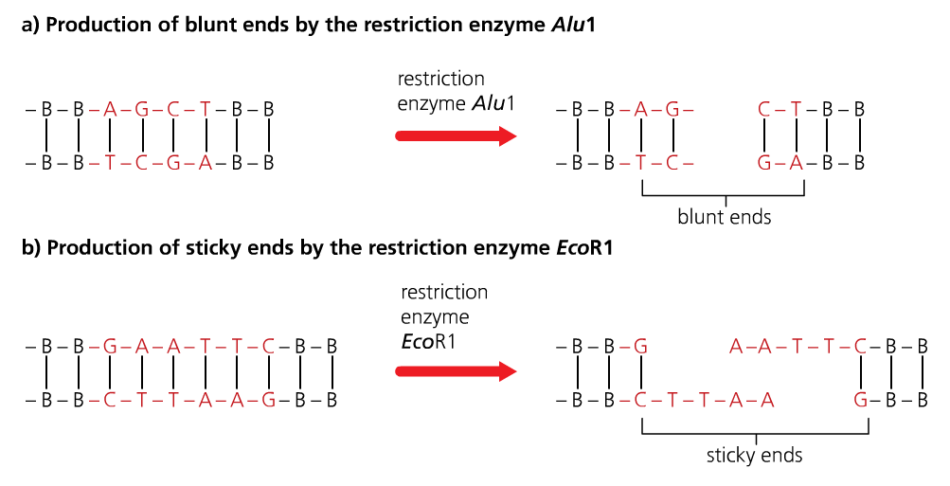
Sticky ends are important as they allow the DNA fragment to be inserted into another organism / species DNA, if the other organism’s DNA is cut using the same restriction enzyme.

Slide 12
The gene may be a few hundred bases amongst many millions in the human genome. There a number of methods used to isolate the gene:
Method 1: Using reverse transcriptase.
Method 2: Using restriction enzymes
Method 3: Using a gene machine
Activity:
There are 5 identical bacterial DNA sequences and 5 different restriction endonucleases.
On each DNA strand:
Highlight the recognition sequence.
The enzyme reads the top chain of the recognition site first from left to right. On the top line draw a vertical line between the 2 bases the enzymes cuts
The enzyme reads the bottom chain of the recognition site second from right to left. On the bottom line draw a vertical line between 2 bases the enzyme cuts.
Connect the 2 vertical lines with a horizontal line.

Slide 13
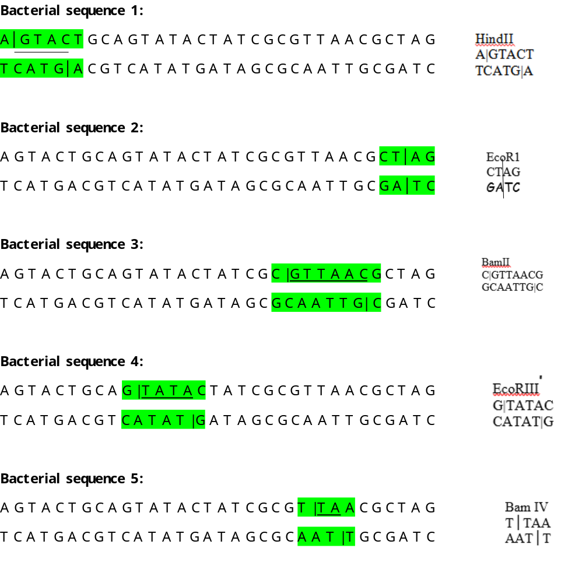
The first 2 chains have been labeled for you
Sticky end
Rest of DNA
Blunt end

Slide 14
Term | Definition
Restriction endonuclease/ Enzyme
Recognition site
Palindrome
Blunt sticky end
Staggered sticky end
Enzymes
Cut DNA at specific recognition site
4-8 bases long nucleotide sequence
Where restriction enzyme attaches and cut
Base sequence reads the same forwards and backwards
Recognition site cuts in a straight down
Recognition site cuts leaving staggered exposed bases
Allows/ attached to complementary exposed bases.

Slide 15
Isolation of the Gene
Firstly you need to isolate DNA fragments that have the gene you need
Fragments of DNA can be isolated by several methods, including:
Conversion of mRNA to complementary DNA (cDNA) using reverse transcriptase
Using restriction enzymes to cut a fragment containing the desired gene from DNA
Creating the gene in a ‘gene machine’
From the spec

Slide 16
The gene may be a few hundred bases amongst many millions in the human genome. There a number of methods used to isolate the gene:
Method 1: Using reverse transcriptase.
Method 2: Using restriction enzymes
Method 3: Using a gene machine
Method 1: Using reverse transcriptase- Flipped learning.
Recap: Watch the following video which described how transcription normally work.
https://m.youtube.com/watch?v=ztPkv7wc3yU- 1 minute 27.
Watch the following video: Use the video known as cDNA
https://www.youtube.com/watch?v=y-MbXgGnAw4 1 minute 28
Re-watch the video above and complete the boxes on page 3 in your booklet.

Slide 17
EXAMPLE:
1. Beta Cells from islets of langerhans in the human pancreas –where the insulin gene is transcribed into mRNA (no introns)
2. mRNA coding for insulin is extracted from the cell
U
C
G
U
U
A
G
C
U
3. mRNA coding for insulin (no introns)
4. mRNA acts as a template on which a cDNA strand is formed using reverse transcriptase
U
C
G
U
U
A
G
C
U
A
G
C
A
A
T
C
G
A
A
G
C
A
A
T
C
G
A
5. Single stranded DNA
Notes:
Genetic information in retroviruses is RNA – they convert it to NA using restriction endonucleases – which we extract!

Slide 18
Note: Don’t abbreviate, write out the full names of bases
A
G
C
A
A
T
C
G
A
5. Single stranded DNA
6. New nucleotides form hydrogen bonds with complementary base pairs.
Adenine- Thymine, Cytosine- Guanine,
7. DNA Polymerase joins the new adjacent nucleotides/forms phosphodiester bonds and double stranded cDNA is formed
T
C
G
T
T
A
G
C
T
A
G
C
A
A
T
C
G
A
T
C
G
T
T
A
G
C
T
A
G
C
A
A
T
C
G
A
8. Copy of Human Insulin gene can now be inserted into host cell/cloned.
Host cell

Slide 19

Question:
Why do scientists have to use the mRNA for insulin, why can’t the scientists take the DNA instead?
Insulin has a specific 2 separate mRNA chains which combine together
The pre-mRNA has to be spliced to get usable instructions to make insulin
Bacteria cannot splice mRNA

Slide 20
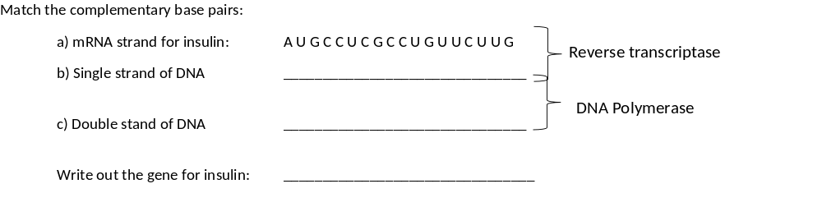
Now you do the process! (page 4)

Slide 21
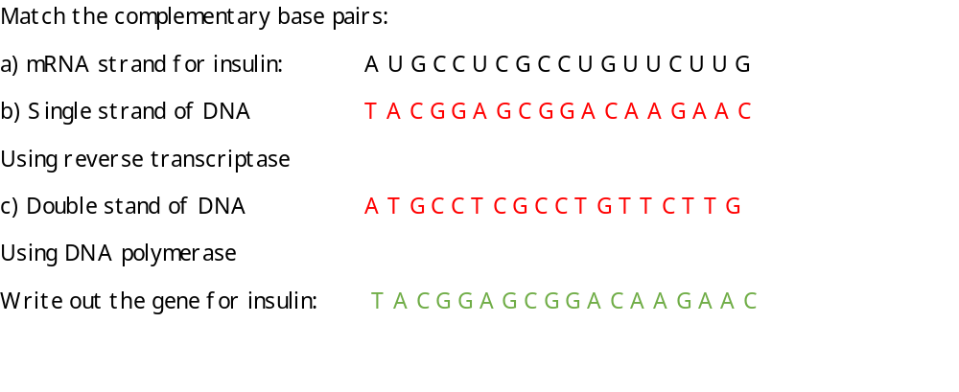

Slide 22
Complete the T/F quiz – page 4
Can you correct the False answers?
There are 2 H bonds between C and G
There are 3 H+ bonds between A and T
T in DNA is replaced by U in RNA
The sugar in DNA is deoxyribose
DNA nucleotides are joined by phospho bonds
DNA polymerase makes peptide bonds
Reverse transcriptase forms a DNA chain from an mRNA template.

Slide 23
Complete the T/F quiz – page 4
Can you correct the False answers?
There are 2 H bonds between C and G False- 3
There are 3 H+ bonds between A and T False 2 H bonds
T in DNA is replaced by U in RNA True- Uracil
The sugar in DNA is deoxyribose True
DNA nucleotides are joined by phospho bonds False- Phosphodiester
DNA polymerase makes peptide bonds False- Phosphodiester
Reverse transcriptase forms a DNA chain from an mRNA template. True

Slide 24
Advantages of using reverse transcriptase
mRNA is easy to obtain as it can be found outside of the nucleus.
Using mRNA isolated from cytoplasm means introns have been removed.

Slide 25
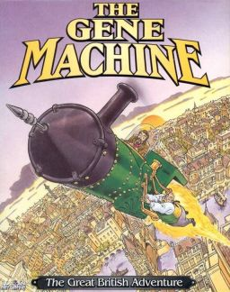
The gene may be a few hundred bases amongst many millions in the human genome. There a number of methods used to isolate the gene:
Method 1: Using reverse transcriptase.
Method 2: Using restriction enzymes
Method 3: Using a gene machine
Method 3: Gene machine.
Protein sequence analysed
Amino-acid sequence worked out
mRNA sequence worked out
DNA sequence worked out
DNA sequence is uploaded into the computer
Computer produces DNA sequence by producing overlapping single strands of nucleotides called Oligonucleotides which can then be assembled into the gene.

Slide 26
The gene may be a few hundred bases amongst many millions in the human genome. There a number of methods used to isolate the gene:
Method 1: Using reverse transcriptase.
Method 2: Using restriction enzymes
Method 3: Using a gene machine
Activity.
Compete the table.
Use amino-acid table on the next slide to help you.

Slide 27
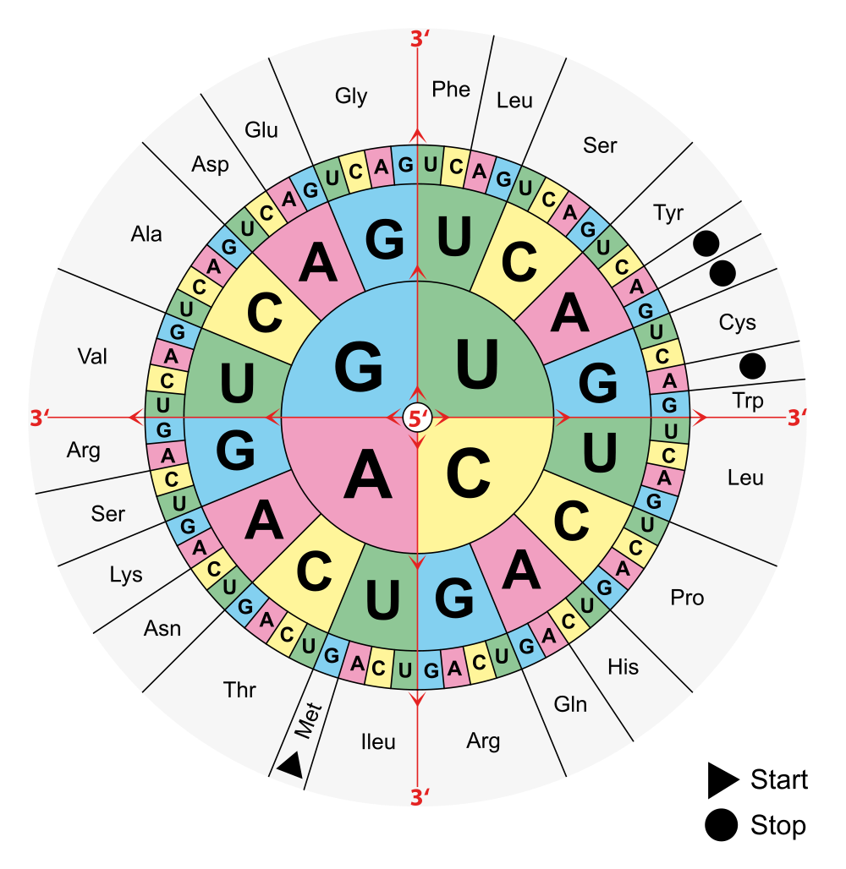
Look at the arrows for direction

Slide 28
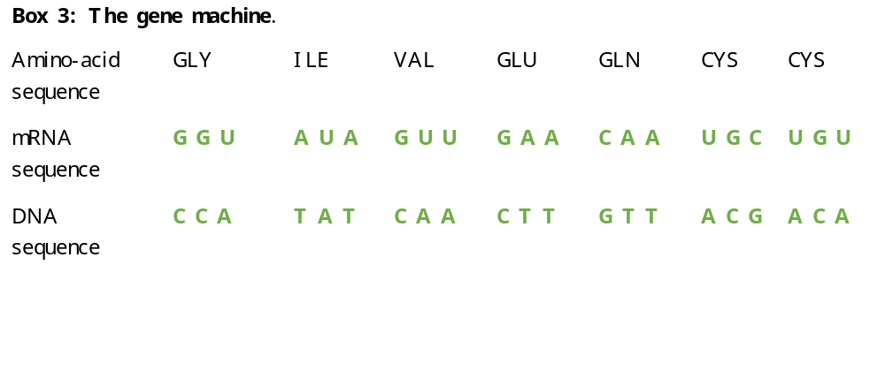
The gene may be a few hundred bases amongst many millions in the human genome. There a number of methods used to isolate the gene:
Method 1: Using reverse transcriptase.
Method 2: Using restriction enzymes
Method 3: Using a gene machine

Slide 29

Maths question.
The DNA sequence for insulin is normally 237 base pairs long, the mRNA chain is only 153 base pairs long. What is the % decrease in base pair length? Show your working.
Difference/original x 100
237 – 153 = 84 / 237 x 100 = -35% or 35% decrease
How long is the amino-acid sequence that the mRNA codes for?
153 nucleotides long
3 nucleotides code for 1 amino-acid
153/3 = 51 amino –acids in length
Extension: Can you give a suggestion for the difference in base pair length?
DNA has introns which are removed/spliced out of the mRNA chain.

Slide 30
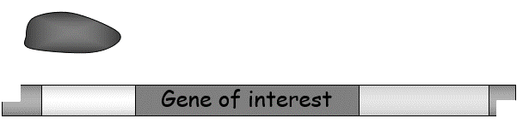
Outcome:
Describe the stages involved in in vivo gene cloning
Explain the addition of promoter and terminator regions
Step 2: Insertion of the desired gene into a suitable vector.
Before a gene can be copied it has to be inserted into a suitable vector so the transgenic organism will be able to read and use the inserted genetic information to produce the protein we want.
Step 2(a): Preparing the DNA fragment for insertion:
Definition: Promotor region: Binding site for RNA Polymerase on DNA
Definition: RNA Polymerase: Enzyme that joins RNA nucleotides to form mRNA during transcription
Definition: Transcription factors: Bind to RNA polymerase and promotor to begin transcription
Definition: Terminator region: Region of DNA that releases RNA polymerase to stop transcription

Slide 31
Preparing the DNA fragment.
Identify the promotor region by colouring it RED, add a label to this region and give its definition.
Identify the enzyme RNA polymerase by colouring it BLUE, add a label and give its definition.
Identify the terminator region by colouring it in YELLOW, add a label and give its definition.
Identify the sticky ends by colouring them in ORANGE, add a label and give their definition.

Slide 32
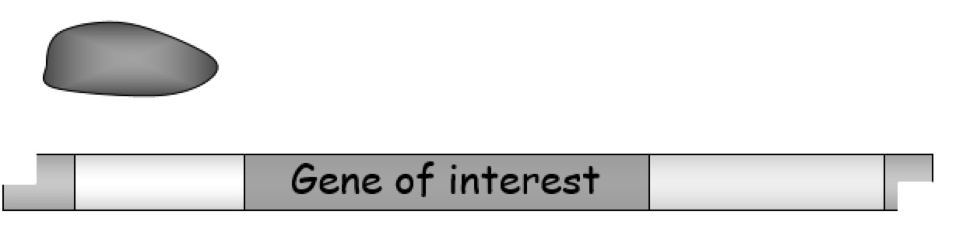
RNA Polymerase: Enzyme that joins RNA nucleotides to form mRNA during transcription
Sticky ends: Exposed DNA bases
Promotor region: Binding site for RNA Polymerase on DNA
Terminator region: Region of DNA that releases RNA polymerase to stop transcription

Slide 33
Answer these question to check your understanding
Explain why each of steps are important in preparing the gene of interest for insertion into a vector. (Can you remember what explain means in your exam?)
  A specific promotor region is added in front of the gene of interest
  A terminator region is added at the end of the gene of interest
  Sticky ends are added at the beginning of the promotor region and at the end of the terminator region.
  Extension: The promotor region is complementary to RNA polymerase but not DNA polymerase.

Slide 34
Explain why each of steps are important in preparing the gene of interest for insertion into a vector. (Can you remember what explain means in your exam?)
  A specific promotor region is added in front of the gene of interest.
  So RNA Polymerase can bind
  so transcription of the gene can start
  producing the mRNA chain
  A terminator region is added at the end of the gene of interest
  So RNA Polymerase can unbind
  so transcription of the gene can finish
  the mRNA chain has been produced
  Sticky ends are added at the beginning of the promotor region and at the end of the terminator region.
  Sticky ends will be complementary to sticky end of the vector/plasmid
  so the gene can be inserted into the vector.
  Extension: The promotor region is complementary to RNA polymerase but not DNA polymerase.
  Enzymes have specific active sites, which bind to a specific sequences on bases on promotor (maybe be aided by the transcription factors).

Slide 35

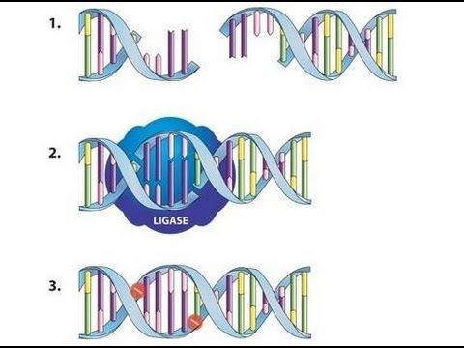
Step 2(b): Inserting the gene of interest into a vector.
The most common type of vector is a PLASMID which can be inserted into a bacterial cell.
To prepare the vector for the gene of interest the vector has to be opened by using the SAME restriction enzyme
So the sticky ends are complementary
DNA Ligase is then used to recombine the 2 pieces of DNA
This is known as RECOMBINANT DNA
Definition:
Vector: A DNA carrier (i.e. bacterial plasmid or virus) used to transfer DNA into cells.
https://www.youtube.com/watch?v=8rXizmLjegI

Slide 36
What have we already covered?
1. The required gene is obtained from donor DNA
3. Plasmid DNA is cut with a RE (at a Restriction Site)
2. First located with a gene probe
5. The enzyme produces complementary sticky ends
6. Donor DNA is joined into a vector, e.g. a plasmid, using ligase enzyme – seals
S-P backbone
4. Donor DNA is cut with SAME RE as used to cut plasmid
8. Vector (recombinant plasmid) carries the gene into recipient cell, e.g. bacterial cell, which divides
7. A recombinant
plasmid is formed
10. When protein synthesis occurs, the donor gene is expressed, and the required product is made
9. The new cells all have the recombinant plasmid, i.e. they are transgenic

Slide 37
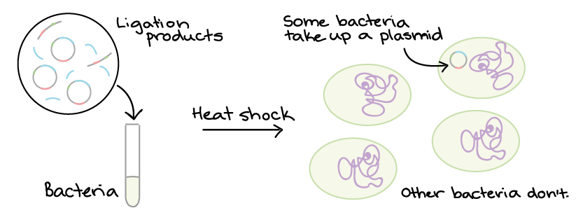
Step 3: Transformation.
Now we have our vector which carries the gene of interest we need to get the recombinant DNA into our microorganisms so the microorganisms can get on with producing the gene that we require.

Slide 38
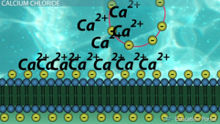
This hasn’t come in an exam question yet
Step 1: Chemical transformation using Ca²⁺:
1. Ca²⁺ has a positive charge
2. DNA has a
negative charge
3. + charge attracted to – charge so DNA will not be repelled by membrane.

Slide 39
This hasn’t come in an exam question yet
Step 2: Heat shock:
Drop Temp
- Less kinetic energy/less vibrations
2. QUICKLY increase temp
- Burst of kinetic energy
- Lots of vibrations
3. Creates gaps in membrane for DNA to move into the bacterial cell.

Slide 40
What have we already covered?
1. The required gene is obtained from donor DNA
3. Plasmid DNA is cut with a RE (at a Restriction Site)
2. First located with a gene probe
5. The enzyme produces complementary sticky ends
6. Donor DNA is joined into a vector, e.g. a plasmid, using ligase enzyme – seals
S-P backbone
4. Donor DNA is cut with SAME RE as used to cut plasmid
8. Vector (recombinant plasmid) carries the gene into recipient cell, e.g. bacterial cell, which divides
7. A recombinant
plasmid is formed
10. When protein synthesis occurs, the donor gene is expressed, and the required product is made
9. The new cells all have the recombinant plasmid, i.e. they are transgenic

Slide 41
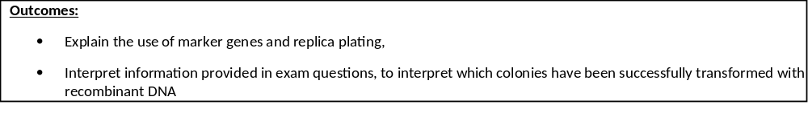
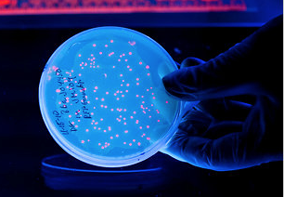
Step 4: Identification of the transformed bacteria.
Only 1% of the bacteria that we try to transform actually take up the vector.
The other 99% of the bacteria are useless to us.
There is no point wasting time and money allowing all 100% of the bacteria to reproduce if we only want 1%.
So, how do we identify the correct
bacteria and what’s happened
to the other 99%?

Slide 42
Step 4: Identification of the transformed bacteria.
Some of the plasmids will have resealed without becoming recombinant- we don’t want this.
Some of the gene of interest will have resealed without becoming recombinant – we don’t want this.
There will be some recombinant DNA – this is what we want.
Some of the bacteria will not have transformed at all- we don’t want these either.

Slide 43
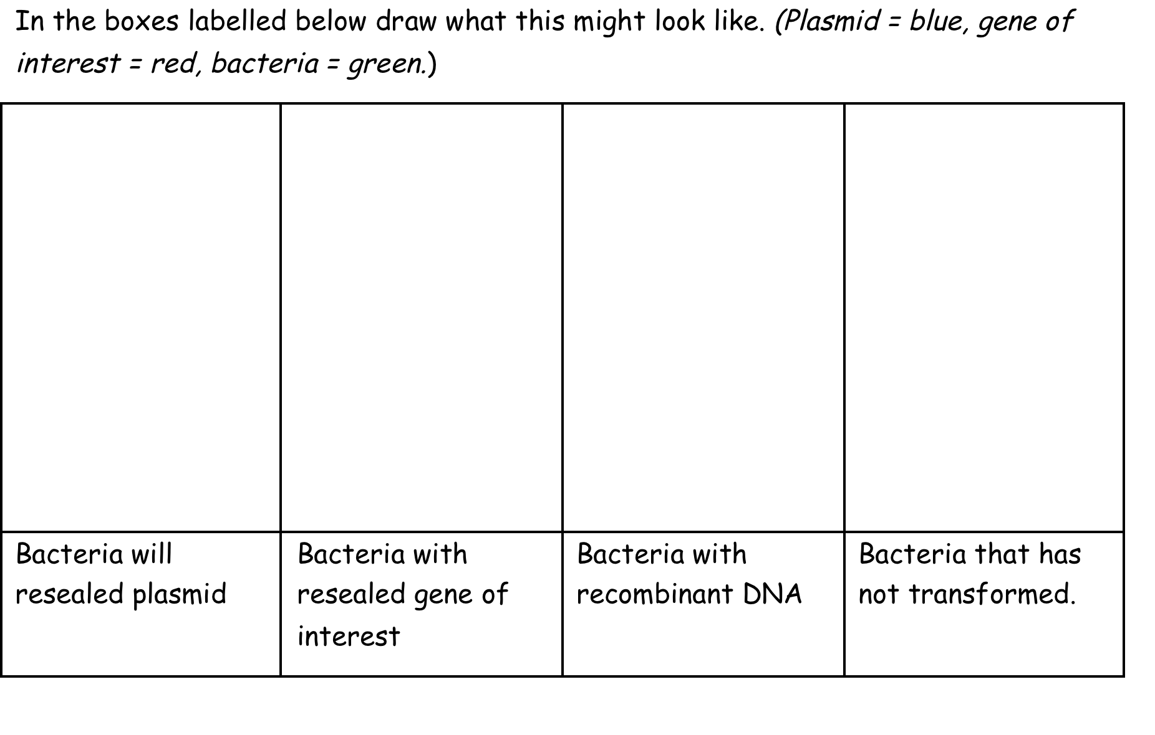
Step 4: Identification of the transformed bacteria.

Slide 44
Step 4: Identification of the transformed bacteria.
X
X
X

Slide 45
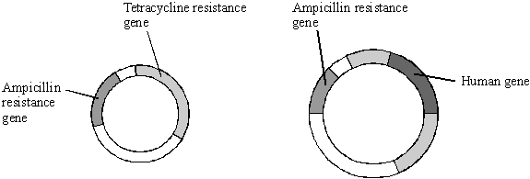
Step 4: Identification of the transformed bacteria.
To help us identify the recombinant DNA in the transformed bacteria we use specialised plasmids as the one shown below- known as an R-plasmid.
Activity: Use the internet to find out what an R plasmid is, can you add labels and annotations to example of a simplified R plasmid shown below?
Definition: Antibiotic resistance:
The ability for microorganisms to withstand the adverse affects of antibiotics.
Definition: Genetic markers:
Is a gene or DNA sequence with a known location on a chromosome that can be used for identification. Can be modified to be fluorescent or radioactive

Slide 46
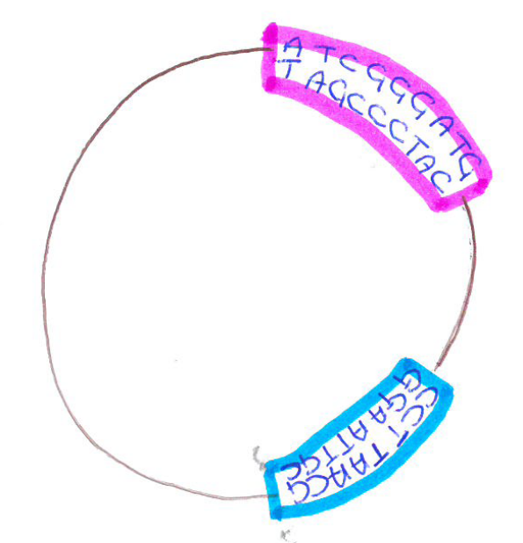
Step 4: Identification of the transformed bacteria.
Our R plasmid has 2 antibiotic resistant gene:
1) Resistant to ampicillin known as the AMP gene.
2) Resistance to tetracycline known as the TET gene.
Activity If we use the BamIV restriction enzyme (activity in the beginning) draw below what would the recombinant plasmid would look like (AMP gene= red, TET gene= blue, gene of interest= green)

Slide 47
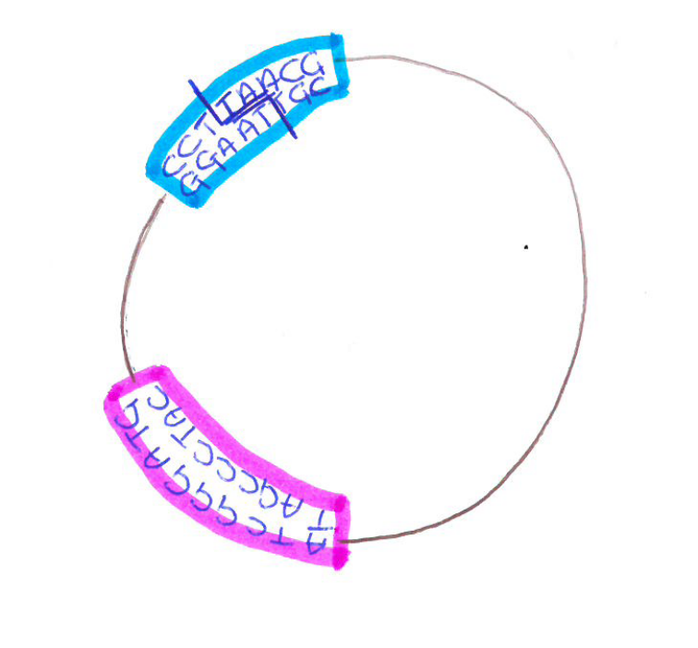
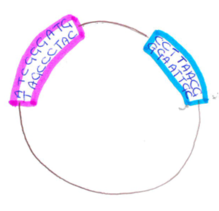
Step 4: Identification of the transformed bacteria.
Recognition sequence for Bam IV
No recognition sequence in AMP gene
AMP gene intact /not disrupted
AMP gene works/bacteria are resistant to ampicillin antibiotic
Recognition sequence in TET gene
TET gene is not intact/TET gene contains gene of interest
TET gene doesn’t work/not resistant

Slide 48
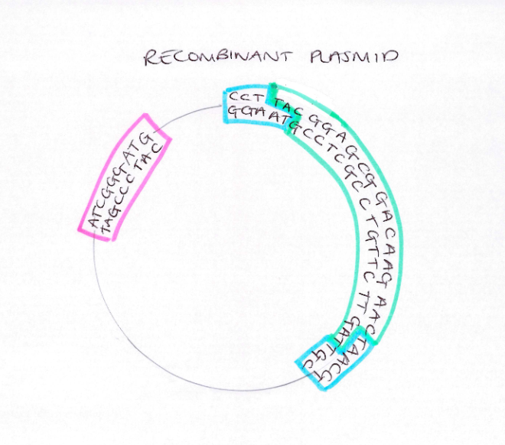

Slide 49
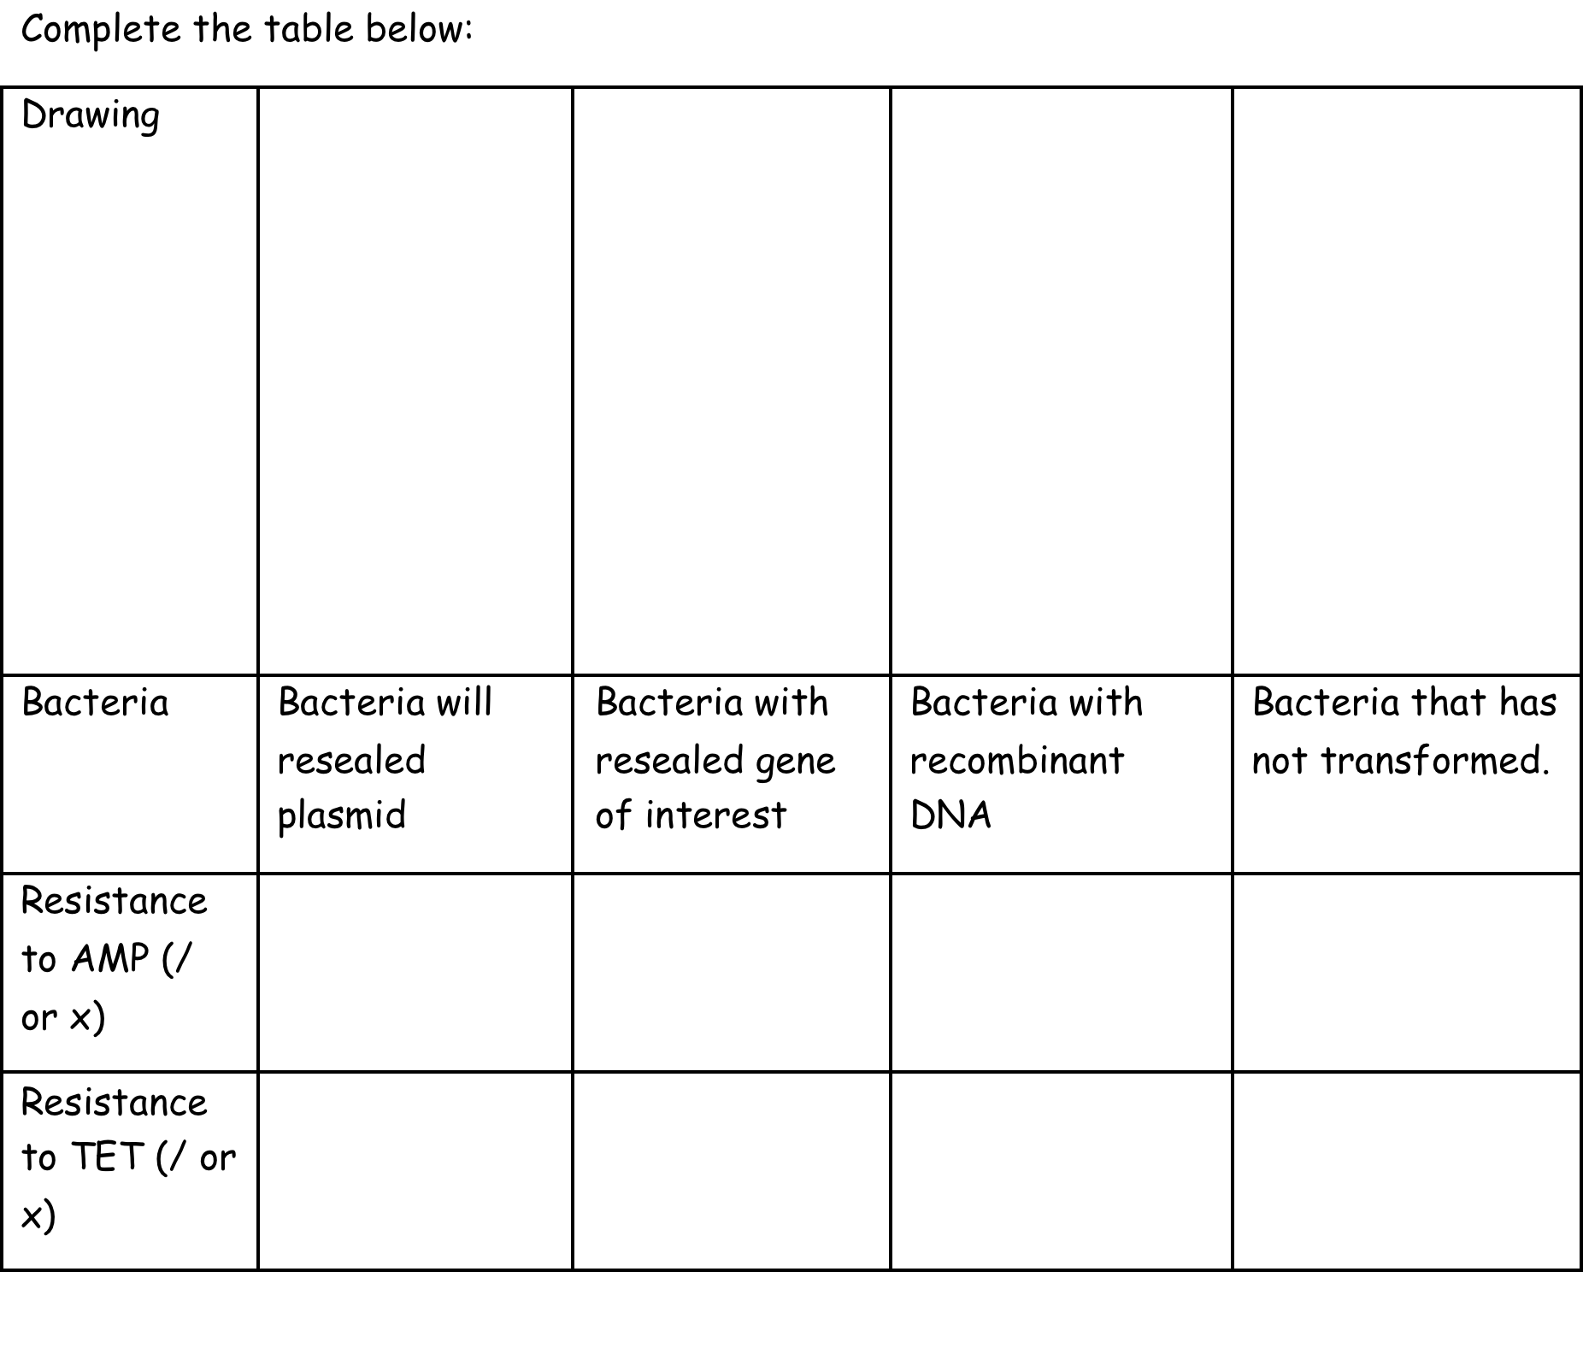
Learning outcomes: Explain the use of marker genes and replica plating, interpret information provided in exam questions, to interpret which colonies have been successfully transformed with recombinant DNA
Step 4: Identification of the transformed bacteria.
/
X
/
X
/
X
X
X

Slide 50
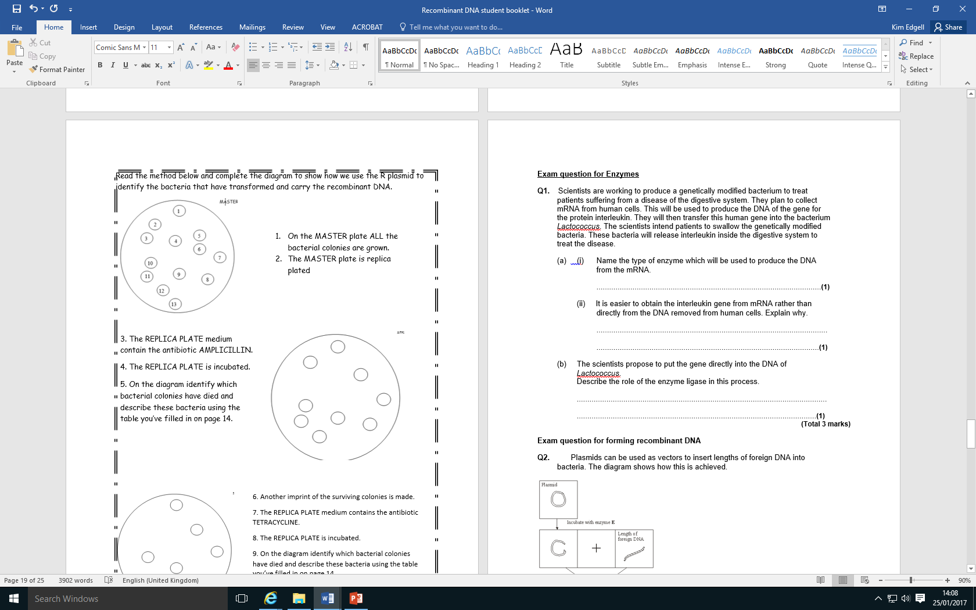
NOTE: The colonies must be transferred in exactly the same position
1st replica plate
1
Bacteria in colonies 3,4,6 and 13 died on AMP plate
Bacteria not resistant to antibiotic AMP/Bacteria doesn’t have AMP resistance gene
2
5
7
10
11
9
8
12

Slide 51
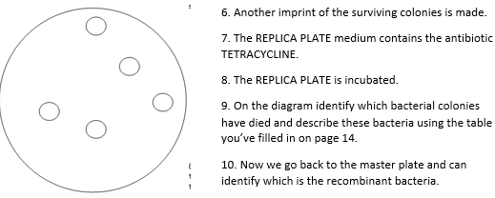
2nd replica plate
1
5
10
7
9
Bacteria in colonies 2,8,11 and 12 died on TET plate
Bacteria not resistant to antibiotic TET/ Bacteria doesn’t have functional TET resistance gene
Return to MASTER plate and use the identified colonies.
We have now identified the RECOMBINANT bacteria- colonies 2,8,11 and 12.
These were the colonies that survived the ampicillin plate but NOT the tetracycline plate.

Slide 52
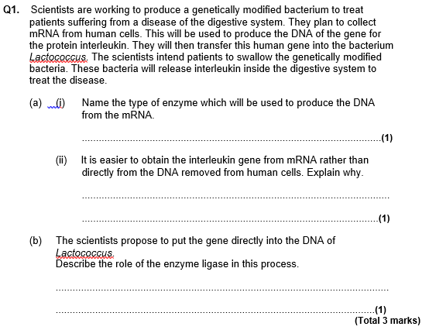
Reverse transcriptase
mRNA present in large amounts in cell making protein
mRNA has been edited/does not contains intron s
(ligase) splices/joins two piece of DNA/”Sticky ends”

Slide 53
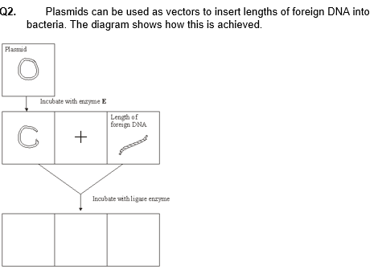
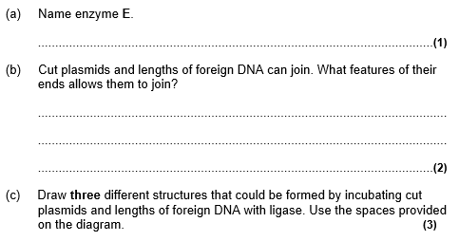
Restriction/endonuclease/named examples
Unpaired bases/sticky ends/staggered
Complementary/explained
Plasmid with foreign DNA joined in ring
Ring with plasmid only
Ring of DNA only,

Slide 54
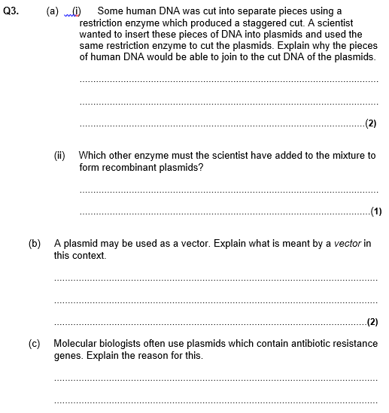
Sticky ends
Reference to complementary base pairing
Ligase
Carrier of DNA/gene
Into cell/other organism/host
Act as marker gene
Allows detection of cells containing plasmid/DNA

Slide 55
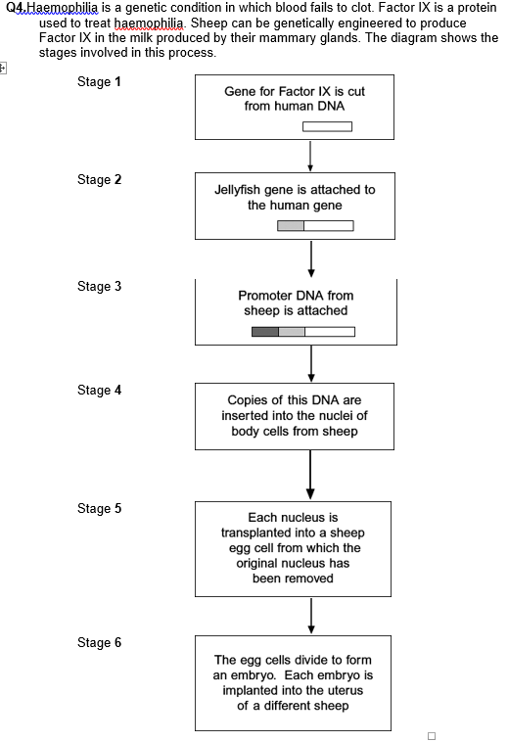
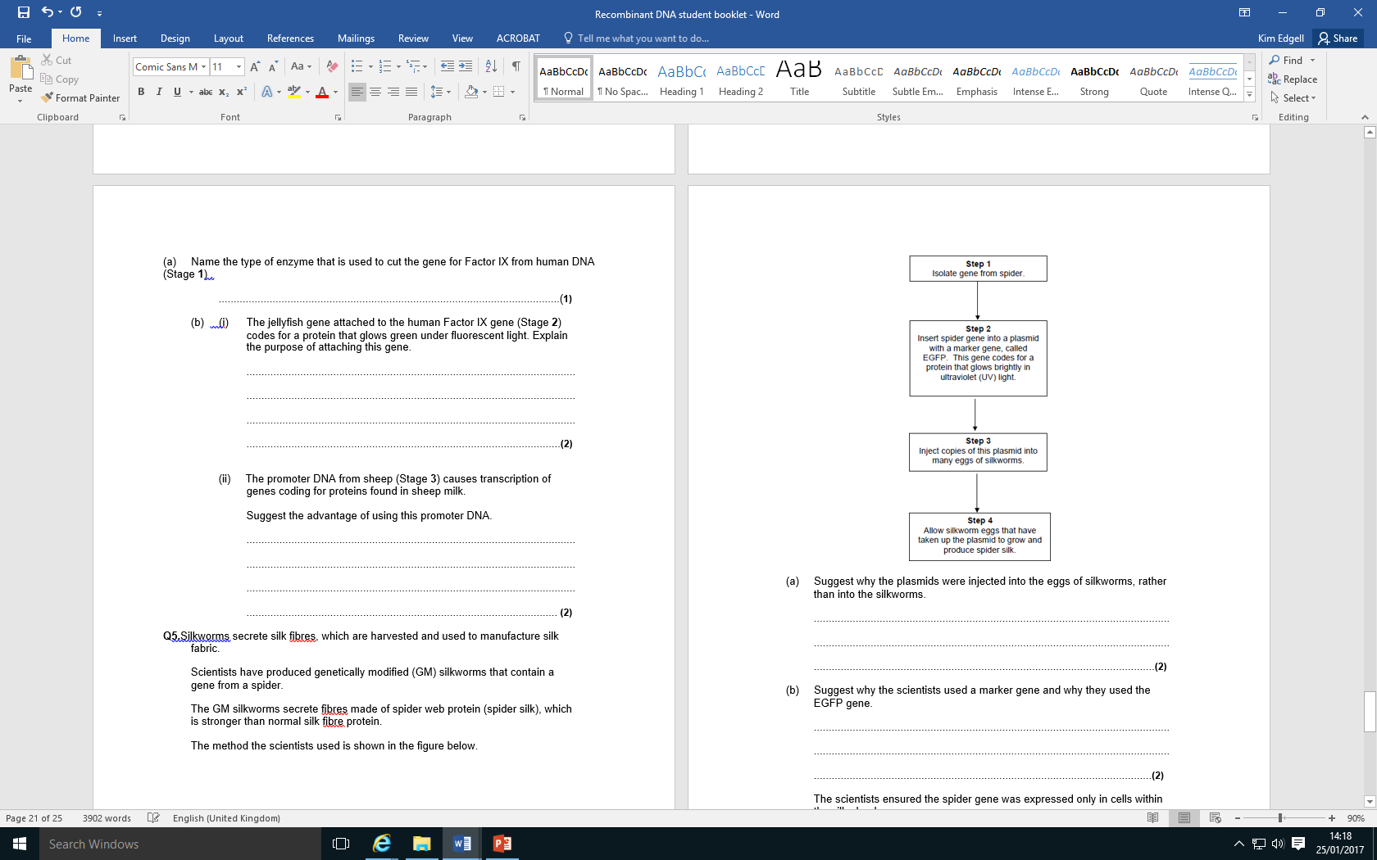
Restriction/endonuclease
Marker gene to show that the gene had been taken up/expressed
Implant cells/embryos that show florescence/contains the jellyfish gene

Slide 56
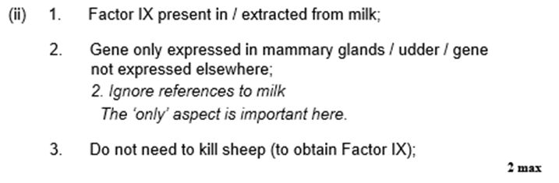

Slide 57
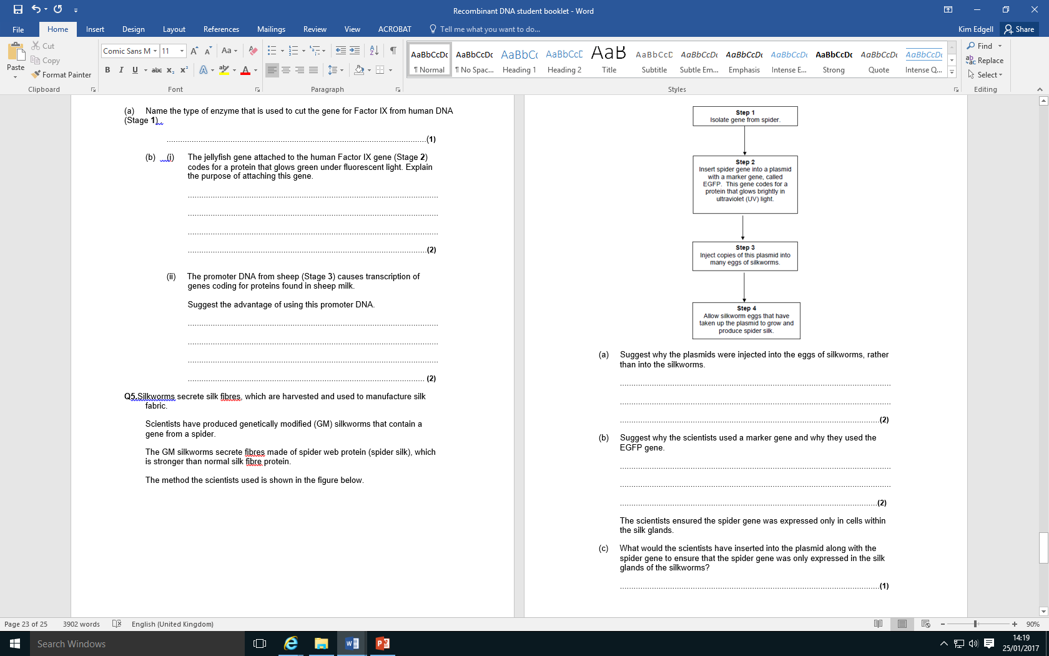
Gene gets into all/most of cells of silkworm
So gets into cells that make silk
Not all eggs will successfully take up the plasmid
Silkworms that have taken up gene will glow

Slide 58
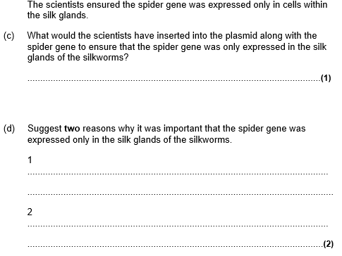
Promoter region
So that proteins can be harvested
Fibres in other cells might cause harm

Slide 59
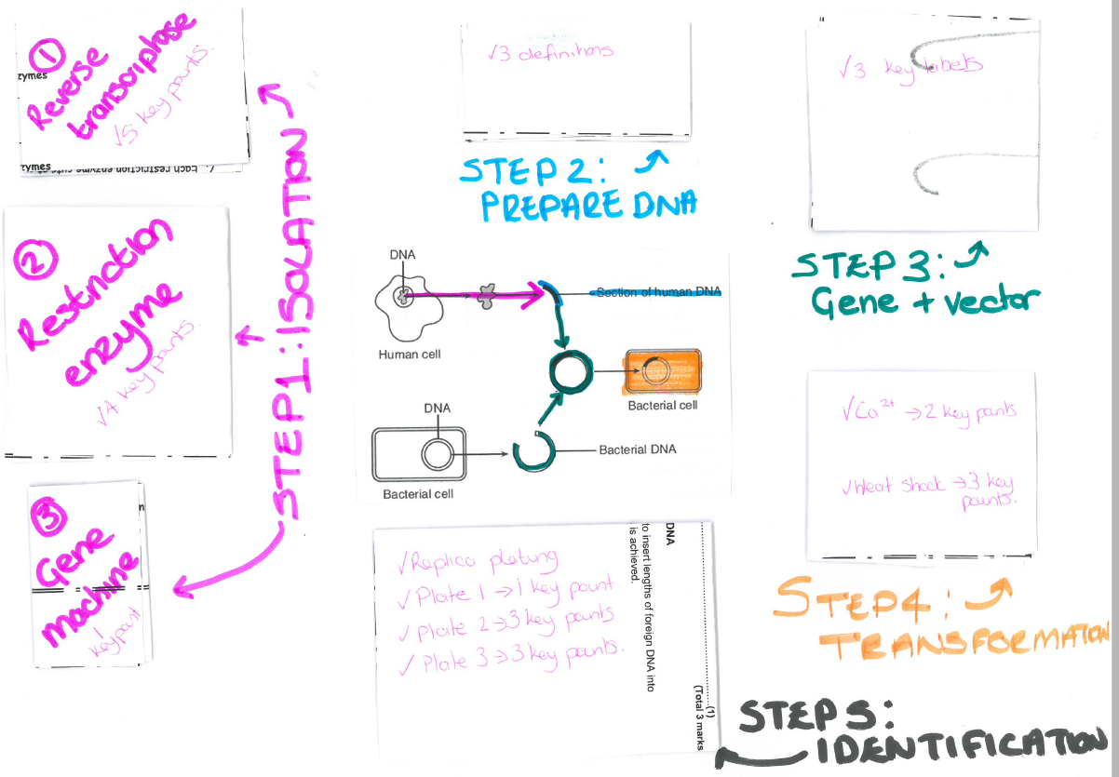
Complete the exam questions at the end of the booklet to test your knowledge.
You can also make each of the activity boxes into a GIANT revision poster like this…
Larger version on the G-drive if you want to see it in more detail.
Larger version on G drive if this is unclear
You will need to fold the boxes to fit them all on one page

