Slide 1
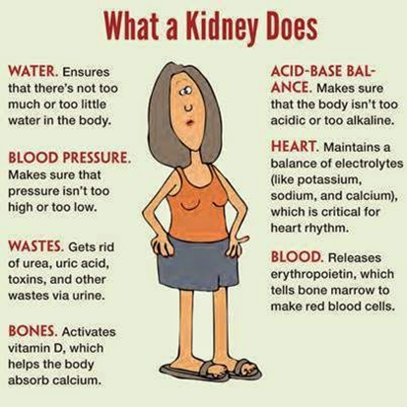
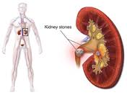
3.6.4: Control of blood water potential
Have you completed the GCSE bridging work? Connect
Have you completed the Year 1 and maths recap? Pg 2

Slide 2
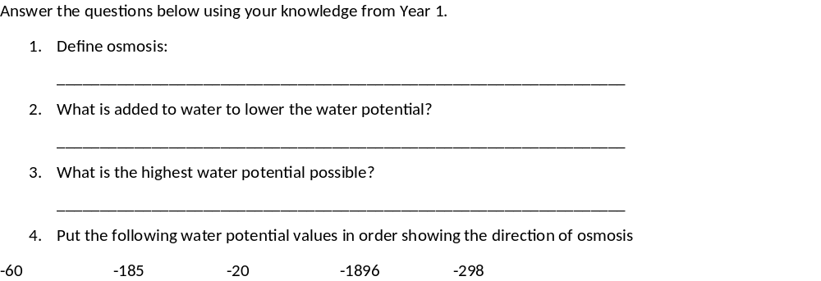
3.6.4: Control of blood water potential
Water molecules, high WP to low WP down WP gradient, passive.
Solute
0
-20 to -60 to -185 to -298 to -1896

Slide 3
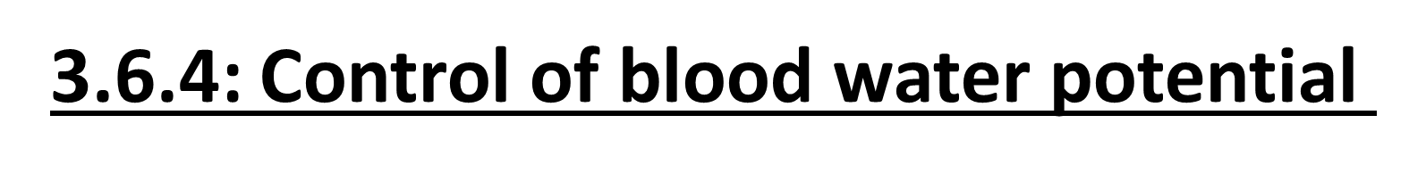
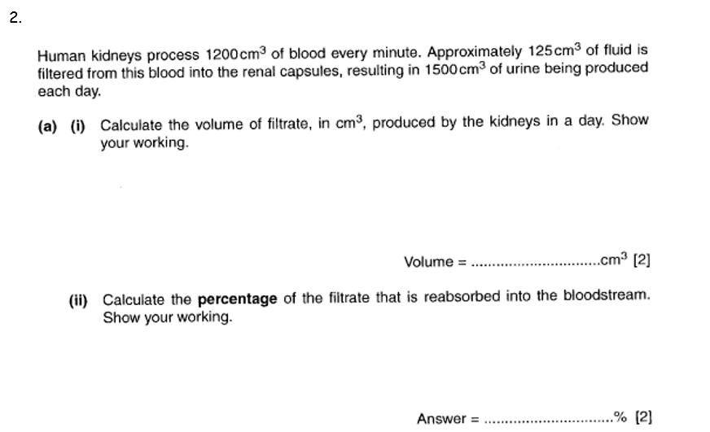
125 X 60 X 24= 180,000
180,000 – 1500
180,000 X100 = 99-99.2%

Slide 4
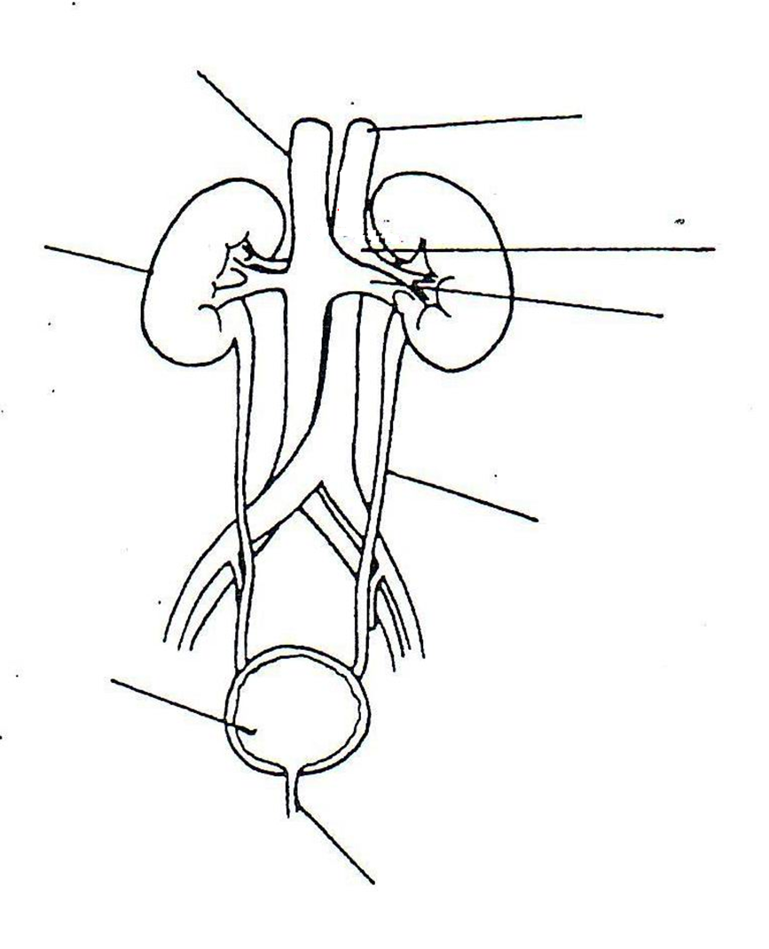
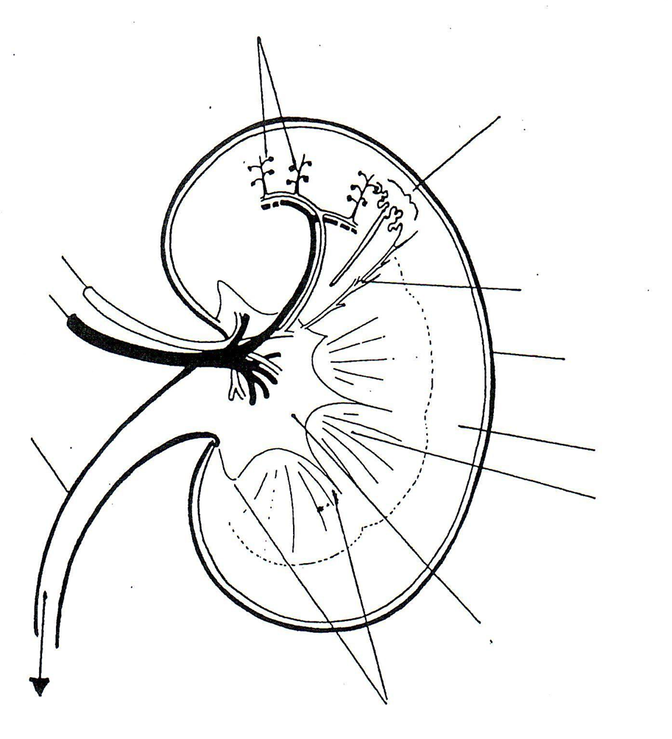
Can you use the labelled images on pages 394-395 of the T & T textbook to label the 2 images below.
Note: The images are not exactly the same so you need to work out the labels, just like the images you will get in your exam
You DO NOT need to learn these label, this is so you understand where we are and the structures we will discuss/describe/explain.

Slide 5
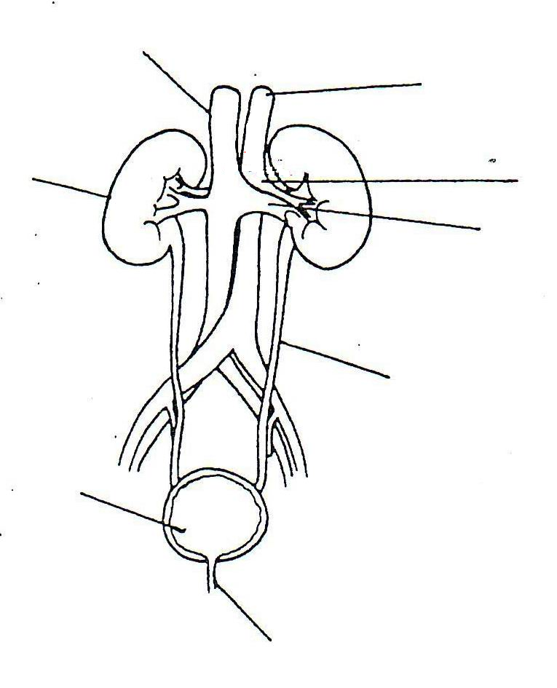
Vena Cava
Aorta
Renal Artery
Right Kidney
Renal Vein
Ureter
Bladder
Urethra

Slide 6
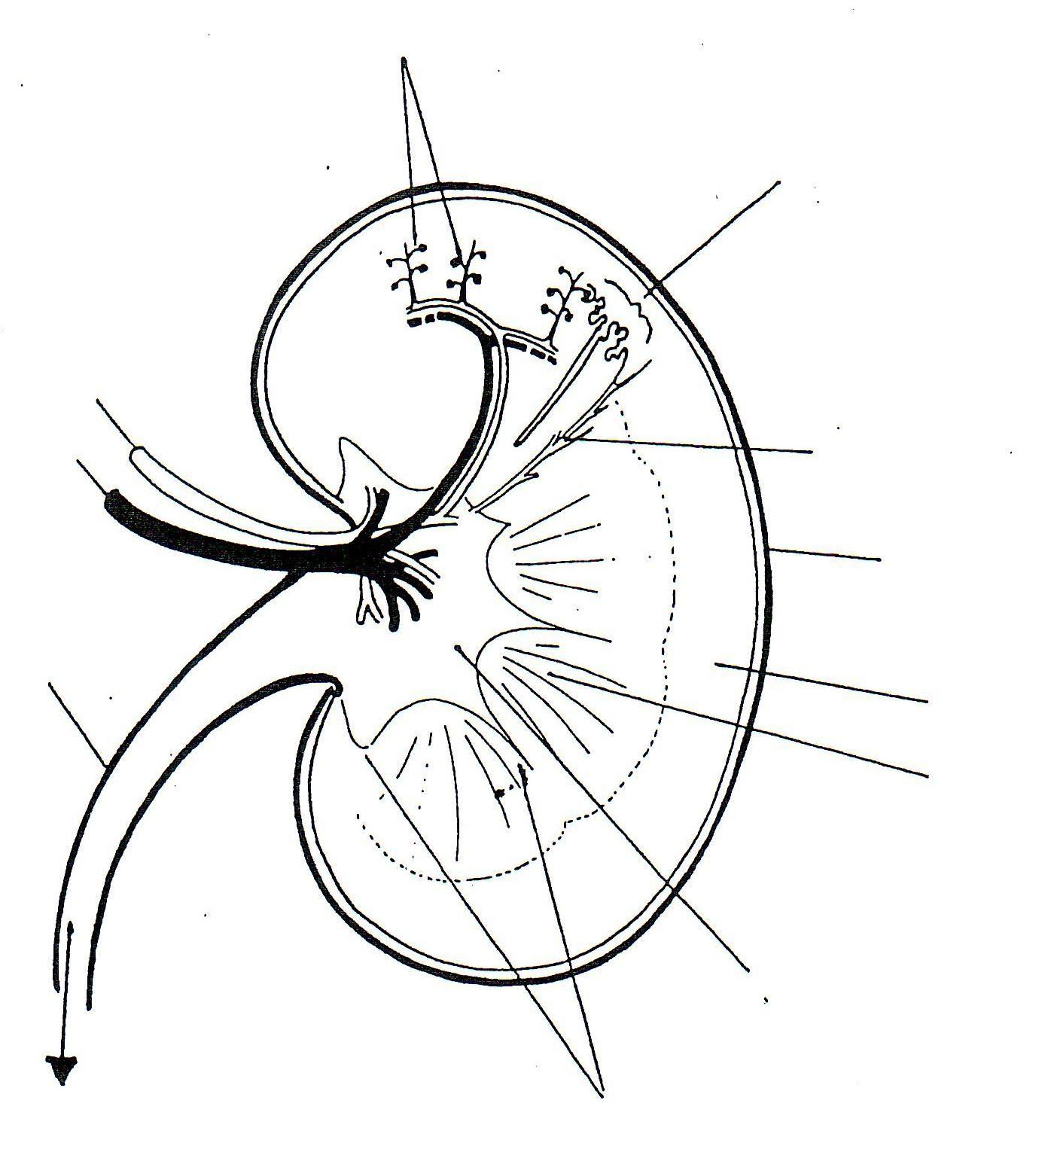
Capillaries
Nephron
Renal artery
Collecting duct
Renal vein
Capsule
Ureter
Cortex
Medulla
Pelvis
Pyramid

Slide 7
Description | Structure
Outer region of the kidney. Contains Bowmans capsule, convoluted tubules and blood vessels
Funnel shaped to collect urine into ureter
Supplies kidney with oxygenated blood
Outer membrane to protect the kidney
Leaves kidney containing deoxygenated blood
Darker inner region of the kidney (tastes salty). Contains loop of Henle, collecting duct and blood vessels.
Cortex
Pelvis
Renal Artery
Capsule
Renal vein
Medulla

Slide 8
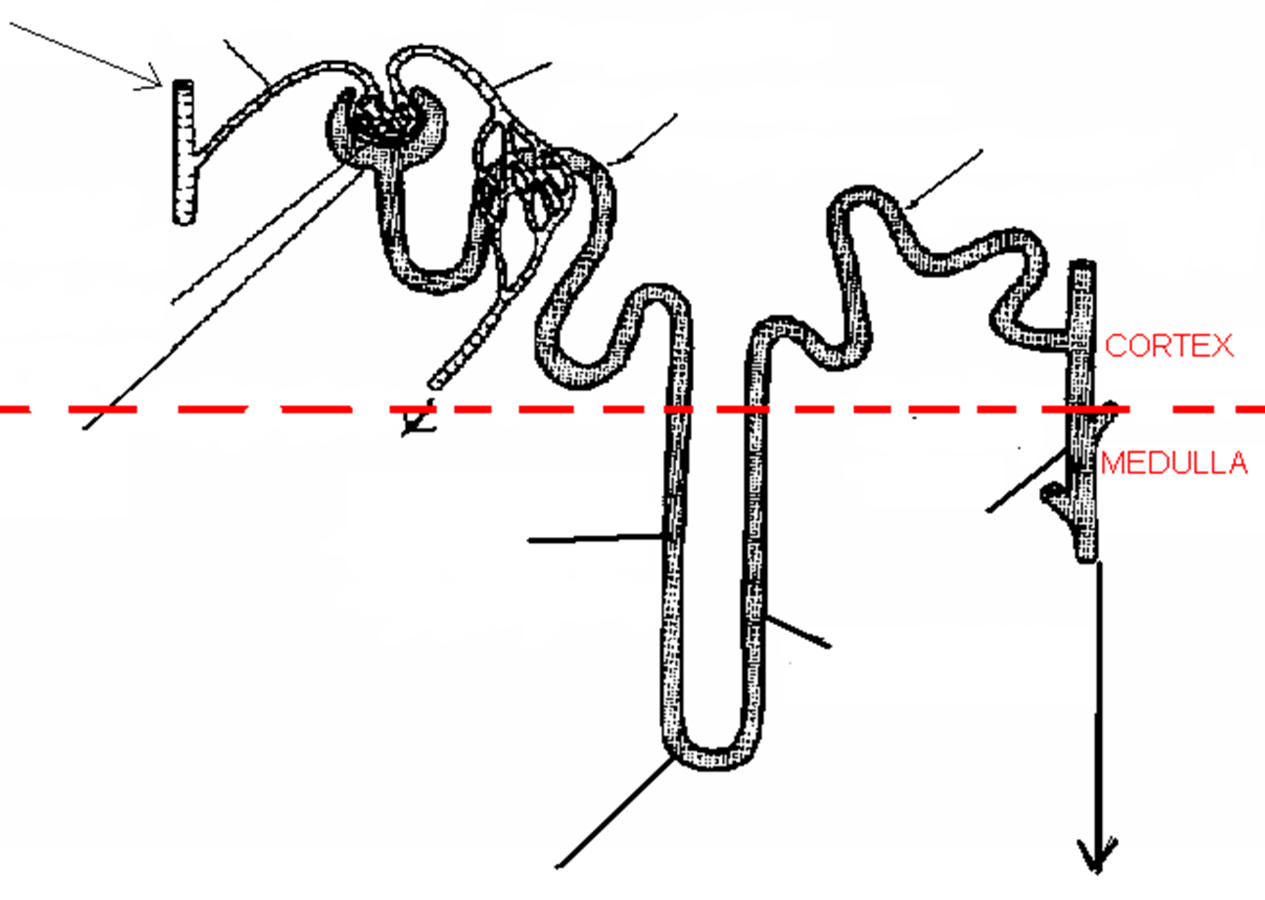
Use words on page 4 in your booklet and diagram on page 397 in toole and toole to add labels to the diagram.
Complete colouring activity on page 4 in your booklet to help identify the different areas and processes we will be looking at

Slide 9

Afferent arteriole
Efferent arteriole
Renal artery
Proximal convoluted tubule
Distal convoluted tubule
Glomerulus
Renal /Bowman’s capsule
Capillaries
Collecting duct
Descending loop
Ascending loop
Loop of Henle
To Pelvis

Slide 10
Afferent arteriole
Efferent arteriole
Renal artery
Proximal convoluted tubule
Distal convoluted tubule
Glomerulus
Renal /Bowman’s capsule
Capillaries
Collecting duct
Descending loop
Ascending loop
Loop of Henle
To Pelvis

Slide 11
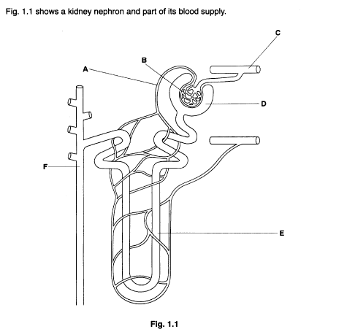
A= Efferent arteriole
B= Glomerulus
C= Renal artery
D= Renal/Bowman’s capsule
E= Descending limb/Loop of Henle
F= Collecting duct
On whiteboard, without notes.
Name structures A-F

Slide 12
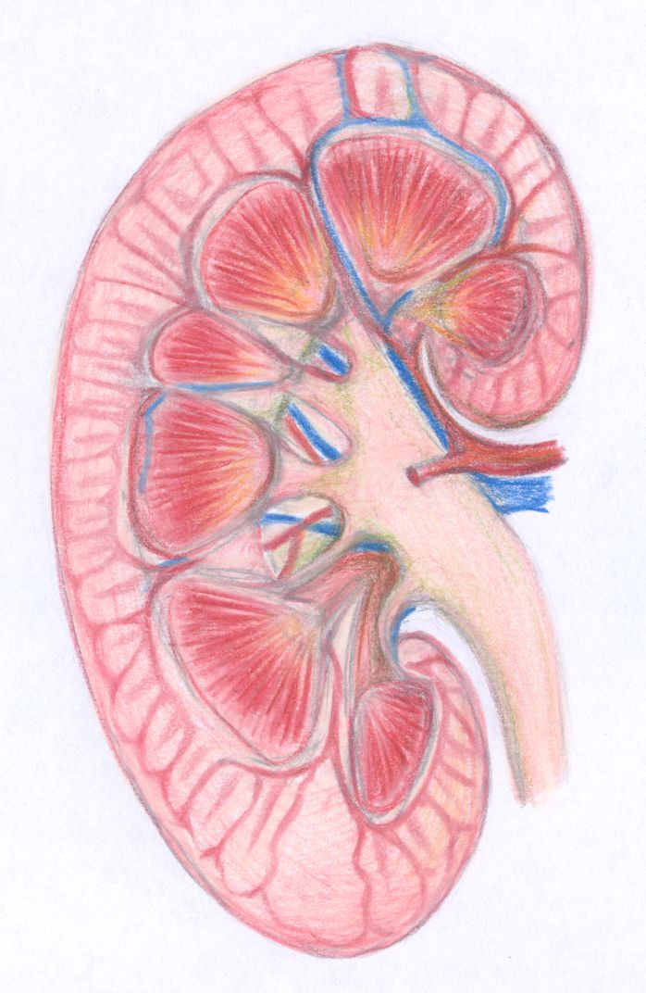
Role of the Kidneys
Regulate the composition of the blood
  Maintain water potential
  Remove urea
  Maintain mineral ion concentration

Slide 13
Kidneys make urine in a two stage process:
Ultrafiltration
Selective Reabsorption

Slide 14
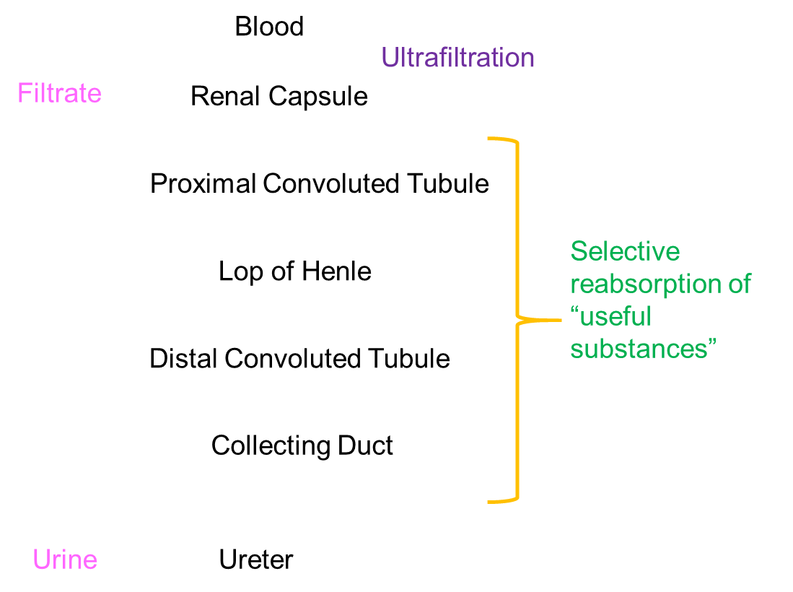
How does a kidney make urine?
On Whiteboard
Draw a flow diagram to show the different parts of the nephron starting with the renal capsule

Slide 15
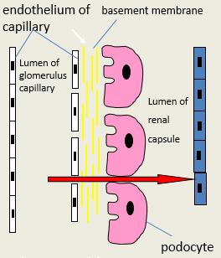
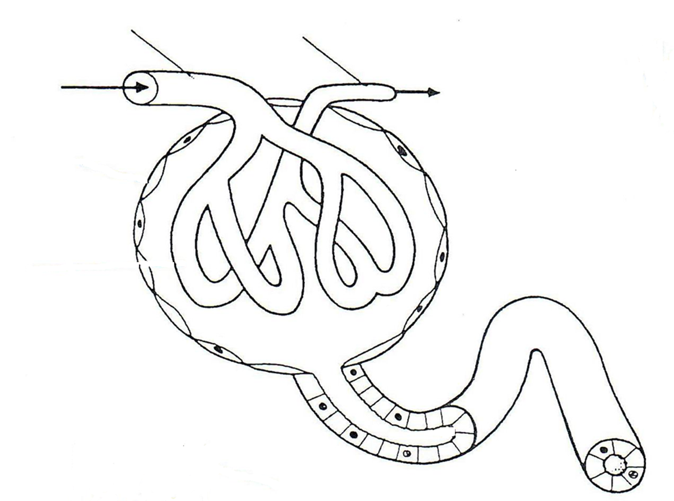
Outcome: Explain the process of ultrafiltration and where it occurs
https://www.youtube.com/watch?v=HK93luvVbYU
Afferent arteriole
Efferent arteriole
Renal Artery
Glomerulus
Renal/Bowman’s capsule
Filtrate to PCT

Slide 16

Outcome: Explain the process of ultrafiltration and where it occurs
https://www.youtube.com/watch?v=HK93luvVbYU
Mark scheme perfect answer.
Hydrostatic pressure:
Small molecules:
Capillary walls:
Basement membrane:
Proteins too large:
Podocytes:
Can you correct the mistakes on the example answer on page 5 in your booklets? The words may be wrong or there may be words missing.
Can you complete the maths activity from page 5-6? Normal hydrostatic pressure is 8kPa.
Higher hydrostatic pressure in glomerulus than in Bowman’s capsule
Forces small molecules and fluid out of glomerulus
Through gaps in the capillary walls into Bowman’s capsule
Basement membrane acts as a filter preventing
Large plasma proteins and RBC’s from leaving glomerulus
Podocytes are finger like projections to support the glomerulus.

Slide 17
Outcome: Explain the process of ultrafiltration and where it occurs
https://www.youtube.com/watch?v=HK93luvVbYU
Occurs in the Loop of Henle, the afferent arteriole has a wider lumen than the efferent arteriole increasing the /\ pressure in the blood plasma compared to the Bowman’s capsule. This forces all molecules out of the blood into the glomerulus through gaps in the walls of the capillary, the fluid is now known as glomerular filtrate. Molecules like amino-acids and glucose are too large to fit through the basement membrane so stay in the glomerulus decrease the water concentration of the blood. Podocytes are finger-like projections that support the structure of the proximal convoluted tubules.
GLOMERULUS
HYDROSTATIC
SMALL
BOWMANS
PLASMA PROTEINS & RBC’S
POTENTIAL
GLOMERULUS

Slide 18
Maths activity: The hydrostatic pressure of the blood is 8kPa, the filtrate has a hydrostatic pressure of 2.7kPA. From the information work out the difference in hydrostatic pressure in the capillary and the glomerular filtrate.
Show your working with units ______________________________________________________________________
Mary suffers with hypertension and has a 20% increase in hydrostatic pressure in the capillaries. A person suffering from hypertension with a hydrostatic pressure up to 9.5kPa will not have permanent damage to their glomerulus but if the kPa goes above 9.5kPa then the person is at risk of permanent damage. Is Mary at risk of permanent damage?
Show your working __________________________________________________________________________
Blood = 8kPa, Filtrate = 2.7kPa
8-2.7= 5.3kPa
Normal hydrostatic pressure = 8kPa
20% of 8 = 1.6kPa
8 +1.6= 9.6kPa
Higher than 9.5kPA so yes at risk of permeant damage,

Slide 19
Quick questions on whiteboards
Why is there a high blood (hydrostatic) pressure in the glomerulus?
2. Why can’t plasma proteins leave the blood in the glomerulus?
3. What effect will these proteins have on the water potential in the glomerulus?
The diameter of the afferent arteriole is wider than the efferent arteriole.
Plasma proteins are too large to leave the blood (more than 69,000 RMM).
Lower (more negative) the water potential in the glomerulus.

Slide 20
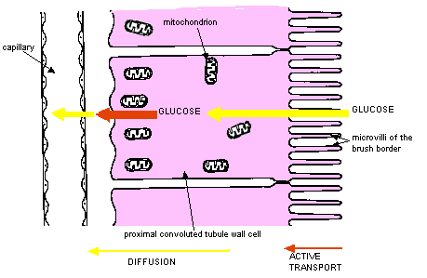
Outcome: Explain the process of selective reabsorption, where it occurs along a nephron and the transport process involved
Exam Question- Year 1
(a) Cells lining the ileum of mammals absorb the monosaccharide glucose by co-transport with sodium ions. Explain how.
___________________________________________________________________
___________________________________________________________________
___________________________________________________________________
___________________________________________________________________
___________________________________________________________________
___________________________________________________________________
___________________________________________________________________ (3)
(a) 1. Sodium ions actively transported from ileum cell to blood;
2. Maintains / forms diffusion gradient for sodium to enter cells from gut (and with it, glucose);
3. Glucose enters by facilitated diffusion with sodium ions;
3

Slide 21

Outcome: Explain the process of selective reabsorption, where it occurs along a nephron and the transport process involved
How are the cells of the proximal convoluted tubule specialised? (complete the information on pg 6)
MANY Mitochondria for…….
MANY carrier/co-transport proteins for….
MANY channel proteins for….
MANY microvilli (known as the “brush border”)
Active transport providing ATP
Active transport
Facilitated diffusion
To increase surface area for absorption

Slide 22
Na+ actively transported from inside the PCT cells to the blood. Lowering the Na+ concentration …..
Inside the PCT cell. Na+ diffuse down a
Concentration gradient from the lumen of the PCT to inside the….
PCT cells through a co-transporter. The co-transporter also carries ALL the glucose or ALL…
The amino-acids. The glucose and the amino-acids will then diffuse from the PCT cells into the…
Blood. This is selective reabsorption.
Can you work out the maths activity on page 7?

Slide 23
Note: about 180dm³ of water enters the nephron each day, 1dm³ leaves the body as urine. 85% of the reabsorption of water occurs in the PCT through selective reabsorption.
Maths activity:
Work out the volume of water that is actually reabsorbed in the PCT from the information above, show your answer as cm³.
The remaining water is reabsorbed in the collecting duct, work out the volume of water that is reabsorbed in the collecting duct in dm³.
Work out the % of water that is reabsorbed in the collecting duct.
153dm³ of water x 1000 = 153,000cm3
180-1-153 = 26dm³
26/180 x 100 = 14%

Slide 24
Exam question practice
Have you done the Kahoot?
https://play.kahoot.it/#/k/27ad7b74-1f04-44cc-9b90-3b7aa44dc623

Slide 25
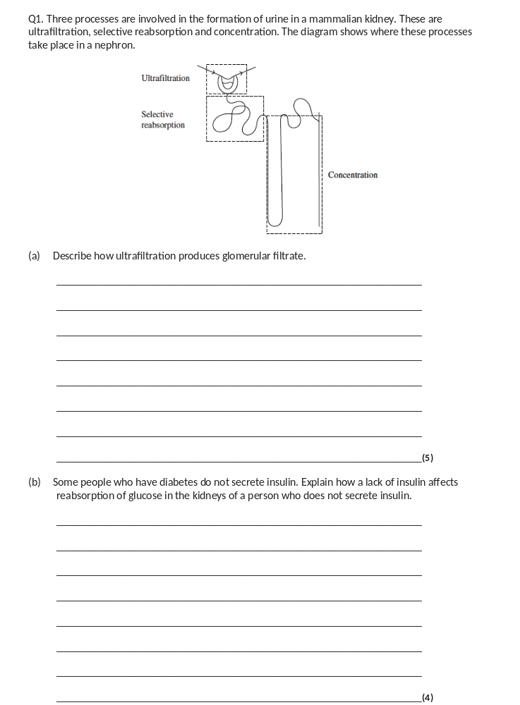
(a) 1. Blood pressure / hydrostatic pressure;
2. Small molecules / named example;
3. Pass through basement membrane / basement membrane acts as filter;
4. Protein too large to go through / large so stays behind;
5. Presence of pores in capillaries / presence of podocytes;
5
(b) 1. High concentration of glucose in blood;
2. High concentration in tubule / in filtrate;
3. Reabsorbed by facilitated diffusion / active transport;
4. Requires proteins / carriers;
5. These are working at maximum rate / are saturated;
6. Not all glucose is reabsorbed / some is lost in urine;
4 max

Slide 26
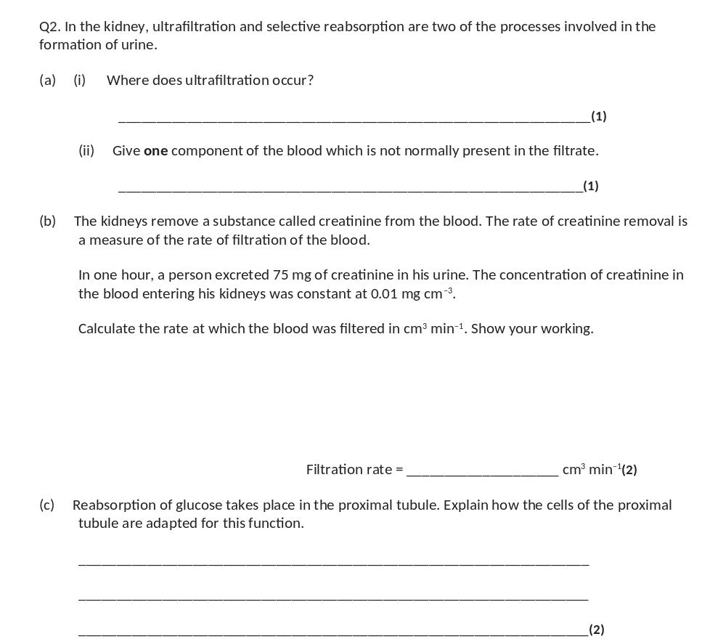
(a) (i) Renal capsule / Bowman’s capsule / glomerulus / basement membrane;
1
(ii) blood cells / platelets / proteins / named plasma protein;
1
(b) 75 divided by 60 / 75 divided by 0.01;
1
Answer 125;
(Correct answer gains two marks)
1
(c) (Many) mitochondria provide ATP / energy for active transport;
(Many) carrier proteins for active transport / channel proteins for facilitated diffusion;
Microvilli / brush border provide large surface area (for absorption);
2 max

Slide 27
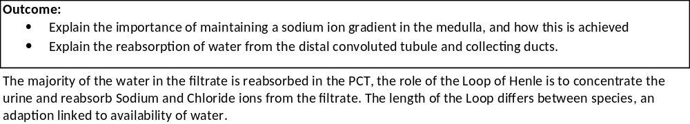
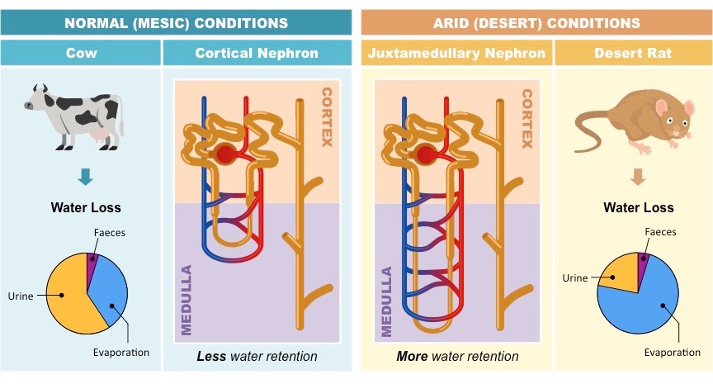

Slide 28
The Loop of Henle
1. In the ascending limb Na+ actively removed into Medulla lowering WP;
2. Ascending limb impermeable to water;
3. In descending limb Na+ diffuse in;
4. Descending limb water moves out by osmosis down WP gradient into tissue fluid then into blood;
5. Low water potential in the medulla maintained;
6. The longer the loop / the deeper into medulla, the lower the water potential in medulla;
7. Water also leaves collecting duct / DCT by osmosis;
This ensures there is always a lower water potential in the tissue fluid of the medulla than in the filtrate for the whole length of the loop of Henle and collecting duct. This means that water is always reabsorbed into the tissue fluid. Once in the tissue fluid it will be reabsorbed back into the blood.
In your booklet draw out how the Loop of Henle works using the mark scheme above. To convert the mark scheme into a diagram requires more concentration so will help improve your memory.

Slide 29
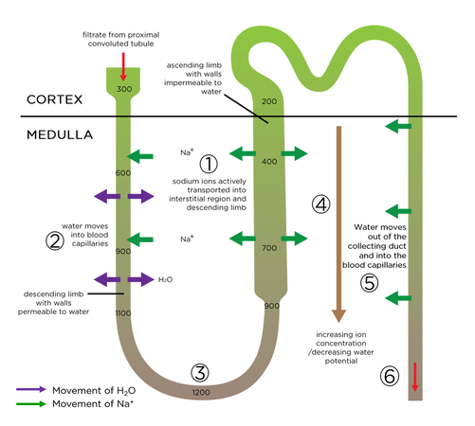

Slide 30
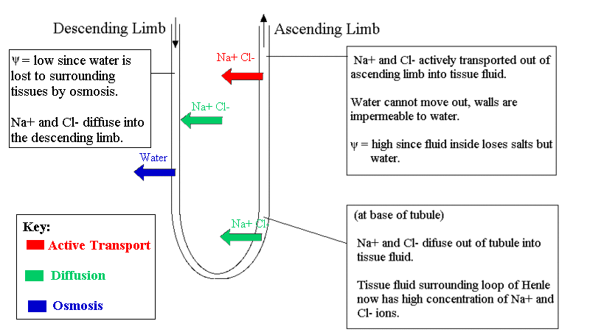

Slide 31
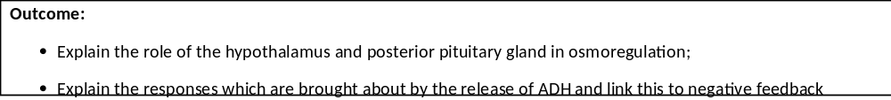
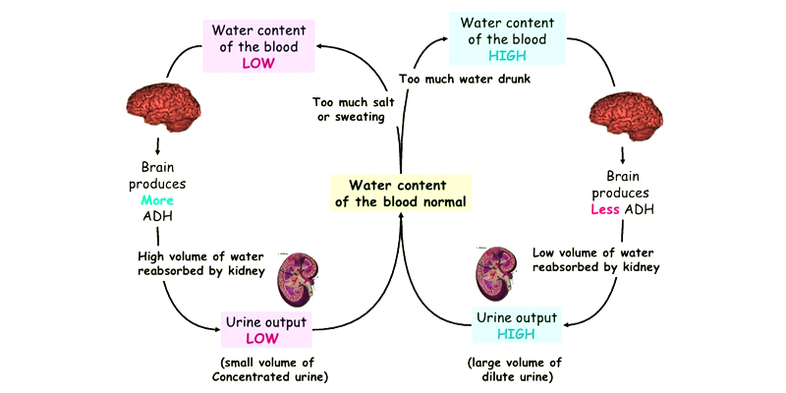
Osmoregulation is an example of a negative feedback loop, this also involves both the hormonal and nervous system.
Complete the Year 2 nervous system recap exam question.

Slide 32
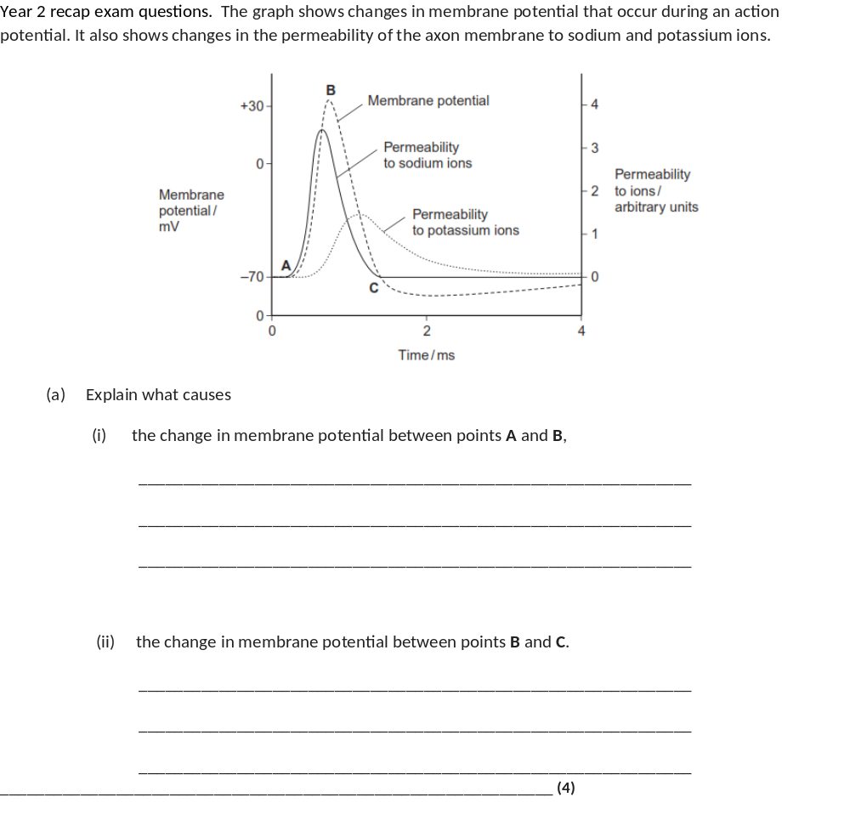
(a) (i) A to B:
Mark (i) and (ii) as a whole
Sodium channels open / membrane more permeable to
sodium (ions);
Max 3 for each section
Sodium ions enter;
By diffusion / from high to low concentration;
Allow ‘diffusion’ point ONCE only
Ref. sodium ions have positive charge / cause change
from negative to positive potential;
Accept refs to sodium and potassium
(ii) After B:
Sodium channels close;
Potassium channels open / membrane more permeable to
potassium ions;
Potassium ions leave;
By diffusion / from high to low concentration (ONCE only);
4 max

Slide 33
Dehydration means the water potential of your blood is too low so more water is reabsorbed into the blood so the urine is more concentrated
When there is a lot of water in the blood, less is reabsorbed and your urine is more dilute
HOW IS THIS CONTROLLED?
Osmoreceptors in the hypothalamus of the brain detect low water potential of blood
This stimulates neurosecretory cells in the hypothalamus to release a hormone called ADH (antidiuretic hormone)
ADH moves to the posterior pituitary gland and is released into the blood

Slide 34
If blood plasma WP is low… | If blood plasma WP is high…
Osmoreceptor in the hypothalamus detect a decrease in WP
The WP in the osmoreceptor is higher than the WP of the blood
Water leaves the osmoreceptor by osmosis down a WP gradient
Osmoreceptor shrinks deforming the membrane of the sensory neurone.
Increasing frequency of action potentials to the pituitary gland causing the release of ADH into the blood capillaries
Osmoreceptor in hypothalamus detects an increase in WP
The WP in osmoreceptor is lower than WP of blood
Water enters osmoreceptor by osmosis down a WP gradient
Osmoreceptor expands, membrane not deformed
Decrease frequency of action potentials to the pituitary gland stopping release of ADH into blood

Slide 35
Capillary wall
Plasma protein
Blood plasma
Red blood cell
Osmoreceptor
WP optimum for blood plasma
Dendrite
Posterior pituitary gland
Myelin Sheath
Node of Ranvier

Slide 36
Dehydrated. WP of blood is lower than the WP of osmoreceptor
Capillary wall
Plasma protein
Blood plasma
Red blood cell
Osmoreceptor
WP optimum for blood plasma
Dendrite
Myelin Sheath
Node of Ranvier

Slide 37
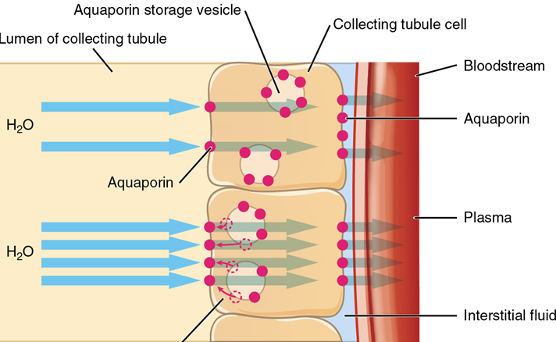
ADH in blood
Binds to complementary receptors on the surface of collect duct cells
Causes vesicles with aquaporins to move and fuse to collect duct membrane
Increases permeability of collecting duct cells to water
More water moves by osmosis down a WP gradient from collecting duct, into cells then into the blood
More concentrated urine/smaller volume of urine.

Slide 38
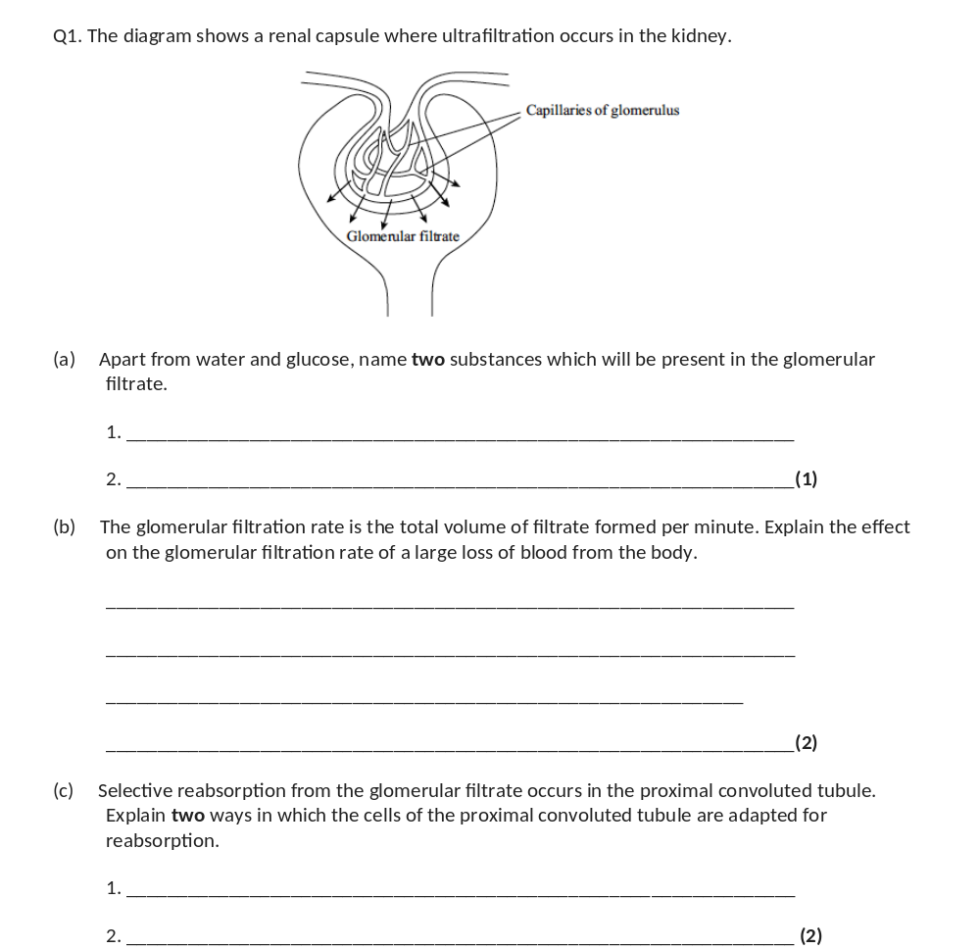
(a) e.g. urea / amino acids / fatty acids / glycerol / ion / small protein;
(one mark for two of above)
1
(b) blood pressure decreased;
(less pressure) forms less filtrate;
2
(c) microvilli provide large surface area;
carrier proteins (in membrane) for active transport;
channel proteins for facilitated diffusion;
specific carriers for specific molecules / sodium pumps;
(many) mitochondria for active transport;
2 max

Slide 39
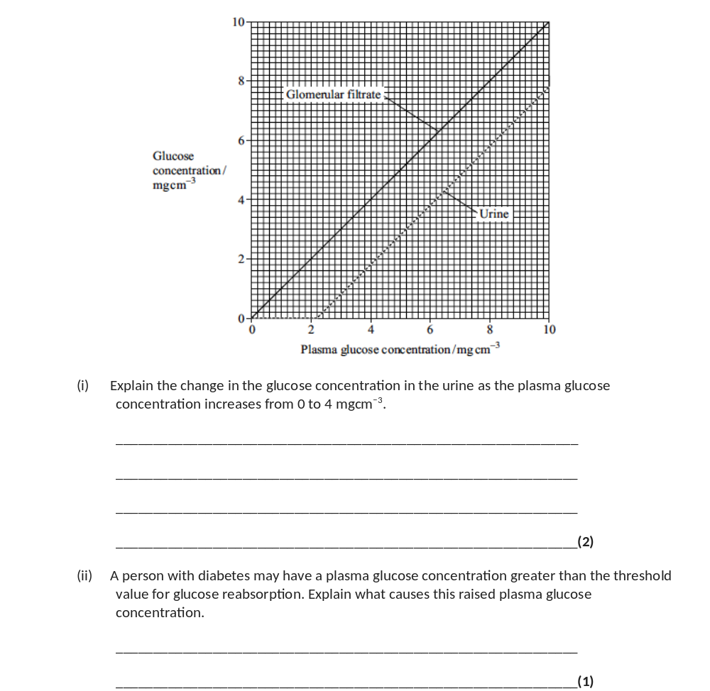
(d) (i) up to 2.2 mg cm⁻³ all glucose reabsorbed / above 2.2 mg cm⁻³ excess glucose not reabsorbed / at 2.2 mg cm⁻³ threshold value reached;
saturation of carriers / active transport mechanism;
2
(ii) decrease in insulin production / receptors not responsive to insulin / specific damage to tubule described / membrane less permeable to glucose;
1

Slide 40
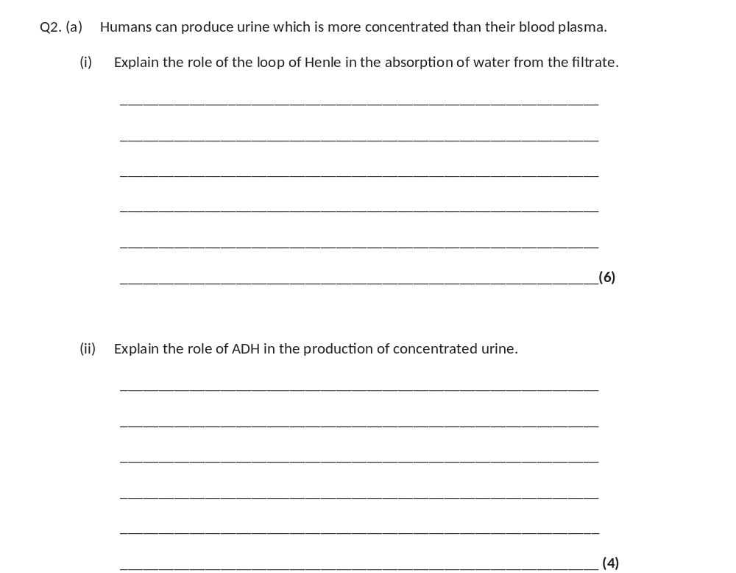
(a) (i) 1. In the ascending limb sodium(ions) actively removed;
2. Ascending limb impermeable to water;
3. In descending limb sodium(ions) diffuse in;
4. Descending limb water moves out / permeable to water;
5. Low water potential / high concentration of ions in the medulla / tissue fluid;
6. The longer the loop / the deeper into medulla, the lower the water potential in medulla / tissue fluid;
7. Water leaves collecting duct / DCT;
8. By osmosis / down water potential gradient;
(credit once only)
6 max
(ii) 1. When water potential of the blood too low;
2. Detected by receptors in the hypothalamus;
3. Pituitary secretes / releases (more) ADH;
4. ADH increases the permeability / recruitment of aquaporins / opens channels for water in the DCT / collecting duct;
5. More water is reabsorbed / leaves the nephron moves into the blood;
6. By osmosis down the water potential gradient;
4 max

Slide 41
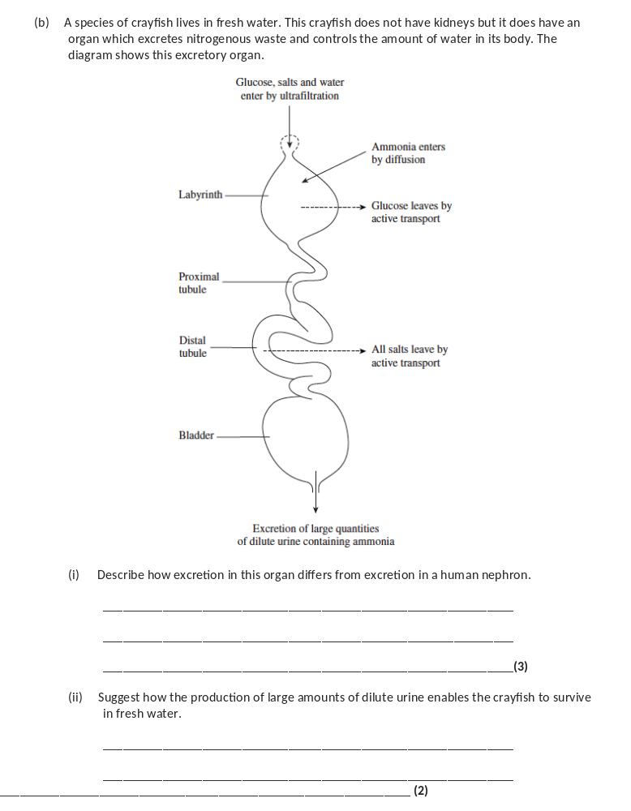
(b) (i) Ammonia not urea;
Ammonia (into labyrinth) enters by diffusion, not (ultra) filtration;
Reabsorption of glucose from labyrinth, not PCT / no reabsorption in PCT;
All salt reabsorbed / no salt in urine, comparison to humans;
Concentrated urine not produced;
3 max
(ii) Water potential lower in cytoplasm of cells / fresh water higher water potential than cells / idea of water potential gradient;
(Removal of excess water) prevents osmotic damage;
OR
All salts reabsorbed (because difficult to replace);
Take in excess water and need to remove it;
2

Slide 42
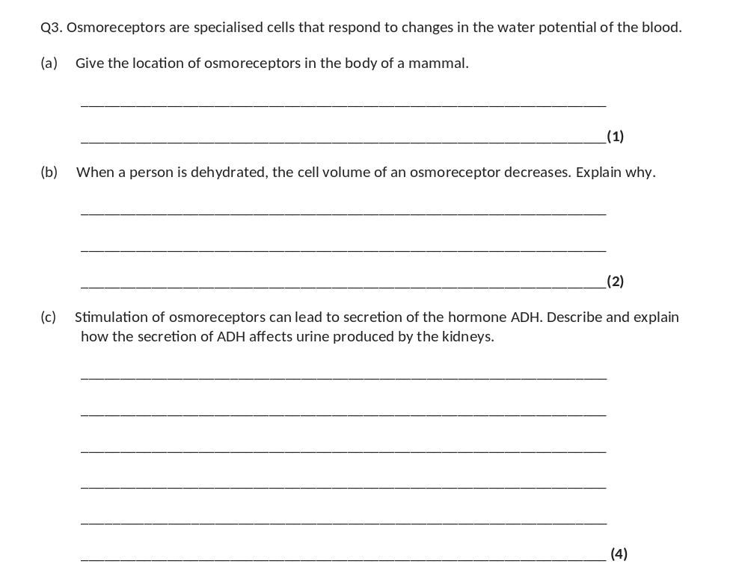
(a) Hypothalamus.
1
(b) 1. Water potential of blood will decrease;
2. Water moves from osmoreceptor into blood by osmosis.
2
(c) 1. Permeability of membrane / cells (to water) is increased;
2. More water absorbed from / leaves distal tubule / collecting duct;
3. Smaller volume of urine;
4. Urine becomes more concentrated.
4

Slide 43
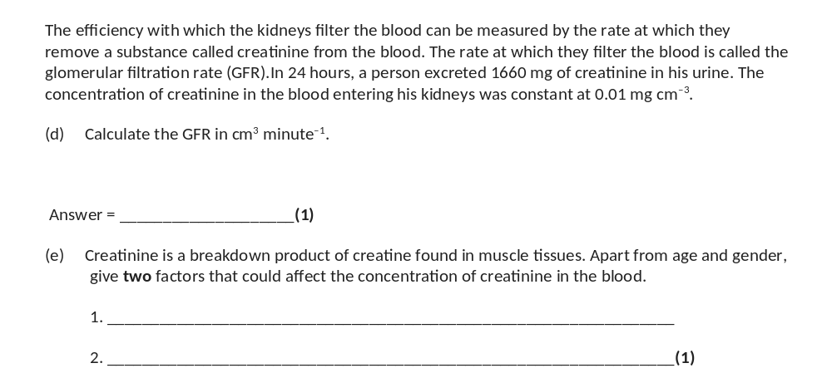
(d) 115.2 / 115.3 (cm³ minute^{–1}).
1
(e) Any two of the following for 1 mark:
Muscle / body mass
Ethnicity
Exercise
Kidney disease – do not accept ‘health’.
1

