Slide 1
Diabetes Mellitus

Slide 2
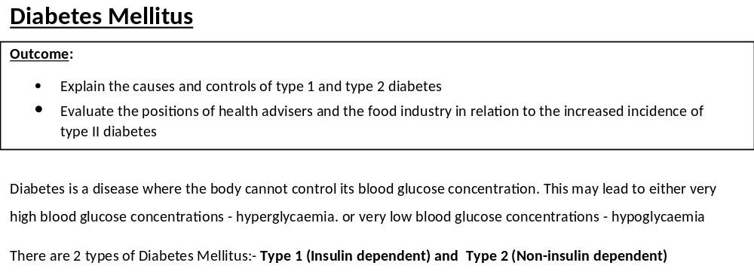
On your own can you think of 2 causes of Diabetes?
In pairs, discuss your ideas. How many causes did you come up with?

Slide 3
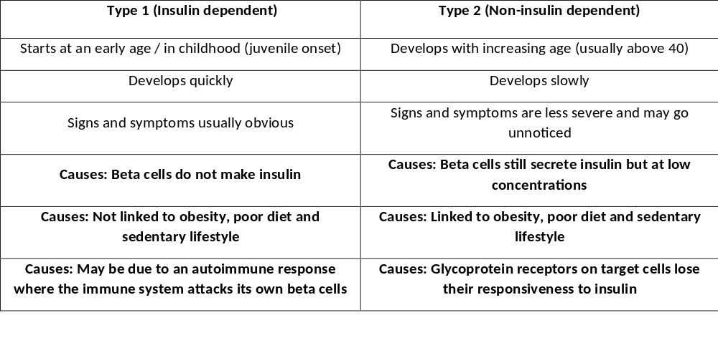

Slide 4
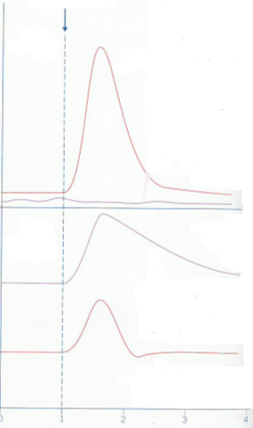
Majority of diabetes exam questions are experimental/data related.
Practice with this graph first then try to apply the same skills to the exam questions at the end of this booklet.
Add labels to the graph in your booklet on page 19, the complete your answers in the boxes on page 20.
Label which lines represent diabetic people and which lines represent non-diabetic people.
Glucose added
Insulin concentration in blood
Blood glucose concentration
Exam tip: If you struggle with a graph write 1 sentence out which includes both axis to understand what the graph is showing
Time (hrs)

Slide 5
Glucose added
Describe and explain the shape of the curve on the graph.
Describe means saying what you see
Explain means giving the biology behind WHY this has happened on the graph
Non diabetic
Insulin concentration in blood
Type 1 diabetic
Type 1 diabetic
Blood glucose concentration
Exam tip: If you have 2 command words in the question then split your answer into a table to help see if you have answered both parts.
Non diabetic

Slide 6
Non diabetics
Beta cells release insulin in response to high blood glucose conc
This stimulates glycogenesis
Increased respiration of glucose
Increased number and increased number of open glucose transporters in target cell membranes

Slide 7
Glucose added
No diabetes
Insulin concentration in blood
Type 1 Diabetes
Beta cells don’t produce insulin so no response to glucose
Type 1 diabetes

Slide 8
Glucose added
Non diabetics
Insulin produced by beta cells in response to increased glucose concentration in blood which rapidly returns blood glucose concentrations to normal by negative feedback mechanisms
Type 1 diabetes
Glucose concentration in blood
No diabetes

Slide 9
Glucose added
Type 1 diabetes
No insulin produced by beta cells so takes a long time for blood glucose concentration to drop after glucose taken up in diet
This drop is eventually caused by respiration of glucose
Type 1 diabetes
Glucose concentration in blood
No diabetes

Slide 10
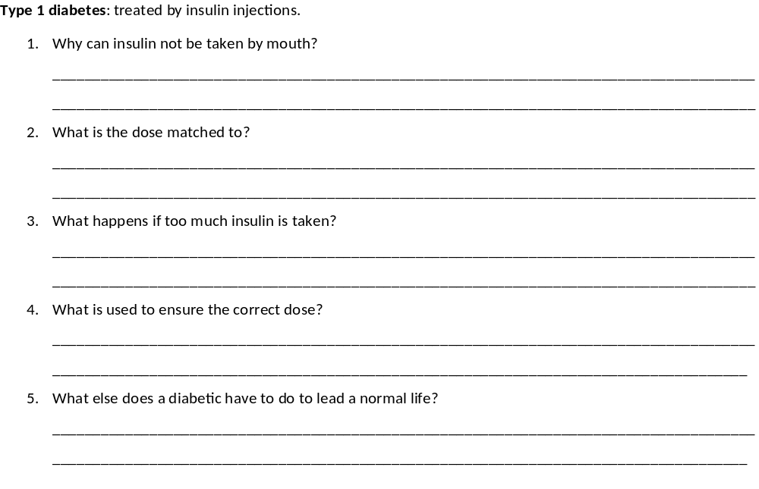
Insulin is a protein and would be digested
Carbohydrate intake and exercise
Low blood glucose conc/hypoglycaemia/unconscious/coma
Biosensors
Inject insulin/manage carbohydrate intake/exercise carefully

Slide 11
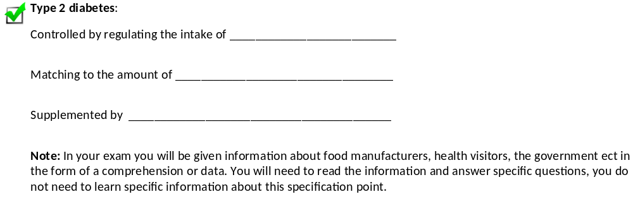
carbohydrate
exercise taken
injections of insulin

Slide 12
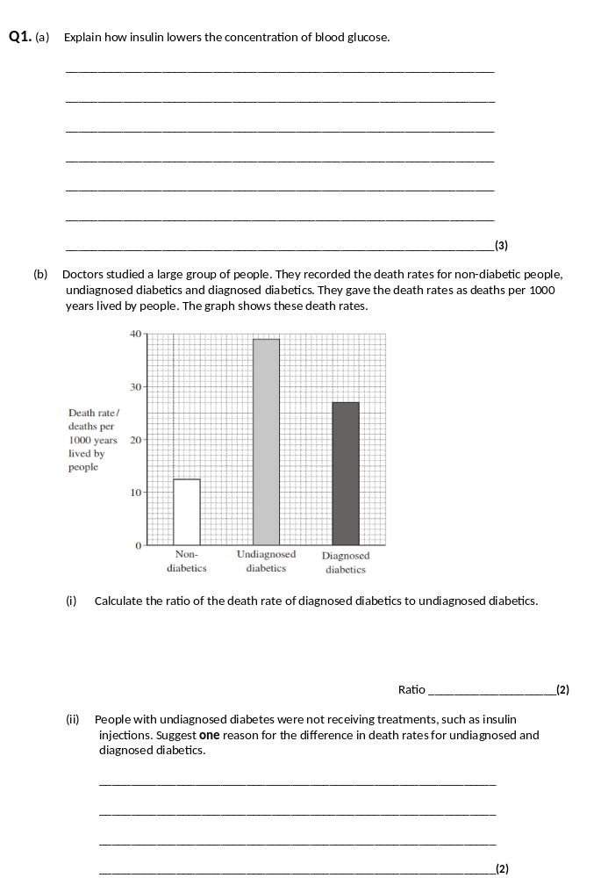
Binds to receptor on target/liver/muscle cell;
Reject reference to insulin as an enzyme
Causes more transport/carrier proteins to become active/
move to (plasma) membrane;
Glucose (diffuses) into cells (and lowers blood glucose);
(Enzymes in cells) convert glucose to glycogen;
Stimulates fatty acids/lipid/fat formation (from glucose);
Raises rate of respiration (in cells), using more glucose;
3 max
(b) (i) 27 : 39;
1 : 1.44;
2 marks for 1 : 1.44
Accept 0.69 : 1
Accept 9 : 13
2
(ii) One suitable reason; with explanation;
e.g. undiagnosed
Diabetic coma/brain cells not enough respiration;
Due to low blood glucose/acidosis/dehydration;
Heart attacks/coronary heart disease;
Due to faster atheroma formation/damage to arteries;
Kidney failure;
Due to damage to blood vessels;
2 max

Slide 13
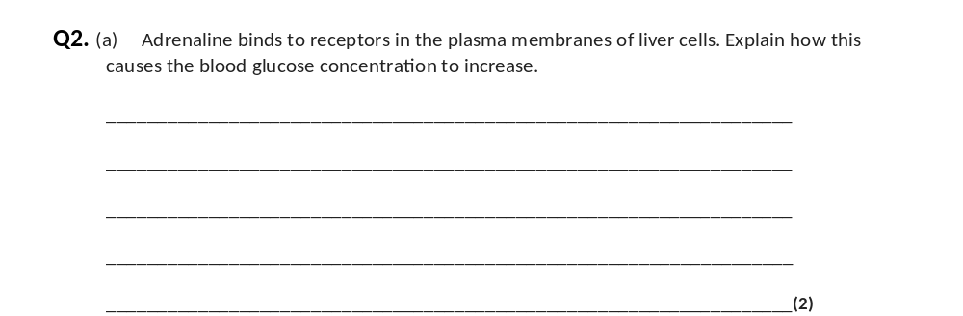
(a) 1. Adenylate cyclase activated / cAMP produced / second messenger produced;
2. Activates enzyme(s) (in cell so) glycogenolysis / gluconeogenesis occurs / glycogenesis inhibited;
2. Neutral: ‘glucose produced’ as given in the question stem
Accept: correct descriptions of these terms
2

Slide 14
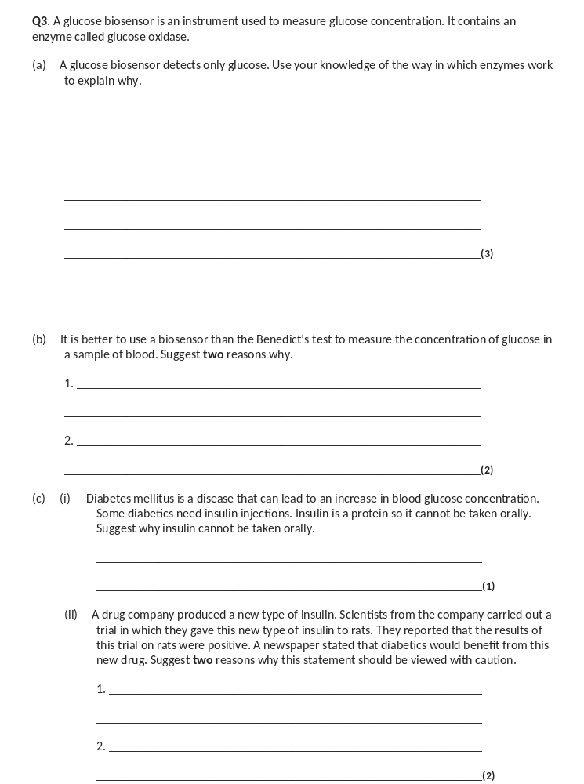
(a) Enzyme / active site has a (specific) tertiary structure;
Only glucose has correct shape / is complementary / will bind / fit to active site;
(Forming) enzyme-substrate complex;
Q Allow second mark if candidate refers to correct shape or complementary in terms of the enzyme. Do not allow ‘same’ shape
Q Do not allow third mark if active site is described as being on substrate.
3
(b) (Only detects glucose whereas) Benedict’s detects (all) reducing sugars / named examples;
Provides a reading / is quantitative / Benedict’s only provides a colour / doesn’t measure concentration / is qualitative / semiquantitative;
Is more sensitive / detects low concentration;
Red colour / colour of blood masks result;
Can monitor blood glucose concentration continuously;
Q Do not credit quicker / more accurate unless qualified.
Q Allow Benedict’s detects monosaccharides for first mark point.
2 max
(c) (i) Broken down by enzymes / digested / denatured (by pH) too large to be absorbed;
1
(ii) Study not carried out on humans / only carried out on rats;
Long-term / side effects not known;
Scientists have vested interest;
Study should be repeated / further studies / sample size not known;
2 max

