Slide 1

Type 4: Monohybrid Inheritance involving Sex linkage
Outcomes:
Explain what is meant by sex-linked alleles, and describe how to represent these
Draw sex-linked monohybrid crosses to predict offspring genotypes and phenotypes.
Apply knowledge to calculate the predicted ratios of genotypes and phenotype of offspring when supplied with appropriate information for all crosses
Definition:
Sex linkage: Any gene carried on either the X or Y chromosome is said to be sex-linked.
Males will only have one allele of a sex linked gene.
Females need to be homozygous recessive to have the condition.
Fill in definition on page 1 in your booklet.

Slide 2
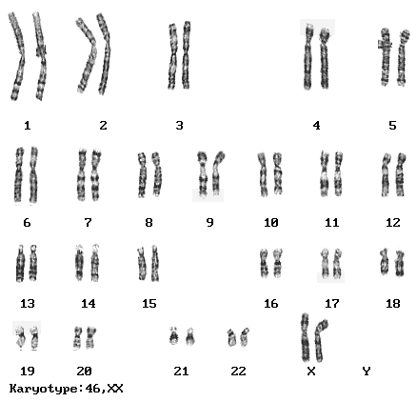
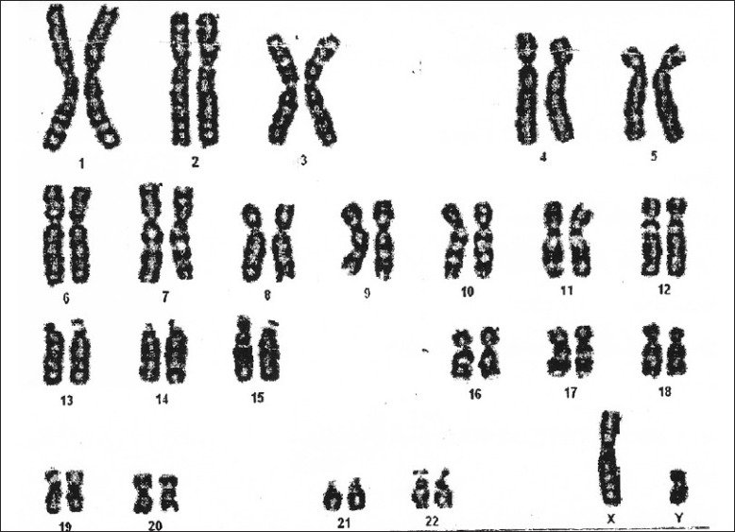
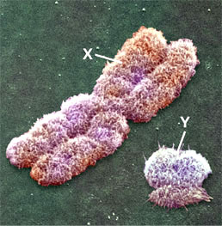
Monohybrid Inheritance involving Sex linkage
Any gene carried on either the X or Y chromosome is said to be sex-linked.
The X chromosome is much longer than the Y chromosome so will carry more genes.
Males will only have one allele of a sex linked gene.
Females still need to be homozygous recessive to have the condition.

Slide 3

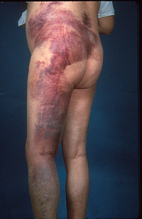
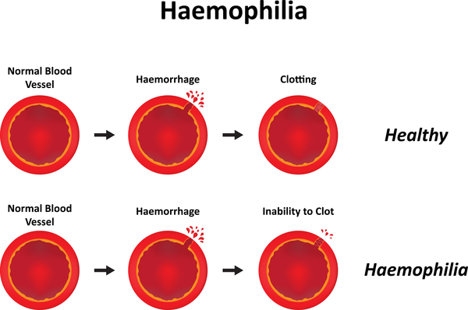
Monohybrid Inheritance involving Sex linkage
Comprehension skill practice.
End of paper 2 is a 15-20 mark comprehension for AO2 skill.
6% of overall A-level grade.
On page 433-434 in Toole and Toole, read through “Sex-linkage- Haemophilia” section and answer the questions on the next slide. Write your answers on page

Slide 4
Monohybrid Inheritance involving Sex linkage
What does non-homologous portion mean?
If a gene is found on the non-homologous portion, how will this affect the appearance of this phenotype in the population?
Why is haemophilia more prominent in males than females?
Using your knowledge of evolution, why would haemophilia be selectively removed from the population?
Haemophilia is caused by a DNA mutation, explain how a DNA mutation would lead of a faulty protein.
Explain why the Haemophilia allele is always linked with the letter X and not the letter Y in a genetic diagram.
Explain why Haemophilia is passed from biological mother to son not biological father to son.
Complete the genotypes table on page 11 in your booklet.
Complete the genetic cross diagram on page 11 in your booklet showing the predicted offspring from a male haemophiliac and female carrier.

Slide 5
Monohybrid Inheritance involving Sex linkage
What does non-homologous portion mean?
If a gene is found on the non-homologous portion, how will this affect the appearance of this phenotype in the population?
Why is haemophilia more prominent in males than females?
Using your knowledge of evolution, why would haemophilia be selectively removed from the population?
Y-chromosome is short so does not carry the allele for the gene found on the X-chromosome
Males more likely to have the disease, will not carry a second allele to cancel out affect of recessive allele
Male only carry 1 allele, females more likely to die from haemophilia especially with onset of puberty.
Haemophilia disadvantageous allele so organisms less likely to survive and reproduce
Will not be able to pass on disadvantageous allele to the next generation
Frequency of allele in population reduces
Frequency of phenotype reduces.
Note: The question asked about the haemophilia allele specifically so your answer must focus on that allele NOT the healthy allele.
Application of knowledge (AO2) instead of recall of knowledge (AO1)

Slide 6
Monohybrid Inheritance involving Sex linkage
Haemophilia is caused by a DNA mutation, explain how a DNA mutation would lead of a faulty protein.
Explain why the Haemophilia allele is always linked with the letter X and not the letter Y in a genetic diagram.
Explain why Haemophilia is passed from biological mother to son not biological father to son.
Change in DNA base sequence
Change in amino-acid sequence/primary structure
Alters position of hydrogen/ionic/disulphide bonds
Change in tertiary structure
Active site no longer complementary to substrate.
X and Y used to represent Sex-linked genes
Haemophilia allele only located on X chromosome
Male sex chromosome = XY
Y can only be inherited from father
X is inherited from mother.
X carries the haemophilia allele.

Slide 7
Monohybrid Inheritance involving Sex linkage
Possible Genotypes | Phenotype
X^{H}X^{H} | Unaffected female
X^{H}X^{h} | Carrier female
X^{h}X^{h} | Lethal combination
X^{H}Y | Unaffected male
X^{h}Y | Haemophiliac male

Slide 8
Monohybrid Inheritance involving Sex linkage
Parental Phenotype= Haemophiliac male x Carrier female
Parental Genotype= X^{h}Y x X^{H}X^{h}
Gametes =
X^{h}
Y
X^{H}
X^{h}
 |  | Male | haemophiliac
Female |  | X^{H}X^{h} Female carrier | X^{H}Y Male unaffected
carrier |  | X^{h}X^{h} Female Lethal Combination | X^{h}Y Male Haemophiliac
X^{h}
Y
X^{H}
X^{h}
F1 Genotype X^{H}X^{h} X^{h}X^{h} X^{H}Y X^{h}Y
F1 Phenotype Female carrier Female Haemophiliac Male unaffected Male haemophiliac
F1 ratio 25% 25% 25% 25%

Slide 9
Apply this knowledge to the exam questions on page 12.
The questions are worth 8 marks. Can you complete the exam question in 12 minutes?
Once you have completed the question, check your answers using the markscheme.
Remember
Highlight which part of your answer is also on the markscheme. Allow you to see which part of your answer are relevant.
If it isn’t on the mark scheme it is not right, if it isn’t written as the markscheme it is not right.
In a different coloured pen add corrections to the question.
Anything you don’t understand make a note of for when you speak to your teacher.

Slide 10
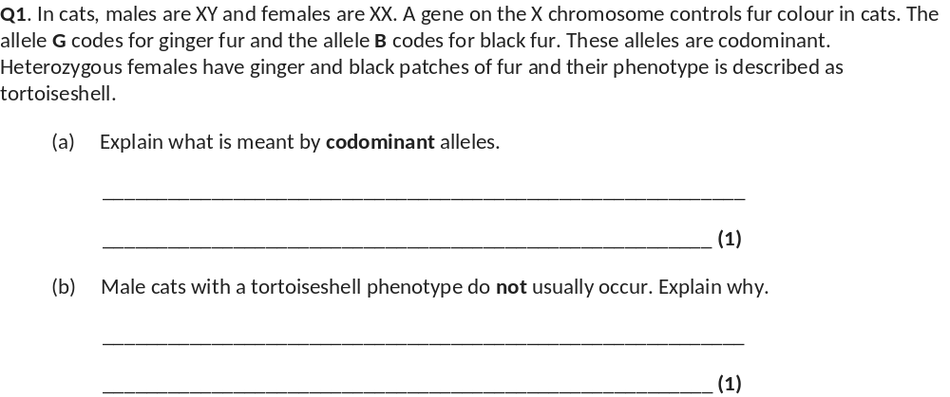
(a) Both alleles are expressed / shown (in the phenotype).
Accept: both alleles contribute (to the phenotype)
Neutral: both alleles are dominant
(b) Only possess one allele / Y chromosome does not carry allele / gene / can’t be heterozygous.
Accept: only possess one gene (for condition)
Neutral: only 1 X chromosome (unqualified)

Slide 11
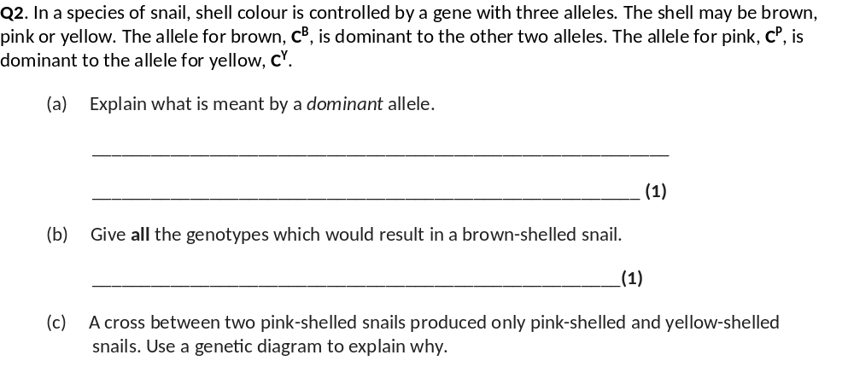
(a) Is always expressed / shown (in the phenotype);
Reject ‘is always present’ without further qualification
C^{B}C^{B}, C^{B}C^{P} and C^{B}C^{Y};
All three are required for the mark
Or
C^{B}C^{B}, C^{P}C^{B} and C^{Y}C^{B};
Accept C^{B}C^{B}, C^{B}C^{P}, C^{B}C^{Y},
C^{Y}C^{B} and C^{P}C^{B}
Accept BB, BP and BY or
BB, BP, BY, YB and PB

Slide 12
1. Two genotypes (as parents) shown as C^{P} C^{Y}
Award one mark maximum for candidates who have misread the question and complete a correct genetic cross between a pink snail, C^{P}C^{Y} and a yellow snail, C^{Y}C^{Y} to give pink and yellow offspring
Or
Two sets of gametes shown as C^{P} and C^{Y};
2. Genotypes of offspring shown as C^{P} C^{Y}, C^{P} C^{P} and C^{Y} C^{Y};
3. Above genotypes of offspring correctly linked to phenotypes i.e. pink and yellow;
Accept ratio (or equivalent) of 3 pink: 1 yellow for mark point 3

Slide 13
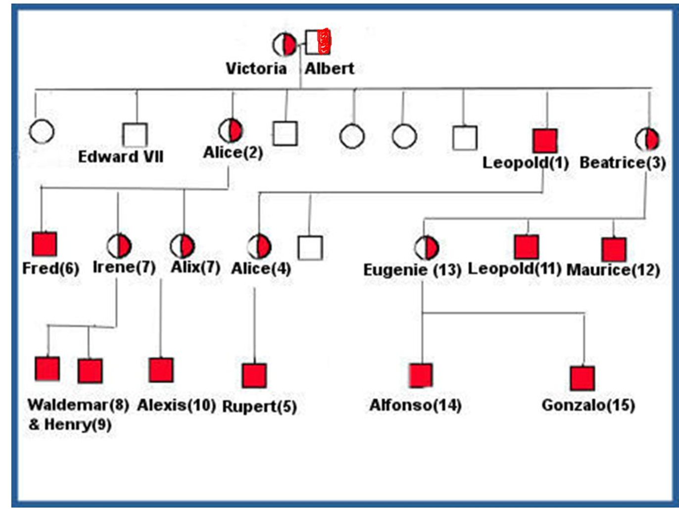
Pedigrees:
MOST COMMON EXAM QUESTION STYLE FOR MONOHYBRIDS
Definition:
Pedigree: Family tree of GENETICALLY related people used to identify simple inheritance patterns
Key:
Males = Squares
Females = Circle
Shading = presence of condition

Slide 14
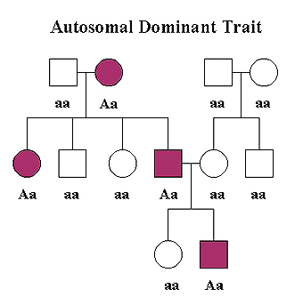
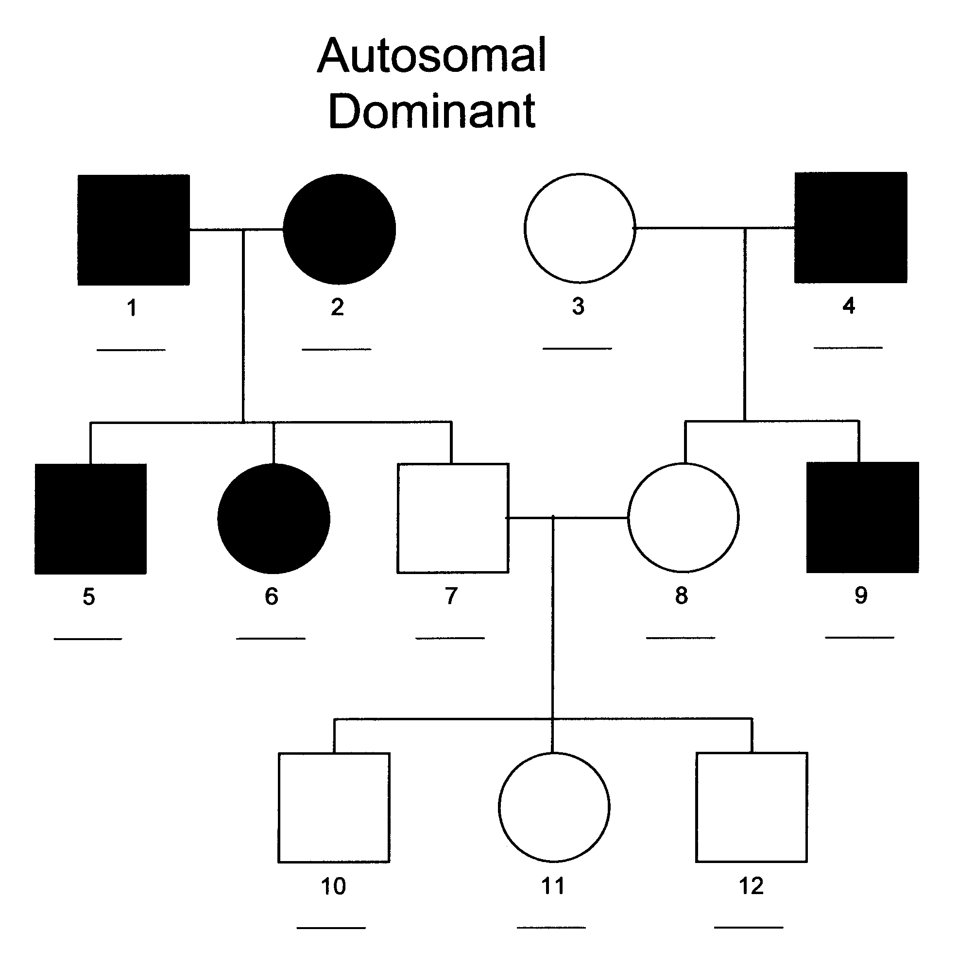
Pedigrees:
Dominant allele:
Only 1 parent needs to be carrier for allele to be inherited.
Recessive phenotype shown in offspring not parents.
STATE evidence from pedigree. Look at last 2 generations
Both parents dominant trait but offspring has recessive trait.

Slide 15
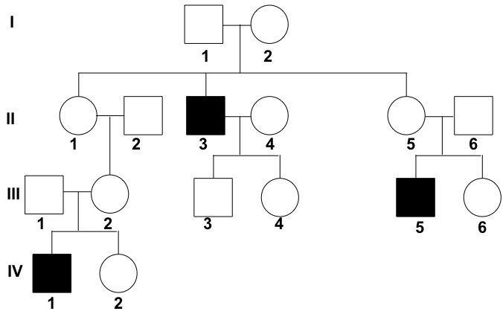
Pedigrees:
Recessive allele:
Both sexes affected
Both parents needs to have allele/heterozygotes for allele to be inherited
STATE evidence from pedigree. Look at last 2 generations.
Parents do not have disease but offspring do.

Slide 16
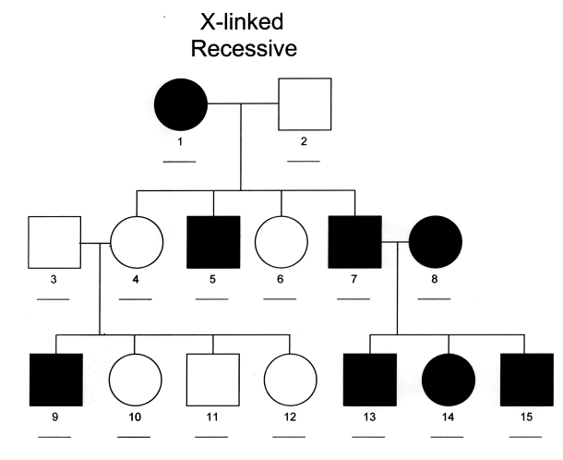
Pedigrees:
X-linked allele:
More common in males
Parents not showing disease but offspring do
STATE evidence from pedigree. Look at last 2 generations.
Parents do not show disease make offspring do.
More common in males

Slide 17

Pedigrees:
Complete practice questions on page 13 in your booklet:
What evidence is there that haemophilia is sex linked?
Using the symbols from your previous table, give the genotypes for
Irene
Edward VII
Gonzalo
3. What evidence is there that haemophilia is caused by a recessive allele? Look at p436

Slide 18
Pedigrees:
What evidence is there that haemophilia is sex linked?
Using the symbols from your previous table, give the genotypes for
Irene
Edward VII
Gonzalo
3. What evidence is there that haemophilia is caused by a recessive allele?
Females who carry the disease have affected males
More common in males
Irene is known carrier has 2 sons with disease
X^{H}X^{h}
X^{H}Y
X^{h}Y
Parents do not have the condition and their children do.
Parents must be heterozygous
Victoria and Albert do not have the disease but Leopold does.

Slide 19
Apply this knowledge to the exam questions on page 14-15.
The questions are worth 11 marks. Can you complete the exam question in 15 minutes?
Once you have completed the question, check your answers using the markscheme.
Remember
Highlight which part of your answer is also on the markscheme. Allow you to see which part of your answer are relevant.
If it isn’t on the mark scheme it is not right, if it isn’t written as the markscheme it is not right.
In a different coloured pen add corrections to the question.
Anything you don’t understand make a note of for when you speak to your teacher.

Slide 20
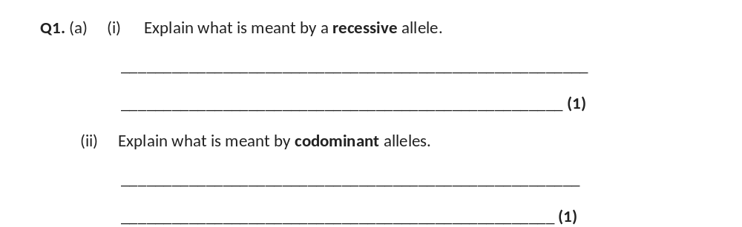
Only expressed when homozygous / two alleles are present / when no dominant allele / is not expressed when heterozygous;
Both alleles are expressed / shown (in the phenotype);
Allow both alleles contribute (to the phenotype).

Slide 21
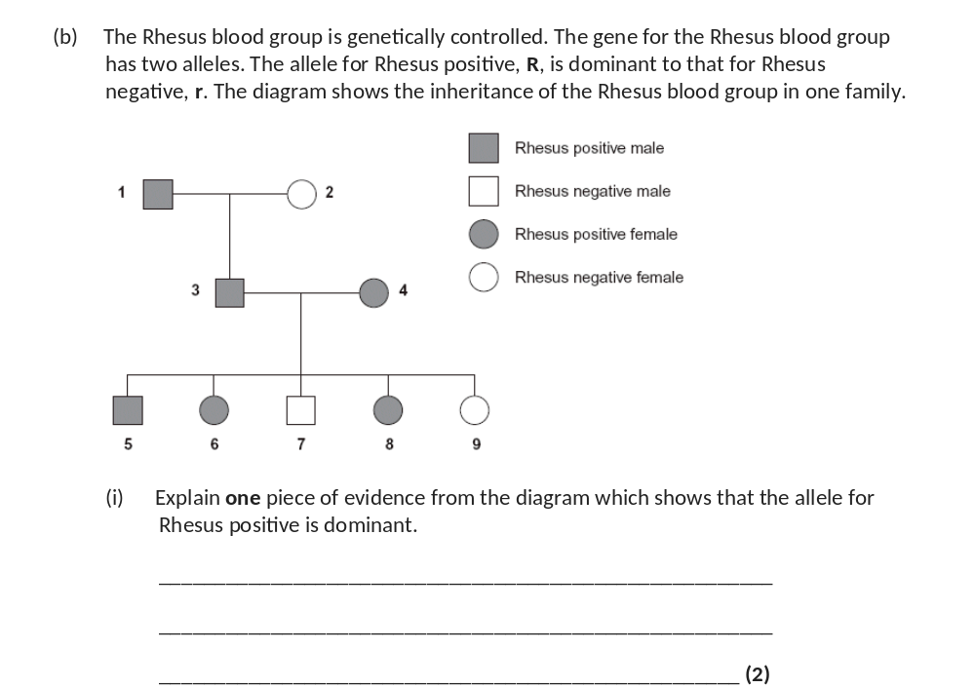
3 and 4 / two Rhesus positives produce Rhesus negative child / children / 7 / 9;
Both Rhesus positives / 3 and 4 carry recessive (allele) / are heterozygous / if Rhesus positive was recessive, all children (of 3 and 4) would be Rhesus positive / recessive;
Answers including correct and incorrect evidence = zero marks evidence and explanation.

Slide 22
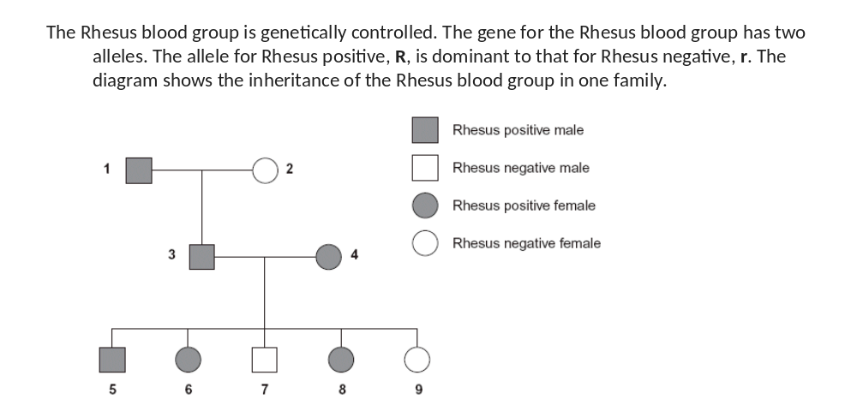
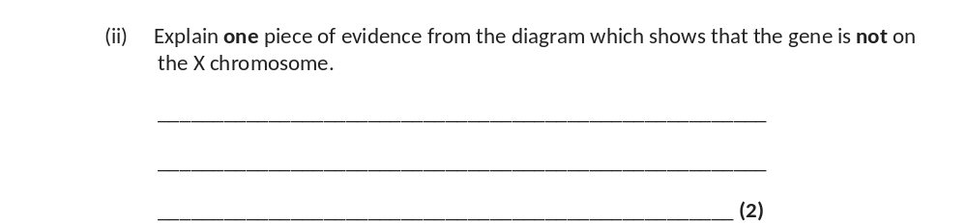
3 would not be / is Rhesus positive / would be Rhesus negative;
3 would receive Rhesus negative (allele) on X (chromosome) from mother
3 could not receive Rhesus positive (allele) from mother
3 would not receive Rhesus positive (allele) / X (chromosome) from father /
1 or 3 will receive Y (chromosome) from father/ 1;
OR
9 would be Rhesus positive /
would not be/ is Rhesus negative)
8 and 9 / all daughters of 3 and 4 would be Rhesus positive;
As 9 would receive X chromosome / dominant allele from father / 3;
One mark for evidence and one mark for explanation linked to this evidence.
Any reference to allele being on Y chromosome negates mark for explanation.

Slide 23
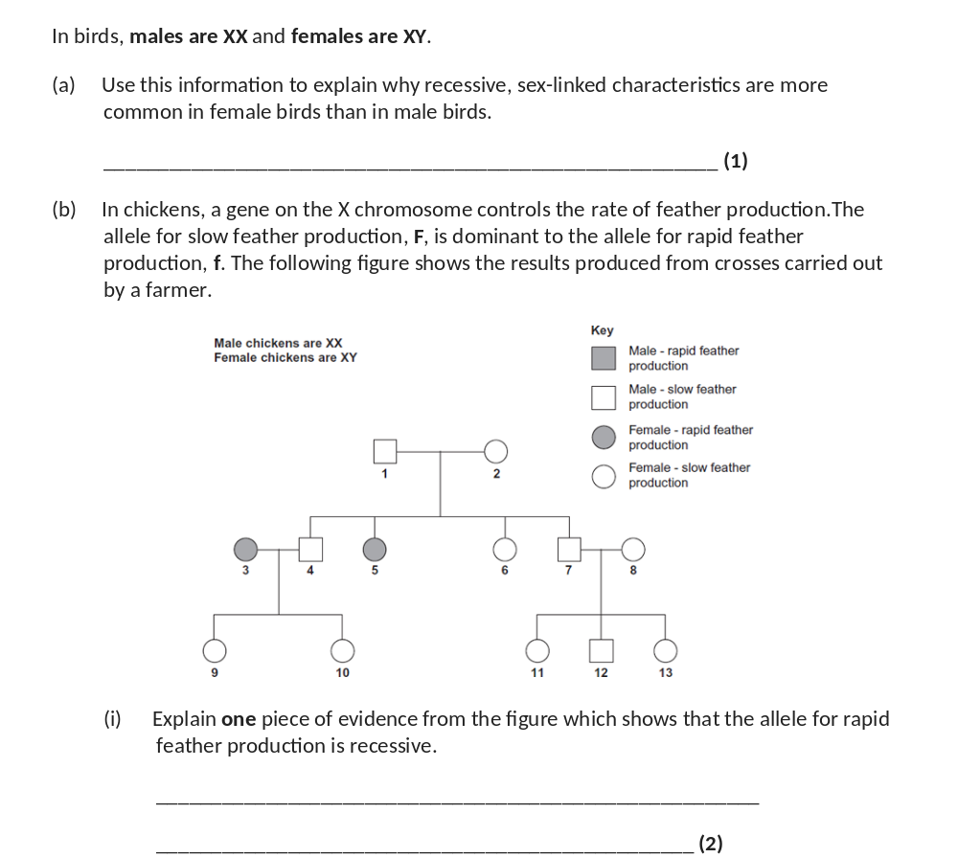
(Recessive) allele is always expressed in females
Or females have one (recessive) allele
Or males need two recessive alleles
Or males need to be homozygous recessive
Or males could have dominant and recessive alleles /be heterozygous / carriers;
Accept: Y chromosome does not carry a dominant allele. Other answers must be in context of allele not chromosome or gene.
1. 1, (2) and 5;
Accept: for 1 mark that 1 and 2 have slow (feather production) but produce one offspring with rapid (feather production).
Neutral: any reference to 3 being offspring of 1.
2. 1 must possess / pass on the recessive allele / 1 must be a carrier / heterozygous / if slow (feather production) is recessive all offspring of (1 and 2) would be slow (feather production) / if rapid (feather production) was dominant 1 would have rapid (feather production);
Reject: both parents must be carriers / possess the recessive allele.
Reject: one of the parents (i.e. not specified) must be a carrier / heterozygous.

Slide 24
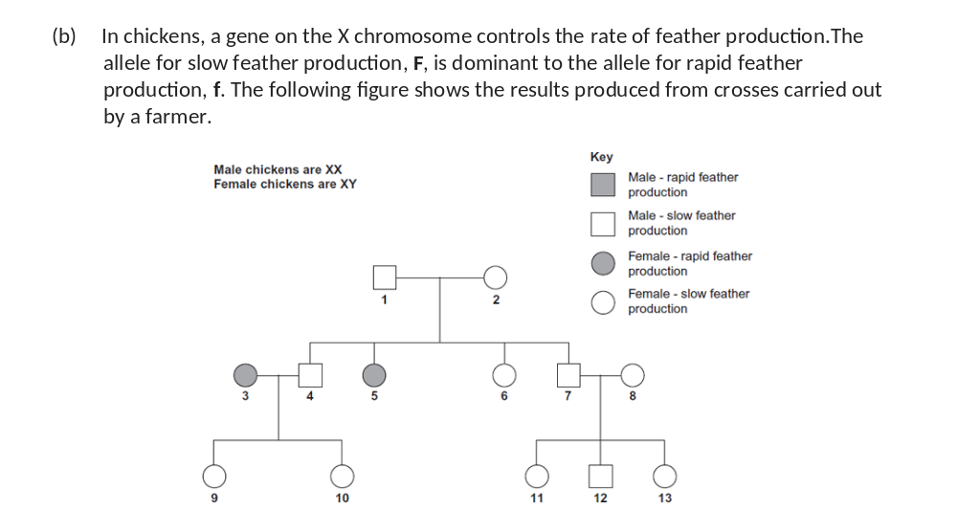
(ii) Give all the possible genotypes of the following chickens from the figure.
Chicken 5 ____________________________________________
Chicken 7 ___________________________________________(2)
5 = X^{f}Y / X^{f}Y⁻ / f / f- / fY ;
7 = X^{F}X^{f} and X^{F}X^{F} (either way round)
or X^{f}X^{F} and X^{F}X^{F} (either way round)
or X^{F}X^{f}, X^{f}X^{F} and X^{F}X^{F}(in any order);
Note: allow 5 = X^{f}Y, X^{f}Y.
Accept: for both 5 and 7 a different letter than F. However, lower case and capital letter must correspond to that shown in the answer. For example accept 7 = X^{R}X^{r} and X^{R}X^{R}.

